Slide 1
Scaling up LDA
William Cohen

Slide 2
First some pictures…

Slide 3


Slide 4
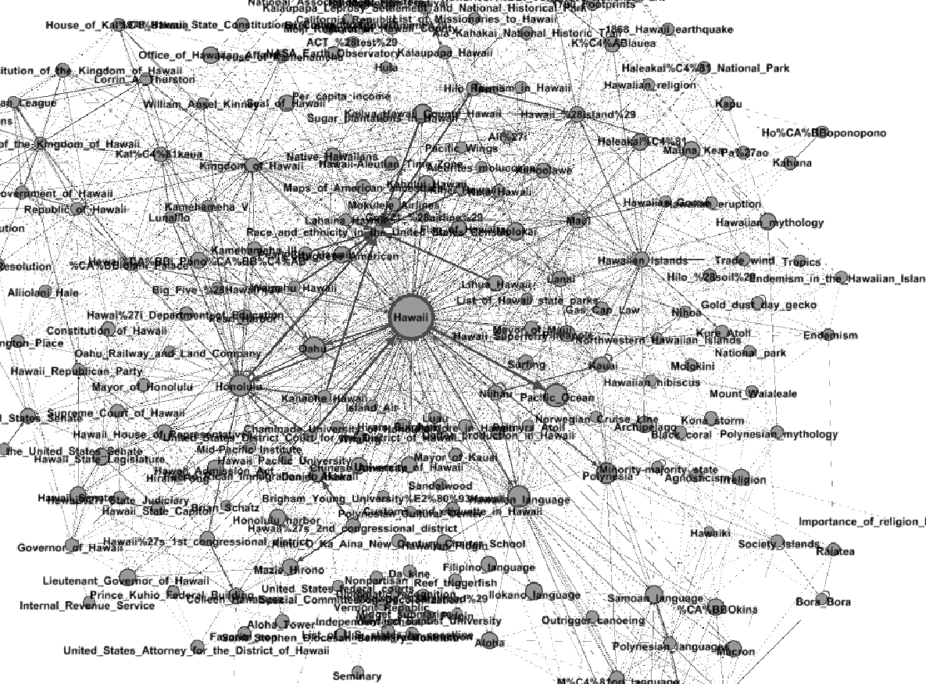

Slide 5
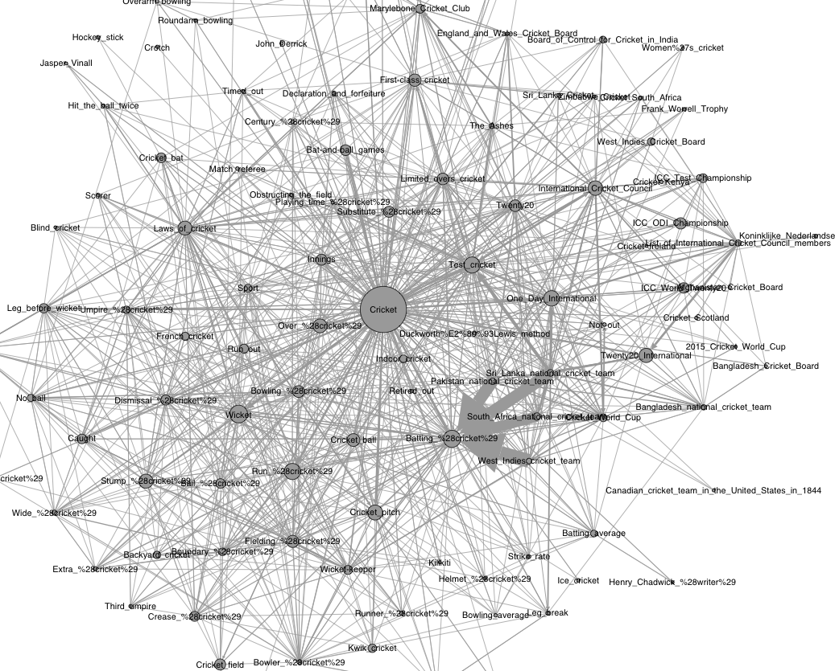

Slide 6
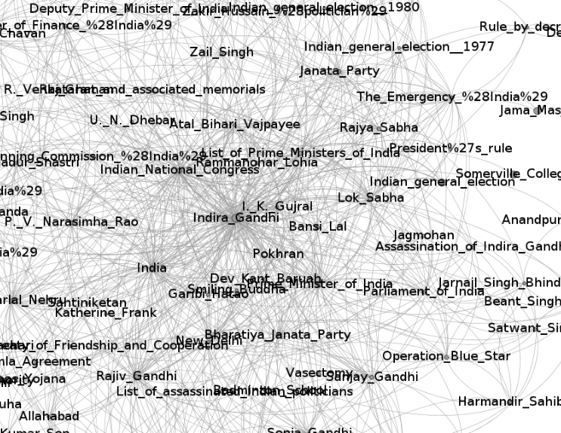

Slide 7
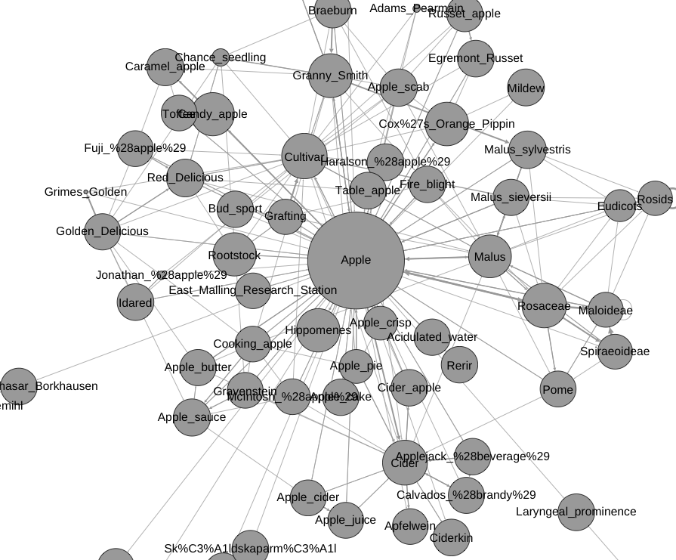

Slide 8
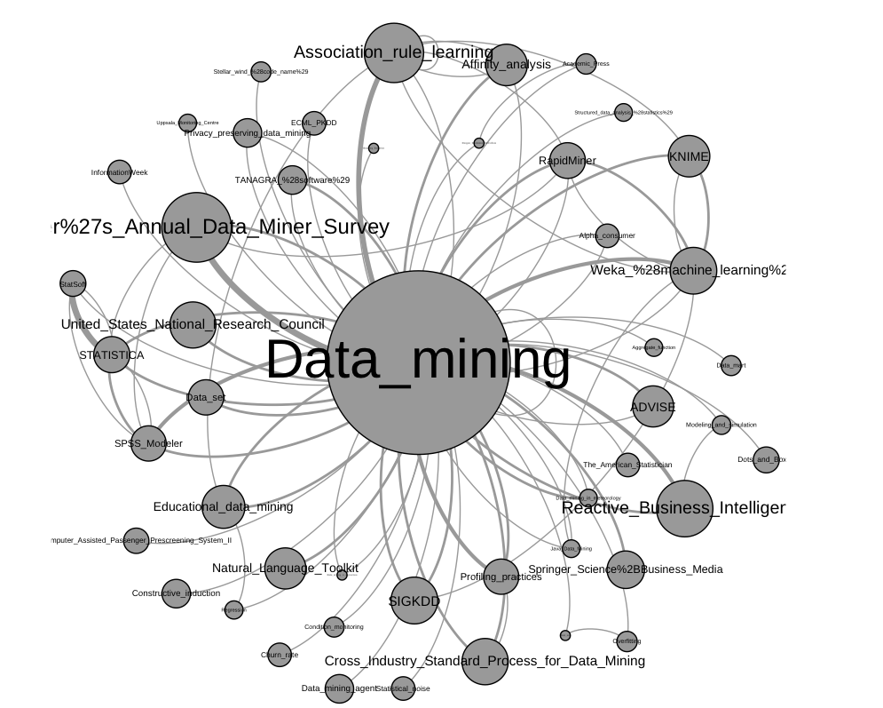

Slide 9
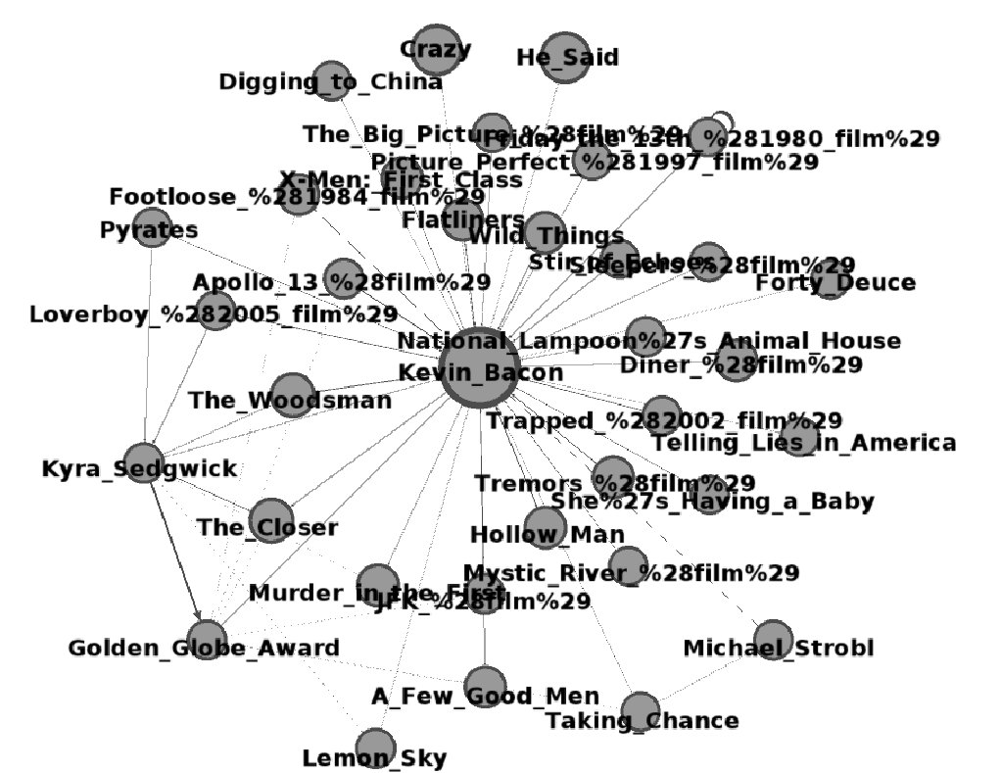

Slide 10
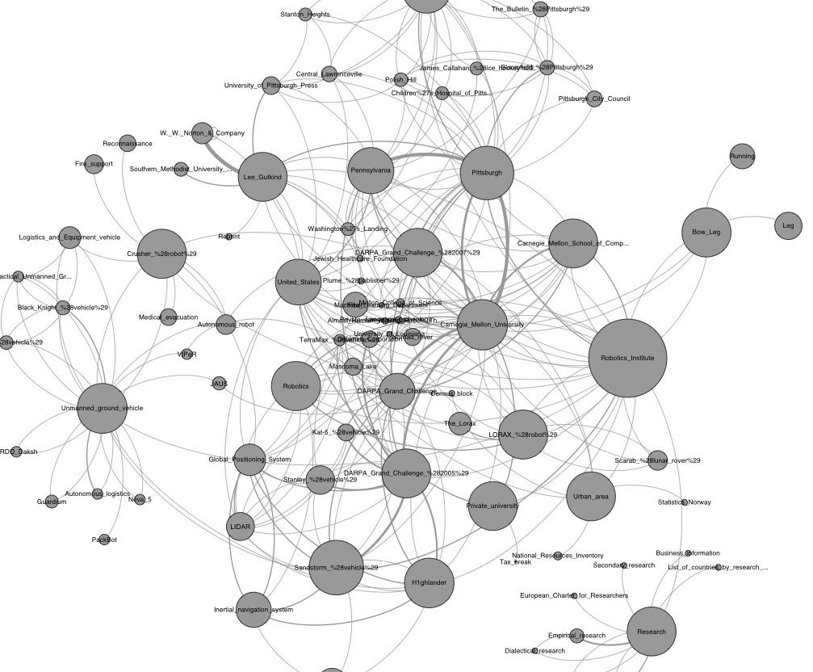

Slide 11
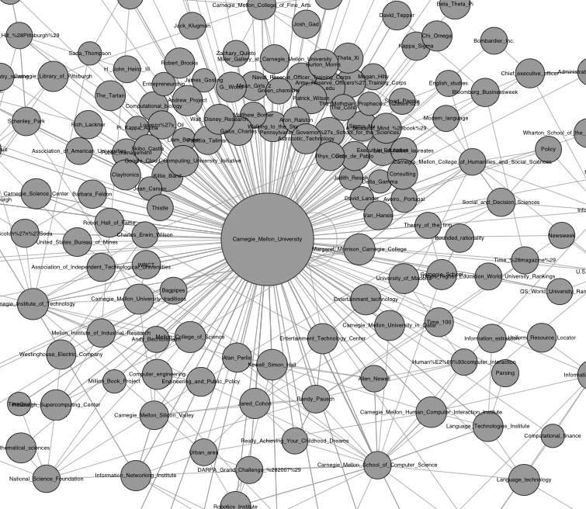

Slide 12
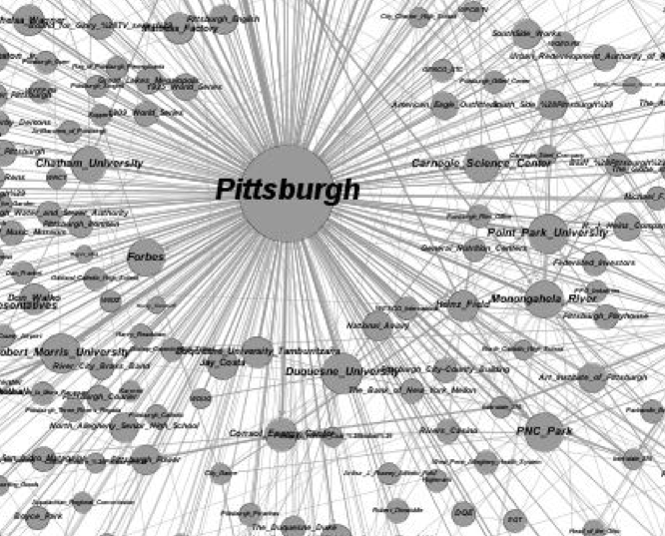

Slide 13
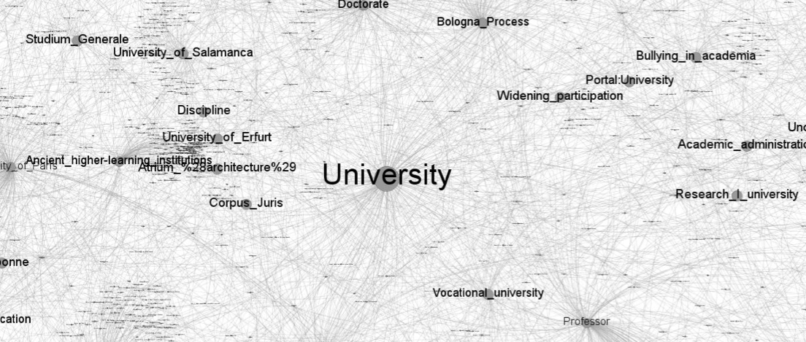

Slide 14
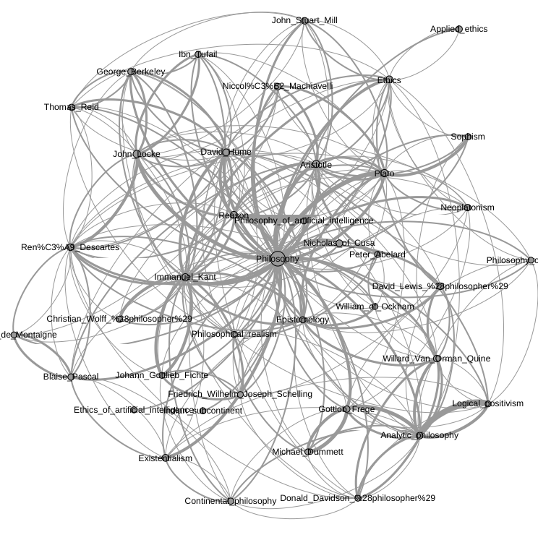

Slide 15
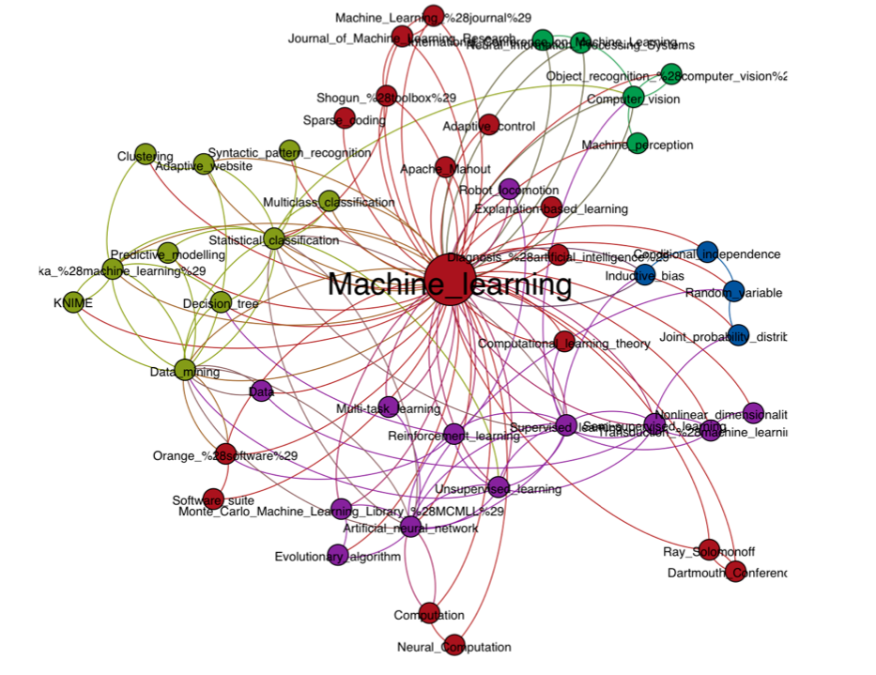

Slide 16
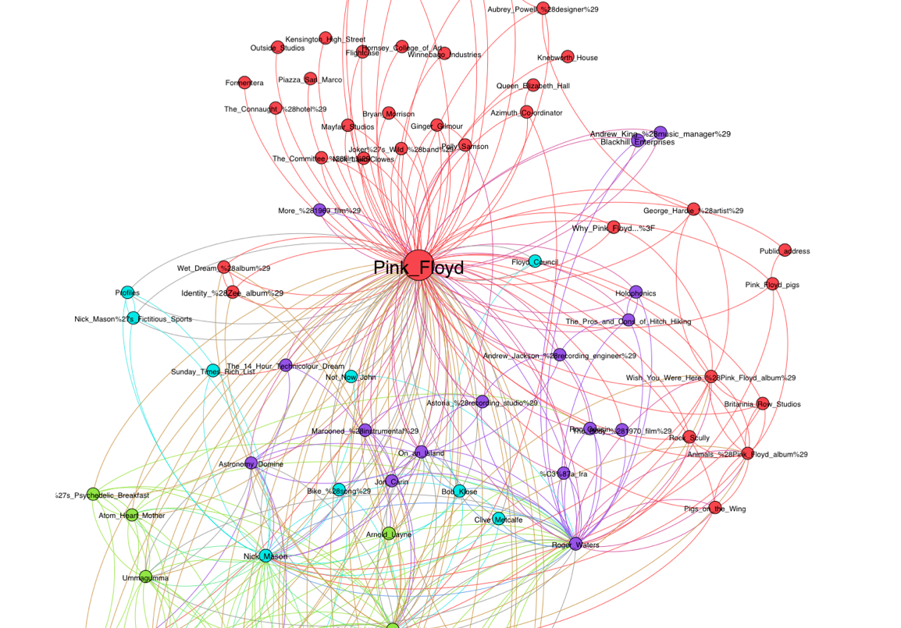

Slide 17
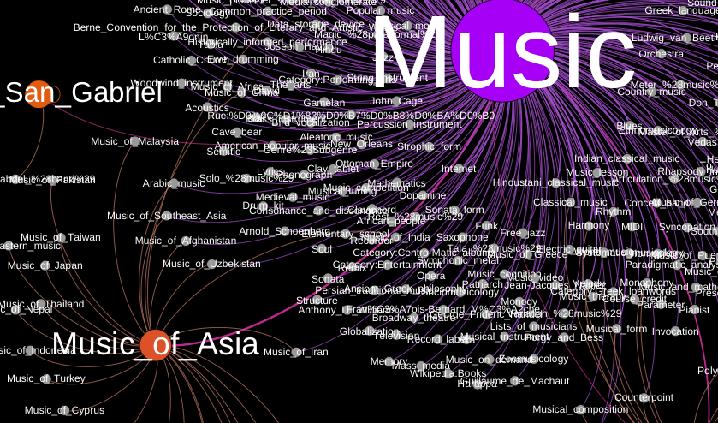

Slide 18
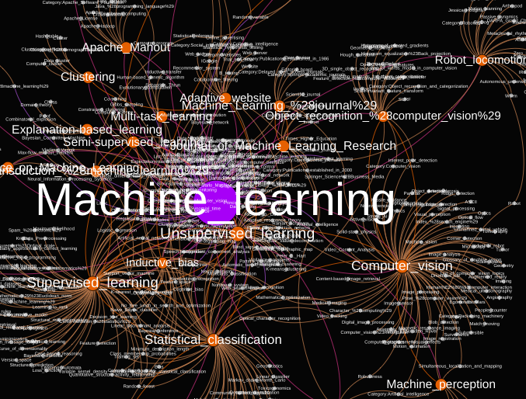

Slide 19
LDA in way too much detail
William Cohen

Slide 20
Review - LDA
Latent Dirichlet Allocation with Gibbs
θ
α
Randomly initialize each z_{m,n}
Repeat for t=1,….
  For each doc m, word n
    Find Pr(z_{mn}=k|other z’s)
    Sample z_{mn} according to that distr.
z
w
N
M
β

Slide 21
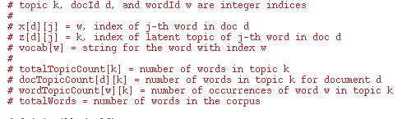
Way way more detail

Slide 22
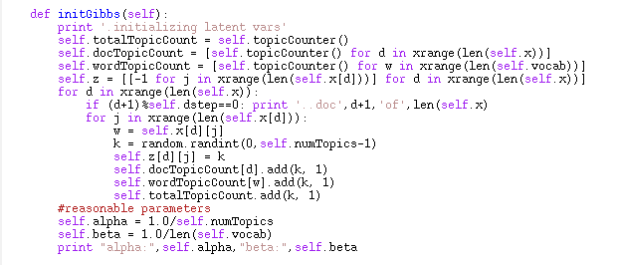
More detail

Slide 23
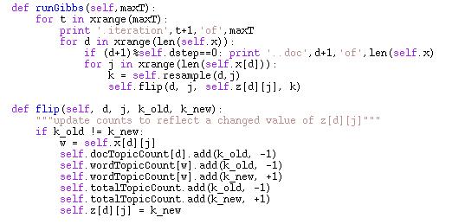

Slide 24
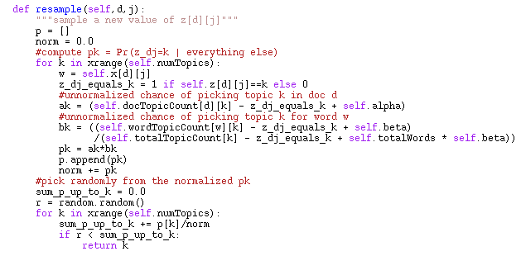

Slide 25
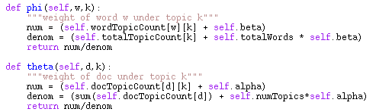
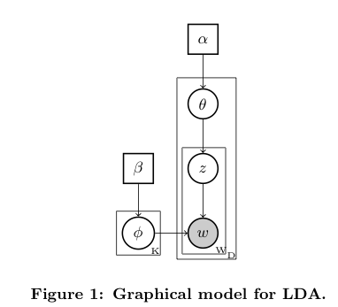
What gets learned…..

Slide 26
In A Math-ier Notation
N[*,k]
N[d,k]
N[*,*]=V
M[w,k]

Slide 27
for each document d and word position j in d
z[d,j] = k, a random topic
N[d,k]++
W[w,k]++ where w = id of j-th word in d

Slide 28
for each pass t=1,2,….
for each document d and word position j in d
z[d,j] = k, a new random topic
update N, W to reflect the new assignment of z:
  N[d,k]++; N[d,k’] - - where k’ is old z[d,j]
  W[w,k]++; W[w,k’] - - where w is w[d,j]

Slide 30
z=1
z=2
random
z=3
unit height
…
…

Slide 31

JMLR 2009

Slide 32
Observation
How much does the choice of z depend on the other z’s in the same document?
  quite a lot
How much does the choice of z depend on the other z’s in elsewhere in the corpus?
  maybe not so much
  depends on Pr(w|t) but that changes slowly
Can we parallelize Gibbs and still get good results?

Slide 33
Question
Can we parallelize Gibbs sampling?
  formally, no: every choice of z depends on all the other z’s
  Gibbs needs to be sequential
    just like SGD

Slide 34
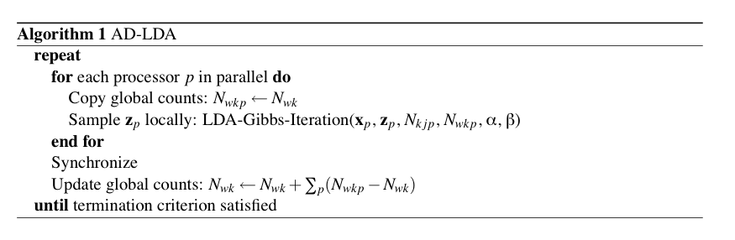
What if you try and parallelize?
Split document/term matrix randomly and distribute to p processors .. then run “Approximate Distributed LDA”

Slide 35
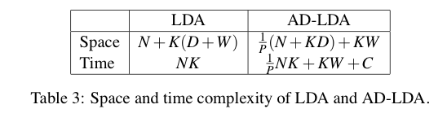
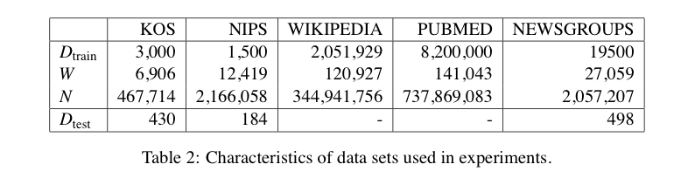
What if you try and parallelize?
D=#docs W=#word(types) K=#topics N=words in corpus

Slide 36
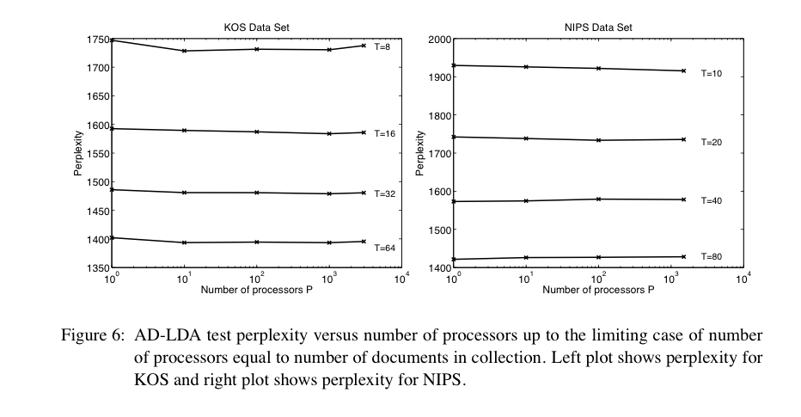

Slide 37
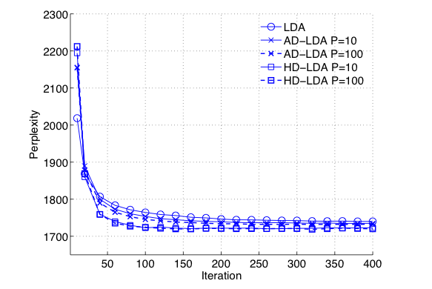

Slide 38
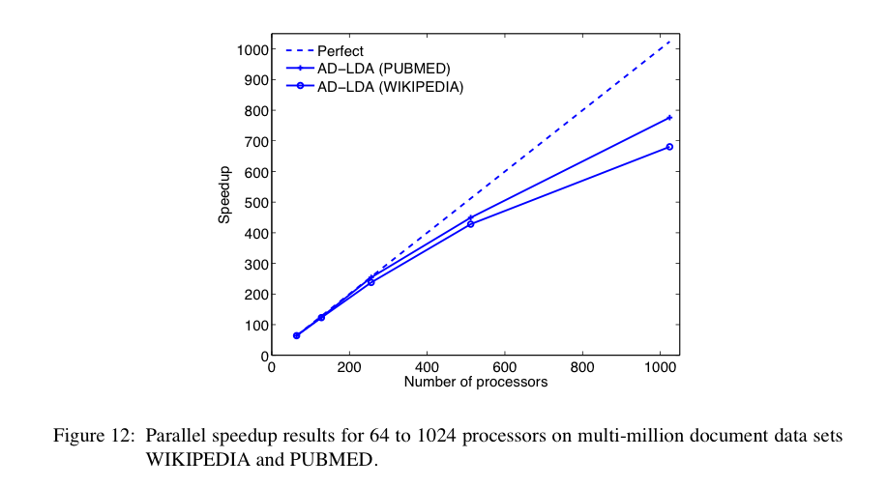

Slide 39
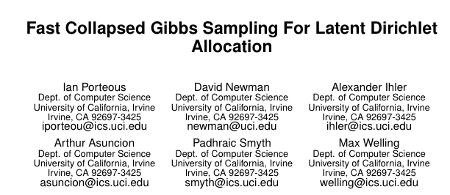

Slide 40
z=1
z=2
random
z=3
unit height
…
…

Slide 41
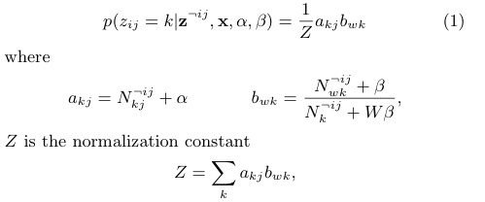

Slide 42
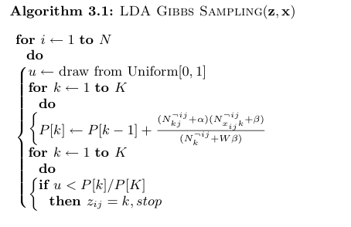
Running total of P(z=k|…) or P(z<=k)

Slide 43
Discussion….
Where do you spend your time?
  sampling the z’s
  each sampling step involves a loop over all topics
  this seems wasteful
    even with many topics, words are often only assigned to a few different topics
      low frequency words appear < K times … and there are lots and lots of them!
      even frequent words are not in every topic

Slide 44
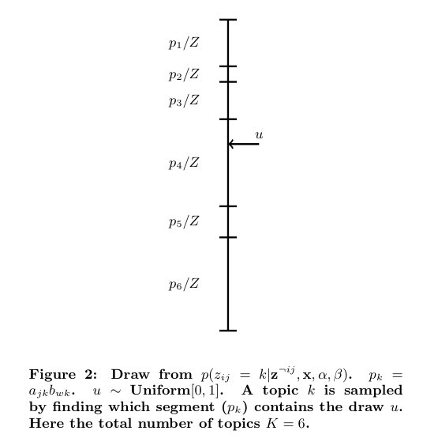
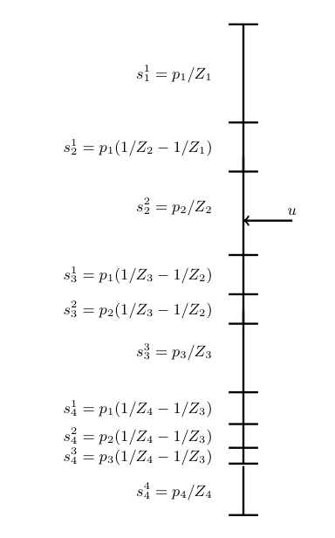
Discussion….
Idea: come up with approximations to Z at each stage - then you might be able to stop early…..
What’s the solution?
Want Z_{i}>=Z

Slide 45
Tricks
How do you compute and maintain the bound?
  see the paper
What order do you go in?
  want to pick large P(k)’s first
  … so we want large P(k|d) and P(k|w)
  … so we maintain k’s in sorted order
    which only change a little bit after each flip, so a bubble-sort will fix up the almost-sorted array

Slide 46
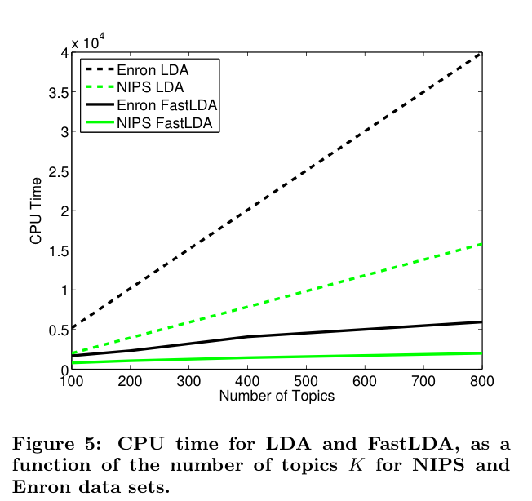
Results

Slide 47
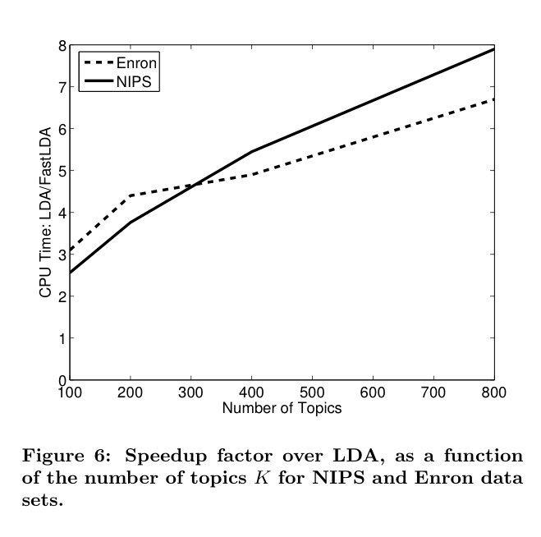
Results

Slide 48
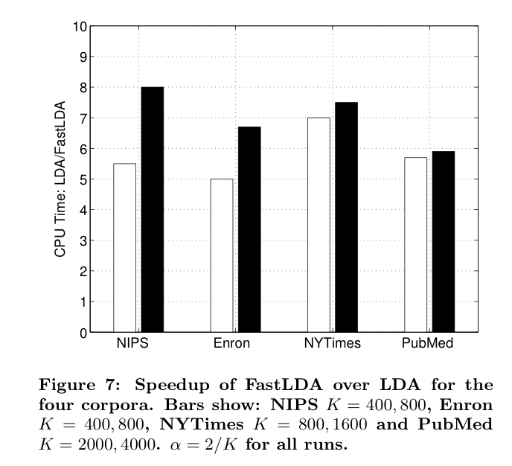
Results

Slide 49
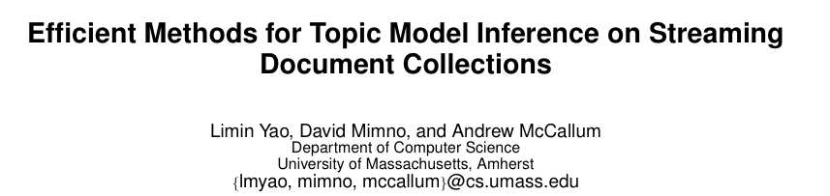
KDD 09

Slide 50


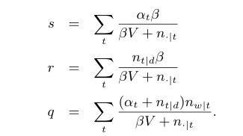
z=s+r+q

Slide 51
If U<s:
  lookup U on line segment with tic-marks at α₁β/(βV + n_{.|1}), α₂β/(βV + n_{.|2}), …
If s<U<r:
  lookup U on line segment for r
Only need to check t such that n_{t|d}>0
z=s+r+q

Slide 52
If U<s:
  lookup U on line segment with tic-marks at α₁β/(βV + n_{.|1}), α₂β/(βV + n_{.|2}), …
If s<U<s+r:
  lookup U on line segment for r
If s+r<U:
  lookup U on line segment for q
Only need to check t such that n_{w|t}>0
z=s+r+q

Slide 53
Only need to check occasionally (< 10% of the time)
Only need to check t such that n_{t|d}>0
Only need to check t such that n_{w|t}>0
z=s+r+q

Slide 54
Only need to store (and maintain) total words per topic and α’s,β,V
Trick; count up n_{t|d} for d when you start working on d and update incrementally
Only need to store n_{t|d} for current d
Need to store n_{w|t} for each word, topic pair …???
z=s+r+q

Slide 55

1. Precompute, for each t,
2. Quickly find t’s such that n_{w|t} is large for w
Most (>90%) of the time and space is here…
Need to store n_{w|t} for each word, topic pair …???
z=s+r+q

Slide 56
1. Precompute, for each t,
2. Quickly find t’s such that n_{w|t} is large for w
map w to an int array
  no larger than frequency w
  no larger than #topics
encode (t,n) as a bit vector
  n in the high-order bits
  t in the low-order bits
keep ints sorted in descending order
Most (>90%) of the time and space is here…
Need to store n_{w|t} for each word, topic pair …???

Slide 57
