Slide 1
Semi-Supervised Learning With Graphs
William Cohen

Slide 2
Administrivia
Last assignment (approx PR/sweep/visualize):
  48hr extension for all
Final proposal:
  Still due Tues 1:30
  I’ve given everyone comments (often brief) and/or questions
Final project:
  We’re asking everyone to keep in touch
    We’re assigning each project a mentor (soon)
    Feel free to discuss issues in office hours
    Send a few bullet points each Tuesday to your mentor outlining progress (or lack of it)
    These are required but won’t be graded

Slide 3
Graph topics so far
Algorithms:
  exact PageRank
    with nodes-in-memory
    with nothing-in-memory
  approximate personalized PageRank (apr)
    using repeated “push”
  a “sweep” to find a coherent subgraph from a personalized PageRank vector/ranking
  iterative averaging
    clamping some nodes
    no clamping
Applications:
  web search, etc
  semi-supervised learning (MRW algorithm), etc, etc
  sampling a graph (with apr)
    SSL
    power iteration clustering

Slide 4
Streaming PageRank
Assume we can store v but not W in memory
Repeat until converged:
  Let v^{t+1} = cu + (1-c)Wv^{t}
Store A as a row matrix: each line is
  i j_{i,1},…,j_{i,d} [the neighbors of i]
Store v’ and v in memory: v’ starts out as cu
For each line “i j_{i,1},…,j_{i,d} “
  For each j in j_{i,1},…,j_{i,d}
    v’[j] += (1-c)v[i]/d
Everything needed for update is right there in row….

Slide 5
Recap: PageRank algorithm
Repeat until converged:
  Let v^{t+1} = cu + (1-c)Wv^{t}
Pure streaming: use a table mapping nodes to degree+pageRank
  Lines are i: degree=d,pr=v
For each edge i,j
  Send to i (in degree/pagerank) table: outlink j
For each line i: degree=d,pr=v:
  send to i: incrementVBy c
  for each message “outlink j”:
    send to j: incrementVBy (1-c)*v/d
For each line i: degree=d,pr=v
  sum up the incrementVBy messages to compute v’
  output new row: i: degree=d,pr=v’

Slide 6
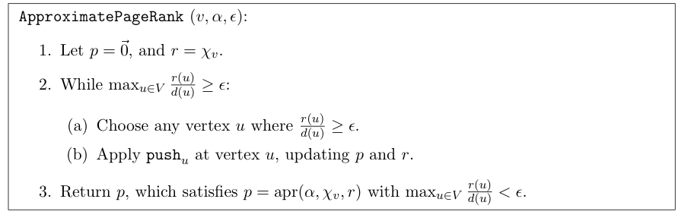
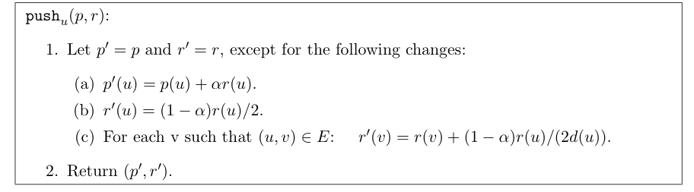
Recap: Approximate Personalized PageRank

Slide 7
Graph topics so far
Algorithms:
  exact PageRank
    with nodes-in-memory
    with nothing-in-memory
  approximate personalized PageRank (apr)
    using repeated “push”
  a “sweep” to find a coherent subgraph from a personalized PageRank vector/ranking
  iterative averaging
    clamping some nodes
    no clamping
Applications:
  web search
  semi-supervised learning (MRW algorithm); etc, etc
  sampling a graph (with apr)
    SSL
    power iteration clustering

Slide 8

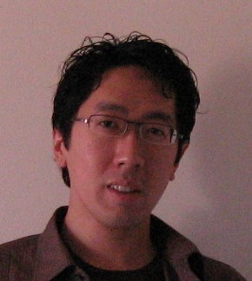



Learning to Search Email
CALO
[SIGIR 2006, CEAS 2006,
WebKDD/SNA 2007]
Term In Subject
Sent
To
William
graph
proposal
CMU
6/17/07
6/18/07
einat@cs.cmu.edu
Notes:
Usually, information retrieval systems, for both the web and email, index data a bipartite graph, which includes words, or terms, on one hand – and files, on the other hand.
Given a query, which is a set of words, the retrieval engine ranks documents by their relevance, or similarity, to the query.
However, email can be represented by a richer graph. With nodes representing persons, dates, meetings and email-addresses.
In this graph, persons are inter-connected via messages that they send or receive, and via the meetings they attend. Files are inter-connected through the social network of the recipients, similar content and so on.
So, we have a typed graph – where every node has a type. And, in addition, the edges in the graph are directed and have types as well.
For example, “sent to” from email to recipient. Or “has subject term” going from an email message and a term appearing in its subject line.
Given a schema of relations, a whole corpus of email can be represented as one joint graph. For email, you can easily extract this information by parsing the email header.

Slide 9
Q: “what are Jason’s email aliases?”
Basic idea: searching personal information is querying a graph for information and query is done with personalized pageRank + filtering output on a type
einat@cs.cmu.edu
Sent To
“Jason”
Has term
inv.
einat
Msg
18
Sent-to
Msg
2
Msg5
Jason
Ernst
Sent to
Email
Sent from
Email
jernst@
cs.cmu.edu
EmailAddressOf
jernst@
andrew.cmu.edu
Similar to
Notes:
Now I can show you how you can answer a question like “what are Jason’s email aliases” given the graph that I just described – and applying random walk on this graph. Where we start from the term node denoting “Jason”.
Walking for one step away from Jason – we reach email file nodes, in which this term appears. For example, they may include “hi Jason” or “Thanks, Jason” or “I talked with Jason” and so on. Then, walking away for another step would lead us to the person node of “Jason Ernst” for which some of these files where sent from or to. and also to node of type email-address – over a relation of “sent to email” and “sent from email”. In this case, this email-address is one of the relevant answers.
Walking for another step would again lead us to this node, as it’s connected to “Jason Ernst” by an alias relation. So now we have some more evidence that this node is relevant. And, if we include edges between entities that have high textual similarity in the graph, we would also reach another email-address of Jason, in another domain.
So, this is how random walks can get us to related entities.
Of course, at every stage, the random walk also goes in irrelevant directions.
The focus of this work is therefore on learning how to tune the graph walks, such that the relevant nodes are preferred over the irrelevant
ones.

Slide 10


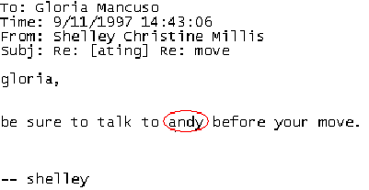
Tasks that are like similarity queries
Person name
disambiguation
[ term “andy”
file msgId ]
“person”
Threading
What are the adjacent messages in this thread?
A proxy for finding “more messages like this one”
[ file msgId ]
“file”
Alias finding
What are the email-addresses of Jason ?...
[ term Jason ]
“email-address”
Meeting attendees finder
Which email-addresses (persons) should I notify about this meeting?
[ meeting mtgId ]
“email-address”
Notes:
We claim that many tasks that seem to be different can be addressed as instances of queries, using the same underlying graph.\
Now, we can solve pretty much all of the problems which I presented in the first slides, phrasing them as queries in this framework.
In our experiments, we got good results also for short walks of 2 or 3 steps.

Slide 11
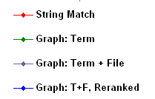
Results
Mgmt. game
PERSON NAME DISAMBIGUATION
Notes:
This is a plot of the recall level at every rank in the returned list, up to rank 10.
The data is for the management game corpus.
Using string matching gives this curve. The recall at rank 10 is limited to about 70%, since some of the names are not lexically similar, and since ambiguous name, like Dave, are assigned the same score for multiple persons.

Slide 12
Results
Mgmt. game
PERSON NAME DISAMBIGUATION
Notes:
With graph walk, where we start from term only, performance is better – mainly because it can handle non-similar name mentions due to co-occurrence modeling.

Slide 13
Results
Mgmt. game
PERSON NAME DISAMBIGUATION
Notes:
Graph walk, using both term and file information, gets much better recall - about 900% at rank 5.
This is mostly due to disambiguation resolution – due to the context that is provided by the file node.
However, the performance at rank 1 is somewhat worse here, and that’s because person nodes that are connected only to the file but not to the term nodes get included.

Slide 14
Results
Mgmt. game
PERSON NAME DISAMBIGUATION
Notes:
Finally, re-ranking the top 10 nodes of the previous method gives this curve – where the recall is almost 100% already at rank 5.
And the correct answer is first in about 80% of the cases.

Slide 15
Graph topics so far
Algorithms:
  exact PageRank
    with nodes-in-memory
    with nothing-in-memory
  approximate personalized PageRank (apr)
    using repeated “push”
  a “sweep” to find a coherent subgraph from a personalized PageRank vector/ranking
  iterative averaging
    clamping some nodes
    no clamping
Applications:
  web search
  semi-supervised learning (MRW algorithm), etc, etc
  sampling a graph (with apr)
    SSL
    power iteration clustering

Slide 16
Semi-Supervised Bootstrapped Learning via Label Propagation
mayor of arg1
arg1 is home of
Information from other categories tells you “how far” (when to stop propagating)
San Francisco
Austin
Paris
Pittsburgh
anxiety
traits such as arg1
live in arg1
traits such as arg1
arrogance
denial
selfishness
denial
selfishness
Seattle
Nodes “near” seeds
Nodes “far from” seeds

Slide 17
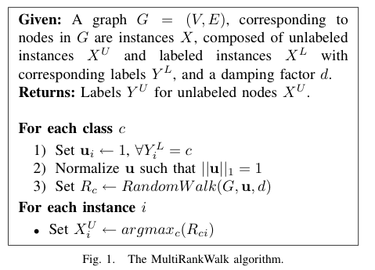

RWR - fixpoint of:
Seed selection
order by PageRank, degree, or randomly
go down list until you have at least k examples/class

Slide 18
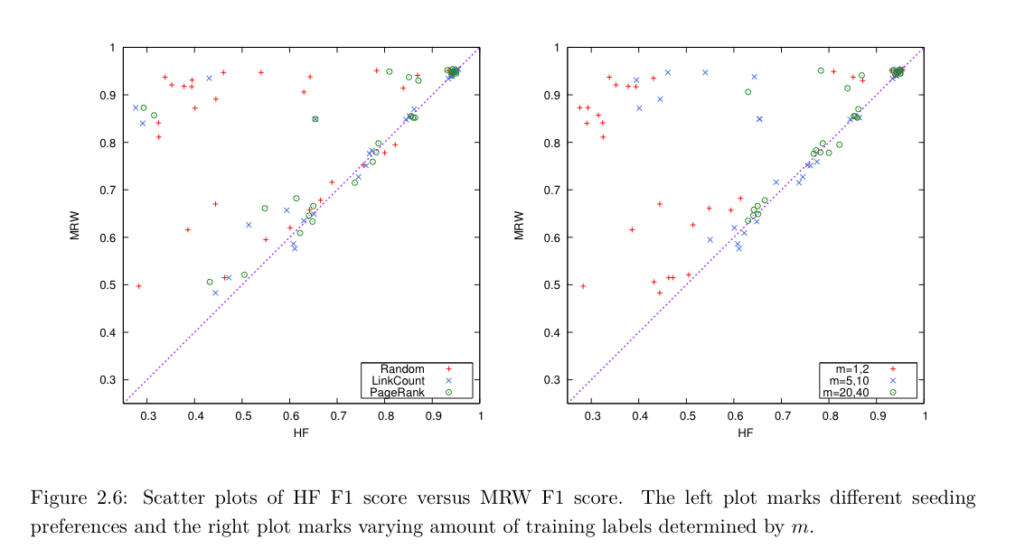
MultiRankWalk vs wvRN/HF/CoEM

Slide 19
Graph topics so far
Algorithms:
  exact PageRank
    with nodes-in-memory
    with nothing-in-memory
  approximate personalized PageRank (apr)
    using repeated “push”
  a “sweep” to find a coherent subgraph from a personalized PageRank vector/ranking
  iterative averaging
    clamping some nodes
    no clamping
Applications:
  web search
  semi-supervised learning (MRW algorithm)
  sampling a graph (with apr)
    SSL: HF/CoEM/wvRN
    power iteration clustering

Slide 20
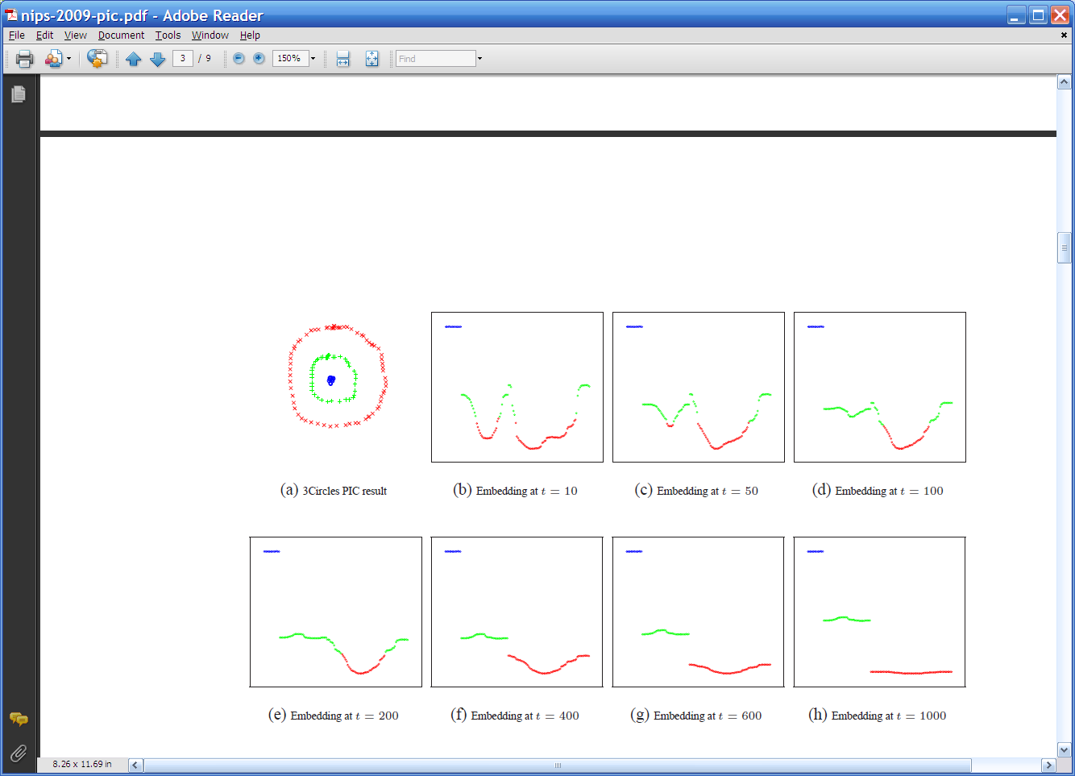
Repeated averaging with neighbors on a sample problem…
blue
green
___red___
Create a graph, connecting all points in the 2-D initial space to all other points
  Weighted by distance
Run power iteration for 10 steps
Plot node id x vs v¹⁰(x)
  nodes are ordered by actual cluster number
g
g
g
g
g
g
g
g
g
r
r
r
r
…
b
b
r
r
r
b
b
b

Slide 21
Repeated averaging with neighbors on a sample problem…
blue
green
___red___
blue
green
___red___
blue
green
___red___
larger
smaller

Slide 22
Repeated averaging with neighbors on a sample problem…
blue
green
___red___
blue
green
___red___
blue
green
___red___
blue
green
___red___
blue
green
___red___

Slide 23
Repeated averaging with neighbors on a sample problem…
very small

Slide 24
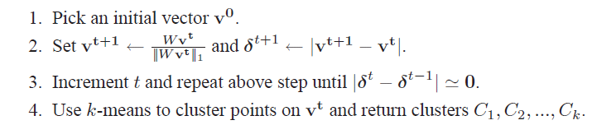
PIC: Power Iteration Clustering run power iteration (repeated averaging w/ neighbors) with early stopping
  V⁰: random start, or “degree matrix” D, or …
  Easy to implement and efficient
  Very easily parallelized
  Experimentally, often better than traditional spectral methods
  Surprising since the embedded space is 1-dimensional!

Slide 25
Harmonic Functions/CoEM/wvRN
then replace v^{t+1}(i) with seed values +1/-1 for labeled data
for 5-10 iterations
Classify data using final values from v

Slide 26
Experiments
“Network” problems: natural graph structure
  PolBooks: 105 political books, 3 classes, linked by copurchaser
  UMBCBlog: 404 political blogs, 2 classes, blogroll links
  AGBlog: 1222 political blogs, 2 classes, blogroll links
“Manifold” problems: cosine distance between classification instances
  Iris: 150 flowers, 3 classes
  PenDigits01,17: 200 handwritten digits, 2 classes (0-1 or 1-7)
  20ngA: 200 docs, misc.forsale vs soc.religion.christian
  20ngB: 400 docs, misc.forsale vs soc.religion.christian
  20ngC: 20ngB + 200 docs from talk.politics.guns
  20ngD: 20ngC + 200 docs from rec.sport.baseball

Slide 27
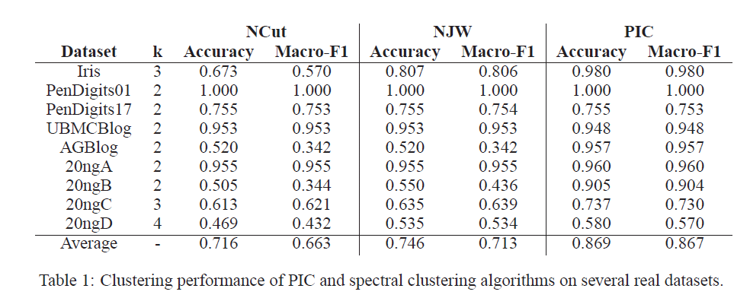
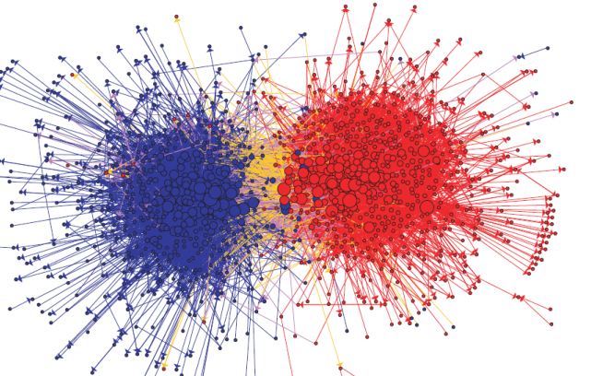
Experimental results: best-case assignment of class labels to clusters

Slide 28
Why I’m talking about graphs
Lots of large data is graphs
  Facebook, Twitter, citation data, and other social networks
  The web, the blogosphere, the semantic web, Freebase, Wikipedia, Twitter, and other information networks
  Text corpora (like RCV1), large datasets with discrete feature values, and other bipartite networks
    nodes = documents or words
    links connect document → word or word → document
  Computer networks, biological networks (proteins, ecosystems, brains, …), …
  Heterogeneous networks with multiple types of nodes
    people, groups, documents

Slide 29
Learning to Search Email
CALO
[SIGIR 2006, CEAS 2006,
WebKDD/SNA 2007]
Term In Subject
Sent
To
William
graph
proposal
CMU
6/17/07
6/18/07
einat@cs.cmu.edu
Notes:
Usually, information retrieval systems, for both the web and email, index data a bipartite graph, which includes words, or terms, on one hand – and files, on the other hand.
Given a query, which is a set of words, the retrieval engine ranks documents by their relevance, or similarity, to the query.
However, email can be represented by a richer graph. With nodes representing persons, dates, meetings and email-addresses.
In this graph, persons are inter-connected via messages that they send or receive, and via the meetings they attend. Files are inter-connected through the social network of the recipients, similar content and so on.
So, we have a typed graph – where every node has a type. And, in addition, the edges in the graph are directed and have types as well.
For example, “sent to” from email to recipient. Or “has subject term” going from an email message and a term appearing in its subject line.
Given a schema of relations, a whole corpus of email can be represented as one joint graph. For email, you can easily extract this information by parsing the email header.

Slide 30
Simplest Case: Bi-partite Graphs
CALO
William
graph
proposal
CMU
Notes:
Usually, information retrieval systems, for both the web and email, index data a bipartite graph, which includes words, or terms, on one hand – and files, on the other hand.
Given a query, which is a set of words, the retrieval engine ranks documents by their relevance, or similarity, to the query.
However, email can be represented by a richer graph. With nodes representing persons, dates, meetings and email-addresses.
In this graph, persons are inter-connected via messages that they send or receive, and via the meetings they attend. Files are inter-connected through the social network of the recipients, similar content and so on.
So, we have a typed graph – where every node has a type. And, in addition, the edges in the graph are directed and have types as well.
For example, “sent to” from email to recipient. Or “has subject term” going from an email message and a term appearing in its subject line.
Given a schema of relations, a whole corpus of email can be represented as one joint graph. For email, you can easily extract this information by parsing the email header.

Slide 31
Outline
Background on spectral clustering
“Power Iteration Clustering”
  Motivation
  Experimental results
Analysis: PIC vs spectral methods
PIC for sparse bipartite graphs
  “Lazy” Distance Computation
  “Lazy” Normalization
  Experimental Results

Slide 32
Motivation: Experimental Datasets are…
“Network” problems: natural graph structure
  PolBooks: 105 political books, 3 classes, linked by copurchaser
  UMBCBlog: 404 political blogs, 2 classes, blogroll links
  AGBlog: 1222 political blogs, 2 classes, blogroll links
  Also: Zachary’s karate club, citation networks, ...
“Manifold” problems: cosine distance between all pairs of classification instances
  Iris: 150 flowers, 3 classes
  PenDigits01,17: 200 handwritten digits, 2 classes (0-1 or 1-7)
  20ngA: 200 docs, misc.forsale vs soc.religion.christian
  20ngB: 400 docs, misc.forsale vs soc.religion.christian
  …
Gets expensive fast

Slide 33
Spectral Clustering: Graph = Matrix
A*v₁ = v₂ “propogates weights from neighbors”
A
*
v₁
=
v₂
 | A | B | C | D | E | F | G | H | I | J
A | _ | 1 | 1 |  |  | 1
B | 1 | _ | 1
C | 1 | 1 | _
D |  |  |  | _ | 1 | 1
E |  |  |  | 1 | _ | 1
F |  |  |  | 1 | 1 | _
G |  |  |  |  |  |  | _ |  | 1 | 1
H |  |  |  |  |  |  |  | _ | 1 | 1
I |  |  |  |  |  |  | 1 | 1 | _ | 1
J |  |  |  |  |  |  | 1 | 1 | 1 | _
A | 3
B | 2
C | 3
D
E
F
G
H
I
J
A | 2*1+3*1+0*1
B | 3*1+3*1
C | 3*1+2*1
D
E
F
G
H
I
J
C
A
B
G
I
H
J
F
D
E
M

Slide 34
Spectral Clustering: Graph = Matrix
W*v₁ = v₂ “propogates weights from neighbors”
W
*
v₁
=
v₂
W: normalized so columns sum to 1
 | A | B | C | D | E | F | G | H | I | J
A | _ | .5 | .5 |  |  | .3
B | .3 | _ | .5
C | .3 | .5 | _
D |  |  |  | _ | .5 | .3
E |  |  |  | .5 | _ | .3
F | .3 |  |  | .5 | .5 | _
G |  |  |  |  |  |  | _ |  | .3 | .3
H |  |  |  |  |  |  |  | _ | .3 | .3
I |  |  |  |  |  |  | .5 | .5 | _ | .3
J |  |  |  |  |  |  | .5 | .5 | .3 | _
A | 3
B | 2
C | 3
D
E
F
G
H
I
J
A | 2*.5+3*.5+0*.3
B | 3*.3+3*.5
C | 3*.33+2*.5
D
E
F
G
H
I
J
C
A
B
G
I
H
J
F
D
E
W = D⁻¹*A
D[i,i]=1/degree(i)

Slide 35
Lazy computation of distances and normalizers
Recall PIC’s update is
  v^{t} = W * v^{t-1 =} = D⁻¹A * v^{t-1}
  …where D is the [diagonal] degree matrix: D=A*1
My favorite distance metric for text is length-normalized TFIDF:
  Def’n: A(i,j)=<v_{i},v_{j}>/||v_{i}||*||v_{j}||
  Let N(i,i)=||v_{i}|| … and N(i,j)=0 for i!=j
  Let F(i,k)=TFIDF weight of word w_{k} in document v_{i}
  Then: A = N⁻¹F^{T}FN⁻¹
1 is a column vector of 1’s
<u,v>=inner product
||u|| is L2-norm

Slide 36
Lazy computation of distances and normalizers
Equivalent to using TFIDF/cosine on all pairs of examples but requires only sparse matrices
Recall PIC’s update is
  v^{t} = W * v^{t-1 =} = D⁻¹A * v^{t-1}
  …where D is the [diagonal] degree matrix: D=A*1
  Let F(i,k)=TFIDF weight of word w_{k} in document v_{i}
  Compute N(i,i)=||v_{i}|| … and N(i,j)=0 for i!=j
  Don’t compute A = N⁻¹F^{T}FN⁻¹
  Let D(i,i)= N⁻¹F^{T}FN⁻¹*1 where 1 is an all-1’s vector
    Computed as D=N⁻¹⁽F^{T(}F(N⁻¹*1))) for efficiency
  New update:
    v^{t} = D⁻¹A * v^{t-1} = D⁻¹ N⁻¹F^{T}FN⁻¹ *v^{t-1}

Slide 37
Experimental results
RCV1 text classification dataset
  800k + newswire stories
  Category labels from industry vocabulary
  Took single-label documents and categories with at least 500 instances
  Result: 193,844 documents, 103 categories
Generated 100 random category pairs
  Each is all documents from two categories
  Range in size and difficulty
  Pick category 1, with m₁ examples
  Pick category 2 such that 0.5m₁<m₂<2m₁

Slide 38
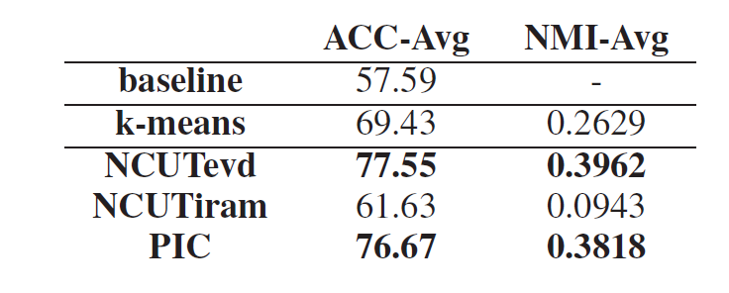
Results
NCUTevd: Ncut with exact eigenvectors
NCUTiram: Implicit restarted Arnoldi method
No stat. signif. diffs between NCUTevd and PIC

Slide 39
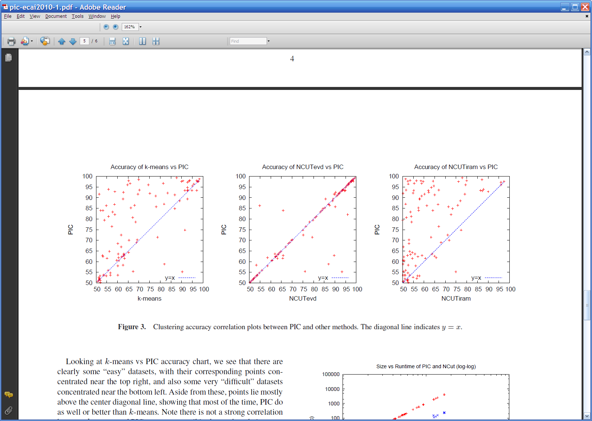
Results

Slide 40
Results

Slide 41
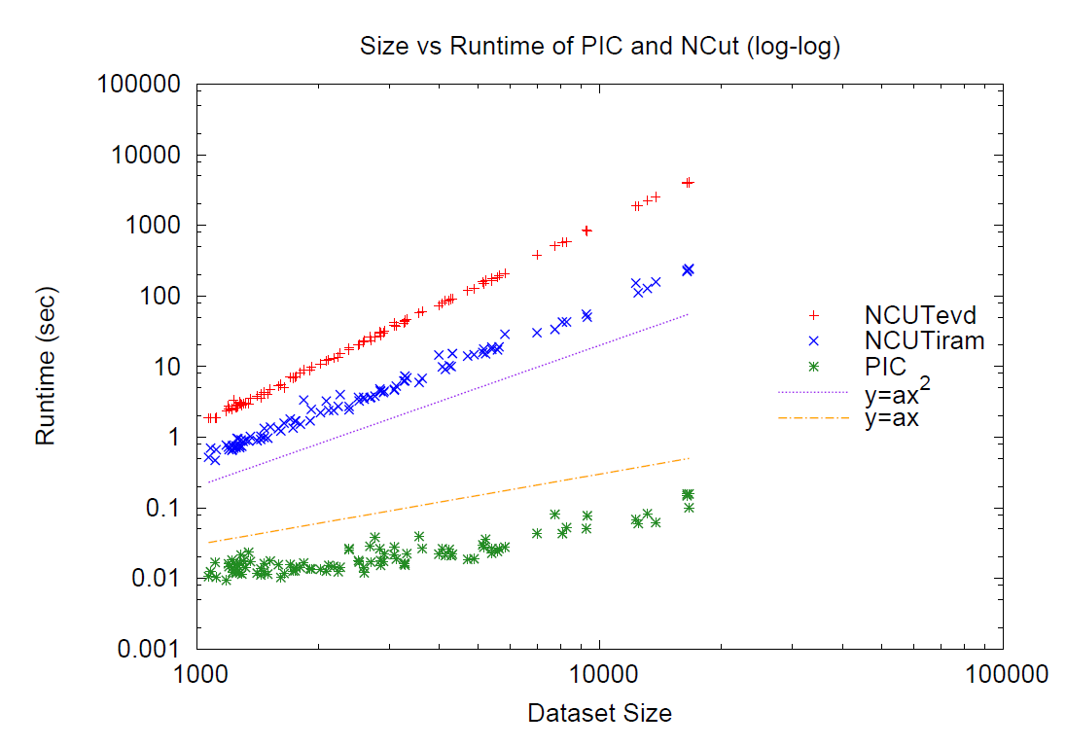
Results

Slide 42
Results
Linear run-time implies constant number of iterations
Number of iterations to “acceleration-convergence” is hard to analyze:
  Faster than a single complete run of power iteration to convergence
  On our datasets
    10-20 iterations is typical
    30-35 is exceptional

Slide 43
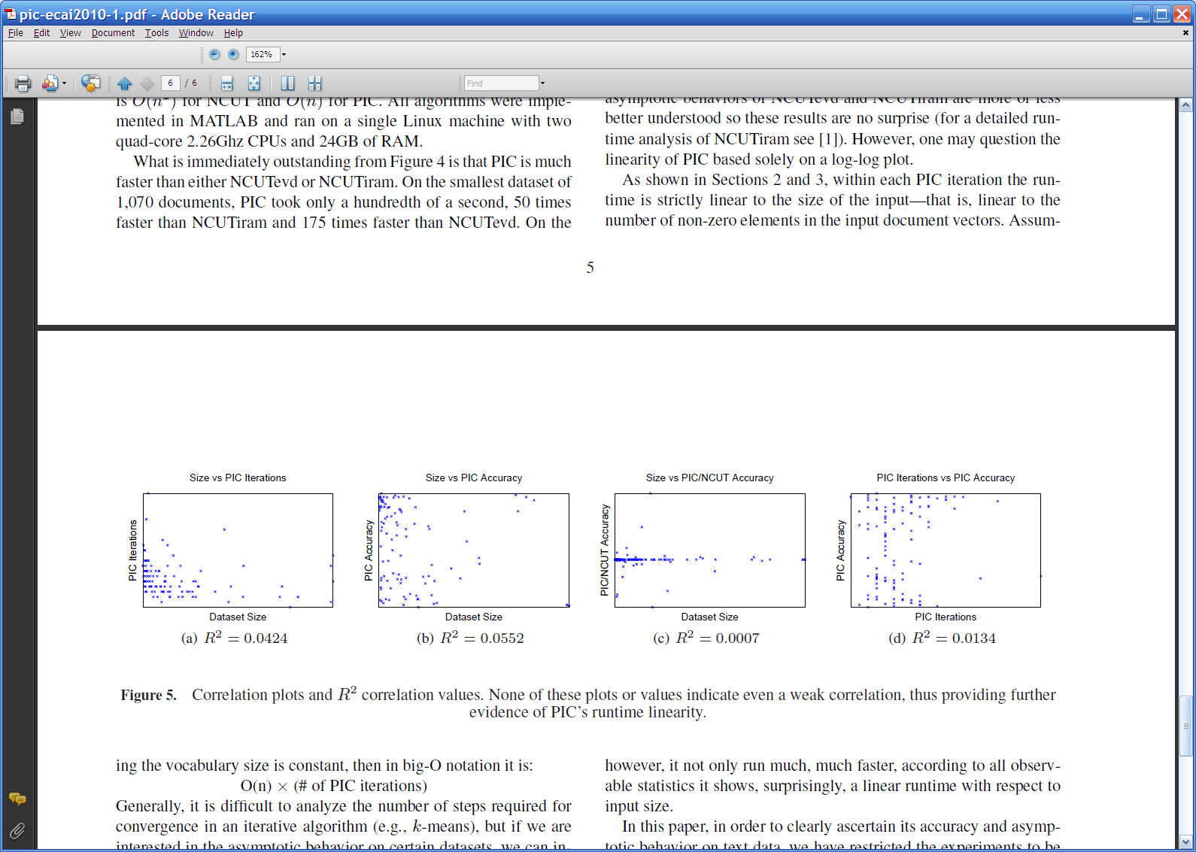

Slide 44
Implicit Manifolds on the NELL datasets
mayor of arg1
arg1 is home of
San Francisco
Austin
Paris
Pittsburgh
anxiety
traits such as arg1
live in arg1
traits such as arg1
arrogance
denial
selfishness
denial
selfishness
Seattle
Nodes “near” seeds
Nodes “far from” seeds

Slide 45
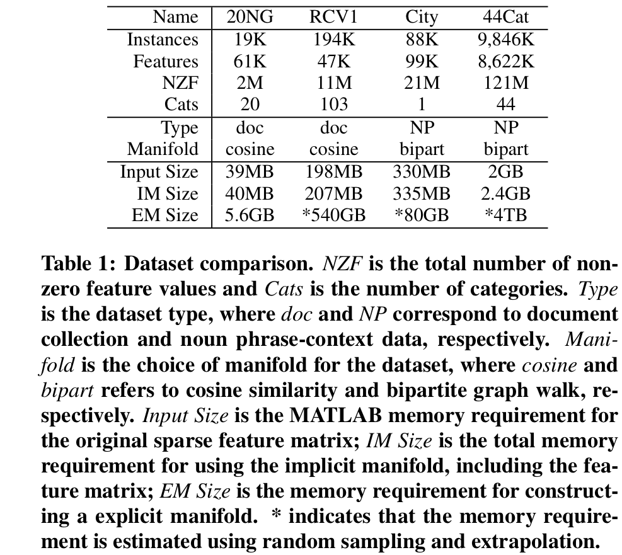
Using the Manifold Trick for SSL

Slide 46
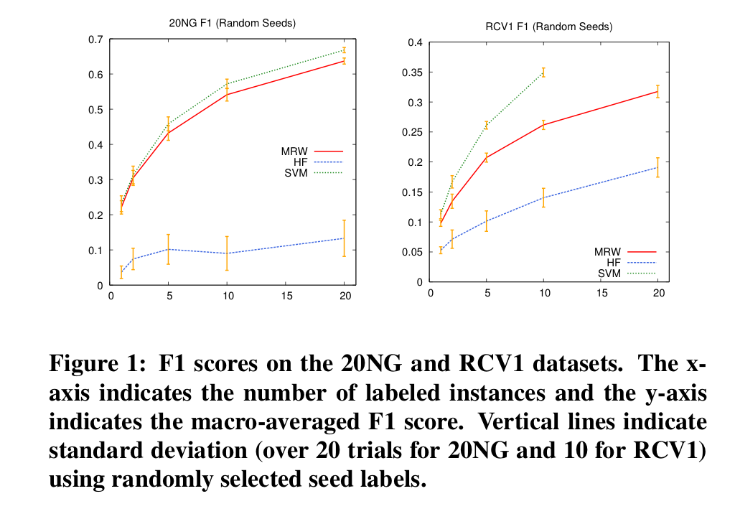
Using the Manifold Trick for SSL

Slide 47
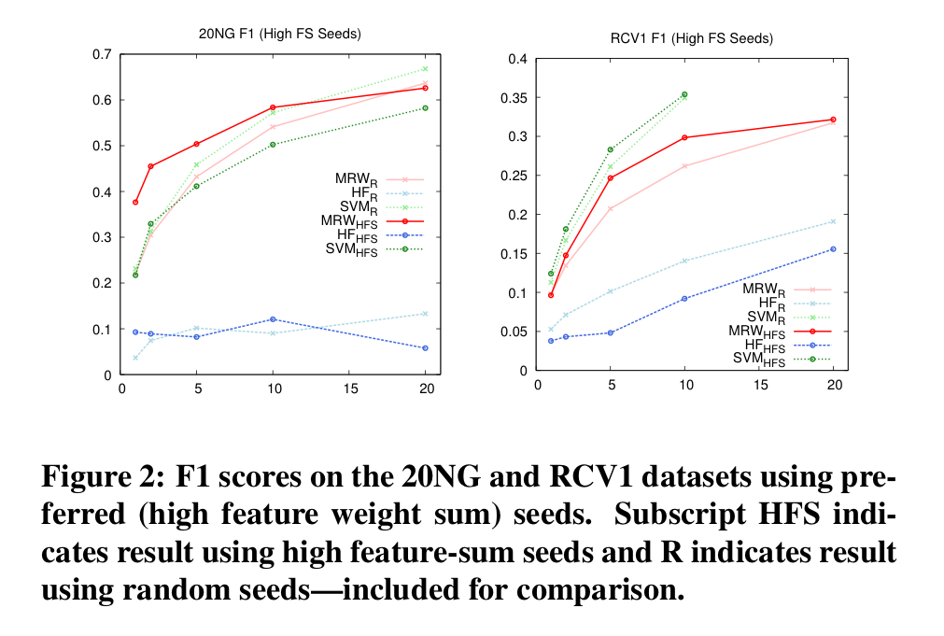
Using the Manifold Trick for SSL

Slide 48
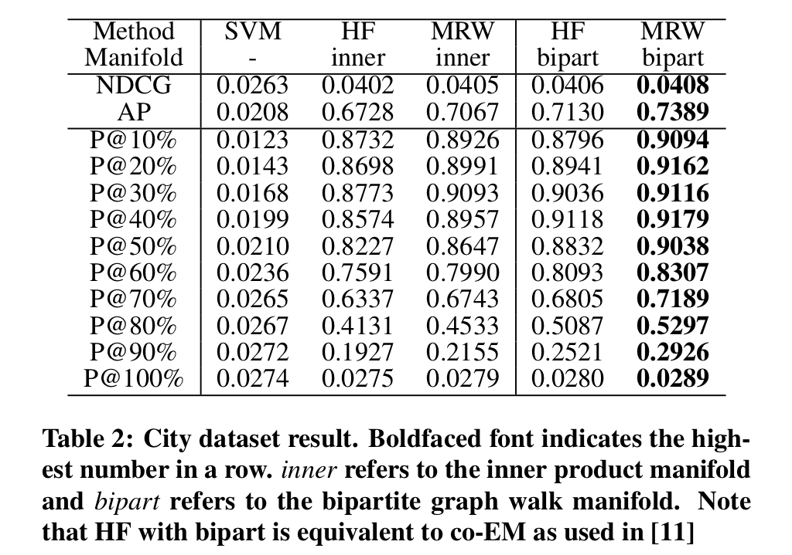
Using the Manifold Trick for SSL

Slide 49
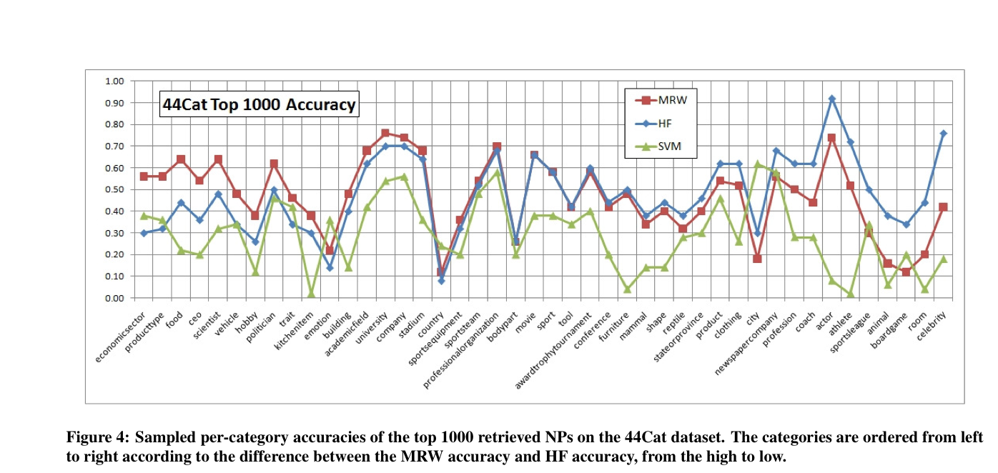
Using the Manifold Trick for SSL

Slide 50
Using the Manifold Trick for SSL
A smoothing trick:

Slide 51
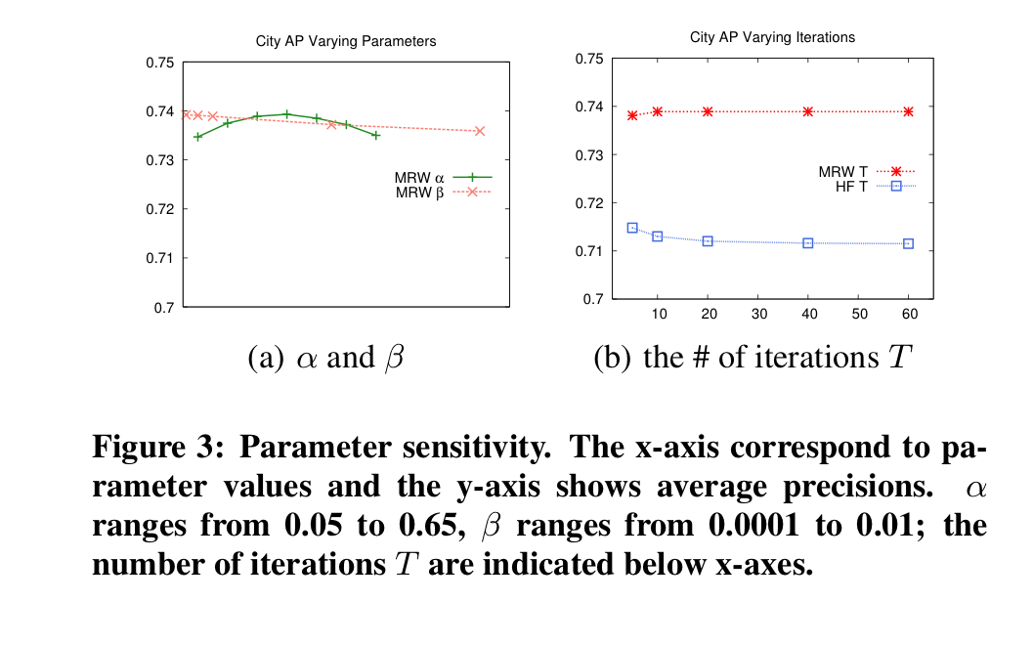
Using the Manifold Trick for SSL

