Slide 1
Semi-Supervised Learning With Graphs
William Cohen

Slide 2
Administrivia
Project initial proposals
if you’re on a team, please have everyone hand in a copy of the proposal
it’s not late but it’s easier for me to track
my instructor comments might have questions
I’m trying to identify high-risk issues
the final proposal would be the right time to address these questions

Slide 3
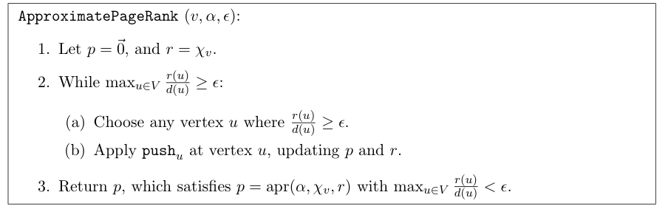
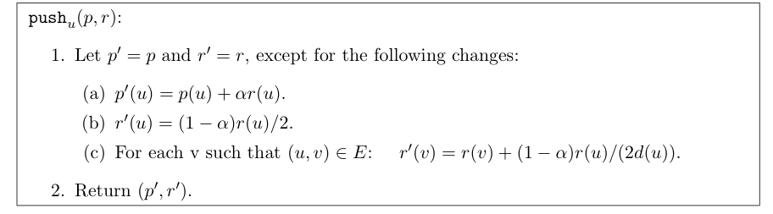
Recap: Approximate PageRank

Slide 4
APR – Ordering for Scanning
Scan repeatedly through an adjacency-list encoding of the graph
For every line you read u, v₁,…,v_{d(u)} such that r(u)/d(u) > ε:
benefit: storage is O(1/εα) for the hash tables, avoids any seeking

Slide 5
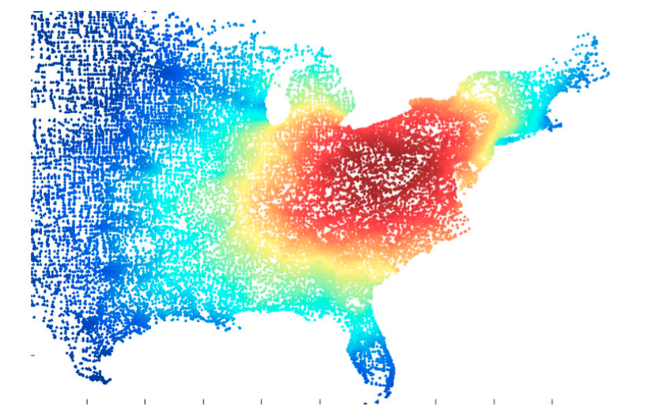
Key idea: a “sweep”
Order vertices v₁, v₂, …. by highest apr(s)
Pick a prefix S={ v₁, v₂, …. v_{k} }:
S={}; volS =0; B={}
For k=1,…n:
S += {v_{k}}
volS += degree(v_{k})
B += {u: v_{k}→u and u not in S}
Φ[k] = |B|/volS
Pick k: Φ[k] is smallest

Slide 6

Scoring a graph prefix
the edges leaving S
vol(S) is sum of deg(x) for x in S
for small S: Prob(random edge leaves S)

Slide 7
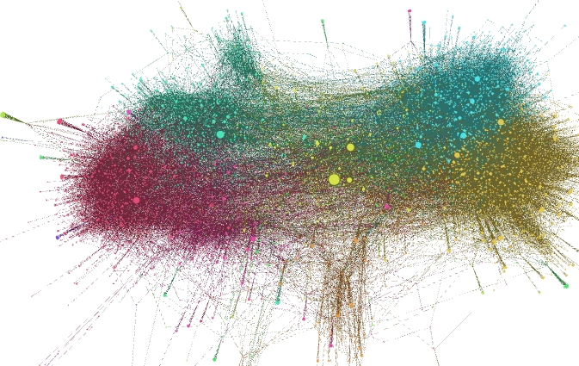
Putting this together
Given a graph
that’s too big for memory, and/or
that’s only accessible via API
…we can extract a sample in an interesting area
Run the apr/rwr from a seed node
Sweep to find a low-conductance subset
Then
compute statistics
test out some ideas
visualize it…

Slide 8
Today
Scalable semi-supervised learning on graphs
SSL with RWR
SSL with coEM/wvRN/HF
Scalable unsupervised learning on graphs
Power iteration clustering
…

Slide 9
Semi-supervised learning
A pool of labeled examples L
A (usually larger) pool of unlabeled examples U
Can you improve accuracy somehow using U?

Slide 10
Semi-Supervised Bootstrapped Learning/Self-training
Extract cities:
Paris
Pittsburgh
Seattle
Cupertino
San Francisco
Austin
denial
anxiety
selfishness
Berlin
mayor of arg1
live in arg1
arg1 is home of
traits such as arg1

Slide 11
Semi-Supervised Bootstrapped Learning via Label Propagation
mayor of arg1
arg1 is home of
San Francisco
Austin
Paris
Pittsburgh
anxiety
live in arg1
traits such as arg1
denial
selfishness
Seattle

Slide 12
Semi-Supervised Bootstrapped Learning via Label Propagation
mayor of arg1
arg1 is home of
Information from other categories tells you “how far” (when to stop propagating)
San Francisco
Austin
Paris
Pittsburgh
anxiety
traits such as arg1
live in arg1
traits such as arg1
arrogance
denial
selfishness
denial
selfishness
Seattle
Nodes “near” seeds
Nodes “far from” seeds

Slide 13
Semi-Supervised Learning as Label Propagation on a (Bipartite) Graph
mayor of arg1
Propagation methods: “personalized PageRank” (aka damped PageRank, random-walk-with-reset)
arg1 is home of
San Francisco
Austin
Paris
Pittsburgh
Propagate labels to nearby nodes
X is “near” Y if there is a high probability of reaching X from Y with a random walk where each step is either (a) move to a random neighbor or (b) jump back to start node Y, if you’re at an NP node
rewards multiple paths
penalizes long paths
penalizes high-fanout paths
anxiety
live in arg1
traits such as arg1
denial
selfishness
Seattle
I like arg1
beer

Slide 14


ASONAM-2010 (Advances in Social Networks Analysis and Mining)

Slide 15
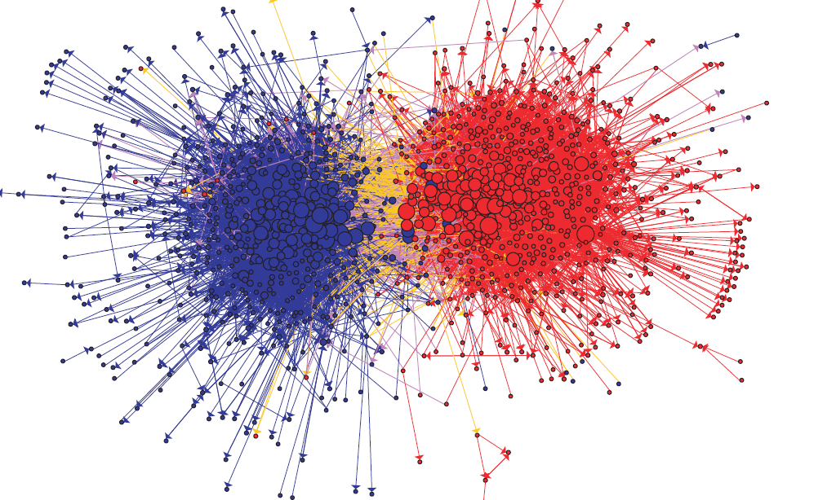
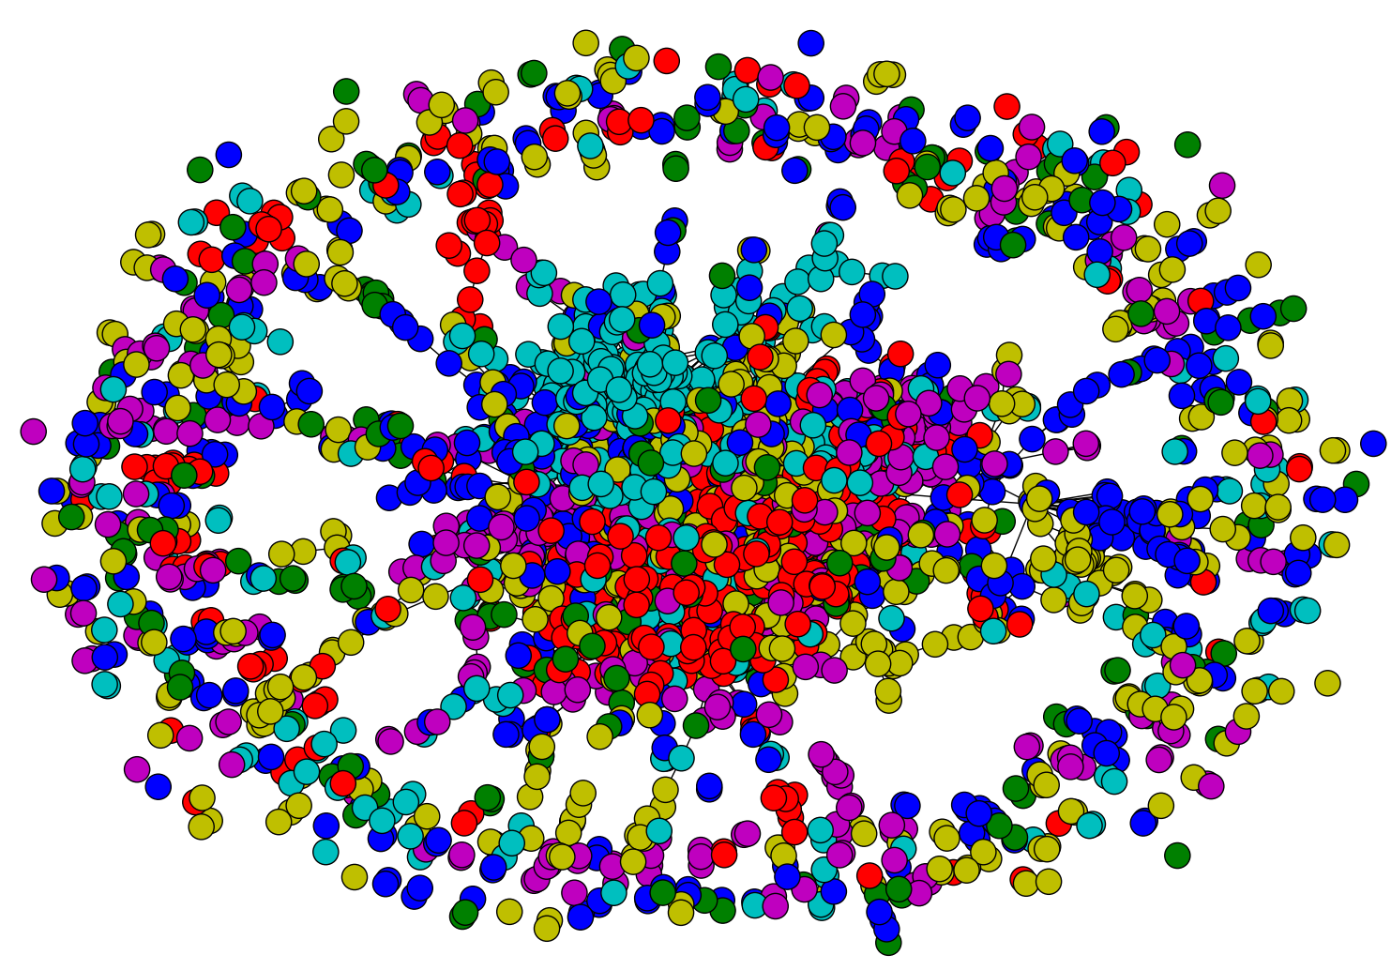
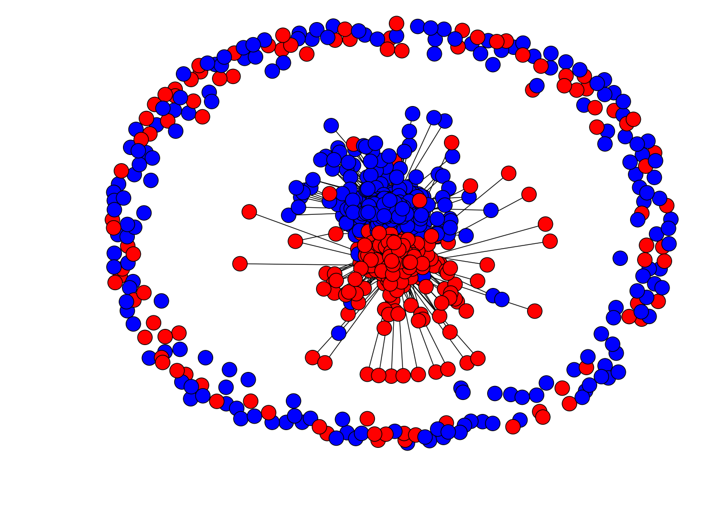
Network Datasets with Known Classes
UBMCBlog
AGBlog
MSPBlog
Cora
Citeseer

Slide 16
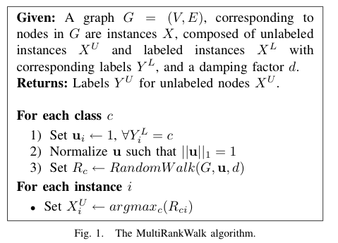

RWR - fixpoint of:
Seed selection
order by PageRank, degree, or randomly
go down list until you have at least k examples/class

Slide 17
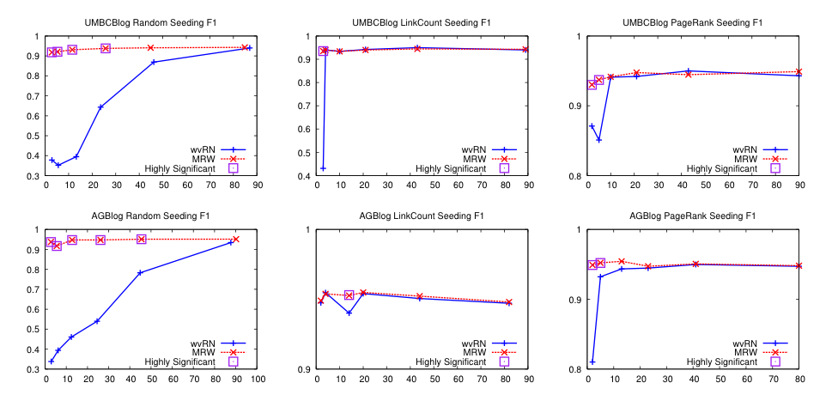
Results – Blog data
Random
Degree
PageRank

Slide 18
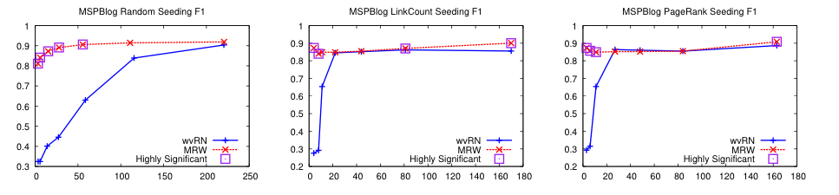
Results – More blog data
Random
Degree
PageRank

Slide 19
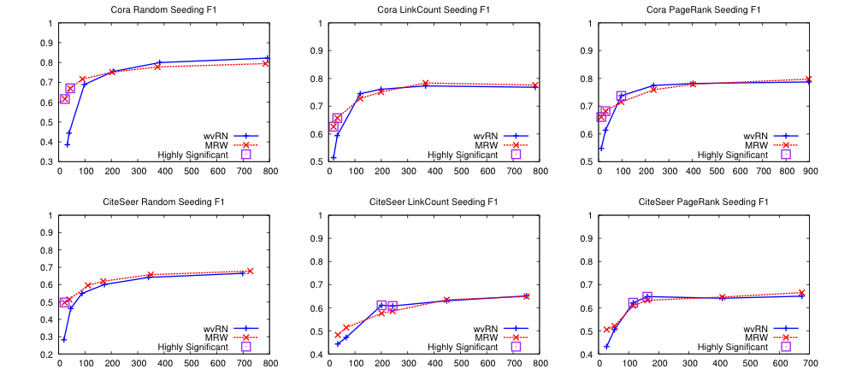
Results – Citation blog data
Random
Degree
PageRank

Slide 20
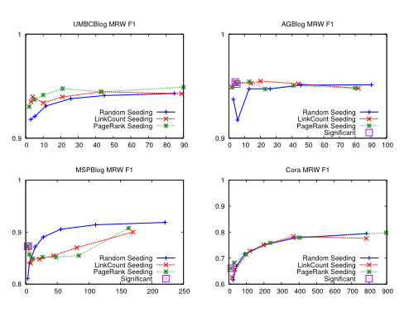
Seeding – MultiRankWalk

Slide 21
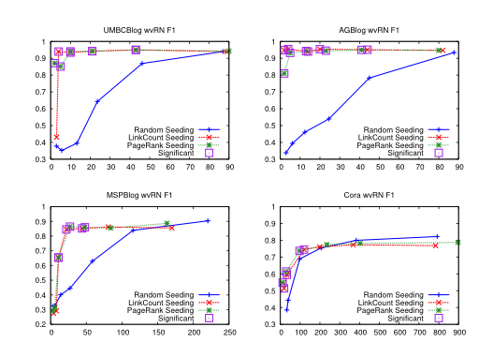
Seeding – HF/wvRN

Slide 22
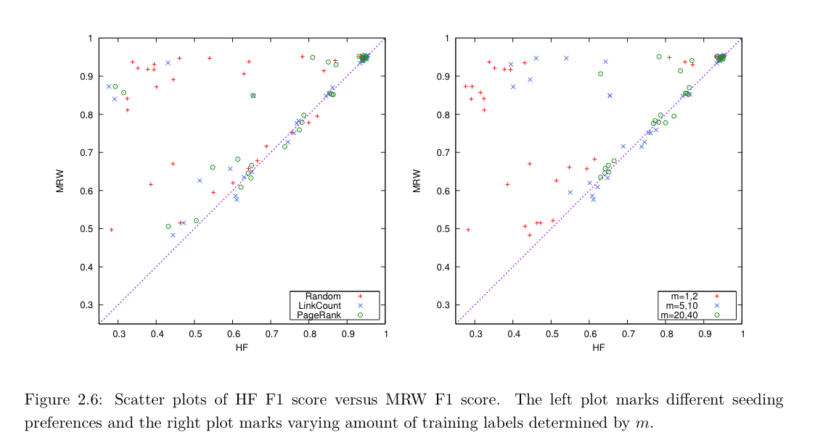
MultiRankWalk vs wvRN/HF/CoEM

Slide 23
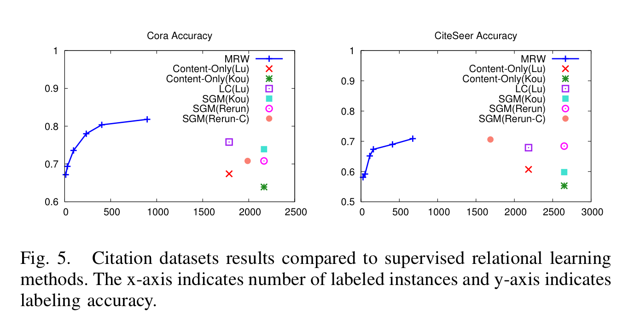
How well does MWR work?
Notes:
Re-run-C connected version of dataset
Lu is Lu & Getoor, 2003

Slide 24
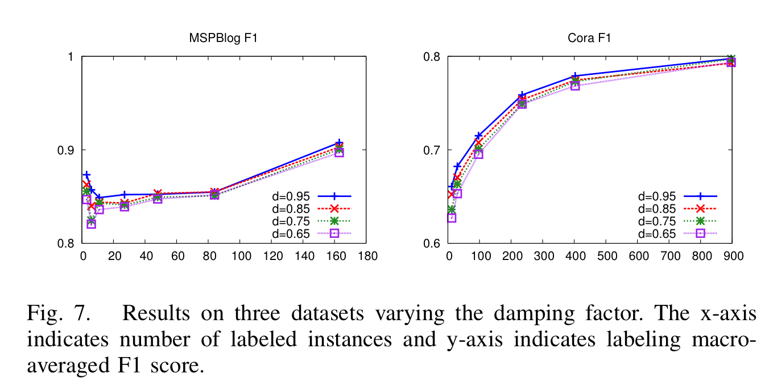
Parameter Sensitivity

Slide 25
Semi-supervised learning
A pool of labeled examples L
A (usually larger) pool of unlabeled examples U
Can you improve accuracy somehow using U?

Slide 26
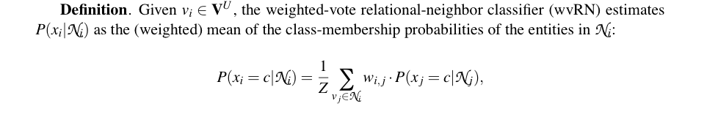
CoEM/HF/wvRN
One definition [MacKassey & Provost, JMLR 20xx]:…
A harmonic field – the score of each node in the graph is the harmonic (linearly weighted) average of its neighbors’ scores;
[X. Zhu, Z. Ghahramani, and J. Lafferty, ICML 2003]

Slide 27
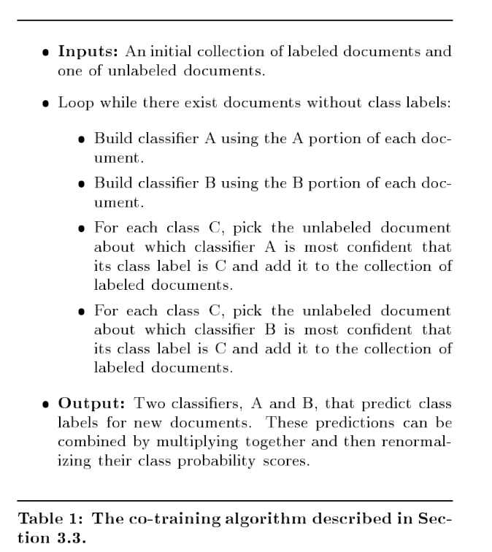
CoEM/wvRN/HF
Another justification of the same algorithm….
… start with co-training with a naïve Bayes learner

Slide 28
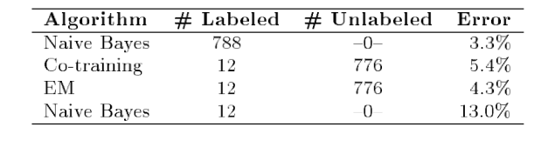
CoEM/wvRN/HF
One algorithm with several justifications….
One is to start with co-training with a naïve Bayes learner
And compare to an EM version of naïve Bayes
E: soft-classify unlabeled examples with NB classifier
M: re-train classifier with soft-labeled examples
Notes:
on webkb – anchor text and words on page

Slide 29
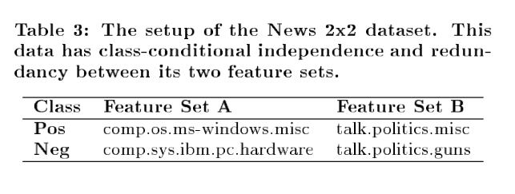
CoEM/wvRN/HF
A second experiment
each + example: concatenate features from two documents, one of class A+, one of class B+
each - example: concatenate features from two documents, one of class A-, one of class B-
features are prefixed with “A”, “B” ➔ disjoint
Notes:
on webkb – anchor text and words on page

Slide 30
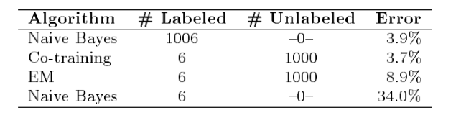
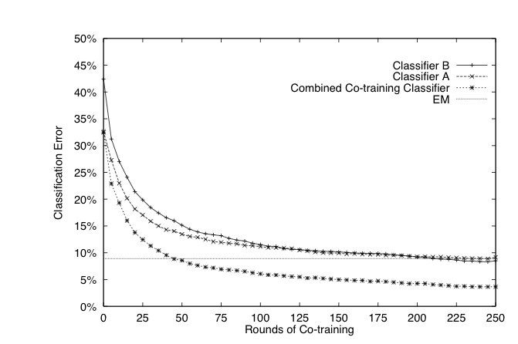
CoEM/wvRN/HF
A second experiment
each + example: concatenate features from two documents, one of class A+, one of class B+
each - example: concatenate features from two documents, one of class A-, one of class B-
features are prefixed with “A”, “B” ➔ disjoint
NOW co-training outperforms EM
Notes:
on webkb – anchor text and words on page

Slide 31
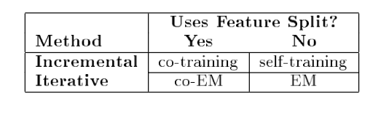
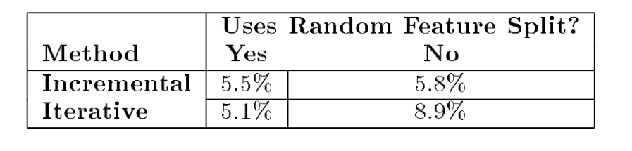
CoEM/wvRN/HF
vs an EM version of naïve Bayes
E: soft-classify unlabeled examples with NB classifier
M: re-train classifier with soft-labeled examples
Co-training with a naïve Bayes learner
Notes:
on webkb – anchor text and words on page

Slide 32
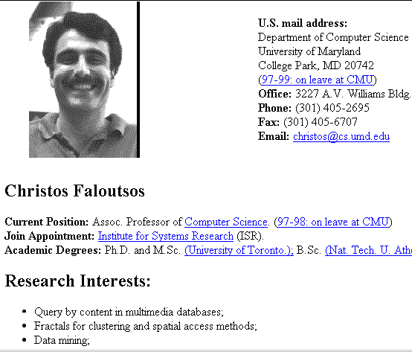
Co-Training Rote Learner
hyperlinks
pages
+
+
+
+
My advisor
+
+
+
+
+
-
-
-
-
-
-
-
-
-
-
-
-

Slide 33
Co-EM Rote Learner: equivalent to HF!
NPs
contexts
+
Pittsburgh
+
+
+
+
+
+
lives in _
+
+
-
-
-
-
-
-
-
-
-
-
-
-

Slide 34
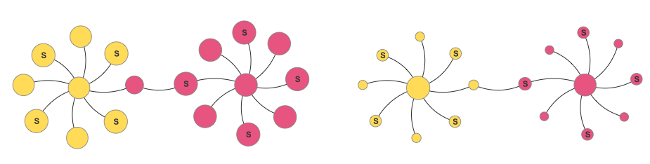
MultiRank Walk vs HF/wvRN/CoEM
Seeds are marked S
HF
MRW

Slide 35
From SemiSupervised to Unsupervised Learning

Slide 36
Spectral Clustering: Graph = Matrix
 | A | B | C | D | E | F | G | H | I | J
A |  | 1 |  | 1 |  | 1
B | 1 |  | 1
C |  | 1
D | 1 |  |  |  |  | 1
E |  |  |  |  |  | 1
F | 1 |  |  | 1 | 1
G |  |  |  |  |  |  |  |  | 1
H |  |  |  |  |  |  | 1 |  | 1 | 1
I |  |  |  |  |  |  | 1 | 1 |  | 1
J |  |  |  |  |  |  |  | 1 | 1
C
A
B
G
I
H
J
F
D
E

Slide 37
Spectral Clustering: Graph = Matrix Transitively Closed Components = “Blocks”
 | A | B | C | D | E | F | G | H | I | J
A | _ | 1 | 1 |  |  | 1
B | 1 | _ | 1
C | 1 | 1 | _
D |  |  |  | _ | 1 | 1
E |  |  |  | 1 | _ | 1
F | 1 |  |  | 1 | 1 | _
G |  |  |  |  |  |  | _ |  | 1 | 1
H |  |  |  |  |  |  |  | _ | 1 | 1
I |  |  |  |  |  |  | 1 | 1 | _ | 1
J |  |  |  |  |  |  | 1 | 1 | 1 | _
C
A
B
G
I
H
J
F
D
E
Of course we can’t see the “blocks” unless the nodes
are sorted by cluster…

Slide 38
Spectral Clustering: Graph = Matrix Vector = Node → Weight
M
v
 | A | B | C | D | E | F | G | H | I | J
A | _ | 1 | 1 |  |  | 1
B | 1 | _ | 1
C | 1 | 1 | _
D |  |  |  | _ | 1 | 1
E |  |  |  | 1 | _ | 1
F | 1 |  |  | 1 | 1 | _
G |  |  |  |  |  |  | _ |  | 1 | 1
H |  |  |  |  |  |  |  | _ | 1 | 1
I |  |  |  |  |  |  | 1 | 1 | _ | 1
J |  |  |  |  |  |  | 1 | 1 | 1 | _
 | A
A | 3
B | 2
C | 3
D
E
F
G
H
I
J
C
A
B
G
I
H
J
F
D
E
M

Slide 39
Spectral Clustering: Graph = Matrix M*v₁ = v₂ “propogates weights from neighbors”
M
*
v₁
=
v₂
 | A | B | C | D | E | F | G | H | I | J
A | _ | 1 | 1 |  |  | 1
B | 1 | _ | 1
C | 1 | 1 | _
D |  |  |  | _ | 1 | 1
E |  |  |  | 1 | _ | 1
F |  |  |  | 1 | 1 | _
G |  |  |  |  |  |  | _ |  | 1 | 1
H |  |  |  |  |  |  |  | _ | 1 | 1
I |  |  |  |  |  |  | 1 | 1 | _ | 1
J |  |  |  |  |  |  | 1 | 1 | 1 | _
A | 3
B | 2
C | 3
D
E
F
G
H
I
J
A | 2*1+3*1+0*1
B | 3*1+3*1
C | 3*1+2*1
D
E
F
G
H
I
J
C
A
B
G
I
H
J
F
D
E
M

Slide 40
Spectral Clustering: Graph = Matrix W*v₁ = v₂ “propogates weights from neighbors”
W
*
v₁
=
v₂
W: normalized so columns sum to 1
 | A | B | C | D | E | F | G | H | I | J
A | _ | .5 | .5 |  |  | .3
B | .3 | _ | .5
C | .3 | .5 | _
D |  |  |  | _ | .5 | .3
E |  |  |  | .5 | _ | .3
F | .3 |  |  | .5 | .5 | _
G |  |  |  |  |  |  | _ |  | .3 | .3
H |  |  |  |  |  |  |  | _ | .3 | .3
I |  |  |  |  |  |  | .5 | .5 | _ | .3
J |  |  |  |  |  |  | .5 | .5 | .3 | _
A | 3
B | 2
C | 3
D
E
F
G
H
I
J
A | 2*.5+3*.5+0*.3
B | 3*.3+3*.5
C | 3*.33+2*.5
D
E
F
G
H
I
J
C
A
B
G
I
H
J
F
D
E

Slide 41
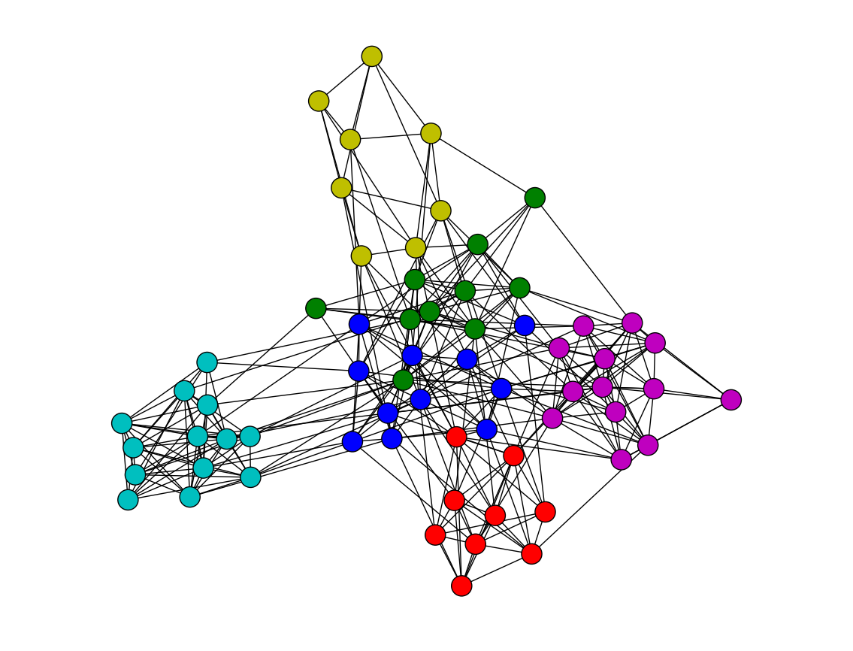
Spectral Clustering: Graph = Matrix W*v₁ = v₂ “propogates weights from neighbors”
Q: How do I pick v to be an eigenvector for a block-stochastic matrix?

Slide 42
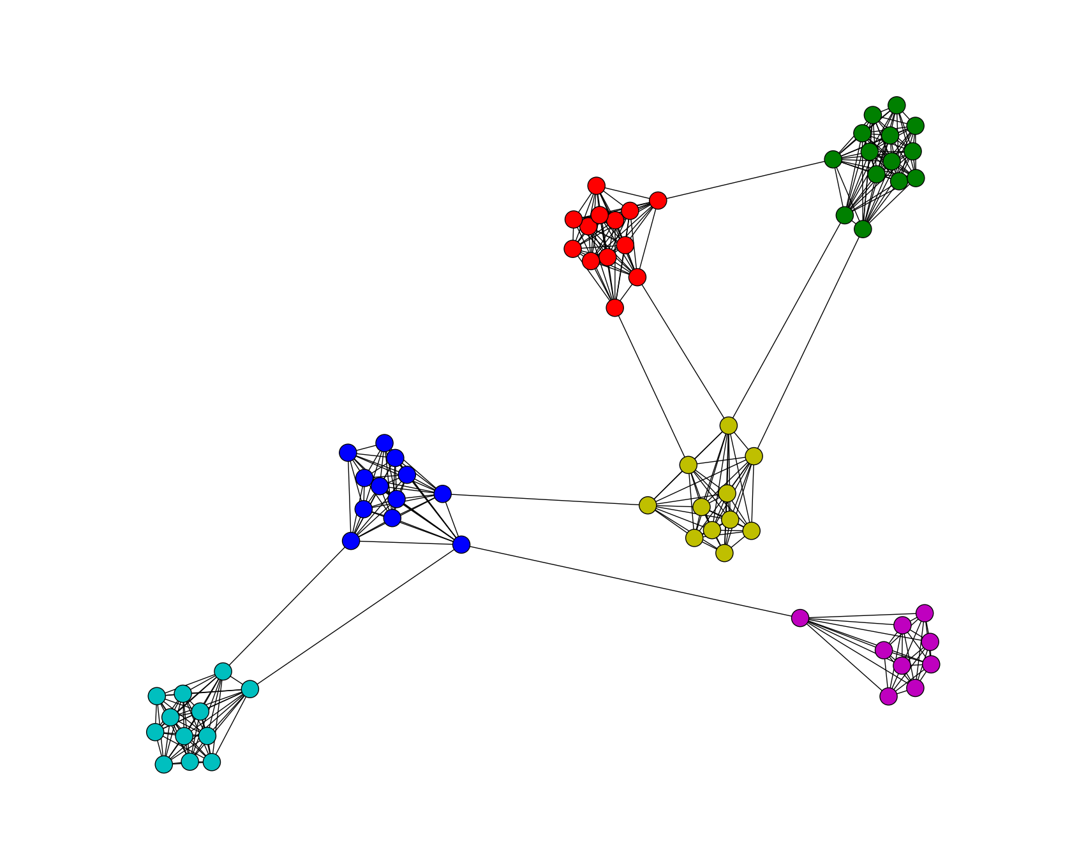
Spectral Clustering: Graph = Matrix W*v₁ = v₂ “propogates weights from neighbors”
How do I pick v to be an eigenvector for a block-stochastic matrix?

Slide 43
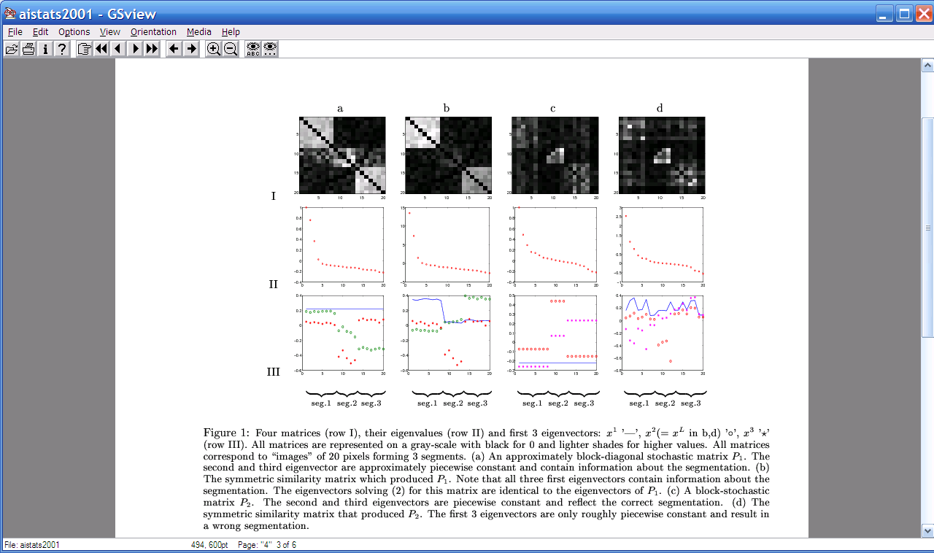
Spectral Clustering: Graph = Matrix W*v₁ = v₂ “propogates weights from neighbors”
λ₁
e₁
λ₂
“eigengap”
e₃
λ₃
λ₄
e₂
λ₅,_{6,7,….}
[Shi & Meila, 2002]

Slide 44
Spectral Clustering: Graph = Matrix W*v₁ = v₂ “propogates weights from neighbors”
e₂
0.4
0.2
x
x
x
x
x
x
x
x
x
0.0
x
x
x
-0.2
y
z
y
y
z
-0.4
y
z
z
e₃
z
z
z
z
z
z
y
z
e₁
-0.4
-0.2
0
0.2
e₂
[Shi & Meila, 2002]

Slide 45
Spectral Clustering: Graph = Matrix W*v₁ = v₂ “propogates weights from neighbors”
If W is connected but roughly block diagonal with k blocks then
the top eigenvector is a constant vector
the next k eigenvectors are roughly piecewise constant with “pieces” corresponding to blocks
M

Slide 46
Spectral Clustering: Graph = Matrix W*v₁ = v₂ “propogates weights from neighbors”
If W is connected but roughly block diagonal with k blocks then
the “top” eigenvector is a constant vector
the next k eigenvectors are roughly piecewise constant with “pieces” corresponding to blocks
Spectral clustering:
Find the top k+1 eigenvectors v₁,…,v_{k+1}
Discard the “top” one
Replace every node a with k-dimensional vector x_{a} = <v₂(a),…,v_{k+1} (a) >
Cluster with k-means
M

Slide 47
Spectral Clustering: Pros and Cons
Elegant, and well-founded mathematically
Tends to avoid local minima
Optimal solution to relaxed version of mincut problem (Normalized cut, aka NCut)
Works quite well when relations are approximately transitive (like similarity, social connections)
Expensive for very large datasets
Computing eigenvectors is the bottleneck
Approximate eigenvector computation not always useful
Noisy datasets sometimes cause problems
Picking number of eigenvectors and k is tricky
“Informative” eigenvectors need not be in top few
Performance can drop suddenly from good to terrible

Slide 48
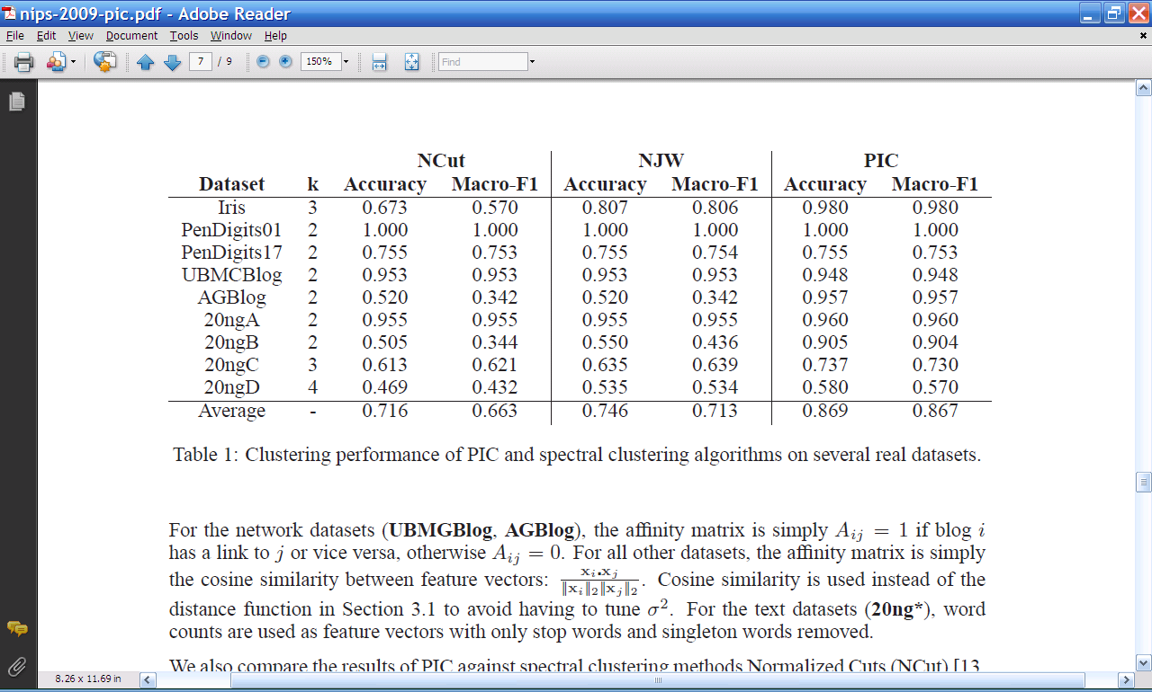
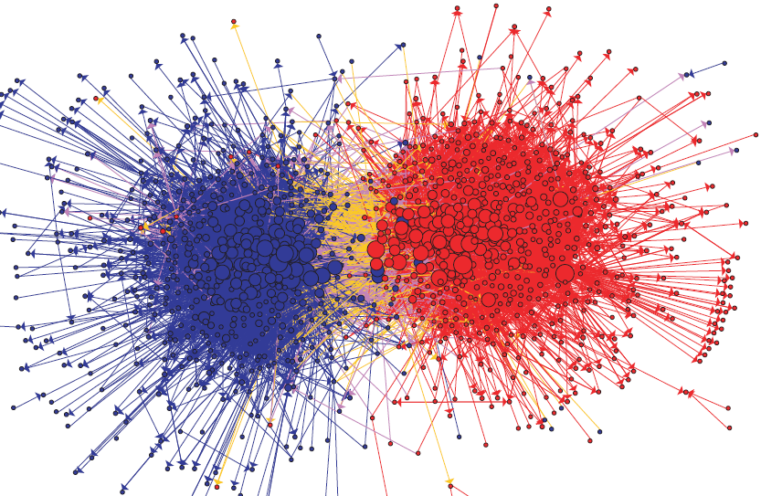
Experimental results: best-case assignment of class labels to clusters

Slide 49
Spectral Clustering: Graph = Matrix M*v₁ = v₂ “propogates weights from neighbors”
M
*
v₁
=
v₂
 | A | B | C | D | E | F | G | H | I | J
A | _ | 1 | 1 |  |  | 1
B | 1 | _ | 1
C | 1 | 1 | _
D |  |  |  | _ | 1 | 1
E |  |  |  | 1 | _ | 1
F |  |  |  | 1 | 1 | _
G |  |  |  |  |  |  | _ |  | 1 | 1
H |  |  |  |  |  |  |  | _ | 1 | 1
I |  |  |  |  |  |  | 1 | 1 | _ | 1
J |  |  |  |  |  |  | 1 | 1 | 1 | _
A | 3
B | 2
C | 3
D
E
F
G
H
I
J
A | 5
B | 6
C | 5
D
E
F
G
H
I
J
C
A
B
G
I
H
J
F
D
E
M

Slide 50
Repeated averaging with neighbors as a clustering method
Pick a vector v⁰ (maybe at random)
Compute v¹ = Wv⁰
i.e., replace v⁰[x] with weighted average of v⁰[y] for the neighbors y of x
Plot v¹[x] for each x
Repeat for v², v³, …
Variants widely used for semi-supervised learning
clamping of labels for nodes with known labels
Without clamping, will converge to constant v^{t}
What are the dynamics of this process?

Slide 51
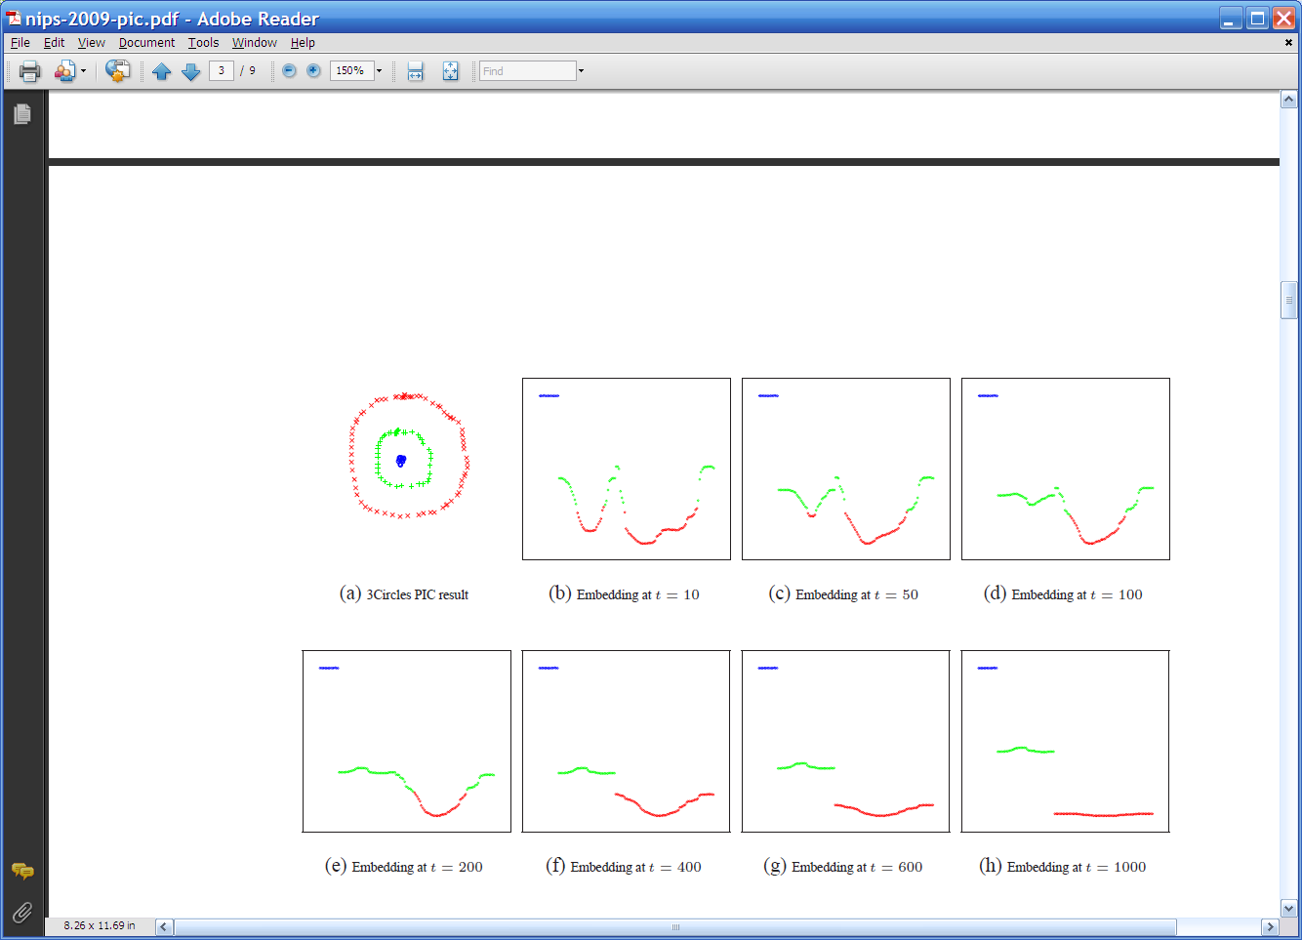
Repeated averaging with neighbors on a sample problem…
blue
green
___red___
Create a graph, connecting all points in the 2-D initial space to all other points
Weighted by distance
Run power iteration for 10 steps
Plot node id x vs v¹⁰(x)
nodes are ordered by actual cluster number
g
g
g
g
g
g
g
g
g
r
r
r
r
…
b
b
r
r
r
b
b
b

Slide 52
Repeated averaging with neighbors on a sample problem…
blue
green
___red___
blue
green
___red___
blue
green
___red___
larger
smaller

Slide 53
Repeated averaging with neighbors on a sample problem…
blue
green
___red___
blue
green
___red___
blue
green
___red___
blue
green
___red___
blue
green
___red___

Slide 54
Repeated averaging with neighbors on a sample problem…
very small

Slide 55
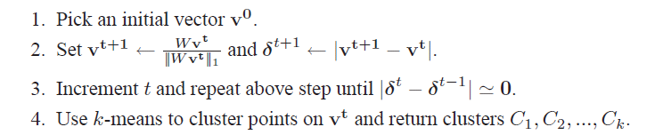
PIC: Power Iteration Clustering run power iteration (repeated averaging w/ neighbors) with early stopping
V⁰: random start, or “degree matrix” D, or …
Easy to implement and efficient
Very easily parallelized
Experimentally, often better than traditional spectral methods
Surprising since the embedded space is 1-dimensional!

Slide 56
Experiments
“Network” problems: natural graph structure
PolBooks: 105 political books, 3 classes, linked by copurchaser
UMBCBlog: 404 political blogs, 2 classes, blogroll links
AGBlog: 1222 political blogs, 2 classes, blogroll links
“Manifold” problems: cosine distance between classification instances
Iris: 150 flowers, 3 classes
PenDigits01,17: 200 handwritten digits, 2 classes (0-1 or 1-7)
20ngA: 200 docs, misc.forsale vs soc.religion.christian
20ngB: 400 docs, misc.forsale vs soc.religion.christian
20ngC: 20ngB + 200 docs from talk.politics.guns
20ngD: 20ngC + 200 docs from rec.sport.baseball

Slide 57

Experimental results: best-case assignment of class labels to clusters

Slide 58
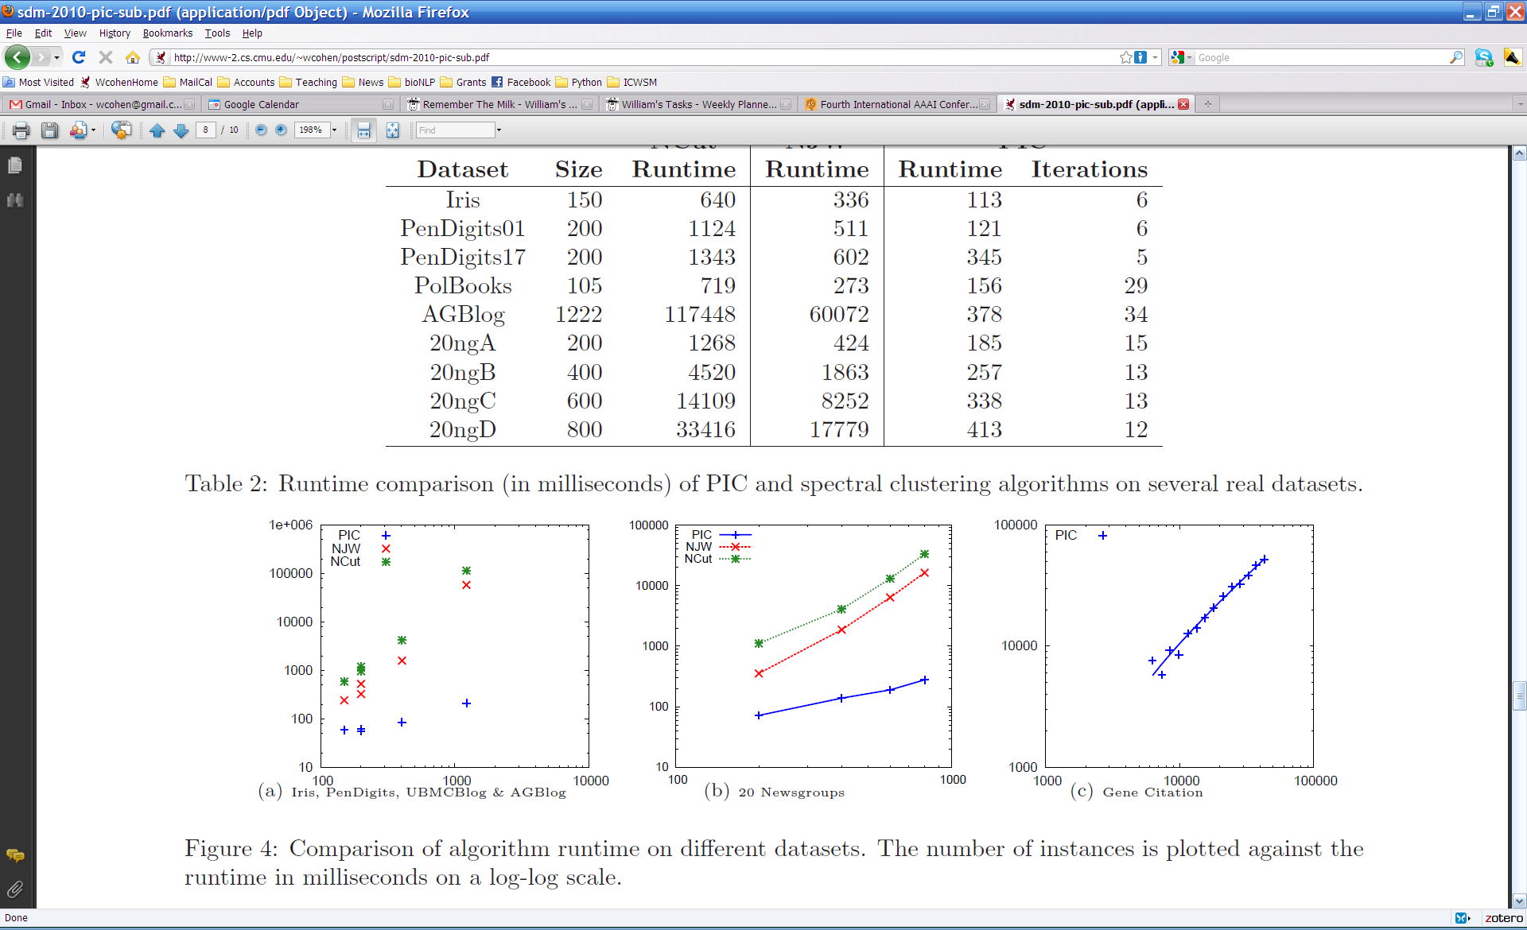

Slide 59
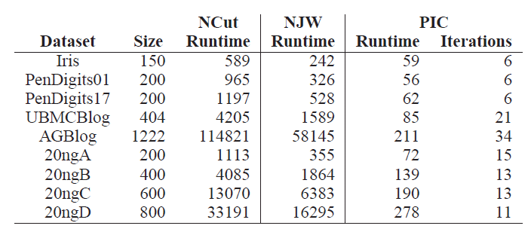
Experiments: run time and scalability
Time in millisec

