Slide 1
Graph Algorithms:
Classification
William Cohen

Slide 2
Outline
Last week:
  PageRank – one algorithm on graphs
    edges and nodes in memory
    nodes in memory
    nothing in memory
This week:
  William’s lecture
    (Semi)Supervised learning on graphs
    Properties of (social) graphs
  Joey Gonzales guest lecture
    GraphLab

Slide 3

SIGIR 2007

Slide 4
Example of a Learning Problem on Graphs
WebSpam detection
  Dataset: WEBSPAM 2006
    crawl of .uk domain
  78M pages, 11,400 hosts
    2,725 hosts labeled spam/nonspam
    3,106 hosts assumed non/spam (.gov.uk, …)
    22% spam, 10% borderline
  graph: 3B edges, 1.2Gb
  content: 8x 55Gb compressed
    summary: 3.3M pages, 400 pages/host

Slide 5
Features for spam/nonspam - 1
Content-based features
  Precision/recall of words in page relative to words in a query log
  Number of words on page, title, …
  Fraction of anchor text, visible text, …
  Compression rate of page
    ratio of size before/after being gzipped
  Trigram entropy

Slide 6
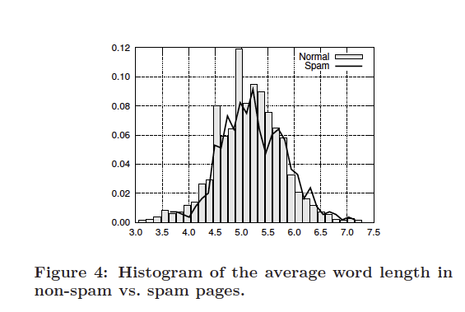
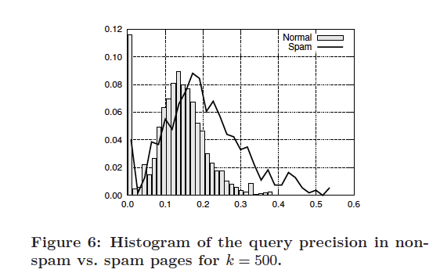
Content features
Aggregate page features for a host:
features for home page and highest PR page in host
average value and standard deviation of each page feature

Slide 7
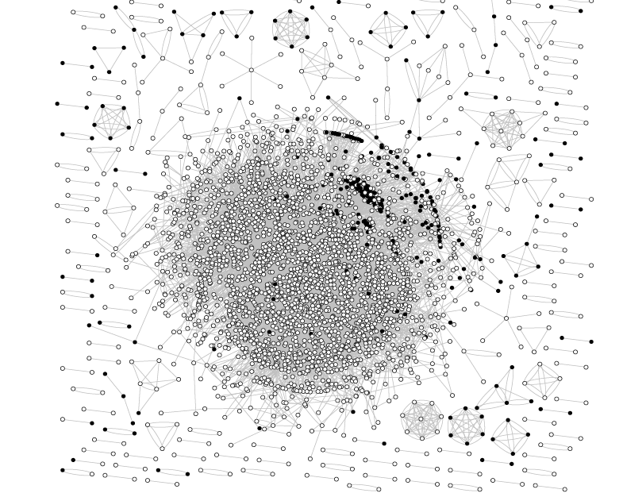
labeled nodes with more than 100 links between them

Slide 8
labeled nodes with more than 100 links between them

Slide 9
labeled nodes with more than 100 links between them

Slide 10
Features for spam/nonspam - 2
Link-based features of host
  indegree/outdegree
  PageRank
  TrustRank, Truncated TrustRank
    roughly PageRank “personalized” to start with trusted pages (dmoz) – also called RWR
      PR update: v^{t+1} = cu + (1-c)Wv^{t}
      Personaled PR update: v^{t+1} = cp + (1-c)Wv^{t}
        p is a “personalization vector”
  number of d-supporters of a node
    x d-supports y iff shortest path x→y has length d
    computable with a randomized algorithm

Slide 11
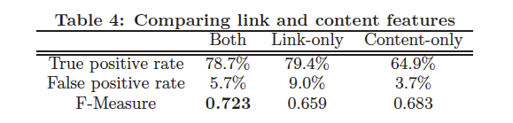
Initial results
Classifier – bagged cost-sensitive decision tree

Slide 12
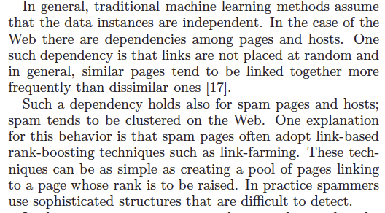
Are link-based features enough?

Slide 13
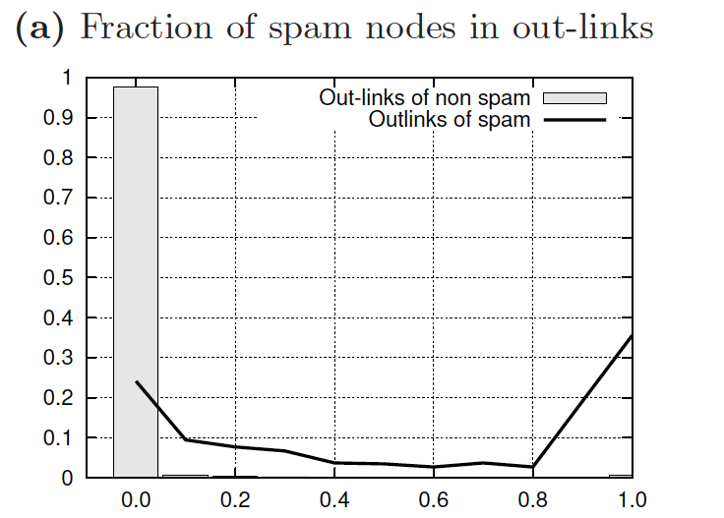
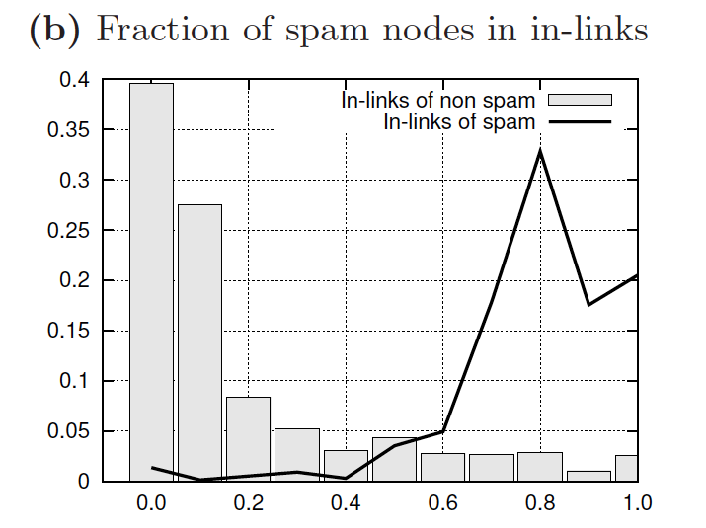
Are link-based features enough?
We could construct a useful feature for classifying spam – if we could classify hosts as spam/nonspam

Slide 14
Are link-based features enough?
Idea 1
  Cluster full graph into many (1000) small pieces
    Use METIS
  If predicted spam-fraction in a cluster is above a threshold, call the whole cluster spam
  If predicted spam-fraction in a cluster is below a threshold, call the whole cluster non-spam

Slide 15
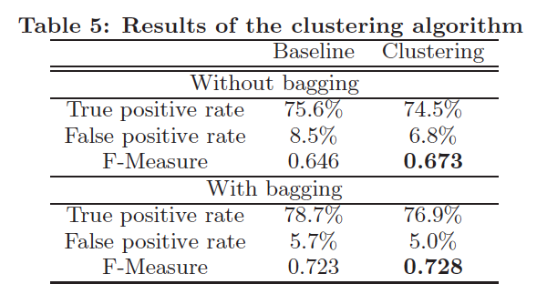
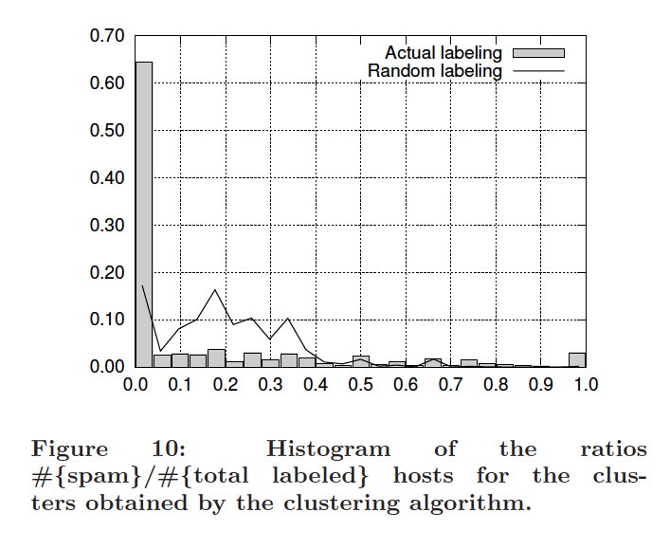
Are link-based features enough?
Clustering result (Idea 1)

Slide 16

Are link-based features enough?
Idea 2: Label propogation is PPR/RWR
  initialize v so v[host] (aka v_{h}) is fraction of predicted spam nodes
  update v iteratively, using personalized pageRank starting from predicted spammyness

Slide 17
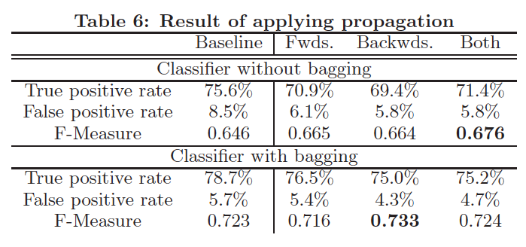
Are link-based features enough?
Results with idea 2:

Slide 18
Are link-based features enough?
Idea 3: “Stacking”
  Compute predicted spammyness of a host p(h)
    by running cross-validation on your data, to avoid looking at predictions from an overfit classifier
  Compute new features for each h
    average predicted spammyness of inlinks of h
    average predicted spammyness of outlinks of h
  Rerun the learner with the larger feature set
  At classification time use two classifiers
    one to compute predicted spammyness w/o the new inlink/outlink features
    one to compute spammyness with the features
      which are based on the first classifier

Slide 19
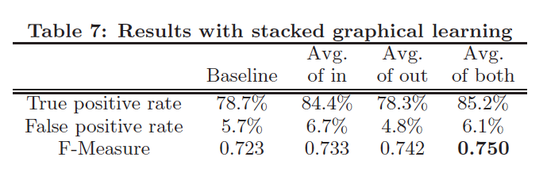
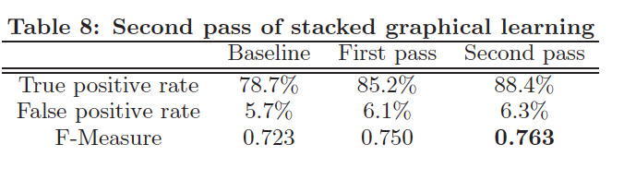
Results with stacking

Slide 20
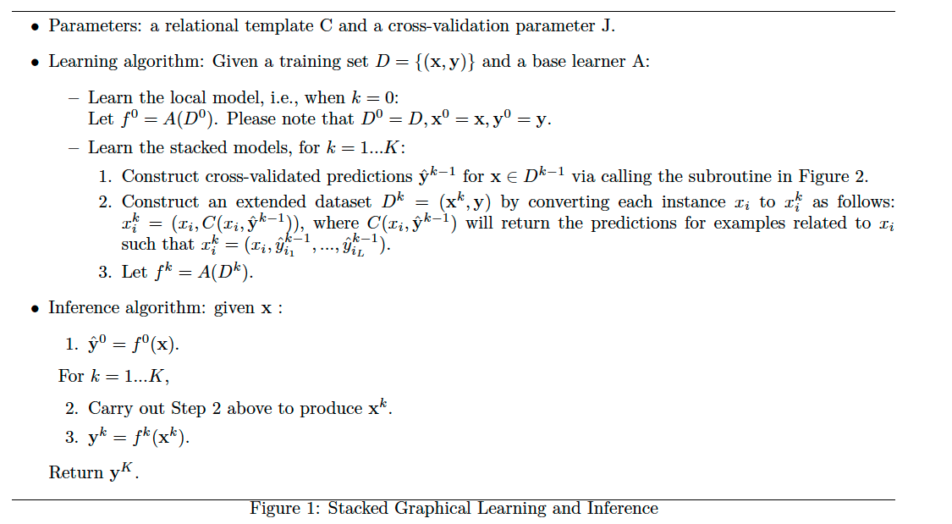
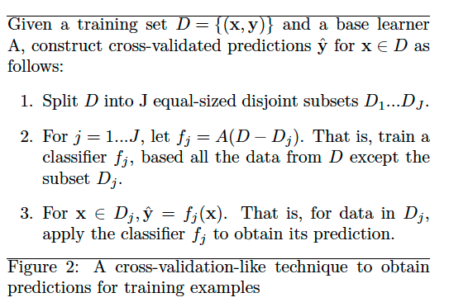
More detail on stacking [Kou & Cohen, SDM 2007]

Slide 21
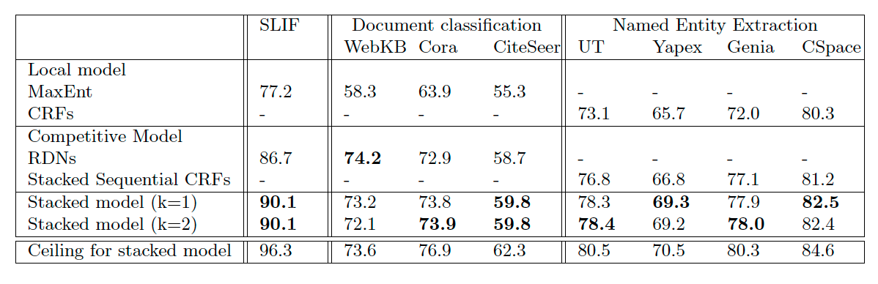
More detail on stacking [Kou & Cohen, SDM 2007]

Slide 22
Baseline: Relational Dependency Network
Aka pseudo-likelihood learning
Learn Pr(y|x₁,…,x_{n},y₁,…,y_{n}):
  predict class give local features, and classes of neighboring instances (as features)
  requires classes of neighboring instances to be available to run classifier
    true at training time, not test time
At test:
  randomly initialize y’s
  repeatedly pick a node, and pick new y from learned model Pr(y|x₁,…,x_{n},y₁,…,y_{n})
    Gibbs sampling

Slide 23
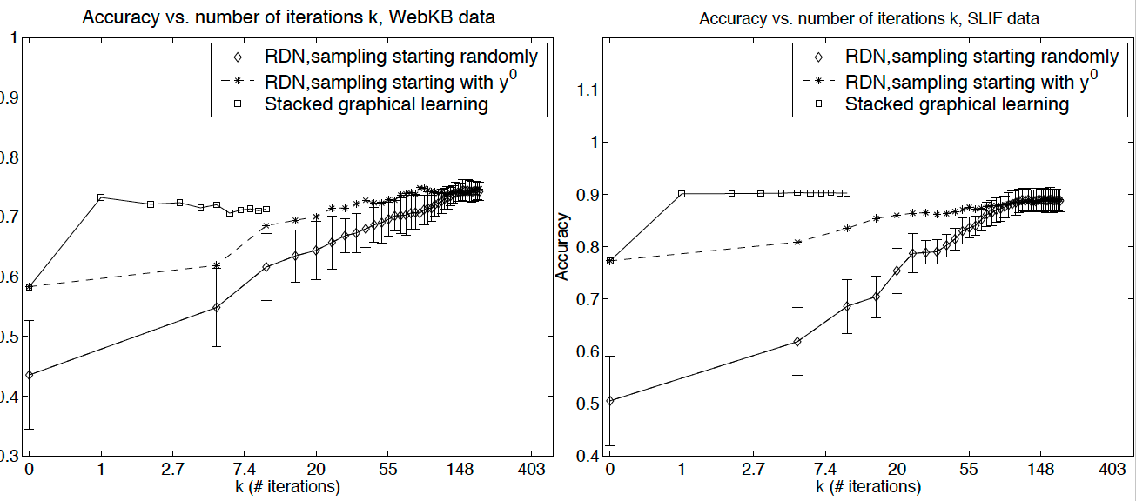
More detail on stacking [Kou & Cohen, SDM 2007]

Slide 24
More detail on stacking [Kou & Cohen, SDM 2007]
Summary:
  very fast at test time
  easy to implement
  easy to construct features that rely on aggregations of neighboring classifications
  on-line learning + stacking avoids cost of cross-validation (Kou, Carvalho, Cohen 2008)
But:
  does not extend well to semi-supervised learning
  does not always outperform label propagation
    especially in “natural” social-network like graphs

