Slide 1
Graph Algorithms:
Properties of Graphs?
William Cohen

Slide 2
Outline
Last week:
  PageRank – one algorithm on graphs
    edges and nodes in memory
    nodes in memory
    nothing in memory
This week:
  William’s lecture
    (Semi)Supervised learning on graphs
    Properties of (social) graphs
  Joey Gonzales guest lecture
    GraphLab

Slide 3
Why I’m talking about graphs
Lots of large data is graphs
  Facebook, Twitter, citation data, and other social networks
  The web, the blogosphere, the semantic web, Freebase, Wikipedia, Twitter, and other information networks
  Text corpora (like RCV1), large datasets with discrete feature values, and other bipartite networks
    nodes = documents or words
    links connect document → word or word → document
  Computer networks, biological networks (proteins, ecosystems, brains, …), …
  Heterogeneous networks with multiple types of nodes
    people, groups, documents

Slide 4
Properties of Graphs
Descriptive Statistics
Models of Growth/Formation
Number of connected components
Diameter
Degree distribution
…
Erdos-Renyi
Preferential attachment
Stochastic block models
….
Let’s look at some examples of graphs … but first, why are these statistics important?

Slide 5
An important question
How do you explore a dataset?
  compute statistics (e.g., feature histograms, conditional feature histograms, correlation coefficients, …)
  sample and inspect
    run a bunch of small-scale experiments
How do you explore a graph?
  compute statistics (degree distribution, …)
  sample and inspect
    how do you sample?

Slide 6
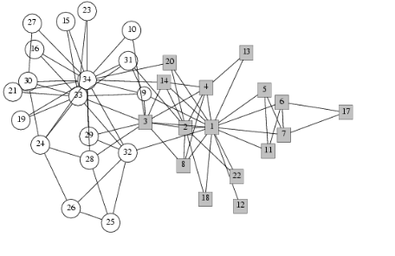
Karate club
Notes:
Karate club

Slide 7
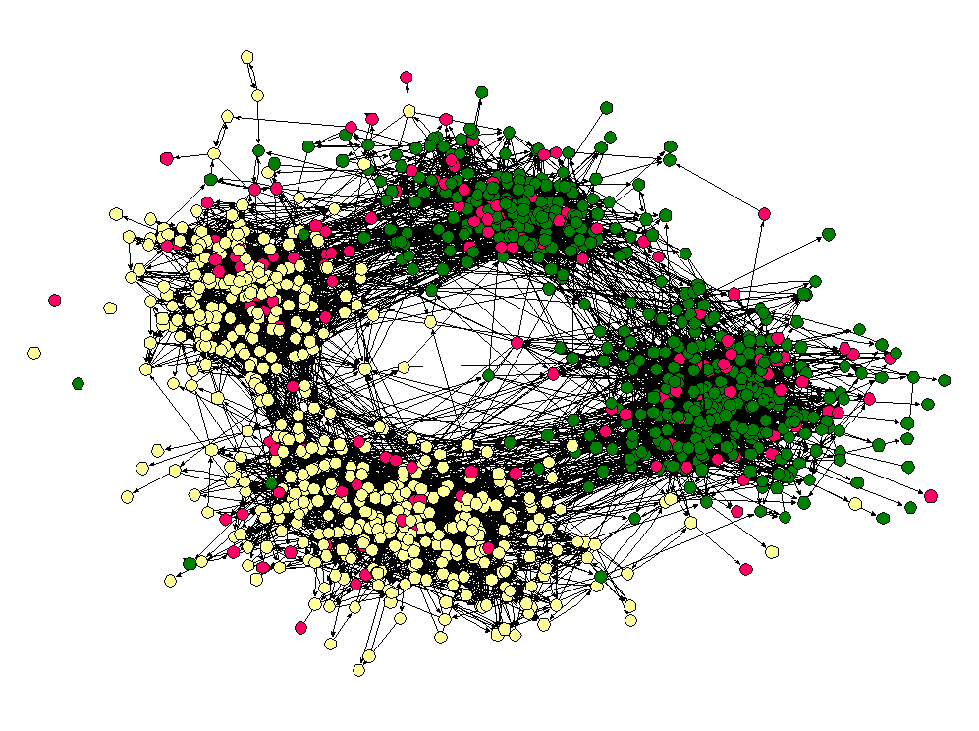
Schoolkids
Notes:
Middle school kids – by race and age

Slide 8
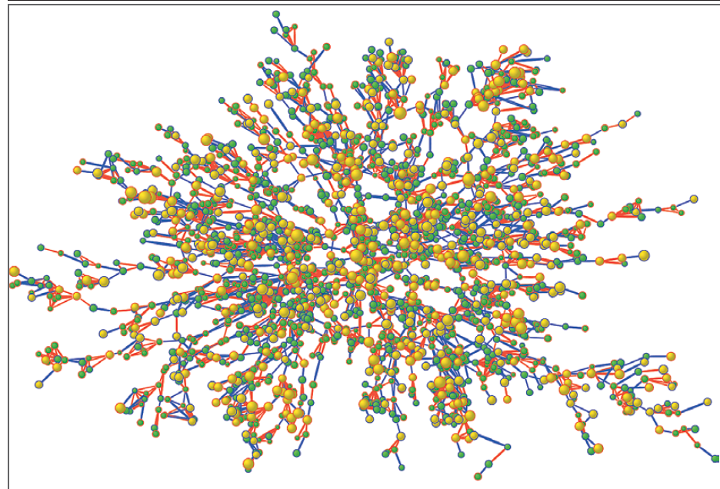
Heart study participants
Notes:
Heart study

Slide 9
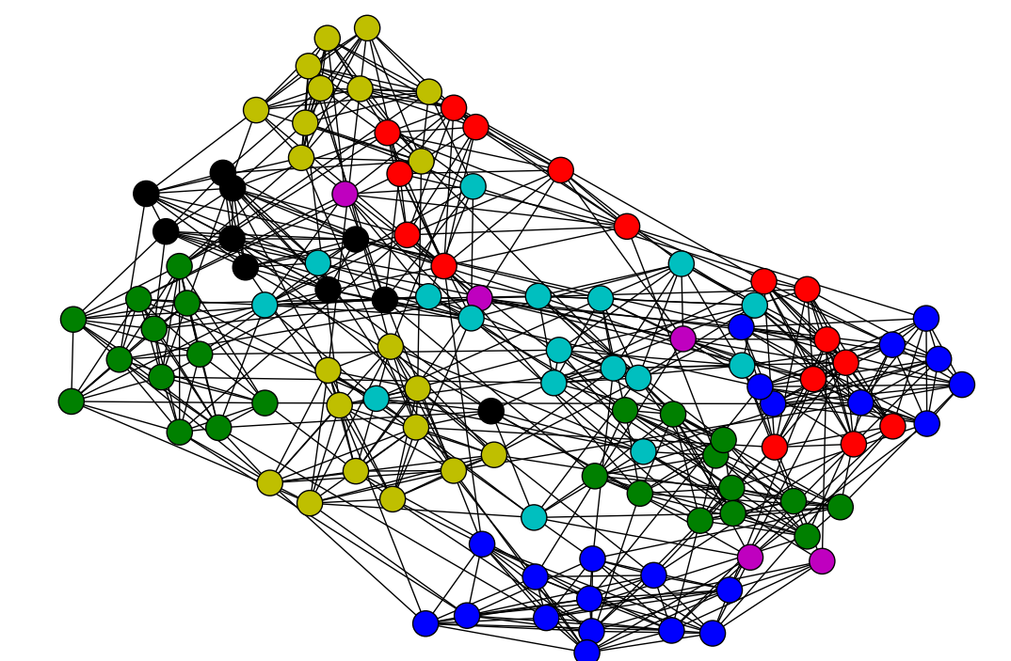
College football
Notes:
College football teams

Slide 10
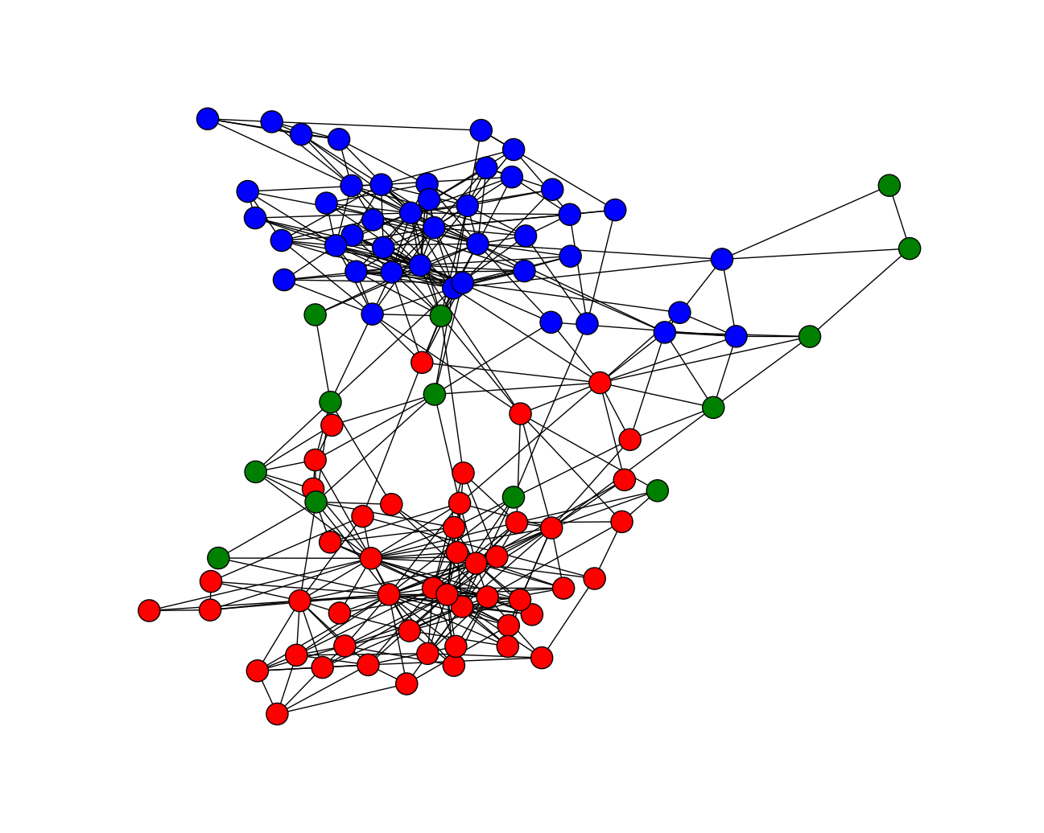
books
Notes:
books

Slide 11
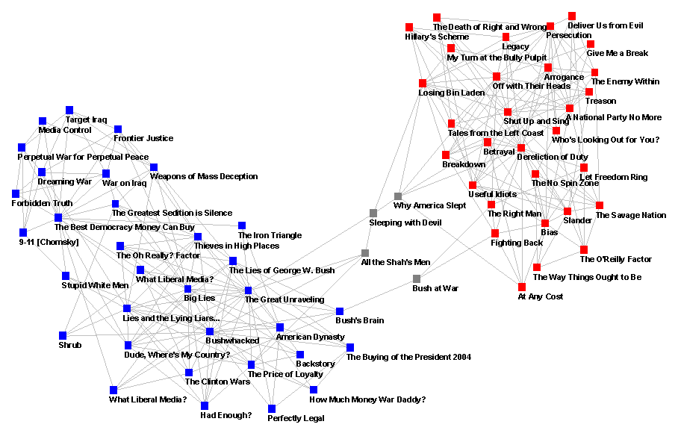

Slide 12
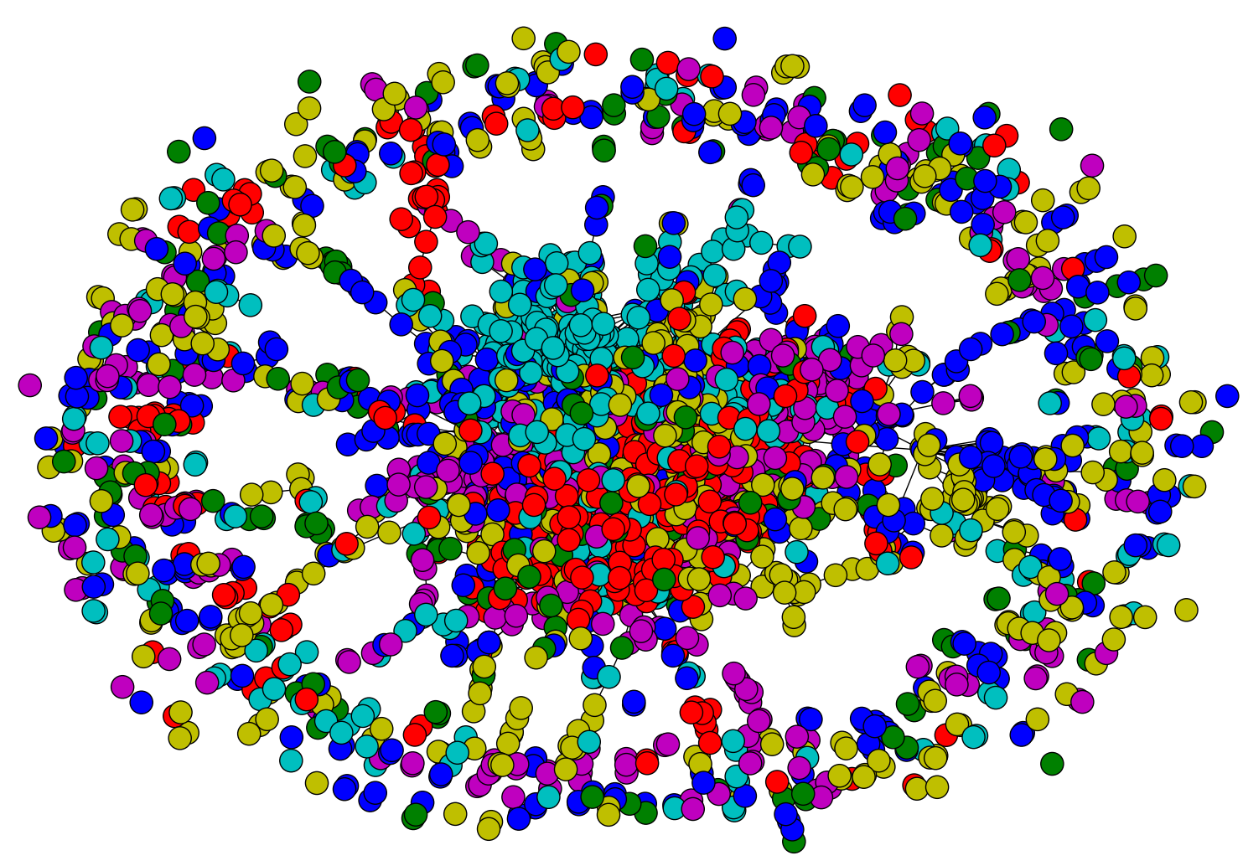
citations
Notes:
citeseer

Slide 13
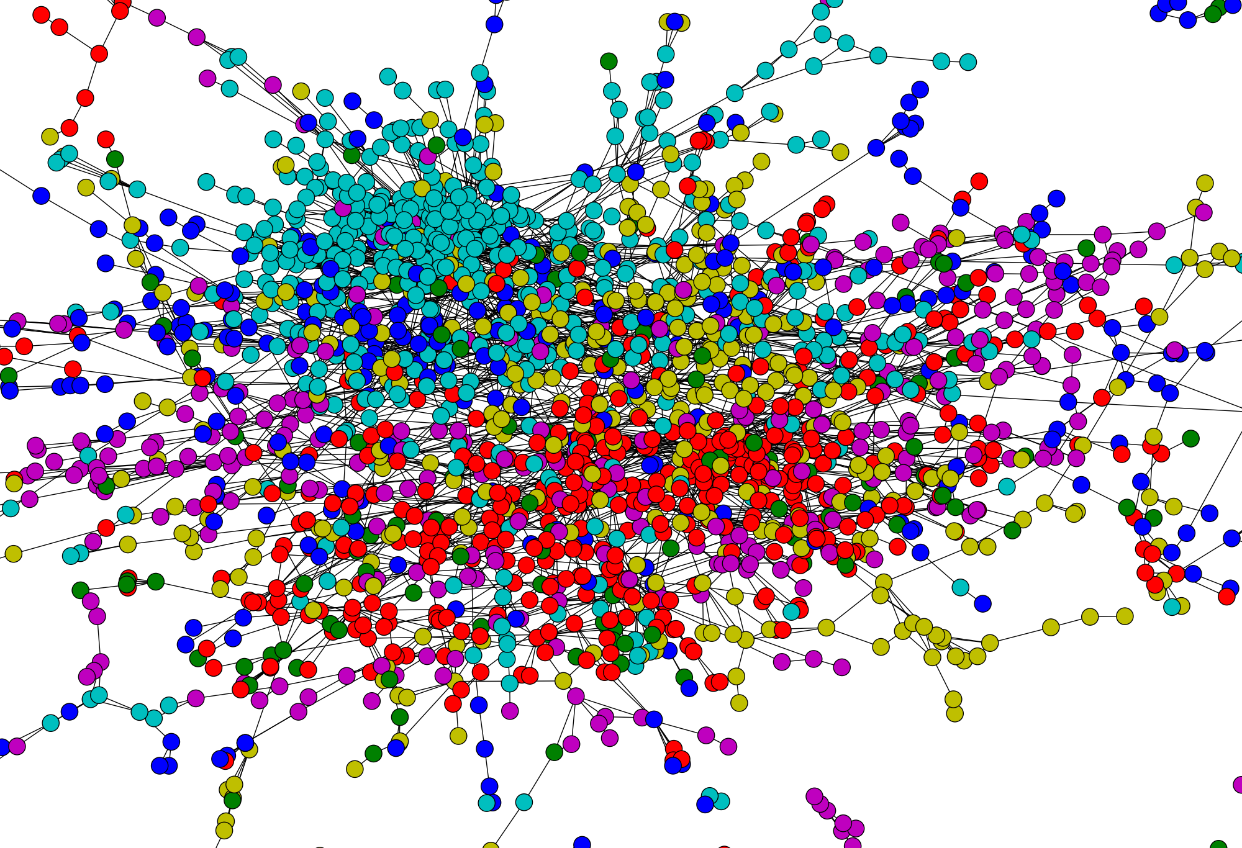

Slide 14
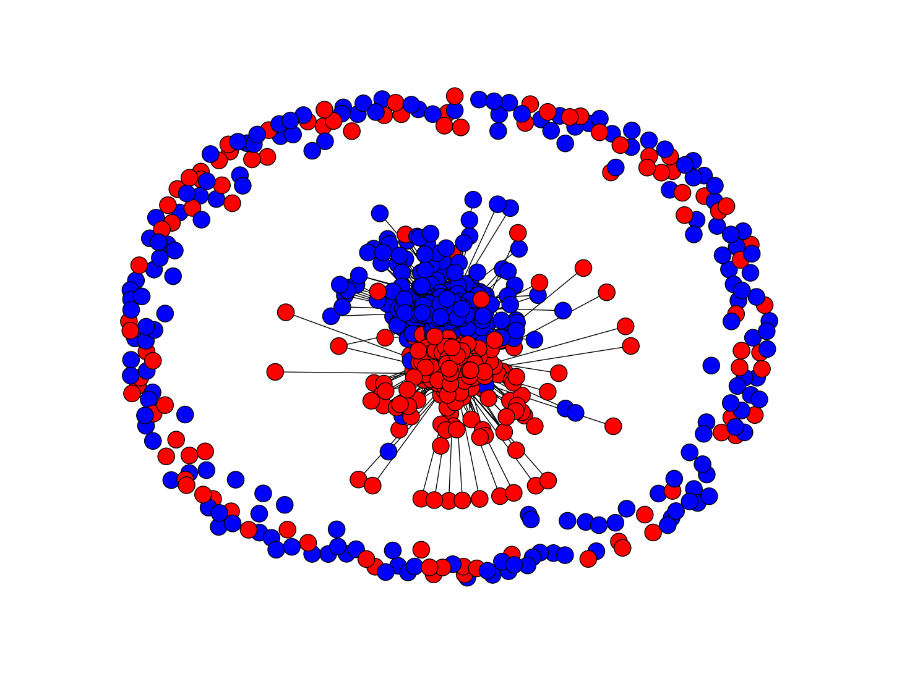
Notes:
blogs

Slide 15
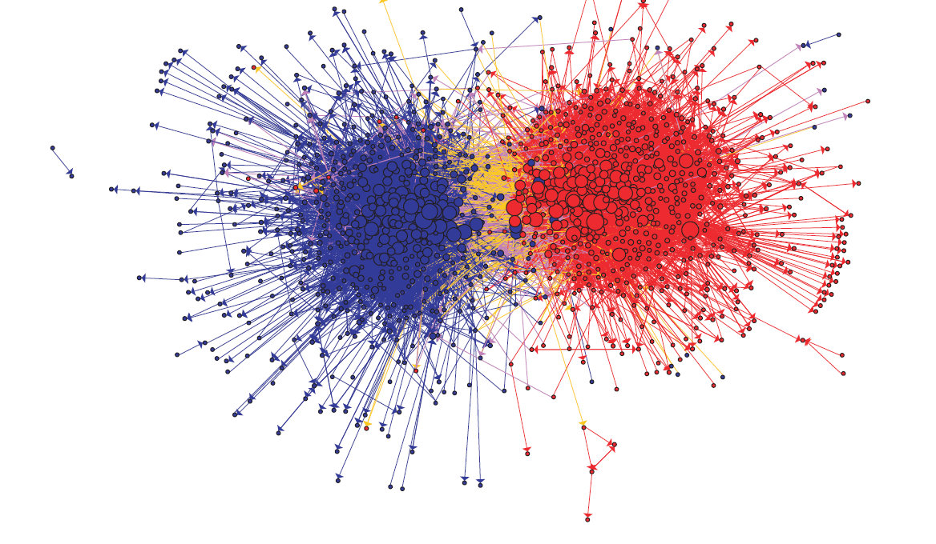
Notes:
blogs

Slide 16
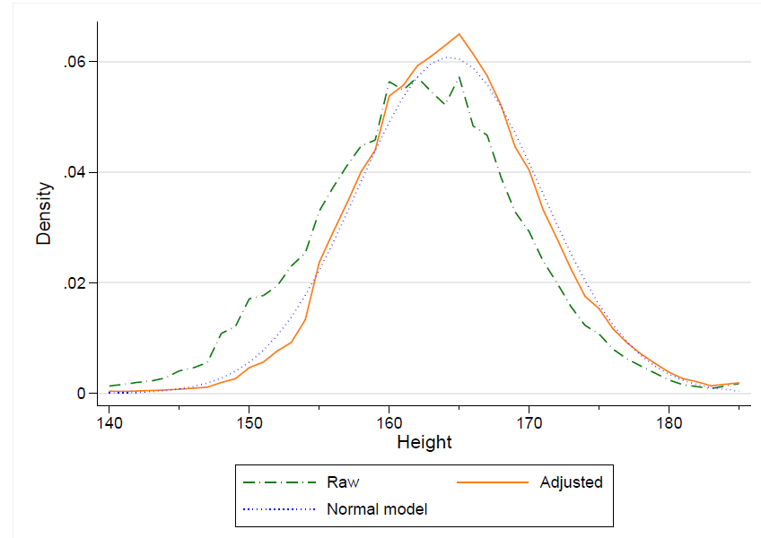
How do you model graphs?
Notes:
Height of italian men at military age, raw and adjusted for age

Slide 17
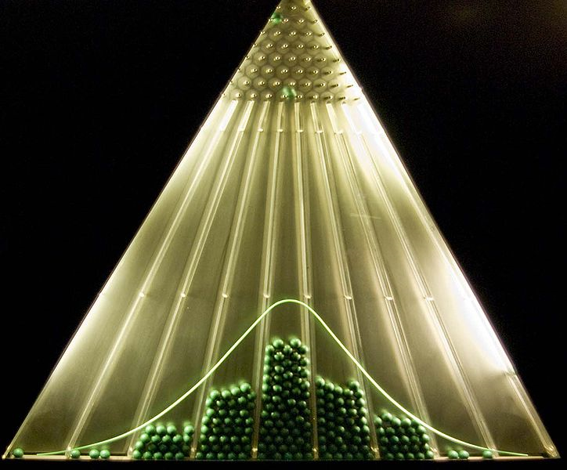

What are we trying to do?
Normal curve:
Data to fit
Underlying process that “explains” the data
Closed-form parametric form
Only models a small part of the data

Slide 18
Graphs
Set V of vertices/nodes v1,… , set E of edges (u,v),….
  Edges might be directed and/or weighted and/or labeled
Degree of v is #edges touching v
  Indegree and Outdegree for directed graphs
Path is sequence of edges (v0,v1),(v1,v2),….
Geodesic path between u and v is shortest path connecting them
  Diameter is max _{u,v in V} {length of geodesic between u,v}
  Effective diameter is 90th percentile
  Mean diameter is over connected pairs
(Connected) component is subset of nodes that are all pairwise connected via paths
Clique is subset of nodes that are all pairwise connected via edges
Triangle is a clique of size three

Slide 19
Graphs
Some common properties of graphs:
  Distribution of node degrees
  Distribution of cliques (e.g., triangles)
  Distribution of paths
    Diameter (max shortest-path)
    Effective diameter (90th percentile)
    Connected components
  …
Some types of graphs to consider:
  Real graphs (social & otherwise)
  Generated graphs:
    Erdos-Renyi
    “Bernoulli” or “Poisson”
    Watts-Strogatz “small world” graphs
    Barbosi-Albert “preferential attachment”
    …

Slide 20
Erdos-Renyi graphs
Take n nodes, and connect each pair with probability p
  Mean degree is z=p(n-1)

Slide 21
Erdos-Renyi graphs
Take n nodes, and connect each pair with probability p
  Mean degree is z=p(n-1)
  Mean number of neighbors distance d from v is z^{d}
  How large does d need to be so that z^{d} >=n ?
    If z>1, d = log(n)/log(z)
    If z<1, you can’t do it
  So:
    There tend to be either many small components (z<1) or one large one (z<1) giant connected component)
  Another intuition:
    If there are a two large connected components, then with high probability a few random edges will link them up.

Slide 23
Notes:
blogs

Slide 24
Erdos-Renyi graphs
Take n nodes, and connect each pair with probability p
  Mean degree is z=p(n-1)
  Mean number of neighbors distance d from v is z^{d}
  How large does d need to be so that z^{d} >=n ?
    If z>1, d = log(n)/log(z)
    If z<1, you can’t do it
  So:
    If z>1, diameters tend to be small (relative to n)

Slide 25
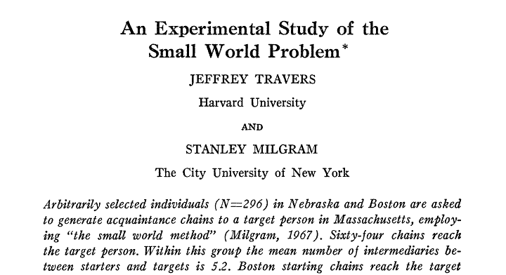
Sociometry, Vol. 32, No. 4. (Dec., 1969), pp. 425-443.
64 of 296 chains succeed, avg chain length is 6.2

Slide 26
Illustrations of the Small World
Millgram’s experiment
Erdős numbers
  http://www.ams.org/mathscinet/searchauthors.html
Bacon numbers
  http://oracleofbacon.org/
LinkedIn
  http://www.linkedin.com/
  Privacy issues: the whole network is not visible to all

Slide 27
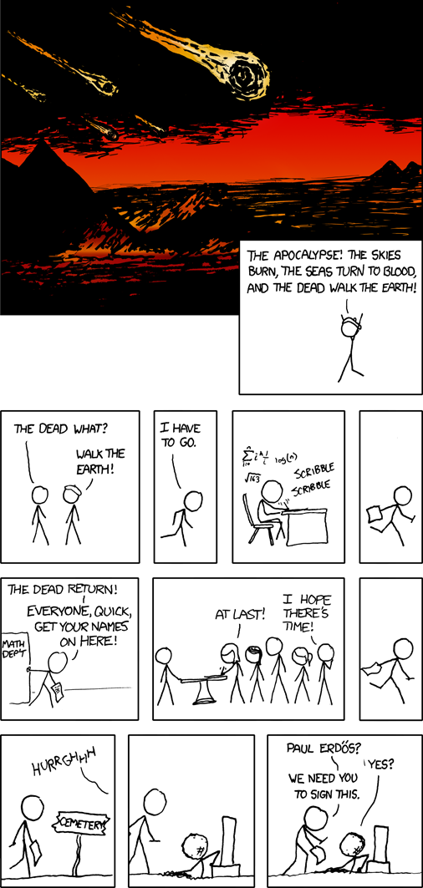

Slide 28
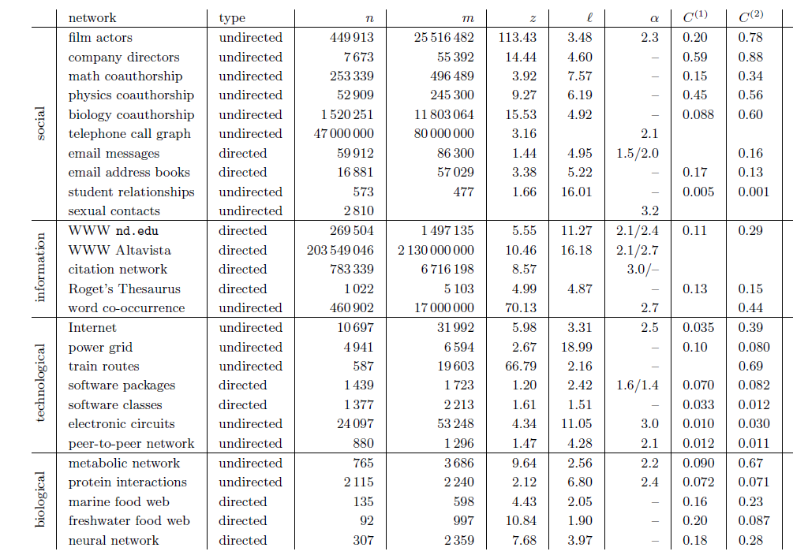

Slide 29
Erdos-Renyi graphs
Take n nodes, and connect each pair with probability p
  Mean degree is z=p(n-1)
This is usually not a good model of degree distribution in natural networks

Slide 30
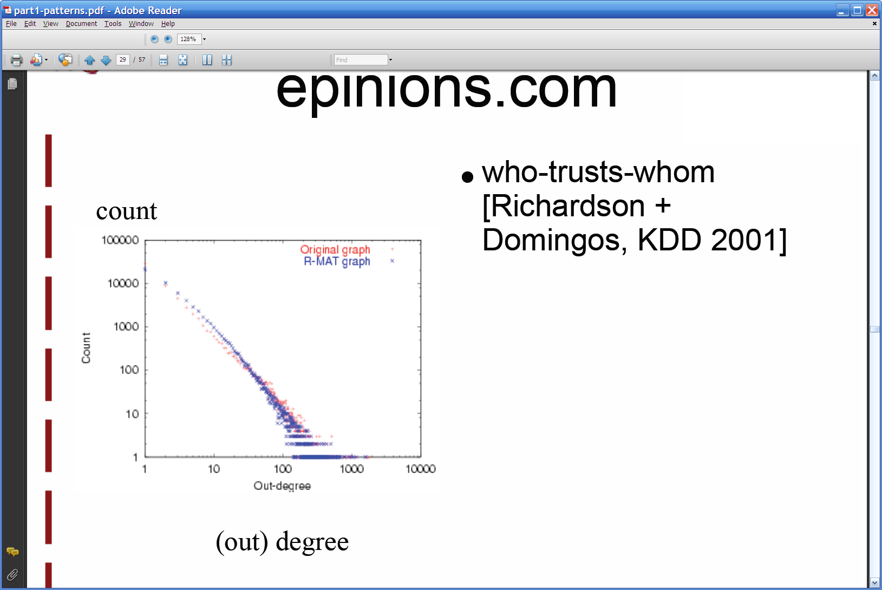
Degree distribution
Plot cumulative degree
  X axis is degree
  Y axis is #nodes that have degree at least k
Typically use a log-log scale
  Straight lines are a power law; normal curve dives to zero at some point
  Left: trust network in epinions web site from Richardson & Domingos

Slide 31
Degree distribution
Plot cumulative degree
  X axis is degree
  Y axis is #nodes that have degree at least k
Typically use a log-log scale
  Straight lines are a power law; normal curve dives to zero at some point
    This defines a “scale” for the network
  Left: trust network in epinions web site from Richardson & Domingos

Slide 32
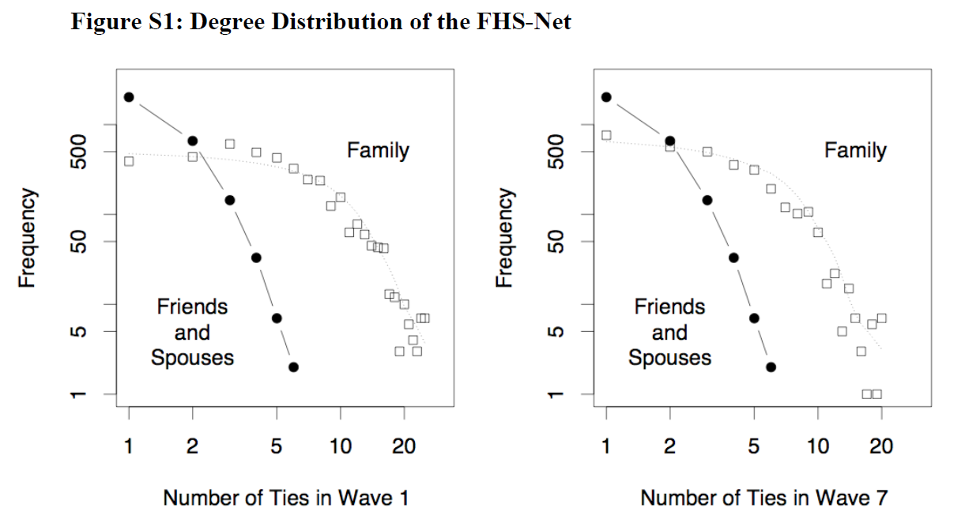
Friendship network in Framington Heart Study

Slide 33
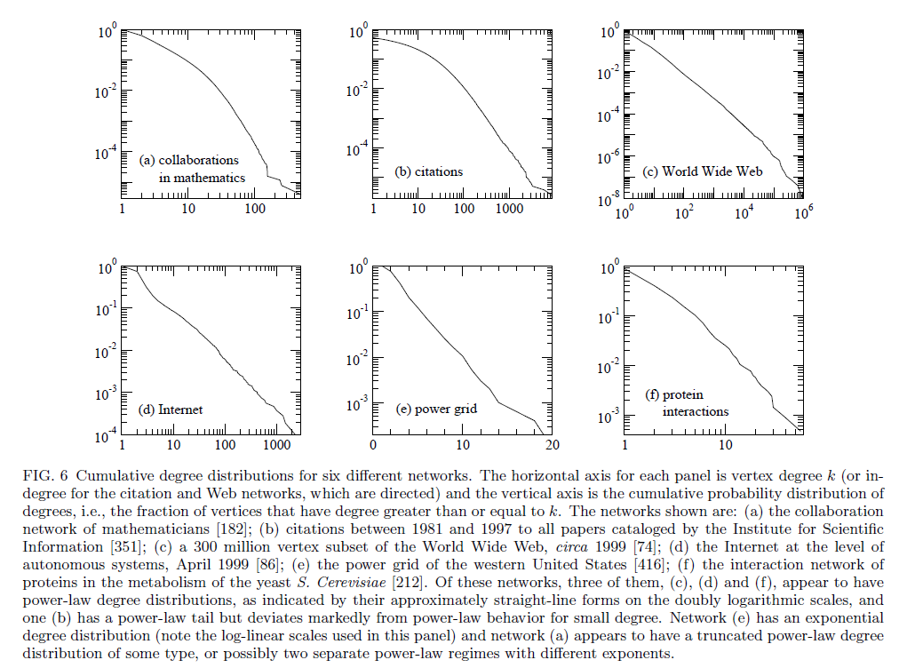

Slide 35
Graphs
Some common properties of graphs:
  Distribution of node degrees
  Distribution of cliques (e.g., triangles)
  Distribution of paths
    Diameter (max shortest-path)
    Effective diameter (90th percentile)
    Connected components
  …
Some types of graphs to consider:
  Real graphs (social & otherwise)
  Generated graphs:
    Erdos-Renyi
    “Bernoulli” or “Poisson”
    Watts-Strogatz “small world” graphs
    Barbosi-Albert “preferential attachment”
    …

Slide 36
Graphs
Some common properties of graphs:
  Distribution of node degrees: often scale-free
  Distribution of cliques (e.g., triangles)
  Distribution of paths
    Diameter (max shortest-path)
    Effective diameter (90th percentile) often small
    Connected components usually one giant CC
  …
Some types of graphs to consider:
  Real graphs (social & otherwise)
  Generated graphs:
    Erdos-Renyi
    “Bernoulli” or “Poisson”
    Watts-Strogatz “small world” graphs
    Barbosi-Albert “preferential attachment” generates scale-free graphs
    …

Slide 37
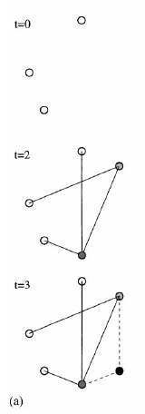
Barabasi-Albert Networks
Science 286 (1999)
Start from a small number of node, add a new node with m links
Preferential Attachment
  Probability of these links to connect to existing nodes is proportional to the node’s degree
  ‘Rich gets richer’
This creates ‘hubs’: few nodes with very large degrees

Slide 38
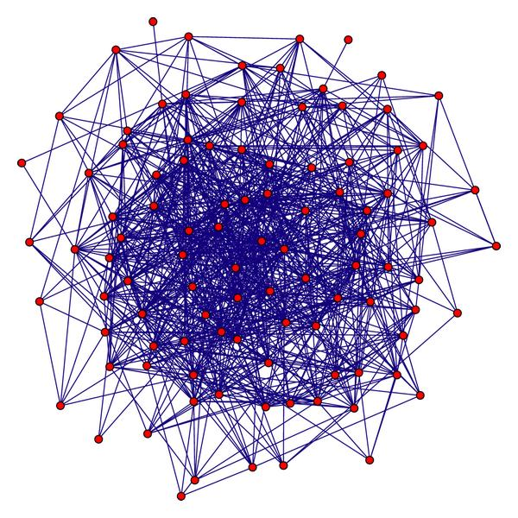
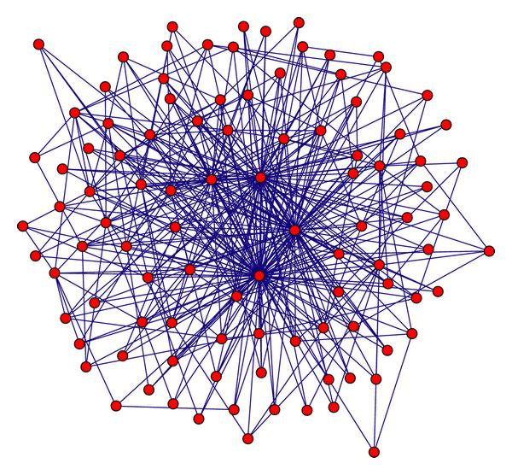
Random graph
(Erdos Renyi)
Preferential attachment
(Barabasi-Albert)
Notes:
Artificial graph

Slide 39
Graphs
Some common properties of graphs:
  Distribution of node degrees: often scale-free
  Distribution of cliques (e.g., triangles)
  Distribution of paths
    Diameter (max shortest-path)
    Effective diameter (90th percentile) often small
    Connected components usually one giant CC
  …
Some types of graphs to consider:
  Real graphs (social & otherwise)
  Generated graphs:
    Erdos-Renyi
    “Bernoulli” or “Poisson”
    Watts-Strogatz “small world” graphs
    Barbosi-Albert “preferential attachment” generates scale-free graphs
    …

Slide 40
Homophily
One definition: excess edges between similar nodes
  E.g., assume nodes are male and female and Pr(male)=p, Pr(female)=q.
  Is Pr(gender(u)≠ gender(v) | edge (u,v)) >= 2pq?
Another def’n: excess edges between common neighbors of v

Slide 41
Homophily
Another def’n: excess edges between common neighbors of v

Slide 42
Homophily
In a random Erdos-Renyi graph:
In natural graphs two of your mutual friends might well be friends:
Like you they are both in the same class (club, field of CS, …)
You introduced them

Slide 43
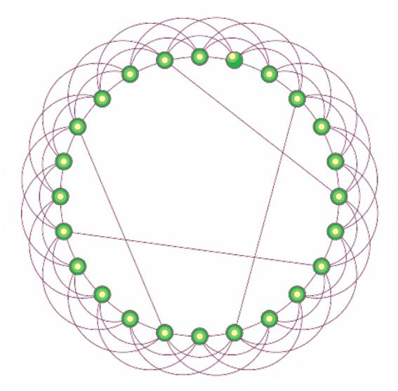
Watts-Strogatz model
Start with a ring
Connect each node to k nearest neighbors
  ➔ homophily
Add some random shortcuts from one point to another
  ➔ small diameter
Degree distribution not scale-free
Generalizes to d dimensions

Slide 45
An important question
How do you explore a dataset?
  compute statistics (e.g., feature histograms, conditional feature histograms, correlation coefficients, …)
  sample and inspect
    run a bunch of small-scale experiments
How do you explore a graph?
  compute statistics (degree distribution, …)
  sample and inspect
    how do you sample?

Slide 46

KDD 2006

Slide 47
Brief summary
Define goals of sampling:
  “scale-down” – find G’<G with similar statistics
  “back in time”: for a growing G, find G’<G that is similar (statistically) to an earlier version of G
Experiment on real graphs with plausible sampling methods, such as
  RN – random nodes, sampled uniformly
  …
See how well they perform

Slide 48
Brief summary
Experiment on real graphs with plausible sampling methods, such as
  RN – random nodes, sampled uniformly
    RPN – random nodes, sampled by PageRank
    RDP – random nodes sampled by in-degree
  RE – random edges
  RJ – run PageRank’s “random surfer” for n steps
  RW – run RWR’s “random surfer” for n steps
  FF – repeatedly pick r(i) neighbors of i to “burn”, and then recursively sample from them

Slide 49
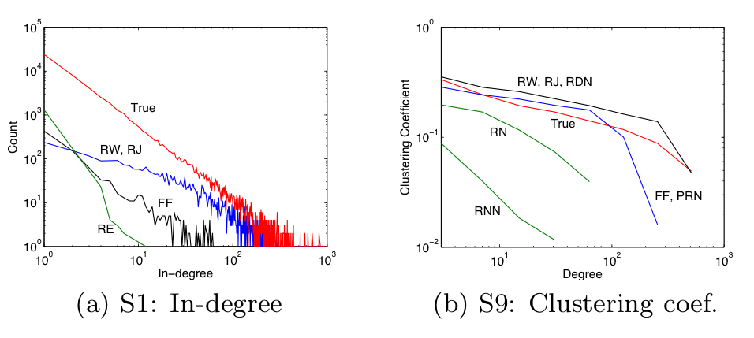
10% sample – pooled on five datasets

Slide 50
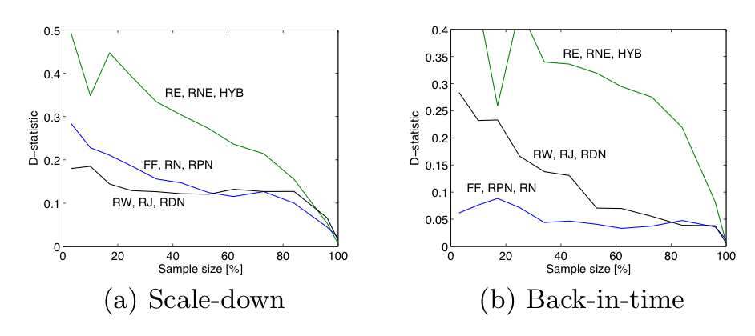
d-statistic measures agreement between distributions
D=max{|F(x)-F’(x)|} where F, F’ are cdf’s
max over nine different statistics

Slide 51
