Slide 1
Randomized Algorithms Graph Algorithms
William Cohen

Slide 2
Outline
Randomized methods
SGD with the hash trick (review)
Other randomized algorithms
Bloom filters
Locality sensitive hashing
Graph Algorithms

Slide 3

Learning as optimization for regularized logistic regression
Algorithm:
Initialize arrays W, A of size R and set k=0
For each iteration t=1,…T
For each example (x_{i},y_{i})
Let V be hash table so that
p_{i} = … ; k++
For each hash value h: V[h]>0:
W[h] *= (1 - λ2μ)^{k-A[j]}
W[h] = W[h] + λ(y_{i} - p^{i})V[h]
A[j] = k

Slide 4
Learning as optimization for regularized logistic regression
Initialize arrays W, A of size R and set k=0
For each iteration t=1,…T
For each example (x_{i},y_{i})
k++; let V be a new hash table; let tmp=0
For each j: x_{i} ^{j} >0: V[hash(j)%R] += x_{i} ^{j}
Let ip=0
For each h: V[h]>0:
W[h] *= (1 - λ2μ)^{k-A[j]}
ip+= V[h]*W[h]
A[h] = k
p = 1/(1+exp(-ip))
For each h: V[h]>0:
W[h] = W[h] + λ(y_{i} - p^{i})V[h]
regularize W[h]’s

Slide 5
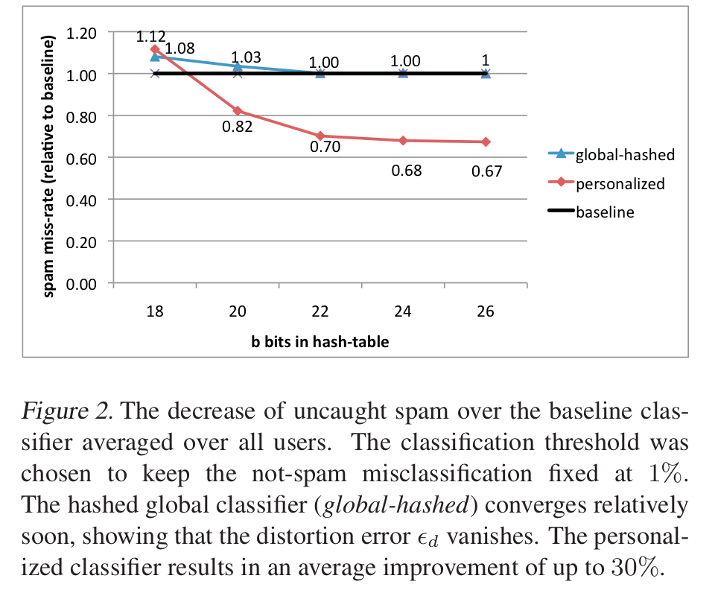
An example
2^26 entries = 1 Gb @ 8bytes/weight
Notes:
3,2M emails
400k users
40M tokens

Slide 6
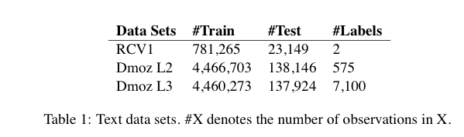
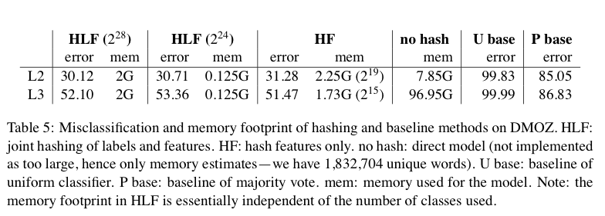
Results

Slide 7
A variant of feature hashing
Hash each feature multiple times with different hash functions
Now, each w has k chances to not collide with another useful w’
An easy way to get multiple hash functions
Generate some random strings s₁,…,s_{L}
Let the k-th hash function for w be the ordinary hash of concatenation w•s_{k}

Slide 8
A variant of feature hashing
Why would this work?
Claim: with 100,000 features and 100,000,000 buckets:
k=1 ➔Pr(any duplication) ≈1
k=2 ➔Pr(any duplication) ≈0.4
k=3 ➔ Pr(any duplication) ≈0.01

Slide 9
Hash Trick - Insights
Save memory: don’t store hash keys
Allow collisions
even though it distorts your data some
Let the learner (downstream) take up the slack
Here’s another famous trick that exploits these insights….

Slide 10
Bloom filters
Interface to a Bloom filter
BloomFilter(int maxSize, double p);
void bf.add(String s); // insert s
bool bd.contains(String s);
// If s was added return true;
// else with probability at least 1-p return false;
// else with probability at most p return true;
I.e., a noisy “set” where you can test membership (and that’s it)
Notes:
note a hash table would do this in constant time and storage
the hash trick does this as well

Slide 11
Bloom filters
Another implementation
Allocate M bits, bit[0]…,bit[1-M]
Pick K hash functions hash(1,s),hash(2,s),….
E.g: hash(s,i) = hash(s+ randomString[i])
To add string s:
For i=1 to k, set bit[hash(i,s)] = 1
To check contains(s):
For i=1 to k, test bit[hash(i,s)]
Return “true” if they’re all set; otherwise, return “false”
We’ll discuss how to set M and K soon, but for now:
Let M = 1.5*maxSize // less than two bits per item!
Let K = 2*log(1/p) // about right with this M

Slide 12



Bloom filters
Analysis:
Assume hash(i,s) is a random function
Look at Pr(bit j is unset after n add’s):
… and Pr(collision):
…. fix m and n and minimize k:
k =

Slide 13
Bloom filters
Analysis:
Assume hash(i,s) is a random function
Look at Pr(bit j is unset after n add’s):
… and Pr(collision):
…. fix m and n, you can minimize k:
p =
k =

Slide 14


Bloom filters
Analysis:
Plug optimal k=m/n*ln(2) back into Pr(collision):
Now we can fix any two of p, n, m and solve for the 3rd:
E.g., the value for m in terms of n and p:
p =

Slide 15
Bloom filters: demo

Slide 16
Bloom filters
An example application
Finding items in “sharded” data
Easy if you know the sharding rule
Harder if you don’t (like Google n-grams)
Simple idea:
Build a BF of the contents of each shard
To look for key, load in the BF’s one by one, and search only the shards that probably contain key
Analysis: you won’t miss anything, you might look in some extra shards
You’ll hit O(1) extra shards if you set p=1/#shards

Slide 17
Bloom filters
An example application
discarding singleton features from a classifier
Scan through data once and check each w:
if bf1.contains(w): bf2.add(w)
else bf1.add(w)
Now:
bf1.contains(w) ⬄ w appears >= once
bf2.contains(w) ⬄ w appears >= 2x
Then train, ignoring words not in bf2

Slide 18
Bloom filters
An example application
discarding rare features from a classifier
seldom hurts much, can speed up experiments
Scan through data once and check each w:
if bf1.contains(w):
if bf2.contains(w): bf3.add(w)
else bf2.add(w)
else bf1.add(w)
Now:
bf2.contains(w) ⬄ w appears >= 2x
bf3.contains(w) ⬄ w appears >= 3x
Then train, ignoring words not in bf3

Slide 19
Bloom filters
More on this next week…..

Slide 20
LSH: key ideas
Goal:
map feature vector x to bit vector bx
ensure that bx preserves “similarity”

Slide 21

Random Projections

Slide 22
Random projections
u
+
+
+
+
+
+
+
+
+
-
-
-
-
-
-
-
-
-
-u
2γ

Slide 23
Random projections
To make those points “close” we need to project to a direction orthogonal to the line between them
u
+
+
+
+
+
+
+
+
+
-
-
-
-
-
-
-
-
-
-u
2γ

Slide 24
Random projections
Any other direction will keep the distant points distant.
u
+
+
+
+
+
+
+
+
+
-
-
-
-
-
-
-
-
-
So if I pick a random r and r.x and r.x’ are closer than γ then probably x and x’ were close to start with.
-u
2γ

Slide 25
LSH: key ideas
Goal:
map feature vector x to bit vector bx
ensure that bx preserves “similarity”
Basic idea: use random projections of x
Repeat many times:
Pick a random hyperplane r
Compute the inner product or r with x
Record if x is “close to” r (r.x>=0)
the next bit in bx
Theory says that is x’ and x have small cosine distance then bx and bx’ will have small Hamming distance

Slide 26
LSH: key ideas
Naïve algorithm:
Initialization:
For i=1 to outputBits:
For each feature f:
Draw r(f,i) ~ Normal(0,1)
Given an instance x
For i=1 to outputBits:
LSH[i] =
sum(x[f]*r[i,f] for f with non-zero weight in x) > 0 ? 1 : 0
Return the bit-vector LSH
Problem:
the array of r’s is very large

Slide 27
LSH: “pooling” (van Durme)
Better algorithm:
Initialization:
Create a pool:
Pick a random seed s
For i=1 to poolSize:
Draw pool[i] ~ Normal(0,1)
For i=1 to outputBits:
Devise a random hash function hash(i,f):
E.g.: hash(i,f) = hashcode(f) XOR randomBitString[i]
Given an instance x
For i=1 to outputBits:
LSH[i] = sum(
x[f] * pool[hash(i,f) % poolSize] for f in x) > 0 ? 1 : 0
Return the bit-vector LSH

Slide 28
LSH: key ideas
Advantages:
with pooling, this is a compact re-encoding of the data
you don’t need to store the r’s, just the pool
leads to very fast nearest neighbor method
just look at other items with bx’=bx
also very fast nearest-neighbor methods for Hamming distance
similarly, leads to very fast clustering
cluster = all things with same bx vector
More next week….

Slide 29
Graph Algorithms

Slide 30
Graph algorithms
PageRank implementations
in memory
streaming, node list in memory
streaming, no memory
map-reduce

Slide 31
Google’s PageRank
Inlinks are “good” (recommendations)
Inlinks from a “good” site are better than inlinks from a “bad” site
but inlinks from sites with many outlinks are not as “good”...
“Good” and “bad” are relative.
web site xxx
web site xxx
web site xxx
web site a b c d e f g
web
site
pdq pdq ..
web site yyyy
web site a b c d e f g
web site yyyy

Slide 32
Google’s PageRank
web site xxx
Imagine a “pagehopper” that always either
follows a random link, or
jumps to random page
web site xxx
web site a b c d e f g
web
site
pdq pdq ..
web site yyyy
web site a b c d e f g
web site yyyy

Slide 33
Google’s PageRank (Brin & Page, http://www-db.stanford.edu/~backrub/google.html)
web site xxx
Imagine a “pagehopper” that always either
follows a random link, or
jumps to random page
PageRank ranks pages by the amount of time the pagehopper spends on a page:
or, if there were many pagehoppers, PageRank is the expected “crowd size”
web site xxx
web site a b c d e f g
web
site
pdq pdq ..
web site yyyy
web site a b c d e f g
web site yyyy

Slide 34
PageRank in Memory
Let u = (1/N, …, 1/N)
dimension = #nodes N
Let A = adjacency matrix: [a_{ij}=1 ⬄ i links to j]
Let W = [w_{ij} = a_{ij}/outdegree(i)]
w_{ij} is probability of jump from i to j
Let v⁰ = (1,1,….,1)
or anything else you want
Repeat until converged:
Let v^{t+1} = cu + (1-c)Wv^{t}
c is probability of jumping “anywhere randomly”

Slide 35
Streaming PageRank
Assume we can store v but not W in memory
Repeat until converged:
Let v^{t+1} = cu + (1-c)Wv^{t}
Store A as a row matrix: each line is
i j_{i,1},…,j_{i,d} [the neighbors of i]
Store v’ and v in memory: v’ starts out as cu
For each line “i j_{i,1},…,j_{i,d} “
For each j in j_{i,1},…,j_{i,d}
v’[j] += (1-c)v[i]/d

Slide 36
Streaming PageRank: with some long rows
Repeat until converged:
Let v^{t+1} = cu + (1-c)Wv^{t}
Store A as a list of edges: each line is: “i d(i) j”
Store v’ and v in memory: v’ starts out as cu
For each line “i d j“
v’[j] += (1-c)v[i]/d

Slide 37
Streaming PageRank: with some long rows
Repeat until converged:
Let v^{t+1} = cu + (1-c)Wv^{t}
Preprocessing A

Slide 38
Streaming PageRank: with some long rows
Repeat until converged:
Let v^{t+1} = cu + (1-c)Wv^{t}
Pure streaming
foreach line i,j,d(i),v(i):
send to i: inc_v c
send to j: inc v (1-c)*v(i)/d(i)
Sort and add messages to get v’
Then for each line: i,v’
send to i: (so that the msg comes before j’s): set_v v’
then can do the scan thru the reduce inputs to reset v to v’

Slide 39
Streaming PageRank: constant memory
Repeat until converged:
Let v^{t+1} = cu + (1-c)Wv^{t}
PRStats: each line is I,d(i),v(i)
Links: each line is i,j
Phase 1: for each link i,j
send to i: “link” j
Combine with PRStats, sort and reduce:
For each i,d(i),v(i)
For each msg “link j”
Send to i “incv c”
Send to j “incv (1-c)v(i)/d(j)”
Combine with PRStats, sort and reduce:
For each I,d(i),v(i)”
v’ = 0
For each msg “incv delta”: v’ += delta
Output new I,d(i),v’(i)

Slide 40
Streaming PageRank: constant memory
in
out
Repeat until converged:
Let v^{t+1} = cu + (1-c)Wv^{t}
PRStats: each line is I,d(i),v(i)
Links: each line is i,j
Phase 1: for each link i,j
send to i: “link” j
Combine with PRStats, sort and reduce:
For each i,d(i),v(i)
For each msg “link j”
Send to i “incv c”
Send to j “incv (1-c)v(i)/d(j)”
Combine with PRStats, sort and reduce:
For each I,d(i),v(i)”
v’ = 0
For each msg “incv delta”: v’ += delta
Output new I,d(i),v’(i)
I j1
I j2
I ~link j1
I ~link j2
….
+ PRstats
I,d(i),v(i)
~link j1
~link j2
….
I ~incv x
j1 ~incv x1
j2 ~incv x2
+ PRstats
I,d(i),v(i)
~incv x1
~incv x2
….
I d(i), v’(i)

