Slide 1
Randomized Algorithms Graph Algorithms
William Cohen

Slide 2
Outline
Randomized methods
SGD with the hash trick (review)
Other randomized algorithms
Bloom filters
Locality sensitive hashing
Graph Algorithms

Slide 3

Learning as optimization for regularized logistic regression
Algorithm:
Initialize arrays W, A of size R and set k=0
For each iteration t=1,…T
For each example (x_{i},y_{i})
Let V be hash table so that
p_{i} = … ; k++
For each hash value h: V[h]>0:
W[h] *= (1 - λ2μ)^{k-A[j]}
W[h] = W[h] + λ(y_{i} - p^{i})V[h]
A[j] = k

Slide 4
Learning as optimization for regularized logistic regression
Initialize arrays W, A of size R and set k=0
For each iteration t=1,…T
For each example (x_{i},y_{i})
k++; let V be a new hash table; let tmp=0
For each j: x_{i} ^{j} >0: V[hash(j)%R] += x_{i} ^{j}
Let ip=0
For each h: V[h]>0:
W[h] *= (1 - λ2μ)^{k-A[j]}
ip+= V[h]*W[h]
A[h] = k
p = 1/(1+exp(-ip))
For each h: V[h]>0:
W[h] = W[h] + λ(y_{i} - p^{i})V[h]
regularize W[h]’s

Slide 5
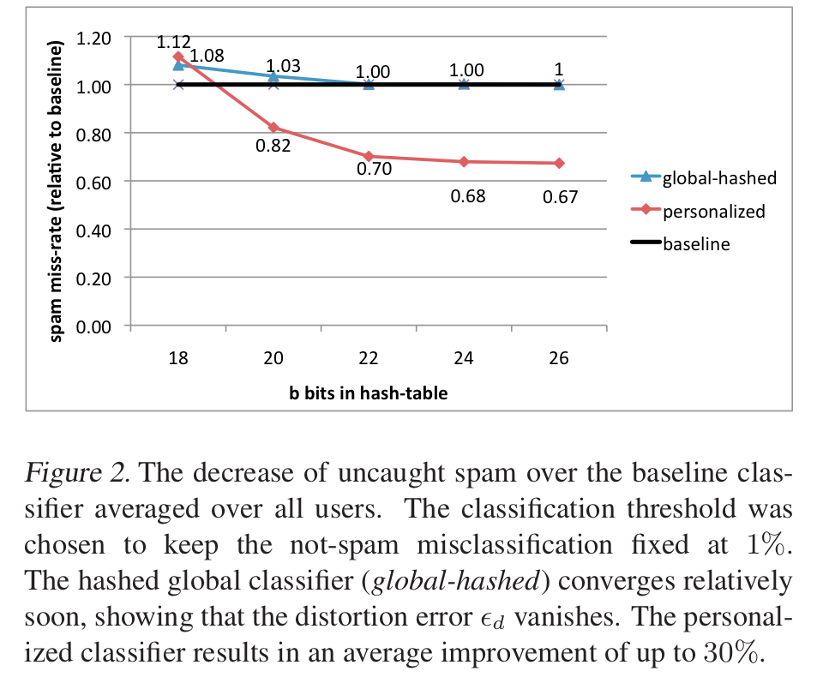
An example
2^26 entries = 1 Gb @ 8bytes/weight
Notes:
3,2M emails
400k users
40M tokens

Slide 6
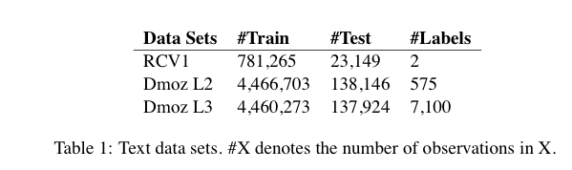
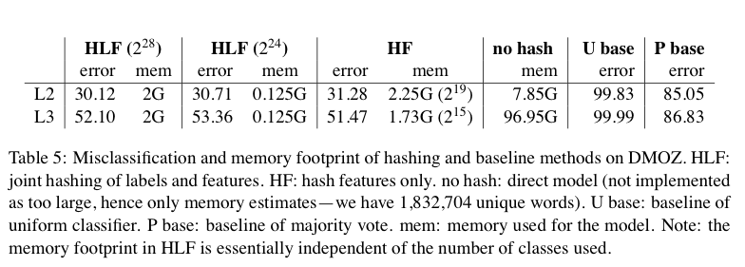
Results

Slide 7
A variant of feature hashing
Hash each feature multiple times with different hash functions
Now, each w has k chances to not collide with another useful w’
An easy way to get multiple hash functions
Generate some random strings s₁,…,s_{L}
Let the k-th hash function for w be the ordinary hash of concatenation w•s_{k}

Slide 8
A variant of feature hashing
Why would this work?
Claim: with 100,000 features and 100,000,000 buckets:
k=1 ➔Pr(any duplication) ≈1
k=2 ➔Pr(any duplication) ≈0.4
k=3 ➔ Pr(any duplication) ≈0.01

Slide 9
Hash Trick - Insights
Save memory: don’t store hash keys
Allow collisions
even though it distorts your data some
Let the learner (downstream) take up the slack
Here’s another famous trick that exploits these insights….

Slide 10
Bloom filters
Interface to a Bloom filter
BloomFilter(int maxSize, double p);
void bf.add(String s); // insert s
bool bd.contains(String s);
// If s was added return true;
// else with probability at least 1-p return false;
// else with probability at most p return true;
I.e., a noisy “set” where you can test membership (and that’s it)
Notes:
note a hash table would do this in constant time and storage
the hash trick does this as well

Slide 11
Bloom filters
Another implementation
Allocate M bits, bit[0]…,bit[1-M]
Pick K hash functions hash(1,s),hash(2,s),….
E.g: hash(s,i) = hash(s+ randomString[i])
To add string s:
For i=1 to k, set bit[hash(i,s)] = 1
To check contains(s):
For i=1 to k, test bit[hash(i,s)]
Return “true” if they’re all set; otherwise, return “false”
We’ll discuss how to set M and K soon, but for now:
Let M = 1.5*maxSize // less than two bits per item!
Let K = 2*log(1/p) // about right with this M

Slide 12



Bloom filters
Analysis:
Assume hash(i,s) is a random function
Look at Pr(bit j is unset after n add’s):
… and Pr(collision):
…. fix m and n and minimize k:
k =

Slide 13
Bloom filters
Analysis:
Assume hash(i,s) is a random function
Look at Pr(bit j is unset after n add’s):
… and Pr(collision):
…. fix m and n, you can minimize k:
p =
k =

Slide 14


Bloom filters
Analysis:
Plug optimal k=m/n*ln(2) back into Pr(collision):
Now we can fix any two of p, n, m and solve for the 3rd:
E.g., the value for m in terms of n and p:
p =

Slide 15
Bloom filters: demo

Slide 16
Bloom filters
An example application
Finding items in “sharded” data
Easy if you know the sharding rule
Harder if you don’t (like Google n-grams)
Simple idea:
Build a BF of the contents of each shard
To look for key, load in the BF’s one by one, and search only the shards that probably contain key
Analysis: you won’t miss anything, you might look in some extra shards
You’ll hit O(1) extra shards if you set p=1/#shards

Slide 17
Bloom filters
An example application
discarding singleton features from a classifier
Scan through data once and check each w:
if bf1.contains(w): bf2.add(w)
else bf1.add(w)
Now:
bf1.contains(w) ⬄ w appears >= once
bf2.contains(w) ⬄ w appears >= 2x
Then train, ignoring words not in bf2

Slide 18
Bloom filters
An example application
discarding rare features from a classifier
seldom hurts much, can speed up experiments
Scan through data once and check each w:
if bf1.contains(w):
if bf2.contains(w): bf3.add(w)
else bf2.add(w)
else bf1.add(w)
Now:
bf2.contains(w) ⬄ w appears >= 2x
bf3.contains(w) ⬄ w appears >= 3x
Then train, ignoring words not in bf3

Slide 19
Bloom filters
More on this next week…..

Slide 20
LSH: key ideas
Goal:
map feature vector x to bit vector bx
ensure that bx preserves “similarity”

Slide 21

Random Projections

Slide 22
Random projections
u
+
+
+
+
+
+
+
+
+
-
-
-
-
-
-
-
-
-
-u
2γ

Slide 23
Random projections
To make those points “close” we need to project to a direction orthogonal to the line between them
u
+
+
+
+
+
+
+
+
+
-
-
-
-
-
-
-
-
-
-u
2γ

Slide 24
Random projections
Any other direction will keep the distant points distant.
u
+
+
+
+
+
+
+
+
+
-
-
-
-
-
-
-
-
-
So if I pick a random r and r.x and r.x’ are closer than γ then probably x and x’ were close to start with.
-u
2γ

Slide 25
LSH: key ideas
Goal:
map feature vector x to bit vector bx
ensure that bx preserves “similarity”
Basic idea: use random projections of x
Repeat many times:
Pick a random hyperplane r
Compute the inner product or r with x
Record if x is “close to” r (r.x>=0)
the next bit in bx
Theory says that is x’ and x have small cosine distance then bx and bx’ will have small Hamming distance

Slide 26
LSH: key ideas
Naïve algorithm:
Initialization:
For i=1 to outputBits:
For each feature f:
Draw r(f,i) ~ Normal(0,1)
Given an instance x
For i=1 to outputBits:
LSH[i] =
sum(x[f]*r[i,f] for f with non-zero weight in x) > 0 ? 1 : 0
Return the bit-vector LSH
Problem:
the array of r’s is very large

Slide 27
LSH: “pooling” (van Durme)
Better algorithm:
Initialization:
Create a pool:
Pick a random seed s
For i=1 to poolSize:
Draw pool[i] ~ Normal(0,1)
For i=1 to outputBits:
Devise a random hash function hash(i,f):
E.g.: hash(i,f) = hashcode(f) XOR randomBitString[i]
Given an instance x
For i=1 to outputBits:
LSH[i] = sum(
x[f] * pool[hash(i,f) % poolSize] for f in x) > 0 ? 1 : 0
Return the bit-vector LSH

Slide 28
LSH: key ideas
Advantages:
with pooling, this is a compact re-encoding of the data
you don’t need to store the r’s, just the pool
leads to very fast nearest neighbor method
just look at other items with bx’=bx
also very fast nearest-neighbor methods for Hamming distance
similarly, leads to very fast clustering
cluster = all things with same bx vector
More next week….

Slide 29
Graph Algorithms

Slide 30
Graph algorithms
PageRank implementations
in memory
streaming, node list in memory
streaming, no memory
map-reduce
A little like Naïve Bayes variants
data in memory
word counts in memory
stream-and-sort
map-reduce

Slide 31
Google’s PageRank
Inlinks are “good” (recommendations)
Inlinks from a “good” site are better than inlinks from a “bad” site
but inlinks from sites with many outlinks are not as “good”...
“Good” and “bad” are relative.
web site xxx
web site xxx
web site xxx
web site a b c d e f g
web
site
pdq pdq ..
web site yyyy
web site a b c d e f g
web site yyyy

Slide 32
Google’s PageRank
web site xxx
Imagine a “pagehopper” that always either
follows a random link, or
jumps to random page
web site xxx
web site a b c d e f g
web
site
pdq pdq ..
web site yyyy
web site a b c d e f g
web site yyyy

Slide 33
Google’s PageRank (Brin & Page, http://www-db.stanford.edu/~backrub/google.html)
web site xxx
Imagine a “pagehopper” that always either
follows a random link, or
jumps to random page
PageRank ranks pages by the amount of time the pagehopper spends on a page:
or, if there were many pagehoppers, PageRank is the expected “crowd size”
web site xxx
web site a b c d e f g
web
site
pdq pdq ..
web site yyyy
web site a b c d e f g
web site yyyy

Slide 34
PageRank in Memory
Let u = (1/N, …, 1/N)
dimension = #nodes N
Let A = adjacency matrix: [a_{ij}=1 ⬄ i links to j]
Let W = [w_{ij} = a_{ij}/outdegree(i)]
w_{ij} is probability of jump from i to j
Let v⁰ = (1,1,….,1)
or anything else you want
Repeat until converged:
Let v^{t+1} = cu + (1-c)Wv^{t}
c is probability of jumping “anywhere randomly”

Slide 35
Streaming PageRank
Assume we can store v but not W in memory
Repeat until converged:
Let v^{t+1} = cu + (1-c)Wv^{t}
Store A as a row matrix: each line is
i j_{i,1},…,j_{i,d} [the neighbors of i]
Store v’ and v in memory: v’ starts out as cu
For each line “i j_{i,1},…,j_{i,d} “
For each j in j_{i,1},…,j_{i,d}
v’[j] += (1-c)v[i]/d
Everything needed for update is right there in row….

Slide 36
Streaming PageRank: with some long rows
Repeat until converged:
Let v^{t+1} = cu + (1-c)Wv^{t}
Store A as a list of edges: each line is: “i d(i) j”
Store v’ and v in memory: v’ starts out as cu
For each line “i d j“
v’[j] += (1-c)v[i]/d
We need to get the degree of i and store it locally

Slide 37
Streaming PageRank: preprocessing
Original encoding is edges (i,j)
Mapper replaces i,j with i,1
Reducer is a SumReducer
Result is pairs (i,d(i))
Then: join this back with edges (i,j)
For each i,j pair:
send j as a message to node i in the degree table
messages always sorted after non-messages
the reducer for the degree table sees i,d(i) first
then j1, j2, ….
can output the key,value pairs with key=i, value=d(i), j

Slide 38
Preprocessing Control Flow: 1
I | J
i1 | j1,1
i1 | j1,2
… | …
i1 | j1,k1
i2 | j2,1
… | …
i3 | j3,1
… | …
I
i1 | 1
i1 | 1
… | …
i1 | 1
i2 | 1
… | …
i3 | 1
… | …
I
i1 | 1
i1 | 1
… | …
i1 | 1
i2 | 1
… | …
i3 | 1
… | …
I | d(i)
i1 | d(i1)
.. | …
i2 | d(i2)
… | …
i3 | d)i3)
… | …
MAP
SORT
REDUCE
Summing values

Slide 39
Preprocessing Control Flow: 2
I | J
i1 | ~j1,1
i1 | ~j1,2
… | …
i2 | ~j2,1
… | …
I | J
i1 | j1,1
i1 | j1,2
… | …
i2 | j2,1
… | …
I
i1 | d(i1)
i1 | ~j1,1
i1 | ~j1,2
.. | …
i2 | d(i2)
i2 | ~j2,1
i2 | ~j2,2
… | …
I
i1 | d(i1) | j1,1
i1 | d(i1) | j1,2
… | … | …
i1 | d(i1) | j1,n1
i2 | d(i2) | j2,1
… | … | …
i3 | d(i3) | j3,1
… | … | …
I | d(i)
i1 | d(i1)
.. | …
i2 | d(i2)
… | …
I | d(i)
i1 | d(i1)
.. | …
i2 | d(i2)
… | …
MAP
SORT
REDUCE
copy or convert to messages
join degree with edges

Slide 40
Streaming PageRank: with some long rows
Repeat until converged:
Let v^{t+1} = cu + (1-c)Wv^{t}
Pure streaming: use a table mapping nodes to degree+pageRank
Lines are i: degree=d,pr=v
For each edge i,j
Send to i (in degree/pagerank) table: outlink j
For each line i: degree=d,pr=v:
send to i: incrementVBy c
for each message “outlink j”:
send to j: incrementVBy (1-c)*v/d
For each line i: degree=d,pr=v
sum up the incrementVBy messages to compute v’
output new row: i: degree=d,pr=v’
One identity mapper with two inputs (edges, degree/pr table)
Reducer outputs the incrementVBy messages
Two-input mapper + reducer

Slide 41
Control Flow: Streaming PR
I | J
i1 | j1,1
i1 | j1,2
… | …
i2 | j2,1
… | …
I | d/v
i1 | d(i1),v(i1)
i1 | ~j1,1
i1 | ~j1,2
.. | …
i2 | d(i2),v(i2)
i2 | ~j2,1
i2 | ~j2,2
… | …
to | delta
i1 | c
j1,1 | (1-c)v(i1)/d(i1)
… | …
j1,n1 | i
i2 | c
j2,1 | …
… | …
i3 | c
I | delta
i1 | c
i1 | (1-c)v(…)….
i1 | (1-c)…
.. | …
i2 | c
i2 | (1-c)…
i2 | ….
… | …
I | d/v
i1 | d(i1),v(i1)
i2 | d(i2),v(i2)
… | …
REDUCE
MAP
SORT
MAP
SORT
send “pageRank updates ” to outlinks
copy or convert to messages

Slide 42
Control Flow: Streaming PR
to | delta
i1 | c
j1,1 | (1-c)v(i1)/d(i1)
… | …
j1,n1 | i
i2 | c
j2,1 | …
… | …
i3 | c
I | delta
i1 | c
i1 | (1-c)v(…)….
i1 | (1-c)…
.. | …
i2 | c
i2 | (1-c)…
i2 | ….
… | …
I | v’
i1 | ~v’(i1)
i2 | ~v’(i2)
… | …
I | d/v
i1 | d(i1),v’(i1)
i2 | d(i2),v’(i2)
… | …
I | d/v
i1 | d(i1),v(i1)
i2 | d(i2),v(i2)
… | …
REDUCE
MAP
SORT
REDUCE
MAP
SORT
REDUCE
Summing values
Replace v with v’

Slide 43
Control Flow: Streaming PR
I | J
i1 | j1,1
i1 | j1,2
… | …
i2 | j2,1
… | …
and back around for next iteration….
I | d/v
i1 | d(i1),v(i1)
i2 | d(i2),v(i2)
… | …
MAP
copy or convert to messages

Slide 44
More on graph algorithms
PageRank is a one simple example of a graph algorithm
but an important one
personalized PageRank (aka “random walk with restart”) is an important operation in machine learning/data analysis settings
PageRank is typical in some ways
Trivial when graph fits in memory
Easy when node weights fit in memory
More complex to do with constant memory
A major expense is scanning through the graph many times
… same as with SGD/Logistic regression
disk-based streaming is much more expensive than memory-based approaches
Locality of access is very important!
gains if you can pre-cluster the graph even approximately
avoid sending messages across the network – keep them local

Slide 45
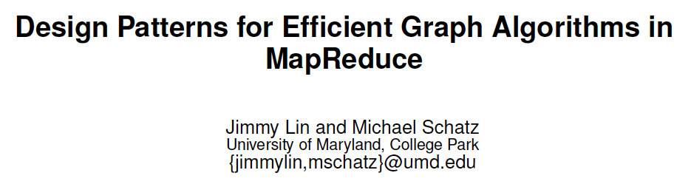
Machine Learning in Graphs - 2010

Slide 46
Some ideas
Combiners are helpful
Store outgoing incrementVBy messages and aggregate them
This is great for high indegree pages
Hadoop’s combiners are suboptimal
Messages get emitted before being combined
Hadoop makes weak guarantees about combiner usage

Slide 47
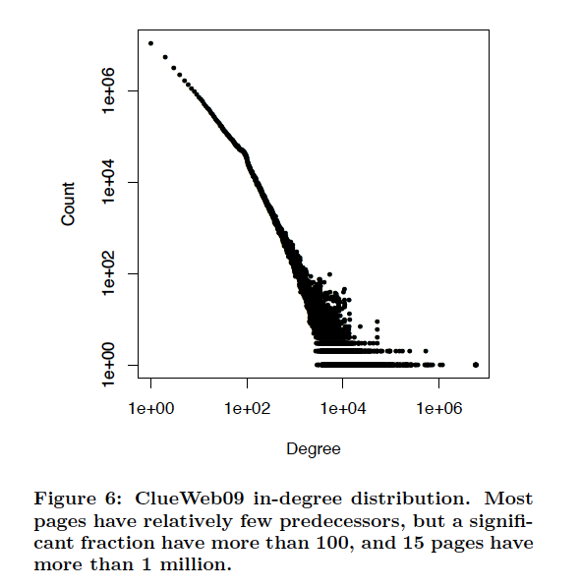

Slide 48
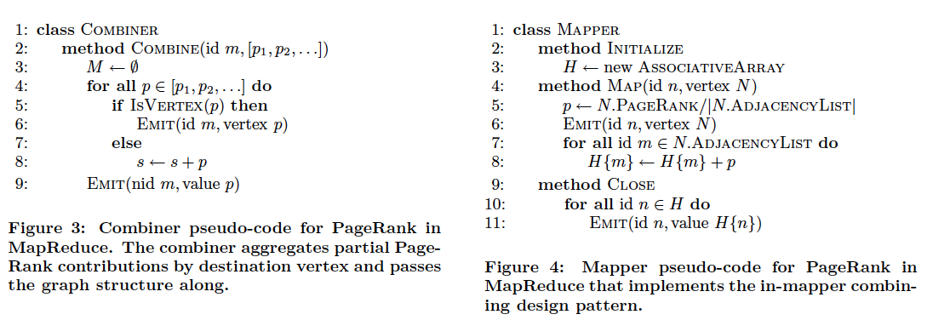
I’d think you want to spill the hash table to memory when it gets large

Slide 49
Some ideas
Most hyperlinks are within a domain
If we keep domains on the same machine this will mean more messages are local
To do this, build a custom partitioner that knows about the domain of each nodeId and keeps nodes on the same domain together
Assign node id’s so that nodes in the same domain are together – partition node ids by range
Change Hadoop’s Partitioner for this

Slide 50
Some ideas
Repeatedly shuffling the graph is expensive
We should separate the messages about the graph structure (fixed over time) from messages about pageRank weights (variable)
compute and distribute the edges once
read them in incrementally in the reducer
not easy to do in Hadoop!
call this the “Schimmy” pattern

Slide 51
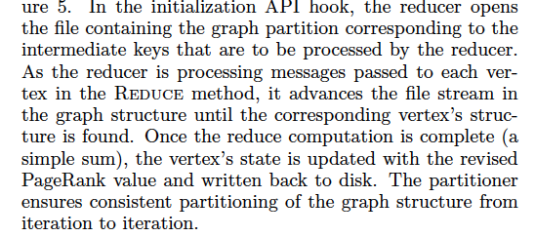
Schimmy
Relies on fact that keys are sorted, and sorts the graph input the same way…..

Slide 52
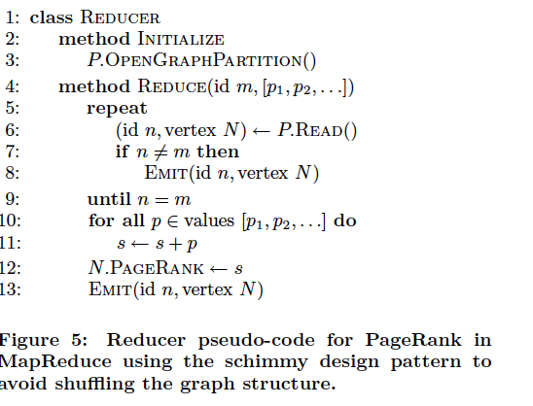
Schimmy

Slide 53
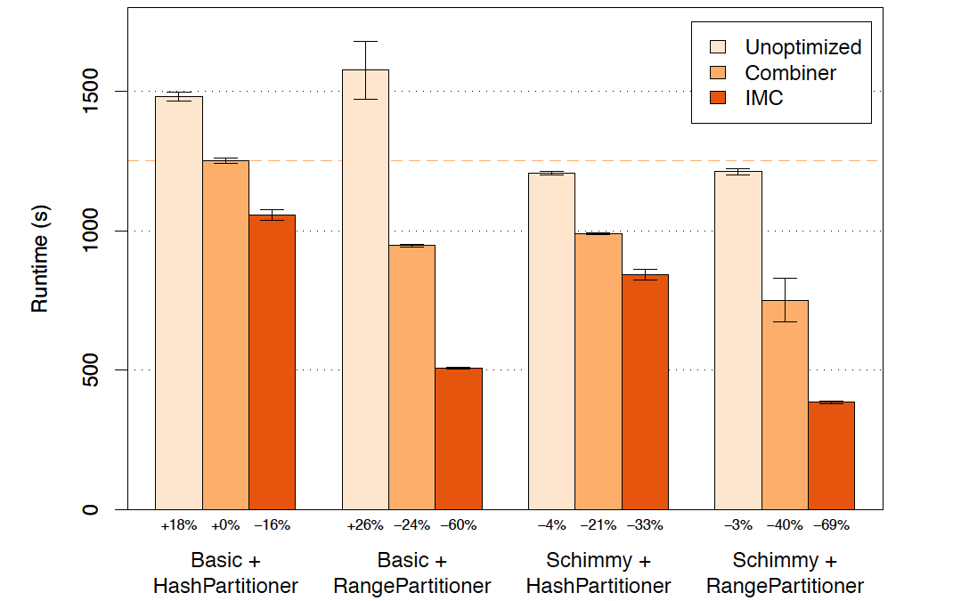
Results

