Slide 1
Randomized Algorithms
William Cohen

Slide 2
Outline
SGD with the hash trick (review)
Background on other randomized algorithms
  Bloom filters
  Locality sensitive hashing

Slide 3

Learning as optimization for regularized logistic regression
Algorithm:
Initialize arrays W, A of size R and set k=0
For each iteration t=1,…T
  For each example (x_{i},y_{i})
    Let V be hash table so that
    p_{i} = … ; k++
    For each hash value h: V[h]>0:
        W[h] *= (1 - λ2μ)^{k-A[j]}
        W[h] = W[h] + λ(y_{i} - p^{i})V[h]
        A[j] = k

Slide 4
Learning as optimization for regularized logistic regression
Initialize arrays W, A of size R and set k=0
For each iteration t=1,…T
  For each example (x_{i},y_{i})
    k++; let V be a new hash table; let tmp=0
    For each j: x_{i} ^{j} >0: V[hash(j)%R] += x_{i} ^{j}
    Let ip=0
    For each h: V[h]>0:
      W[h] *= (1 - λ2μ)^{k-A[j]}
      ip+= V[h]*W[h]
      A[h] = k
    p = 1/(1+exp(-ip))
    For each h: V[h]>0:
      W[h] = W[h] + λ(y_{i} - p^{i})V[h]
regularize W[h]’s

Slide 5
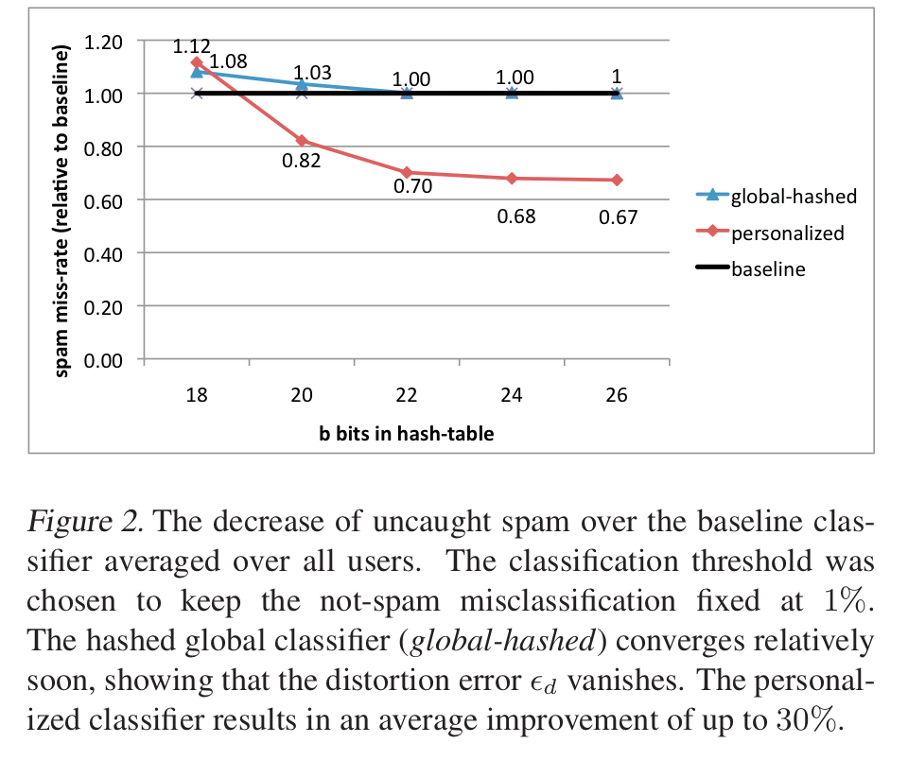
An example
2^26 entries = 1 Gb @ 8bytes/weight
Notes:
3,2M emails
400k users
40M tokens

Slide 6
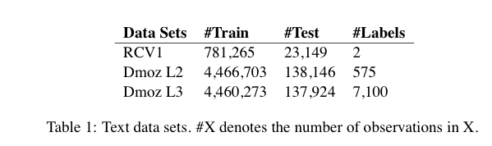
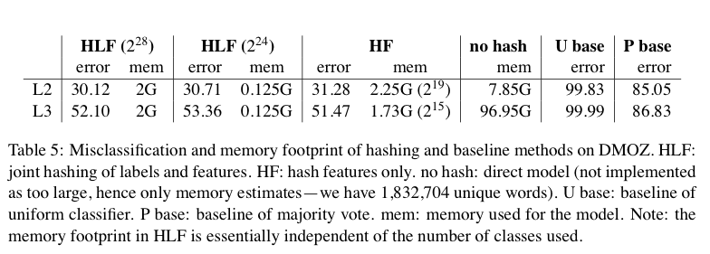
Results

Slide 7
A variant of feature hashing
Hash each feature multiple times with different hash functions
Now, each w has k chances to not collide with another useful w’
An easy way to get multiple hash functions
  Generate some random strings s₁,…,s_{L}
  Let the k-th hash function for w be the ordinary hash of concatenation w•s_{k}

Slide 8
A variant of feature hashing
Why would this work?
Claim: with 100,000 features and 100,000,000 buckets:
  k=1 ➔Pr(any duplication) ≈1
  k=2 ➔Pr(any duplication) ≈0.4
  k=3 ➔ Pr(any duplication) ≈0.01

Slide 9
Hash Trick - Insights
Save memory: don’t store hash keys
Allow collisions
  even though it distorts your data some
Let the learner (downstream) take up the slack
Here’s another famous trick that exploits these insights….

Slide 10
Bloom filter interface
Interface to a Bloom filter
  BloomFilter(int maxSize, double p);
  void bf.add(String s); // insert s
  bool bd.contains(String s);
    // If s was added return true;
    // else with probability at least 1-p return false;
    // else with probability at most p return true;
  I.e., a noisy “set” where you can test membership (and that’s it)
Notes:
note a hash table would do this in constant time and storage
the hash trick does this as well

Slide 11
Bloom filters
Another implementation
  Allocate M bits, bit[0]…,bit[1-M]
  Pick K hash functions hash(1,s),hash(2,s),….
    E.g: hash(s,i) = hash(s+ randomString[i])
  To add string s:
    For i=1 to k, set bit[hash(i,s)] = 1
  To check contains(s):
    For i=1 to k, test bit[hash(i,s)]
    Return “true” if they’re all set; otherwise, return “false”
  We’ll discuss how to set M and K soon, but for now:
    Let M = 1.5*maxSize // less than two bits per item!
    Let K = 2*log(1/p) // about right with this M

Slide 12



Bloom filters
Analysis:
  Assume hash(i,s) is a random function
  Look at Pr(bit j is unset after n add’s):
  … and Pr(collision):
  …. fix m and n and minimize k:
k =

Slide 13


Bloom filters
Analysis:
  Plug optimal k=m/n*ln(2) back into Pr(collision):
  Now we can fix any two of p, n, m and solve for the 3rd:
  E.g., the value for m in terms of n and p:
p =

Slide 14
Bloom filters: demo

Slide 15
Bloom filters
An example application
  Finding items in “sharded” data
    Easy if you know the sharding rule
    Harder if you don’t (like Google n-grams)
Simple idea:
  Build a BF of the contents of each shard
  To look for key, load in the BF’s one by one, and search only the shards that probably contain key
  Analysis: you won’t miss anything…but, you might look in some extra shards
  You’ll hit O(1) extra shards if you set p=1/#shards

Slide 16
Bloom filters
An example application
  discarding singleton features from a classifier
Scan through data once and check each w:
  if bf1.contains(w): bf2.add(w)
  else bf1.add(w)
Now:
  bf1.contains(w) ⬄ w appears >= once
  bf2.contains(w) ⬄ w appears >= 2x
Then train, ignoring words not in bf2

Slide 17
Bloom filters
An example application
  discarding rare features from a classifier
  seldom hurts much, can speed up experiments
Scan through data once and check each w:
  if bf1.contains(w):
    if bf2.contains(w): bf3.add(w)
    else bf2.add(w)
  else bf1.add(w)
Now:
  bf2.contains(w) ⬄ w appears >= 2x
  bf3.contains(w) ⬄ w appears >= 3x
Then train, ignoring words not in bf3

Slide 18
Bloom filters
More on Thursday….

Slide 19
LSH: key ideas
Bloom filter:
  Set represented by a small bit vector
  Can answer containment queries fairly accurately
Locality sensitive hashing:
  map feature vector x to bit vector bx
  ensure that bx preserves “similarity” of the original vectors

Slide 20

Random Projections

Slide 21
Random projections
u
+
+
+
+
+
+
+
+
+
-
-
-
-
-
-
-
-
-
-u
2γ

Slide 22
Random projections
Any other direction will keep the distant points distant.
u
+
+
+
+
+
+
+
+
+
-
-
-
-
-
-
-
-
-
So if I pick a random r and r.x and r.x’ are closer than γ then probably x and x’ were close to start with.
-u
2γ

Slide 23
Random projections
To make those points “close” we need to project to a direction orthogonal to the line between them
u
+
+
+
+
+
+
+
+
+
-
-
-
-
-
-
-
-
-
-u
2γ

Slide 24
Random projections
Put this another way: when is r.x>0 and r.x’<0 ?
u
+
+
+
+
+
+
+
+
+
-
-
-
-
-
-
-
-
-
-u

Slide 25
Random projections
some where in here is ok
r.x’ < 0
u
+
+
+
+
+
r.x > 0
+
+
+
+
-
-
-
-
-
-
-
-
-
-u

Slide 26
Random projections
r.x’ < 0
u
+
+
+
+
+
r.x > 0
+
+
+
+
-
-
-
-
-
-
-
-
-
-u
some where in here is ok

Slide 27
Random projections
Claim:
r.x’ < 0
u
+
+
+
+
+
r.x > 0
+
+
+
+
-
-
-
-
-
-
-
-
-
-u
some where in here is ok

Slide 28




Some math
Pick random vector r, define
Claim:
So:
And:

Slide 29
LSH: key ideas
Goal:
  map feature vector x to bit vector bx
  ensure that bx preserves “similarity”
Basic idea: use random projections of x
  Repeat many times:
    Pick a random hyperplane r
    Compute the inner product or r with x
    Record if x is “close to” r (r.x>=0)
      the next bit in bx
    Theory says that is x’ and x have small cosine distance then bx and bx’ will have small Hamming distance
Famous use: near-duplicate web page detection in AltaVista (Broder, 97)

Slide 30
LSH: key ideas
Naïve algorithm:
  Initialization:
    For i=1 to outputBits:
      For each feature f:
        Draw r(f,i) ~ Normal(0,1)
  Given an instance x
    For i=1 to outputBits:
      LSH[i] =
      sum(x[f]*r[i,f] for f with non-zero weight in x) > 0 ? 1 : 0
    Return the bit-vector LSH
  Problem:
    you need many r’s to be accurate
    storing these is expensive
    Ben will give us more ideas Thursday

Slide 31
LSH: “pooling” (van Durme)
Better algorithm:
  Initialization:
    Create a pool:
      Pick a random seed s
      For i=1 to poolSize:
        Draw pool[i] ~ Normal(0,1)
    For i=1 to outputBits:
      Devise a random hash function hash(i,f):
        E.g.: hash(i,f) = hashcode(f) XOR randomBitString[i]
  Given an instance x
    For i=1 to outputBits:
      LSH[i] = sum(
      x[f] * pool[hash(i,f) % poolSize] for f in x) > 0 ? 1 : 0
    Return the bit-vector LSH

Slide 32
LSH: key ideas
Advantages:
  with pooling, this is a compact re-encoding of the data
    you don’t need to store the r’s, just the pool
  leads to very fast nearest neighbor method
    just look at other items with bx’=bx
    also very fast nearest-neighbor methods for Hamming distance
  similarly, leads to very fast clustering
    cluster = all things with same bx vector
More Thursday….

Slide 33
Finding neighbors of LSH vectors
After hashing x₁,…,x_{n} we have bx₁, … bx_{n}
How do I find closest neighbors of bx_{i} ?
One approach (Indyk & Motwana):
  Pick random permutation p of bits
  Permute to bx₁, … bx_{n} get bx₁^{p}, … bx_{n}^{p}
  Sort them
  Check B closest neighbors of bx_{i}^{p} in that sorted list, and keep the k closest
  Repeat many times
Each pass finds some close neighbors of every element
  So, can do single-link-clustering with sequential scans

