Slide 1
Efficient Logistic Regression with Stochastic Gradient Descent: The Continuing Saga
William Cohen

Slide 2
Outline
SGD review
The “hash trick”
the idea
an experiment
Other randomized algorithms
Bloom filters
Locality sensitive hashing

Slide 3
Learning as optimization: general procedure for SGD
Goal: Learn the parameter θ of …
Dataset: D={x₁,…,x_{n}}
or maybe D={(x₁,y₁)…,(x_{n} , y_{n)}}
Write down Pr(D|θ) as a function of θ
Big-data problem: we don’t want to load all the data D into memory, and the gradient depends on all the data
Solution:
pick a small subset of examples B<<D
approximate the gradient using them
“on average” this is the right direction
take a step in that direction
repeat….
B = one example is a very popular choice

Slide 4
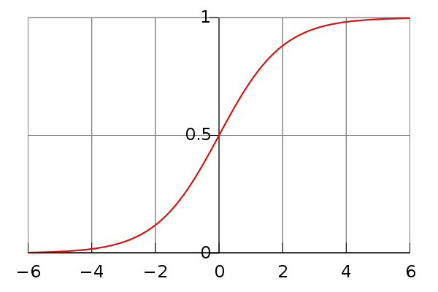

Learning as optimization for logistic regression
Goal: Learn the parameter θ of a classifier
Which classifier?
We’ve seen y = sign(x . w) but sign is not continuous…
Convenient alternative: replace sign with the logistic function

Slide 5
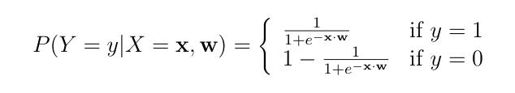
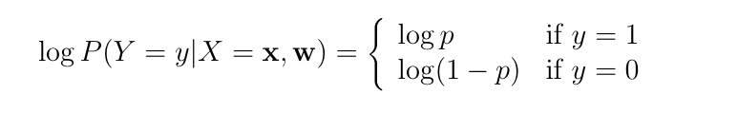
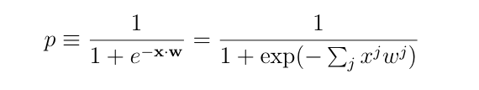
Learning as optimization for logistic regression
Goal: Learn the parameter w of the classifier
Probability of a single example (y,x) would be
Or with logs:

Slide 6
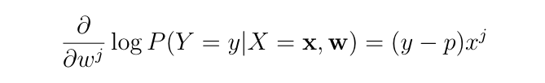
And the gradient is…
Key computational point:
if x^{j}=0 then the gradient of w^{j} is zero
so when processing an example you only need to update weights for the non-zero features of an example.

Slide 7


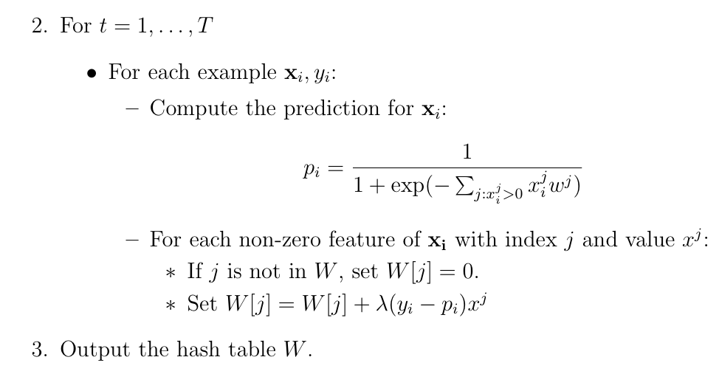
Learning as optimization for logistic regression
Final algorithm:
-- do this in random order

Slide 8
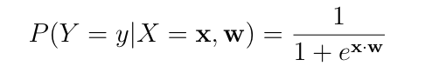
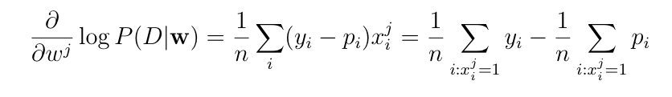
Learning as optimization for logistic regression
Goal: Learn the parameter θ of a classifier
Which classifier?
We’ve seen y = sign(x . w) but sign is not continuous…
Convenient alternative: replace sign with the logistic function
Practical problem: this overfits badly with sparse features
e.g., if w^{j} is only in positive examples, its gradient is always positive !

Slide 9
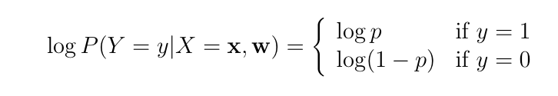
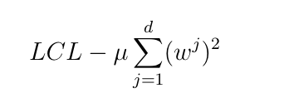
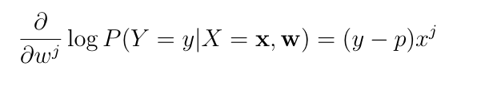
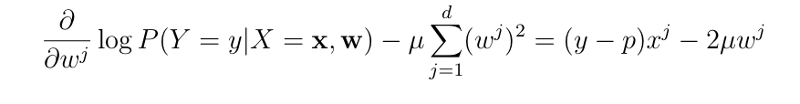
Regularized logistic regression
Replace LCL
with LCL + penalty for large weights, eg
So:
becomes:

Slide 10


Regularized logistic regression
Replace LCL
with LCL + penalty for large weights, eg
So the update for wj becomes:
Or

Slide 11
Learning as optimization for regularized logistic regression
Algorithm:
Time goes from O(nT) to O(nmT) where
n = number of non-zero entries,
m = number of features,
T = number of passes over data

Slide 12
Learning as optimization for regularized logistic regression
Final algorithm:
Initialize hashtable W
For each iteration t=1,…T
For each example (x_{i},y_{i})
p_{i} = …
For each feature W[j]
W[j] = W[j] - λ2μW[j]
If x_{i}^{j}>0 then
W[j] = W[j] + λ(y_{i} - p^{i})x_{j}

Slide 13
Learning as optimization for regularized logistic regression
Final algorithm:
Initialize hashtable W
For each iteration t=1,…T
For each example (x_{i},y_{i})
p_{i} = …
For each feature W[j]
W[j] *= (1 - λ2μ)
If x_{i}^{j}>0 then
W[j] = W[j] + λ(y_{i} - p^{i})x_{j}

Slide 14
Learning as optimization for regularized logistic regression
Final algorithm:
Initialize hashtables W, A and set k=0
For each iteration t=1,…T
For each example (x_{i},y_{i})
p_{i} = … ; k++
For each feature W[j]
If x_{i}^{j}>0 then
W[j] *= (1 - λ2μ)^{k-A[j]}
W[j] = W[j] + λ(y_{i} - p^{i})x_{j}
A[j] = k
k-A[j] is number of examples seen since the last time we did an x>0 update on W[j]

Slide 15
Learning as optimization for regularized logistic regression
Final algorithm:
Initialize hashtables W, A and set k=0
For each iteration t=1,…T
For each example (x_{i},y_{i})
p_{i} = … ; k++
For each feature W[j]
If x_{i}^{j}>0 then
W[j] *= (1 - λ2μ)^{k-A[j]}
W[j] = W[j] + λ(y_{i} - p^{i})x_{j}
A[j] = k
Time goes from O(nmT) back to to O(nT) where
n = number of non-zero entries,
m = number of features,
T = number of passes over data
memory use doubles (m → 2m)

Slide 16
Fixes and optimizations
This is the basic idea but
we need to apply “weight decay” to features in an example before we compute the prediction
we need to apply “weight decay” before we save the learned classifier
my suggestion:
an abstraction for a logistic regression classifier

Slide 17
A possible SGD implementation
class SGDLogistic Regression {
/** Predict using current weights **/
double predict(Map features);
/** Apply weight decay to a single feature and record when in A[ ]**/
void regularize(string feature, int currentK);
/** Regularize all features then save to disk **/
void save(string fileName,int currentK);
/** Load a saved classifier **/
static SGDClassifier load(String fileName);
/** Train on one example **/
void train1(Map features, double trueLabel, int k) {
// regularize each feature
// predict and apply update
}
}
// main ‘train’ program assumes a stream of randomly-ordered examples and outputs classifier to disk; main ‘test’ program prints predictions for each test case in input.

Slide 18
A possible SGD implementation
class SGDLogistic Regression {
…
}
// main ‘train’ program assumes a stream of randomly-ordered examples and outputs classifier to disk; main ‘test’ program prints predictions for each test case in input.
<100 lines (in python)
Other mains:
A “shuffler:”
stream thru a training file T times and output instances
output is randomly ordered, as much as possible, given a buffer of size B
Something to collect predictions + true labels and produce error rates, etc.

Slide 19
A possible SGD implementation
Parameter settings:
W[j] *= (1 - λ2μ)^{k-A[j]}
W[j] = W[j] + λ(y_{i} - p^{i})x_{j}
I didn’t tune especially but used
μ=0.1
λ=η* E⁻² where E is “epoch”, η=½
epoch: number of times you’ve iterated over the dataset, starting at E=1

Slide 20
Hash Kernels “The Hash Trick”

Slide 21
Pop quiz
Most of the weights in a classifier are
small and not important

Slide 22
How can we exploit this?
One idea: combine uncommon words together randomly
Examples:
replace all occurrances of “humanitarianism” or “biopsy” with “humanitarianismOrBiopsy”
replace all occurrances of “schizoid” or “duchy” with “schizoidOrDuchy”
replace all occurrances of “gynecologist” or “constrictor” with “gynecologistOrConstrictor”
…
For Naïve Bayes this breaks independence assumptions
it’s not obviously a problem for logistic regression, though
I could combine
two low-weight words (won’t matter much)
a low-weight and a high-weight word (won’t matter much)
two high-weight words (not very likely to happen)
How much of this can I get away with?
certainly a little
is it enough to make a difference? how much memory does it save?

Slide 23
How can we exploit this?
Another observation:
the values in my hash table are weights
the keys in my hash table are strings for the feature names
We need them to avoid collisions
But maybe we don’t care about collisions?
Allowing “schizoid” & “duchy” to collide is equivalent to replacing all occurrences of “schizoid” or “duchy” with “schizoidOrDuchy”

Slide 24
Learning as optimization for regularized logistic regression
Algorithm:
Initialize hashtables W, A and set k=0
For each iteration t=1,…T
For each example (x_{i},y_{i})
p_{i} = … ; k++
For each feature j: x_{i}^{j}>0:
W[j] *= (1 - λ2μ)^{k-A[j]}
W[j] = W[j] + λ(y_{i} - p^{i})x_{j}
A[j] = k

Slide 25
Learning as optimization for regularized logistic regression
Algorithm:
Initialize arrays W, A of size R and set k=0
For each iteration t=1,…T
For each example (x_{i},y_{i})
Let V be hash table so that
p_{i} = … ; k++
For each hash value h: V[h]>0:
W[h] *= (1 - λ2μ)^{k-A[j]}
W[h] = W[h] + λ(y_{i} - p^{i})V[h]
A[j] = k

Slide 26
Learning as optimization for regularized logistic regression
Algorithm:
Initialize arrays W, A of size R and set k=0
For each iteration t=1,…T
For each example (x_{i},y_{i})
Let V be hash table so that
p_{i} = … ; k++
For each hash value h: V[h]>0:
W[h] *= (1 - λ2μ)^{k-A[j]}
W[h] = W[h] + λ(y_{i} - p^{i})V[h]
A[j] = k
???

Slide 27
Learning as optimization for regularized logistic regression
Algorithm:
Initialize arrays W, A of size R and set k=0
For each iteration t=1,…T
For each example (x_{i},y_{i})
Let V be hash table so that
p_{i} = … ; k++
???

Slide 28
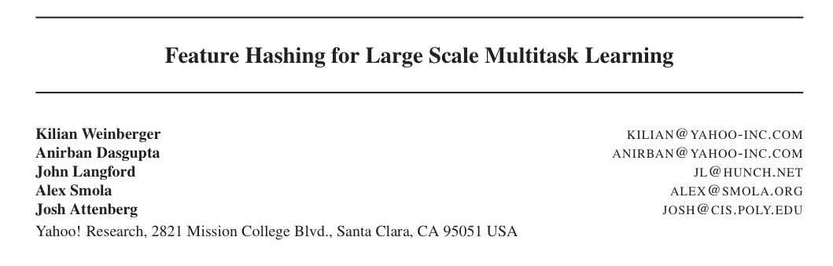
ICML 2009

Slide 29
An interesting example
Spam filtering for Yahoo mail
Lots of examples and lots of users
Two options:
one filter for everyone—but users disagree
one filter for each user—but some users are lazy and don’t label anything
Third option:
classify (msg,user) pairs
features of message i are words w_{i,1},…,w_{i,ki}
feature of user is his/her id u
features of pair are: w_{i,1},…,w_{i,ki} and u•w_{i,1},…,u•w_{i,ki}
based on an idea by Hal Daumé, used for transfer learning

Slide 30

An example
E.g., this email to wcohen
features:
dear, madam, sir,…. investment, broker,…, wcohen•dear, wcohen•madam, wcohen,…,
idea: the learner will figure out how to personalize my spam filter by using the wcohen•X features

Slide 31
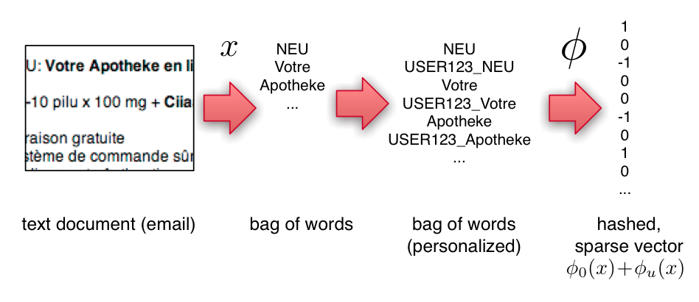
An example
Compute personalized features and multiple hashes on-the-fly:
a great opportunity to use several processors and speed up i/o

Slide 32
Experiments
3.2M emails
40M tokens
430k users
16T unique features – after personalization

Slide 33
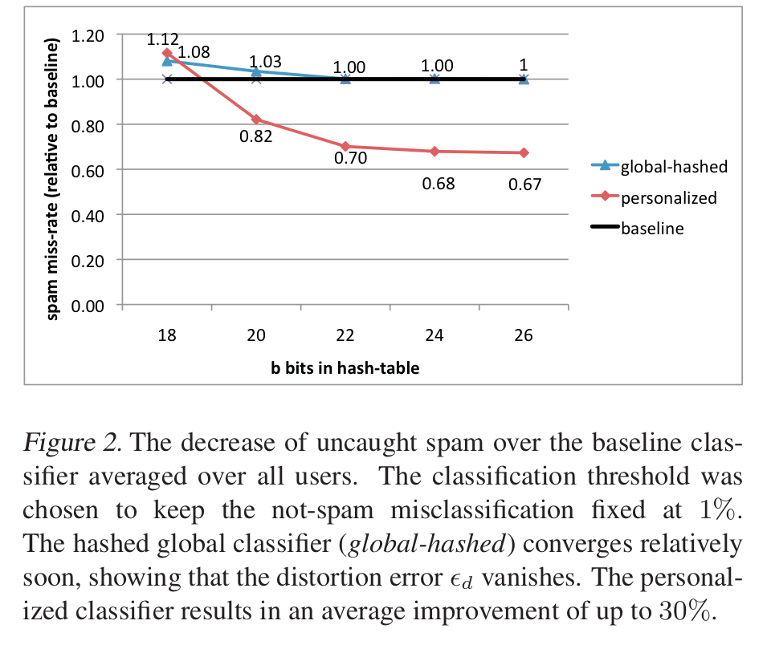
An example
2^26 entries = 1 Gb @ 8bytes/weight
Notes:
3,2M emails
400k users
40M tokens

Slide 34
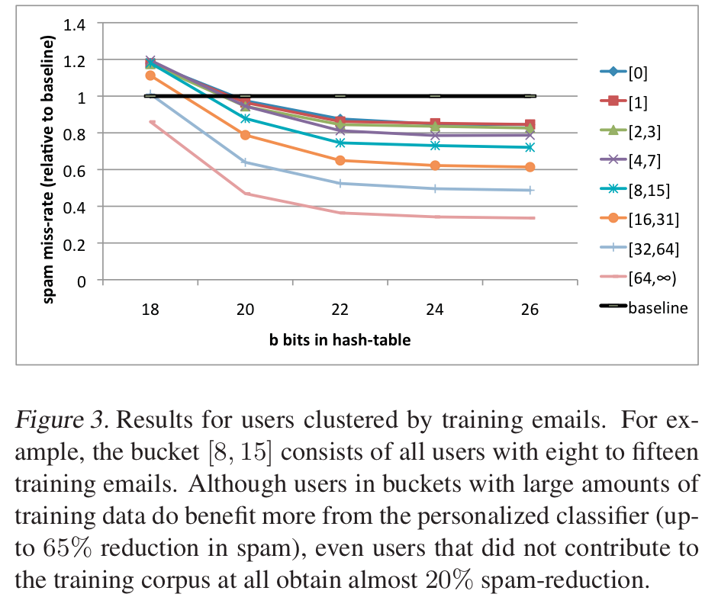

Slide 35
Some details
Slightly different hash to avoid systematic bias
m is the number of buckets you hash into (R in my discussion)

Slide 36
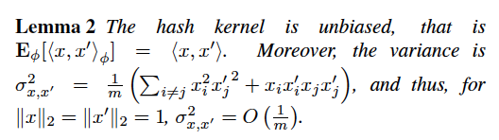
Some details
Slightly different hash to avoid systematic bias
m is the number of buckets you hash into (R in my discussion)

Slide 37
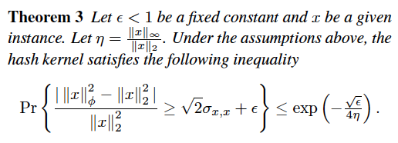
Some details
I.e. – a hashed vector is probably close to the original vector

Slide 38
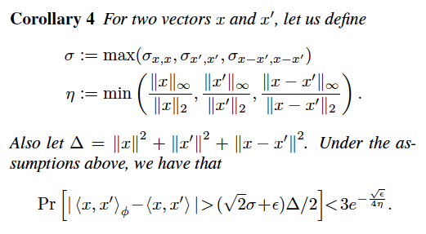
Some details
I.e. the inner products between x and x’ are probably not changed too much by the hash function: a classifier will probably still work

Slide 39
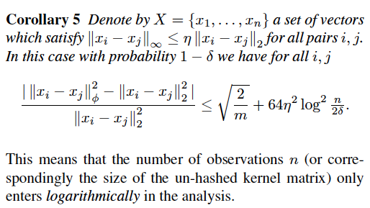
Some details
Notes:
should read this proof

Slide 40
The hash kernel: implementation
One problem: debugging is harder
Features are no longer meaningful
There’s a new way to ruin a classifier
Change the hash function ☹
You can separately compute the set of all words that hash to h and guess what features mean
Build an inverted index h→w1,w2,…,

Slide 41
A variant of feature hashing
Hash each feature multiple times with different hash functions
Now, each w has k chances to not collide with another useful w’
An easy way to get multiple hash functions
Generate some random strings s₁,…,s_{L}
Let the k-th hash function for w be the ordinary hash of concatenation w•s_{k}

Slide 42
A variant of feature hashing
Why would this work?
Claim: with 100,000 features and 100,000,000 buckets:
k=1 ➔Pr(any duplication) ≈1
k=2 ➔Pr(any duplication) ≈0.4
k=3 ➔ Pr(any duplication) ≈0.01

Slide 43
Experiments
Shi et al, JMLR 2009
http://jmlr.csail.mit.edu/papers/v10/shi09a.html
RCV1 dataset
Use hash kernels with TF-approx-IDF representation
TF and IDF done at level of hashed features, not words
IDF is approximated from subset of data
Not sure of value of “c” or data subset

Slide 44
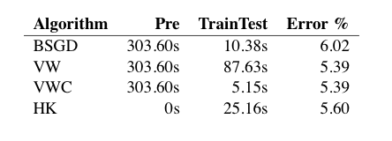
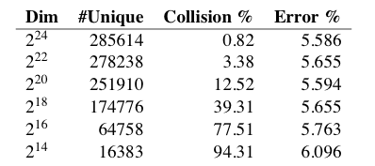
Results

Slide 45
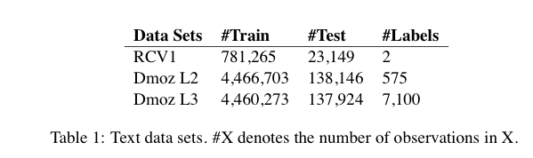
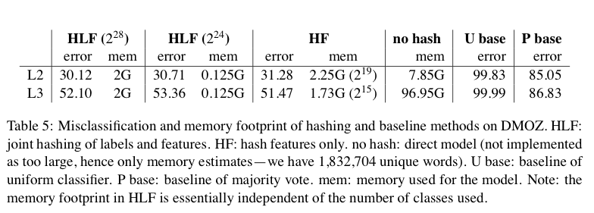
Results

Slide 46
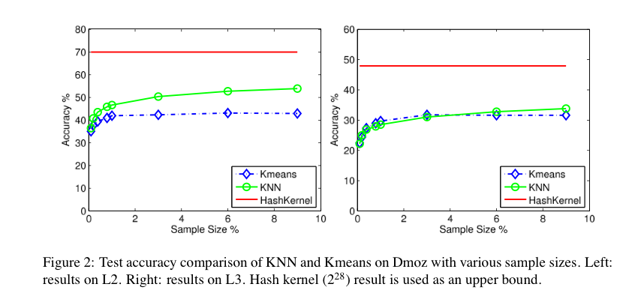
Results

Slide 47
Bloom filters
Interface to a Bloom filter
BloomFilter(int maxSize, double p);
void bf.add(String s); // insert s
bool bd.contains(String s);
// If s was added return true;
// else with probability at least 1-p return false;
// else with probability at most p return true;
I.e., a noisy “set” where you can test membership (and that’s it)
Hash table: constant time and storage
Notes:
note a hash table would do this in constant time and

Slide 48
Bloom filters
Another implementation
Allocate M bits, bit[0]…,bit[1-M]
Pick K hash functions hash(1,s),hash(2,s),….
E.g: hash(s,i) = hash(s+ randomString[i])
To add string s:
For i=1 to k, set bit[hash(i,s)] = 1
To check contains(s):
For i=1 to k, test bit[hash(i,s)]
Return “true” if they’re all set; otherwise, return “false”
We’ll discuss how to set M and K soon, but for now:
Let M = 1.5*maxSize // less than two bits per item!
Let K = 2*log(1/p) // about right with this M

Slide 49



Bloom filters
Analysis:
Assume hash(i,s) is a random function
Look at Pr(bit j is unset after n add’s):
… and Pr(collision):
…. fix m and n and minimize k:
k =

Slide 50
Bloom filters
Analysis:
Assume hash(i,s) is a random function
Look at Pr(bit j is unset after n add’s):
… and Pr(collision):
…. fix m and n, you can minimize k:
p =
k =

Slide 51


Bloom filters
Analysis:
Plug optimal k=m/n*ln(2) back into Pr(collision):
Now we can fix any two of p, n, m and solve for the 3rd:
E.g., the value for m in terms of n and p:
p =

Slide 52
Bloom filters: demo

Slide 53
Bloom filters
An example application
Finding items in “sharded” data
Easy if you know the sharding rule
Harder if you don’t (like Google n-grams)
Simple idea:
Build a BF of the contents of each shard
To look for key, load in the BF’s one by one, and search only the shards that probably contain key
Analysis: you won’t miss anything, you might look in some extra shards
You’ll hit O(1) extra shards if you set p=1/#shards

Slide 54
Bloom filters
An example application
discarding singleton features from a classifier
Scan through data once and check each w:
if bf1.contains(w): bf2.add(w)
else bf1.add(w)
Now:
bf1.contains(w) ⬄ w appears >= once
bf2.contains(w) ⬄ w appears >= 2x
Then train, ignoring words not in bf2

Slide 55
Bloom filters
An example application
discarding rare features from a classifier
seldom hurts much, can speed up experiments
Scan through data once and check each w:
if bf1.contains(w):
if bf2.contains(w): bf3.add(w)
else bf2.add(w)
else bf1.add(w)
Now:
bf2.contains(w) ⬄ w appears >= 2x
bf3.contains(w) ⬄ w appears >= 3x
Then train, ignoring words not in bf3

Slide 56
Bloom filters
More on this next week…..

Slide 57
LSH: key ideas
Goal:
map feature vector x to bit vector bx
ensure that bx preserves “similarity”

Slide 58

Random Projections

Slide 59
Random projections
u
+
+
+
+
+
+
+
+
+
-
-
-
-
-
-
-
-
-
-u
2γ

Slide 60
Random projections
To make those points “close” we need to project to a direction orthogonal to the line between them
u
+
+
+
+
+
+
+
+
+
-
-
-
-
-
-
-
-
-
-u
2γ

Slide 61
Random projections
Any other direction will keep the distant points distant.
u
+
+
+
+
+
+
+
+
+
-
-
-
-
-
-
-
-
-
So if I pick a random r and r.x and r.x’ are closer than γ then probably x and x’ were close to start with.
-u
2γ

Slide 62
LSH: key ideas
Goal:
map feature vector x to bit vector bx
ensure that bx preserves “similarity”
Basic idea: use random projections of x
Repeat many times:
Pick a random hyperplane r
Compute the inner product or r with x
Record if x is “close to” r (r.x>=0)
the next bit in bx
Theory says that is x’ and x have small cosine distance then bx and bx’ will have small Hamming distance

Slide 63
LSH: key ideas
Naïve algorithm:
Initialization:
For i=1 to outputBits:
For each feature f:
Draw r(f,i) ~ Normal(0,1)
Given an instance x
For i=1 to outputBits:
LSH[i] =
sum(x[f]*r[i,f] for f with non-zero weight in x) > 0 ? 1 : 0
Return the bit-vector LSH
Problem:
the array of r’s is very large

Slide 64
LSH: “pooling” (van Durme)
Better algorithm:
Initialization:
Create a pool:
Pick a random seed s
For i=1 to poolSize:
Draw pool[i] ~ Normal(0,1)
For i=1 to outputBits:
Devise a random hash function hash(i,f):
E.g.: hash(i,f) = hashcode(f) XOR randomBitString[i]
Given an instance x
For i=1 to outputBits:
LSH[i] = sum(
x[f] * pool[hash(i,f) % poolSize] for f in x) > 0 ? 1 : 0
Return the bit-vector LSH

Slide 65
LSH: key ideas
Advantages:
with pooling, this is a compact re-encoding of the data
you don’t need to store the r’s, just the pool
leads to very fast nearest neighbor method
just look at other items with bx’=bx
also very fast nearest-neighbor methods for Hamming distance
similarly, leads to very fast clustering
cluster = all things with same bx vector
More next week….

