Slide 1
Efficient Logistic Regression with Stochastic Gradient Descent – part 2
William Cohen

Slide 2

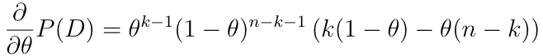
Learning as optimization: warmup
Goal: Learn the parameter θ of a binomial
Dataset: D={x₁,…,x_{n}}, x_{i} is 0 or 1, k of them are 1
= 0
θ= 0
θ= 1
k- kθ – nθ + kθ = 0
nθ = k
θ = k/n

Slide 3
Learning as optimization: general procedure
Goal: Learn the parameter θ of a classifier
  probably θ is a vector
Dataset: D={x₁,…,x_{n}}
Write down Pr(D|θ) as a function of θ
Maximize by differentiating and setting to zero

Slide 4
Learning as optimization: general procedure
Goal: Learn the parameter θ of …
Dataset: D={x₁,…,x_{n}}
  or maybe D={(x₁,y₁)…,(x_{n} , y_{n)}}
Write down Pr(D|θ) as a function of θ
  Maybe easier to work with log Pr(D|θ)
Maximize by differentiating and setting to zero
  Or, use gradient descent: repeatedly take a small step in the direction of the gradient

Slide 5
Learning as optimization: general procedure for SGD
Goal: Learn the parameter θ of …
Dataset: D={x₁,…,x_{n}}
  or maybe D={(x₁,y₁)…,(x_{n} , y_{n)}}
Write down Pr(D|θ) as a function of θ
Big-data problem: we don’t want to load all the data D into memory, and the gradient depends on all the data
Solution:
  pick a small subset of examples B<<D
  approximate the gradient using them
    “on average” this is the right direction
  take a step in that direction
  repeat….
B = one example is a very popular choice

Slide 6
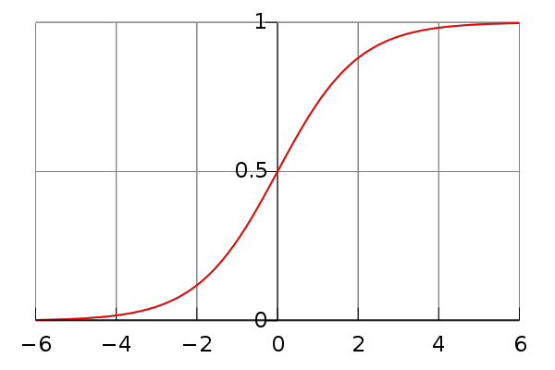

Learning as optimization for logistic regression
Goal: Learn the parameter θ of a classifier
  Which classifier?
  We’ve seen y = sign(x . w) but sign is not continuous…
  Convenient alternative: replace sign with the logistic function

Slide 7
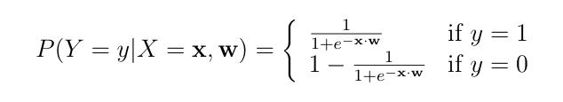
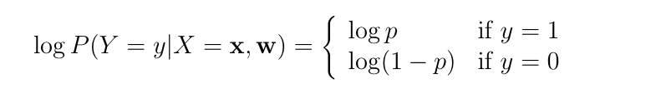
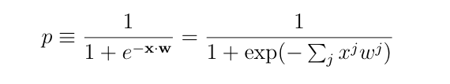
Learning as optimization for logistic regression
Goal: Learn the parameter w of the classifier
Probability of a single example (y,x) would be
Or with logs:

Slide 8
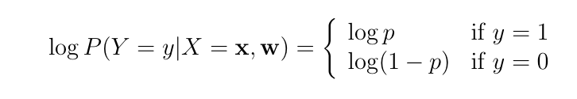
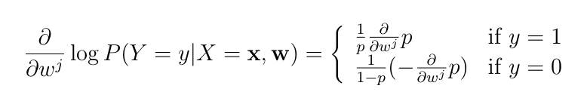


Slide 9
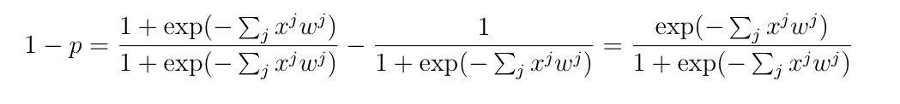
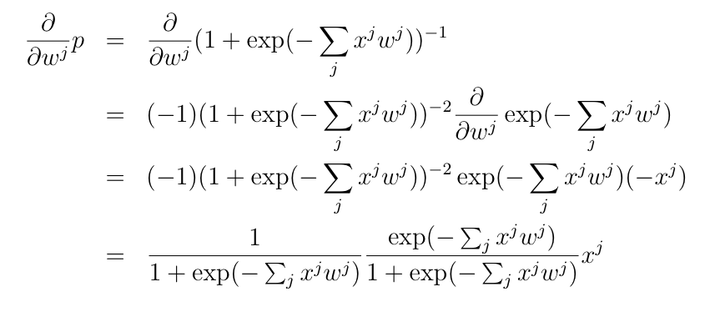

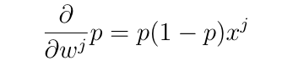
p

Slide 10
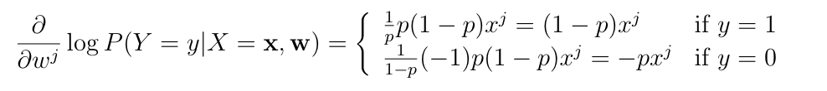
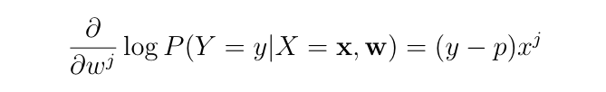


Slide 11
An observation
Key computational point:
if x^{j}=0 then the gradient of w^{j} is zero
so when processing an example you only need to update weights for the non-zero features of an example.

Slide 12

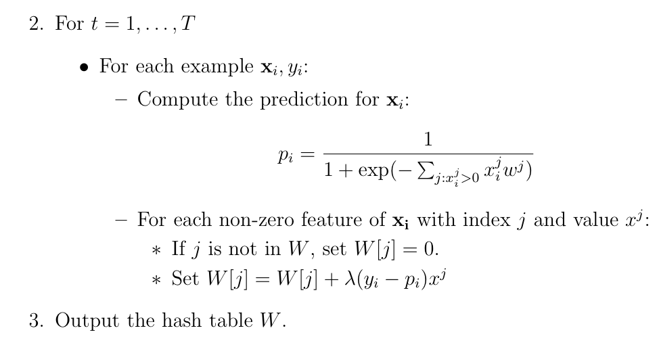
Learning as optimization for logistic regression
Final algorithm:
-- do this in random order

Slide 13
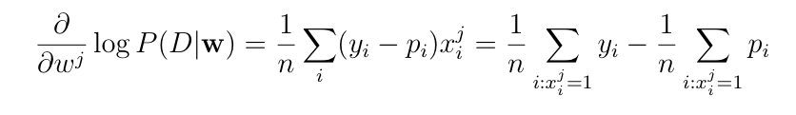
Another observation
Consider averaging the gradient over all the examples D={(x₁,y₁)…,(x_{n} , y_{n)}}

Slide 14
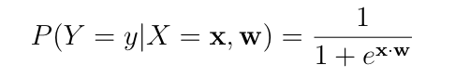
Learning as optimization for logistic regression
Goal: Learn the parameter θ of a classifier
  Which classifier?
  We’ve seen y = sign(x . w) but sign is not continuous…
  Convenient alternative: replace sign with the logistic function
Practical problem: this overfits badly with sparse features
  e.g., if w^{j} is only in positive examples, its gradient is always positive !

Slide 15
Outline
Logistic regression and SGD
  Learning as optimization
  Logistic regression:
    a linear classifier optimizing P(y|x)
  Stochastic gradient descent
    “streaming optimization” for ML problems
  Regularized logistic regression
  Sparse regularized logistic regression
  Memory-saving logistic regression

Slide 16
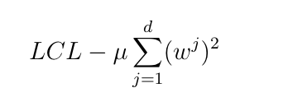
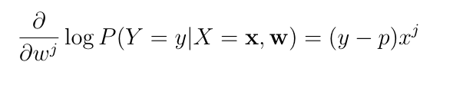
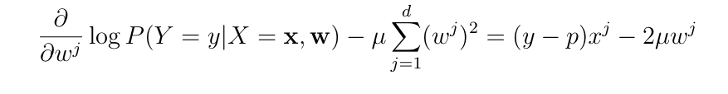
Regularized logistic regression
Replace LCL
with LCL + penalty for large weights, eg
So:
becomes:

Slide 17


Regularized logistic regression
Replace LCL
with LCL + penalty for large weights, eg
So the update for wj becomes:
Or

Slide 18
Learning as optimization for logistic regression
Algorithm:
-- do this in random order

Slide 19
Learning as optimization for regularized logistic regression
Algorithm:
Time goes from O(nT) to O(nmT) where
n = number of non-zero entries,
m = number of features,
T = number of passes over data

Slide 20
Learning as optimization for regularized logistic regression
Final algorithm:
Initialize hashtable W
For each iteration t=1,…T
  For each example (x_{i},y_{i})
    p_{i} = …
    For each feature W[j]
      W[j] = W[j] - λ2μW[j]
      If x_{i}^{j}>0 then
        W[j] = W[j] + λ(y_{i} - p^{i})x_{j}

Slide 21
Learning as optimization for regularized logistic regression
Final algorithm:
Initialize hashtable W
For each iteration t=1,…T
  For each example (x_{i},y_{i})
    p_{i} = …
    For each feature W[j]
      W[j] *= (1 - λ2μ)
      If x_{i}^{j}>0 then
        W[j] = W[j] + λ(y_{i} - p^{i})x_{j}

Slide 22
Learning as optimization for regularized logistic regression
Final algorithm:
Initialize hashtable W
For each iteration t=1,…T
  For each example (x_{i},y_{i})
    p_{i} = …
    For each feature W[j]
      If x_{i}^{j}>0 then
        W[j] *= (1 - λ2μ)^{A}
        W[j] = W[j] + λ(y_{i} - p^{i})x_{j}
A is number of examples seen since the last time we did an x>0 update on W[j]

Slide 23
Learning as optimization for regularized logistic regression
Final algorithm:
Initialize hashtables W, A and set k=0
For each iteration t=1,…T
  For each example (x_{i},y_{i})
    p_{i} = … ; k++
    For each feature W[j]
      If x_{i}^{j}>0 then
        W[j] *= (1 - λ2μ)^{k-A[j]}
        W[j] = W[j] + λ(y_{i} - p^{i})x_{j}
        A[j] = k
k-A[j] is number of examples seen since the last time we did an x>0 update on W[j]

Slide 24
Learning as optimization for regularized logistic regression
Final algorithm:
Initialize hashtables W, A and set k=0
For each iteration t=1,…T
  For each example (x_{i},y_{i})
    p_{i} = … ; k++
    For each feature W[j]
      If x_{i}^{j}>0 then
        W[j] *= (1 - λ2μ)^{k-A[j]}
        W[j] = W[j] + λ(y_{i} - p^{i})x_{j}
        A[j] = k
Time goes from O(nmT) back to to O(nT) where
n = number of non-zero entries,
m = number of features,
T = number of passes over data
memory use doubles (m → 2m)

Slide 25
Outline
[other stuff]
Logistic regression and SGD
  Learning as optimization
  Logistic regression:
    a linear classifier optimizing P(y|x)
  Stochastic gradient descent
    “streaming optimization” for ML problems
  Regularized logistic regression
  Sparse regularized logistic regression
  Memory-saving logistic regression

Slide 26
Pop quiz
In text classification most words are
  rare
  not correlated with any class
  given low weights in the LR classifier
  unlikely to affect classification
  not very interesting

Slide 27
Pop quiz
In text classification most bigrams are
  rare
  not correlated with any class
  given low weights in the LR classifier
  unlikely to affect classification
  not very interesting

Slide 28
Pop quiz
Most of the weights in a classifier are
  important
  not important

Slide 29
How can we exploit this?
One idea: combine uncommon words together randomly
Examples:
  replace all occurrances of “humanitarianism” or “biopsy” with “humanitarianismOrBiopsy”
  replace all occurrances of “schizoid” or “duchy” with “schizoidOrDuchy”
  replace all occurrances of “gynecologist” or “constrictor” with “gynecologistOrConstrictor”
  …
For Naïve Bayes this breaks independence assumptions
  it’s not obviously a problem for logistic regression, though
I could combine
  two low-weight words (won’t matter much)
  a low-weight and a high-weight word (won’t matter much)
  two high-weight words (not very likely to happen)
How much of this can I get away with?
  certainly a little
  is it enough to make a difference? how much memory does it save?

Slide 30
How can we exploit this?
Another observation:
  the values in my hash table are weights
  the keys in my hash table are strings for the feature names
    We need them to avoid collisions
But maybe we don’t care about collisions?
  Allowing “schizoid” & “duchy” to collide is equivalent to replacing all occurrences of “schizoid” or “duchy” with “schizoidOrDuchy”

Slide 31
Learning as optimization for regularized logistic regression
Algorithm:
Initialize hashtables W, A and set k=0
For each iteration t=1,…T
  For each example (x_{i},y_{i})
    p_{i} = … ; k++
    For each feature j: x_{i}^{j}>0:
        W[j] *= (1 - λ2μ)^{k-A[j]}
        W[j] = W[j] + λ(y_{i} - p^{i})x_{j}
        A[j] = k

Slide 32
Learning as optimization for regularized logistic regression
Algorithm:
Initialize arrays W, A of size R and set k=0
For each iteration t=1,…T
  For each example (x_{i},y_{i})
    Let V be hash table so that
    p_{i} = … ; k++
    For each hash value h: V[h]>0:
        W[h] *= (1 - λ2μ)^{k-A[j]}
        W[h] = W[h] + λ(y_{i} - p^{i})V[h]
        A[j] = k

Slide 33
Learning as optimization for regularized logistic regression
Algorithm:
Initialize arrays W, A of size R and set k=0
For each iteration t=1,…T
  For each example (x_{i},y_{i})
    Let V be hash table so that
    p_{i} = … ; k++
    For each hash value h: V[h]>0:
        W[h] *= (1 - λ2μ)^{k-A[j]}
        W[h] = W[h] + λ(y_{i} - p^{i})V[h]
        A[j] = k
???

Slide 34
A variant of feature hashing
Hash each feature multiple times with different hash functions
Easy way to get multiple hash functions
  Generate some random strings s₁,…,s_{L}
  Let the k-th hash function for w be the ordinary hash of concatenation w•s_{i}
now, each w has k chances to not collide with another useful w’

Slide 35
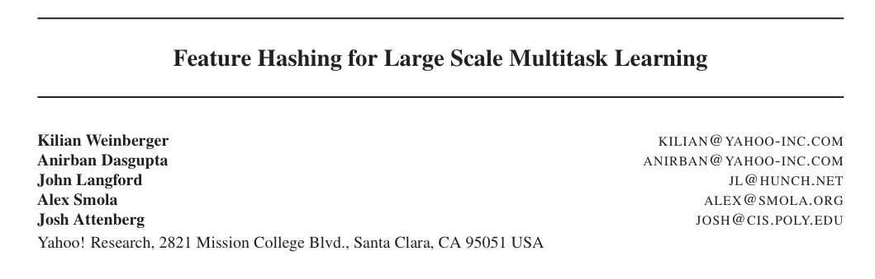
ICML 2009

Slide 36
An interesting example
Spam filtering for Yahoo mail
  Lots of examples and lots of users
  Two options:
    one filter for everyone—but users disagree
    one filter for each user—but some users are lazy and don’t label anything
  Third option:
    classify (msg,user) pairs
    features of message i are words w_{i,1},…,w_{i,ki}
    feature of user is his/her id u
    features of pair are: w_{i,1},…,w_{i,ki} and u•w_{i,1},…,u•w_{i,ki}
    based on an idea by Hal Daumé

Slide 37
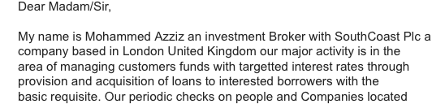
An example
E.g., this email to wcohen
features:
  dear, madam, sir,…. investment, broker,…, wcohen•dear, wcohen•madam, wcohen,…,
idea: the learner will figure out how to personalize my spam filter by using the wcohen•X features

Slide 38
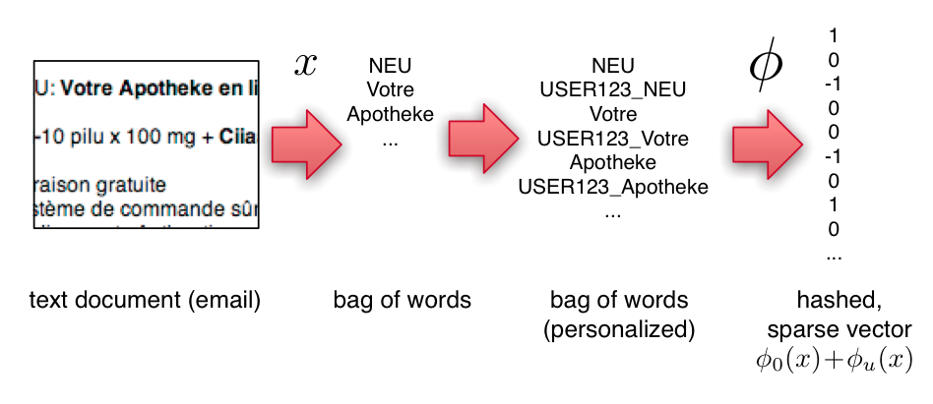
An example
Compute personalized features and multiple hashes on-the-fly:
a great opportunity to use several processors and speed up i/o

Slide 39
Experiments
3.2M emails
40M tokens
430k users
16T unique features – after personalization

Slide 40
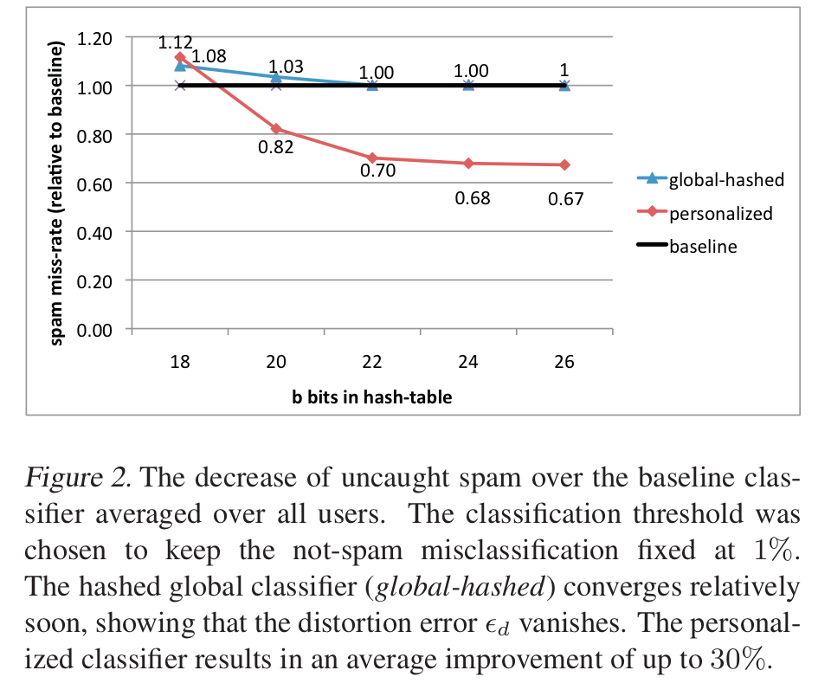
An example
2^26 entries = 1 Gb @ 8bytes/weight
Notes:
3,2M emails
400k users
40M tokens

Slide 41
