Slide 1
Other Map-Reduce (ish) Frameworks
William Cohen

Slide 2
Y:Y=Hadoop+X or Hadoop~=Y
What else are people using?
  instead of Hadoop
  on top of Hadoop

Slide 3
Issues with Hadoop
Too much typing
  programs are not concise
Too low level
  missing abstractions
  hard to specify a workflow
Not well suited to iterative operations
  E.g., E/M, k-means clustering, …
  Workflow and memory-loading issues
Disclaimer
  I haven’t done real development with any of these…
http://www.dataspora.com/2011/04/pigs-bees-and-elephants-a-comparison-of-eight-mapreduce-languages/

Slide 4
Y:Y=Hadoop+X
Cascading
  Java library for map-reduce workflows
  Also some library operations for common mappers/reducers
Notes:
except streaming

Slide 5
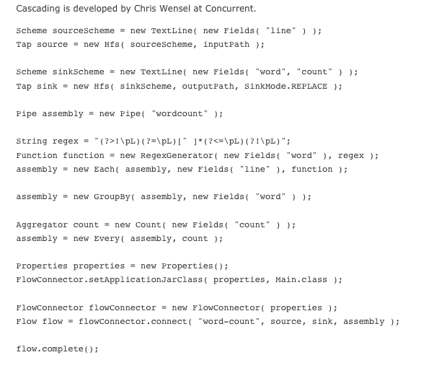
Cascading WordCount Example

Slide 6
Y:Y=Hadoop+X
Cascading
  Java library for map-reduce workflows
    expressed as “Pipe”s, to which you add Each, Every, GroupBy, …
  Also some library operations for common mappers/reducers
    e.g. RegexGenerator
  Turing-complete since it’s an API for Java
Pipes
  C++ library for map-reduce workflows on Hadoop

Slide 7
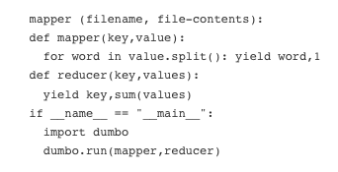
Dumbo word count
Python level over map-reduce – very concise
One run statement/Dumbo program—i.e., it’s not for complex workflows: every program must be a map-reduce chain

Slide 8
Hadoop streaming
start with stream & sort pipeline
cat data | mapper.py | sort –k1,1 | reducer.py
run with hadoop streaming instead
bin/hadoop jar contrib/streaming/hadoop-*streaming*.jar
-file mapper.py –file reducer.py
-mapper mapper.py
-reducer reducer.py
-input /hdfs/path/to/inputDir
-output /hdfs/path/to/outputDir
-mapred.map.tasks=20
-mapred.reduce.tasks=20

Slide 9
Hadoop streaming examples
bin/hadoop jar contrib/streaming/hadoop-*streaming*.jar
-mapper /bin/cat
-reducer /bin/cat
-input /hdfs/path/to/inputDir
-output /hdfs/path/to/outputDir
-mapred.map.tasks=20
-mapred.reduce.tasks=20

Slide 10
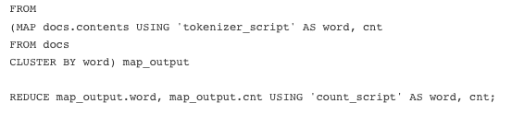
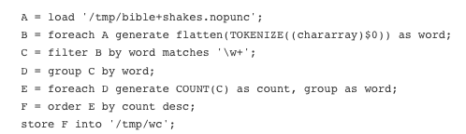
Hive and PIG: word count
Declarative ….. stable

Slide 11
More on Pig
Pig Latin
  atomic types + compound types like tuple, bag, map
  execute locally/interactively or on hadoop
can embed Pig in Java (and python and …)
can call out to Java from Pig
  example here
Stay tuned for Ron Bekkerman’s talk next week
Similar (ish) system from Microsoft: DryadLinq

Slide 12
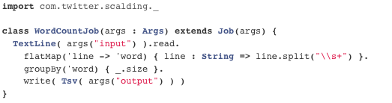
Scalding word count example
Scala domain-specific language based on Cascades

Slide 13
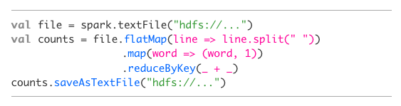
Spark word count example
Research project, based on Scala and Hadoop

Slide 14
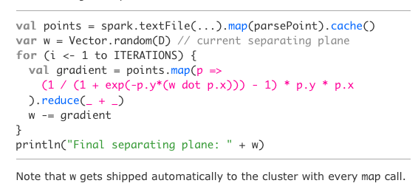
Spark logistic regression example

Slide 15
Spark logistic regression example
Allows caching data in memory

Slide 16
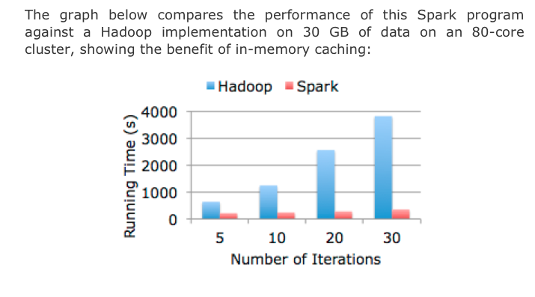
Spark logistic regression example

