Slide 1
Some More Efficient Learning Methods
William W. Cohen

Slide 2
Groundhog Day!

Slide 3
Large-vocabulary Naïve Bayes
Create a hashtable C
For each example id, y, x₁,….,x_{d} in train:
C(“Y=ANY”) ++; C(“Y=y”) ++
For j in 1..d:
C(“Y=y ^ X=x_{j}”) ++

Slide 4
Large-vocabulary Naïve Bayes
Create a hashtable C
For each example id, y, x₁,….,x_{d} in train:
C(“Y=ANY”) ++; C(“Y=y”) ++
Print “Y=ANY += 1”
Print “Y=y += 1”
For j in 1..d:
C(“Y=y ^ X=x_{j}”) ++
Print “Y=y ^ X=x_{j} += 1”
Sort the event-counter update “messages”
Scan the sorted messages and compute and output the final counter values
Think of these as “messages” to another component to increment the counters
java MyTrainertrain | sort | java MyCountAdder > model

Slide 5
Large-vocabulary Naïve Bayes
Y=business += 1
Y=business += 1
…
Y=business ^ X =aaa += 1
…
Y=business ^ X=zynga += 1
Y=sports ^ X=hat += 1
Y=sports ^ X=hockey += 1
Y=sports ^ X=hockey += 1
Y=sports ^ X=hockey += 1
…
Y=sports ^ X=hoe += 1
…
Y=sports += 1
…
Create a hashtable C
For each example id, y, x₁,….,x_{d} in train:
C(“Y=ANY”) ++; C(“Y=y”) ++
Print “Y=ANY += 1”
Print “Y=y += 1”
For j in 1..d:
C(“Y=y ^ X=x_{j}”) ++
Print “Y=y ^ X=x_{j} += 1”
Sort the event-counter update “messages”
We’re collecting together messages about the same counter
Scan and add the sorted messages and output the final counter values

Slide 6
Large-vocabulary Naïve Bayes
Scan-and-add:
streaming
previousKey = Null
sumForPreviousKey = 0
For each (event,delta) in input:
If event==previousKey
sumForPreviousKey += delta
Else
OutputPreviousKey()
previousKey = event
sumForPreviousKey = delta
OutputPreviousKey()
define OutputPreviousKey():
If PreviousKey!=Null
print PreviousKey,sumForPreviousKey
Y=business += 1
Y=business += 1
…
Y=business ^ X =aaa += 1
…
Y=business ^ X=zynga += 1
Y=sports ^ X=hat += 1
Y=sports ^ X=hockey += 1
Y=sports ^ X=hockey += 1
Y=sports ^ X=hockey += 1
…
Y=sports ^ X=hoe += 1
…
Y=sports += 1
…
Accumulating the event counts requires constant storage … as long as the input is sorted.

Slide 7
Distributed Counting → Stream and Sort Counting
Hash table1
example 1
example 2
example 3
….
Machine 1
Hash table2
Machine 2
“C[x] +=D”
Message-routing logic
Counting logic
. . .
Hash table2
Machine K
Machine 0

Slide 8
Distributed Counting → Stream and Sort Counting
example 1
example 2
example 3
….
C[x1] += D1
C[x1] += D2
….
“C[x] +=D”
Logic to combine counter updates
Sort
Counting logic
BUFFER
Machine A
Machine C
Machine B

Slide 9
Using Large-vocabulary Naïve Bayes - 1
For each example id, y, x₁,….,x_{d} in test:
Sort the event-counter update “messages”
Scan and add the sorted messages and output the final counter values
For each example id, y, x₁,….,x_{d} in test:
For each y’ in dom(Y):
Compute log Pr(y’,x₁,….,x_{d}) =
Model size: min O(n), O(|V||dom(Y)|)

Slide 10
Using Large-vocabulary Naïve Bayes -1
[For assignment]
For each example id, y, x₁,….,x_{d} in test:
Sort the event-counter update “messages”
Scan and add the sorted messages and output the final counter values
Initialize a HashSet NEEDED and a hashtable C
For each example id, y, x₁,….,x_{d} in test:
Add x₁,….,x_{d} to NEEDED
For each event, C(event) in the summed counters
If event involves a NEEDED term x read it into C
For each example id, y, x₁,….,x_{d} in test:
For each y’ in dom(Y):
Compute log Pr(y’,x₁,….,x_{d}) = ….
Model size: O(|V|)
Time: O(n₂), size of test
Memory: same
Time: O(n₂)
Memory: same
Time: O(n₂)
Memory: same

Slide 11
Using naïve Bayes - 2
Test data
Record of all event counts for each word
id₁ found an aardvark in zynga’s farmville today!
id₂ …
id₃ ….
id₄ …
id₅ …
..
w | Counts associated with W
aardvark | C[w^Y=sports]=2
agent | C[w^Y=sports]=1027,C[w^Y=worldNews]=564
… | …
zynga | C[w^Y=sports]=21,C[w^Y=worldNews]=4464
Counter records
found ~ctr to id₁
aardvark ~ctr to id₂
…
today ~ctr to id_{i}
…
Classification logic
Combine and sort
requests

Slide 12
Using naïve Bayes - 2
w | Counts
aardvark | C[w^Y=sports]=2
aardvark | ~ctr to id1
agent | C[w^Y=sports]=…
agent | ~ctr to id345
agent | ~ctr to id9854
… | ~ctr to id345
agent | ~ctr to id34742
…
zynga | C[…]
zynga | ~ctr to id1
Record of all event counts for each word
w | Counts
aardvark | C[w^Y=sports]=2
agent | …
…
zynga | …
Counter records
found ~ctr to id₁
aardvark ~ctr to id₂
…
today ~ctr to id_{i}
…
Combine and sort
Request-handling logic
requests

Slide 13
Using naïve Bayes - 2
w | Counts
aardvark | C[w^Y=sports]=2
aardvark | ~ctr to id1
agent | C[w^Y=sports]=…
agent | ~ctr to id345
agent | ~ctr to id9854
… | ~ctr to id345
agent | ~ctr to id34742
…
zynga | C[…]
zynga | ~ctr to id1
previousKey = somethingImpossible
For each (key,val) in input:
…
define Answer(record,request):
find id where “request = ~ctr to id”
print “id ~ctr for request is record”
Output:
id1 ~ctr for aardvark is C[w^Y=sports]=2
…
id1 ~ctr for zynga is ….
…
Combine and sort
Request-handling logic
requests

Slide 14
Using naïve Bayes - 2
w | Counts
aardvark | C[w^Y=sports]=2
aardvark | ~ctr to id1
agent | C[w^Y=sports]=…
agent | ~ctr to id345
agent | ~ctr to id9854
… | ~ctr to id345
agent | ~ctr to id34742
…
zynga | C[…]
zynga | ~ctr to id1
Output:
id1 ~ctr for aardvark is C[w^Y=sports]=2
…
id1 ~ctr for zynga is ….
…
id₁ found an aardvark in zynga’s farmville today!
id₂ …
id₃ ….
id₄ …
id₅ …
..
Request-handling logic
Combine and sort
????

Slide 15
Using naïve Bayes - 2
What we ended up with
Key | Value
id1 | found aardvark zynga farmville today
 | ~ctr for aardvark is C[w^Y=sports]=2
 | ~ctr for found is C[w^Y=sports]=1027,C[w^Y=worldNews]=564
 | …
id2 | w_{2,1} w_{2,2} w_{2,3} ….
 | ~ctr for w_{2,1} is …
… | …

Slide 16
Review/outline
Groundhog Day!
How to implement Naïve Bayes
Time is linear in size of data (one scan!)
We need to count C( X=word ^ Y=label)
Can you parallelize Naïve Bayes?
Trivial solution 1
Split the data up into multiple subsets
Count and total each subset independently
Add up the counts
Result should be the same

Slide 17
Stream and Sort Counting → Distributed Counting
Standardized message routing logic
example 1
example 2
example 3
….
C[x1] += D1
C[x1] += D2
….
“C[x] +=D”
Logic to combine counter updates
Counting logic
Sort
Machines A1,…
Machines C1,..,
Machines B1,…,
Trivial to parallelize!
Easy to parallelize!

Slide 18
Stream and Sort Counting → Distributed Counting
Standardized message routing logic
example 1
example 2
example 3
….
C[x1] += D1
C[x1] += D2
….
“C[x] +=D”
Logic to combine counter updates
Counting logic
Sort
BUFFER
Machines A1,…
Machines C1,..,
Machines B1,…,
Trivial to parallelize!
Easy to parallelize!

Slide 19
Review/outline
Groundhog Day!
How to implement Naïve Bayes
Time is linear in size of data (one scan!)
We need to count C( X=word ^ Y=label)
Can you parallelize Naïve Bayes?
Trivial solution 1
Split the data up into multiple subsets
Count and total each subset independently
Add up the counts
Result should be the same
This is unusual for streaming learning algorithms
Why?

Slide 20
Review/outline
Groundhog Day!
How to implement Naïve Bayes
Time is linear in size of data (one scan!)
We need to count C( X=word ^ Y=label)
Can you parallelize Naïve Bayes?
Trivial solution 1
Split the data up into multiple subsets
Count and total each subset independently
Add up the counts
Result should be the same
This is unusual for streaming learning algorithms
Today: another algorithm that is similarly fast
…and some theory about streaming algorithms
…and a streaming algorithm that is not so fast

Slide 21
Rocchio’s algorithm
Relevance Feedback in Information Retrieval, SMART Retrieval System Experiments in Automatic Document Processing, 1971, Prentice Hall Inc.

Slide 22
Groundhog Day!

Slide 23
Large-vocabulary Naïve Bayes
Create a hashtable C
For each example id, y, x₁,….,x_{d} in train:
C(“Y=ANY”) ++; C(“Y=y”) ++
For j in 1..d:
C(“Y=y ^ X=x_{j}”) ++

Slide 24
Rocchio’s algorithm
Many variants of these formulae
…as long as u(w,d)=0 for words not in d!
Store only non-zeros in u(d), so size is O(|d| )
But size of u(y) is O(|n_{V}| )

Slide 25
Rocchio’s algorithm
Given a table mapping w to DF(w), we can compute v(d) from the words in d…and the rest of the learning algorithm is just adding…

Slide 26
Rocchio v Bayes
Imagine a similar process but for labeled documents…
Train data
Event counts
id₁ y1 w_{1,1} w_{1,2} w_{1,3} …. w_{1,k1}
id₂ y2 w_{2,1} w_{2,2} w_{2,3} ….
id₃ y3 w_{3,1} w_{3,2} ….
id₄ y4 w_{4,1} w_{4,2} …
id₅ y5 w_{5,1} w_{5,2} ….
..
X=w₁^Y=sports
X=w₁^Y=worldNews
X=..
X=w₂^Y=…
X=…
…
5245
1054
2120
37
3
…
Recall Naïve Bayes test process?
id₁ y1 w_{1,1} w_{1,2} w_{1,3} …. w_{1,k1}
id₂ y2 w_{2,1} w_{2,2} w_{2,3} ….
id₃ y3 w_{3,1} w_{3,2} ….
id₄ y4 w_{4,1} w_{4,2} …
C[X=w_{1,1}^Y=sports]=5245, C[X=w_{1,1}^Y=..],C[X=w_{1,2}^…]
C[X=w_{2,1}^Y=….]=1054,…, C[X=w_{2,k2}^…]
C[X=w_{3,1}^Y=….]=…
…

Slide 27
Rocchio….
Train data
Rocchio: DF counts
id₁ y1 w_{1,1} w_{1,2} w_{1,3} …. w_{1,k1}
id₂ y2 w_{2,1} w_{2,2} w_{2,3} ….
id₃ y3 w_{3,1} w_{3,2} ….
id₄ y4 w_{4,1} w_{4,2} …
id₅ y5 w_{5,1} w_{5,2} ….
..
aardvark
agent
…
12
1054
2120
37
3
…
id₁ y1 w_{1,1} w_{1,2} w_{1,3} …. w_{1,k1}
id₂ y2 w_{2,1} w_{2,2} w_{2,3} ….
id₃ y3 w_{3,1} w_{3,2} ….
id₄ y4 w_{4,1} w_{4,2} …
v(w_{1,1},id1), v(w_{1,2},id1)…v(w_{1,k1},id1)
v(w_{2,1},id2), v(w_{2,2},id2)…
…
…

Slide 28
Rocchio….
Train data
Rocchio: DF counts
id₁ y1 w_{1,1} w_{1,2} w_{1,3} …. w_{1,k1}
id₂ y2 w_{2,1} w_{2,2} w_{2,3} ….
id₃ y3 w_{3,1} w_{3,2} ….
id₄ y4 w_{4,1} w_{4,2} …
id₅ y5 w_{5,1} w_{5,2} ….
..
aardvark
agent
…
12
1054
2120
37
3
…
id₁ y1 w_{1,1} w_{1,2} w_{1,3} …. w_{1,k1}
id₂ y2 w_{2,1} w_{2,2} w_{2,3} ….
id₃ y3 w_{3,1} w_{3,2} ….
id₄ y4 w_{4,1} w_{4,2} …
v(id₁ )
v(id₂ )
…
…

Slide 29
Rocchio….
Train data
Rocchio: DF counts
id₁ y1 w_{1,1} w_{1,2} w_{1,3} …. w_{1,k1}
id₂ y2 w_{2,1} w_{2,2} w_{2,3} ….
id₃ y3 w_{3,1} w_{3,2} ….
id₄ y4 w_{4,1} w_{4,2} …
id₅ y5 w_{5,1} w_{5,2} ….
..
aardvark
agent
…
12
1054
2120
37
3
…
id₁ y1 w_{1,1} w_{1,2} w_{1,3} …. w_{1,k1}
id₂ y2 w_{2,1} w_{2,2} w_{2,3} ….
id₃ y3 w_{3,1} w_{3,2} ….
id₄ y4 w_{4,1} w_{4,2} …
v(id₁ )
v(id₂ )
…
…

Slide 30
Rocchio….
id₁ y1 w_{1,1} w_{1,2} w_{1,3} …. w_{1,k1}
id₂ y2 w_{2,1} w_{2,2} w_{2,3} ….
id₃ y3 w_{3,1} w_{3,2} ….
id₄ y4 w_{4,1} w_{4,2} …
v(w_{1,1} w_{1,2} w_{1,3} …. w_{1,k1} ), the document vector for id₁
v(w_{2,1} w_{2,2} w_{2,3} ….)= v(w_{2,1} ,d), v(w_{2,2} ,d), …
…
…
For each (y, v), go through the non-zero values in v …one for each w in the document d…and increment a counter for that dimension of v(y)
Message: increment v(y1)’s weight for w_{1,1} by αv(w_{1,1} ,d) /|C_{y}|
Message: increment v(y1)’s weight for w_{1,2} by αv(w_{1,2} ,d) /|C_{y}|

Slide 31
Rocchio at Test Time
Train data
Rocchio: DF counts
id₁ y1 w_{1,1} w_{1,2} w_{1,3} …. w_{1,k1}
id₂ y2 w_{2,1} w_{2,2} w_{2,3} ….
id₃ y3 w_{3,1} w_{3,2} ….
id₄ y4 w_{4,1} w_{4,2} …
id₅ y5 w_{5,1} w_{5,2} ….
..
aardvark
agent
…
v(y1,w)=0.0012
v(y1,w)=0.013, v(y2,w)=…
....
…
id₁ y1 w_{1,1} w_{1,2} w_{1,3} …. w_{1,k1}
id₂ y2 w_{2,1} w_{2,2} w_{2,3} ….
id₃ y3 w_{3,1} w_{3,2} ….
id₄ y4 w_{4,1} w_{4,2} …
v(id₁ ), v(w_{1,1},y1),v(w_{1,1},y1),….,v(w_{1,k1},yk),…,v(w_{1,k1},yk)
v(id₂ ), v(w_{2,1},y1),v(w_{2,1},y1),….
…
…

Slide 32
Rocchio Summary
Compute DF
one scan thru docs
Compute v(id_{i}) for each document
output size O(n)
Add up vectors to get v(y)
Classification ~= disk NB
time: O(n), n=corpus size
like NB event-counts
time: O(n)
one scan, if DF fits in memory
like first part of NB test procedure otherwise
time: O(n)
one scan if v(y)’s fit in memory
like NB training otherwise

Slide 33
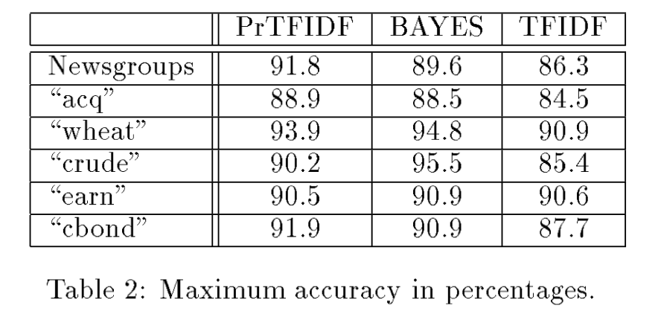
Rocchio results…
Joacchim ’98, “A Probabilistic Analysis of the Rocchio Algorithm…”
Variant TF and IDF formulas
Rocchio’s method (w/ linear TF)

Slide 34
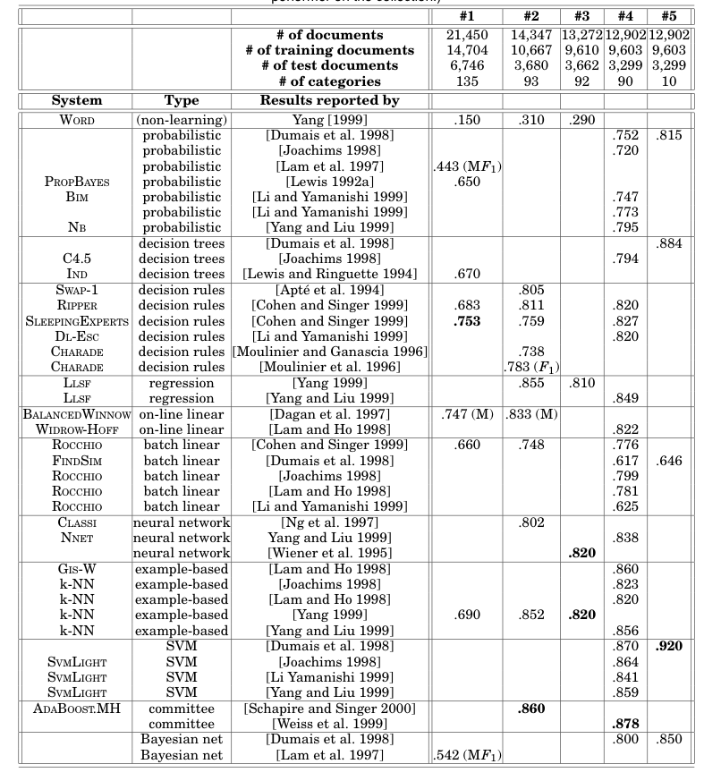
Notes:
Sebastiani’s survey

Slide 35
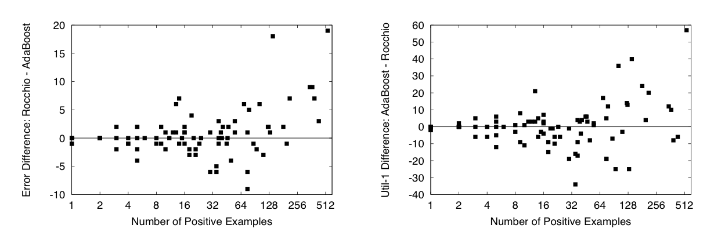
Rocchio results…
Schapire, Singer, Singhal, “Boosting and Rocchio Applied to Text Filtering”, SIGIR 98
Reuters 21578 – all classes (not just the frequent ones)
Notes:
Boosting and Rocchio Applied to Text Filtering. Robert Schapire, Yoram Singer, Amit Singhal. ACM SIGIR'98, pages 215-223, 1998.

Slide 36
A hidden agenda
Part of machine learning is good grasp of theory
Part of ML is a good grasp of what hacks tend to work
These are not always the same
Especially in big-data situations
Catalog of useful tricks so far
Brute-force estimation of a joint distribution
Naive Bayes
Stream-and-sort, request-and-answer patterns
BLRT and KL-divergence (and when to use them)
TF-IDF weighting – especially IDF
it’s often useful even when we don’t understand why

Slide 37
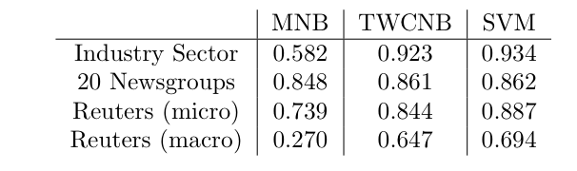
One more Rocchio observation
Rennie et al, ICML 2003, “Tackling the Poor Assumptions of Naïve Bayes Text Classifiers”
NB + cascade of hacks
Notes:
Rennie, Shih, Teevan, and Karger (2003) Tackling the Poor Assumptions of Naive Bayes Text Classifiers.
lingpipe-blog.com/.../rennie-shih-teevan-and-karger-2003-tackling-p...
Feb 16, 2009 – Rennie, Shih, Teevan, Karger (2003) Tackling the Poor Assumptions of Naive Bayes Text Classifiers. In ICML. Rennie et al. introduce four ...
Tackling the - AAAI

Slide 38
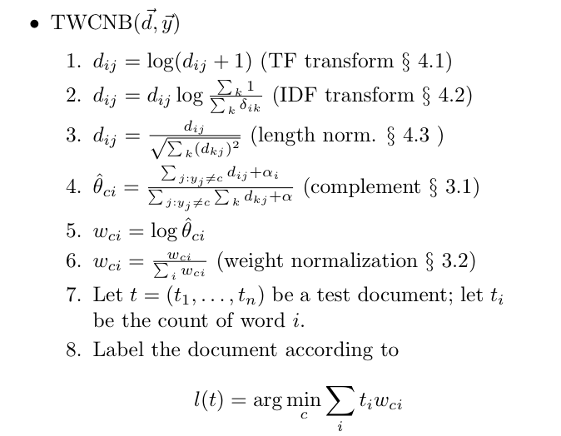
One more Rocchio observation
Rennie et al, ICML 2003, “Tackling the Poor Assumptions of Naïve Bayes Text Classifiers”
“In tests, we found the length normalization to be most useful, followed by the log transform…these transforms were also applied to the input of SVM”.
Notes:
Rennie, Shih, Teevan, and Karger (2003) Tackling the Poor Assumptions of Naive Bayes Text Classifiers.
lingpipe-blog.com/.../rennie-shih-teevan-and-karger-2003-tackling-p...
Feb 16, 2009 – Rennie, Shih, Teevan, Karger (2003) Tackling the Poor Assumptions of Naive Bayes Text Classifiers. In ICML. Rennie et al. introduce four ...
Tackling the - AAAI

Slide 39
One? more Rocchio observation
Documents/labels
Split into documents subsets
Documents/labels – 1
Documents/labels – 2
Documents/labels – 3
Compute DFs
DFs -1
DFs - 2
DFs -3
Sort and add counts
DFs
Notes:
Rennie, Shih, Teevan, and Karger (2003) Tackling the Poor Assumptions of Naive Bayes Text Classifiers.
lingpipe-blog.com/.../rennie-shih-teevan-and-karger-2003-tackling-p...
Feb 16, 2009 – Rennie, Shih, Teevan, Karger (2003) Tackling the Poor Assumptions of Naive Bayes Text Classifiers. In ICML. Rennie et al. introduce four ...
Tackling the - AAAI

Slide 40
One?? more Rocchio observation
DFs
Documents/labels
Split into documents subsets
Documents/labels – 1
Documents/labels – 2
Documents/labels – 3
Compute partial v(y)’s
v-1
v-2
v-3
Sort and add vectors
v(y)’s
Notes:
Rennie, Shih, Teevan, and Karger (2003) Tackling the Poor Assumptions of Naive Bayes Text Classifiers.
lingpipe-blog.com/.../rennie-shih-teevan-and-karger-2003-tackling-p...
Feb 16, 2009 – Rennie, Shih, Teevan, Karger (2003) Tackling the Poor Assumptions of Naive Bayes Text Classifiers. In ICML. Rennie et al. introduce four ...
Tackling the - AAAI

Slide 41
O(1) more Rocchio observation
Documents/labels
Split into documents subsets
Documents/labels – 1
Documents/labels – 2
Documents/labels – 3
DFs
DFs
Compute partial v(y)’s
DFs
v-1
v-2
v-3
Sort and add vectors
v(y)’s
We have shared access to the DFs, but only shared read access – we don’t need to share write access. So we only need to copy the information across the different processes.
Notes:
Rennie, Shih, Teevan, and Karger (2003) Tackling the Poor Assumptions of Naive Bayes Text Classifiers.
lingpipe-blog.com/.../rennie-shih-teevan-and-karger-2003-tackling-p...
Feb 16, 2009 – Rennie, Shih, Teevan, Karger (2003) Tackling the Poor Assumptions of Naive Bayes Text Classifiers. In ICML. Rennie et al. introduce four ...
Tackling the - AAAI

Slide 42
Review/outline
Groundhog Day!
How to implement Naïve Bayes
Time is linear in size of data (one scan!)
We need to count C( X=word ^ Y=label)
Can you parallelize Naïve Bayes?
Trivial solution 1
Split the data up into multiple subsets
Count and total each subset independently
Add up the counts
Result should be the same
This is unusual for streaming learning algorithms
Why?

Slide 43
Two fast algorithms
Naïve Bayes: one pass
Rocchio: two passes
if vocabulary fits in memory
Both method are algorithmically similar
count and combine
Thought experiment: what if we duplicated some features in our dataset many times?
e.g., Repeat all words that start with “t” 10 times.

Slide 44
Two fast algorithms
This isn’t silly – often there are features that are “noisy” duplicates, or important phrases of different length
Naïve Bayes: one pass
Rocchio: two passes
if vocabulary fits in memory
Both method are algorithmically similar
count and combine
Thought thought thought thought thought thought thought thought thought thought experiment: what if we duplicated some features in our dataset many times times times times times times times times times times?
e.g., Repeat all words that start with “t” “t” “t” “t” “t” “t” “t” “t” “t” “t” ten ten ten ten ten ten ten ten ten ten times times times times times times times times times times.
Result: some features will be over-weighted in classifier

Slide 45
Two fast algorithms
This isn’t silly – often there are features that are “noisy” duplicates, or important phrases of different length
Naïve Bayes: one pass
Rocchio: two passes
if vocabulary fits in memory
Both method are algorithmically similar
count and combine
Result: some features will be over-weighted in classifier
unless you can somehow notice are correct for interactions/dependencies between features
Claim: naïve Bayes is fast because it’s naive

Slide 46
Can we make this interesting? Yes!
Key ideas:
Pick the class variable Y
Instead of estimating P(X₁,…,X_{n},Y) = P(X₁)*…*P(X_{n})*Pr(Y), estimate P(X₁,…,X_{n}|Y) = P(X₁|Y)*…*P(X_{n}|Y)
Or, assume P(Xi|Y)=Pr(Xi|X₁,…,X_{i-1},X_{i+1},…X_{n},Y)
Or, that Xi is conditionally independent of every Xj, j!=I, given Y.
How to estimate?
MLE

Slide 47
One simple way to look for interactions
Naïve Bayes
sparse vector of TF values for each word in the document…plus a “bias” term for f(y)
dense vector of g(x,y) scores for each word in the vocabulary .. plus f(y) to match bias term

Slide 48
One simple way to look for interactions
Naïve Bayes
Scan thu data:
whenever we see x with y we increase g(x,y)
whenever we see x with ~y we increase g(x,~y)
dense vector of g(x,y) scores for each word in the vocabulary

Slide 49
One simple way to look for interactions
Train Data
^
instance x_{i}
B
Compute: y_{i} = v_{k} . x_{i}
If mistake: v_{k+1} = v_{k} + correction
+1,-1: label y_{i}
To detect interactions:
increase/decrease v_{k} only if we need to (for that example)
otherwise, leave it unchanged
We can be sensitive to duplication by stopping updates when we get better performance

Slide 50
One simple way to look for interactions
Naïve Bayes – two class version
Scan thru data:
whenever we see x with y we increase g(x,y)-g(x,~y)
whenever we see x with ~y we decrease g(x,y)-g(x,~y)
We do this regardless of whether it seems to help or not on the data….if there are duplications, the weights will become arbitrarily large
To detect interactions:
increase/decrease g(x,y)-g(x,~y) only if we need to (for that example)
otherwise, leave it unchanged
dense vector of g(x,y) scores for each word in the vocabulary

Slide 51
Theory: the prediction game
Player A:
picks a “target concept” c
for now - from a finite set of possibilities C (e.g., all decision trees of size m)
for t=1,….,
Player A picks x=(x₁,…,x_{n}) and sends it to B
For now, from a finite set of possibilities (e.g., all binary vectors of length n)
B predicts a label, ŷ, and sends it to A
A sends B the true label y=c(x)
we record if B made a mistake or not
We care about the worst case number of mistakes B will make over all possible concept & training sequences of any length
The “Mistake bound” for B, M_{B}(C), is this bound

Slide 52
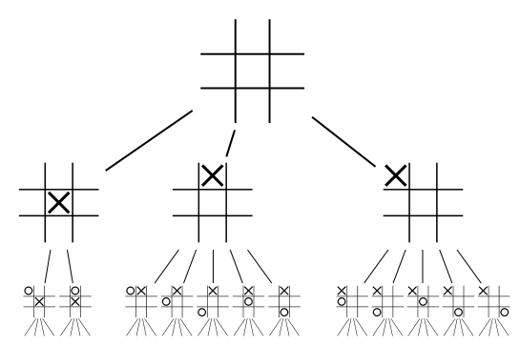
Some possible algorithms for B
not practical – just possible
The “optimal algorithm”
Build a min-max game tree for the prediction game and use perfect play
C
00
01
10
11
ŷ(01)=0
ŷ(01)=1
y=0
y=1
{c in C:c(01)=1}
{c in C: c(01)=0}

Slide 53
Some possible algorithms for B
not practical – just possible
The “optimal algorithm”
Build a min-max game tree for the prediction game and use perfect play
Suppose B only makes a mistake on each x a finite number of times k (say k=1).
After each mistake, the set of possible concepts will decrease…so the tree will have bounded size.
C
00
01
10
11
ŷ(01)=0
ŷ(01)=1
y=0
y=1
{c in C:c(01)=1}
{c in C: c(01)=0}

Slide 54
Some possible algorithms for B
not practical – just possible
The “Halving algorithm”
Remember all the previous examples
To predict, cycle through all c in the “version space” of consistent concepts in c, and record which predict 1 and which predict 0
Predict according to the majority vote
Analysis:
With every mistake, the size of the version space is decreased in size by at least half
So M_{halving}(C) <= log₂(|C|)

Slide 55
Some possible algorithms for B
The “Halving algorithm”
Remember all the previous examples
To predict, cycle through all c in the “version space” of consistent concepts in c, and record which predict 1 and which predict 0
Predict according to the majority vote
Analysis:
With every mistake, the size of the version space is decreased in size by at least half
So M_{halving}(C) <= log₂(|C|)
not practical – just possible
C
00
01
10
11
ŷ(01)=0
ŷ(01)=1
y=0
y=1
y=1
{c in C: c(01)=0}
{c in C:c(01)=1}

Slide 56
More results
A set s is “shattered” by C if for any subset s’ of s, there is a c in C that contains all the instances in s’ and none of the instances in s-s’.
The “VC dimension” of C is |s|, where s is the largest set shattered by C.
Notes:
hyperplane – 2d-1

Slide 57
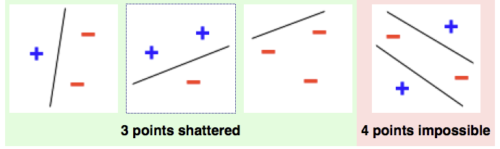
More results
A set s is “shattered” by C if for any subset s’ of s, there is a c in C that contains all the instances in s’ and none of the instances in s-s’.
The “VC dimension” of C is |s|, where s is the largest set shattered by C.
VCdim is closely related to pac-learnability of concepts in C.
Notes:
hyperplane – 2d-1

Slide 58
More results
A set s is “shattered” by C if for any subset s’ of s, there is a c in C that contains all the instances in s’ and none of the instances in s-s’.
The “VC dimension” of C is |s|, where s is the largest set shattered by C.
C
Theorem:
M_{opt}(C)>=VC(C)
Proof: game tree has depth >= VC(C)
00
01
10
11
ŷ(01)=0
ŷ(01)=1
y=0
y=1
{c in C:c(01)=1}
{c in C: c(01)=0}
Notes:
hyperplane – 2d-1

Slide 59
More results
A set s is “shattered” by C if for any subset s’ of s, there is a c in C that contains all the instances in s’ and none of the instances in s-s’.
The “VC dimension” of C is |s|, where s is the largest set shattered by C.
C
Corollary: for finite C
VC(C) <= M_{opt}(C) <= log2(|C|)
00
01
10
11
ŷ(01)=0
ŷ(01)=1
Proof: M_{opt}(C) <= M_{halving}(C)
<=log2(|C|)
y=0
y=1
{c in C:c(01)=1}
{c in C: c(01)=0}
Notes:
hyperplane – 2d-1

Slide 60
More results
A set s is “shattered” by C if for any subset s’ of s, there is a c in C that contains all the instances in s’ and none of the instances in s-s’.
The “VC dimension” of C is |s|, where s is the largest set shattered by C.
Theorem: it can be that
M_{opt}(C) >> VC(C)
Proof: C = set of one-dimensional threshold functions.
-
?
+
Notes:
hyperplane – 2d-1

Slide 61
The prediction game
Are there practical algorithms where we can compute the mistake bound?

Slide 62
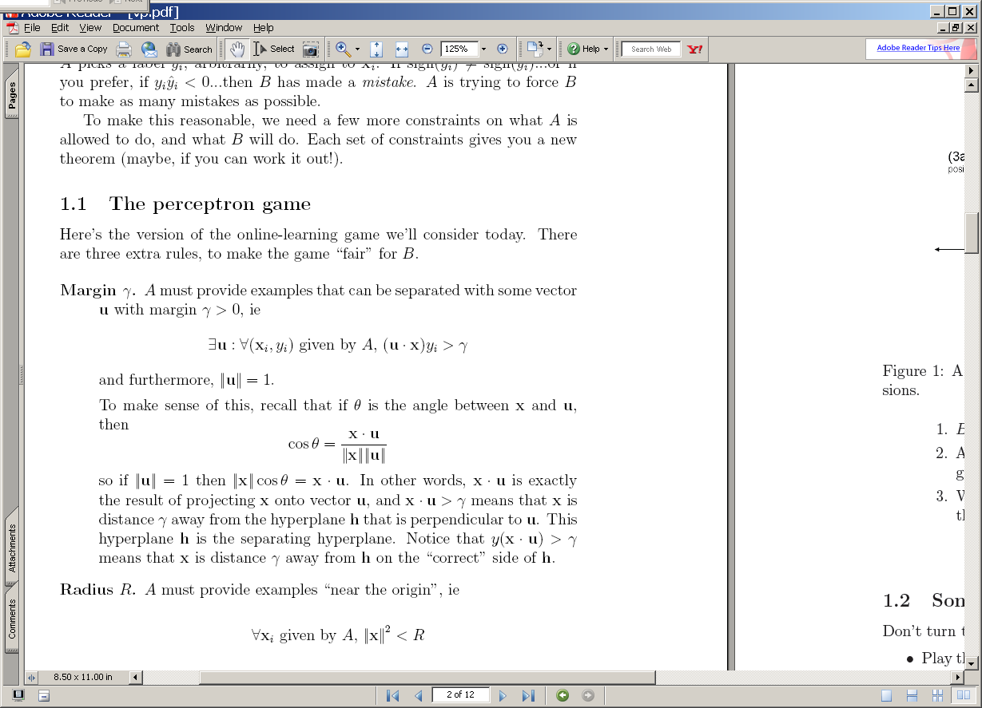
The voted perceptron
^
instance x_{i}
B
Compute: y_{i} = v_{k} . x_{i}
A
^
If mistake: v_{k+1} = v_{k} + y_{i} x_{i}
y_{i}
y_{i}

Slide 63
(1) A target u
(2) The guess v₁ after one positive example.
u
u
v₁
+x₁
-u
-u
2γ
2γ
(3a) The guess v₂ after the two positive examples: v₂=v₁+x₂
(3b) The guess v₂ after the one positive and one negative example: v₂=v₁-x₂
u
u
+x₂
v₂
v₂
v₁
v₁
+x₁
-x₂
-u
-u
2γ
2γ
If mistake: v_{k+1} = v_{k} + y_{i} x_{i}

Slide 64
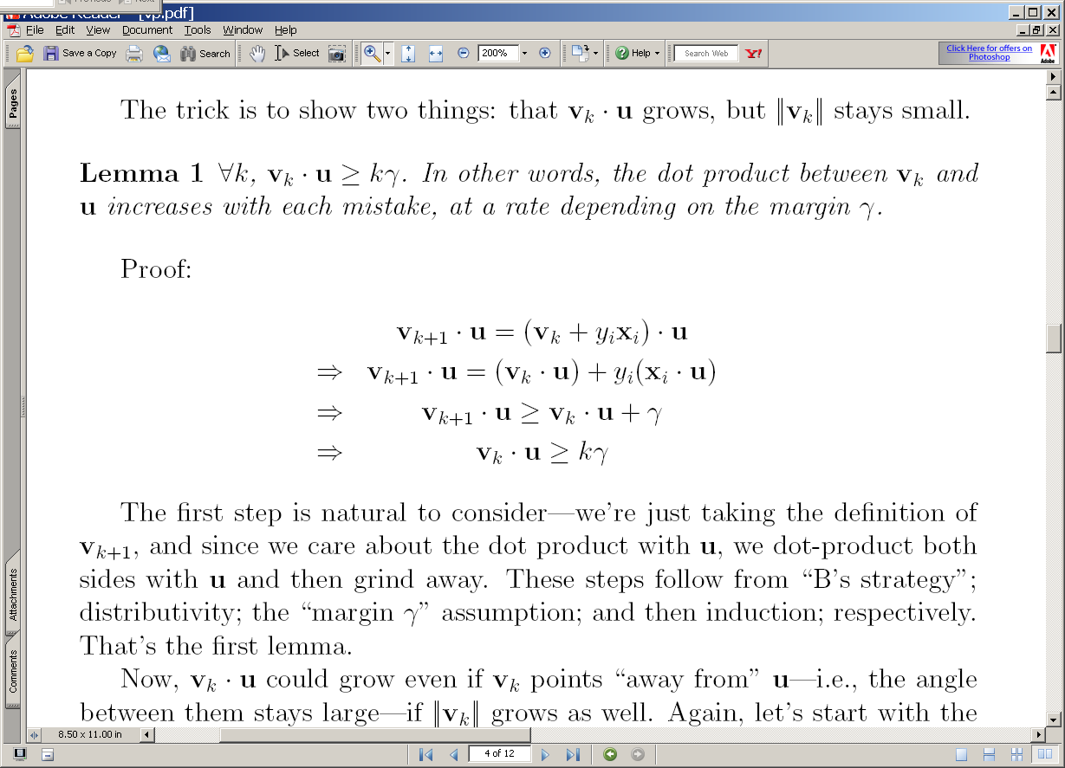
(3a) The guess v₂ after the two positive examples: v₂=v₁+x₂
(3b) The guess v₂ after the one positive and one negative example: v₂=v₁-x₂
u
u
+x₂
v₂
v₂
>γ
v₁
v₁
+x₁
-x₂
-u
-u
2γ
2γ

Slide 65
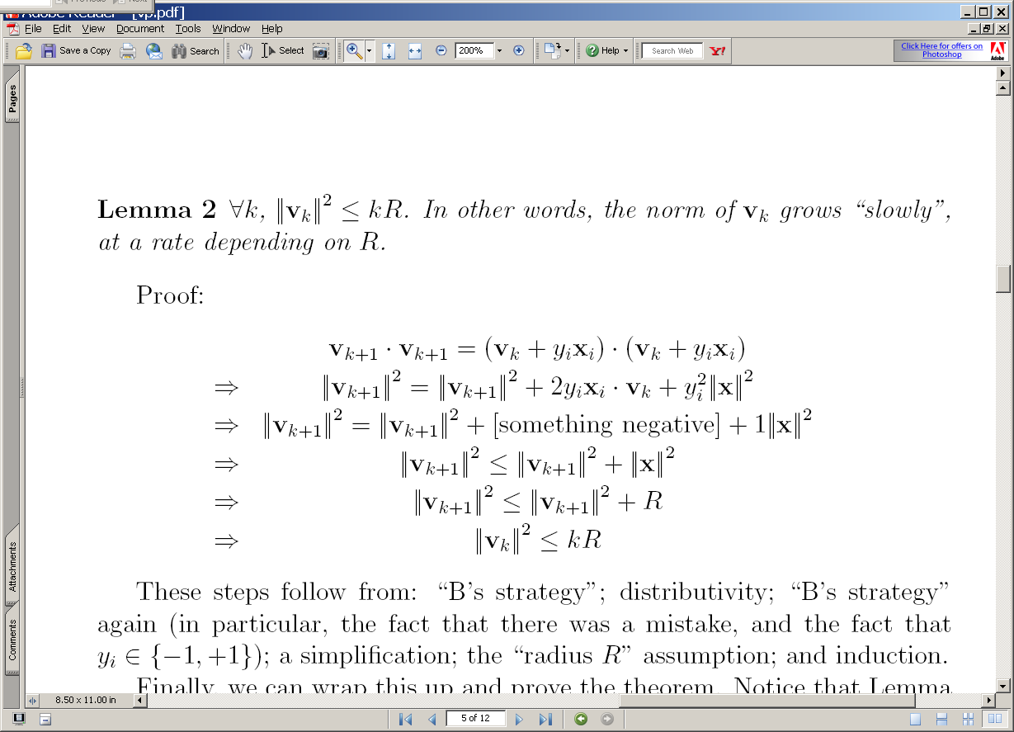
(3a) The guess v₂ after the two positive examples: v₂=v₁+x₂
(3b) The guess v₂ after the one positive and one negative example: v₂=v₁-x₂
u
u
+x₂
v₂
v₂
v₁
v₁
+x₁
-x₂
-u
-u
2γ
2γ

Slide 66
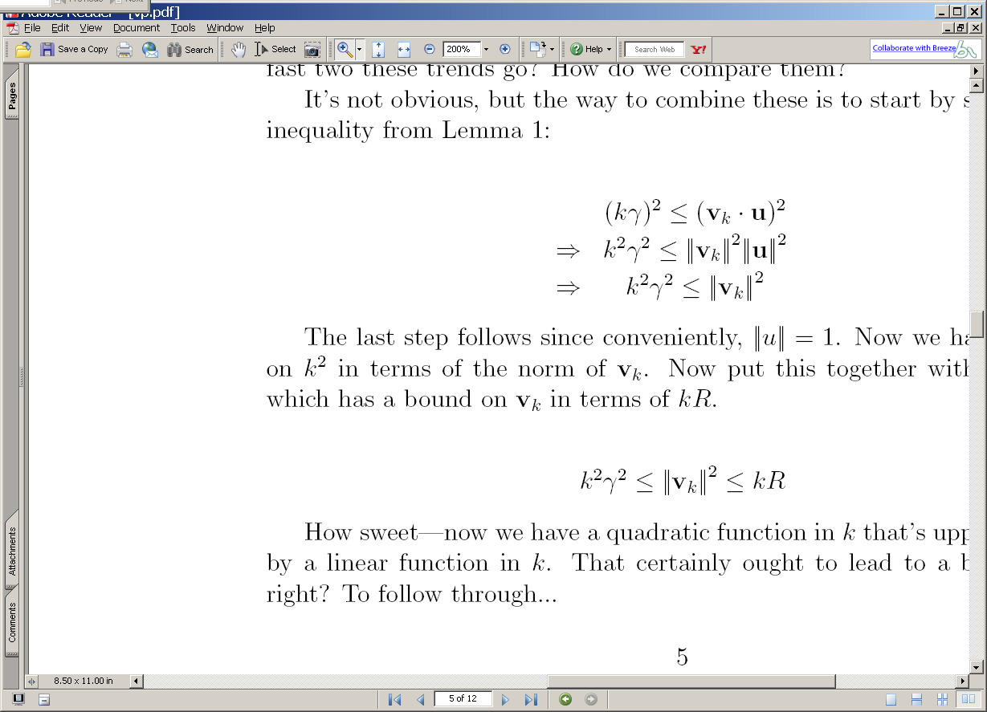
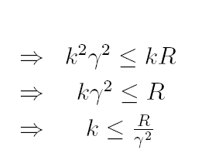
2
2
2
2
2

Slide 67
Summary
We have shown that
If : exists a u with unit norm that has margin γ on examples in the seq (x₁,y₁),(x₂,y₂),….
Then : the perceptron algorithm makes < R²/ γ² mistakes on the sequence (where R >= ||x_{i}||)
Independent of dimension of the data or classifier (!)
This doesn’t follow from M(C)<=VCDim(C)
We don’t know if this algorithm could be better
There are many variants that rely on similar analysis (ROMMA, Passive-Aggressive, MIRA, …)
We don’t know what happens if the data’s not separable
Unless I explain the “Δ trick” to you
We don’t know what classifier to use “after” training

Slide 68
The Δ Trick
Replace x_{i} with x’_{i} so X becomes [X | I Δ]
Replace R² in our bounds with R² + Δ²
Let d_{i} = max(0, γ - y_{i} x_{i} u)
Let u’ = (u₁,…,u_{n}, y₁d₁/Δ, … y_{m}d_{m}/Δ) * 1/Z
So Z=sqrt(1 + D²/ Δ²), for D=sqrt(d₁²+…+d_{m}²)
Mistake bound is (R² + Δ²)Z² / γ²
Let Δ = sqrt(RD) ➔ k <= ((R + D)/ γ)²

Slide 69
Summary
We have shown that
If : exists a u with unit norm that has margin γ on examples in the seq (x₁,y₁),(x₂,y₂),….
Then : the perceptron algorithm makes < R²/ γ² mistakes on the sequence (where R >= ||x_{i}||)
Independent of dimension of the data or classifier (!)
We don’t know what happens if the data’s not separable
Unless I explain the “Δ trick” to you
We don’t know what classifier to use “after” training

Slide 70
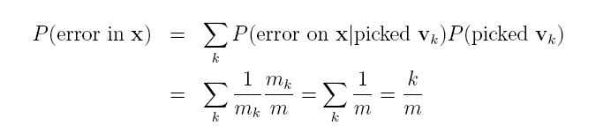
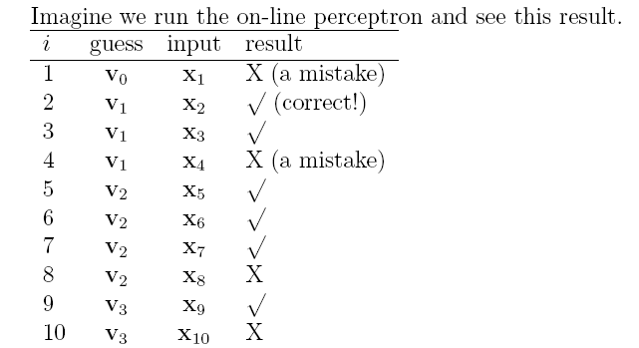
On-line to batch learning
Pick a v_{k} at random according to m_{k}/m, the fraction of examples it was used for.
Predict using the v_{k} you just picked.
(Actually, use some sort of deterministic approximation to this).

Slide 71
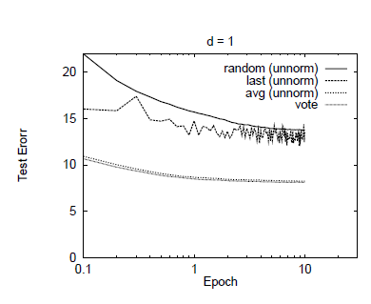

Slide 72
Complexity of perceptron learning
Algorithm:
v=0
for each example x,y:
if sign(v.x) != y
v = v + yx
O(n)
init hashtable
for x_{i}!=0, v_{i} += yx_{i}
O(|x|)=O(|d|)

Slide 73
Complexity of averaged perceptron
Algorithm:
vk=0
va = 0
for each example x,y:
if sign(vk.x) != y
va = va + vk
vk = vk + yx
mk = 1
else
nk++
O(n) O(n|V|)
init hashtables
for vk_{i}!=0, va_{i} += vk_{i}
for x_{i}!=0, v_{i} += yx_{i}
O(|V|)
O(|x|)=O(|d|)

Slide 74
Parallelizing perceptrons
Instances/labels
Split into example subsets
Instances/labels – 1
Instances/labels – 2
Instances/labels – 3
Compute vk’s on subsets
vk/va -1
vk/va- 2
vk/va-3
Combine somehow?
vk
Notes:
Rennie, Shih, Teevan, and Karger (2003) Tackling the Poor Assumptions of Naive Bayes Text Classifiers.
lingpipe-blog.com/.../rennie-shih-teevan-and-karger-2003-tackling-p...
Feb 16, 2009 – Rennie, Shih, Teevan, Karger (2003) Tackling the Poor Assumptions of Naive Bayes Text Classifiers. In ICML. Rennie et al. introduce four ...
Tackling the - AAAI

Slide 75
Parallelizing perceptrons
Instances/labels
Split into example subsets
Instances/labels – 1
Instances/labels – 2
Instances/labels – 3
Compute vk’s on subsets
vk/va -1
vk/va- 2
vk/va-3
Combine somehow
vk/va
Notes:
Rennie, Shih, Teevan, and Karger (2003) Tackling the Poor Assumptions of Naive Bayes Text Classifiers.
lingpipe-blog.com/.../rennie-shih-teevan-and-karger-2003-tackling-p...
Feb 16, 2009 – Rennie, Shih, Teevan, Karger (2003) Tackling the Poor Assumptions of Naive Bayes Text Classifiers. In ICML. Rennie et al. introduce four ...
Tackling the - AAAI

Slide 76
Parallelizing perceptrons
vk/va
Instances/labels
Split into example subsets
Instances/labels – 1
Instances/labels – 2
Instances/labels – 3
Compute vk’s on subsets
vk/va -1
vk/va- 2
vk/va-3
Synchronize with messages
vk/va
Notes:
Rennie, Shih, Teevan, and Karger (2003) Tackling the Poor Assumptions of Naive Bayes Text Classifiers.
lingpipe-blog.com/.../rennie-shih-teevan-and-karger-2003-tackling-p...
Feb 16, 2009 – Rennie, Shih, Teevan, Karger (2003) Tackling the Poor Assumptions of Naive Bayes Text Classifiers. In ICML. Rennie et al. introduce four ...
Tackling the - AAAI

Slide 77
Review/outline
Groundhog Day!
How to implement Naïve Bayes
Time is linear in size of data (one scan!)
We need to count C( X=word ^ Y=label)
Can you parallelize Naïve Bayes?
Trivial solution 1
Split the data up into multiple subsets
Count and total each subset independently
Add up the counts
Result should be the same
This is unusual for streaming learning algorithms
Why? no interaction between feature weight updates
For perceptron that’s not the case

Slide 78
A hidden agenda
Part of machine learning is good grasp of theory
Part of ML is a good grasp of what hacks tend to work
These are not always the same
Especially in big-data situations
Catalog of useful tricks so far
Brute-force estimation of a joint distribution
Naive Bayes
Stream-and-sort, request-and-answer patterns
BLRT and KL-divergence (and when to use them)
TF-IDF weighting – especially IDF
it’s often useful even when we don’t understand why
Perceptron/mistake bound model
often leads to fast, competitive, easy-to-implement methods
parallel versions are non-trivial to implement/understand

