Slide 1
Phrase Finding;
Stream-and-Sort vs
“Request-and-Answer”
William W. Cohen

Slide 2
Outline
Even more on stream-and-sort and naïve Bayes
Another problem: “meaningful” phrase finding
Implementing phrase finding efficiently
Some other phrase-related problems

Slide 3
Last Week
How to implement Naïve Bayes
  Time is linear in size of data (one scan!)
  We need to count C( X=word ^ Y=label)
How to implement Naïve Bayes with large vocabulary and small memory
  General technique: “Stream and sort”
    Very little seeking (only in merges in merge sort)
    Memory-efficient
    Counting, indexing, accumulating word “contexts”, …
    Next week: stream and sort → map-reduce and Hadoop

Slide 4
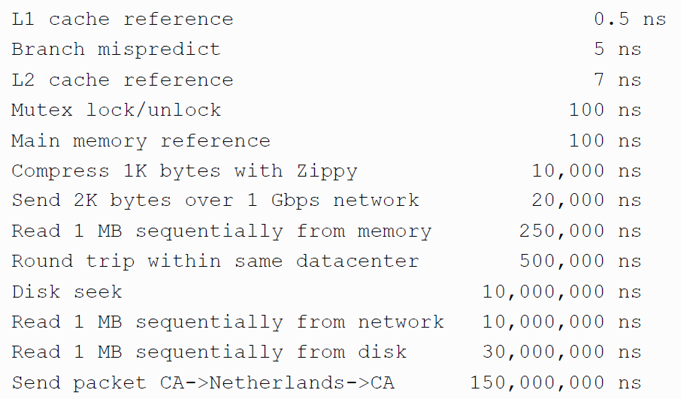
Numbers (Jeff Dean says) Everyone Should Know
~= 10x
~= 15x
40x
~= 100,000x
Notes:
150x – commercial flight vs a brisk walk
100,000x – 5 hr flights would take 57 years
100,000x – 500 miles vs about 8 meters
15,000,000x – here to beijing vs 100 meters

Slide 5
Distributed Counting → Stream and Sort Counting
Hash table1
example 1
example 2
example 3
….
Machine 1
Hash table2
Machine 2
“C[x] +=D”
Message-routing logic
Counting logic
. . .
Hash table2
Machine K
Machine 0

Slide 6
Distributed Counting → Stream and Sort Counting
Communication is limited to one direction
example 1
example 2
example 3
….
C[x1] += D1
C[x1] += D2
….
“C[x] +=D”
Logic to combine counter updates
Sort
Counting logic
Machine A
Machine C
Machine B

Slide 7
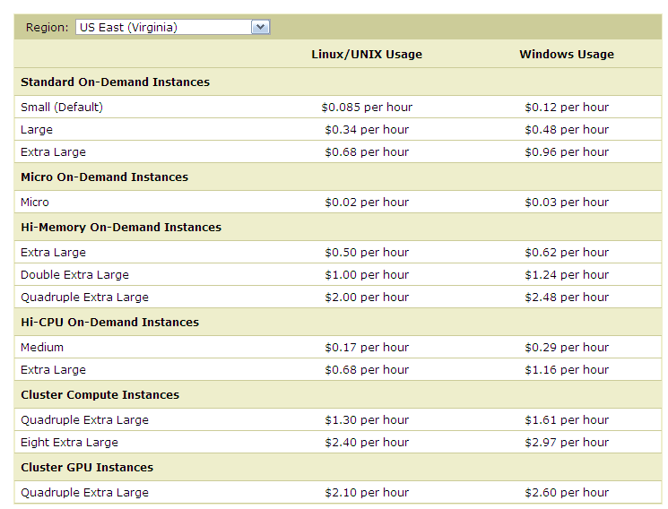
Micro:
0.6G memory
Standard:
S: 1.7Gb
L: 7.5Gb
XL: 15Mb
Hi Memory:
XXL: 34.2
XXXXL: 68.4

Slide 8
Last Week
How to implement Naïve Bayes
  Time is linear in size of data (one scan!)
  We need to count C( X=word ^ Y=label)
How to implement Naïve Bayes with large vocabulary and small memory
  General technique: “Stream and sort”
    Very little seeking (only in merges in merge sort)
    Memory-efficient
    Counting, indexing, accumulating word “contexts”, …
    Next week: stream and sort → map-reduce and Hadoop
End of lecture: the tragic flaw in our implementation!

Slide 9
Large-vocabulary Naïve Bayes is Expensive to Use
For each example id, y, x₁,….,x_{d} in test:
Sort the event-counter update “messages”
Scan and add the sorted messages and output the final counter values
For each example id, y, x₁,….,x_{d} in test:
  For each y’ in dom(Y):
    Compute log Pr(y’,x₁,….,x_{d}) =
Model size: max O(n), O(|V||dom(Y)|)

Slide 10
Large-vocabulary Naïve Bayes is Expensive to Use
For each example id, y, x₁,….,x_{d} in test:
Sort the event-counter update “messages”
Scan and add the sorted messages and output the final counter values
For each example id, y, x₁,….,x_{d} in test:
  For each y’ in dom(Y):
    Compute log Pr(y’,x₁,….,x_{d}) =
Model size: max O(n), O(|V||dom(Y)|)

Slide 11
The workaround I suggested
For each example id, y, x₁,….,x_{d} in test:
Sort the event-counter update “messages”
Scan and add the sorted messages and output the final counter values
Initialize a HashSet NEEDED and a hashtable C
For each example id, y, x₁,….,x_{d} in test:
  Add x₁,….,x_{d} to NEEDED
For each event, C(event) in the summed counters
  If event involves a NEEDED term x read it into C
For each example id, y, x₁,….,x_{d} in test:
  For each y’ in dom(Y):
    Compute log Pr(y’,x₁,….,x_{d}) = ….

Slide 12
Can we do better?
Test data
Event counts
id₁ w_{1,1} w_{1,2} w_{1,3} …. w_{1,k1}
id₂ w_{2,1} w_{2,2} w_{2,3} ….
id₃ w_{3,1} w_{3,2} ….
id₄ w_{4,1} w_{4,2} …
id₅ w_{5,1} w_{5,2} ….
..
X=w₁^Y=sports
X=w₁^Y=worldNews
X=..
X=w₂^Y=…
X=…
…
5245
1054
2120
37
3
…
What we’d like
id₁ w_{1,1} w_{1,2} w_{1,3} …. w_{1,k1}
id₂ w_{2,1} w_{2,2} w_{2,3} ….
id₃ w_{3,1} w_{3,2} ….
id₄ w_{4,1} w_{4,2} …
C[X=w_{1,1}^Y=sports]=5245, C[X=w_{1,1}^Y=..],C[X=w_{1,2}^…]
C[X=w_{2,1}^Y=….]=1054,…, C[X=w_{2,k2}^…]
C[X=w_{3,1}^Y=….]=…
…

Slide 13
Can we do better?
Event counts
X=w₁^Y=sports
X=w₁^Y=worldNews
X=..
X=w₂^Y=…
X=…
…
5245
1054
2120
37
3
…
Step 1: group counters by word w
How:
Stream and sort:
  for each C[X=w^Y=y]=n
    print “w C[Y=y]=n”
  sort and build a list of values associated with each key w
w | Counts associated with W
aardvark | C[w^Y=sports]=2
agent | C[w^Y=sports]=1027,C[w^Y=worldNews]=564
… | …
zynga | C[w^Y=sports]=21,C[w^Y=worldNews]=4464

Slide 14
If these records were in a key-value DB we would know what to do….
Test data
Record of all event counts for each word
id₁ w_{1,1} w_{1,2} w_{1,3} …. w_{1,k1}
id₂ w_{2,1} w_{2,2} w_{2,3} ….
id₃ w_{3,1} w_{3,2} ….
id₄ w_{4,1} w_{4,2} …
id₅ w_{5,1} w_{5,2} ….
..
w | Counts associated with W
aardvark | C[w^Y=sports]=2
agent | C[w^Y=sports]=1027,C[w^Y=worldNews]=564
… | …
zynga | C[w^Y=sports]=21,C[w^Y=worldNews]=4464
Step 2: stream through and for each test case
id_{i} w_{i,1} w_{i,2} w_{i,3} …. w_{i,ki}
request the event counters needed to classify id_{i} from the event-count DB, then classify using the answers
Classification logic

Slide 15
Is there a stream-and-sort analog of this request-and-answer pattern?
Test data
Record of all event counts for each word
id₁ w_{1,1} w_{1,2} w_{1,3} …. w_{1,k1}
id₂ w_{2,1} w_{2,2} w_{2,3} ….
id₃ w_{3,1} w_{3,2} ….
id₄ w_{4,1} w_{4,2} …
id₅ w_{5,1} w_{5,2} ….
..
w | Counts associated with W
aardvark | C[w^Y=sports]=2
agent | C[w^Y=sports]=1027,C[w^Y=worldNews]=564
… | …
zynga | C[w^Y=sports]=21,C[w^Y=worldNews]=4464
Step 2: stream through and for each test case
id_{i} w_{i,1} w_{i,2} w_{i,3} …. w_{i,ki}
request the event counters needed to classify id_{i} from the event-count DB, then classify using the answers
Classification logic

Slide 16
Recall: Stream and Sort Counting: sort messages so the recipient can stream through them
example 1
example 2
example 3
….
C[x1] += D1
C[x1] += D2
….
“C[x] +=D”
Logic to combine counter updates
Sort
Counting logic
Machine A
Machine C
Machine B

Slide 17
Is there a stream-and-sort analog of this request-and-answer pattern?
Test data
Record of all event counts for each word
id₁ w_{1,1} w_{1,2} w_{1,3} …. w_{1,k1}
id₂ w_{2,1} w_{2,2} w_{2,3} ….
id₃ w_{3,1} w_{3,2} ….
id₄ w_{4,1} w_{4,2} …
id₅ w_{5,1} w_{5,2} ….
..
w | Counts associated with W
aardvark | C[w^Y=sports]=2
agent | C[w^Y=sports]=1027,C[w^Y=worldNews]=564
… | …
zynga | C[w^Y=sports]=21,C[w^Y=worldNews]=4464
W_{1,1} counters to id₁
W_{1,2} counters to id₂
…
W_{i,j} counters to id_{i}
…
Classification logic

Slide 18
Is there a stream-and-sort analog of this request-and-answer pattern?
Test data
Record of all event counts for each word
id₁ found an aarvark in zynga’s farmville today!
id₂ …
id₃ ….
id₄ …
id₅ …
..
w | Counts associated with W
aardvark | C[w^Y=sports]=2
agent | C[w^Y=sports]=1027,C[w^Y=worldNews]=564
… | …
zynga | C[w^Y=sports]=21,C[w^Y=worldNews]=4464
found ctr to id₁
aardvark ctr to id₁
…
today ctr to id₁
…
Classification logic

Slide 19
Is there a stream-and-sort analog of this request-and-answer pattern?
Test data
Record of all event counts for each word
id₁ found an aarvark in zynga’s farmville today!
id₂ …
id₃ ….
id₄ …
id₅ …
..
w | Counts associated with W
aardvark | C[w^Y=sports]=2
agent | C[w^Y=sports]=1027,C[w^Y=worldNews]=564
… | …
zynga | C[w^Y=sports]=21,C[w^Y=worldNews]=4464
~ is the last ascii character
% export LC_COLLATE=C
means that it will sort after anything else with unix sort
found ~ctr to id₁
aardvark ~ctr to id₁
…
today ~ctr to id₁
…
Classification logic

Slide 20
Is there a stream-and-sort analog of this request-and-answer pattern?
Test data
Record of all event counts for each word
id₁ found an aardvark in zynga’s farmville today!
id₂ …
id₃ ….
id₄ …
id₅ …
..
w | Counts associated with W
aardvark | C[w^Y=sports]=2
agent | C[w^Y=sports]=1027,C[w^Y=worldNews]=564
… | …
zynga | C[w^Y=sports]=21,C[w^Y=worldNews]=4464
Counter records
found ~ctr to id₁
aardvark ~ctr to id₂
…
today ~ctr to id_{i}
…
Classification logic
Combine and sort
requests

Slide 21
A stream-and-sort analog of the request-and-answer pattern…
w | Counts
aardvark | C[w^Y=sports]=2
aardvark | ~ctr to id1
agent | C[w^Y=sports]=…
agent | ~ctr to id345
agent | ~ctr to id9854
… | ~ctr to id345
agent | ~ctr to id34742
…
zynga | C[…]
zynga | ~ctr to id1
Record of all event counts for each word
w | Counts
aardvark | C[w^Y=sports]=2
agent | …
…
zynga | …
Counter records
found ~ctr to id₁
aardvark ~ctr to id₁
…
today ~ctr to id₁
…
Combine and sort
Request-handling logic
requests

Slide 22
A stream-and-sort analog of the request-and-answer pattern…
w | Counts
aardvark | C[w^Y=sports]=2
aardvark | ~ctr to id1
agent | C[w^Y=sports]=…
agent | ~ctr to id345
agent | ~ctr to id9854
… | ~ctr to id345
agent | ~ctr to id34742
…
zynga | C[…]
zynga | ~ctr to id1
previousKey = somethingImpossible
For each (key,val) in input:
  If key==previousKey
    Answer(recordForPrevKey,val)
  Else
    previousKey = key
    recordForPrevKey = val
define Answer(record,request):
find id where “request = ~ctr to id”
print “id ~ctr for request is record”
Combine and sort
Request-handling logic
requests

Slide 23
A stream-and-sort analog of the request-and-answer pattern…
w | Counts
aardvark | C[w^Y=sports]=2
aardvark | ~ctr to id1
agent | C[w^Y=sports]=…
agent | ~ctr to id345
agent | ~ctr to id9854
… | ~ctr to id345
agent | ~ctr to id34742
…
zynga | C[…]
zynga | ~ctr to id1
previousKey = somethingImpossible
For each (key,val) in input:
  If key==previousKey
    Answer(recordForPrevKey,val)
  Else
    previousKey = key
    recordForPrevKey = val
define Answer(record,request):
find id where “request = ~ctr to id”
print “id ~ctr for request is record”
Output:
id1 ~ctr for aardvark is C[w^Y=sports]=2
…
id1 ~ctr for zynga is ….
…
Combine and sort
Request-handling logic
requests

Slide 24
A stream-and-sort analog of the request-and-answer pattern…
w | Counts
aardvark | C[w^Y=sports]=2
aardvark | ~ctr to id1
agent | C[w^Y=sports]=…
agent | ~ctr to id345
agent | ~ctr to id9854
… | ~ctr to id345
agent | ~ctr to id34742
…
zynga | C[…]
zynga | ~ctr to id1
Output:
id1 ~ctr for aardvark is C[w^Y=sports]=2
…
id1 ~ctr for zynga is ….
…
id₁ found an aardvark in zynga’s farmville today!
id₂ …
id₃ ….
id₄ …
id₅ …
..
Request-handling logic
Combine and sort
????

Slide 25
What we’d wanted
id₁ w_{1,1} w_{1,2} w_{1,3} …. w_{1,k1}
id₂ w_{2,1} w_{2,2} w_{2,3} ….
id₃ w_{3,1} w_{3,2} ….
id₄ w_{4,1} w_{4,2} …
C[X=w_{1,1}^Y=sports]=5245, C[X=w_{1,1}^Y=..],C[X=w_{1,2}^…]
C[X=w_{2,1}^Y=….]=1054,…, C[X=w_{2,k2}^…]
C[X=w_{3,1}^Y=….]=…
…
What we ended up with
Key | Value
id1 | found aardvark zynga farmville today
 | ~ctr for aardvark is C[w^Y=sports]=2
 | ~ctr for found is C[w^Y=sports]=1027,C[w^Y=worldNews]=564
 | …
id2 | w_{2,1} w_{2,2} w_{2,3} ….
 | ~ctr for w_{2,1} is …
… | …

Slide 26
Implementation summary
java CountForNB train.dat … > eventCounts.dat
java CountsByWord eventCounts.dat | sort
| java CollectRecords > words.dat
java requestWordCounts test.dat
| tee words.dat | sort | java answerWordCountRequests
| tee test.dat| sort | testNBUsingRequests
train.dat
counts.dat
id₁ w_{1,1} w_{1,2} w_{1,3} …. w_{1,k1}
id₂ w_{2,1} w_{2,2} w_{2,3} ….
id₃ w_{3,1} w_{3,2} ….
id₄ w_{4,1} w_{4,2} …
id₅ w_{5,1} w_{5,2} ….
..
X=w1^Y=sports
X=w1^Y=worldNews
X=..
X=w2^Y=…
X=…
…
5245
1054
2120
37
3
…

Slide 27
Implementation summary
java CountForNB train.dat … > eventCounts.dat
java CountsByWord eventCounts.dat | sort
| java CollectRecords > words.dat
java requestWordCounts test.dat
| tee words.dat | sort | java answerWordCountRequests
| tee test.dat| sort | testNBUsingRequests
words.dat
w | Counts associated with W
aardvark | C[w^Y=sports]=2
agent | C[w^Y=sports]=1027,C[w^Y=worldNews]=564
… | …
zynga | C[w^Y=sports]=21,C[w^Y=worldNews]=4464

Slide 28
Implementation summary
java CountForNB train.dat … > eventCounts.dat
java CountsByWord eventCounts.dat | sort
| java CollectRecords > words.dat
java requestWordCounts test.dat
| tee words.dat | sort | java answerWordCountRequests
| tee test.dat| sort | testNBUsingRequests
output looks like this
input looks like this
words.dat
found ~ctr to id₁
aardvark ~ctr to id₂
…
today ~ctr to id_{i}
…
w | Counts
aardvark | C[w^Y=sports]=2
agent | …
…
zynga | …
w | Counts
aardvark | C[w^Y=sports]=2
aardvark | ~ctr to id1
agent | C[w^Y=sports]=…
agent | ~ctr to id345
agent | ~ctr to id9854
… | ~ctr to id345
agent | ~ctr to id34742
…
zynga | C[…]
zynga | ~ctr to id1

Slide 29
Implementation summary
java CountForNB train.dat … > eventCounts.dat
java CountsByWord eventCounts.dat | sort
| java CollectRecords > words.dat
java requestWordCounts test.dat
| tees words.dat | sort | java answerWordCountRequests
| tee test.dat| sort | testNBUsingRequests
Output looks like this
Output:
id1 ~ctr for aardvark is C[w^Y=sports]=2
…
id1 ~ctr for zynga is ….
…
test.dat
id₁ found an aardvark in zynga’s farmville today!
id₂ …
id₃ ….
id₄ …
id₅ …
..

Slide 30
Implementation summary
java CountForNB train.dat … > eventCounts.dat
java CountsByWord eventCounts.dat | sort
| java CollectRecords > words.dat
java requestWordCounts test.dat
| tees words.dat | sort | java answerWordCountRequests
| tee test.dat| sort | testNBUsingRequests
Input looks like this
Key | Value
id1 | found aardvark zynga farmville today
 | ~ctr for aardvark is C[w^Y=sports]=2
 | ~ctr for found is C[w^Y=sports]=1027,C[w^Y=worldNews]=564
 | …
id2 | w_{2,1} w_{2,2} w_{2,3} ….
 | ~ctr for w_{2,1} is …
… | …

Slide 31
Outline
Even more on stream-and-sort and naïve Bayes
Another problem: “meaningful” phrase finding
Implementing phrase finding efficiently
Some other phrase-related problems

Slide 32
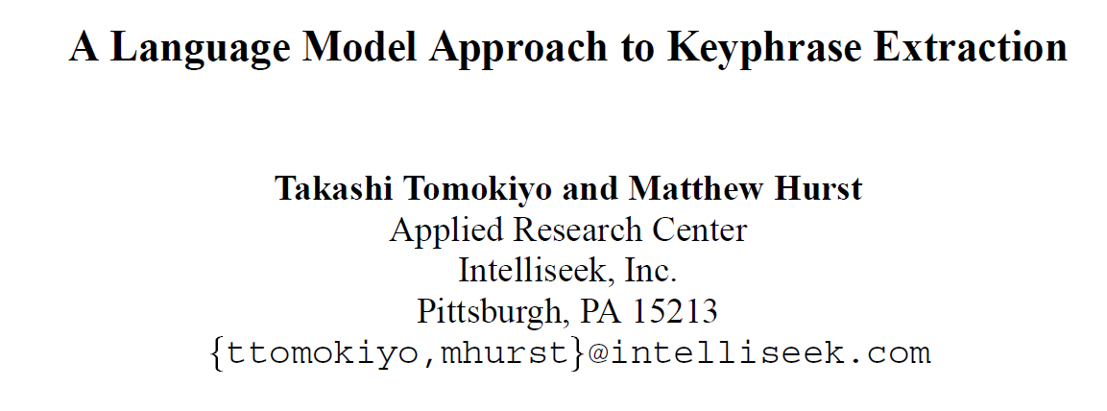
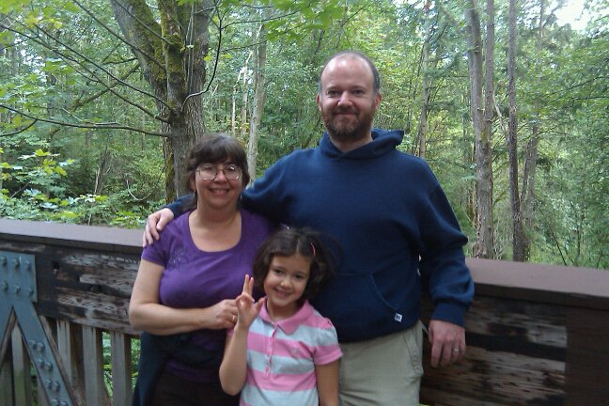
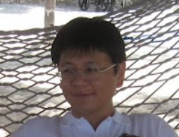


Slide 33
ACL Workshop 2003

Slide 34
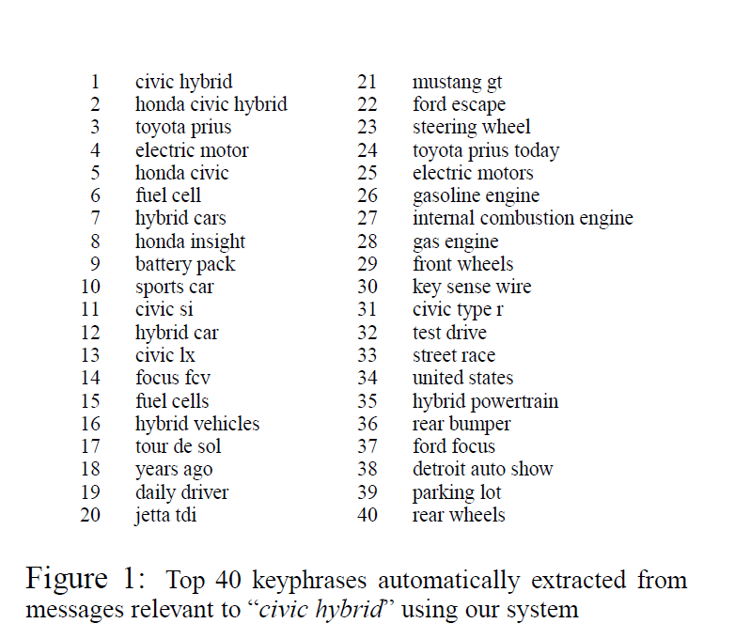

Slide 35
Why phrase-finding?
There are lots of phrases
There’s not supervised data
It’s hard to articulate
  What makes a phrase a phrase, vs just an n-gram?
    a phrase is independently meaningful (“test drive”, “red meat”) or not (“are interesting”, “are lots”)
  What makes a phrase interesting?

Slide 36
The breakdown: what makes a good phrase
Two properties:
  Phraseness: “the degree to which a given word sequence is considered to be a phrase”
    Statistics: how often words co-occur together vs separately
  Informativeness: “how well a phrase captures or illustrates the key ideas in a set of documents” – something novel and important relative to a domain
    Background corpus and foreground corpus; how often phrases occur in each

Slide 37
“Phraseness”₁ – based on BLRT
Binomial Ratio Likelihood Test (BLRT):
  Draw samples:
    n₁ draws, k₁ successes
    n₂ draws, k₂ successes
    Are they from one binominal (i.e., k₁/n₁ and k₂/n₂ were different due to chance) or from two distinct binomials?
  Define
    p_{i}=k_{i} / n_{i}, p=(k₁+k²)/(n₁+n₂),
    L(p,k,n) = p^{k}(1-p)^{n-k}

Slide 38
“Phraseness”₁ – based on BLRT
Binomial Ratio Likelihood Test (BLRT):
  Draw samples:
    n₁ draws, k₁ successes
    n₂ draws, k₂ successes
    Are they from one binominal (i.e., k₁/n₁ and k₂/n₂ were different due to chance) or from two distinct binomials?
  Define
    p_{i}=k_{i}/n_{i}, p=(k₁+k²)/(n₁+n₂),
    L(p,k,n) = p^{k}(1-p)^{n-k}

Slide 39
“Phraseness”₁ – based on BLRT
  Define
    p_{i}=k_{i} /n_{i}, p=(k₁+k²)/(n₁+n₂),
    L(p,k,n) = p^{k}(1-p)^{n-k}
Phrase x y: W₁=x ^ W₂=y
 |  | comment
k₁ | C(W₁=x ^ W₂=y) | how often bigram x y occurs in corpus C
n₁ | C(W₁=x) | how often word x occurs in corpus C
k₂ | C(W₁≠x^W₂=y) | how often y occurs in C after a non-x
n₂ | C(W₁≠x) | how often a non-x occurs in C
Does y occur at the same frequency after x as in other positions?

Slide 40
“Informativeness”₁ – based on BLRT
  Define
    p_{i}=k_{i} /n_{i}, p=(k₁+k²)/(n₁+n₂),
    L(p,k,n) = p^{k}(1-p)^{n-k}
Phrase x y: W₁=x ^ W₂=y and two corpora, C and B
 |  | comment
k₁ | C(W₁=x ^ W₂=y) | how often bigram x y occurs in corpus C
n₁ | C(W₁=* ^ W₂=*) | how many bigrams in corpus C
k₂ | B(W₁=x^W₂=y) | how often x y occurs in background corpus
n₂ | B(W₁=* ^ W₂=*) | how many bigrams in background corpus
Does x y occur at the same frequency in both corpora?

Slide 41
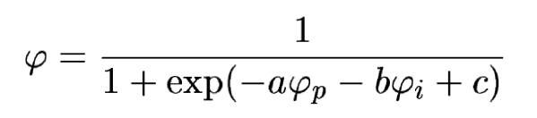
The breakdown: what makes a good phrase
“Phraseness” and “informativeness” are then combined with a tiny classifier, tuned on labeled data.
Background corpus: 20 newsgroups dataset (20k messages, 7.4M words)
Foreground corpus: rec.arts.movies.current-films June-Sep 2002 (4M words)
Results?

Slide 42
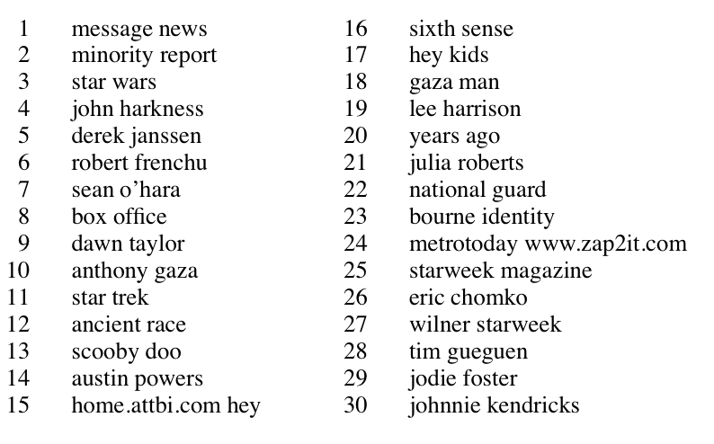

Slide 43
The breakdown: what makes a good phrase
Two properties:
  Phraseness: “the degree to which a given word sequence is considered to be a phrase”
    Statistics: how often words co-occur together vs separately
  Informativeness: “how well a phrase captures or illustrates the key ideas in a set of documents” – something novel and important relative to a domain
    Background corpus and foreground corpus; how often phrases occur in each
  Another intuition: our goal is to compare distributions and see how different they are:
    Phraseness: estimate x y with bigram model or unigram model
    Informativeness: estimate with foreground vs background corpus

Slide 44


The breakdown: what makes a good phrase
  Another intuition: our goal is to compare distributions and see how different they are:
    Phraseness: estimate x y with bigram model or unigram model
    Informativeness: estimate with foreground vs background corpus
  To compare distributions, use KL-divergence
“Pointwise KL divergence”

Slide 45

The breakdown: what makes a good phrase
  To compare distributions, use KL-divergence
Phraseness: difference between bigram and unigram language model in foreground
“Pointwise KL divergence”
Bigram model: P(x y)=P(x)P(y|x)
Unigram model: P(x y)=P(x)P(y)

Slide 46
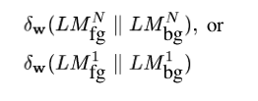

The breakdown: what makes a good phrase
  To compare distributions, use KL-divergence
Informativeness: difference between foreground and background models
“Pointwise KL divergence”
Bigram model: P(x y)=P(x)P(y|x)
Unigram model: P(x y)=P(x)P(y)

Slide 47
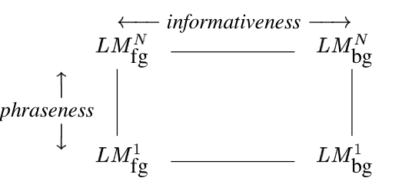
The breakdown: what makes a good phrase
  To compare distributions, use KL-divergence
Combined: difference between foreground bigram model and background unigram model
“Pointwise KL divergence”
Bigram model: P(x y)=P(x)P(y|x)
Unigram model: P(x y)=P(x)P(y)

Slide 48
The breakdown: what makes a good phrase
  To compare distributions, use KL-divergence
Subtle advantages:
BLRT scores “more frequent in foreground” and “more frequent in background” symmetrically, pointwise KL does not.
Phrasiness and informativeness scores are more comparable – straightforward combination w/o a classifier is reasonable.
Language modeling is well-studied:
  extensions to n-grams, smoothing methods, …
  we can build on this work in a modular way
Combined: difference between foreground bigram model and background unigram model

Slide 49
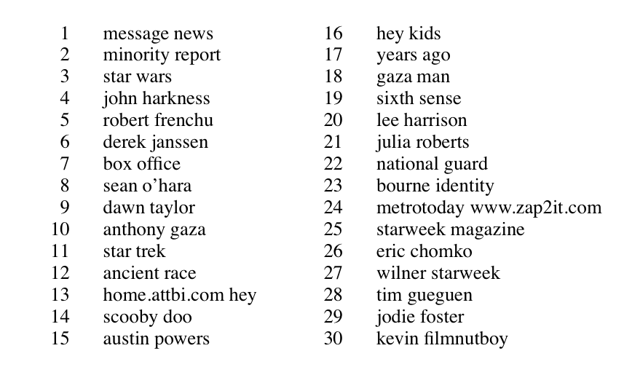
Pointwise KL, combined
Notes:
pointwise KL combined

Slide 50
Why phrase-finding?
Phrases are where the standard supervised “bag of words” representation starts to break.
There’s not supervised data, so it’s hard to see what’s “right” and why
It’s a nice example of using unsupervised signals to solve a task that could be formulated as supervised learning
It’s a nice level of complexity, if you want to do it in a scalable way.

Slide 51
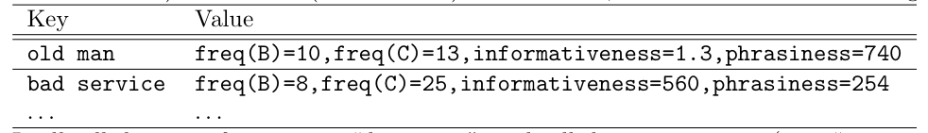
Implementation
Request-and-answer pattern
  Main data structure: tables of key-value pairs
    key is a phrase x y
    value is a mapping from a attribute names (like phraseness, freq-in-B, …) to numeric values.
  Keys and values are just strings
  We’ll operate mostly by sending messages to this data structure and getting results back, or else streaming thru the whole table
  For really big data: we’d also need tables where key is a word and val is set of attributes of the word (freq-in-B, freq-in-C, …)

Slide 52
Generating and scoring phrases: 1
Stream through foreground corpus and count events “W₁=x ^ W₂=y” the same way we do in training naive Bayes: stream-and sort and accumulate deltas (a “sum-reduce”)
  Don’t bother generating boring phrases (e.g., crossing a sentence, contain a stopword, …)
Then stream through the output and convert to phrase, attributes-of-phrase records with one attribute: freq-in-C=n
Stream through foreground corpus and count events “W₁=x” in a (memory-based) hashtable….
This is enough* to compute phrasiness:
  ψ_{p}(x y) = f( freq-in-C(x), freq-in-C(y), freq-in-C(x y))
…so you can do that with a scan through the phrase table that adds an extra attribute (holding word frequencies in memory).
* actually you also need total # words and total #phrases….

Slide 53
Generating and scoring phrases: 2
Stream through background corpus and count events “W₁=x ^ W₂=y” and convert to phrase, attributes-of-phrase records with one attribute: freq-in-B=n
Sort the two phrase-tables: freq-in-B and freq-in-C and run the output through another “reducer” that
  appends together all the attributes associated with the same key, so we now have elements like

Slide 54
Generating and scoring phrases: 3
Scan the through the phrase table one more time and add the informativeness attribute and the overall quality attribute
Summary, assume word vocabulary n_{W} is small:
Scan foreground corpus C for phrases: O(n_{C}) producing m_{C} phrase records – of course m_{C} << n_{C}
Compute phrasiness: O(m_{C})
Scan background corpus B for phrases: O(n_{B}) producing m_{B}
Sort together and combine records: O(m log m), m=m_{B} + m_{C}
Compute informativeness and combined quality: O(m)
Assumes word counts fit in memory

Slide 55
Ramping it up – keeping word counts out of memory
Goal: records for xy with attributes freq-in-B, freq-in-C, freq-of-x-in-C, freq-of-y-in-C, …
Assume I have built built phrase tables and word tables….how do I incorporate the word attributes into the phrase records?
For each phrase xy, request necessary word frequencies:
  Print “x ~request=freq-in-C,from=xy”
  Print “y ~request=freq-in-C,from=xy”
Sort all the word requests in with the word tables
Scan through the result and generate the answers: for each word w, a₁=n₁,a₂=n₂,….
  Print “xy ~request=freq-in-C,from=w”
Sort the answers in with the xy records
Scan through and augment the xy records appropriately

Slide 56
Generating and scoring phrases: 3
Summary
Scan foreground corpus C for phrases, words: O(n_{C})
  producing m_{C} phrase records, v_{C} word records
Scan phrase records producing word-freq requests: O(m_{C} )
  producing 2m_{C} requests
Sort requests with word records: O((2m_{C} + v_{C} )log(2m_{C} + v_{C}))
= O(m_{C}log m_{C}) since v_{C} < m_{C}
Scan through and answer requests: O(m_{C})
Sort answers with phrase records: O(m_{C}log m_{C})
Repeat 1-5 for background corpus: O(n_{B} + m_{B}logm_{B})
Combine the two phrase tables: O(m log m), m = m_{B} + m_{C}
Compute all the statistics: O(m)

Slide 57
More cool work with phrases
Turney: Thumbs up or thumbs down?: semantic orientation applied to unsupervised classification of reviews.ACL ‘02.
Task: review classification (65-85% accurate, depending on domain)
  Identify candidate phrases (e.g., adj-noun bigrams, using POS tags)
  Figure out the semantic orientation of each phrase using “pointwise mutual information” and aggregate
SO(phrase) = PMI(phrase,'excellent') − PMI(phrase,'poor')

Slide 58
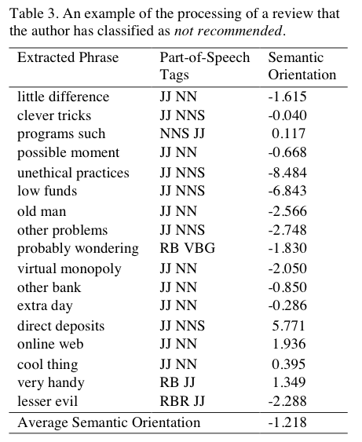
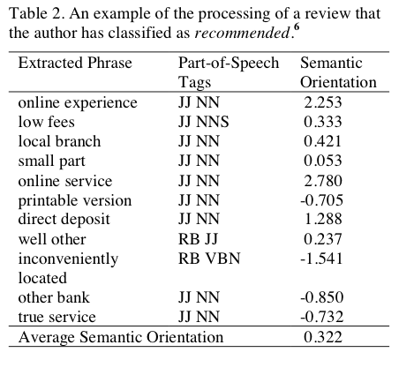

Slide 59
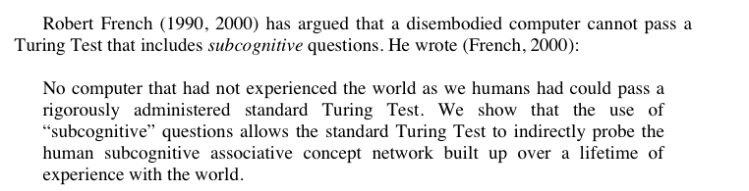
“Answering Subcognitive Turing Test Questions: A Reply to French” - Turney

Slide 60
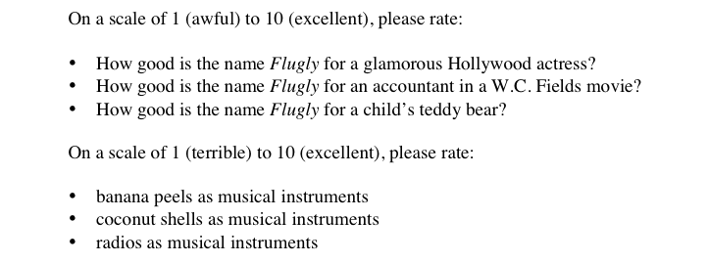
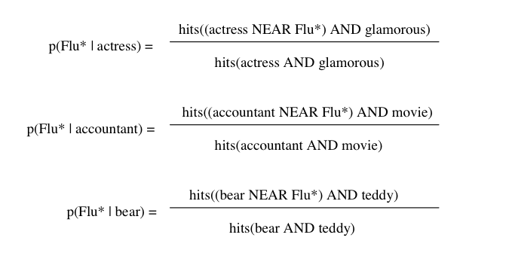
More from Turney
LOW
HIGHER
HIGHEST

Slide 61
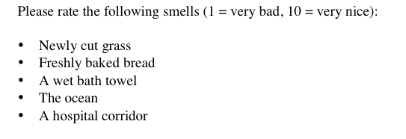

Slide 62
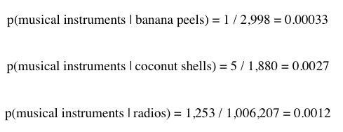

Slide 63
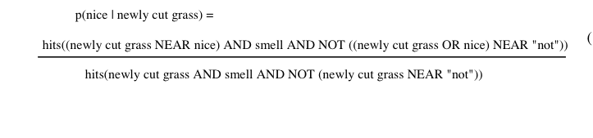
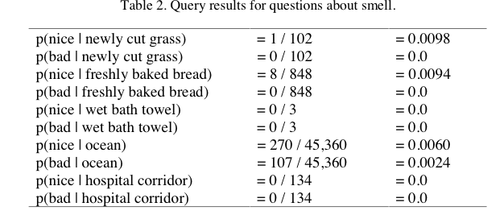

Slide 64
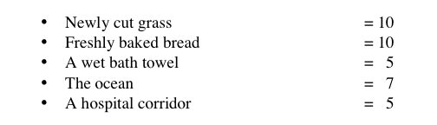

Slide 65


More cool work with phrases
Locating Complex Named Entities in Web Text. Doug Downey, Matthew Broadhead, and Oren Etzioni, IJCAI 2007.
Task: identify complex named entities like “Proctor and Gamble”, “War of 1812”, “Dumb and Dumber”, “Secretary of State William Cohen”, …
Formulation: decide whether to or not to merge nearby sequences of capitalized words axb, using variant of
For k=1, ck is PM (w/o the log). For k=2, ck is “Symmetric Conditional Probability”

Slide 66
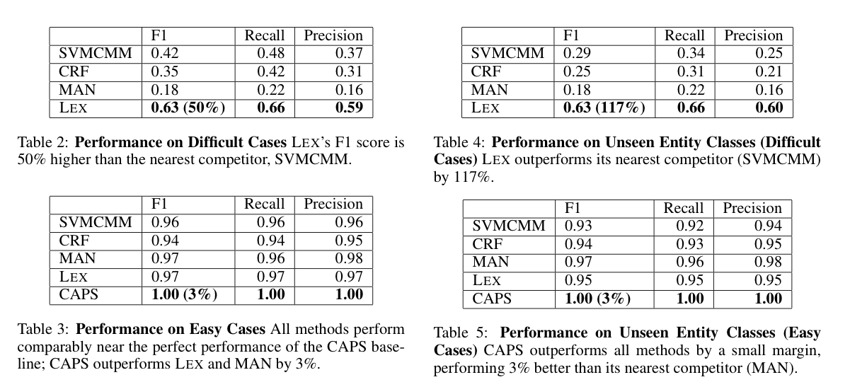
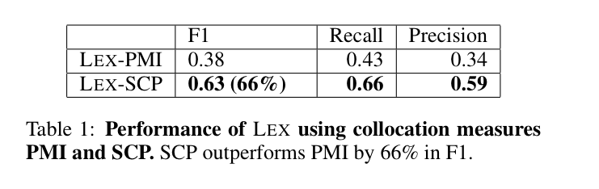
Downey et al results

Slide 67
Outline
Even more on stream-and-sort and naïve Bayes
  Request-answer pattern
Another problem: “meaningful” phrase finding
  Statistics for identifying phrases (or more generally correlations and differences)
  Also using foreground and background corpora
Implementing “phrase finding” efficiently
  Using request-answer
Some other phrase-related problems
  Semantic orientation
  Complex named entity recognition

