Slide 1
Naïve Bayes for Large Vocabularies
William W. Cohen

Slide 2
Summary to date
Computational complexity: what and how to count
  Memory vs disk access
  Cost of scanning vs seeks for disk (and memory)
Probability review
Classification with a “density estimator”
Naïve Bayes as a density estimator/classifier
How to evaluate classifiers and density estimators
How to implement Naïve Bayes
  Time is linear in size of data (one scan!)
  Assuming the event counters fit in memory
  We need to count
  C(Y=label), C( X=word ^ Y=label), C(X=word)

Slide 3
Today
Naïve Bayes with huge feature sets
  i.e. ones that don’t fit in memory
Pros and cons of possible approaches
  Traditional “DB” (actually, key-value store)
  Memory-based distributed DB
  Stream-and-sort counting
Optimizations
Other tasks for stream-and-sort
A detail about large-vocabulary Naïve Bayes…..

Slide 4
Complexity of Naïve Bayes
Assume hashtable holding all counts fits in memory
Sequential reads
You have a train dataset and a test dataset
Initialize an “event counter” (hashtable) C
For each example id, y, x₁,….,x_{d} in train:
  C(“Y=ANY”) ++; C(“Y=y”) ++
  For j in 1..d:
    C(“Y=y ^ X=x_{j}”) ++
For each example id, y, x₁,….,x_{d} in test:
  For each y’ in dom(Y):
    Compute log Pr(y’,x₁,….,x_{d}) =
  Return the best y’
Complexity: O(n), n=size of train
where:
q_{j} = 1/|V|
q_{y} = 1/|dom(Y)|
m=1
Sequential reads
Complexity: O(|dom(Y)|*n’), n’=size of test

Slide 5
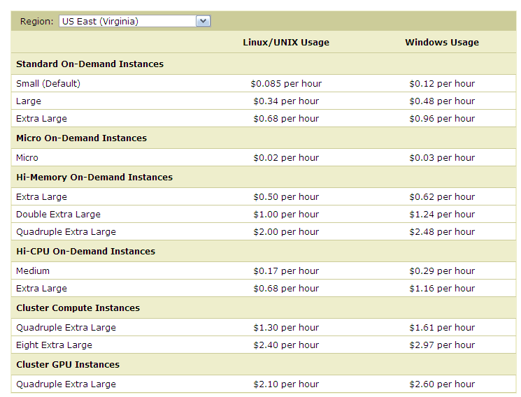
What’s next
How to implement Naïve Bayes
  Assuming the event counters do not fit in memory
Why?
Micro:
0.6G memory
Standard:
S: 1.7Gb
L: 7.5Gb
XL: 15Mb
Hi Memory:
XXL: 34.2
XXXXL: 68.4

Slide 6
What’s next
How to implement Naïve Bayes
  Assuming the event counters do not fit in memory
Why?
  Zipf’s law: many words that you see, you don’t see often.

Slide 7
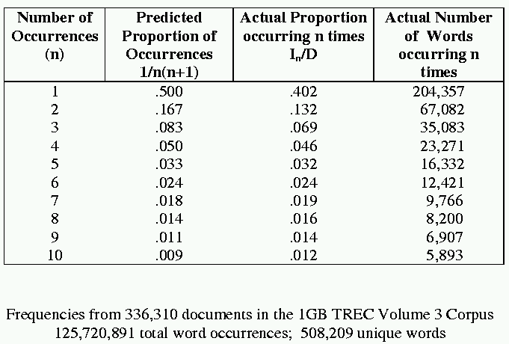
[Via Bruce Croft]

Slide 8
What’s next
How to implement Naïve Bayes
  Assuming the event counters do not fit in memory
Why?
Heaps’ Law: If V is the size of the vocabulary and the n is the length of the corpus in words:
Typical constants:
  K ≈ 1/10−1/100
  β ≈ 0.4−0.6 (approx. square-root)
Why?
  Proper names, missspellings, neologisms, …
Summary:
  For text classification for a corpus with O(n) words, expect to use O(sqrt(n)) storage for vocabulary.
  Scaling might be worse for other cases (e.g., hypertext, phrases, …)

Slide 9

What’s next
How to implement Naïve Bayes
  Assuming the event counters do not fit in memory
Possible approaches:
  Use a database? (or at least a key-value store)

Slide 10
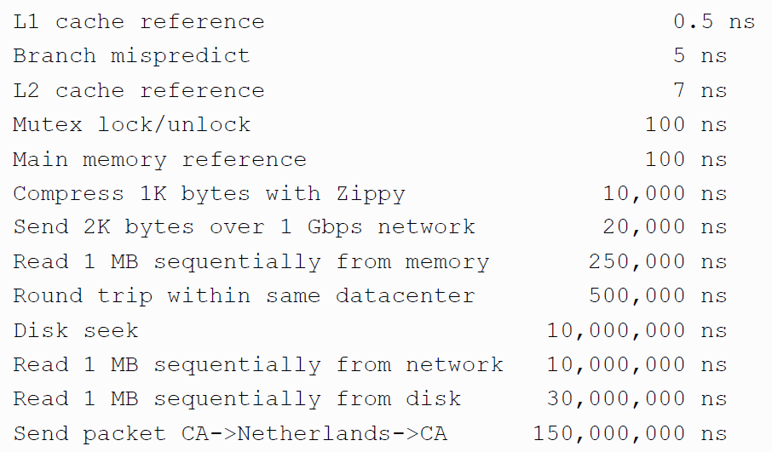
Numbers (Jeff Dean says) Everyone Should Know
~= 10x
~= 15x
40x
~= 100,000x
Notes:
150x – commercial flight vs a brisk walk
100,000x – 5 hr flights would take 57 years
100,000x – 500 miles vs about 8 meters
15,000,000x – here to beijing vs 100 meters

Slide 11
Using a database for Big ML
We often want to do random access on big data
  E.g., different versions of examples for q/a
  E.g., spot-checking parameter weights to see if they are sensible
Simplest approach:
  Sort the data and use binary search ➔ O(log₂n) seeks to find query row

Slide 12
Using a database for Big ML
We often want to do random access on big data
  E.g., different versions of examples for q/a
  E.g., spot-checking parameter weights to see if they are sensible
Almost-as-simple idea based on fact that disk seek time ~= reading 1Mb
  Let K=rows/Mb (e.g., K=1000)
  Scan through data once and record the seek position of every K-th row in an index file (or memory)
  To find row r:
    Find the r’, last item in the index smaller than r
    Seek to r’ and read the next megabyte
Cheap since index is size n/1000
Cost is ~= 2 seeks

Slide 13
A simple indexed store
Data on disk
Key | Value
Y=sports | 134,242
Y=sports^X=aardvark | 2
Y=sports^X=aaron | 7,212
….
Y=sports^X=bengals | 5,432
…
…
Y=sports^X=zymurgist | 7
Y=worldNews | 345,007
Y=worldNews^…
…
Index in memory
Key | Ptr
Y=sports | 0
Y=sports^X=bengals | 10324523
Y=sports^X=zymurgist | 20434314
… | 30431411
…
1Mb
1Mb
Accessing r:
Scan index to find last r’<= r
(no disk access)
Seek to r’s position in DB (10ms)
Read next 1Mb sequentially (10ms)
1Mb

Slide 14
Using a database for Big ML
Summary: we’ve gone from ~= 1 seek (best possible) to ~= 2 seeks---plus finding r’ in the index.
  If index is O(1Mb) then finding r’ is also like 1 seek
  So we’re paying about 3 seeks per random access in a Gb
What if the index is still large?
  Build (the same sort of index) for the index!
  Now we’re paying 4 seeks for each random access into a Tb
  ….and repeat recursively if you need
This is called a B-tree
  It only gets complicated when we want to delete and insert.

Slide 15
What’s next
How to implement Naïve Bayes
  Assuming the event counters do not fit in memory
Possible approaches:
  Use a database?
    Counts are stored on disk, not in memory
    …So, accessing a count might involve some seeks
      Caveat: many DBs are good at caching frequently-used values, so seeks might be infrequent …..
O(n*scan) ➔ O(n*scan*4*seek)

Slide 16
What’s next
How to implement Naïve Bayes
  Assuming the event counters do not fit in memory
Possible approaches:
  Use a memory-based distributed database?
    Counts are stored on disk, not in memory
    …So, accessing a count might involve some seeks
      Caveat: many DBs are good at caching frequently-used values, so seeks might be infrequent …..
O(n*scan) ➔ O(n*scan*???)

Slide 17
Counting
example 1
example 2
example 3
….
“increment C[x] by D”
Hash table, database, etc
Counting logic

Slide 18
Counting
example 1
example 2
example 3
….
“increment C[x] by D”
Hash table, database, etc
Counting logic
Hashtable issue: memory is too small
Database issue: seeks are slow

Slide 19
Distributed Counting
Hash table1
example 1
example 2
example 3
….
Machine 1
Hash table2
Machine 2
“increment C[x] by D”
Counting logic
. . .
Hash table2
Machine K
Machine 0
Now we have enough memory….

Slide 20
Distributed Counting
Hash table1
example 1
example 2
example 3
….
Machine 1
Hash table2
Machine 2
“increment C[x] by D”
Counting logic
. . .
New issues:
Machines and memory cost $$!
Routing increment requests to right machine
Sending increment requests across the network
Communication complexity
Hash table2
Machine K
Machine 0

Slide 21
Numbers (Jeff Dean says) Everyone Should Know
~= 10x
~= 15x
40x
~= 100,000x
Notes:
150x – commercial flight vs a brisk walk
100,000x – 5 hr flights would take 57 years
100,000x – 500 miles vs about 8 meters
15,000,000x – here to beijing vs 100 meters

Slide 22
What’s next
How to implement Naïve Bayes
  Assuming the event counters do not fit in memory
Possible approaches:
  Use a memory-based distributed database?
    Extra cost: Communication costs: O(n) … but that’s “ok”
    Extra complexity: routing requests correctly
      Note: If the increment requests were ordered seeks would not be needed!
O(n*scan) ➔ O(n*scan+n*send)
1) Distributing data in memory across machines is not as cheap as accessing memory locally because of communication costs.
2) The problem we’re dealing with is not size. It’s the interaction between size and locality: we have a large structure that’s being accessed in a non-local way.

Slide 23
What’s next
How to implement Naïve Bayes
  Assuming the event counters do not fit in memory
Possible approaches:
  Use a memory-based distributed database?
    Extra cost: Communication costs: O(n) … but that’s “ok”
    Extra complexity: routing requests correctly
  Compress the counter hash table?
    Use integers as keys instead of strings?
    Use approximate counts?
    Discard infrequent/unhelpful words?
  Trade off time for space somehow?
    Observation: if the counter updates were better-ordered we could avoid using disk
O(n*scan) ➔ O(n*scan+n*send)
Great ideas which we’ll discuss more later

Slide 24
Large-vocabulary Naïve Bayes
Counting
One way trade off time for space:
  Assume you need K times as much memory as you actually have
  Method:
    Construct a hash function h(event)
    For i=0,…,K-1:
      Scan thru the train dataset
      Increment counters for event only if h(event) mod K == i
      Save this counter set to disk at the end of the scan
    After K scans you have a complete counter set
Comment:
  this works for any counting task, not just naïve Bayes
  What we’re really doing here is organizing our “messages” to get more locality….

Slide 25
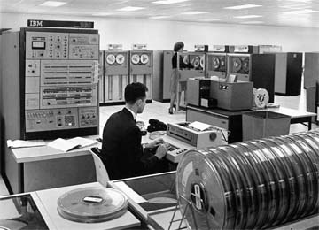
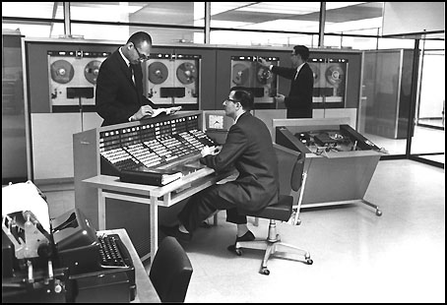
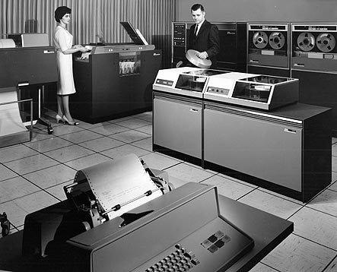


Slide 26
Large vocabulary counting
Another approach:
  Start with
    Q: “what can we do for large sets quickly”?
    A: sorting
      It’s O(n log n), not much worse than linear
      You can do it for very large datasets using a merge sort
        sort k subsets that fit in memory,
        merge results, which can be done in linear time

Slide 27

Alternative visualization

Slide 28
Large-vocabulary Naïve Bayes
Create a hashtable C
For each example id, y, x₁,….,x_{d} in train:
  C(“Y=ANY”) ++; C(“Y=y”) ++
  For j in 1..d:
    C(“Y=y ^ X=x_{j}”) ++

Slide 29
Large-vocabulary Naïve Bayes
Create a hashtable C
For each example id, y, x₁,….,x_{d} in train:
  C(“Y=ANY”) ++; C(“Y=y”) ++
  Print “Y=ANY += 1”
  Print “Y=y += 1”
  For j in 1..d:
    C(“Y=y ^ X=x_{j}”) ++
    Print “Y=y ^ X=x_{j} += 1”
Sort the event-counter update “messages”
Scan the sorted messages and compute and output the final counter values
Think of these as “messages” to another component to increment the counters
java MyTrainertrain | sort | java MyCountAdder > model

Slide 30
Large-vocabulary Naïve Bayes
Y=business += 1
Y=business += 1
…
Y=business ^ X =aaa += 1
…
Y=business ^ X=zynga += 1
Y=sports ^ X=hat += 1
Y=sports ^ X=hockey += 1
Y=sports ^ X=hockey += 1
Y=sports ^ X=hockey += 1
…
Y=sports ^ X=hoe += 1
…
Y=sports += 1
…
Create a hashtable C
For each example id, y, x₁,….,x_{d} in train:
  C(“Y=ANY”) ++; C(“Y=y”) ++
  Print “Y=ANY += 1”
  Print “Y=y += 1”
  For j in 1..d:
    C(“Y=y ^ X=x_{j}”) ++
    Print “Y=y ^ X=x_{j} += 1”
Sort the event-counter update “messages”
  We’re collecting together messages about the same counter
Scan and add the sorted messages and output the final counter values

Slide 31
Large-vocabulary Naïve Bayes
Scan-and-add:
streaming
previousKey = Null
sumForPreviousKey = 0
For each (event,delta) in input:
  If event==previousKey
    sumForPreviousKey += delta
  Else
    OutputPreviousKey()
    previousKey = event
    sumForPreviousKey = delta
OutputPreviousKey()
define OutputPreviousKey():
If PreviousKey!=Null
  print PreviousKey,sumForPreviousKey
Y=business += 1
Y=business += 1
…
Y=business ^ X =aaa += 1
…
Y=business ^ X=zynga += 1
Y=sports ^ X=hat += 1
Y=sports ^ X=hockey += 1
Y=sports ^ X=hockey += 1
Y=sports ^ X=hockey += 1
…
Y=sports ^ X=hoe += 1
…
Y=sports += 1
…
Accumulating the event counts requires constant storage … as long as the input is sorted.

Slide 32
Distributed Counting → Stream and Sort Counting
Hash table1
example 1
example 2
example 3
….
Machine 1
Hash table2
Machine 2
“C[x] +=D”
Message-routing logic
Counting logic
. . .
Hash table2
Machine K
Machine 0

Slide 33
Distributed Counting → Stream and Sort Counting
example 1
example 2
example 3
….
C[x1] += D1
C[x1] += D2
….
“C[x] +=D”
Logic to combine counter updates
Sort
Counting logic
Machine A
Machine C
Machine B

Slide 34
Stream and Sort Counting → Distributed Counting
Standardized message routing logic
example 1
example 2
example 3
….
C[x1] += D1
C[x1] += D2
….
“C[x] +=D”
Logic to combine counter updates
Counting logic
Sort
Machines A1,…
Machines C1,..,
Machines B1,…,
Trivial to parallelize!
Easy to parallelize!

Slide 35
Locality is good
Micro:
0.6G memory
Standard:
S: 1.7Gb
L: 7.5Gb
XL: 15Mb
Hi Memory:
XXL: 34.2
XXXXL: 68.4

Slide 36
Large-vocabulary Naïve Bayes
For each example id, y, x₁,….,x_{d} in train:
  Print Y=ANY += 1
  Print Y=y += 1
  For j in 1..d:
    Print Y=y ^ X=x_{j} += 1
Sort the event-counter update “messages”
Scan and add the sorted messages and output the final counter values
Complexity: O(n), n=size of train
(Assuming a constant number of labels apply to each document)
Complexity: O(nlogn)
Complexity: O(n)
O(|V||dom(Y)|)
java MyTrainertrain | sort | java MyCountAdder > model
Model size: max O(n), O(|V||dom(Y)|)

Slide 37
Today
Naïve Bayes with huge feature sets
  i.e. ones that don’t fit in memory
Pros and cons of possible approaches
  Traditional “DB” (actually, key-value store)
  Memory-based distributed DB
  Stream-and-sort counting
Optimizations
Other tasks for stream-and-sort

Slide 38
Optimizations
java MyTrainertrain | sort | java MyCountAdder > model
O(n)
Input size=n
Output size=n
O(nlogn)
Input size=n
Output size=n
O(n)
Input size=n
Output size=m
m<<n … say O(sqrt(n))
A useful optimization: decrease the size of the input to the sort
Reduces the size from O(n) to O(m)
Compress the output by using simpler messages
  (“C[event] += 1”) ➔ “event 1”
Compress the output more – e.g. string→integer code
  Tradeoff – ease of debugging vs efficiency – are messages meaningful or meaningful in context?

Slide 39
Optimization…
For each example id, y, x₁,….,x_{d} in train:
  Print “Y=ANY += 1”
  Print “Y=y += 1”
  For j in 1..d:
    Print “Y=y ^ X=x_{j} += 1”
Sort the event-counter update “messages”
Scan and add the sorted messages and output the final counter values
Initialize hashtable C
For each example id, y, x₁,….,x_{d} in train:
  C[Y=ANY] += 1
  C[Y=y] += 1
  For j in 1..d:
    C[Y=y ^ X=x_{j}] += 1
  If memory is getting full: output all values from C as messages and re-initialize C
Sort the event-counter update “messages”
Scan and add the sorted messages
java MyTrainertrain | sort | java MyCountAdder > model

Slide 40
Some other stream and sort tasks
Coming up: classify Wikipedia pages
  Features:
    words on page: src w₁ w₂ ….
    outlinks from page: src dst₁ dst₂ …
    how about inlinks to the page?

Slide 41
Some other stream and sort tasks
    outlinks from page: src dst₁ dst₂ …
  Algorithm:
    For each input line src dst₁ dst₂ … dst_{n} print out
      dst₁ inlinks.= src
      dst₂ inlinks.= src
      …
      dst_{n} inlinks.= src
    Sort this output
    Collect the messages and group to get
      dst src₁ src₂ … src_{n}

Slide 42
Some other stream and sort tasks
prevKey = Null
sumForPrevKey = 0
For each (event += delta) in input:
  If event==prevKey
    sumForPrevKey += delta
  Else
    OutputPrevKey()
    prevKey = event
    sumForPrevKey = delta
OutputPrevKey()
define OutputPrevKey():
If PrevKey!=Null
  print PrevKey,sumForPrevKey
prevKey = Null
linksToPrevKey = [ ]
For each (dst inlinks.= src) in input:
  If dst==prevKey
    linksPrevKey.append(src)
  Else
    OutputPrevKey()
    prevKey = dst
    linksToPrevKey=[src]
OutputPrevKey()
define OutputPrevKey():
If PrevKey!=Null
  print PrevKey, linksToPrevKey

Slide 43
Some other stream and sort tasks
What if we run this same program on the words on a page?
  Features:
    words on page: src w₁ w₂ ….
    outlinks from page: src dst₁ dst₂ …
Out2In.java
w₁ src_{1,1} src_{1,2} src_{1,3} ….
w₂ src_{2,1} …
…
an inverted index for the documents

Slide 44
Some other stream and sort tasks
    outlinks from page: src dst₁ dst₂ …
  Algorithm:
    For each input line src dst₁ dst₂ … dst_{n} print out
      dst₁ inlinks.= src
      dst₂ inlinks.= src
      …
      dst_{n} inlinks.= src
    Sort this output
    Collect the messages and group to get
      dst src₁ src₂ … src_{n}

Slide 45
Some other stream and sort tasks
prevKey = Null
sumForPrevKey = 0
For each (event += delta) in input:
  If event==prevKey
    sumForPrevKey += delta
  Else
    OutputPrevKey()
    prevKey = event
    sumForPrevKey = delta
OutputPrevKey()
define OutputPrevKey():
If PrevKey!=Null
  print PrevKey,sumForPrevKey
prevKey = Null
linksToPrevKey = [ ]
For each (dst inlinks.= src) in input:
  If dst==prevKey
    linksPrevKey.append(src)
  Else
    OutputPrevKey()
    prevKey = dst
    linksToPrevKey=[src]
OutputPrevKey()
define OutputPrevKey():
If PrevKey!=Null
  print PrevKey, linksToPrevKey

Slide 46
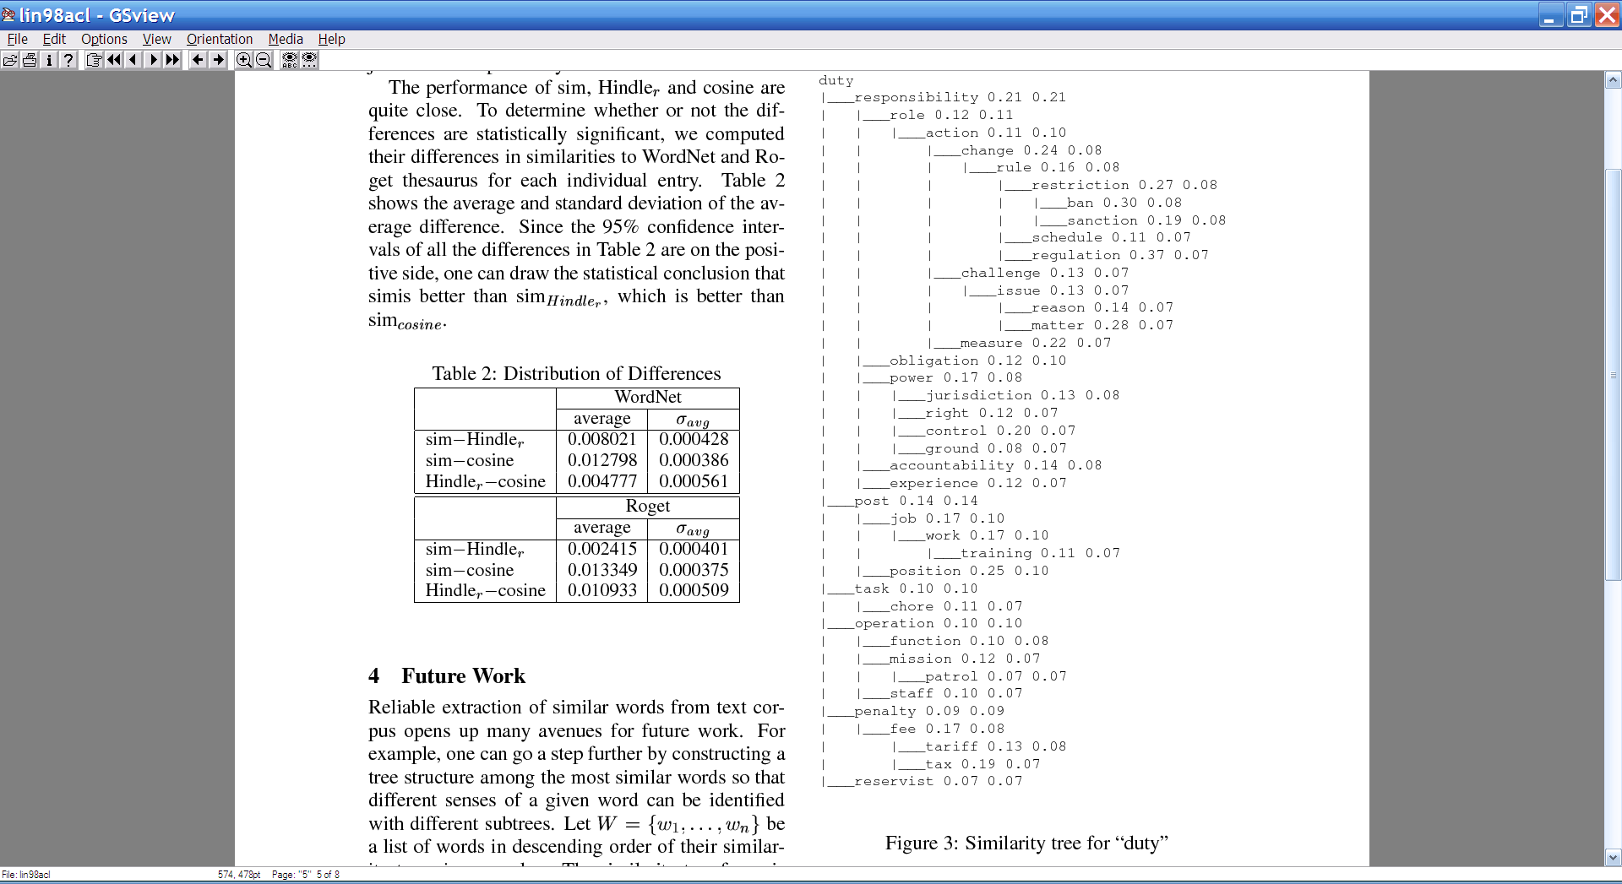
Some other stream and sort tasks
Later on: distributional clustering of words

Slide 47
Some other stream and sort tasks
Later on: distributional clustering of words
Algorithm:
For each word w in a corpus print w and the words in a window around it
  Print “wi context .= (w_{i-k},…,w_{i-1},w_{i+1},…,w_{i+k} )”
Sort the messages and collect all contexts for each w – thus creating an instance associated with w
Cluster the dataset
  Or train a classifier and classify it

Slide 48
Some other stream and sort tasks
prevKey = Null
sumForPrevKey = 0
For each (event += delta) in input:
  If event==prevKey
    sumForPrevKey += delta
  Else
    OutputPrevKey()
    prevKey = event
    sumForPrevKey = delta
OutputPrevKey()
define OutputPrevKey():
If PrevKey!=Null
  print PrevKey,sumForPrevKey
prevKey = Null
ctxOfPrevKey = [ ]
For each (w c.= w₁,…,w_{k}) in input:
  If dst==prevKey
    ctxOfPrevKey.append(
      w₁,…,w_{k} )
  Else
    OutputPrevKey()
    prevKey = w
    ctxOfPrevKey=[w₁,..,w_{k}]
OutputPrevKey()
define OutputPrevKey():
If PrevKey!=Null
  print PrevKey, ctxOfPrevKey

Slide 49
Some other stream and sort tasks
Finding unambiguous geographical names
GeoNames.org: for each place in its database, stores
  Several alternative names
  Latitude/Longitude
  …
Lets you put places on a map (e.g., Google Maps)
Problem: many names are ambiguous, especially if you allow an approximate match
  Paris, London, … even Carnegie Mellon

Slide 50
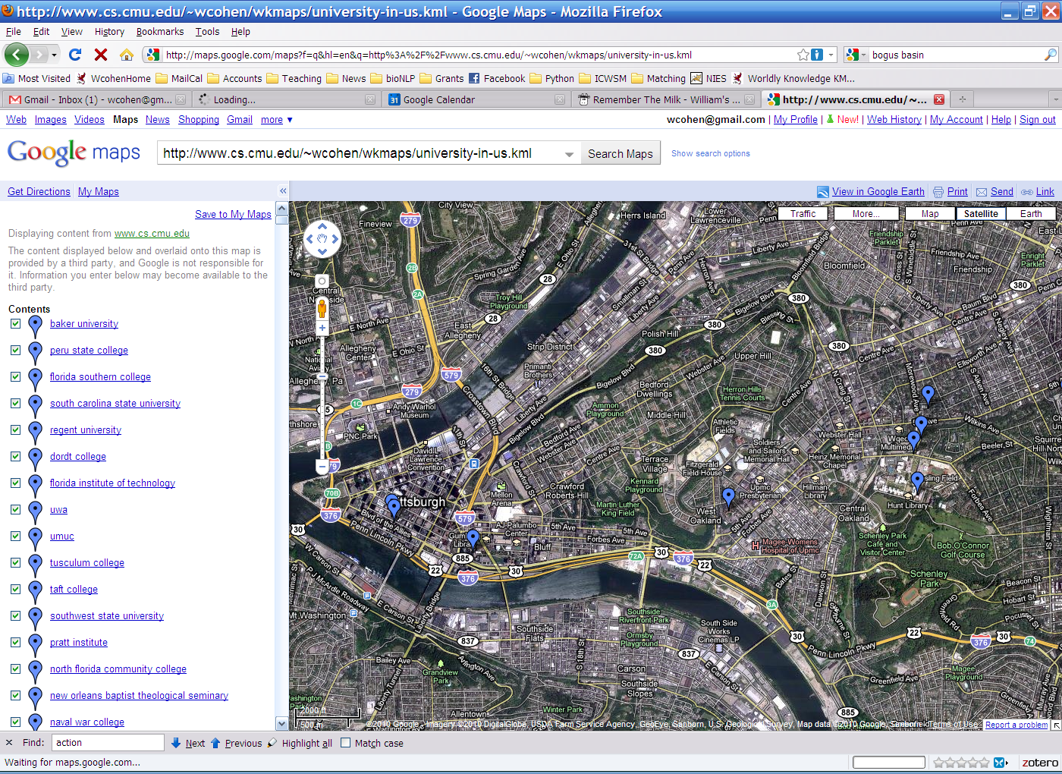
Point Park (College|University)
Carnegie Mellon [University [School]]

Slide 51
Some other stream and sort tasks
Finding almost unambiguous geographical names
GeoNames.org: for each place in the database
  print all plausible soft-match substrings in each alternative name, paired with the lat/long, e.g.
    Carnegie Mellon University at lat1,lon1
    Carnegie Mellon at lat1,lon1
    Mellon University at lat1,lon1
    Carnegie Mellon School at lat2,lon2
    Carnegie Mellon at lat2,lon2
    Mellon School at lat2,lon2
    …
  Sort and collect… and filter

Slide 52
Some other stream and sort tasks
prevKey = Null
sumForPrevKey = 0
For each (event += delta) in input:
  If event==prevKey
    sumForPrevKey += delta
  Else
    OutputPrevKey()
    prevKey = event
    sumForPrevKey = delta
OutputPrevKey()
define OutputPrevKey():
If PrevKey!=Null
  print PrevKey,sumForPrevKey
prevKey = Null
locOfPrevKey = Gaussian()
For each (place at lat,lon) in input:
  If dst==prevKey
    locOfPrevKey.observe(lat, lon)
  Else
    OutputPrevKey()
    prevKey = place
    locOfPrevKey = Gaussian()
    locOfPrevKey.observe(lat, lon)
OutputPrevKey()
define OutputPrevKey():
If PrevKey!=Null and locOfPrevKey.stdDev() < 1 mile
  print PrevKey, locOfPrevKey.avg()

Slide 53
Today
Naïve Bayes with huge feature sets
  i.e. ones that don’t fit in memory
Pros and cons of possible approaches
  Traditional “DB” (actually, key-value store)
  Memory-based distributed DB
  Stream-and-sort counting
Optimizations
Other tasks for stream-and-sort
A detail about large-vocabulary Naïve Bayes…..

Slide 54
Complexity of Naïve Bayes
Assume hashtable holding all counts fits in memory
Sequential reads
You have a train dataset and a test dataset
Initialize an “event counter” (hashtable) C
For each example id, y, x₁,….,x_{d} in train:
  C(“Y=ANY”) ++; C(“Y=y”) ++
  For j in 1..d:
    C(“Y=y ^ X=x_{j}”) ++
For each example id, y, x₁,….,x_{d} in test:
  For each y’ in dom(Y):
    Compute log Pr(y’,x₁,….,x_{d}) =
  Return the best y’
Complexity: O(n), n=size of train
where:
q_{j} = 1/|V|
q_{y} = 1/|dom(Y)|
m=1
Sequential reads
Complexity: O(|dom(Y)|*n’), n’=size of test

Slide 55
Using Large-vocabulary Naïve Bayes
For each example id, y, x₁,….,x_{d} in test:
Sort the event-counter update “messages”
Scan and add the sorted messages and output the final counter values
For each example id, y, x₁,….,x_{d} in test:
  For each y’ in dom(Y):
    Compute log Pr(y’,x₁,….,x_{d}) =
Model size: max O(n), O(|V||dom(Y)|)

Slide 56
Using Large-vocabulary Naïve Bayes
[For assignment]
For each example id, y, x₁,….,x_{d} in test:
Sort the event-counter update “messages”
Scan and add the sorted messages and output the final counter values
Initialize a HashSet NEEDED and a hashtable C
For each example id, y, x₁,….,x_{d} in test:
  Add x₁,….,x_{d} to NEEDED
For each event, C(event) in the summed counters
  If event involves a NEEDED term x read it into C
For each example id, y, x₁,….,x_{d} in test:
  For each y’ in dom(Y):
    Compute log Pr(y’,x₁,….,x_{d}) = ….
Model size: O(|V|)
Time: O(n₂), size of test
Memory: same
Time: O(n₂)
Memory: same
Time: O(n₂)
Memory: same

Slide 57
Large-Vocabulary Naïve Bayes
Learning/Counting
Using Counts
Counts on disk with a key-value store
Counts as messages to a set of distributed processes
Repeated scans to build up partial counts
Counts as messages in a stream-and-sort system
Assignment: Counts as messages but buffered in memory
Assignment:
  Scan through counts to find those needed for test set
  Classify with counts in memory
Put counts in a database
Use partial counts and repeated scans of the test data?
Re-organize the counts and test set so that you can classify in a stream

