Slide 1
Naïve Bayes
William W. Cohen

Slide 2
Probabilistic and Bayesian Analytics
Again filched from:
Note to other teachers and users of these slides. Andrew would be delighted if you found this source material useful in giving your own lectures. Feel free to use these slides verbatim, or to modify them to fit your own needs. PowerPoint originals are available. If you make use of a significant portion of these slides in your own lecture, please include this message, or the following link to the source repository of Andrew’s tutorials: http://www.cs.cmu.edu/~awm/tutorials . Comments and corrections gratefully received.
Andrew W. Moore
School of Computer Science
Carnegie Mellon University
www.cs.cmu.edu/~awm
awm@cs.cmu.edu
412-268-7599

Slide 3
Last lecture: what we expect you to know
Events
discrete random variables, boolean random variables, multinomial random variables
Axioms of probability
What defines a reasonable theory of uncertainty
Compound events (A ^ B)
Independent events
Conditional probabilities
Def’n, chain rule
Bayes rule and beliefs
Joint probability distributions
Inference with the joint
Estimating a joint with counts
Estimating using “imagined” data (Dirichlet prior)
A “big data” example
0 <= P(A) <= 1
P(True) = 1
P(False) = 0
P(A or B) = P(A) + P(B) - P(A and B)

Slide 4
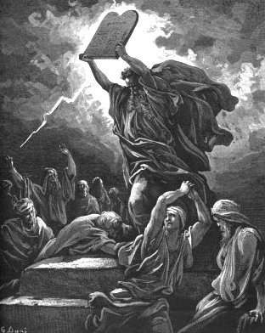

The Axioms Of Probability

Slide 5
Some of A Joint Distribution
A | B | C | D | E | p
is | the | effect | of | the | 0.00036
is | the | effect | of | a | 0.00034
. | The | effect | of | this | 0.00034
to | this | effect | : | “ | 0.00034
be | the | effect | of | the | …
 | … | … | … | … | …
not | the | effect | of | any | 0.00024
 | … | … | … | … | …
does | not | affect | the | general | 0.00020
does | not | affect | the | question | 0.00020
any | manner | affect | the | principle | 0.00018

Slide 6
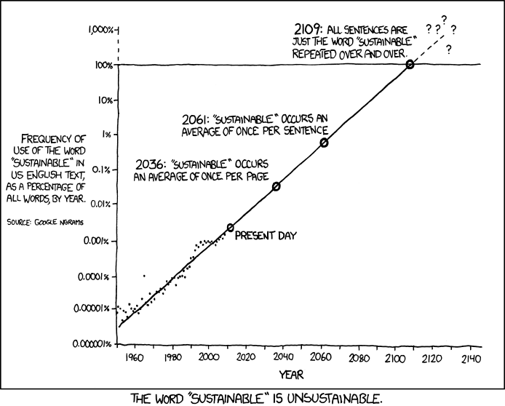
Monday’s xkcd
http://xkcd.com/ngram-charts/

Slide 7
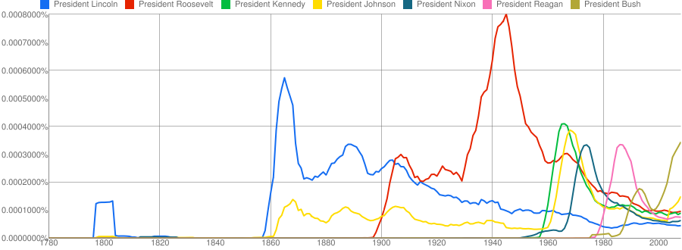
Coupled Temporal Scoping of Relational Facts. P.P. Talukdar, D.T. Wijaya and T.M. Mitchell. In Proceedings of the ACM International Conference on Web Search and Data Mining (WSDM), 2012
Understanding Semantic Change of Words Over Centuries. D.T. Wijaya and R. Yeniterzi. In Workshop on Detecting and Exploiting Cultural Diversity on the Social Web (DETECT), 2011 at CIKM 2011

Slide 8
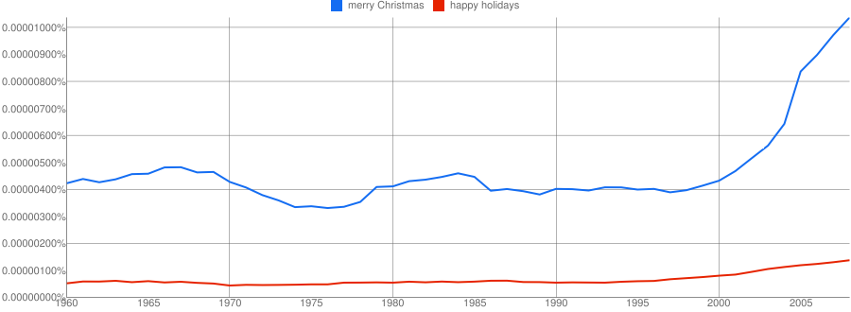
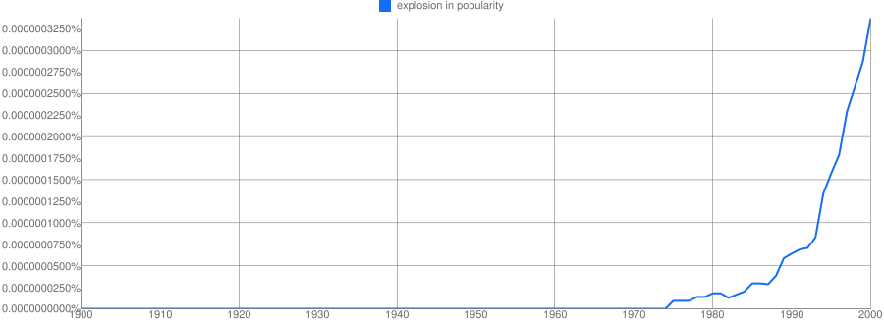

Slide 9
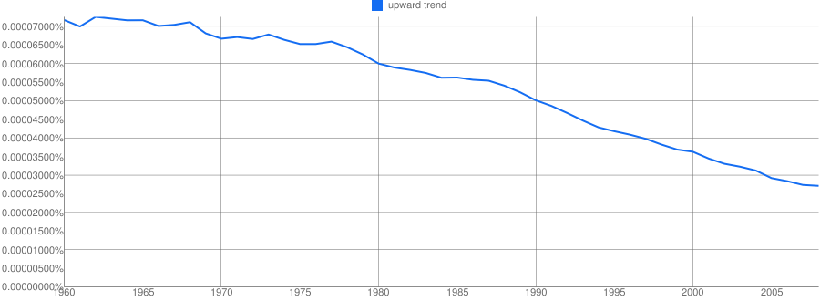

Slide 10
Some of A Joint Distribution
A | B | C | D | E | p
is | the | effect | of | the | 0.00036
is | the | effect | of | a | 0.00034
. | The | effect | of | this | 0.00034
to | this | effect | : | “ | 0.00034
be | the | effect | of | the | …
 | … | … | … | … | …
not | the | effect | of | any | 0.00024
 | … | … | … | … | …
does | not | affect | the | general | 0.00020
does | not | affect | the | question | 0.00020
any | manner | affect | the | principle | 0.00018

Slide 11
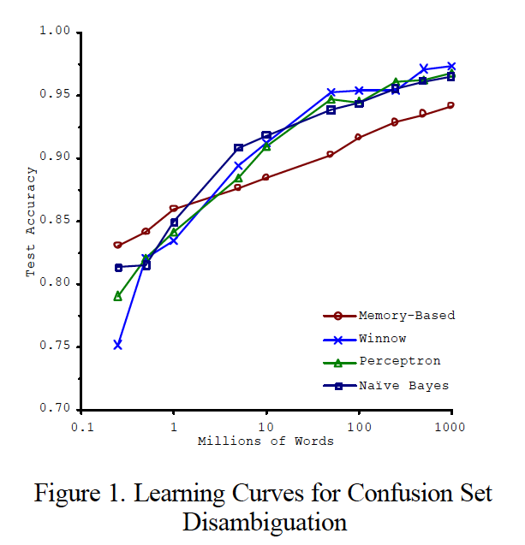
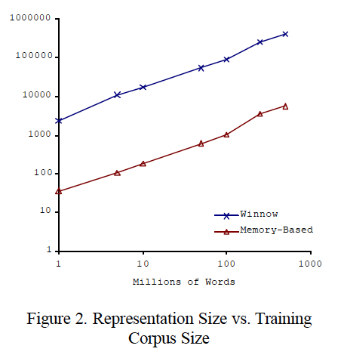
Big ML c. 2001 (Banko & Brill, “Scaling to Very Very Large…”, ACL 2001)
Task: distinguish pairs of easily-confused words (“affect” vs “effect”) in context

Slide 12
An experiment
Starting point: Google books 5-gram data
All 5-grams that appear >= 40 times in a corpus of 1M English books
approx 80B words
5-grams: 30Gb compressed, 250-300Gb uncompressed
Each 5-gram contains frequency distribution over years
Extract all 5-grams from books published before 2000 that contain ‘effect’ or ‘affect’ in middle position
about 20 “disk hours”
approx 100M occurrences
approx 50k distinct n-grams --- not big
Wrote code to compute
Pr(A,B,C,D,E|C=affect or C=effect)
Pr(any subset of A,…,E|any other subset,C=affect V effect)

Slide 13
Demo
My~Documents/docs/demo
_X is a variable to report, _ is a variable to marginalize out, anything else is a word
Sample queries:
query.py trainData has no _C on _E
Pr(C,E|A=has,B=no,D=on)
query.py trainData _ not _C _D _E
Pr(C,D,E|B=not)

Slide 14
Density Estimation
Our Joint Distribution learner is our first example of something called Density Estimation
A Density Estimator learns a mapping from a set of attributes values to a Probability
Input
Attributes
Density
Estimator
Probability

Slide 15
Density Estimation
Compare it against the two other major kinds of models:
Input
Attributes
Classifier
Prediction of
categorical output or class
One of a few discrete values
Input
Attributes
Density
Estimator
Probability
Input
Attributes
Regressor
Prediction of
real-valued output

Slide 16
Density Estimation ➔ Classification
Input
Attributes
x
Classifier
Prediction of
categorical output
One of y1, …., yk
Input
Attributes
Density
Estimator
^
P(x,y)
Class
To classify x
Use your estimator to compute P(x,y1), …., P(x,yk)
Return the class y* with the highest predicted probability
^
^
Binary case: predict POS if P(x)>0.5
^
^
^
^
^
Ideally is correct with P(x,y*) = P(x,y*)/(P(x,y1) + …. + P(x,yk))

Slide 17
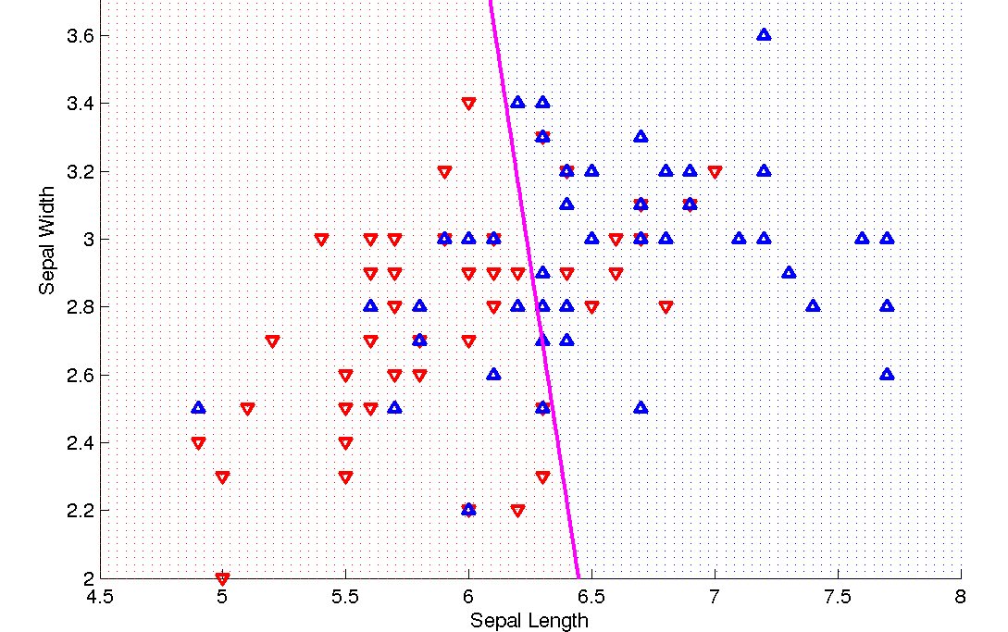
Classification vs Density Estimation
Classification

Slide 18
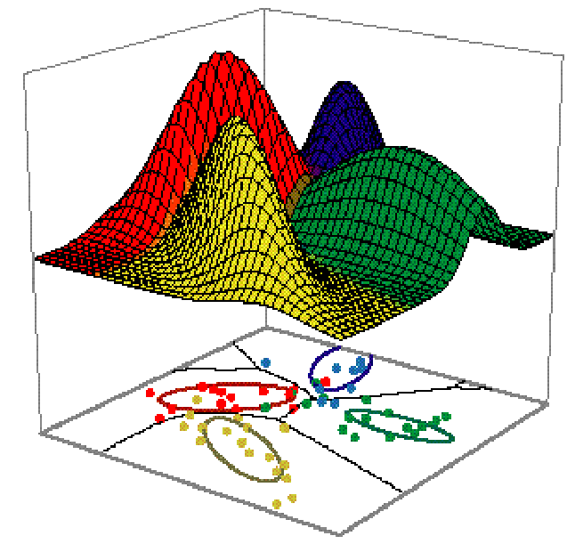
Classification vs Density Estimation
Classification
Density Estimation

Slide 19

Classification vs density estimation

Slide 20
How do you evaluate?
Classification
Density Estimation
Estimate Pr(error)
Given n test examples and k errors, error rate is Pr(error) ~= k/n.
Given n test examples x₁,y₁, …, x_{n},y_{n}, compute
Avg # bits to encode the true labels using a code based on your density estimator. (Optimal code will use -logP(Y=y) bits for event Y=y.)

Slide 21
Summary: The Good News
We have a way to learn a Density Estimator from data.
Density estimators can do many good things…
Can sort the records by probability, and thus spot weird records (anomaly detection)
Can do inference: P(E1|E2)
Automatic Doctor / Help Desk etc
Ingredient for Bayes Classifiers (see later)

Slide 22
Bayes Classifiers
If we can do inference over Pr(X₁…,X_{d},Y)…
… in particular compute Pr(X₁…X_{d}|Y) and Pr(Y).
And then we can use Bayes’ rule to compute

Slide 23
Summary: The Bad News
Density estimation by directly learning the joint is trivial, mindless and dangerous
Andrew’s joke
Density estimation by directly learning the joint is hopeless unless you have some combination of
Very few attributes
Attributes with low “arity”
Lots and lots of data
Otherwise you can’t estimate all the row frequencies

Slide 24
Back to the demo
Extracted all affect/effect 5-grams from the old (small) Reuters corpus
about 20k documents
about 723 n-grams, 661 distinct
Financial news, not novels or textbooks
Tried to predict center word with:
Pr(C|A=a,B=b,D=d,E=e)
Of 723 combinations of a,b,d,e, only 101 (about 14%) appear in the n-gram corpus.
Of those there is only one error.

Slide 25
Another experiment
Extracted all affect/effect 5-grams from the old (small) Reuters corpus
about 20k documents
about 723 n-grams, 661 distinct
Financial news, not novels or textbooks
Extension: tried to predict center word with:
Pr(C|A=a,B=b,D=d,E=e)
then P(C|A,B,D,C=effect V affect)
then P(C|B,D, C=effect V affect)
then P(C|B, C=effect V affect)
then P(C, C=effect V affect)

Slide 26
EXAMPLES
“The cumulative _ of the” → effect (1.0)
“Go into _ on January” → effect (1.0)
“From cumulative _ of accounting” not present
Nor is ““From cumulative _ of _”
But “_ cumulative _ of _” → effect (1.0)
“Would not _ Finance Minister” not present
But “_ not _ _ _” → affect (0.9625)

Slide 27
Performance …
Pattern | Used | Errors
P(C|A,B,D,E) | 101 | 1
P(C|A,B,D) | 157 | 6
P(C|B,D) | 163 | 13
P(C|B) | 244 | 78
P(C) | 58 | 31
Is this good performance?
Do other brute-force estimates of joint probabilities have the same problem?

Slide 28
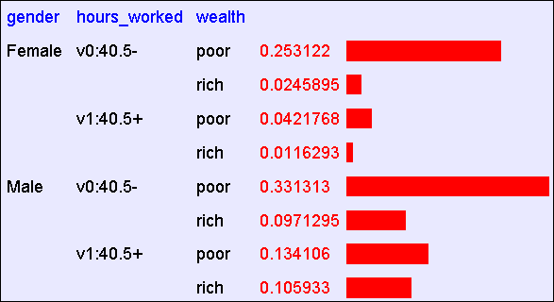
Flashback
Size of table:
2¹⁵=32768 (if all binary) ➔ avg of 1.5 examples per row
Actual m = 1,974,927, 360 (if continuous attributes binarized)
Abstract: Predict whether income exceeds $50K/yr based on census data. Also known as "Census Income" dataset. [Kohavi, 1996]
Number of Instances: 48,842
Number of Attributes: 14 (in UCI’s copy of dataset) + 1; 3 (here)

Slide 29
Naïve Density Estimation
The problem with the Joint Estimator is that it just mirrors the training data.
We need something which generalizes more usefully.
The naïve model generalizes strongly:
Assume that each attribute is distributed independently of any of the other attributes.

Slide 30
Independently Distributed Data
Review: A and B are independent if
Pr(A,B)=Pr(A)Pr(B)
Sometimes written:
A and B are conditionally independent given C if Pr(A,B|C)=Pr(A|C)*Pr(B|C)
Written

Slide 31
Using the Naïve Distribution
Once you have a Naïve Distribution you can easily compute any row of the joint distribution.
Suppose A, B, C and D are independently distributed. What is P(A ^ ~B ^ C ^ ~D)?

Slide 32
Using the Naïve Distribution
Once you have a Naïve Distribution you can easily compute any row of the joint distribution.
Suppose A, B, C and D are independently distributed. What is P(A^~B^C^~D)?
= P(A|~B^C^~D) P(~B^C^~D)
= P(A) P(~B^C^~D)
= P(A) P(~B|C^~D) P(C^~D)
= P(A) P(~B) P(C^~D)
= P(A) P(~B) P(C|~D) P(~D)
= P(A) P(~B) P(C) P(~D)

Slide 33
Naïve Distribution General Case
Suppose X₁,X₂,…,X_{d} are independently distributed.
So if we have a Naïve Distribution we can construct any row of the implied Joint Distribution on demand.
How do we learn this?

Slide 34
Learning a Naïve Density Estimator
MLE
Dirichlet (MAP)
Another trivial learning algorithm!

Slide 35
Probabilistic and Bayesian Analytics
Again filched from:
Note to other teachers and users of these slides. Andrew would be delighted if you found this source material useful in giving your own lectures. Feel free to use these slides verbatim, or to modify them to fit your own needs. PowerPoint originals are available. If you make use of a significant portion of these slides in your own lecture, please include this message, or the following link to the source repository of Andrew’s tutorials: http://www.cs.cmu.edu/~awm/tutorials . Comments and corrections gratefully received.
Andrew W. Moore
School of Computer Science
Carnegie Mellon University
www.cs.cmu.edu/~awm
awm@cs.cmu.edu
412-268-7599

Slide 36
Is this an interesting learning algorithm?
No
^
For n-grams, what is P(C=effect|A=will)?
In joint: P(C=effect|A=will) = 0.38
In naïve: P(C=effect|A=will) = P(C=effect) = #[C=effect]/#totalNgrams = 0.94 (!)
What is P(C=effect|B=no)?
In joint: P(C=effect|A=will) = 0.999
In naïve: P(C=effect|B=no) = P(C=effect) = 0.94
^
^
^
^
^
^
^

Slide 37
Bayes Classifiers
If we can do inference over Pr(X,Y)…
… in particular compute Pr(X|Y) and Pr(Y).
We can compute

Slide 38
Can we make this interesting? Yes!
Key ideas:
Pick the class variable Y
Instead of estimating P(X₁,…,X_{n},Y) = P(X₁)*…*P(X_{n})*Y, estimate P(X₁,…,X_{n}|Y) = P(X₁|Y)*…*P(X_{n}|Y)
Or, assume P(X_{i}|Y)=Pr(X_{i}|X₁,…,X_{i-1},X_{i+1},…X_{n},Y)
Or, that X_{i} is conditionally independent of every X_{j}, j!=i, given Y.
How to estimate?
MLE

Slide 39
Can we make this interesting? Yes!
Key ideas:
Pick the class variable Y
Instead of estimating P(X₁,…,X_{n},Y) = P(X₁)*…*P(X_{n})*Y, estimate P(X₁,…,X_{n}|Y) = P(X₁|Y)*…*P(X_{n}|Y)
Or, assume P(X_{i}|Y)=Pr(X_{i}|X₁,…,X_{i-1},X_{i+1},…X_{n},Y)
Or, that X_{i} is conditionally independent of every X_{j}, j!=i, given Y.
How to estimate?
MLE

Slide 40
Can we make this interesting? Yes!
Key ideas:
Pick the class variable Y
Instead of estimating P(X₁,…,X_{n},Y) = P(X₁)*…*P(X_{n})*Pr(Y), estimate P(X₁,…,X_{n}|Y) = P(X₁|Y)*…*P(X_{n}|Y)
Or, assume P(Xi|Y)=Pr(Xi|X₁,…,X_{i-1},X_{i+1},…X_{n},Y)
Or, that Xi is conditionally independent of every Xj, j!=I, given Y.
How to estimate?
MLE

Slide 41
The Naïve Bayes classifier – v1
Dataset: each example has
A unique id id
Why? For debugging the feature extractor
d attributes X₁,…,X_{d}
Each X_{i} takes a discrete value in dom(X_{i})
One class label Y in dom(Y)
You have a train dataset and a test dataset

Slide 42
The Naïve Bayes classifier – v1
You have a train dataset and a test dataset
Initialize an “event counter” (hashtable) C
For each example id, y, x₁,….,x_{d} in train:
C(“Y=ANY”) ++; C(“Y=y”) ++
For j in 1..d:
C(“Y=y ^ X_{j}=x_{j}”) ++
For each example id, y, x₁,….,x_{d} in test:
For each y’ in dom(Y):
Compute Pr(y’,x₁,….,x_{d}) =
Return the best y’

Slide 43
The Naïve Bayes classifier – v1
You have a train dataset and a test dataset
Initialize an “event counter” (hashtable) C
For each example id, y, x₁,….,x_{d} in train:
C(“Y=ANY”) ++; C(“Y=y”) ++
For j in 1..d:
C(“Y=y ^ X_{j}=x_{j}”) ++
For each example id, y, x₁,….,x_{d} in test:
For each y’ in dom(Y):
Compute Pr(y’,x₁,….,x_{d}) =
Return the best y’
This will overfit, so …

Slide 44
The Naïve Bayes classifier – v1
You have a train dataset and a test dataset
Initialize an “event counter” (hashtable) C
For each example id, y, x₁,….,x_{d} in train:
C(“Y=ANY”) ++; C(“Y=y”) ++
For j in 1..d:
C(“Y=y ^ X_{j}=x_{j}”) ++
For each example id, y, x₁,….,x_{d} in test:
For each y’ in dom(Y):
Compute Pr(y’,x₁,….,x_{d}) =
Return the best y’
where:
q_{j} = 1/|dom(X_{j})|
q_{y} = 1/|dom(Y)|
m=1
This will underflow, so …

Slide 45
The Naïve Bayes classifier – v1
You have a train dataset and a test dataset
Initialize an “event counter” (hashtable) C
For each example id, y, x₁,….,x_{d} in train:
C(“Y=ANY”) ++; C(“Y=y”) ++
For j in 1..d:
C(“Y=y ^ X_{j}=x_{j}”) ++
For each example id, y, x₁,….,x_{d} in test:
For each y’ in dom(Y):
Compute log Pr(y’,x₁,….,x_{d}) =
Return the best y’
where:
q_{j} = 1/|dom(X_{j})|
q_{y} = 1/|dom(Y)|
m=1

Slide 46
The Naïve Bayes classifier – v2
For text documents, what features do you use?
One common choice:
X₁ = first word in the document
X₂ = second word in the document
X₃ = third …
X₄ = …
…
But: Pr(X₁₃=hockey|Y=sports) is probably not that different from Pr(X₁₁=hockey|Y=sports)…so instead of treating them as different variables, treat them as different copies of the same variable

Slide 47
The Naïve Bayes classifier – v1
You have a train dataset and a test dataset
Initialize an “event counter” (hashtable) C
For each example id, y, x₁,….,x_{d} in train:
C(“Y=ANY”) ++; C(“Y=y”) ++
For j in 1..d:
C(“Y=y ^ X_{j}=x_{j}”) ++
For each example id, y, x₁,….,x_{d} in test:
For each y’ in dom(Y):
Compute Pr(y’,x₁,….,x_{d}) =
Return the best y’

Slide 48
The Naïve Bayes classifier – v2
You have a train dataset and a test dataset
Initialize an “event counter” (hashtable) C
For each example id, y, x₁,….,x_{d} in train:
C(“Y=ANY”) ++; C(“Y=y”) ++
For j in 1..d:
C(“Y=y ^ X_{j}=x_{j}”) ++
For each example id, y, x₁,….,x_{d} in test:
For each y’ in dom(Y):
Compute Pr(y’,x₁,….,x_{d}) =
Return the best y’

Slide 49
The Naïve Bayes classifier – v2
You have a train dataset and a test dataset
Initialize an “event counter” (hashtable) C
For each example id, y, x₁,….,x_{d} in train:
C(“Y=ANY”) ++; C(“Y=y”) ++
For j in 1..d:
C(“Y=y ^ X=x_{j}”) ++
For each example id, y, x₁,….,x_{d} in test:
For each y’ in dom(Y):
Compute Pr(y’,x₁,….,x_{d}) =
Return the best y’

Slide 50
The Naïve Bayes classifier – v2
You have a train dataset and a test dataset
Initialize an “event counter” (hashtable) C
For each example id, y, x₁,….,x_{d} in train:
C(“Y=ANY”) ++; C(“Y=y”) ++
For j in 1..d:
C(“Y=y ^ X=x_{j}”) ++
For each example id, y, x₁,….,x_{d} in test:
For each y’ in dom(Y):
Compute log Pr(y’,x₁,….,x_{d}) =
Return the best y’
where:
q_{j} = 1/|V|
q_{y} = 1/|dom(Y)|
m=1

Slide 51
The Naïve Bayes classifier – v2
You have a train dataset and a test dataset
To classify documents, these might be:
http://wcohen.com academic,FacultyHome William W. Cohen Research Professor Machine Learning Department Carnegie Mellon University Member of the Language Technology Institute the joint CMU-Pitt Program in Computational Biology the Lane Center for Computational Biology and the Center for Bioimage Informatics Director of the Undergraduate Minor in Machine Learning Bio Teaching Projects Publications recent all Software Datasets Talks Students Colleagues Blog Contact Info Other Stuff …
http://google.com commercial Search Images Videos ….
…
How about for n-grams?

Slide 52
The Naïve Bayes classifier – v2
You have a train dataset and a test dataset
To do spelling correction these might be
ng1223 effect a_the b_main d_of e_the
ng1224 affect a_shows b_not d_mice e_in
….
I.e., encode event X_{i}=w with another event X=i_w
Question: are there any differences in behavior?

Slide 53
Complexity of Naïve Bayes
Assume hashtable holding all counts fits in memory
Sequential reads
You have a train dataset and a test dataset
Initialize an “event counter” (hashtable) C
For each example id, y, x₁,….,x_{d} in train:
C(“Y=ANY”) ++; C(“Y=y”) ++
For j in 1..d:
C(“Y=y ^ X=x_{j}”) ++
For each example id, y, x₁,….,x_{d} in test:
For each y’ in dom(Y):
Compute log Pr(y’,x₁,….,x_{d}) =
Return the best y’
Complexity: O(n), n=size of train
where:
q_{j} = 1/|V|
q_{y} = 1/|dom(Y)|
m=1
Sequential reads
Complexity: O(|dom(Y)|*n’), n’=size of test

Slide 54
Complexity of Naïve Bayes
You have a train dataset and a test dataset
Process:
Count events in the train dataset
O(n₁), where n₁ is total size of train
Write the counts to disk
O(min(|dom(X)|*|dom(Y)|, n₁)
O(|V|), if V is vocabulary and dom(Y) is small
Classify the test dataset
O(|V|+n₂)
Worst-case memory usage:
O(min(|dom(X)|*|dom(Y)|, n₁)

Slide 55
Naïve Bayes v2
This is one example of a streaming classifier
Each example is only read only once
You can create a classifier and perform classifications at any point
Memory is minimal (<< O(n))
Ideally it would be constant
Traditionally less than O(sqrt(N))
Order doesn’t matter
Nice because we may not control the order of examples in real life
This is a hard one to get a learning system to have!
There are few competitive learning methods that as stream-y as naïve Bayes…

Slide 56
First assigment
Implement naïve Bayes v2
Run and test it on Reuters RCV2
O(100k) newswire stories
One of the largest widely-used classification datasets
Details on the wiki
Turn in by next Tuesday (blackbook)
Remember office hours: Wed,Thurs,Fri
Hint to all:
The next assignment will be a Naïve Bayes that does not use a hashtable for event counts
Thursday’s lecture
You will want to reuse some stuff from this assignment later….

