Slide 1
Machine Learning from Big Datasets
William Cohen

Slide 2
Outline
Intro
  Who, Where, When - administrivia
  What/How
    Proposed outline & load
    Resources – languages and machines
      Java (for Hadoop)
      Small machines – understand essence of scaling
      Amazon cloud, Blacklight
    Grading
      60% assignments, 30% project, 10% class participation; can drop lowest assignment grade
  Why – motivations
    ML about 20 years ago, 15, 10, 5
Review - analysis of computational complexity
  How to count and what to count

Slide 3
Who/Where/When
TAs:
  Alona Fyshe (also teaching one section): 10am Wed
  Ni Lao: 3pm-4:30pm on Thursday, Hillman 5507.
  William: 11am Friday, Gates 8217
William W. Cohen
  1990-mid 1990’s: AT&T Bell Labs (working on ILP and scalable propositional rule-learning algorithms)
  Mid 1990’s—2000: AT&T Research (text,classification, data integration, knowledge-as-text, information extraction)
  2000-2002: Whizbang! Labs (info extraction from Web)
  2002-2008, 2010-2012: CMU (IE, biotext, social networks, learning in graphs, info extraction from Web)
  2008-2009: Visiting Scientist at Google
Course assistant: Sharon Cavlovich
Wiki: google://”cohen CMU”→teaching → http://malt.ml.cmu.edu/mw/index.php/Machine_Learning_with_Large_Datasets_10-605_in_Spring_2012

Slide 4
What/How
  Syllabus/outline
  I kind of like language tasks, especially for this task:
  The data (usually) makes sense
  The models (usually) make sense
  The models (usually) are complex, so
    More data actually helps
    Learning simple models vs complex ones is sometimes computationally different

Slide 5
What/How
Programming Language:
  Java and Hadoop
  Most assignments will not use anything else
Resources:
  Your desktop/laptop (4 weeks)
    You’ll need approximately 0.5Tb space.
    (Let me know if this is likely to be a problem.)
  Amazon Elastic Cloud (2 weeks)
    Amazon EC2 [http://aws.amazon.com/ec2/]
    Allocation: $100 worth of time per student
  BlackLight (available for projects)
    SGI 4096 2.3Gb cores, 2x 16Tb coherent memory
    Runs GraphLab, Java, …

Slide 6
What/How
60% assignments
  Weekly programming assignments
    Not a lot of lines of code, but it will take you time to get them right
  You can drop one assignment grade but
  …assignments are pretty cumulative
30% project
  4-week project at end of course
  We strongly encourage groups of 2-3
10% class participation

Slide 7
Project
More later
  We will add a page with pointers to datasets and ideas for projects
  Lots about scalable ML is still not well-understood so there’s lots of opportunities for a meaningful study

Slide 8
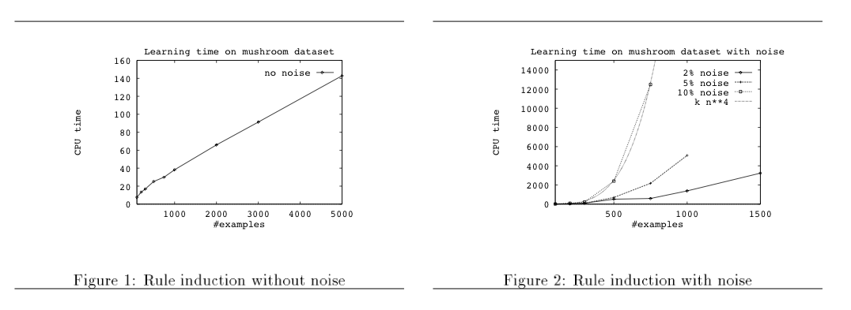
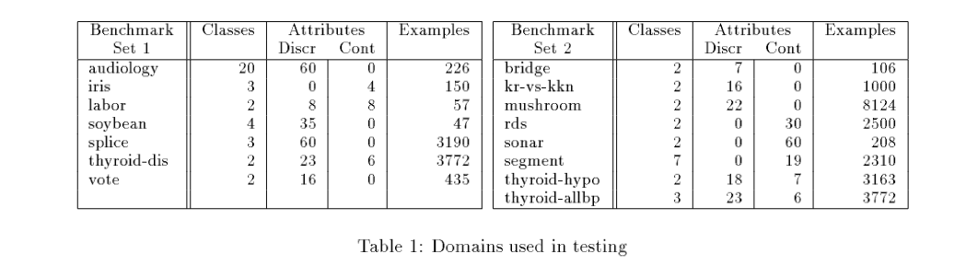
Big ML c. 1993 (Cohen, “Efficient…Rule Learning”, IJCAI 1993)
$ ./code/ripper pdata/promoters
Final hypothesis is:
prom :- am34=g, am35=t (34/1).
prom :- am36=t, am33=a (12/3).
prom :- am12=a, am43=t (4/1).
prom :- am41=a, am43=a (3/0).
default nonprom (48/0).

Slide 9
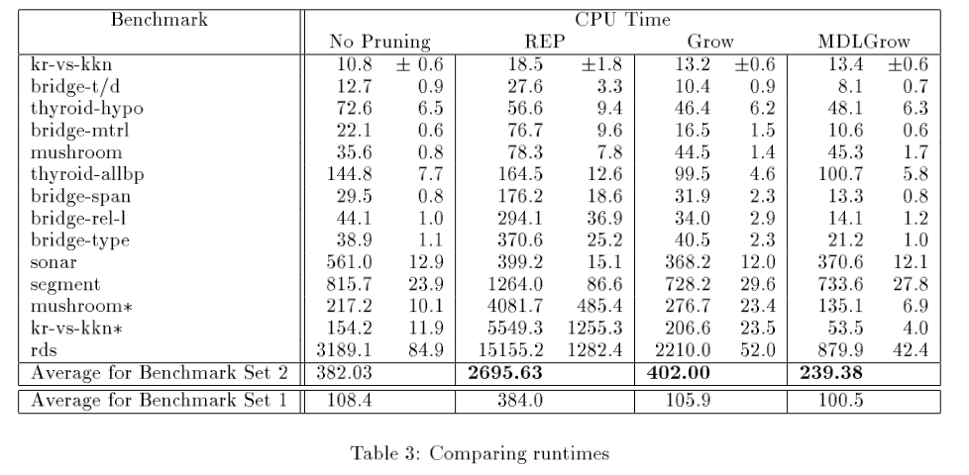

Slide 10
More on this paper
Algorithm
Analysis
Fit the POS,NEG example
While POS isn’t empty:
  Let R be “if True ➔ pos”
  While NEG isn’t empty:
    Pick the “best” [i] condition c of the form “xi=True” or “xi=false”
    Add c to the LHS of R
    Remove examples that don’t satisfy c from NEG
  Add R to the rule set [ii]
  Remove examples that satisfy R from POS
Prune the rule set:
  …
The total number of iterations of L1 is the number of conditions in the rule set – call it m
Picking the “best” condition requires looking at all examples – say there are n of these
Time is at least m*n
The problem:
  When there are noisy positive examples the algorithm builds rules that cover just 1-2 of them
  So with huge noisy datasets you build huge rulesets
L1
quadratic
cubic!
    [i] “Best” is wrt some statistics on c’s coverage of POS,NEG
    [ii] R is now of the form “if xi1=_ and xi2=_ and … ➔ pos”

Slide 11
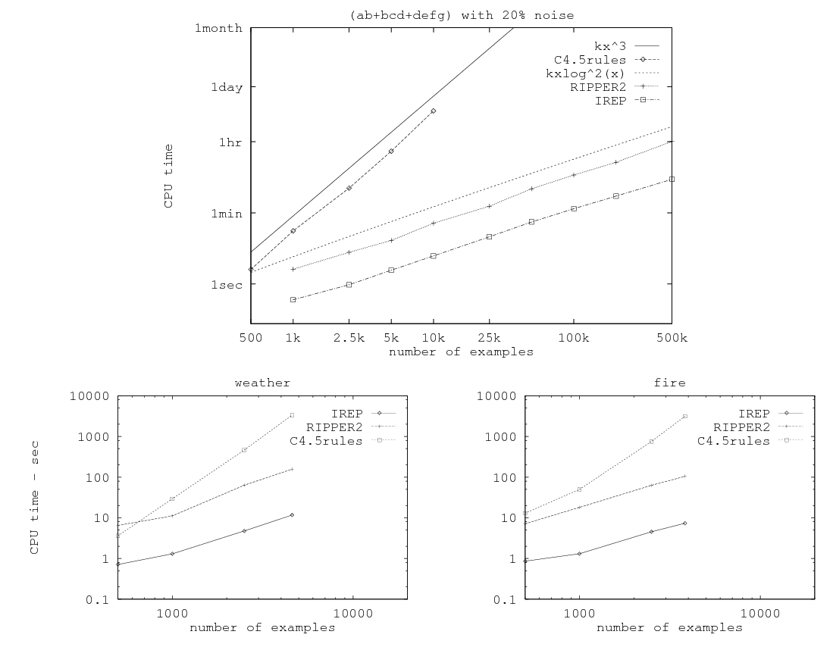
Related paper from 1995…

Slide 12
So in mid 1990’s…..
Experimental datasets were small
Many commonly used algorithms were asymptotically “slow”

Slide 13
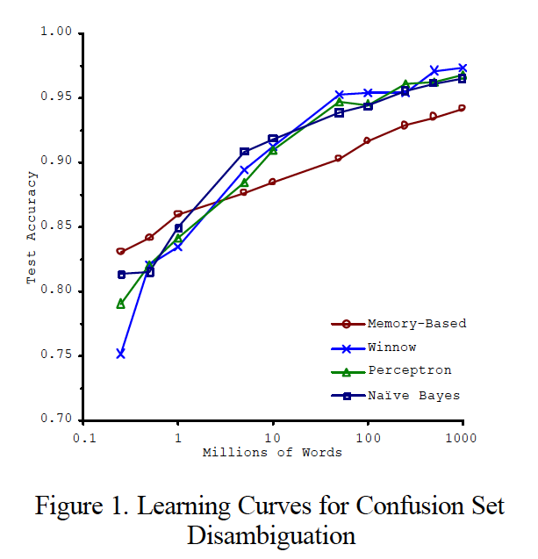
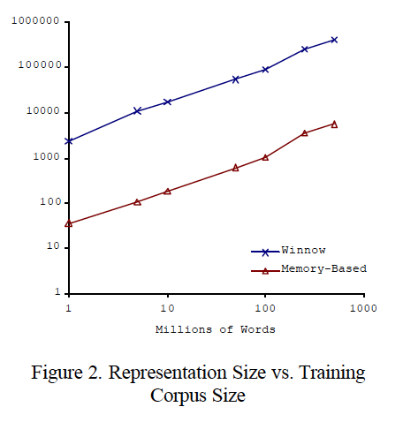
Big ML c. 2001 (Banko & Brill, “Scaling to Very Very Large…”, ACL 2001)
Task: distinguish pairs of easily-confused words (“affect” vs “effect”) in context

Slide 14
Why More Data Helps
[some bigrams for a decision]

Slide 15
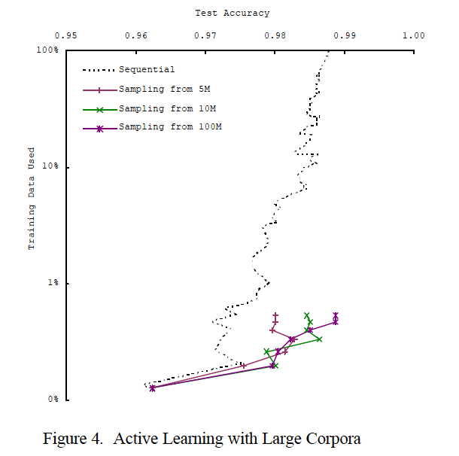
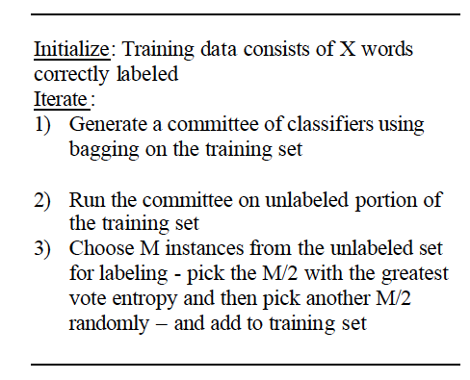
Big ML c. 2001 (Banko & Brill, “Scaling to Very Very Large…”, ACL 2001)

Slide 16
So in 2001…..
We’re learning:
  “there’s no data like more data”
  For many tasks, there’s no real substitute for using lots of data

Slide 17
…and in 2009
Eugene Wigner’s article “The Unreasonable Effectiveness of Mathematics in the Natural Sciences” examines why so much of physics can be neatly explained with simple mathematical formulas such as f = ma or e = mc². Meanwhile, sciences that involve human beings rather than elementary particles have proven more resistant to elegant mathematics. Economists suffer from physics envy over their inability to neatly model human behavior. An informal, incomplete grammar of the English language runs over 1,700 pages.
Perhaps when it comes to natural language processing and related fields, we’re doomed to complex theories that will never have the elegance of physics equations. But if that’s so, we should stop acting as if our goal is to author extremely elegant theories, and instead embrace complexity and make use of the best ally we have: the unreasonable effectiveness of data.
Norvig, Pereira, Halevy, “The Unreasonable Effectiveness of Data”, 2009

Slide 18
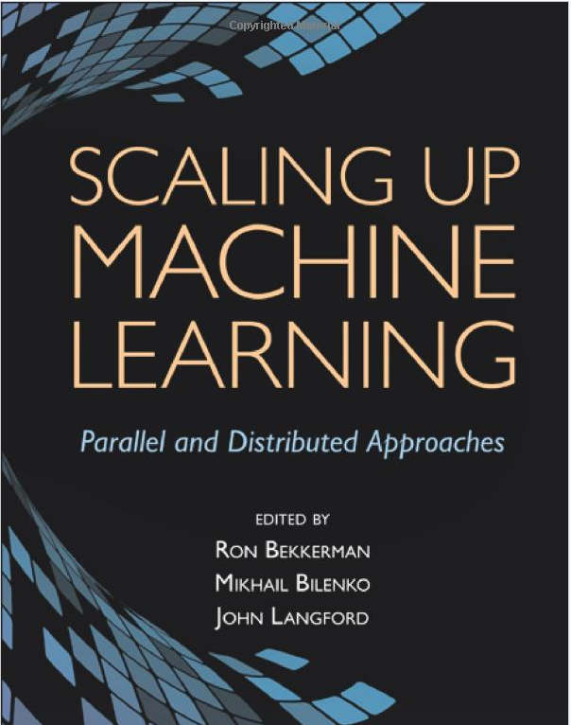
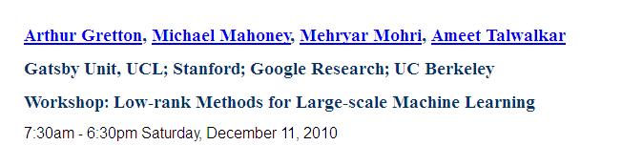
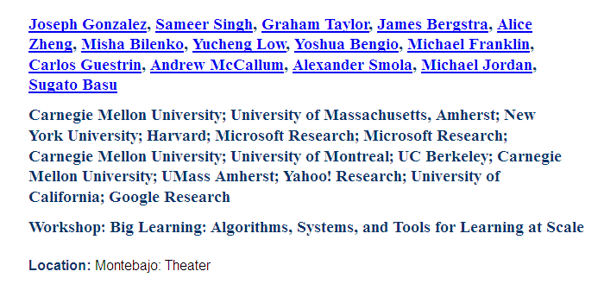
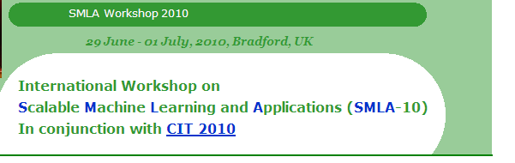
…and in 2012
Dec 2011

Slide 19
How do we use very large amounts of data?
*
Working with big data is not about
  code optimization
  learning details of todays hardware/software:
    GraphLab, Hadoop, parallel hardware, ….
Working with big data is about
  Understanding the cost of what you want to do
  Understanding what the tools that available offer
  Understanding how much can be accomplished with linear or nearly-linear operations (e.g., sorting, …)
  Understanding how to organize your computations so that they effectively use whatever’s fast
  Understanding how to test/debug/verify with large data
* according to William

Slide 20
Asymptotic Analysis: Basic Principles
Usually we only care about positive f(n), g(n), n here…

Slide 21
Asymptotic Analysis: Basic Principles
Less pedantically:
Some useful rules:
Only highest-order terms matter
Leading constants don’t matter
Degree of something in a log doesn’t matter

Slide 22
Back to rule pruning….
Algorithm
Analysis
Fit the POS,NEG exampleWhile POS isn’t empty:
  Let R be “if True ➔ pos”
  While NEG isn’t empty:
    Pick the “best” [1] condition c of the form “xi=True” or “xi=false”
    Add c to the LHS of R
    Remove examples that don’t satisfy c from NEG
  Add R to the rule set [2]
  Remove examples that satisfy R from POS
Prune the rule set:
  For each condition c in the rule set:
    Evaluate the accuracy of the ruleset w/o c on heldout data
  If removing any c improves accuracy
    Remove c and repeat the pruning step
Assume n examples
Assume m conditions in rule set
Growing rules takes time at least Ω(m*n) if evaluating c is Ω(n)
When data is clean m is small, fitting takes linear time
When k% of data is noisy, m is Ω(n*0.01*k) so growing rules takes Ω(n²)
Pruning a rule set with m = 0.01*kn extra conditions is very slow: Ω(n³) if implemented naively
    [1] “Best” is wrt some statistics on c’s coverage of POS,NEG
    [2] R is now of the form “if xi1=_ and xi2=_ and … ➔ pos”

Slide 23
Empirical analysis of complexity: plot run-time on a log-log plot and measure the slope (using linear regression)

Slide 24
Where do asymptotics break down?
When the constants are too big
  or n is too small
When we can’t predict what the program will do
  Eg, how many iterations before convergence? Does it depend on data size or not?
When there are different types of operations with different costs
  We need to understand what we should count

Slide 25
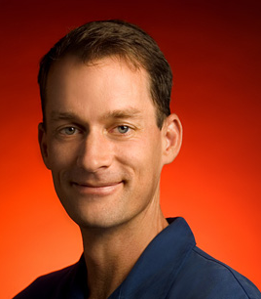
What do we count?
Compilers don’t warn Jeff Dean. Jeff Dean warns compilers.
Jeff Dean builds his code before committing it, but only to check for compiler and linker bugs.
Jeff Dean writes directly in binary. He then writes the source code as a documentation for other developers.
Jeff Dean once shifted a bit so hard, it ended up on another computer.
When Jeff Dean has an ergonomic evaluation, it is for the protection of his keyboard.
gcc -O4 emails your code to Jeff Dean for a rewrite.
When he heard that Jeff Dean's autobiography would be exclusive to the platform, Richard Stallman bought a Kindle.
Jeff Dean puts his pants on one leg at a time, but if he had more legs, you’d realize the algorithm is actually only O(logn)

Slide 26
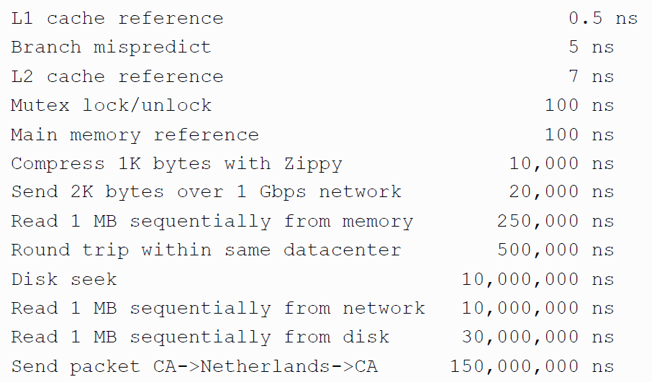
Numbers (Jeff Dean says) Everyone Should Know

Slide 27
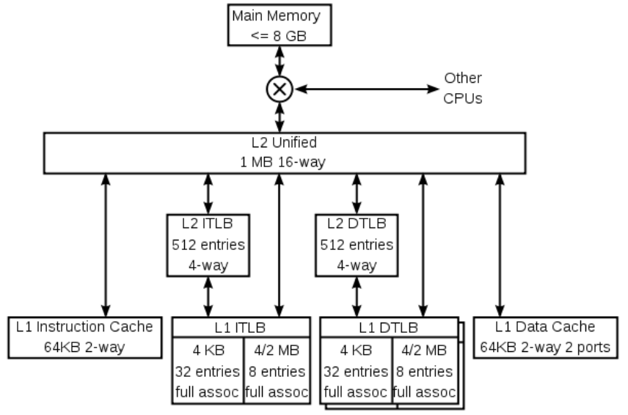
A typical CPU (not to scale)
K8 core in the AMD Athlon 64 CPU
Hard disk (1Tb)
128x bigger
16x bigger
256x bigger
Notes:
16 – me vs chihuhua – or vs midsize car
256 – me vs 2 iphones – or vs a sperm whale or 3 elephants

Slide 28

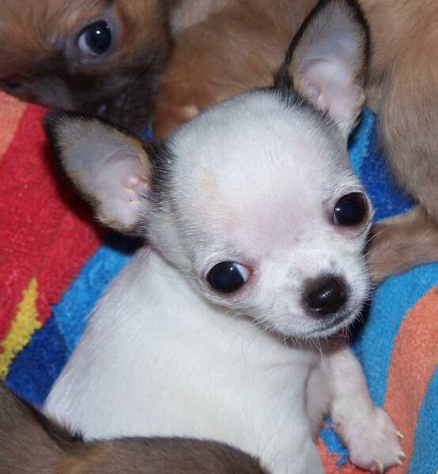
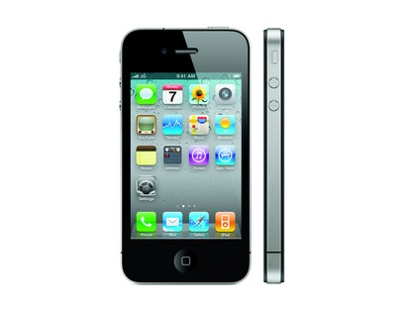
A typical CPU (not to scale)
K8 core in the AMD Athlon 64 CPU
Hard disk (1Tb)
128x bigger
16x bigger
256x bigger
Notes:
16 – me vs chihuhua – or vs midsize car
256 – me vs 2 iphones – or vs a sperm whale or 3 elephants

Slide 29
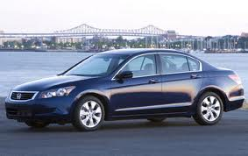
A typical CPU (not to scale)
K8 core in the AMD Athlon 64 CPU
Hard disk (1Tb)
128x bigger
16x bigger
256x bigger
Notes:
16 – me vs chihuhua – or vs midsize car
256 – me vs 2 iphones – or vs a sperm whale or 3 elephants

Slide 30
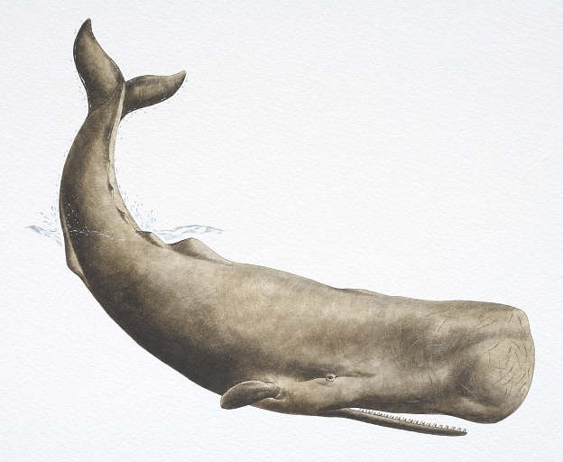
A typical CPU (not to scale)
K8 core in the AMD Athlon 64 CPU
Hard disk (1Tb)
128x bigger
16x bigger
256x bigger
Notes:
16 – me vs chihuhua – or vs midsize car
256 – me vs 2 iphones – or vs a sperm whale or 3 elephants

Slide 31
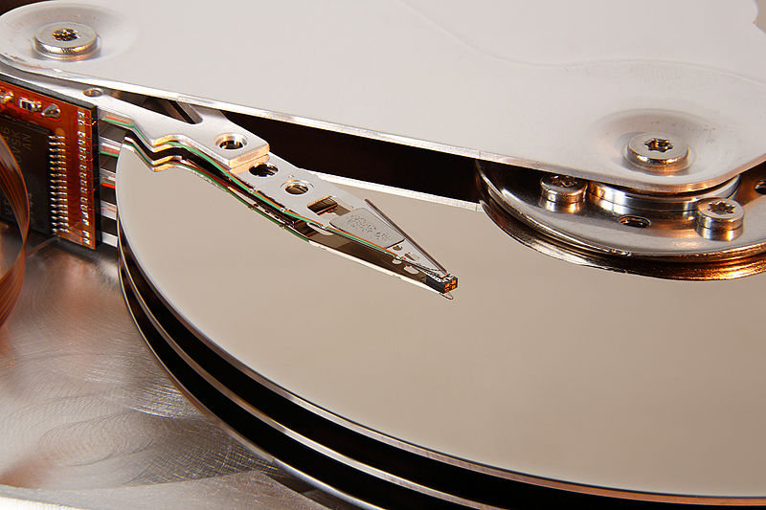
A typical disk
Notes:
16 – me vs chihuhua – or vs midsize car
256 – me vs 2 iphones – or vs a sperm whale or 3 elephants

Slide 32
Numbers (Jeff Dean says) Everyone Should Know
~= 10x
~= 15x
40x
~= 100,000x
Notes:
150x – commercial flight vs a brisk walk
100,000x – 5 hr flights would take 57 years
100,000x – 500 miles vs about 8 meters
15,000,000x – here to beijing vs 100 meters

Slide 33
What do we count?
Compilers don’t warn Jeff Dean. Jeff Dean warns compilers.
….
Memory access/instructions are qualitatively different from disk access
Seeks are qualitatively different from sequential reads on disk
Cache, disk fetches, etc work best when you stream through data sequentially
Best case for data processing: stream through the data once in sequential order, as it’s found on disk.

Slide 34
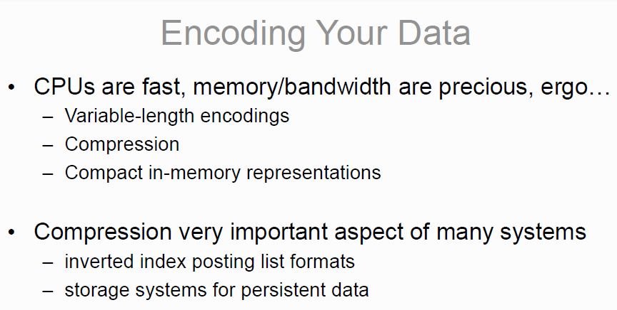
Other lessons -?
*
* but not important enough for this class’s assignments….

Slide 35
What/How
  Syllabus/outline

