Slide 1
Semi-Supervised Learning
William Cohen

Slide 2
Outline
The general idea and an example (NELL)
Some types of SSL
Margin-based: transductive SVM
Logistic regression with entropic regularization
Generative: seeded k-means
Nearest-neighbor like: graph-based SSL

Slide 3
Intro to Semi-Supervised Learning (SSL)

Slide 4
Semi-supervised learning
Given:
A pool of labeled examples L
A (usually larger) pool of unlabeled examples U
Option 1 for using L and U :
Ignore U and use supervised learning on L
Option 2:
Ignore labels in L+U and use k-means, etc find clusters; then label each cluster using L
Question:
Can you use both L and U to do better?

Slide 5
SSL is Somewhere Between Clustering and Supervised Learning

Slide 6
SSL is Between Clustering and SL

Slide 7
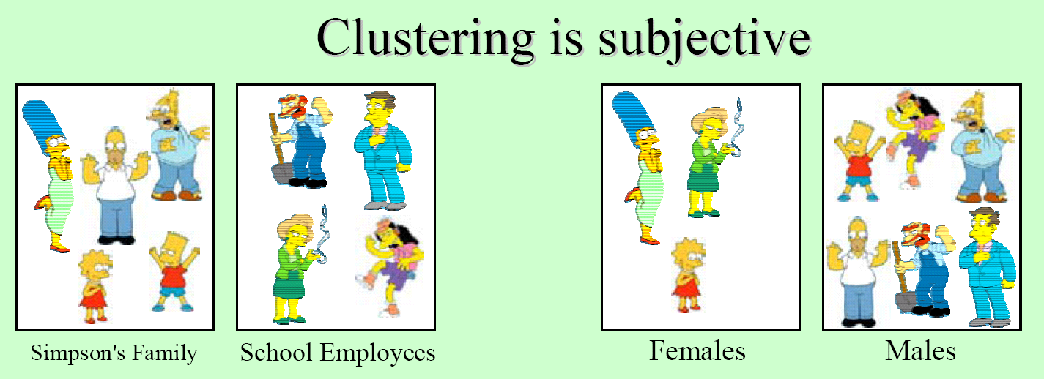
What is a natural grouping among these objects?
slides: Bhavana Dalvi

Slide 8
SSL is Between Clustering and SL
clustering is unconstrained and may not give you what you want
maybe this clustering is as good as the other

Slide 9
SSL is Between Clustering and SL

Slide 10
SSL is Between Clustering and SL

Slide 11
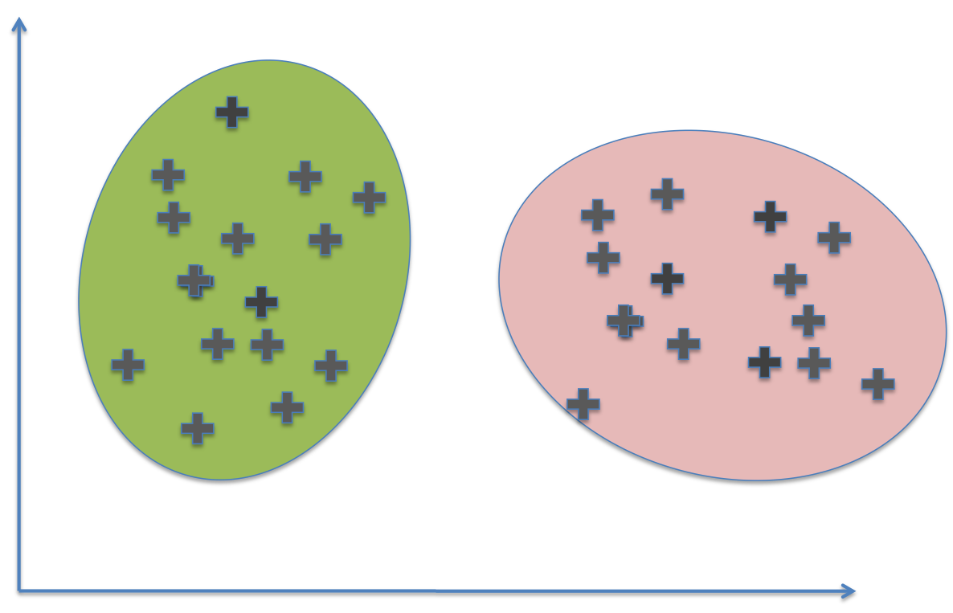
SSL is Between Clustering and SL
supervised learning with few labels is also unconstrained and may not give you what you want

Slide 12
SSL is Between Clustering and SL

Slide 13
SSL is Between Clustering and SL
This clustering isn’t consistent with the labels

Slide 14
SSL is Between Clustering and SL
|Predicted Green|/|U| ~= 50%

Slide 15
SSL in Action: The NELL System

Slide 16
Outline
The general idea and an example (NELL)
Some types of SSL
Margin-based: transductive SVM
Logistic regression with entropic regularization
Generative: seeded k-means
Nearest-neighbor like: graph-based SSL

Slide 17
Transductive SVM

Slide 18
Two Kinds of Learning
Inductive SSL:
Input: training set
(x₁,y₁),…,(x_{n},y_{n})
x_{n+1} , x_{n+2} ,…,x_{n+m}
Output: classifier
f(x) = y
Classifier can be run on any test example x
Transductive SSL:
Input: training set
(x₁,y₁),…,(x_{n},y_{n})
x_{n+1} , x_{n+2} ,…,x_{n+m}
Output: classifier
f(x_{i}) = y
Classifier is only defined for x_{i}’s seen at training time

Slide 20
Standard SVM

Slide 21
Tranductive SVM

Slide 22
Not a convex problem – need to do some sort of search to guess the labels for the unlabeled examples

Slide 23
SSL using regularized SGD for logistic regression
P(y|x)=logistic(x . w)
Define loss function
Differentiate the function and use gradient descent to learn

Slide 24
SSL using regularized SGD for logistic regression
P(y|x)=logistic(x . w)
Define loss function
Differentiate the function and use gradient descent to learn
Entropy of predictions on the unlabeled examples

Slide 25
Logistic regression with entropic regularization
High entropy example: high probability of being in either class
Low entropy example: very confident in one class
Again, a convex problem – need to do some sort of search to guess the labels for the unlabeled examples

Slide 26
Semi-Supervised K-Means and MIXTURE MODELS

Slide 27
k-means

Slide 28
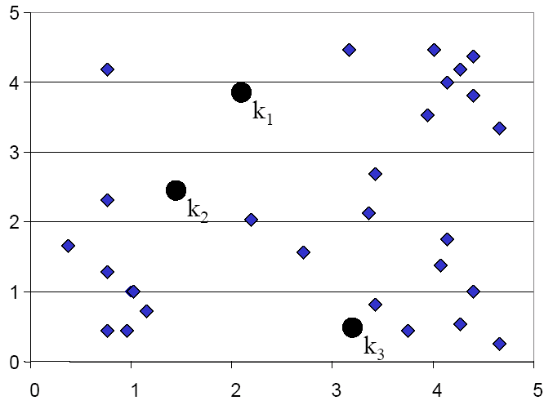
K-means Clustering: Step 1

Slide 29
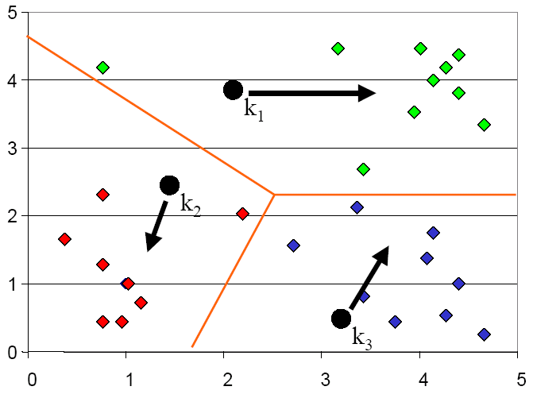
K-means Clustering: Step 2

Slide 30
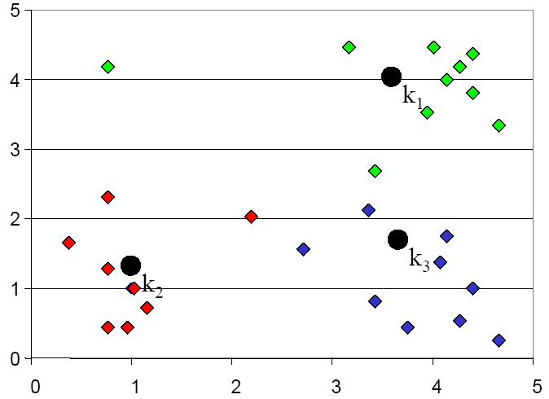
K-means Clustering: Step 3

Slide 31
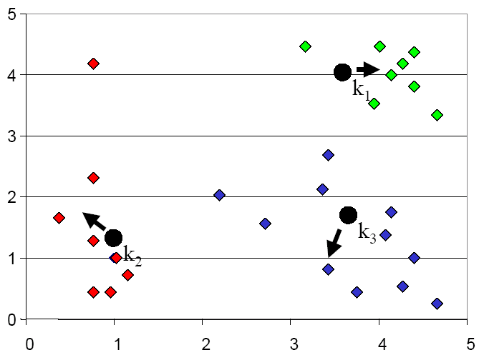
K-means Clustering: Step 4

Slide 32
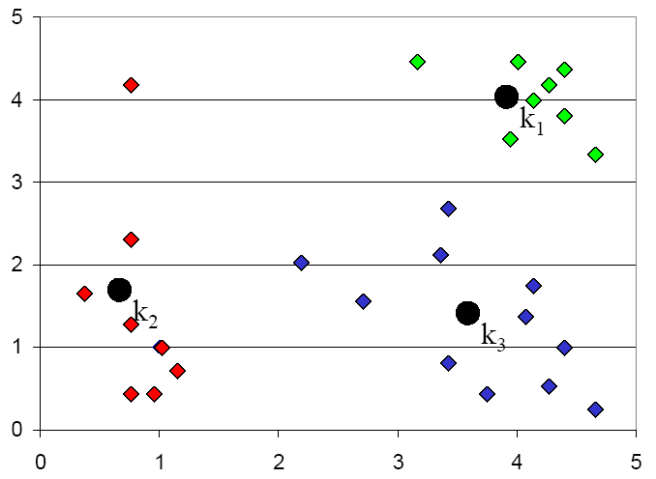
K-means Clustering: Step 5

Slide 34
Seeded k-means
k is the number of classes
using the labeled “seed” data
except keep the seeds in the class they are known to belong to

Slide 35
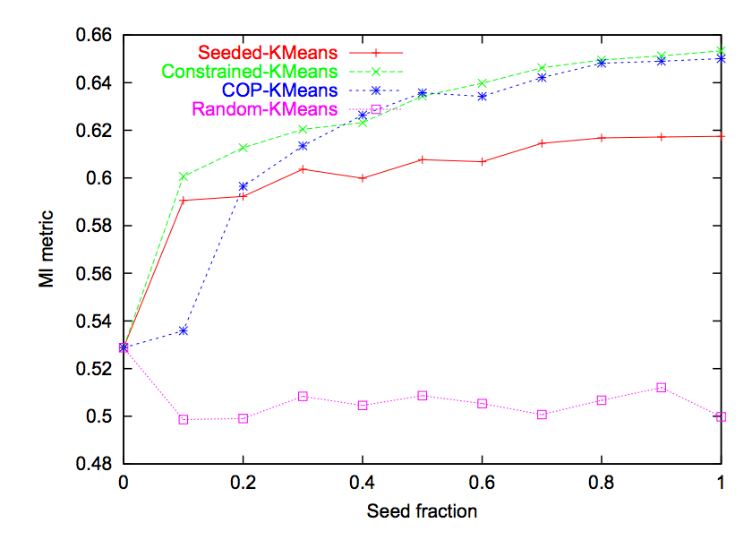
Basu and Mooney ICML 2002
Seeded k-means (constrained k-means)
Just use labeled data to initialize the clusters
Unsupervised k-means
Some old baseline I’m not going to even talk about
20 Newsgroups dataset

Slide 36
Outline
The general idea and an example (NELL)
Some types of SSL
Margin-based: transductive SVM
Logistic regression with entropic regularization
Generative: seeded k-means
Some recent extensions….
Nearest-neighbor like: graph-based SSL

Slide 37
Seeded k-means for a hierarchical classification tasks
Bit vector with one bit for each category
Simple extension:
Don’t assign to one of K classes: instead make a decision about every class in the ontology
example → {1,..K} example → 00010001
Pick “closest” bit vector consistent with constraints
this is an (ontology-sized) optimization problem that you solve independently for each example

Slide 38
Seeded k-means
k is the number of classes
using the labeled “seed” data
best consistent set of categories from the ontology
except keep the seeds in the classes they are known to belong to

Slide 39
Automatic Gloss Finding for a Knowledge Base
Glosses: Natural language definitions of named entities.
E.g. “Microsoft” is an American multinational corporation headquartered in Redmond that develops, manufactures, licenses, supports and sells computer software, consumer electronics and personal computers and services ...
Input: Knowledge Base i.e. a set of concepts (e.g. company) and entities belonging to those concepts (e.g. Microsoft), and a set of potential glosses.
Output: Candidate glosses matched to relevant entities in the KB. “Microsoft is an American multinational corporation headquartered in Redmond …” is mapped to entity “Microsoft” of type “Company”.
[Automatic Gloss Finding for a Knowledge Base using Ontological Constraints, Bhavana Dalvi Mishra, Einat Minkov, Partha Pratim Talukdar, and William W. Cohen, 2014, Under submission]

Slide 40
Example: Gloss finding

Slide 41
Example: Gloss finding

Slide 42
Example: Gloss finding

Slide 43
Example: Gloss finding

Slide 44
Training a clustering model
Fruit
Company
Unlabeled: Ambiguous
Labeled: Unambiguous

Slide 45
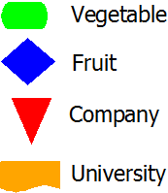
GLOFIN: Clustering glosses

Slide 46
GLOFIN: Clustering glosses

Slide 47
GLOFIN: Clustering glosses

Slide 48
GLOFIN: Clustering glosses

Slide 49
GLOFIN: Clustering glosses

Slide 50
GLOFIN: Clustering glosses

Slide 51
GLOFIN on NELL Dataset
275 categories, 247K candidate glosses, #train=20K, #test=227K

Slide 52
Outline
The general idea and an example (NELL)
Some types of SSL
Margin-based: transductive SVM
Logistic regression with entropic regularization
Generative: seeded k-means
Nearest-neighbor like: graph-based SSL

Slide 53
Idea: construct a graph connecting the most similar examples (k-NN graph)
Intuition: nearby points should have similar labels – labels should “propagate” through the graph
Formalization: try and minimize “energy” defined as:
Harmonic fields – Gharamani, Lafferty and Zhu
In this example y is a length-10 vector
Observed label

Slide 54
Result 1: at the minimal energy state, each node’s value is a weighted average of its neighbor’s weights:
Harmonic fields – Gharamani, Lafferty and Zhu
Observed label

Slide 55
“Harmonic field” LP algorithm
Result 2: you can reach the minimal energy state with a simple iterative algorithm:
Step 1: For each seed example (x_{i},y_{i}):
Let V⁰(i,c) = [| y_{i}= c |]
Step 2: for t=1,…,T --- T is about 5
Let V^{t+1}(i,c) =weighted average of V^{t+1}(j,c) for all j that are linked to i, and renormalize
For seeds, reset V^{t+1}(i,c) = [| y_{i}= c |]

Slide 56
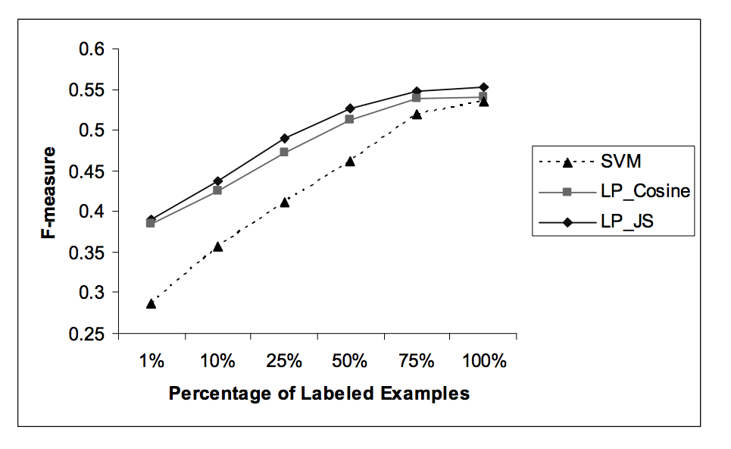
Harmonic fields – Gharamani, Lafferty and Zhu
This family of techniques is called “Label propagation”

Slide 57
Harmonic fields – Gharamani, Lafferty and Zhu
This family of techniques is called “Label propagation”
This experiment points out some of the issues with LP:
What distance metric do you use?
What energy function do you minimize?
What is the right value for K in your K-NN graph? Is a K-NN graph right?
If you have lots of data, how expensive is it to build the graph?

Slide 58
NELL: Uses Co-EM ~= HF
Extract cities:
Examples
Paris
Pittsburgh
Seattle
Cupertino
San Francisco
Austin
denial
anxiety
selfishness
Berlin
mayor of arg1
live in arg1
arg1 is home of
traits such as arg1
Features

Slide 59
Semi-Supervised Bootstrapped Learning via Label Propagation
mayor of arg1
arg1 is home of
San Francisco
Austin
Paris
Pittsburgh
anxiety
live in arg1
traits such as arg1
denial
selfishness
Seattle

Slide 60
Semi-Supervised Bootstrapped Learning via Label Propagation
mayor of arg1
arg1 is home of
Information from other categories tells you “how far” (when to stop propagating)
San Francisco
Austin
Paris
Pittsburgh
anxiety
traits such as arg1
live in arg1
traits such as arg1
arrogance
denial
selfishness
denial
selfishness
Seattle
Nodes “near” seeds
Nodes “far from” seeds

Slide 61
Difference: graph construction is not instance-to-instance but instance-to-feature
Paris
San Francisco
Austin
Pittsburgh
anxiety
denial
selfishness
Seattle

Slide 62
Some other general issues with SSL
How much unlabeled data do you want?
Suppose you’re optimizing J = J_{L}(L) + J_{U}(U)
If |U| >> |L| does J_{U} dominate J?
If so you’re basically just clustering
Often we need to balance J_{L} and J_{U}
Besides L, what other information about the task is useful (or necessary)?
Common choice: relative frequency of classes
Various ways of incorporating this into the optimization problem

Slide 63
Key and not-so-key points
The general idea : what is SSL and when do you want to use it?
NELL as an example of SSL
Different SSL methods:
margin-based approach: start with a supervised learner
transductive SVM: what’s optimized and why
logistic reg with entropic regularization
k-means versus seeded k-means: start with clustering
The core algorithm and what
Extension to hierarchical case and GLOFIN
nearest-neighbor like: graph-based SSL and LP
The HF algorithm and the energy function being minimized

