Slide 1
Course Overview and Review of Probability
William W. Cohen
Machine Learning 10-601

Slide 2
OVERVIEW of 601
Spring 2016
Section B

Slide 3
This is 10-601B (I’m William Cohen)
Main information page: the class wiki
  My home page → teaching
Those pages
  have all the lecture slides and homeworks
  link to everything else we’ll be using
    eg, Piazza, Autolab, MediaTech

Slide 4
What the course is about…
Normal computer science:
  Human figures out how to do something
  Human programs the computer to do it
Machine learning
  Somebody (maybe humans) does something … usually many times
  A computer learns how to do it from data
  Classification learning – one kind of ML:
    Task: label an object with one of a fixed set of labels
    Examples: …

Slide 5
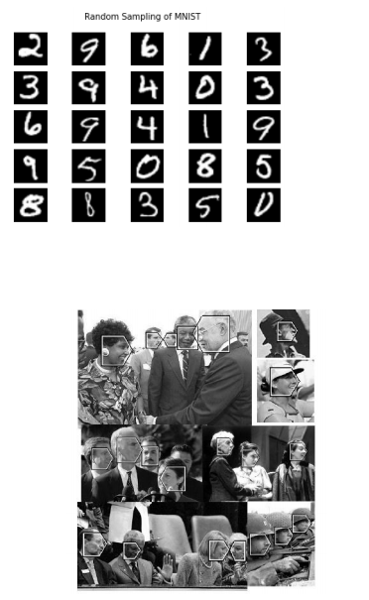


Classification learning
classes: 0,1,2,…,9
f
“5”
classes: left, right, up, down, forward
f
“right”
classes: noface, left, right, up, down, forward
f
“noface”
f
“fwd”

Slide 6
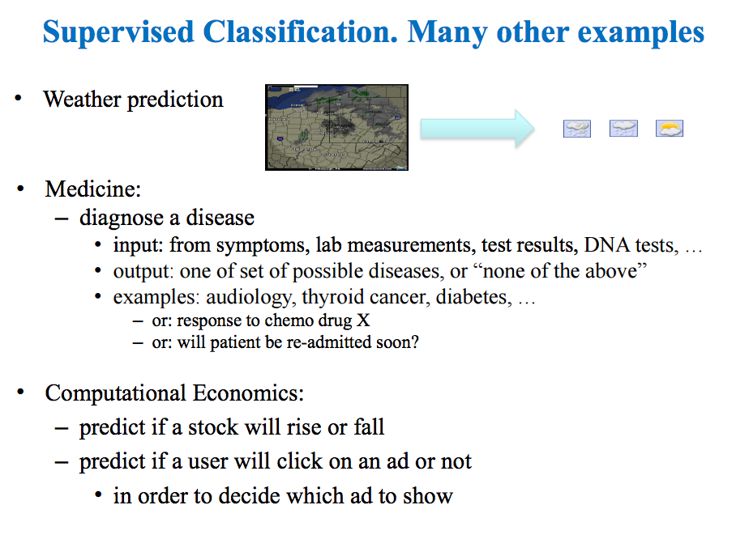

Slide 7
Classification learning
classes: 1,2,…,9
What does f look like?
f
“5”
f(input) = output
input: usually a vector
= <p11,p12,…,p1N,p21,….,p2N,….,pNN>
= <0,0,0,0,…,0,1,1,0,1,1,0,…., …. 0,0,0 >

Slide 8
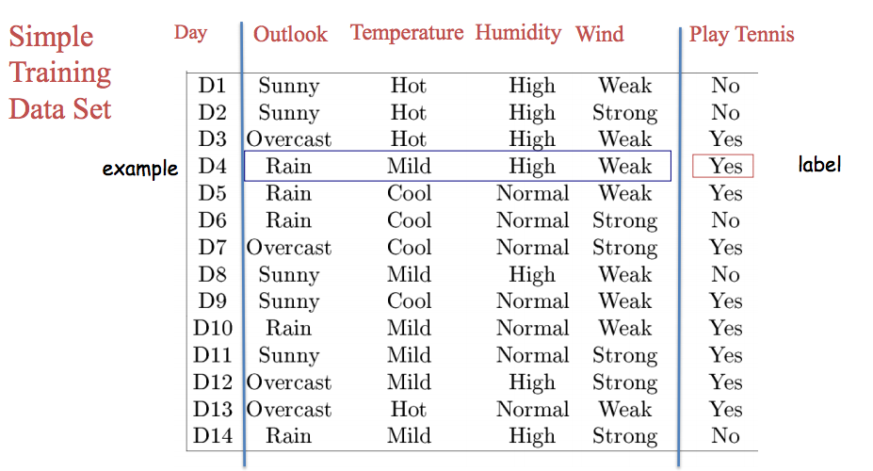
3
1
3
1

Slide 9
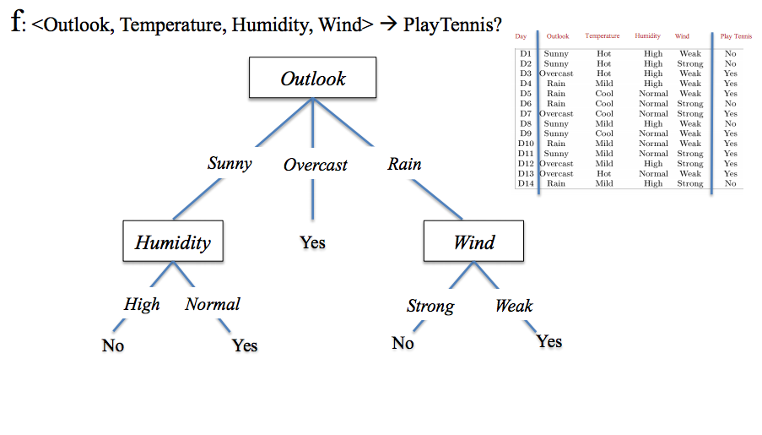

Slide 10
What the course is about…
Normal computer science:
  Human figures out how to do something
  Human programs the computer to do it
Machine learning
  Somebody (maybe humans) does something … usually many times
  A computer learns how to do it from data
  Classification learning – one kind of ML:
    Task: label an object with one of a fixed set of labels
    Examples: learning to label feature vectors with a decision tree using TDIDT

Slide 11
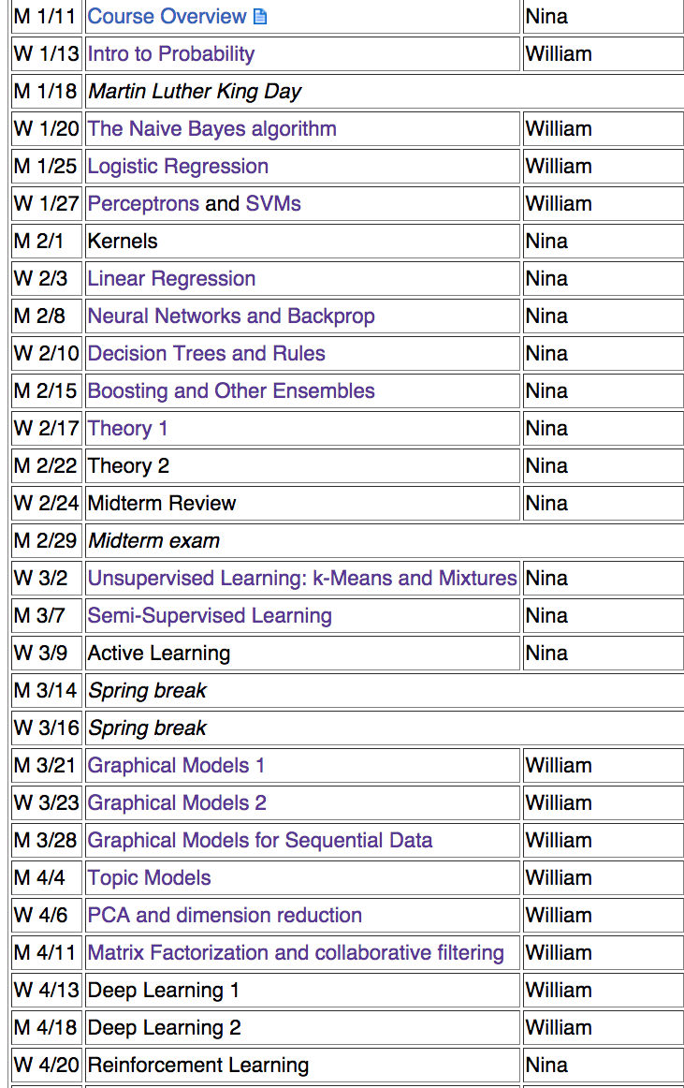
What the course is about…
Crucial background
Supervised classification
learning … and regression
(predicting numeric values)
Different learning algorithms, and different approaches and ways of analyzing performance
Why do these techniques generalize?

Slide 12
What the course is about…
Other models for learning:
learning + unlabeled data;
learning with q/a
Richer tools for describing probability distributions
More learning models
and advanced topics

Slide 13
a review of probability
Why I’m starting with

Slide 14
Why Probability is Important

Slide 15
What is machine learning good for?
Tasks involving uncertainty and/or complexity.
If there is uncertainty how should you
… represent it, formally?
… reason about it, precisely?
… generalize from data, justifiably?

Slide 16
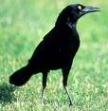

A paradox of induction
A black crow seems to support the hypothesis “all crows are black”.
A pink highlighter supports the hypothesis “all non-black things are non-crows”
Thus, a pink highlighter supports the hypothesis “all crows are black”.

Slide 17
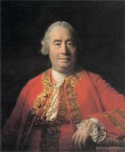
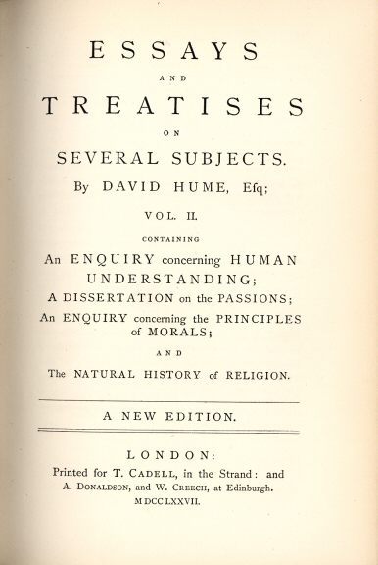
Hume’s Problem of Induction
David Hume (1711-1776): pointed out
  Empirically, induction seems to work
  Statement (1) is an application of induction.
This stumped people for about 200 years (Karl Popper, 1902-1994)
Of the Different Species of Philosophy.
Of the Origin of Ideas
Of the Association of Ideas
Sceptical Doubts Concerning the Operations of the Understanding
Sceptical Solution of These Doubts
Of Probability⁹
Of the Idea of Necessary Connexion
Of Liberty and Necessity
Of the Reason of Animals
Of Miracles
Of A Particular Providence and of A Future State
….

Slide 18
anything
If there is uncertainty how should you
… represent it, formally?
… reason about it, precisely?
Success stories:
  geometry (Euclid, 300 BCE): five axioms, proofs, and theorems
  logic and Boolean algebra (1854)
  probability and games of chance (1800’s, Laplace)
  axiomatic treatment of probability (1900’s, Kolmorogov)

Slide 19


Models
True about the model
True about the world
has 1 propeller (aft)
ship number = 571
….
14” long
built in 2013
has 1 propeller (aft)
ship number = 571
….
320’ long
built in 1955

Slide 20

Formal Model of Geometry
Axioms:
two points ➔ one line
one line segment ➔ one line
one line segment, endpoint ➔ one circle
all right angles are congruent
parallel lines don’t meet
“Lines”
“Triangles”
True about the world
True about the model
sum of degrees of angles in a triangle = 180
….
sum of degrees of angles in a triangle = 180
….

Slide 21
Formal Model of Uncertainty
?
“?”
“?”
True about the world
True about the model
?
….
?
….

Slide 22
Experiments, Outcomes, Random Variables and Events
A is a Boolean-valued random variable if
  A denotes an event,
  there is uncertainty as to whether A occurs.
Define P(A) as “the fraction of experiments in which A is true”
  We’re assuming all possible outcomes are equiprobable
Examples
  You roll two 6-sided die (the experiment) and get doubles (A=doubles, the outcome)
  I pick two students in the class (the experiment) and they have the same birthday (A=same birthday, the outcome)
a possible outcome of an “experiment”
the experiment is not deterministic

Slide 23
Formal Model of Uncertainty
Axioms of probability
Pr(A) >= 0
Pr(True) = 1
If A1, A2, …. are disjoint then
Pr(A1 or A2 or … ) = Pr(A1) + Pr(A2) + …
“Experiments”
“Outcomes”
True about the world
True about the model
….
….

Slide 24
Some more examples of uncertainty
A is a Boolean-valued random variable if
  A denotes an event,
  there is uncertainty as to whether A occurs.
More examples
  A = You wake up tomorrow with a headache
  A = The US president in 2023 will be male
  A = there is intelligent life elsewhere in our galaxy
  A = the 1,000,000,000,000,000,000,000th digit of π is 7
  A = I woke up today with a headache
Define P(A) as “the fraction of possible worlds in which A is true”
  … seems a little awkward …
  what if we just define P(A) as an arbitrary measure of belief?

Slide 25
Formal Model of Uncertainty
Axioms of probability
Pr(A) >= 0
Pr(True) = 1
If A1, A2, …. are disjoint then
Pr(A1 or A2 or … ) = Pr(A1) + Pr(A2) + …
“Beliefs”
“Observations”
True about the world
True about the model
….
….

Slide 26

These Axioms are Not to be Trifled With
- Andrew Moore
There have been many many other approaches to understanding “uncertainty”:
    Fuzzy Logic, three-valued logic, Dempster-Shafer, non-monotonic reasoning, …
40 years ago people in AI argued about these; now they mostly don’t
  Any scheme for combining uncertain information, uncertain “beliefs”, etc,… really should obey these axioms to be internally consistent (from Jayne, 1958; Cox 1930’s)
  If you gamble based on “uncertain beliefs”, then [you can be exploited by an opponent] ⬄ [your uncertainty formalism violates the axioms] - di Finetti 1931 (the “Dutch book argument”)

Slide 27
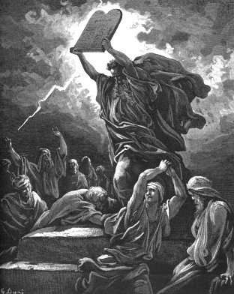
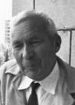
(This is Andrew’s joke)
The Axioms Of Probability
I guess this is Andrey Kolmorogov

Slide 28
Examples of Reasoning with Axioms of Probability

Slide 29
Andrew’s Axioms of Probability
K1,K2,K3
Pr(A) >= 0
Pr(True) = 1
If A1, A2, …. are disjoint then
Pr(A1 or A2 or … ) = Pr(A1) + Pr(A2) + …
A1,A2,A3,A4
0 <= P(A) <= 1
P(True) = 1
P(False) = 0
P(A or B) = P(A) + P(B) - P(A and B)
Are these the same as before?

Slide 30
Andrew’s Axioms of Probability
K1,…,K3
A1,…,A4
Pr(A) >= 0
Pr(True) = 1
If A1, A2, …. are disjoint then
Pr(A1 or A2 or … ) = Pr(A1) + Pr(A2) + …
✔
0 <= P(A) <= 1
P(True) = 1 ✔
P(False) = 0
P(A or B) = P(A) + P(B) - P(A and B)
Monotonicity: if A is a subset of B, then P(A) <= P(B)
Proof:
A subset of B ➔ B = A + C for C=B-A
A and C are disjoint ➔ P(B) = P(A or C)=P(A) + P(C)
P(C) >= 0
So P(B) >= P(A)
K3
K1
Monotonicity and K2 ➔ A1

Slide 31
Andrew’s Axioms of Probability
Pr(A) >= 0
Pr(True) = 1
If A1, A2, …. are disjoint then
Pr(A1 or A2 or … ) = Pr(A1) + Pr(A2) + …
✔
0 <= P(A) <= 1
P(True) = 1 ✔
P(False) = 0
P(A or B) = P(A) + P(B) - P(A and B)
✔
Theorem: P(~A) = 1 - P(A)
Proof:
P(A or ~A) = P(True) = 1
A and ~A are disjoint ➔ P(A) + P(~A )=P(A or ~A)
  P(A) + P(~A) = 1
  ….then solve for P(~A)
K2
K3
K2 + K3 + A2 ➔ A3

Slide 32
Andrew’s Axioms of Probability
Pr(A) >= 0
Pr(True) = 1
If A1, A2, …. are disjoint then
Pr(A1 or A2 or … ) = Pr(A1) + Pr(A2) + …
✔
0 <= P(A) <= 1
P(True) = 1 ✔
P(False) = 0
P(A or B) = P(A) + P(B) - P(A and B)
✔
✔
Theorem: P(A or B) = P(A) + P(B) - P(A and B)
Proof:
E1 = A and ~(A and B)
E2 = (A and B)
E3 = B and ~(A and B)
E1 or E2 or E3 = A or B and E1, E2, E3 disjoint ➔
  P(A or B) = P(E1) + P(E2) + P(E3)
further P(A) = P(E1) + P(E2) and P(B) = P(E3) + P(E2)
...
P(E1)+P(E2)
- P(E2)
P(E3)+P(E2)
K2
K3

Slide 33
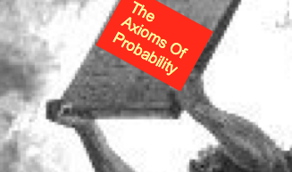
Conclusion…
T/F: Do you want to be famous for developing a new theory of uncertainty?
Answer: no. It would either violate one of the axioms, or just be a syntactic variant of probability

Slide 34
Key Concepts in Probability

Slide 35
Probability - what you need to really, really know
Probabilities are cool
Random variables and events
The axioms of probability
  These define a formal model for uncertainty
Independence

Slide 36
Independent Events
Definition: two events A and B are independent if Pr(A and B)=Pr(A)*Pr(B).
Intuition: outcome of A has no effect on the outcome of B (and vice versa).
  We need to assume the different rolls are independent to solve the problem.
  You frequently need to assume the independence of something to solve any learning problem.

Slide 37
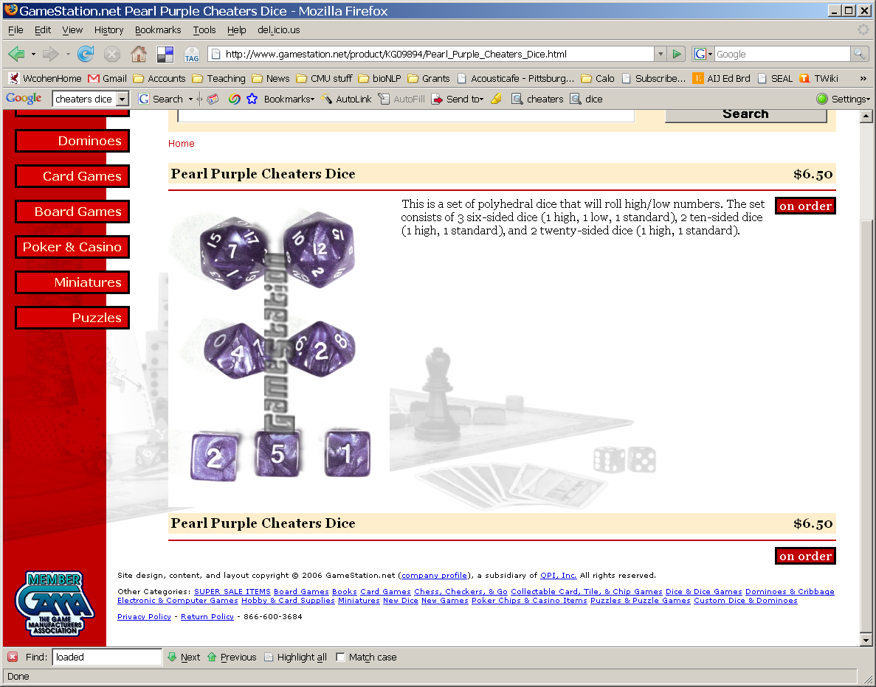
Some practical problems
You’re the DM in a D&D game.
Joe brings his own d20 and throws 4 critical hits in a row to start off
  DM=dungeon master
  D20 = 20-sided die
  “Critical hit” = 19 or 20
What are the odds of that happening with a fair die?
Ci=critical hit on trial i, i=1,2,3,4
P(C1 and C2 … and C4) = P(C1)*…*P(C4) = (1/10)^4
To get there we assumed the rolls were independent
Notes:
8/52 * 7/52 * 6/52 ~= 2.4/10,000 w/o replacement, (8/3)^3 ~= 3.6/10,000

Slide 38
Multivalued Discrete Random Variables
Suppose A can take on more than 2 values
A is a random variable with arity k if it can take on exactly one value out of {v₁,v₂, .. v_{k}}
  Example: V={1,2,3….,20}: good for 20-sided dice games
Notation: let’s write the event AHasValueOfv as “A=v”
To get the right behavior: define as axioms:

Slide 39
….or in pictures
A=2
A=3
A=5
A=4
A=1

Slide 40
More about Multivalued Random Variables
  Another example: modeling English text
  V={aaliyah, aardvark, …, zymurge, zynga}
  very useful for modeling text (but hard to keep track of unless you have a computer):
  A1=another A2=example A3=v A4=“=“ … A31=computer A32=“)” A33=“:”

Slide 41
Continuous Random Variables
The discrete case: sum over all values of A is 1
The continuous case: infinitely many values for A and the integral is 1
Pr(A) >= 0
Pr(True) = 1
If A1, A2, …. are disjoint then
Pr(A1 or A2 or … ) = Pr(A1) + Pr(A2) + …
also….
f(x) is a probability density function (pdf)

Slide 42

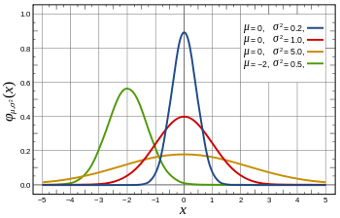
Continuous Random Variables

Slide 43
Key Concepts in Probability:
Conditional Probability and the Chain Rule

Slide 44
Probability - what you need to really, really know
Probabilities are cool
Random variables and events
The axioms of probability
Independence, binomials, multinomials, continuous distributions, pdf’s
Conditional probabilities

Slide 45
A practical problem
I have two d20 die, one loaded, one standard
Loaded die will give a 19/20 (“critical hit”) half the time.
In the game, someone hands me a random die, which is fair (A) with P(A)=0.5. Then I roll, and either get a critical hit (B) or not (~B).
What is P(B)?
P(B) = P(B and A) + P(B and ~A)
= 0.1*0.5 + 0.5*(0.5) = 0.3

Slide 46
A practical problem
I have lots of standard d20 die, lots of loaded die, all identical.
Loaded die will give a 19/20 (“critical hit”) half the time.
In the game, someone hands me a random die, which is fair (A) or loaded (~A), with P(A) depending on how I mix the die. Then I roll, and either get a critical hit (B) or not (~B)
Can I mix the dice together so that P(B) is anything I want - say, p(B)= 0.137 ?
P(B) = P(B and A) + P(B and ~A)
= 0.1*λ + 0.5*(1- λ) = 0.137
“mixture model”
λ = (0.5 - 0.137)/0.4 = 0.9075
Mixtures let us build more complex models from simpler ones.

Slide 47
Another picture for this problem
It’s more convenient to say
“if you’ve picked a fair die then …” i.e. Pr(critical hit|fair die)=0.1
“if you’ve picked the loaded die then….” Pr(critical hit|loaded die)=0.5
Conditional probability:
Pr(B|A) = P(B^A)/P(A)
A (fair die)
~A (loaded)
~A and B
P(B|A)
P(B|~A)
A and B

Slide 48
Definition of Conditional Probability
P(A ^ B)
P(A|B) = -----------
P(B)
Corollary: The Chain Rule
P(A ^ B) = P(A|B) P(B)

Slide 49
Some practical problems
“marginalizing out” A
I have 3 standard d20 dice, 1 loaded die.
Experiment: (1) pick a d20 uniformly at random then (2) roll it. Let A=d20 picked is fair and B=roll 19 or 20 with that die. What is P(B)?
P(B) = P(B|A) P(A) + P(B|~A) P(~A)
= 0.1*0.75 + 0.5*0.25 = 0.2

Slide 50
P(B) = P(B|A)P(A) + P(B|~A)P(~A)
P(A)
P(~A)
A (fair die)
~A (loaded)
~A and B
P(B|A)
P(B|~A)
A and B

Slide 51
NOTATION

Slide 52
Very widely used shortcut
Put another way: the chain rule holds for any events A and B. For multivalued discrete variables, there are many possible “A events” (events I could denote by A) and many possible “B events”.
Consequence: estimating Pr(A|B) might mean estimating many numbers….

Slide 53
Definition of Conditional Probability
P(A ^ B)
P(A|B) = -----------
P(B)
Corollary: The Chain Rule
P(A ^ B) = P(A|B) P(B)

Slide 54
Key Concepts in Probability:
Smoothing

Slide 55
Some practical problems
I bought a loaded d20 on EBay…but it didn’t come with any useful specs. How can I find out how it behaves?
1. Collect some data (20 rolls)
2. Estimate Pr(i)=C(rolls of i)/C(any roll)

Slide 56
One solution
I bought a loaded d20 on EBay…but it didn’t come with any specs. How can I find out how it behaves?
P(1)=0
P(2)=0
P(3)=0
P(4)=0.1
…
P(19)=0.25
P(20)=0.2
MLE = maximum
likelihood estimate
But: Do I really think it’s impossible to roll a 1,2 or 3?

Slide 57
A better solution
I bought a loaded d20 on EBay…but it didn’t come with any specs. How can I find out how it behaves?
0. Imagine some data (20 rolls, each i shows up 1x)
1. Collect some data (20 rolls)
2. Estimate Pr(i)=C(rolls of i)/C(any roll)

Slide 58
A better solution
I bought a loaded d20 on EBay…but it didn’t come with any specs. How can I find out how it behaves?
P(1)=1/40
P(2)=1/40
P(3)=1/40
P(4)=(2+1)/40
…
P(19)=(5+1)/40
P(20)=(4+1)/40=1/8
0.25 vs. 0.125 – really different! Maybe I should “imagine” less data?

Slide 59
A better solution?
P(1)=1/40
P(2)=1/40
P(3)=1/40
P(4)=(2+1)/40
…
P(19)=(5+1)/40
P(20)=(4+1)/40=1/8
0.25 vs. 0.125 – really different! Maybe I should “imagine” less data?

Slide 60
A better solution?
Q: What if I used m rolls with a probability of q=1/20 of rolling any i?
I can use this formula with m>20, or even with m<20 … say with m=1

Slide 61
A better solution
Q: What if I used m rolls with a probability of q=1/20 of rolling any i?
If m>>C(ANY) then your imagination q rules
If m<<C(ANY) then your data rules BUT you never ever ever end up with Pr(i)=0

Slide 62
Terminology – more later
This is called a uniform Dirichlet prior
C(i), C(ANY) are sufficient statistics
MLE = maximum
likelihood estimate
MAP= maximum
a posteriori estimate

Slide 63
Recap:
Probabilities are Awesome

Slide 64
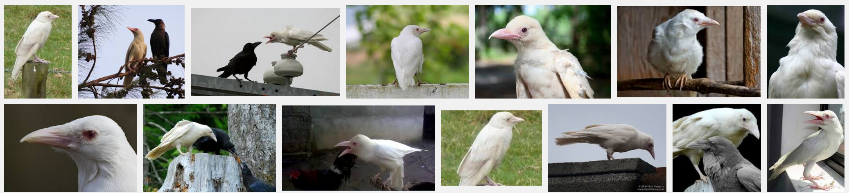
whut?
crows
non-crows
not black
black
B = black
C = crow
collect statistics for P(B|C)

Slide 65
Key Concepts in Probability:
Bayes rule

Slide 66
Some practical problems
I have 3 standard d20 dice, 1 loaded die.
Experiment: (1) pick a d20 uniformly at random then (2) roll it. Let A=d20 picked is fair and B=roll 19 or 20 with that die.
Suppose B happens (e.g., I roll a 20). What is the chance the die I rolled is fair? i.e. what is P(A|B) ?

Slide 67
P(A|B) = ?
P(A and B) = P(A|B) * P(B)
P(B|A) * P(A)
P(A|B) =
P(A and B) = P(B|A) * P(A)
P(B)
P(A|B) * P(B) = P(B|A) * P(A)
P(B)
A (fair die)
~A (loaded)
P(A)
P(~A)
A and B
~A and B
P(B|A)
P(B|~A)

Slide 68
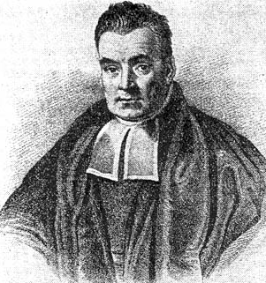
posterior
prior
P(B|A) * P(A)
P(A|B) =
Bayes’ rule
P(B)
P(A|B) * P(B)
P(B|A) =
P(A)
Bayes, Thomas (1763) An essay towards solving a problem in the doctrine of chances. Philosophical Transactions of the Royal Society of London, 53:370-418
…by no means merely a curious speculation in the doctrine of chances, but necessary to be solved in order to a sure foundation for all our reasonings concerning past facts, and what is likely to be hereafter…. necessary to be considered by any that would give a clear account of the strength of analogical or inductive reasoning…

Slide 69
Probability - what you need to really, really know
Probabilities are cool
Random variables and events
The Axioms of Probability
Independence, binomials, multinomials, …
Conditional probabilities
Bayes Rule

Slide 70
Some practical problems
Joe throws 4 critical hits in a row, is Joe cheating?
A = Joe using cheater’s die
C = roll 19 or 20; P(C|A)=0.5, P(C|~A)=0.1
B = C1 and C2 and C3 and C4
Pr(B|A) = 0.0625 P(B|~A)=0.0001
Notes:
perl try.pl 0.01
q = 0.863259668508287
perl try.pl 0.0001
q = 0.0588290662650602
perl try.pl 0.001
q = 0.384852216748769

Slide 71
What’s the experiment and outcome here?
Outcome A: Joe is cheating
Experiment:
  Joe picked a die uniformly at random from a bag containing 10,000 fair die and one bad one.
  Joe is a D&D player picked uniformly at random from set of 1,000,000 people and n of them cheat with probability p>0.
  I have no idea, but I don’t like his looks. Call it P(A)=0.1

Slide 72
Remember: Don’t Mess with The Axioms
A subjective belief can be treated, mathematically, like a probability
  Use those axioms!
There have been many many other approaches to understanding “uncertainty”:
    Fuzzy Logic, three-valued logic, Dempster-Shafer, non-monotonic reasoning, …
25 years ago people in AI argued about these; now they mostly don’t
  Any scheme for combining uncertain information, uncertain “beliefs”, etc,… really should obey these axioms
  If you gamble based on “uncertain beliefs”, then [you can be exploited by an opponent] ⬄ [your uncertainty formalism violates the axioms] - di Finetti 1931 (the “Dutch book argument”)

Slide 73
Some practical problems
Joe throws 4 critical hits in a row, is Joe cheating?
A = Joe using cheater’s die
C = roll 19 or 20; P(C|A)=0.5, P(C|~A)=0.1
B = C1 and C2 and C3 and C4
Pr(B|A) = 0.0625 P(B|~A)=0.0001
Moral: with enough evidence the prior P(A) doesn’t really matter.
Notes:
perl try.pl 0.01
q = 0.863259668508287
perl try.pl 0.0001
q = 0.0588290662650602
perl try.pl 0.001
q = 0.384852216748769

Slide 74
Stopped here Wed 11/13

Slide 75
Key Concepts in Probability:
SMOOTHING, MLE, and MAP

Slide 76
Probability - what you need to really, really know
Probabilities are cool
Random variables and events
The Axioms of Probability
Independence, binomials, multinomials
Conditional probabilities
Bayes Rule
MLE’s, smoothing, and MAPs

Slide 77
Some practical problems
I bought a loaded d20 on EBay…but it didn’t come with any specs. How can I find out how it behaves?
1. Collect some data (20 rolls)
2. Estimate Pr(i)=C(rolls of i)/C(any roll)

Slide 78
One solution
I bought a loaded d20 on EBay…but it didn’t come with any specs. How can I find out how it behaves?
P(1)=0
P(2)=0
P(3)=0
P(4)=0.1
…
P(19)=0.25
P(20)=0.2
MLE = maximum
likelihood estimate
But: Do I really think it’s impossible to roll a 1,2 or 3?

Slide 79
A better solution
I bought a loaded d20 on EBay…but it didn’t come with any specs. How can I find out how it behaves?
0. Imagine some data (20 rolls, each i shows up 1x)
1. Collect some data (20 rolls)
2. Estimate Pr(i)=C(rolls of i)/C(any roll)

Slide 80
A better solution
I bought a loaded d20 on EBay…but it didn’t come with any specs. How can I find out how it behaves?
P(1)=1/40
P(2)=1/40
P(3)=1/40
P(4)=(2+1)/40
…
P(19)=(5+1)/40
P(20)=(4+1)/40=1/8
0.25 vs. 0.125 – really different! Maybe I should “imagine” less data?

Slide 81
A better solution?
P(1)=1/40
P(2)=1/40
P(3)=1/40
P(4)=(2+1)/40
…
P(19)=(5+1)/40
P(20)=(4+1)/40=1/8
0.25 vs. 0.125 – really different! Maybe I should “imagine” less data?

Slide 82
A better solution?
Q: What if I used m rolls with a probability of q=1/20 of rolling any i?
I can use this formula with m>20, or even with m<20 … say with m=1

Slide 83
A better solution
Q: What if I used m rolls with a probability of q=1/20 of rolling any i?
If m>>C(ANY) then your imagination q rules
If m<<C(ANY) then your data rules BUT you never ever ever end up with Pr(i)=0

Slide 84
Terminology – more later
This is called a uniform Dirichlet prior
C(i), C(ANY) are sufficient statistics
MLE = maximum
likelihood estimate
MAP= maximum
a posteriori estimate

Slide 85
Why we call this a MAP
Simple case: replace the die with a coin
  Now there’s one parameter: q=P(H)
  I start with a prior over q, P(q)
  I get some data: D={D1=H, D2=T, ….}
  I compute maximum of posterior of q

Slide 86

Why we call this a MAP
Simple case: replace the die with a coin
  Now there’s one parameter: q=P(H)
  I start with a prior over q, P(q)
  I get some data: D={D1=H, D2=T, ….}
  I compute the posterior of q
The math works if the pdf f(x) =
α,βare imaginary pos/neg examples

Slide 87
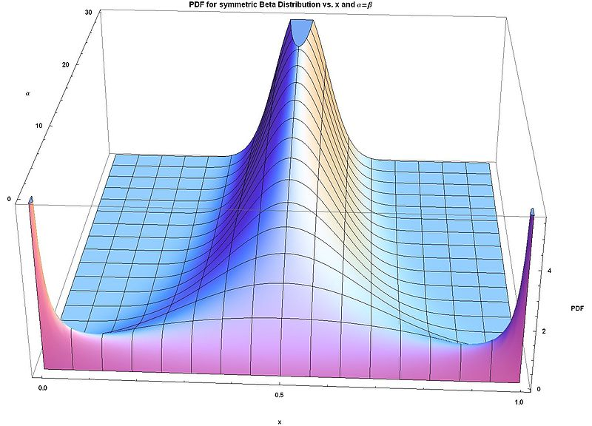
Why we call this a MAP
The math works if the pdf f(x) =
α,βare imaginary pos/neg examples

Slide 88

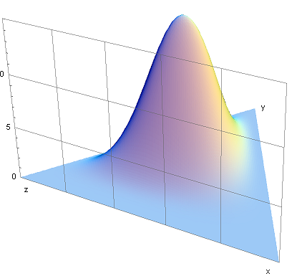
Why we call this a MAP
This is called a beta distribution
The generalization to multinomials is called a Dirichlet distribution
Parameters are
f(x₁,…,x_{K}) =

Slide 89
Some MORE TERMS

Slide 90


Probability Density Function
Discrete distributions
Continuous: Probability density function (pdf) vs Cumulative Density Function (CDF):
1
2
3
4
5
6
f(x)
x
a
Notes:
Example: heights of individuals

Slide 91





Cumulative Density Functions
Total probability
Probability Density Function (PDF)
Properties:
F(x)

Slide 92



Expectations
Mean/Expected Value:
Variance:
More examples:

Slide 93



Multivariate versions….
Joint for (x,y)
Marginal:
Conditionals:
Chain rule:

Slide 94


Bayes Rule
Standard form:
Replacing the bottom:

Slide 95

Binomial
Distribution:
Mean/Var:
Notes:
Tossing a coin n times, and counting the number of heads

Slide 96



Uniform
Anything is equally likely in the region [a,b]
Distribution:
Mean/Var
a
b
Notes:
Max likelihood between [0,a]
Web hits within an hour
P-value for drug efficacy

Slide 97

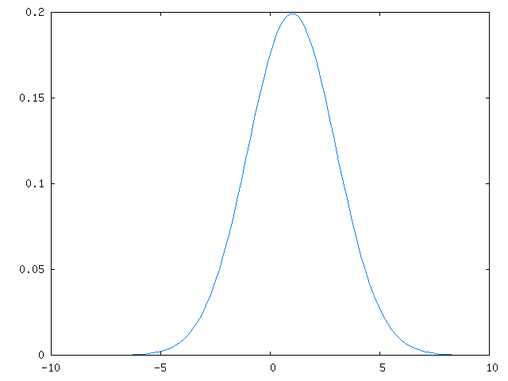
Gaussian (Normal)
If I look at the height of women in country xx, it will look approximately Gaussian
Small random noise errors, look Gaussian/Normal
Distribution:
Mean/var

Slide 98
Why Do People Use Gaussians
Central Limit Theorem: (loosely)
  Sum of a large number of IID random variables is approximately Gaussian

Slide 99
Sum of Gaussians
The sum of two Gaussians is a Gaussian:

Slide 100

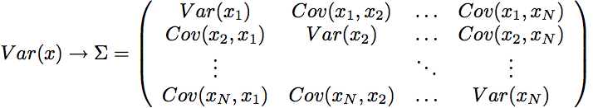
Multivariate Gaussians
Distribution for vector x
PDF:

Slide 101
Multivariate Gaussians

Slide 102
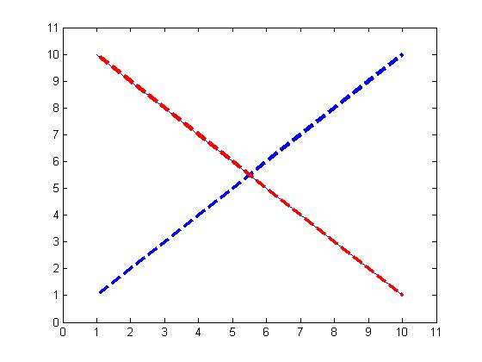
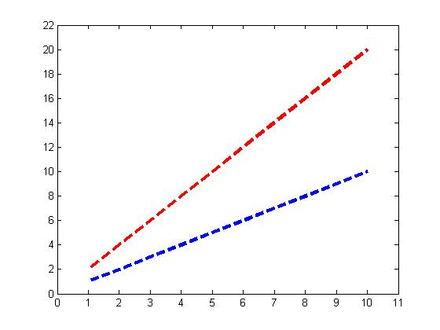
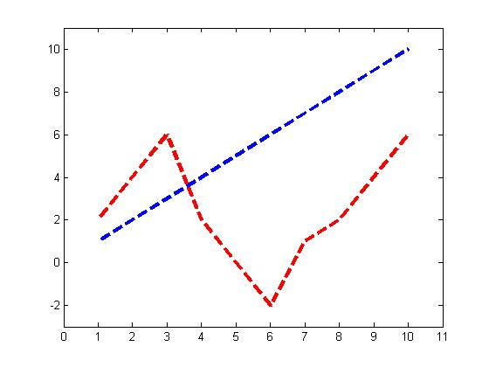
Covariance examples
Anti-correlated
Correlated
Independent (almost)
Covariance: -9.2
Covariance: 18.33
Covariance: 0.6

Slide 103
How much do grad students sleep?
Lets try to estimate the distribution of the time students spend sleeping (outside class).

Slide 104
Possible statistics
X
Sleep time
Mean of X:
E{X}
7.03
Variance of X:
Var{X} = E{(X-E{X})^2}
3.05
Notes:
Derive variance

Slide 105
Covariance: Sleep vs. GPA
Co-Variance of X1, X2:
Covariance{X1,X2} = E{(X1-E{X1})(X2-E{X2})}
= 0.88

Slide 106
Key Concepts in Probability:
The JOINT DISTRIBUTION

Slide 107
Probability - what you need to really, really know
Probabilities are cool
Random variables and events
The Axioms of Probability
Independence, binomials, multinomials
Conditional probabilities
Bayes Rule
MLE’s, smoothing, and MAPs
The joint distribution

Slide 108
Some practical problems
I have 1 standard d6 die, 2 loaded d6 die.
Loaded high: P(X=6)=0.50 Loaded low: P(X=1)=0.50
Experiment: pick one d6 uniformly at random (A) and roll it. What is more likely – rolling a seven or rolling doubles?
Three combinations: HL, HF, FL
P(D) = P(D ^ A=HL) + P(D ^ A=HF) + P(D ^ A=FL)
= P(D | A=HL)*P(A=HL) + P(D|A=HF)*P(A=HF) + P(A|A=FL)*P(A=FL)

Slide 109
Some practical problems
I have 1 standard d6 die, 2 loaded d6 die.
Loaded high: P(X=6)=0.50 Loaded low: P(X=1)=0.50
Experiment: pick one d6 uniformly at random (A) and roll it. Repeat a second time. What is more likely – rolling a seven or rolling doubles?
Roll 1
Three combinations: HL, HF, FL
 | 1 | 2 | 3 | 4 | 5 | 6
1 | D |  |  |  |  | 7
2 |  | D |  |  | 7
3 |  |  | D | 7
4 |  |  | 7 | D
5 |  | 7 |  |  | D
6 | 7 |  |  |  |  | D
Roll 2

Slide 110
A brute-force solution
A | Roll 1 | Roll 2 | P
FL | 1 | 1 | 1/3 * 1/6 * ½
FL | 1 | 2 | 1/3 * 1/6 * 1/10
FL | 1 | … | …
… | 1 | 6
FL | 2 | 1
FL | 2 | …
… | … | …
FL | 6 | 6
HL | 1 | 1
HL | 1 | 2
… | … | …
HF | 1 | 1
…
Comment
doubles
A joint probability table shows P(X1=x1 and … and Xk=xk) for every possible combination of values x1,x2,…., xk
With this you can compute any P(A) where A is any boolean combination of the primitive events (Xi=Xk), e.g.
P(doubles)
P(seven or eleven)
P(total is higher than 5)
….
seven
doubles
doubles
Notes:
How big is the table?

Slide 111
The Joint Distribution
Example: Boolean variables A, B, C
Recipe for making a joint distribution of M variables:

Slide 112
The Joint Distribution
Example: Boolean variables A, B, C
Recipe for making a joint distribution of M variables:
Make a truth table listing all combinations of values of your variables (if there are M Boolean variables then the table will have 2^{M} rows).
A | B | C
0 | 0 | 0
0 | 0 | 1
0 | 1 | 0
0 | 1 | 1
1 | 0 | 0
1 | 0 | 1
1 | 1 | 0
1 | 1 | 1

Slide 113
The Joint Distribution
Example: Boolean variables A, B, C
Recipe for making a joint distribution of M variables:
Make a truth table listing all combinations of values of your variables (if there are M Boolean variables then the table will have 2^{M} rows).
For each combination of values, say how probable it is.
A | B | C | Prob
0 | 0 | 0 | 0.30
0 | 0 | 1 | 0.05
0 | 1 | 0 | 0.10
0 | 1 | 1 | 0.05
1 | 0 | 0 | 0.05
1 | 0 | 1 | 0.10
1 | 1 | 0 | 0.25
1 | 1 | 1 | 0.10

Slide 114
The Joint Distribution
Example: Boolean variables A, B, C
Recipe for making a joint distribution of M variables:
Make a truth table listing all combinations of values of your variables (if there are M Boolean variables then the table will have 2^{M} rows).
For each combination of values, say how probable it is.
If you subscribe to the axioms of probability, those numbers must sum to 1.
A | B | C | Prob
0 | 0 | 0 | 0.30
0 | 0 | 1 | 0.05
0 | 1 | 0 | 0.10
0 | 1 | 1 | 0.05
1 | 0 | 0 | 0.05
1 | 0 | 1 | 0.10
1 | 1 | 0 | 0.25
1 | 1 | 1 | 0.10
A
0.05
0.10
0.05
0.10
0.25
0.05
C
B
0.10
0.30

Slide 115
Estimating The Joint Distribution
Example: Boolean variables A, B, C
Recipe for making a joint distribution of M variables:
Make a truth table listing all combinations of values of your variables (if there are M Boolean variables then the table will have 2^{M} rows).
For each combination of values, estimate how probable it is from data.
If you subscribe to the axioms of probability, those numbers must sum to 1.
A | B | C | Prob
0 | 0 | 0 | 0.30
0 | 0 | 1 | 0.05
0 | 1 | 0 | 0.10
0 | 1 | 1 | 0.05
1 | 0 | 0 | 0.05
1 | 0 | 1 | 0.10
1 | 1 | 0 | 0.25
1 | 1 | 1 | 0.10
A
0.05
0.10
0.05
0.10
0.25
0.05
C
B
0.10
0.30

Slide 116
Density Estimation
Our Joint Distribution learner is our first example of something called Density Estimation
A Density Estimator learns a mapping from a set of attributes values to a Probability
Input
Attributes
Density
Estimator
Probability

Slide 117
Density Estimation – looking ahead
Compare it against the two other major kinds of models:
Input
Attributes
Classifier
Prediction of
categorical output or class
One of a few discrete values
Input
Attributes
Density
Estimator
Probability
Input
Attributes
Regressor
Prediction of
real-valued output

