Slide 1
Directed Graphical Probabilistic Models: learning in DGMs
William W. Cohen
Machine Learning 10-601

Slide 2
REVIEW OF DGMs

Slide 3

Another difficult problem: common-sense reasoning

Slide 4
Another difficult problem: common-sense reasoning

Slide 5
Summary of Monday(1): Bayes nets
Many problems can be solved using the joint probability P(X₁,…,X_{n}).
Bayes nets describe a way to compactly write the joint.
For a Bayes net:
A | P(A)
1 | 0.33
2 | 0.33
3 | 0.33
First guess
The money
B | P(B)
1 | 0.33
2 | 0.33
3 | 0.33
A
B
Stick or swap?
D
C
The goat
A | B | C | P(C|A,B)
1 | 1 | 2 | 0.5
1 | 1 | 3 | 0.5
1 | 2 | 3 | 1.0
1 | 3 | 2 | 1.0
… | … | … | …
E
Conditional independence:
Second guess
A | C | D | P(E|A,C,D)
… | … | … | …

Slide 6
Summary of Monday(2): d-separation
X
E
Y
There are three ways paths from X to Y given evidence E can be blocked.
X is d-separated from Y given E iff all paths from X to Y given E are blocked
If X is d-separated from Y given E, then I<X,E,Y>
Z
Z
Z
All the ways paths can be blocked

Slide 7
Quiz1: which are d-separated?
Evidence nodes are filled
X1
Z
Y1
X2
Z
Y2
X3
Z
Y3
https://piazza.com/class/ij382zqa2572hc?cid=444

Slide 8
Quiz2: which is an example of explaining away?
Evidence nodes are filled
X2
Z
Y2
X3
Z
Y3
https://piazza.com/class/ij382zqa2572hc?cid=445

Slide 9
Summary of Wednesday(1): inference “down”
Simplified!
d-sep + polytree
Recursive call to P(E⁻|Y)
propagating requests for “belief due to evidential support” down the tree
I.e. info on Pr(E-|X) flows up

Slide 10
Summary of Wed(2): inference “up”
CPT table lookup
Recursive call to P(.|E⁺)
propagating requests for “belief due to causal evidence” up the tree
Evidence for Uj that doesn’t go thru X
I.e. info on Pr(X|E+) flows down

Slide 11
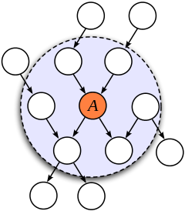
Summary of Wed(2.5) Markov blanket
The Markov blanket for a random variable A is the set of variables B₁,…,B_{k} that A is not conditionally independent of
  I.e., not d-separated from
For DGM this includes parents, children, and “co-parents” (other parents of children)
  because explaining away

Slide 12
Summary of Wed(3): sideways?!
recursion
Similar ideas as before but more complex recursion:
Z’s are NOT independent of X (because explaining away)
Neither are they strictly higher or lower in the tree.

Slide 13
Summary of Wed(4)
We reduced P(X|E) to product of two recursively calculated parts:
  P(X=x|E⁺)
    i.e., CPT for X and product of “forward” messages from parents
  P(E⁻|X=x)
    i.e., combination of “backward” messages from parents, CPTs, and P(Z|E_{Z\Yk}), a simpler instance of P(X|E)
  This can also be implemented by message-passing (belief propagation)
    Messages are distributions – i.e., vectors

Slide 14
Another difficult problem: common-sense reasoning
Have we solved the common-sense reasoning problem?
Yes: We use directed graphical models.
Semantics: how to specify them
Inference: how to use them
The last piece:
Learning: how to find parameters

Slide 15
Learning in DGMs

Slide 16
Learning for Bayes nets
Input:
  Sample of the joint:
  Graph structure of the variables
    for I=1,…,N, you know Xi and parents(Xi)
Output:
  Estimated CPTs
A
B
B | P(B)
1 | 0.33
2 | 0.33
3 | 0.33
D
C
Method (discrete variables):
Estimate each CPT independently
Use a MLE or MAP
A | B | C | P(C|A,B)
1 | 1 | 2 | 0.5
1 | 1 | 3 | 0.5
1 | 2 | 3 | 1.0
1 | 3 | 2 | 1.0
… | … | … | …
E
…

Slide 17
Learning for Bayes nets
Method (discrete variables):
Estimate each CPT independently
Use a MLE or MAP estimate for
MLE estimate:
A
B
B | P(B)
1 | 0.33
2 | 0.33
3 | 0.33
D
C
A | B | C | P(C|A,B)
1 | 1 | 2 | 0.5
1 | 1 | 3 | 0.5
1 | 2 | 3 | 1.0
1 | 3 | 2 | 1.0
… | … | … | …
E
…

Slide 18
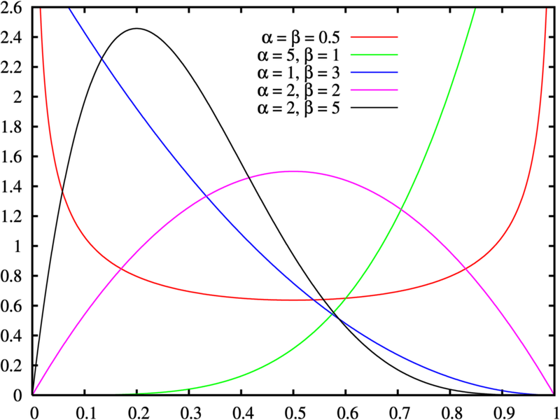
MAP estimates
The beta distribution:
“pseudo-data”: like hallucinating a few heads and a few tails

Slide 19
MAP estimates
The Dirichlet distribution:
“pseudo-data”: like hallucinating α_{i} examples of X=i for each value of i

Slide 20
Learning for Bayes nets
Method (discrete variables):
Estimate each CPT independently
Use a MLE or MAP estimate for
MAP estimate:
A
B
B | P(B)
1 | 0.33
2 | 0.33
3 | 0.33
D
C
A | B | C | P(C|A,B)
1 | 1 | 2 | 0.5
1 | 1 | 3 | 0.5
1 | 2 | 3 | 1.0
1 | 3 | 2 | 1.0
… | … | … | …
E
…

Slide 21
Learning for Bayes nets
Method (discrete variables):
Estimate each CPT independently
Use a MLE or MAP estimate for
MAP estimate:
A
B
B | P(B)
1 | 0.33
2 | 0.33
3 | 0.33
D
C
A | B | C | P(C|A,B)
1 | 1 | 2 | 0.5
1 | 1 | 3 | 0.5
1 | 2 | 3 | 1.0
1 | 3 | 2 | 1.0
… | … | … | …
E

Slide 22
Wait, that’s it?

Slide 23
Learning for Bayes nets
Actually – yes.
Method (discrete variables):
Estimate each CPT independently
Use a MLE or MAP estimate for
MAP estimate:
A
B
B | P(B)
1 | 0.33
2 | 0.33
3 | 0.33
D
C
A | B | C | P(C|A,B)
1 | 1 | 2 | 0.5
1 | 1 | 3 | 0.5
1 | 2 | 3 | 1.0
1 | 3 | 2 | 1.0
… | … | … | …
E
…

Slide 24
DGMS that Describe Learning Algorithms

Slide 25

A network with a familiar generative story
For each document d in the corpus:
  Pick a label y_{d} from Pr(Y)
  For each word in d:
    Pick a word x_{id} from Pr(X|Y=y_{d})
 | Pr(Y=y)
onion | 0.3
economist | 0.7
Y
“Tied parameters”
etc
for X1
Y | X1 | Pr(X|y=y)
onion | aardvark | 0.034
onion | ai | 0.0067
… | … | …
economist | aardvark | 0.0000003
….
economist | zymurgy | 0.01000
X1
X2
X3
X4
for X3
for X2
Y | X3 | Pr(X|y=y)
onion | aardvark | 0.034
onion | ai | 0.0067
… | … | …
economist | aardvark | 0.0000003
….
economist | zymurgy | 0.01000
Y | X2 | Pr(X|y=y)
onion | aardvark | 0.034
onion | ai | 0.0067
… | … | …
economist | aardvark | 0.0000003
….
economist | zymurgy | 0.01000

Slide 26
A network with a familiar generative story
For each document d in the corpus (of size D):
  Pick a label y_{d} from Pr(Y)
  For each word in d (of length N_{d}):
    Pick a word x_{id} from Pr(X|Y=y_{d})
 | Pr(Y=y)
onion | 0.3
economist | 0.7
Y
for every X
Y | X | Pr(X|y=y)
onion | aardvark | 0.034
onion | ai | 0.0067
… | … | …
economist | aardvark | 0.0000003
….
economist | zymurgy | 0.01000
X
N_{d}
D
Plate diagram

Slide 27
Learning for Bayes nets naïve Bayes
Method (discrete variables):
Estimate each CPT independently
Use a MLE or MAP estimate for
MAP estimate:
Y
X
N_{d}
D

Slide 28
Inference for Bayes nets naïve Bayes
Y
d-sep + polytree
X₁
X₂
Recursive call to P(E⁻|.)
So far: simple way of propagating requests for “belief due to evidential support” down the tree
I.e. info on Pr(E-|X) flows up

Slide 29
Inference for Bayes nets naïve Bayes
Y
Y
Y
X₁
X₂
So: we end up with a “soft” version of the naïve Bayes classification rule

Slide 30
Summary
Bayes nets
  we can infer Pr(Y|X)
  we can learn CPT parameters from data
    samples from the joint distribution
  this gives us a generative model
    which we can use to design a classifier
Special case: naïve Bayes!
Ok, so what? show me something new!

Slide 31
Learning in DGMs
I lied, there’s actually more.
Hidden (or latent) variables

Slide 32
If we know the parameters (the CPTs) I can infer the values of the hidden variables.
  But, we don’t
If we know the values of the hidden variables we can learn the values of the parameters (the CPTs)
  But, we don’t
Hidden (or latent) variables

Slide 33
Learning with Hidden Variables
Z
Hidden variables: what if some of your data is not completely observed?
Method:
Estimate parameters θsomehow or other.
Predict values of hidden variables using θ.
Add pseudo-data corresponding to these predictions, weighting each example by confidence in its correctness.
Re-estimate parameters using the extended dataset (real + pseudo-data).
Repeat starting at step 2….
X
Y
Expectation-maximization aka EM
Z | X | Y
ugrad | <20 | facebook
ugrad | 20s | facebook
grad | 20s | thesis
grad | 20s | facebook
prof | 30+ | grants
? | <20 | facebook
? | 30s | thesis
expectation
maximization (MLE/MAP)

Slide 34
Learning with Hidden Variables: Example
Z | X1 | X2
ugrad | <20 | facebook
ugrad | 20s | facebook
grad | 20s | thesis
grad | 20s | facebook
prof | 30+ | grants
? | <20 | facebook
? | 30s | thesis
Z
Z | P(Z)
undergr | 0.333
grad | 0.333
prof | 0.333
X1
X2
Z | X1 | P(X1|Z)
undergr | <20 | .4
 | 20s | .4
 | 30+ | .2
grad | <20 | .2
 | 20s | .6
 | 30+ | .2
prof | <20 | .25
 | 20s | .25
 | 30+ | .5
Z | X2 | P(X2|Z)
undergr | facebk | .6
 | thesis | .2
 | grants | .2
grad | facebk | .4
 | thesis | .4
 | grants | .2
prof | facebk | .25
 | thesis | .25
 | grants | .5
Notes:
Detailed example

Slide 35
Learning with Hidden Variables: Example
Z | X1 | X2
ugrad | <20 | facebook
ugrad | 20s | facebook
grad | 20s | thesis
grad | 20s | facebook
prof | 30+ | grants
? | <20 | facebook
? | 30+ | thesis
Z
Z | P(Z)
undergr | 0.333
grad | 0.333
prof | 0.333
X1
X2
Z | X1 | P(X1|Z)
undergr | <20 | .4
 | 20s | .4
 | 30+ | .2
grad | <20 | .2
 | 20s | .6
 | 30+ | .2
prof | <20 | .25
 | 20s | .25
 | 30+ | .5
Z | X2 | P(X2|Z)
undergr | facebk | .6
 | thesis | .2
 | grants | .2
grad | facebk | .4
 | thesis | .4
 | grants | .2
prof | facebk | .25
 | thesis | .25
 | grants | .5
Notes:
Detailed example

Slide 36
Learning with Hidden Variables: Example
Z | X1 | X2
ugrad | <20 | facebook
ugrad | 20s | facebook
grad | 20s | thesis
grad | 20s | facebook
prof | 30+ | grants
ugrad | <20 | facebook
grad | <20 | facebook
prof | <20 | facebook
? | 30s | thesis
Z
Z | P(Z)
undergr | 0.333
grad | 0.333
prof | 0.333
X1
X2
Z | X1 | P(X1|Z)
undergr | <20 | .4
 | 20s | .4
 | 30+ | .2
grad | <20 | .2
 | 20s | .6
 | 30+ | .2
prof | <20 | .25
 | 20s | .25
 | 30+ | .5
Z | X2 | P(X2|Z)
undergr | facebk | .6
 | thesis | .2
 | grants | .2
grad | facebk | .4
 | thesis | .4
 | grants | .2
prof | facebk | .25
 | thesis | .25
 | grants | .5
Z | X1 | X2
ugrad | <20 | facebook
ugrad | 20s | facebook
grad | 20s | thesis
grad | 20s | facebook
prof | 30+ | grants
? | <20 | facebook
? | 30s | thesis
Notes:
Detailed example

Slide 37
Learning with Hidden Variables: Example
Z | X1 | X2
ugrad | <20 | facebook
ugrad | 20s | facebook
grad | 20s | thesis
grad | 20s | facebook
prof | 30+ | grants
ugrad | <20 | facebook
grad | <20 | facebook
prof | <20 | facebook
ugrad | 30+ | thesis
grad | 30+ | thesis
prof | 30+ | thesis
Z
Z | P(Z)
undergr
grad
prof
X1
X2
Z | X1 | P(X1|Z)
undergr | <20
 | 20s
 | 30+
grad | <20
 | 20s
 | 30+
prof | <20
 | 20s
 | 30+
Z | X2 | P(X2|Z)
undergr | facebk
 | thesis
 | grants
grad | facebk
 | thesis
 | grants
prof | facebk
 | thesis
 | grants
Notes:
Detailed example

Slide 38
Learning with Hidden Variables: Example
Z | X1 | X2
ugrad | <20 | facebook
ugrad | 20s | facebook
grad | 20s | thesis
grad | 20s | facebook
prof | 30+ | grants
ugrad | <20 | facebook
grad | <20 | facebook
prof | <20 | facebook
ugrad | 30+ | thesis
grad | 30+ | thesis
prof | 30+ | thesis
Z
X1
X2
Z | P(Z)
undergr
grad
prof
.38
.35
.27
Notes:
Detailed example

Slide 39
Learning with Hidden Variables: Example
Z | X1 | X2
ugrad | <20 | facebook
ugrad | 20s | facebook
grad | 20s | thesis
grad | 20s | facebook
prof | 30+ | grants
ugrad | <20 | facebook
grad | <20 | facebook
prof | <20 | facebook
ugrad | 30+ | thesis
grad | 30+ | thesis
prof | 30+ | thesis
Z
X1
X2
Z | X1 | P(X1|Z)
underg | facebk
 | thesis
 | grants
grad | facebk
 | thesis
 | grants
prof | facebk
 | thesis
 | grants
.24
.32
.54
Notes:
Detailed example

Slide 40
Learning with hidden variables
Z
Hidden variables: what if some of your data is not completely observed?
Method:
Estimate parameters somehow or other.
Predict unknown values from your estimate.
Add pseudo-data corresponding to these predictions, weighting each example by confidence in its correctness.
Re-estimate parameters using the extended dataset (real + pseudo-data).
Repeat starting at step 2….
X1
X2
Z | X1 | X2
ugrad | <20 | facebook
ugrad | 20s | facebook
grad | 20s | thesis
grad | 20s | facebook
prof | 30+ | grants
? | <20 | facebook
? | 30s | thesis

Slide 41
Aside: Why does this work?
X: known data
Z: hidden data
Θ: parameters
Let’s try and maximize Θ
Ignore prior - MLE
Q(z) > 0
Q(z) a pdf
Notes:
Why E/M works: the proof

Slide 42
Aside: Why does this work?
Ignore prior
Q(z) a pdf
Q(z) > 0
Initial estimate of θ
This isn’t really right though: what we’re doing is
Notes:
Why E/M works: the proof

Slide 43
Aside: Jensen’s inequality
Claim: log(q₁x₁+q₂x₂) ≥q₁log(x₁)+q₂log(x₂)
for any downward-concave function, not just log(x)
Further: log(E_{Q}[X]) ≥ E_{Q}[log(X)]
log(q₁x₁+q₂x₂)
log(x₂)
log(x)
*
*
log(x₁)
q₁log(x₁)+q₂log(x₂)
x₁
x₂
q₁x₁+q₂x₂
where q₁+q₂=1
Notes:
Jensen’s inequality picture

Slide 44
Aside: Why does this work?
Ignore prior
Q(z) a pdf
Q(z) > 0
since log(E_{Q}[X]) ≥ E_{Q}[log(X)]
Q is any estimate of θ – say θ₀
θ’ depends on X,Z but not directly on Q so…
P(X,Z,θ’|Q)=P(θ’|X,Z,Q)*P(X,Z|Q)
So, plugging in pseudo-data weighted by Q and finding MLE optimizes a lower bound on log-likelihood
Notes:
Why E/M works: the proof

Slide 45
Aside: Why does this work?
Ignore prior
Q(z) a pdf
Q(z) > 0
since log(E_{Q}[X]) ≥ E_{Q}[log(X)]
So, plugging in pseudo-data weighted by Q and finding MLE optimizes a lower bound on log-likelihood
Notes:
Why E/M works: the proof

Slide 46
Learning with hidden variables
Z
Hidden variables: what if some of your data is not completely observed?
Method (Expectation-Maximization, EM):
Estimate parameters somehow or other.
Predict unknown values from your estimated parameters (Expectation step)
Add pseudo-data corresponding to these predictions, weighting each example by confidence in its correctness.
Re-estimate parameters using the extended dataset (real + pseudo-data).
  You find the MLE or MAP values of the parameters. (Maximization step)
Repeat starting at step 2….
X1
X2
Z | X1 | X2
ugrad | <20 | facebook
ugrad | 20s | facebook
grad | 20s | thesis
grad | 20s | facebook
prof | 30+ | grants
? | <20 | facebook
? | 30s | thesis
EM maximizes a lower bound on log likelihood
It will converge to a local maximum

Slide 47
Summary
Bayes nets
  we can infer Pr(Y|X)
  we can learn CPT parameters from data
    samples from the joint distribution
  this gives us a generative model
    which we can use to design a classifier
Special case: naïve Bayes!
Ok, so what? show me something new!

Slide 48
Semi-supervised naïve Bayes
Given:
  A pool of labeled examples L
  A (usually larger) pool of unlabeled examples U
Option 1 for using L and U :
  Ignore U and use supervised learning on L
Option 2:
  Ignore labels in L+U and use k-means, etc find clusters; then label each cluster using L
Question:
  Can you use both L and U to do better?

Slide 49
Learning for Bayes nets naïve Bayes
Open circle = hidden variable
Y
Y
Algorithm:
naïve Bayes plus EM
X
X
N_{d}
N_{d}
D_{L}
D_{U}

Slide 50
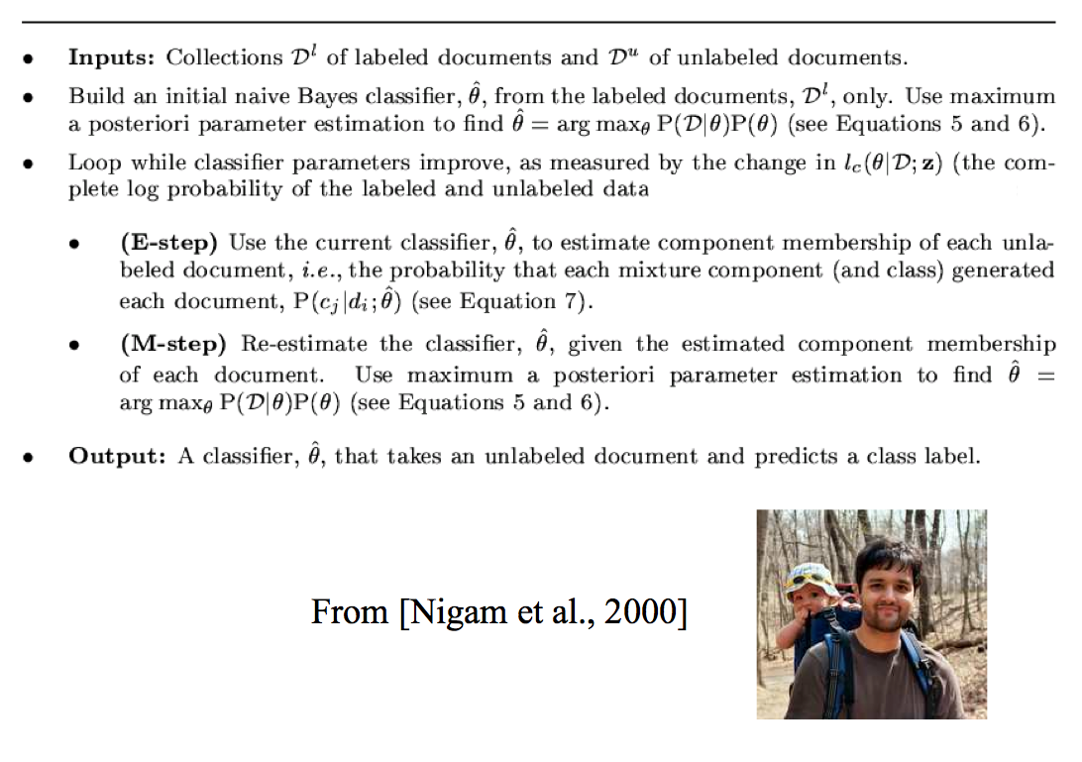

Slide 51
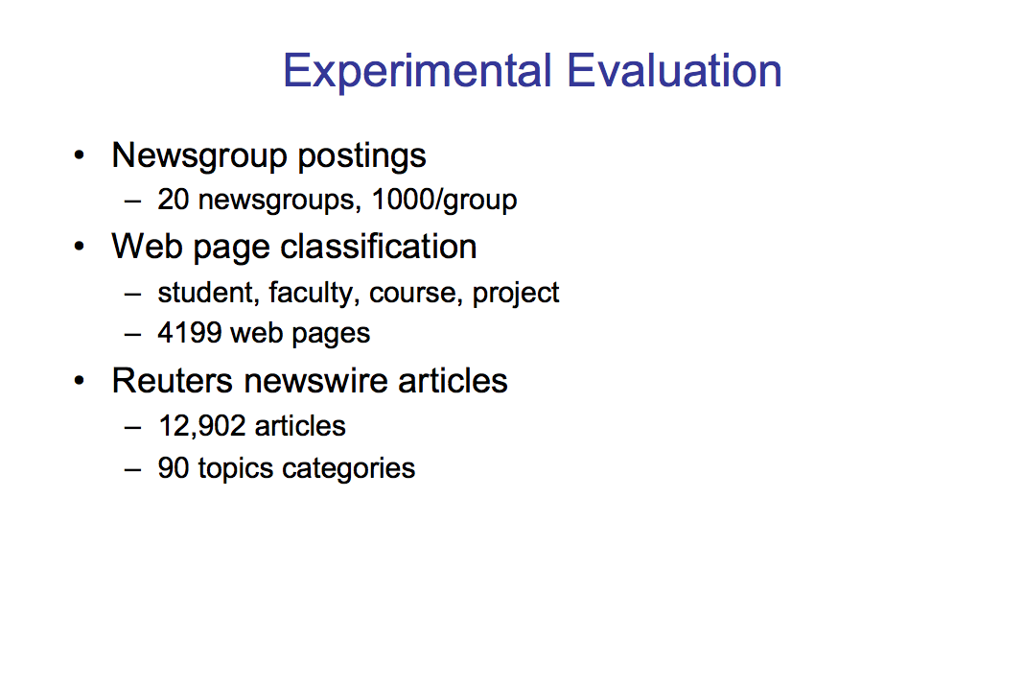

Slide 52
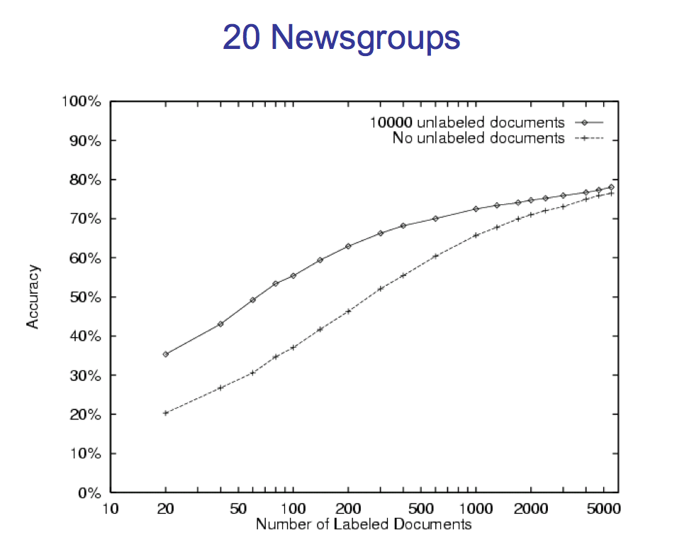

Slide 53
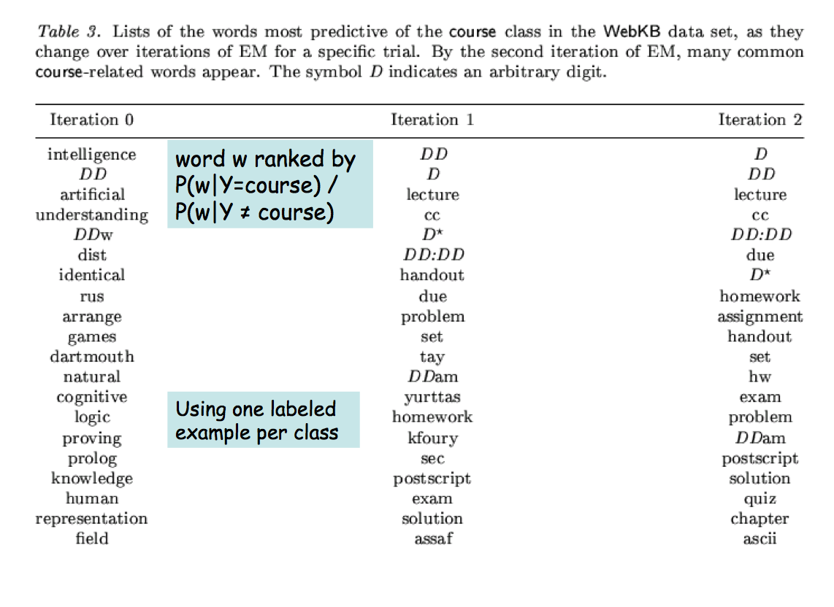
Ok, so what? show me something else new!

Slide 54
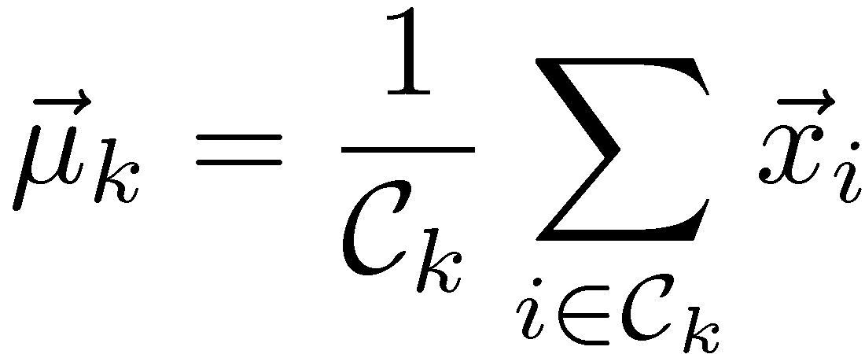
K-Means: Algorithm
Decide on a value for k.
Initialize the k cluster centers randomly if necessary.
Repeat till any object changes its cluster assignment
  Decide the cluster memberships of the N objects by assigning them to the nearest cluster centroid
  Re-estimate the k cluster centers, by assuming the memberships found above are correct.
slides: Bhavana Dalvi

Slide 55
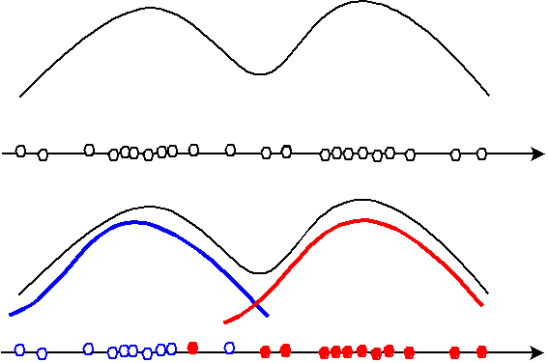
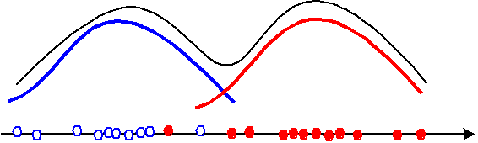
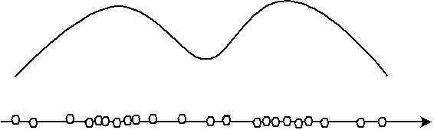
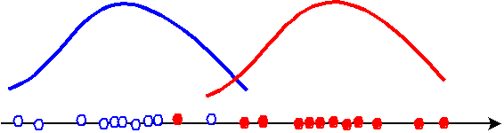
Mixture of Gaussians
slides: Bhavana Dalvi

Slide 56
A Bayes network for a mixture of Gaussians
Z
#hidden mixture component
Pr(X|z=k) is a Gaussian, not a multinomial.
X
M
#examples

Slide 57
A closely related Bayes network for a mixture of Gaussians
Z
#hidden mixture component
each Pr(X|z=k) is a univariate Gaussian, not a multinomial – one for each dimension
X
D
#dimensions
M
#examples

Slide 58
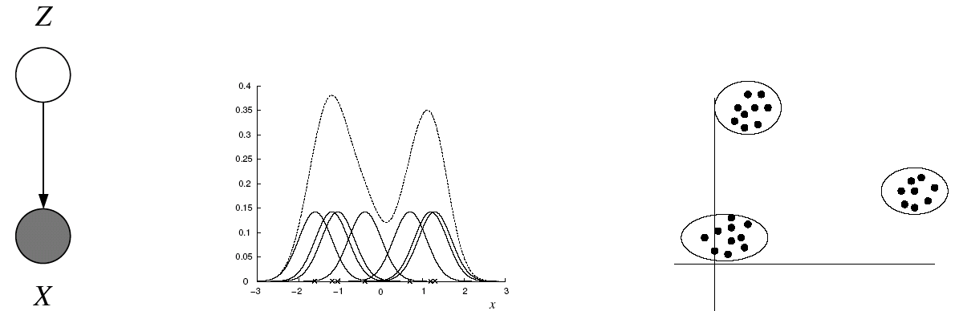
Gaussian Mixture Models (GMMs)
Consider a mixture of K Gaussian components:
This model can be used for unsupervised clustering.
  This model (fit by AutoClass) has been used to discover new kinds of stars in astronomical data, etc.
mixture component
Pr(X|z)
mixture proportion (prior)

Slide 59
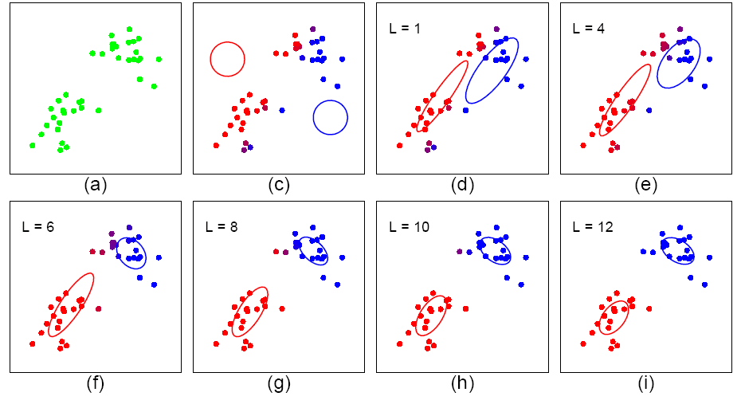
Expectation-Maximization (EM)
Start: "Guess" the mean and covariance of each of the K gaussians
Loop

Slide 61
Expectation-Maximization (EM)
Start: "Guess" the centroid and covariance of each of the K clusters
Loop

Slide 62
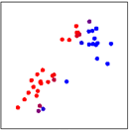
The Expectation-Maximization (EM) Algorithm
E Step: Guess values of Z’s

Slide 63
The Expectation-Maximization (EM) Algorithm
M Step: Update parameter estimates

Slide 64
EM Algorithm for GMM
E Step: Guess values of Z’s
M Step: Update parameter estimates

Slide 65
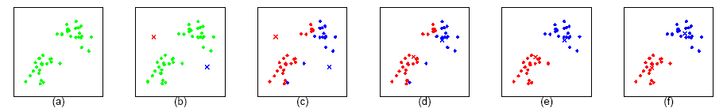
K-means is a hard version of EM
In the K-means “E-step” we do hard assignment:
In the K-means “M-step” we update the means as the weighted sum of the data, but now the weights are 0 or 1:

Slide 66
Soft vs. Hard EM assignments
GMM
K-Means

Slide 67
Questions
Which model is this?
  One multivariate Gaussian
  Two univariate Gaussians
Which does k-means resemble most?

Slide 68
Recap: learning in Bayes nets
We’re learning a density estimator:
  Maps x → Pr(x|θ)
  Data D is unlabeled examples:
  When we learn a classifier (like Naïve Bayes) we’re doing it indirectly:
    One of the X’s is a designated class variable and we infer the value at test time

Slide 69
Recap: learning in Bayes nets
Simple case: all variables are observed
  We just estimate the CPTs from the data using a MAP estimate
Harder case: some variables are hidden
We can use EM:
  Repeatedly find θ,Z,…
  Find expectations over Z with inference
  Maximize θ|Z by with MAP over pseudo-data

Slide 70
Recap: learning in Bayes nets
Simple case: all variables are observed
  We just estimate the CPTs from the data using a MAP estimate
Harder case: some variables are hidden
Practical applications of this:
  Medical diagnosis (expert builds structure, CPTs learned from data)
  …

Slide 71
Recap: learning in Bayes nets
Special cases discussed today
  Supervised multinomial naïve Bayes
  Semi-supervised multinomial naïve Bayes
  Unsupervised mixtures of Gaussians
    “soft k-means”
Special cases discussed next:
  Hidden Markov models

Slide 72
Some things to think about
P(X|Y) | Y observed | Y mixed | Y hidden
Multinomial
Gaussian
naïve Bayes
SS naive Bayes
Mixture of
multinomials
Gaussian
naïve Bayes
Mixture of
Gaussians

