Slide 1
Logistic Regression
William Cohen

Slide 2
Outline
Quick review
classification, naïve Bayes, perceptrons
new result for naïve Bayes
Learning as optimization
Logistic regression via gradient ascent
Overfitting and regularization
Discriminative vs generative classifiers

Slide 3
Naïve Bayes IS LINEAR

Slide 4
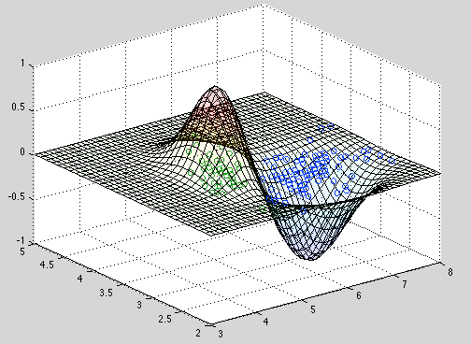
Question: what does the boundary between positive and negative look like for Naïve Bayes?

Slide 5
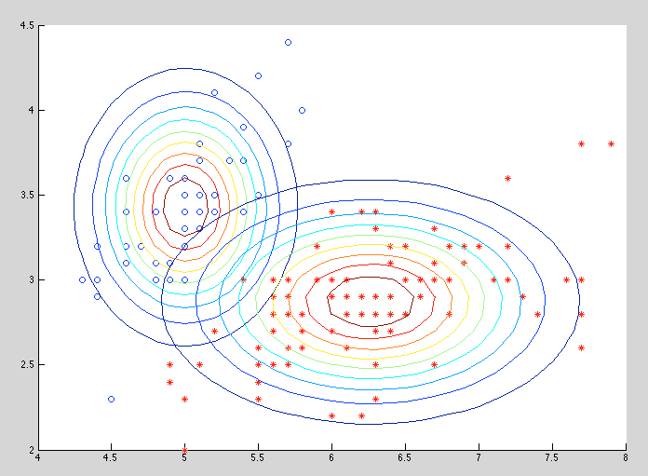

Slide 6
Naïve Bayes is Linear
Convenient assumptions:
Binary X’s
Binary Y’s

Slide 7
two classes only
rearrange terms

Slide 8
if x_{i} = 1 or 0 ….

Slide 9
if x_{i} = 1 or 0 ….

Slide 10
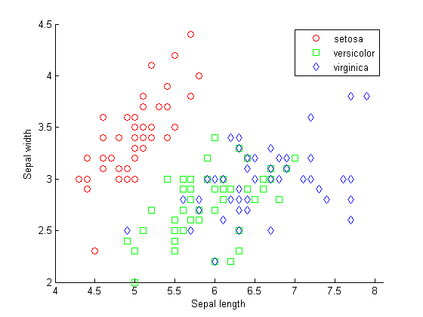
Predict “pos” on (x1,x2) iff ax1 + bx2 + c >0
= sign(ax1 + bx2 + c)

Slide 12
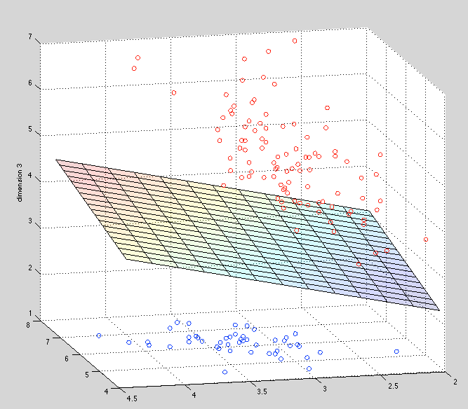

Slide 13
Naïve is Linear
Summary:
Assume conditional independence of attributes given class
Derive a classifier: argmax _{y} Pr(Y=y|X=x)
Turns out to be linear…?
Comments
Linear classifiers are important and interesting
Alternative story:
Assume a “linear model” of Pr(Y=y|X=x)
Find the linear model that fits the data “best”

Slide 14
Review

Slide 15
Quick Review: Probabilistic Learning Methods
Probabilities are useful for modeling uncertainty and non-deterministic processes
A classifier takes as input feature values x = x₁,…,x_{n} and produces a predicted class label y
Classification algorithms can be based on probability:
model the joint distribution of <X₁,…,X_{n},Y> and predict argmax_{y} Pr(y|x₁,…,x_{n} )
Model Pr(X₁,…,X_{n},Y) with a big table (brute-force Bayes)
Model Pr(X₁,…,X_{n},Y) with Bayes’s rule and conditional independence assumptions (naïve Bayes)
Naïve Bayes has a linear decision boundary: i.e., the classifier is of the form sign(x . w)

Slide 16
Learning as Optimization

Slide 17
Learning as optimization
The main idea today
Make two assumptions:
the classifier is linear, like naïve Bayes
ie roughly of the form f_{w}(x) = sign(x . w)
we want to find the classifier w that “fits the data best”
Formalize as an optimization problem
Pick a loss function J(w,D), and find
argmin_{w} J(w)
OR: Pick a “goodness” function, often Pr(D|w), and find the argmax_{w} f_{D}(w)

Slide 18
Learning as optimization: warmup
Find: optimal (MLE) parameter θ of a binomial
Dataset: D={x₁,…,x_{n}}, x_{i} is 0 or 1, k of them are 1

Slide 19
Learning as optimization: warmup
Goal: Find the best parameter θ of a binomial
Dataset: D={x₁,…,x_{n}}, x_{i} is 0 or 1, k of them are 1
= 0
θ= 0
θ= 1
k- kθ – nθ + kθ = 0
nθ = k
θ = k/n

Slide 20
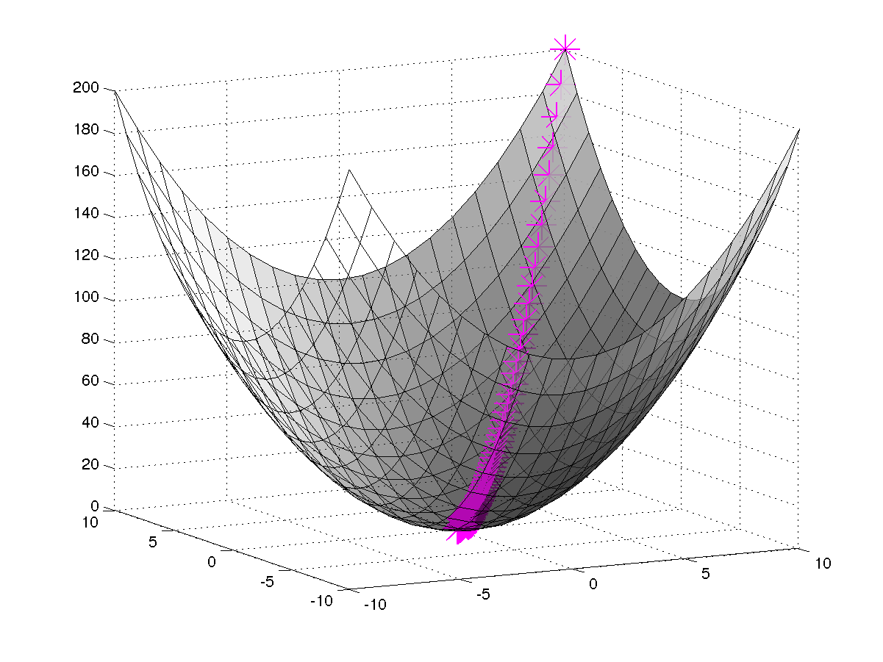
Learning as optimization with gradient ascent
Goal: Learn the parameter w of …
Dataset: D={(x₁,y₁)…,(x_{n} , y_{n)}}
Use your model to define
Pr(D|w) = ….
Set w to maximize Likelihood
Usually we use numeric methods to find the optimum
i.e., gradient ascent: repeatedly take a small step in the direction of the gradient
Difference between ascent and descent is only the sign: I’m going to be sloppy here about that.

Slide 21
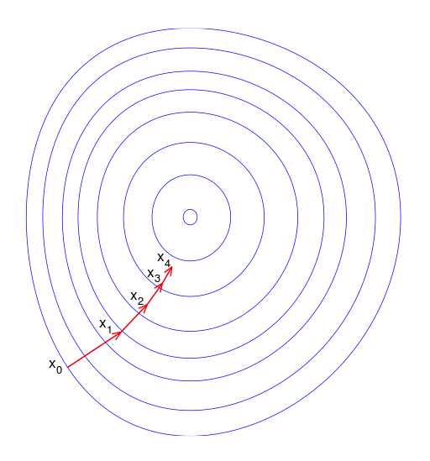
Gradient ascent
To find argmin_{x} f(x):
Start with x₀
For t=1….
x_{t+1} = x_{t} + λ f’(x _{t})
where λ is small

Slide 22
Gradient descent
Likelihood: ascent
Loss: descent

Slide 23
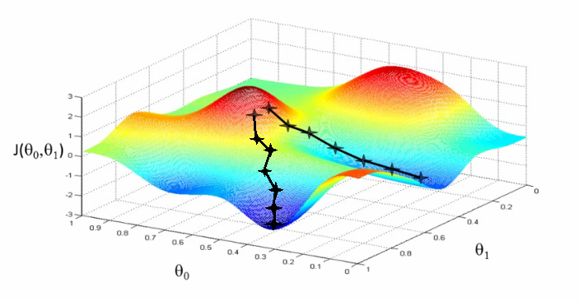
Pros and cons of gradient descent
Simple and often quite effective on ML tasks
Often very scalable
Only applies to smooth functions (differentiable)
Might find a local minimum, rather than a global one

Slide 24
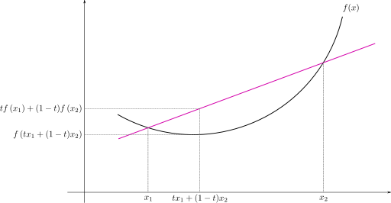
Pros and cons of gradient descent
There is only one local optimum if the function is convex

Slide 25
Learning Linear Classifiers with Gradient ascent Part 1: The Idea

Slide 27
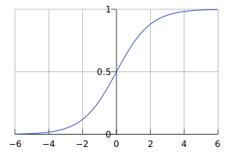
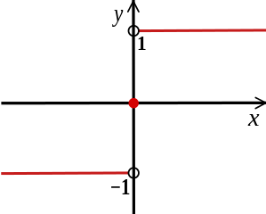
Using gradient ascent for linear classifiers
Replace sign(x . v) with something differentiable: e.g. the logistic(x . v)
sign(x)

Slide 28
Using gradient ascent for linear classifiers
Replace sign(x . w) with something differentiable: e.g. the logistic(x . w)
Define a function on the data that formalizes “how well w predicts the data” (loss function)
Assume y=0 or y=1
Our optimization target is log of conditional likelihood

Slide 29
Using gradient ascent for linear classifiers
Replace sign(x . w) with something differentiable: e.g. the logistic(x . w)
Define a function on the data that formalizes “how well w predicts the data” (log likelihood)
Differentiate the likelihood function and use gradient ascent
Start with w₀
For t=1….
w_{t+1} = w_{t} + λ Loss’_{D}(w _{t})
where λ is small
Warning: this is not a toy
logistic regression

Slide 30
Stochastic Gradient Descent (SGD)
Difference between ascent and descent is only the sign: we’ll be sloppy and use the more common “SGD”
Goal: Learn the parameter θ of …
Dataset: D={x₁,…,x_{n}}
or maybe D={(x₁,y₁)…,(x_{n} , y_{n)}}
Write down Pr(D|θ) as a function of θ
For large datasets this is expensive: we don’t want to load all the data D into memory, and the gradient depends on all the data
An alternative:
pick a small subset of examples B<<D
approximate the gradient using them
“on average” this is the right direction
take a step in that direction
repeat….
B = one example is a very popular choice

Slide 31
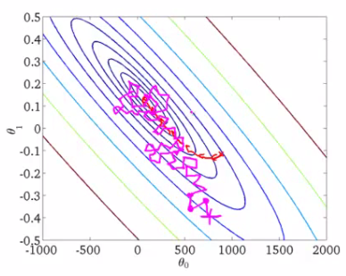
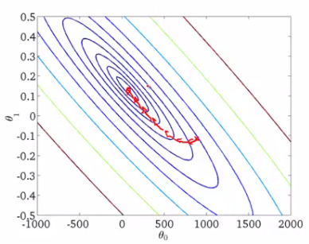
Using SGD for logistic regression
P(y|x)=logistic(x . w)
Define the likelihood:
Differentiate the LCL function and use gradient descent to minimize
Start with w₀
For t=1,…,T - until convergence
For each example x,y in D:
w_{t+1} = w_{t} + λ L_{x,y}(w _{t})
where λ is small
More steps, noisier path toward the minimum, but each step is cheaper

Slide 32
Learning Linear Classifiers with Gradient Descent Part 2: The Gradient
I will start by deriving the gradient for one example (eg SGD) and then move to “batch” gradient descent

Slide 33
Likelihood on one example is:
We’re going to dive into this thing here: d/dw(p)

Slide 34
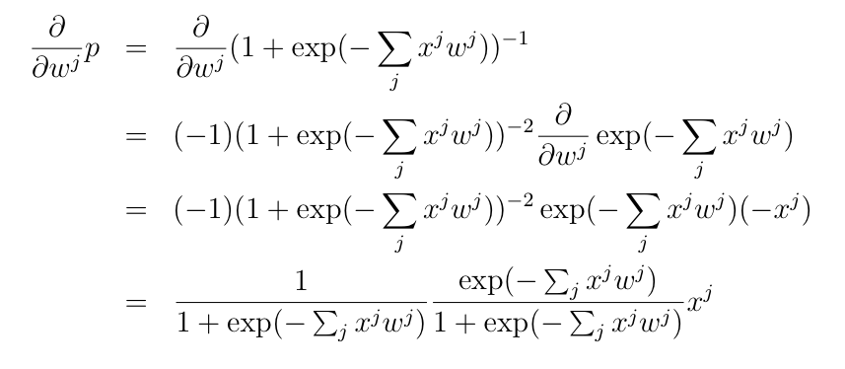
p

Slide 37
Breaking it down: SGD for logistic regression
P(y|x)=logistic(x . w)
Define a function
Differentiate the function and use gradient descent
Start with w₀
For t=1,…,T - until convergence
For each example x,y in D:
w_{t+1} = w_{t} + λ L_{x,y}(w _{t})
where λ is small

Slide 38
Details: Picking learning rate
Use grid-search in log-space over small values on a tuning set:
e.g., 0.01, 0.001, …
Sometimes, decrease after each pass:
e.g factor of 1/(1 + dt), t=epoch
sometimes 1/t²
Fancier techniques I won’t talk about:
Adaptive gradient: scale gradient differently for each dimension (Adagrad, ADAM, ….)

Slide 39
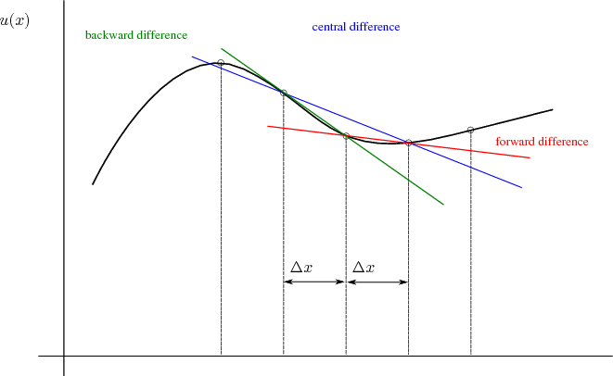
Details: Debugging
Check that gradient is indeed a locally good approximation to the likelihood
“finite difference test”

Slide 40
Logistic Regression: OBSERVATIONS

Slide 41
Convexity and logistic regression
This LCL function is convex: there is only one local minimum.
So gradient descent will give the global minimum.

Slide 42
Non-stochastic gradient descent
In batch gradient descent, average the gradient over all the examples D={(x₁,y₁)…,(x_{n} , y_{n)}}

Slide 43
Non-stochastic gradient descent
This can be interpreted as a difference between the expected value of y|x^{j}=1 in the data and the expected value of y|x^{j}=1 as predicted by the model
Gradient ascent tries to make those equal

Slide 44
This LCL function “overfits”
This can be interpreted as a difference between the expected value of y|x^{j}=1 in the data and the expected value of y|x^{j}=1 as predicted by the model
Gradient ascent tries to make those equal
That’s impossible for some w^{j} !
e.g., if x^{j} =1 only in positive examples, the gradient is always positive

Slide 45
This LCL function “overfits”
This can be interpreted as a difference between the expected value of y|x^{j}=1 in the data and the expected value of y|x^{j}=1 as predicted by the model
Gradient ascent tries to make those equal
That’s impossible for some w^{j} e.g., if they appear only in positive examples, gradient is always possible.
Using this LCL function for text: practically, it’s important to discard rare features to get good results.

Slide 46
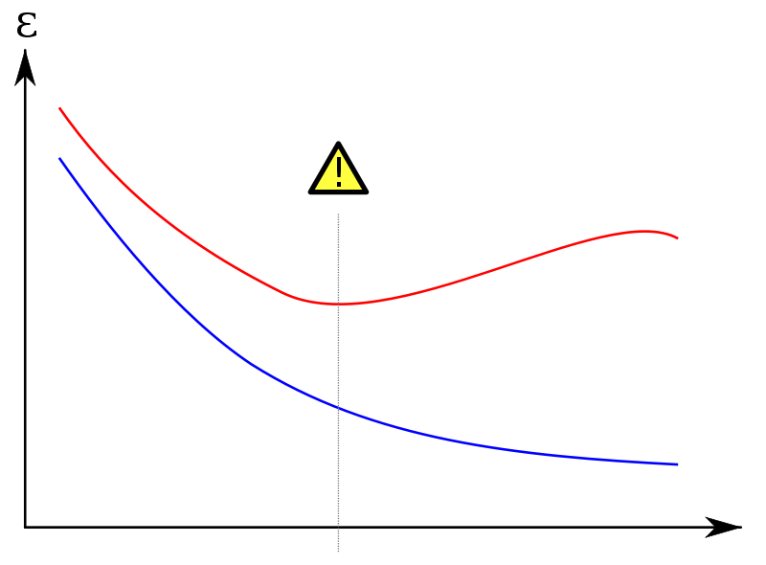
This LCL function “overfits”
Overfitting is often a problem in supervised learning.
When you fit the data (minimize LCL) are you fitting “real structure” in the data or “noise” in the data?
Will the patterns you see appear in a test set or not?
hi error
Error/LCL on an unseen test set D^{test}
Error/LCL on training set D
more features

Slide 47
Regularized Logistic Regression

Slide 48
Regularized logistic regression as a MAP
Minimizing our LCL function maximizes log conditional likelihood of the data (LCL):
like MLE: max_{w} Pr(D|w)
… but focusing on just a part of D
Another possibility: introduce a prior over w
maximize something like a MAP
Pr(w|D) = 1/Z * Pr(D|w)Pr(w)
If the prior w^{j} is zero-mean Gaussian then
Pr(w^{j}) = 1/Z exp(w^{j})⁻²

Slide 49
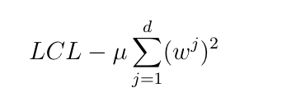
Regularized logistic regression
Replace LCL
with LCL + penalty for large weights, eg
So the update for w^{j} becomes:
Or
(Log Conditional Likelihood, our LCL function)

Slide 50
Breaking it down: regularized SGD for logistic regression
P(y|x)=logistic(x . w)
Define a function
Differentiate the function and use gradient descent
Start with w₀
For t=1,…,T - until convergence
For each example x,y in D:
w_{t+1} = w_{t} + λ L_{x,y}(w _{t})
where λ is small
pushes w toward all-zeros vector (“weight decay”)

Slide 51
Discriminative and generative classifiers

Slide 52
Discriminative vs Generative
Generative classifiers are like Naïve Bayes:
Find θ = argmax _{w} Π_{i} Pr(y_{i},x_{i}|θ)
Different assumptions about generative process for the data: Pr(X,Y), priors on θ,…
Discriminative classifiers are like logistic regression:
Find θ = argmax _{w} Π_{i} Pr(y_{i}|x_{i},θ)
Different assumptions about conditional probability: Pr(Y|X), priors on θ, …

Slide 53
Discriminative vs Generative
With enough data:
naïve Bayes is the best classifier when features are truly independent
why? picking argmax _{y} Pr(y|x) is optimal
Question:
will logistic regression converge to the same classifier as naïve Bayes when the features are actually independent?
Notes:
comments: this was a little short for a full lecture

Slide 54
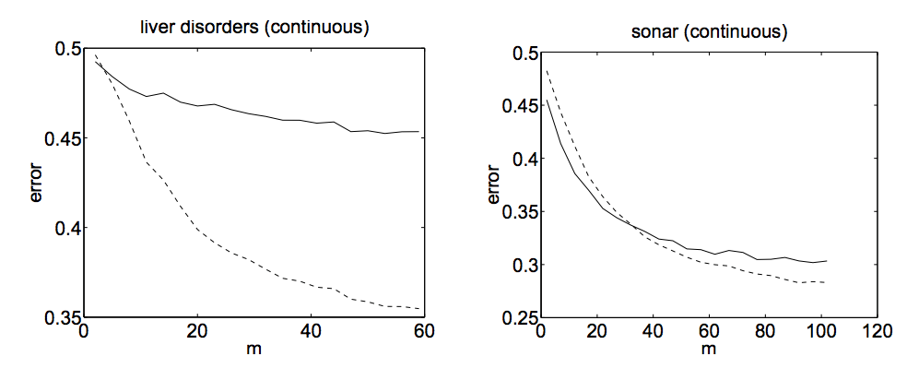
solid: NB dashed: LR

Slide 55
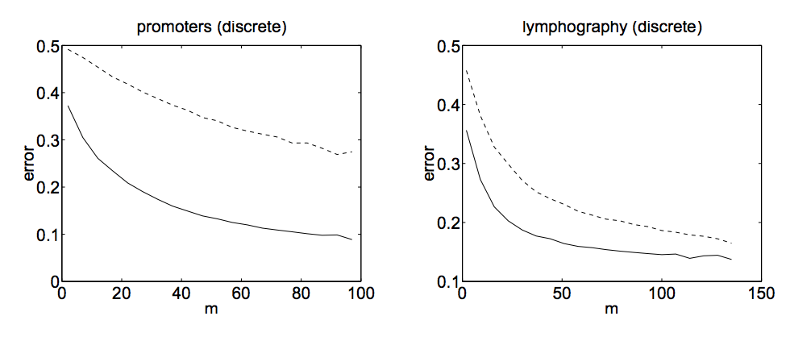
Naïve Bayes makes stronger assumptions about the data
but needs fewer examples to estimate the parameters
“On Discriminative vs Generative Classifiers: ….” Andrew Ng and Michael Jordan, NIPS 2001.

