Slide 1
Deep neural networks

Slide 2
Outline
What’s new in ANNs in the last 5-10 years?
Deeper networks, more data, and faster training
Scalability and use of GPUs ✔
Symbolic differentiation✔
reverse-mode automatic differentiation
“Generalized backprop”
Some subtle changes to cost function, architectures, optimization methods ✔
What types of ANNs are most successful and why?
Convolutional networks (CNNs) ✔
Long term/short term memory networks (LSTM) ✔
Word2vec and embeddings
What are the hot research topics for deep learning?

Slide 3
Review

Slide 4
Recap: parallelism in ANNs
Let X be a matrix with k examples
Let w_{i} be the input weights for the i-th hidden unit
Then Z = X W is output for all m units
for all k examples
w₁ | w₂ | w₃ | … | w_{m}
0.1 | -0.3 | …
-1.7 | …
0.3 | …
1.2
x₁ | 1 | 0 | 1 | 1
x₂ | …
…
x_{k}
There’s a lot of chances to do this in parallel…. with parallel matrix multiplication
x₁.w₁ | x₁.w₂ | … | x₁.w_{m}
x_{k}.w₁ | … | … | x_{k}.w_{m}
XW =

Slide 5
Recap: parallel ANN training
Modern libraries (Matlab, numpy, …) do matrix operations fast, in parallel, on multicore machines
Many ANN implementations exploit this parallelism automatically
Key implementation issue is working with matrices comfortably
GPUs do matrix operations very fast, in parallel
For dense matrixes, not sparse ones!
Training ANNs on GPUs is common
SGD and minibatch sizes of 128

Slide 6
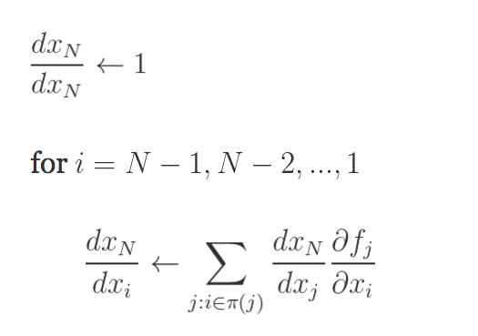
Recap: autodiff for a 2-layer neural network
Step 1: forward
Step 1: backprop
inputs:
return
dC/dC = 1
dC/dP = dC/dC * dCrossEnt_{Y}/dP
dC/dA2 = dC/dP * dsoftmax/dA2
dC/Z2b = dC/dA2 * dtanh/dZ2b
dC/dZ1a = dC/dZ2b * (dadd*/dZ2a + dadd/dB2)
dC/dB2 = dC/Z2b * 1
dC/dZ2a = dC/dZ2b * (dmul/dA1 + dmul/dW2)
dC/dW2 = dC/dZ2a * 1
dC/dA1 = …
Inputs: X,W1,B1,W2,B2
Z1a = mul(X,W1) // matrix mult
Z1b = add*(Z11,B1) // add bias vec
A1 = tanh(Z1b) //element-wise
Z2a = mul(A1,W2)
Z2b = add*(Z2a,B2)
A2 = tanh(Z2b) // element-wise
P = softMax(A2) // vec to vec
C = crossEnt_{Y}(P) // cost function
Target Y; N rows; K outs; D feats, H hidden

Slide 7
Recap: 2-layer neural network
Step 1: forward
inputs:
An autodiff package usually includes
A collection of matrix-oriented operations (mul, add*, …)
For each operation
A forward implementation
A backward implementation for each argument
A way of composing operations into expressions (often using operator overloading) which evaluate to expression trees
Expression simplification/compilation
Lots of tools: Theano, Torch, TensorFlow, ….
return
Inputs: X,W1,B1,W2,B2
Z1a = mul(X,W1) // matrix mult
Z1b = add(Z11,B1) // add bias vec
A1 = tanh(Z1b) //element-wise
Z2a = mul(A1,W2)
Z2b = add(Z2a,B2)
A2 = tanh(Z2b) // element-wise
P = softMax(A2) // vec to vec
C = crossEnt_{Y}(P) // cost function
N*H

Slide 8
Recap: incremental improvements
Use of softmax and cross-entropy loss
Use of alternate non-linearities
reLU, hyperbolic tangent, …
Better understanding of weight initialization
Tricks like data augmentation

Slide 9
Outline
What’s new in ANNs in the last 5-10 years?
Deeper networks, more data, and faster training
Scalability and use of GPUs ✔
Symbolic differentiation✔
reverse-mode automatic differentiation
“Generalized backprop”
Some subtle changes to cost function, architectures, optimization methods ✔
What types of ANNs are most successful and why?
Convolutional networks (CNNs) ✔
Long term/short term memory networks (LSTM) ✔
Word2vec and embeddings
What are the hot research topics for deep learning?

Slide 10
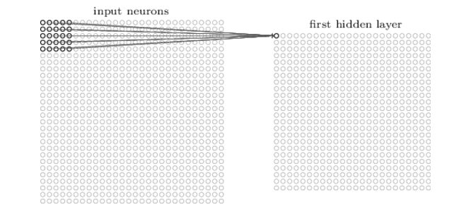
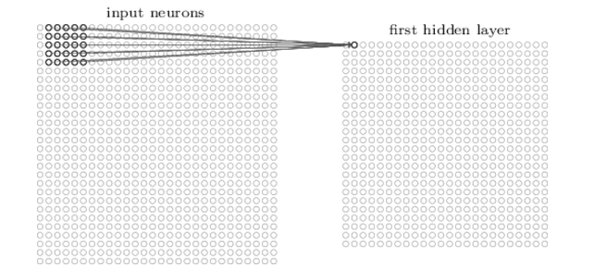
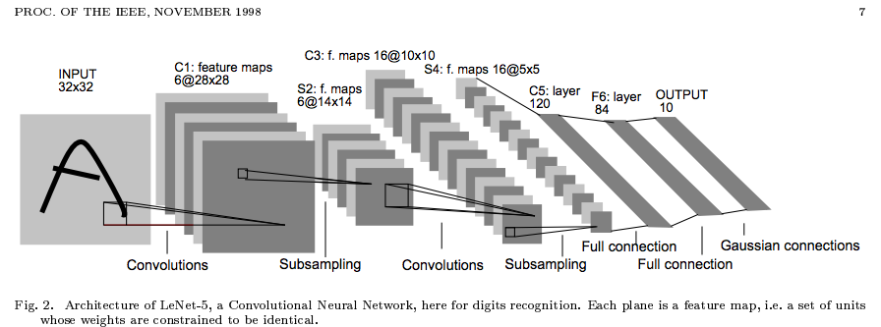
Recap: convolving an image with an ANN
Note that the parameters in the matrix defining the convolution are tied across all places that it is used

Slide 11
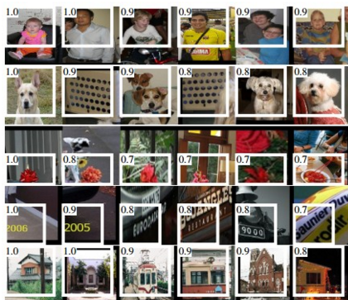
Alternating convolution and downsampling
5 layers up
The subfield in a large dataset that gives the strongest output for a neuron

Slide 12
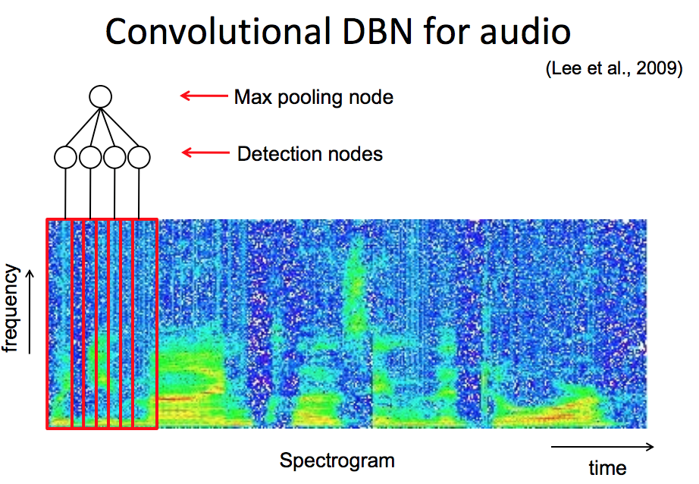
Similar technique applies to audio

Slide 13
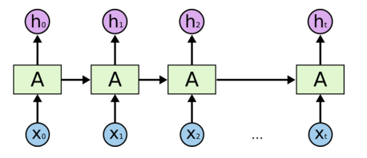
Implementing an LSTM
For t = 1,…,T:
(1)
(2)
(3)
http://colah.github.io/posts/2015-08-Understanding-LSTMs/
Notes:
Info is transferred down the chain, not just propagated
Decide when to insert imformation from input into the “backbone”

Slide 14
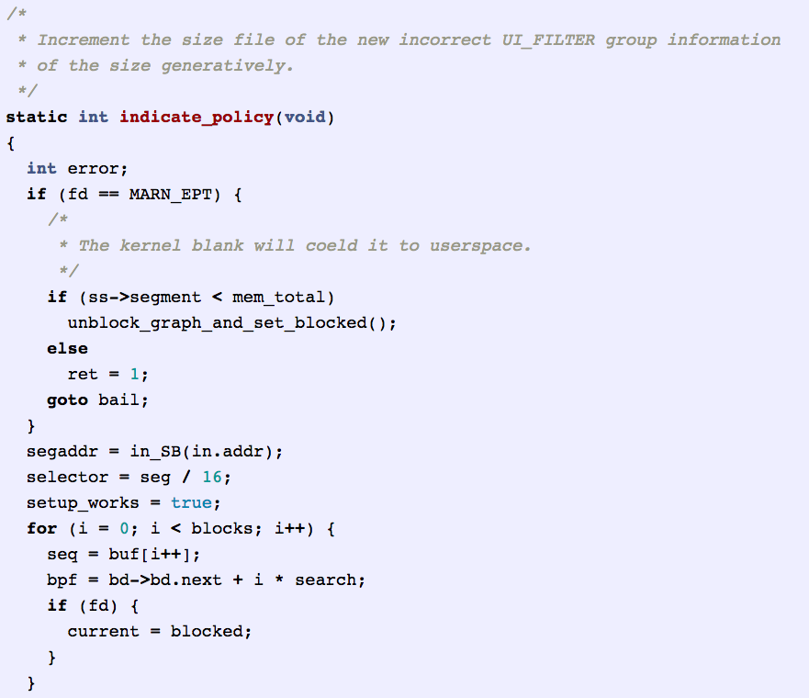
Character-level language model
http://karpathy.github.io/2015/05/21/rnn-effectiveness/

Slide 15
Outline
What’s new in ANNs in the last 5-10 years?
Deeper networks, more data, and faster training
Scalability and use of GPUs ✔
Symbolic differentiation ✔
Some subtle changes to cost function, architectures, optimization methods ✔
What types of ANNs are most successful and why?
Convolutional networks (CNNs) ✔
Long term/short term memory networks (LSTM) ✔
Word2vec and embeddings
What are the hot research topics for deep learning?

Slide 16
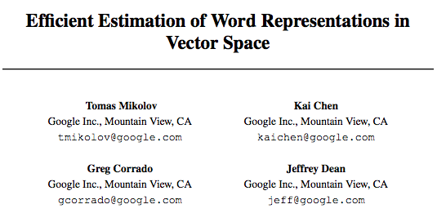
Word2Vec and Word embeddings

Slide 17
Basic idea behind skip-gram embeddings
construct hidden layer that “encodes” that word
So that the hidden layer will predict likely nearby words w(t-K), …, w(t+K)
from an input word w(t) in a document
final step of this prediction is a softmax over lots of outputs

Slide 18
Basic idea behind skip-gram embeddings
Training data:
positive examples are pairs of words w(t), w(t+j) that co-occur
You want to train over a very large corpus (100M words+) and hundreds+ dimensions
Training data:
negative examples are samples of pairs of words w(t), w(t+j) that don’t co-occur

Slide 19
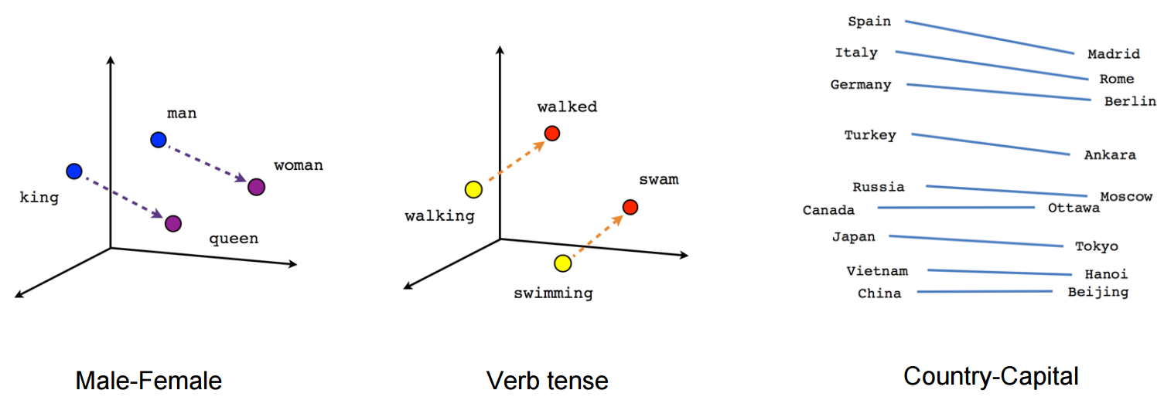
Results from word2vec
https://www.tensorflow.org/versions/r0.7/tutorials/word2vec/index.html

Slide 20
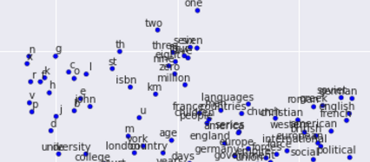
Results from word2vec
https://www.tensorflow.org/versions/r0.7/tutorials/word2vec/index.html

Slide 21
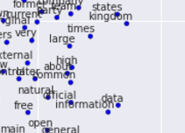
Results from word2vec
https://www.tensorflow.org/versions/r0.7/tutorials/word2vec/index.html

Slide 22
Outline
What’s new in ANNs in the last 5-10 years?
Deeper networks, more data, and faster training
Scalability and use of GPUs ✔
Symbolic differentiation ✔
Some subtle changes to cost function, architectures, optimization methods ✔
What types of ANNs are most successful and why?
Convolutional networks (CNNs) ✔
Long term/short term memory networks (LSTM) ✔
Word2vec and embeddings✔
What are the hot research topics for deep learning?

Slide 23
Some current hot topics
Multi-task learning
Does it help to learn to predict many things at once? e.g., POS tags and NER tags in a word sequence?
Similar to word2vec learning to produce all context words
Extensions of LSTMs that model memory more generally
e.g. for question answering about a story

Slide 24
Some current hot topics
Optimization methods (>> SGD)
Neural models that include “attention”
Ability to “explain” a decision

Slide 25
Examples of attention
Basic idea: similarly to the way an LSTM chooses what to “forget” and “insert” into memory, allow a network to choose what inputs to “attend to” in generation phase

Slide 26
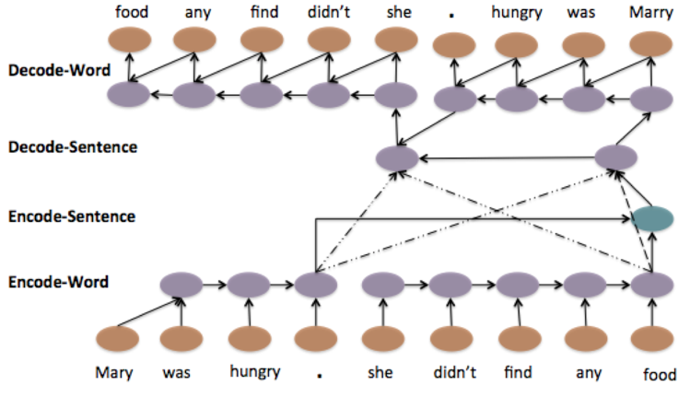
Examples of attention
http://yanran.li/peppypapers/2015/10/07/survey-attention-model-1.html
ACL 15, Li, Luong, Jurafsky

Slide 27
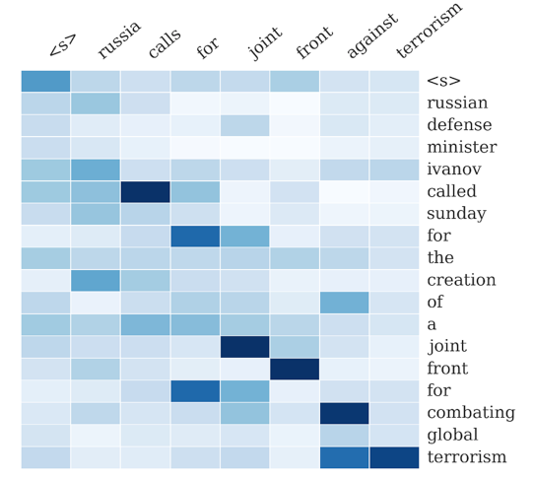
http://yanran.li/peppypapers/2015/10/07/survey-attention-model-1.html
EMNLP 15, Rush, Chopra, Weston

Slide 28
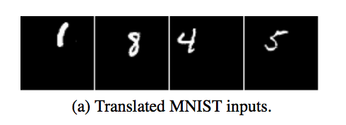
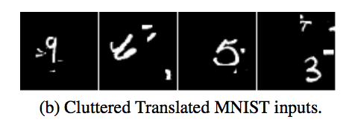
Examples of attention
https://papers.nips.cc/paper/5542-recurrent-models-of-visual-attention.pdf

Slide 29
Examples of attention
Basic idea: similarly to the way an LSTM chooses what to “forget” and “insert” into memory, allow a network to choose a path to focus on in the visual field
https://papers.nips.cc/paper/5542-recurrent-models-of-visual-attention.pdf

Slide 30
Some current hot topics
Knowledge-base embedding: extending word2vec to embed large databases of facts about the world into a low-dimensional space.
TransE, TransR, …
“NLP from scratch”: sequence-labeling and other NLP tasks with minimal amount of feature engineering, only networks and character- or word-level embeddings

Slide 31
Some current hot topics
Computer vision: complex tasks like generating a natural language caption from an image or understanding a video clip
Machine translation
English to Spanish, …
Using neural networks to perform tasks
Driving a car
Playing games (like Go or …)
Reinforcement learning

