Slide 1
Spectral clustering: unsupervised learning on graphs
10-405

Slide 2
Spectral Clustering: Graph = Matrix
 | A | B | C | D | E | F | G | H | I | J
A |  | 1 |  | 1 |  | 1
B | 1 |  | 1
C |  | 1
D | 1 |  |  |  |  | 1
E |  |  |  |  |  | 1
F | 1 |  |  | 1 | 1
G |  |  |  |  |  |  |  |  | 1
H |  |  |  |  |  |  | 1 |  | 1 | 1
I |  |  |  |  |  |  | 1 | 1 |  | 1
J |  |  |  |  |  |  |  | 1 | 1
C
A
B
G
I
H
J
F
D
E

Slide 3
Spectral Clustering: Graph = Matrix Transitively Closed Components = “Blocks”
recall this is a block-stochastic matrix:
each node has a latent “block”
fixed probability qi for links between elements of block i
fixed probability q0 for links between elements of different blocks
 | A | B | C | D | E | F | G | H | I | J
A | _ | 1 | 1 |  |  | 1
B | 1 | _ | 1
C | 1 | 1 | _
D |  |  |  | _ | 1 | 1
E |  |  |  | 1 | _ | 1
F | 1 |  |  | 1 | 1 | _
G |  |  |  |  |  |  | _ |  | 1 | 1
H |  |  |  |  |  |  |  | _ | 1 | 1
I |  |  |  |  |  |  | 1 | 1 | _ | 1
J |  |  |  |  |  |  | 1 | 1 | 1 | _
C
A
B
G
I
H
J
F
D
E
Of course we can’t see the “blocks” unless the nodes
are sorted by cluster…

Slide 4
Spectral Clustering: Graph = Matrix Vector = Node → Weight
M
v
 | A | B | C | D | E | F | G | H | I | J
A | _ | 1 | 1 |  |  | 1
B | 1 | _ | 1
C | 1 | 1 | _
D |  |  |  | _ | 1 | 1
E |  |  |  | 1 | _ | 1
F | 1 |  |  | 1 | 1 | _
G |  |  |  |  |  |  | _ |  | 1 | 1
H |  |  |  |  |  |  |  | _ | 1 | 1
I |  |  |  |  |  |  | 1 | 1 | _ | 1
J |  |  |  |  |  |  | 1 | 1 | 1 | _
 | A
A | 3
B | 2
C | 3
D
E
F
G
H
I
J
C
A
B
G
I
H
J
F
D
E

Slide 5
Spectral Clustering: Graph = Matrix M*v₁ = v₂ “propogates weights from neighbors”
M
*
v₁
=
v₂
 | A | B | C | D | E | F | G | H | I | J
A | _ | 1 | 1 |  |  | 1
B | 1 | _ | 1
C | 1 | 1 | _
D |  |  |  | _ | 1 | 1
E |  |  |  | 1 | _ | 1
F |  |  |  | 1 | 1 | _
G |  |  |  |  |  |  | _ |  | 1 | 1
H |  |  |  |  |  |  |  | _ | 1 | 1
I |  |  |  |  |  |  | 1 | 1 | _ | 1
J |  |  |  |  |  |  | 1 | 1 | 1 | _
A | 3
B | 2
C | 3
D
E
F
G
H
I
J
A | 2*1+3*1+0*1
B | 3*1+3*1
C | 3*1+2*1
D
E
F
G
H
I
J
C
A
B
G
I
H
J
F
D
E
M

Slide 6
Spectral Clustering: Graph = Matrix W*v₁ = v₂ “propogates weights from neighbors”
W
*
v₁
=
v₂
W: normalized so columns sum to 1
 | A | B | C | D | E | F | G | H | I | J
A | _ | .5 | .5 |  |  | .3
B | .3 | _ | .5
C | .3 | .5 | _
D |  |  |  | _ | .5 | .3
E |  |  |  | .5 | _ | .3
F | .3 |  |  | .5 | .5 | _
G |  |  |  |  |  |  | _ |  | .3 | .3
H |  |  |  |  |  |  |  | _ | .3 | .3
I |  |  |  |  |  |  | .5 | .5 | _ | .3
J |  |  |  |  |  |  | .5 | .5 | .3 | _
A | 3
B | 2
C | 3
D
E
F
G
H
I
J
A | 2*.5+3*.5+0*.3
B | 3*.3+3*.5
C | 3*.33+2*.5
D
E
F
G
H
I
J
C
A
B
G
I
H
J
F
D
E

Slide 7
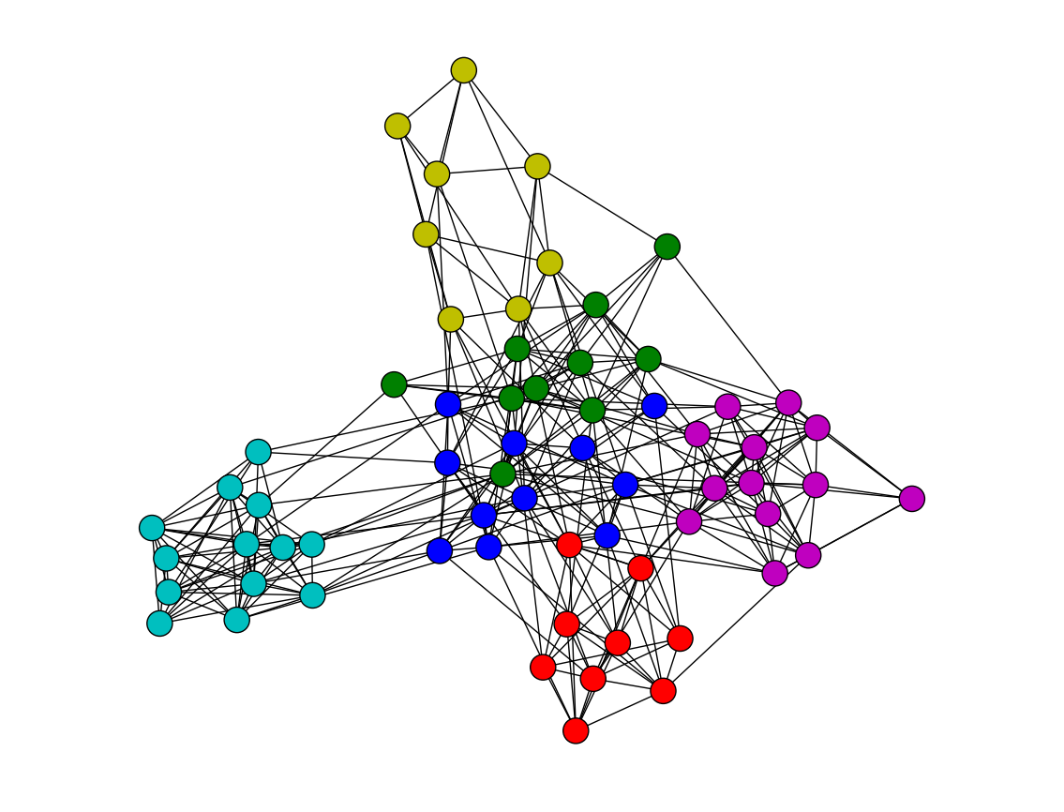
Spectral Clustering: Graph = Matrix W*v₁ = v₂ “propogates weights from neighbors”
Q: How do I pick v to be an eigenvector for a block-stochastic matrix?

Slide 8
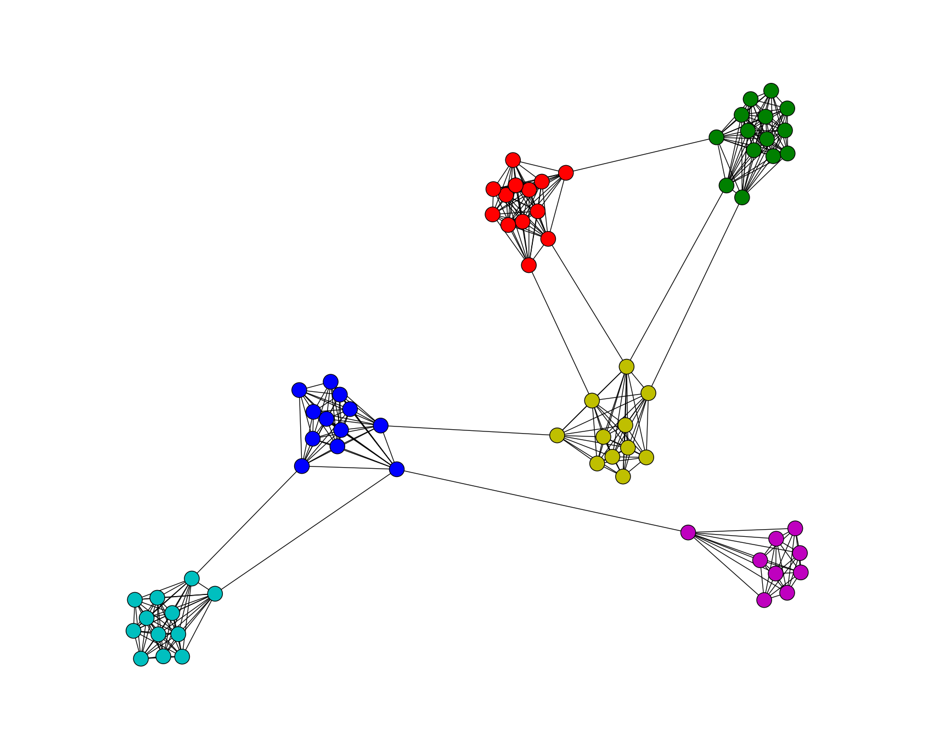
Spectral Clustering: Graph = Matrix W*v₁ = v₂ “propogates weights from neighbors”
How do I pick v to be an eigenvector for a block-stochastic matrix?

Slide 9
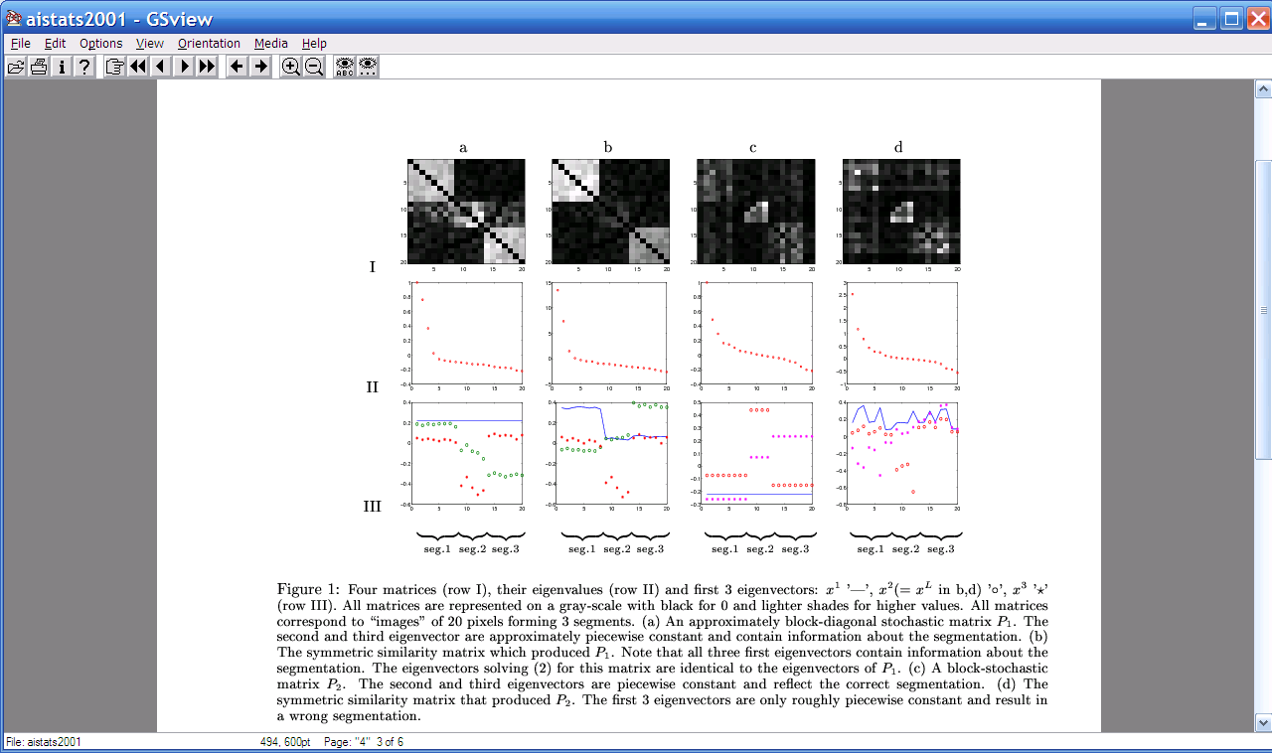
Spectral Clustering: Graph = Matrix W*v₁ = v₂ “propogates weights from neighbors”
λ₁
e₁
λ₂
“eigengap”
e₃
λ₃
λ₄
e₂
λ₅,_{6,7,….}
[Shi & Meila, 2002]

Slide 10
Spectral Clustering: Graph = Matrix W*v₁ = v₂ “propogates weights from neighbors”
0.4
0.2
x
x
x
x
x
x
x
x
x
0.0
x
x
x
-0.2
y
z
y
y
z
-0.4
y
z
z
e₃
z
z
z
z
z
z
y
z
-0.4
-0.2
0
0.2
e₂
[Shi & Meila, 2002]

Slide 11
Spectral Clustering: Graph = Matrix W*v₁ = v₂ “propogates weights from neighbors”
If W is connected but roughly block diagonal with k blocks then
the top eigenvector is a constant vector
the next k eigenvectors are roughly piecewise constant with “pieces” corresponding to blocks

Slide 12
Spectral Clustering: Graph = Matrix W*v₁ = v₂ “propogates weights from neighbors”
If W is connected but roughly block diagonal with k blocks then
the “top” eigenvector is a constant vector
the next k eigenvectors are roughly piecewise constant with “pieces” corresponding to blocks
Spectral clustering:
Find the top k+1 eigenvectors v₁,…,v_{k+1}
Discard the “top” one
Replace every node a with k-dimensional vector x_{a} = <v₂(a),…,v_{k+1} (a) >
Cluster with k-means

Slide 13
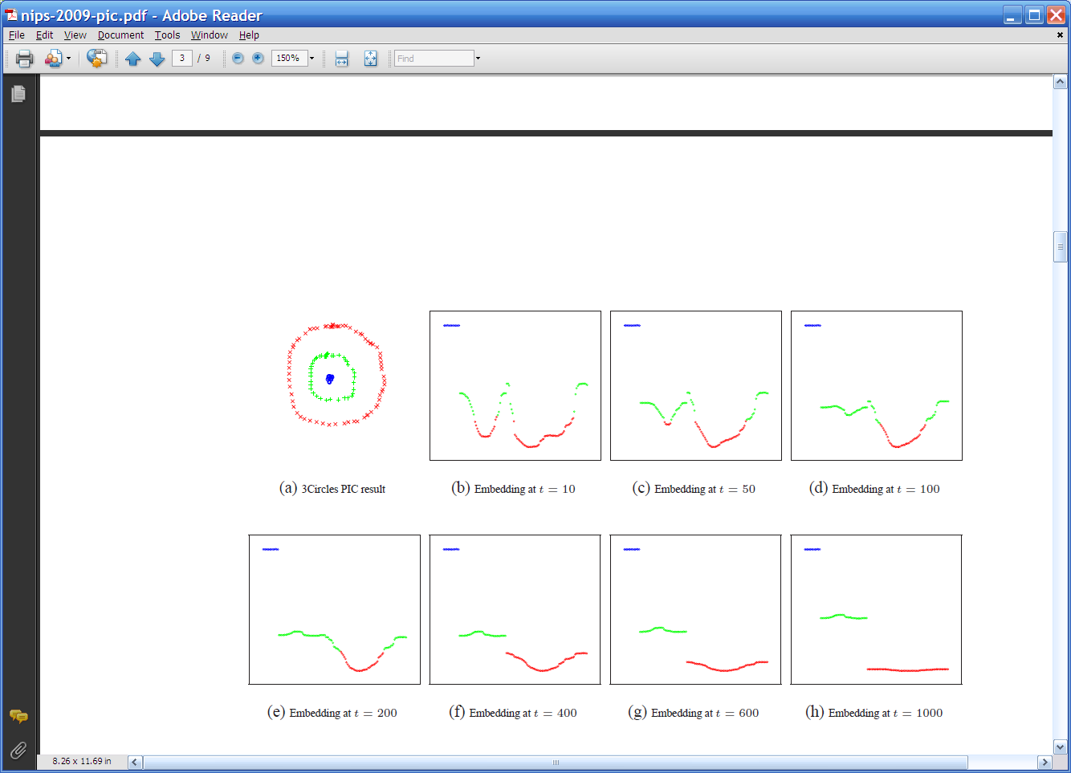
Some 2D examples
Create a graph.
Each 2D point is a vertex
Add edges connecting all points in the 2-D initial space to all other points
Weight of edge is Euclidean distance
g
g
g
g
g
g
g
g
g
r
r
r
r
…
b
b
r
r
r
b
b
b

Slide 14
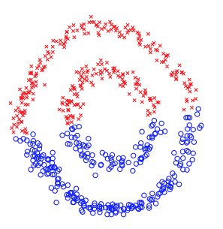
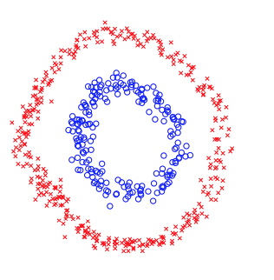

Slide 15
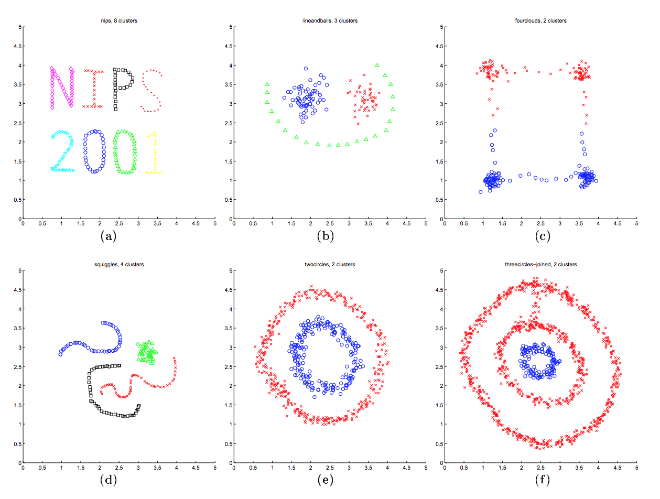

Slide 16
Spectral Clustering: Pros and Cons
Elegant, and well-founded mathematically
Tends to avoid local minima
Optimal solution to relaxed version of mincut problem (Normalized cut, aka NCut)
Works quite well when relations are approximately transitive (like similarity, social connections)
Expensive for very large datasets
Computing eigenvectors is the bottleneck
Approximate eigenvector computation not always useful
Noisy datasets sometimes cause problems
Picking number of eigenvectors and k is tricky
“Informative” eigenvectors need not be in top few
Performance can drop suddenly from good to terrible

Slide 17
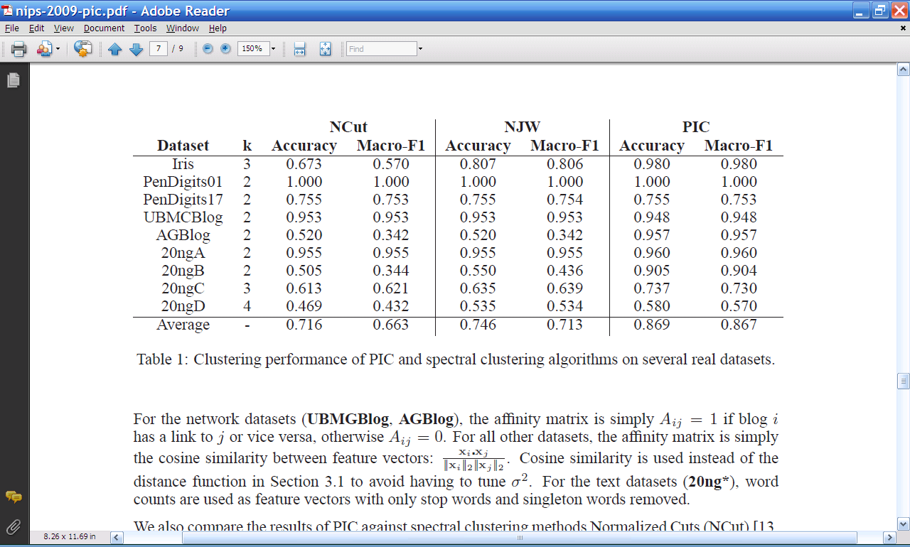
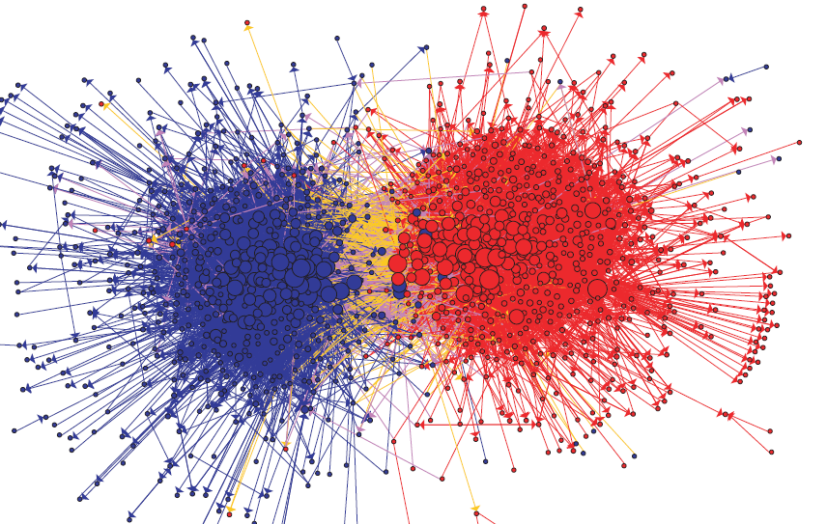
Experimental results: best-case assignment of class labels to clusters

Slide 18
Spectral clustering as Optimization

Slide 19
Spectral Clustering: Graph = Matrix W*v₁ = v₂ “propogates weights from neighbors”
A = adjacency matrix
D = diagonal normalizer for A (# outlinks)
W = A D⁻¹
smallest eigenvecs of D-A are largest eigenvecs of A
smallest eigenvecs of I-W are largest eigenvecs of W
Suppose each y(i)=+1 or -1:
Then y is a cluster indicator that splits the nodes into two
what is y^{T}(D-A)y ?

Slide 20
Same as smoothness criterion used in SSL but now there are no seeds
= size of CUT(y)
NCUT: roughly minimize ratio of transitions between classes vs transitions within classes

Slide 21
Spectral Clustering: Graph = Matrix W*v₁ = v₂ “propogates weights from neighbors”
smallest eigenvecs of D-A are largest eigenvecs of A
smallest eigenvecs of I-W are largest eigenvecs of W
Suppose each y(i)=+1 or -1:
Then y is a cluster indicator that cuts the nodes into two
what is y^{T}(D-A)y ? The cost of the graph cut defined by y
what is y^{T}(I-W)y ? Also a cost of a graph cut defined by y
How to minimize it?
Turns out: to minimize y^{T} X y / (y^{T}y) find smallest eigenvector of X
But: this will not be +1/-1, so it’s a “relaxed” solution

Slide 22
Spectral Clustering: Graph = Matrix W*v₁ = v₂ “propogates weights from neighbors”
λ₁
e₁
λ₂
“eigengap”
e₃
λ₃
λ₄
e₂
λ₅,_{6,7,….}
[Shi & Meila, 2002]

Slide 23
Another way to think about spectral clustering….
Most normal people think about spectral clustering like that - as relaxed optimization
…me, not so much
I like the connection to “averaging”…because…. it leads to a nice fast variation of spectral clustering called power iteration clustering

Slide 24
Unsupervised Learning on Graphs with Power Iteration Clustering

Slide 25
Spectral Clustering: Graph = Matrix
 | A | B | C | D | E | F | G | H | I | J
A |  | 1 |  | 1 |  | 1
B | 1 |  | 1
C |  | 1
D | 1 |  |  |  |  | 1
E |  |  |  |  |  | 1
F | 1 |  |  | 1 | 1
G |  |  |  |  |  |  |  |  | 1
H |  |  |  |  |  |  | 1 |  | 1 | 1
I |  |  |  |  |  |  | 1 | 1 |  | 1
J |  |  |  |  |  |  |  | 1 | 1
C
A
B
G
I
H
J
F
D
E

Slide 26
Spectral Clustering: Graph = Matrix Transitively Closed Components = “Blocks”
sometimes called a block-stochastic matrix:
each node has a latent “block”
fixed probability qi for links between elements of block i
fixed probability q0 for links between elements of different blocks
 | A | B | C | D | E | F | G | H | I | J
A | _ | 1 | 1 |  |  | 1
B | 1 | _ | 1
C | 1 | 1 | _
D |  |  |  | _ | 1 | 1
E |  |  |  | 1 | _ | 1
F | 1 |  |  | 1 | 1 | _
G |  |  |  |  |  |  | _ |  | 1 | 1
H |  |  |  |  |  |  |  | _ | 1 | 1
I |  |  |  |  |  |  | 1 | 1 | _ | 1
J |  |  |  |  |  |  | 1 | 1 | 1 | _
C
A
B
G
I
H
J
F
D
E
Of course we can’t see the “blocks” unless the nodes
are sorted by cluster…

Slide 27
Spectral Clustering: Graph = Matrix Vector = Node → Weight
M
v
 | A | B | C | D | E | F | G | H | I | J
A | _ | 1 | 1 |  |  | 1
B | 1 | _ | 1
C | 1 | 1 | _
D |  |  |  | _ | 1 | 1
E |  |  |  | 1 | _ | 1
F | 1 |  |  | 1 | 1 | _
G |  |  |  |  |  |  | _ |  | 1 | 1
H |  |  |  |  |  |  |  | _ | 1 | 1
I |  |  |  |  |  |  | 1 | 1 | _ | 1
J |  |  |  |  |  |  | 1 | 1 | 1 | _
 | A
A | 3
B | 2
C | 3
D
E
F
G
H
I
J
C
A
B
G
I
H
J
F
D
E
M

Slide 28
Spectral Clustering: Graph = Matrix M*v₁ = v₂ “propogates weights from neighbors”
M
*
v₁
=
v₂
 | A | B | C | D | E | F | G | H | I | J
A | _ | 1 | 1 |  |  | 1
B | 1 | _ | 1
C | 1 | 1 | _
D |  |  |  | _ | 1 | 1
E |  |  |  | 1 | _ | 1
F |  |  |  | 1 | 1 | _
G |  |  |  |  |  |  | _ |  | 1 | 1
H |  |  |  |  |  |  |  | _ | 1 | 1
I |  |  |  |  |  |  | 1 | 1 | _ | 1
J |  |  |  |  |  |  | 1 | 1 | 1 | _
A | 3
B | 2
C | 3
D
E
F
G
H
I
J
A | 2*1+3*1+0*1
B | 3*1+3*1
C | 3*1+2*1
D
E
F
G
H
I
J
C
A
B
G
I
H
J
F
D
E

Slide 29
Spectral Clustering: Graph = Matrix W*v₁ = v₂ “propogates weights from neighbors”
W
*
v₁
=
v₂
W: normalized so columns sum to 1
 | A | B | C | D | E | F | G | H | I | J
A | _ | .5 | .5 |  |  | .3
B | .3 | _ | .5
C | .3 | .5 | _
D |  |  |  | _ | .5 | .3
E |  |  |  | .5 | _ | .3
F | .3 |  |  | .5 | .5 | _
G |  |  |  |  |  |  | _ |  | .3 | .3
H |  |  |  |  |  |  |  | _ | .3 | .3
I |  |  |  |  |  |  | .5 | .5 | _ | .3
J |  |  |  |  |  |  | .5 | .5 | .3 | _
A | 3
B | 2
C | 3
D
E
F
G
H
I
J
A | 2*.5+3*.5+0*.3
B | 3*.3+3*.5
C | 3*.33+2*.5
D
E
F
G
H
I
J
C
A
B
G
I
H
J
F
D
E

Slide 30
Repeated averaging with neighbors as a clustering method
Pick a vector v⁰ (maybe at random)
Compute v¹ = Wv⁰
i.e., replace v⁰[x] with weighted average of v⁰[y] for the neighbors y of x
Plot v¹[x] for each x
Repeat for v², v³, …
Variants widely used for semi-supervised learning
HF/CoEM/wvRN - average + clamping of labels for nodes with known labels
Without clamping, will converge to constant v^{t}
What are the dynamics of this process?

Slide 31
Repeated averaging with neighbors on a sample problem…
blue
green
___red___
Create a graph, connecting all points in the 2-D initial space to all other points
Weighted by distance
Run power iteration (averaging) for 10 steps
Plot node id x vs v¹⁰(x)
nodes are ordered and colored by actual cluster number
g
g
g
g
g
g
g
g
g
r
r
r
r
…
b
b
r
r
r
b
b
b

Slide 32
Repeated averaging with neighbors on a sample problem…
blue
green
___red___
blue
green
___red___
blue
green
___red___
larger
smaller

Slide 33
Repeated averaging with neighbors on a sample problem…
blue
green
___red___
blue
green
___red___
blue
green
___red___
blue
green
___red___
blue
green
___red___

Slide 34
Repeated averaging with neighbors on a sample problem…
very small

Slide 35
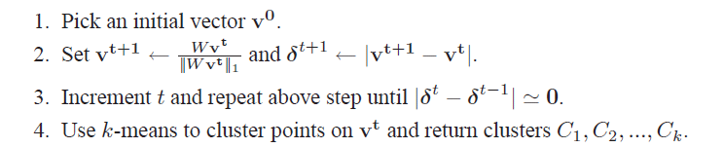
PIC: Power Iteration Clustering run power iteration (repeated averaging w/ neighbors) with early stopping
V⁰: random start, or “degree matrix” D, or …
Easy to implement and efficient
Very easily parallelized
Experimentally, often better than traditional spectral methods
Surprising since the embedded space is 1-dimensional!

Slide 36
Experiments
“Network” problems: natural graph structure
PolBooks: 105 political books, 3 classes, linked by copurchaser
UMBCBlog: 404 political blogs, 2 classes, blogroll links
AGBlog: 1222 political blogs, 2 classes, blogroll links
“Manifold” problems: cosine distance between classification instances
Iris: 150 flowers, 3 classes
PenDigits01,17: 200 handwritten digits, 2 classes (0-1 or 1-7)
20ngA: 200 docs, misc.forsale vs soc.religion.christian
20ngB: 400 docs, misc.forsale vs soc.religion.christian
20ngC: 20ngB + 200 docs from talk.politics.guns
20ngD: 20ngC + 200 docs from rec.sport.baseball

Slide 37

Experimental results: best-case assignment of class labels to clusters

Slide 38
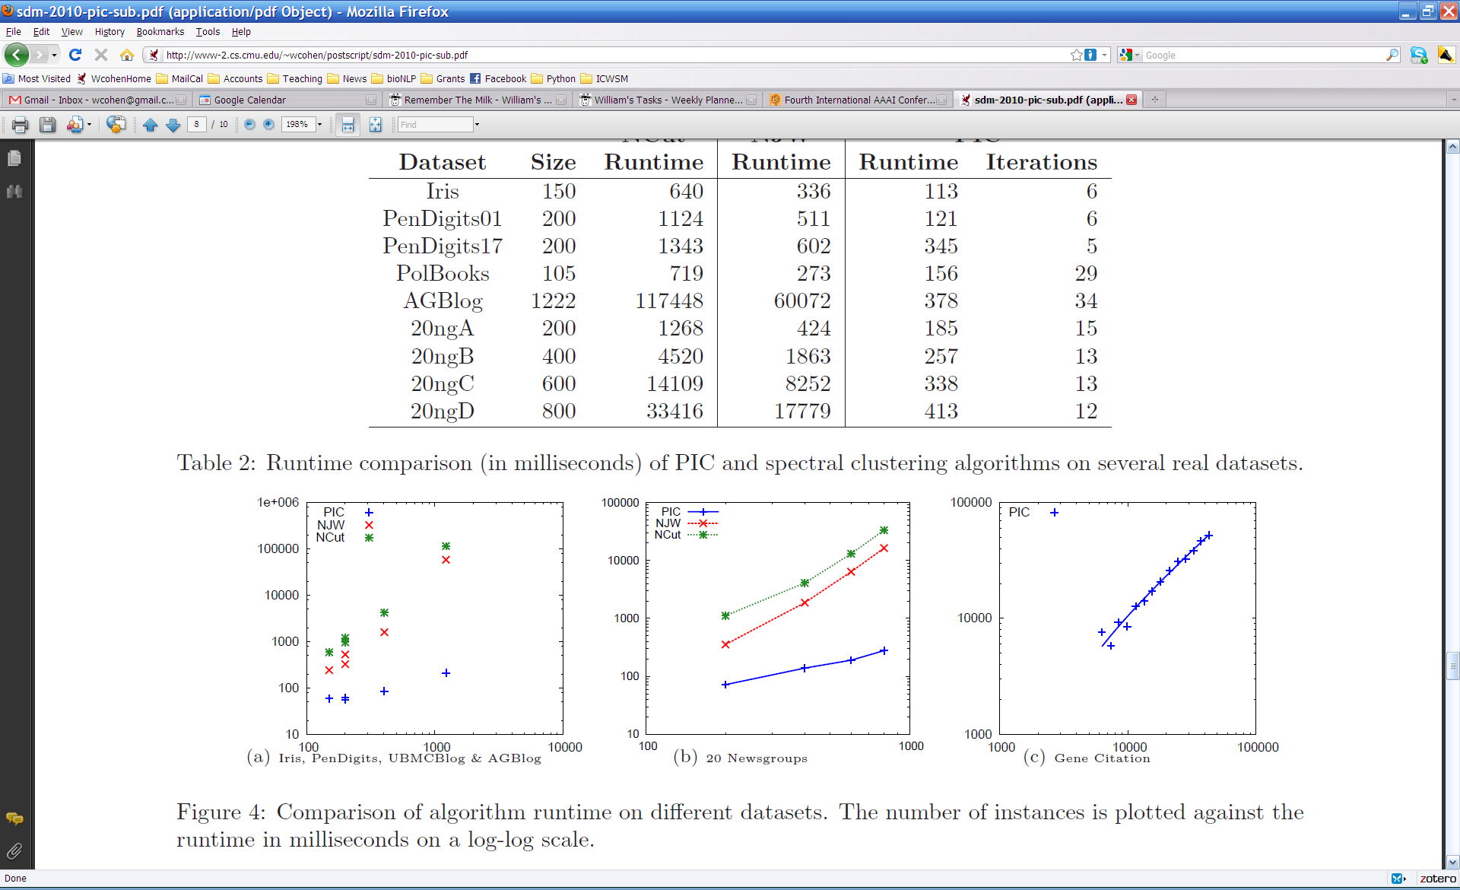

Slide 39
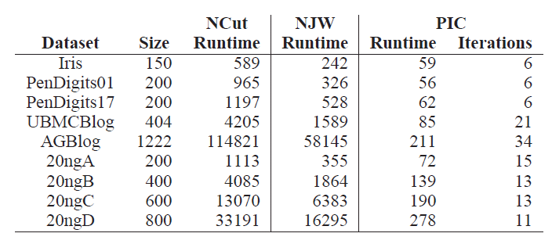
Experiments: run time and scalability
Time in millisec

Slide 40
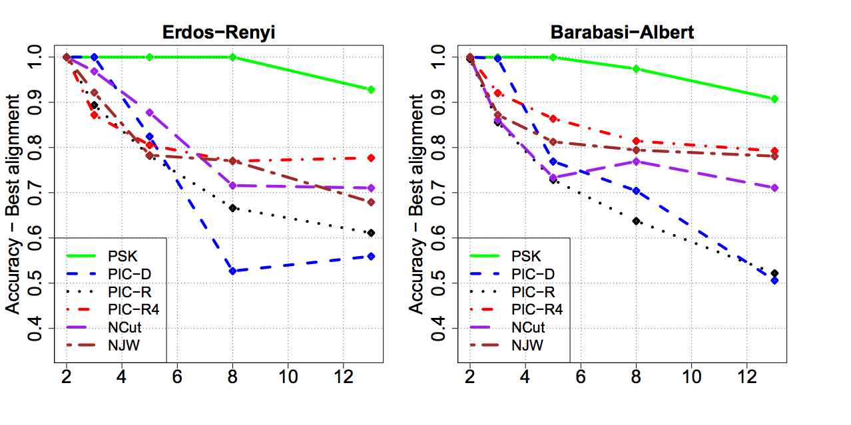
More experiments
Varying the number of clusters for PIC and PIC4 (starts with random 4-d point rather than a random 1-d point).

Slide 41
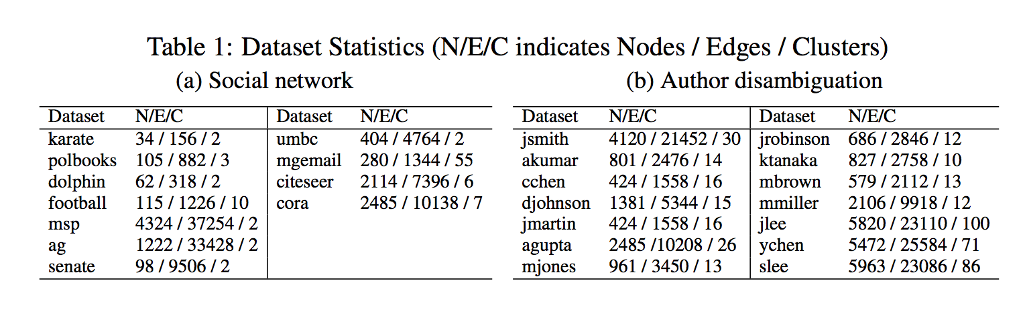
More experiments
More “real” network datasets from various domains

Slide 42
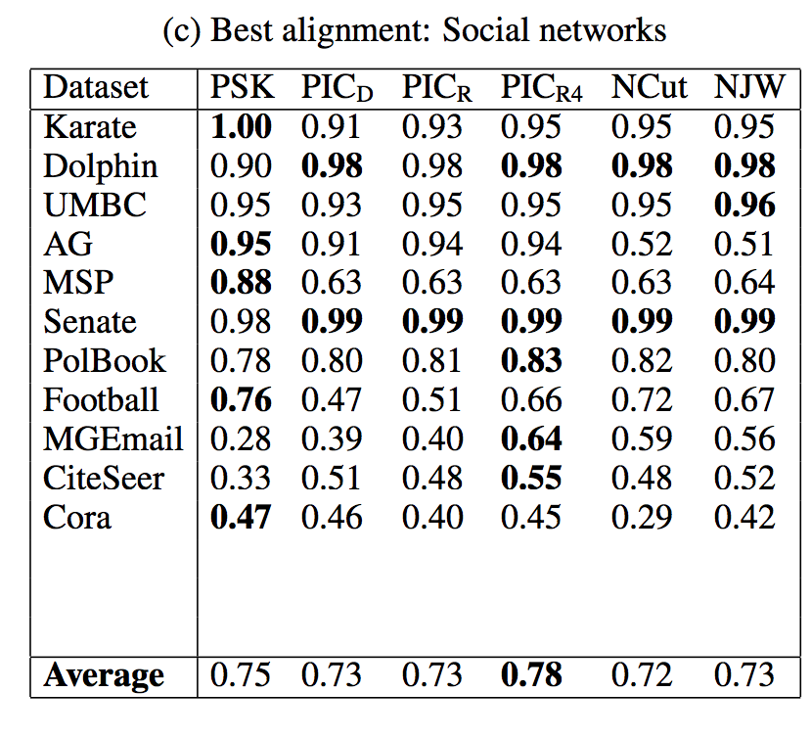
More experiments

Slide 43
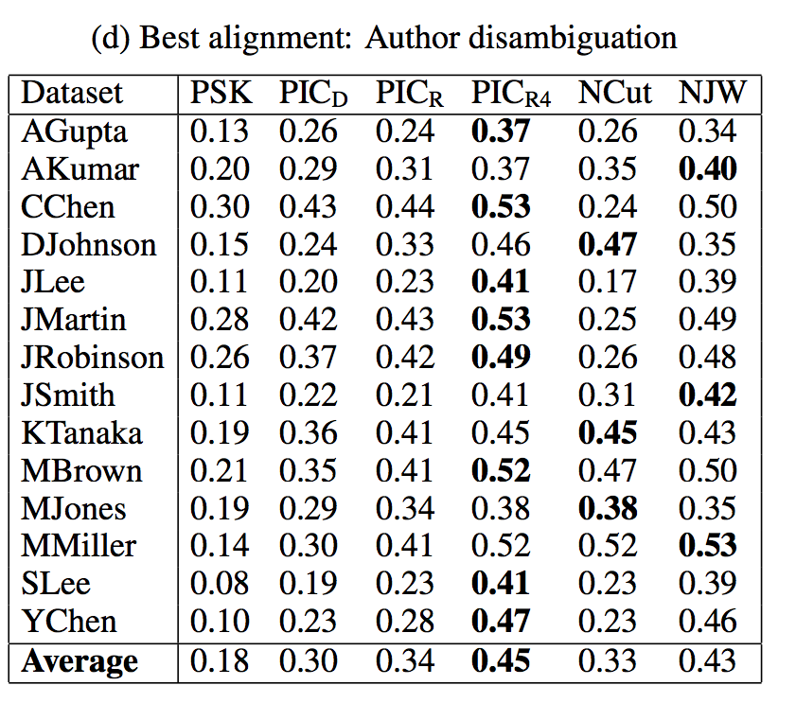

Slide 44
Learning on Graphs For Non-Graph Datasets

Slide 45
Why I’m talking about graphs
Lots of large data is graphs
Facebook, Twitter, citation data, and other social networks
The web, the blogosphere, the semantic web, Freebase, Wikipedia, Twitter, and other information networks
Text corpora (like RCV1), large datasets with discrete feature values, and other bipartite networks
nodes = documents or words
links connect document → word or word → document
Computer networks, biological networks (proteins, ecosystems, brains, …), …
Heterogeneous networks with multiple types of nodes
people, groups, documents

Slide 46

Simplest Case: Bi-partite Graphs
CALO
William
graph
proposal
CMU
Notes:
Usually, information retrieval systems, for both the web and email, index data a bipartite graph, which includes words, or terms, on one hand – and files, on the other hand.
Given a query, which is a set of words, the retrieval engine ranks documents by their relevance, or similarity, to the query.
However, email can be represented by a richer graph. With nodes representing persons, dates, meetings and email-addresses.
In this graph, persons are inter-connected via messages that they send or receive, and via the meetings they attend. Files are inter-connected through the social network of the recipients, similar content and so on.
So, we have a typed graph – where every node has a type. And, in addition, the edges in the graph are directed and have types as well.
For example, “sent to” from email to recipient. Or “has subject term” going from an email message and a term appearing in its subject line.
Given a schema of relations, a whole corpus of email can be represented as one joint graph. For email, you can easily extract this information by parsing the email header.

Slide 47
Motivation: Experimental Datasets `Used for PIC are…
“Network” problems: natural graph structure
PolBooks: 105 political books, 3 classes, linked by copurchaser
UMBCBlog: 404 political blogs, 2 classes, blogroll links
AGBlog: 1222 political blogs, 2 classes, blogroll links
Also: Zachary’s karate club, citation networks, ...
“Manifold” problems: cosine distance between all pairs of classification instances
Iris: 150 flowers, 3 classes
PenDigits01,17: 200 handwritten digits, 2 classes (0-1 or 1-7)
20ngA: 200 docs, misc.forsale vs soc.religion.christian
20ngB: 400 docs, misc.forsale vs soc.religion.christian
…
Gets expensive fast

Slide 48
Spectral Clustering: Graph = Matrix A*v₁ = v₂ “propogates weights from neighbors”
A
*
v₁
=
v₂
 | A | B | C | D | E | F | G | H | I | J
A | _ | 1 | 1 |  |  | 1
B | 1 | _ | 1
C | 1 | 1 | _
D |  |  |  | _ | 1 | 1
E |  |  |  | 1 | _ | 1
F |  |  |  | 1 | 1 | _
G |  |  |  |  |  |  | _ |  | 1 | 1
H |  |  |  |  |  |  |  | _ | 1 | 1
I |  |  |  |  |  |  | 1 | 1 | _ | 1
J |  |  |  |  |  |  | 1 | 1 | 1 | _
A | 3
B | 2
C | 3
D
E
F
G
H
I
J
A | 2*1+3*1+0*1
B | 3*1+3*1
C | 3*1+2*1
D
E
F
G
H
I
J
C
A
B
G
I
H
J
F
D
E
M

Slide 49
Spectral Clustering: Graph = Matrix W*v₁ = v₂ “propogates weights from neighbors”
W
*
v₁
=
v₂
W: normalized so columns sum to 1
 | A | B | C | D | E | F | G | H | I | J
A | _ | .5 | .5 |  |  | .3
B | .3 | _ | .5
C | .3 | .5 | _
D |  |  |  | _ | .5 | .3
E |  |  |  | .5 | _ | .3
F | .3 |  |  | .5 | .5 | _
G |  |  |  |  |  |  | _ |  | .3 | .3
H |  |  |  |  |  |  |  | _ | .3 | .3
I |  |  |  |  |  |  | .5 | .5 | _ | .3
J |  |  |  |  |  |  | .5 | .5 | .3 | _
A | 3
B | 2
C | 3
D
E
F
G
H
I
J
A | 2*.5+3*.5+0*.3
B | 3*.3+3*.5
C | 3*.33+2*.5
D
E
F
G
H
I
J
C
A
B
G
I
H
J
F
D
E
W = D⁻¹*A
D[i,i]=1/degree(i)

Slide 50
Lazy computation of distances and normalizers
Recall PIC’s update is
v^{t} = W * v^{t-1 =} = D⁻¹A * v^{t-1}
…where D is the [diagonal] degree matrix: D=A*1
My favorite distance metric for text is length-normalized TFIDF:
Def’n: A(i,j)=<v_{i},v_{j}>/||v_{i}||*||v_{j}||
Let N(i,i)=||v_{i}|| … and N(i,j)=0 for i!=j
Let F(i,k)=TFIDF weight of word w_{k} in document v_{i}
Then: A = N⁻¹F^{T}FN⁻¹
1 is a column vector of 1’s
<u,v>=inner product
||u|| is L2-norm

Slide 51
Lazy computation of distances and normalizers
Equivalent to using TFIDF/cosine on all pairs of examples but requires only sparse matrices
Recall PIC’s update is
v^{t} = W * v^{t-1 =} = D⁻¹A * v^{t-1}
…where D is the [diagonal] degree matrix: D=diag(A*1)
Let F(i,k)=TFIDF weight of word w_{k} in document v_{i}
Compute N(i,i)=||v_{i}|| … and N(i,j)=0 for i!=j
Don’t compute A = N⁻¹F^{T}FN⁻¹
Let D(i,i)= N⁻¹F^{T}FN⁻¹*1 where 1 is an all-1’s vector
Computed as D=N⁻¹⁽F^{T(}F(N⁻¹*1))) for efficiency
New update:
v^{t} = D⁻¹A * v^{t-1} = D⁻¹ N⁻¹F^{T}FN⁻¹ *v^{t-1}

Slide 52
Experimental results
RCV1 text classification dataset
800k + newswire stories
Category labels from industry vocabulary
Took single-label documents and categories with at least 500 instances
Result: 193,844 documents, 103 categories
Generated 100 random category pairs
Each is all documents from two categories
Range in size and difficulty
Pick category 1, with m₁ examples
Pick category 2 such that 0.5m₁<m₂<2m₁

Slide 53
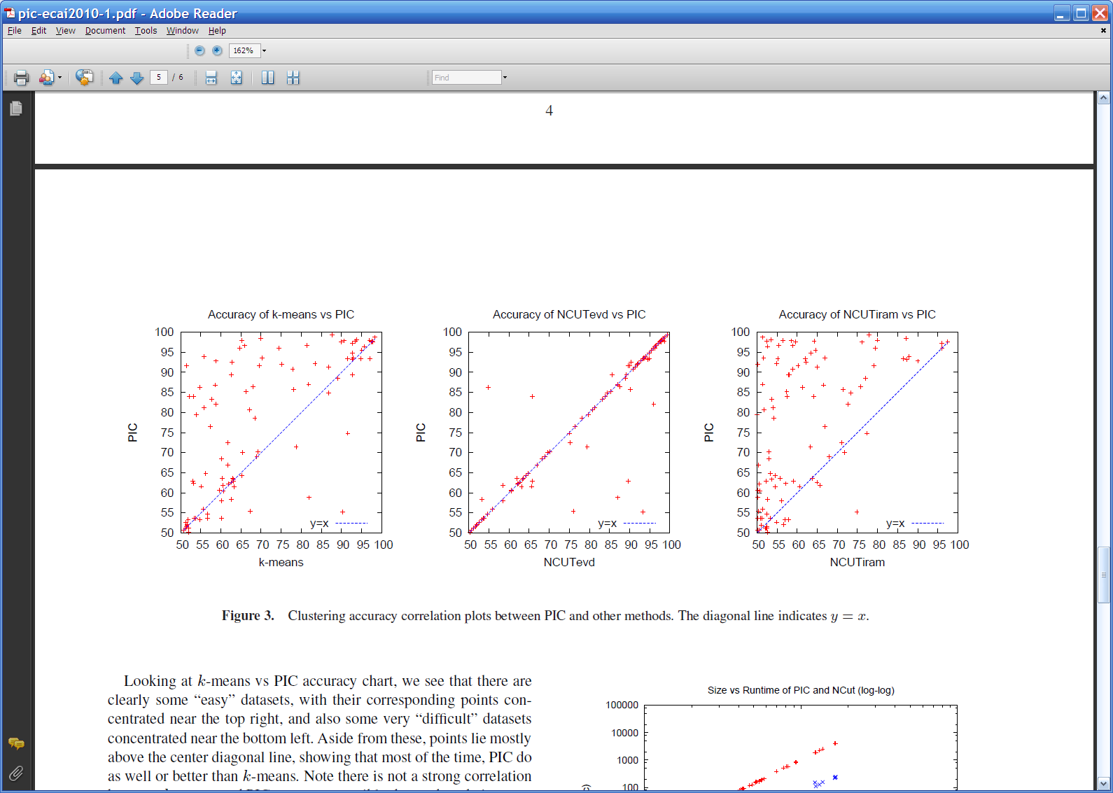
Results
NCUTevd: Ncut with exact eigenvectors
NCUTiram: Implicit restarted Arnoldi method
No stat. signif. diffs between NCUTevd and PIC

Slide 54
Results

Slide 55
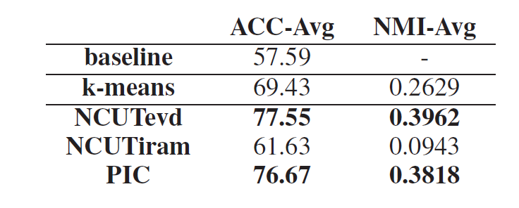
Results
NCUTevd: Ncut with exact eigenvectors
NCUTiram: Implicit restarted Arnoldi method
No stat. signif. diffs between NCUTevd and PIC

Slide 56
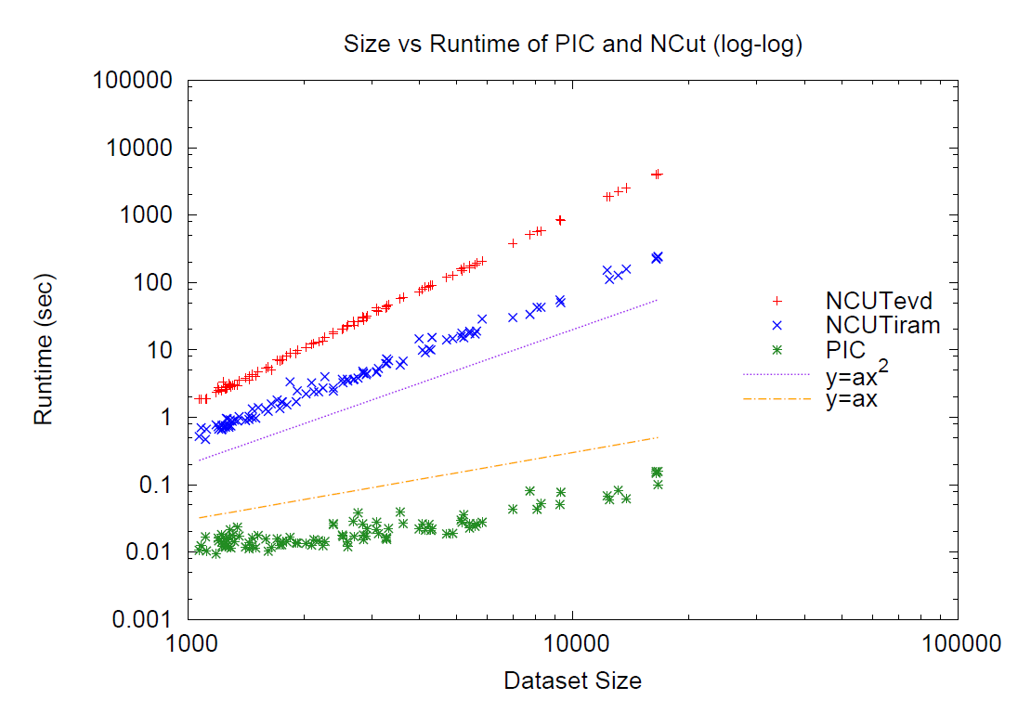
Results

Slide 57
Results
Linear run-time implies constant number of iterations
Number of iterations to “acceleration-convergence” is hard to analyze:
Faster than a single complete run of power iteration to convergence
On our datasets
10-20 iterations is typical
30-35 is exceptional

Slide 58
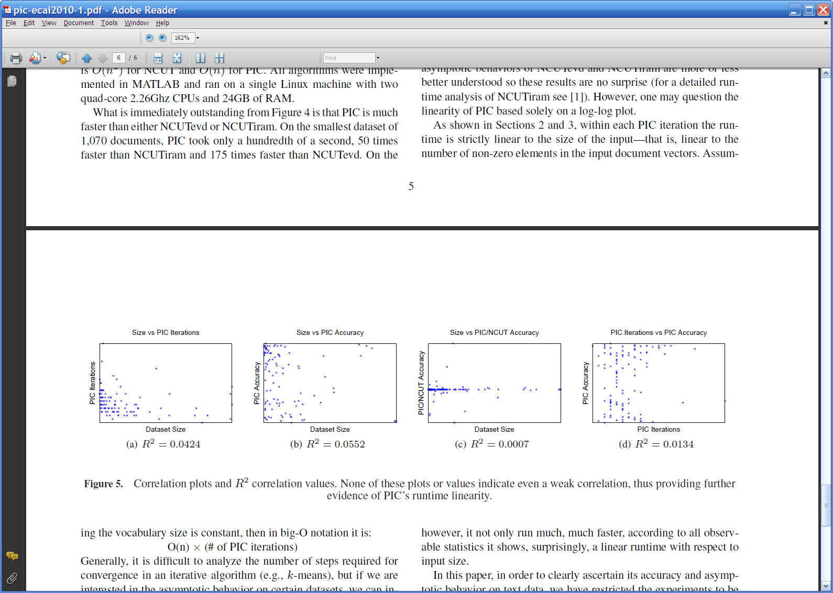

Slide 59
PIC and SSL

Slide 60
PIC: Power Iteration Clustering run power iteration (repeated averaging w/ neighbors) with early stopping

Slide 61
Harmonic Functions/CoEM/wvRN
then replace v^{t+1}(i) with seed values +1/-1 for labeled data
for 5-10 iterations
Classify data using final values from v

Slide 62
Implicit Manifolds on the NELL datasets
mayor of arg1
arg1 is home of
San Francisco
Austin
Paris
Pittsburgh
anxiety
traits such as arg1
live in arg1
traits such as arg1
arrogance
denial
selfishness
denial
selfishness
Seattle
Nodes “near” seeds
Nodes “far from” seeds

Slide 63
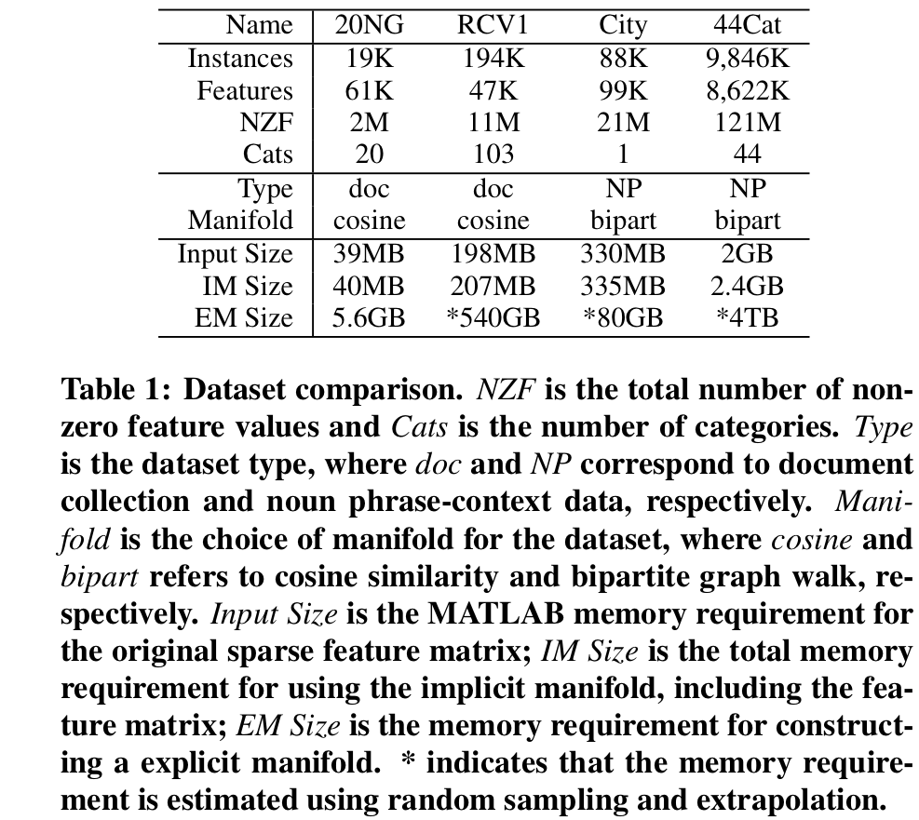
Using the Manifold Trick for SSL

Slide 64
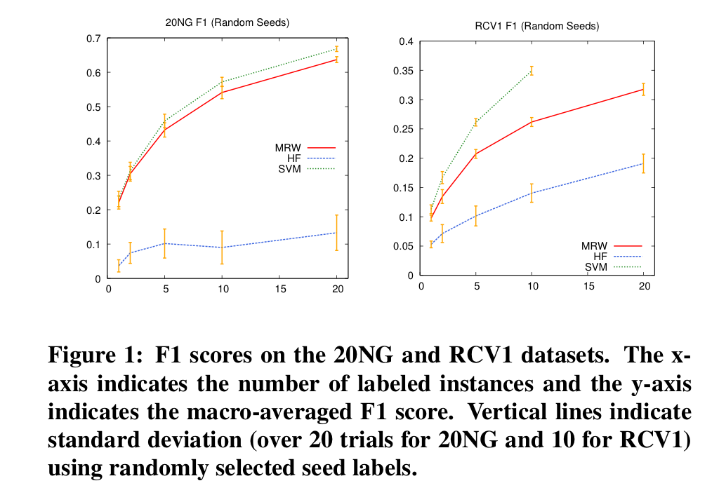
Using the Manifold Trick for SSL

Slide 65
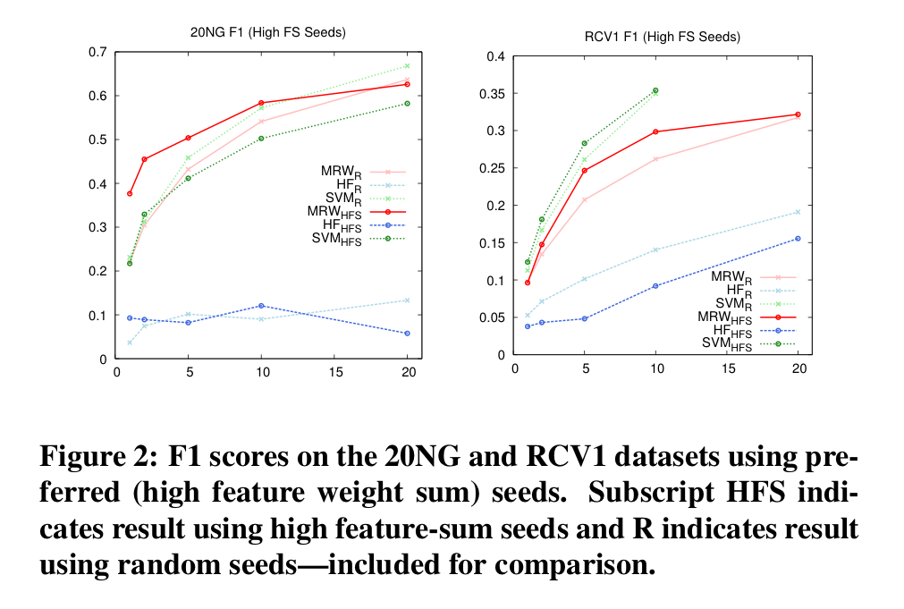
Using the Manifold Trick for SSL

Slide 66
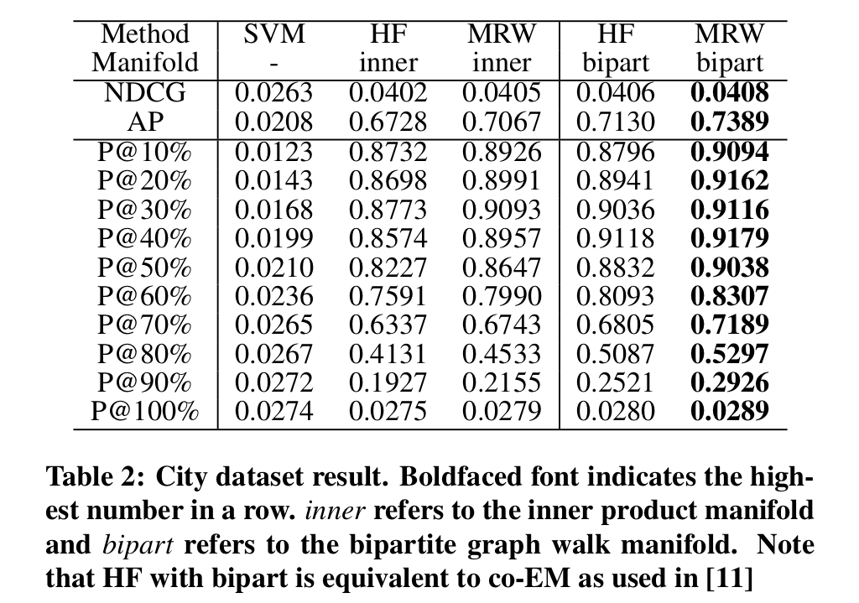
Using the Manifold Trick for SSL

Slide 67
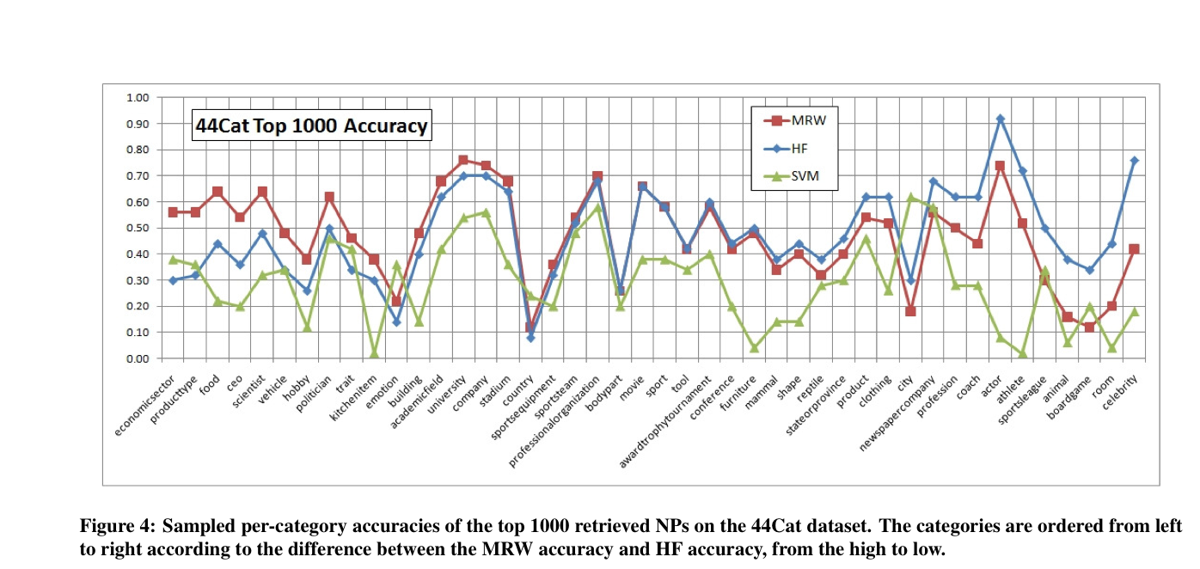
Using the Manifold Trick for SSL

Slide 68
Using the Manifold Trick for SSL
A smoothing trick:

Slide 69
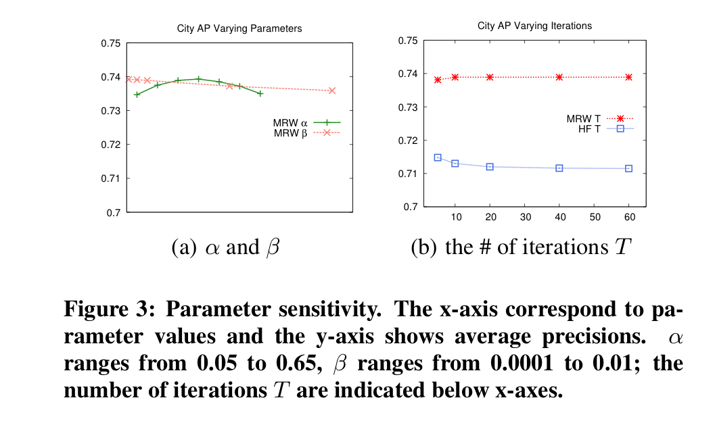
Using the Manifold Trick for SSL

