Slide 1
Intro to Semi-Supervised Learning (SSL)

Slide 2
Semi-supervised learning
Given:
A pool of labeled examples L
A (usually larger) pool of unlabeled examples U
Option 1 for using L and U :
Ignore U and use supervised learning on L
Option 2:
Ignore labels in L+U and use k-means, etc find clusters; then label each cluster using L
Question:
Can you use both L and U to do better?

Slide 3
SSL is Somewhere Between Clustering and Supervised Learning

Slide 4
SSL is Between Clustering and SL

Slide 5
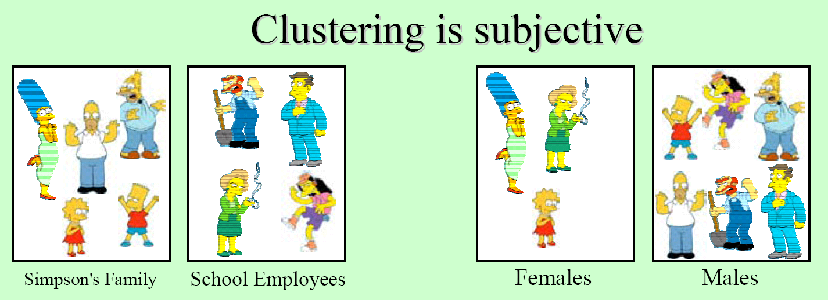
What is a natural grouping among these objects?
slides: Bhavana Dalvi

Slide 6
SSL is Between Clustering and SL
clustering is unconstrained and may not give you what you want
maybe this clustering is as good as the other

Slide 7
SSL is Between Clustering and SL

Slide 8
SSL is Between Clustering and SL

Slide 9
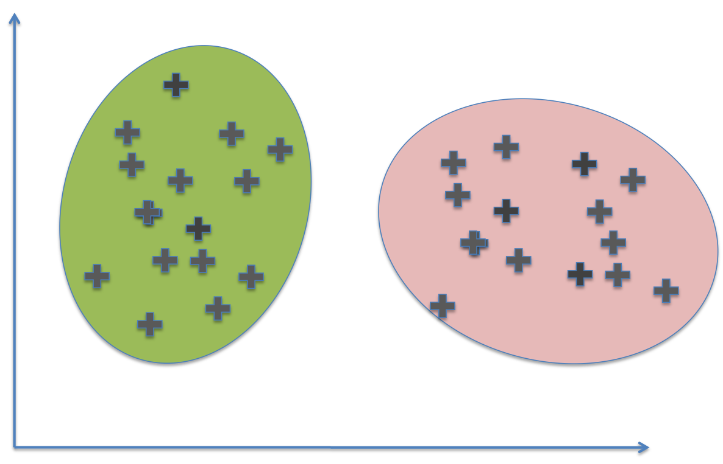
SSL is Between Clustering and SL
supervised learning with few labels is also unconstrained and may not give you what you want

Slide 10
SSL is Between Clustering and SL

Slide 11
SSL is Between Clustering and SL
This clustering isn’t consistent with the labels

Slide 12
SSL is Between Clustering and SL
|Predicted Green|/|U| ~= 50%

Slide 13
SSL in Action: The NELL System

Slide 14
Type of SSL
Margin-based: transductive SVM
Logistic regression with entropic regularization
Generative: seeded k-means
Nearest-neighbor like: graph-based SSL
Label propagation

Slide 15
SSL via “Label Propagation”
Seed labels

Slide 16
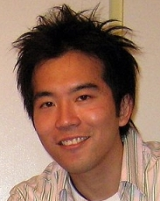
ASONAM-2010 (Advances in Social Networks Analysis and Mining)

Slide 17
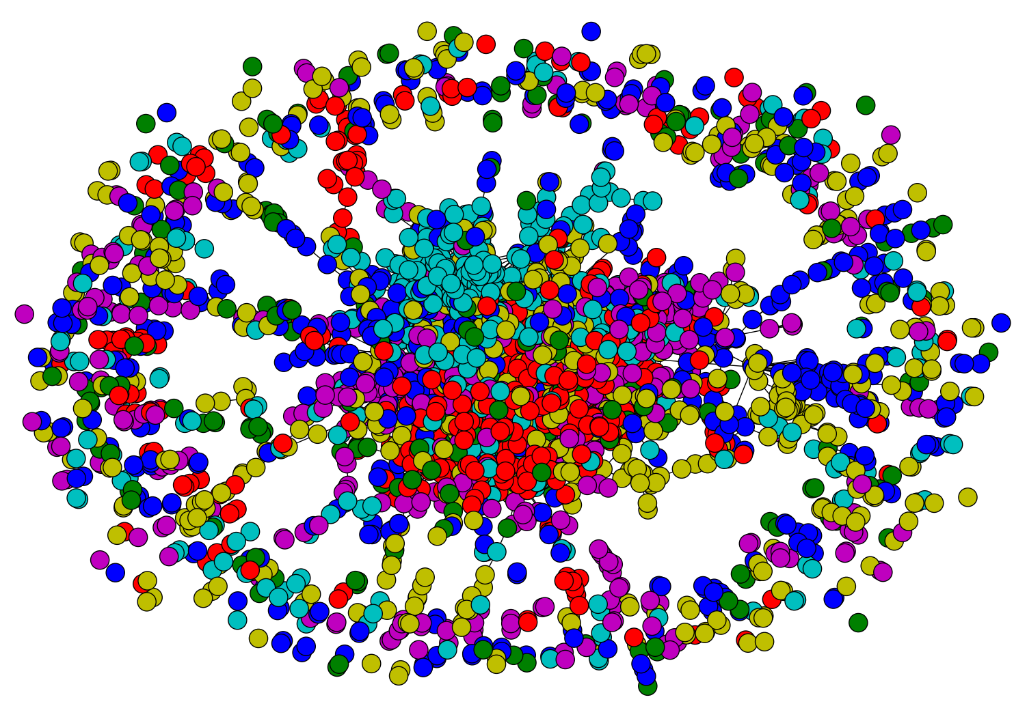
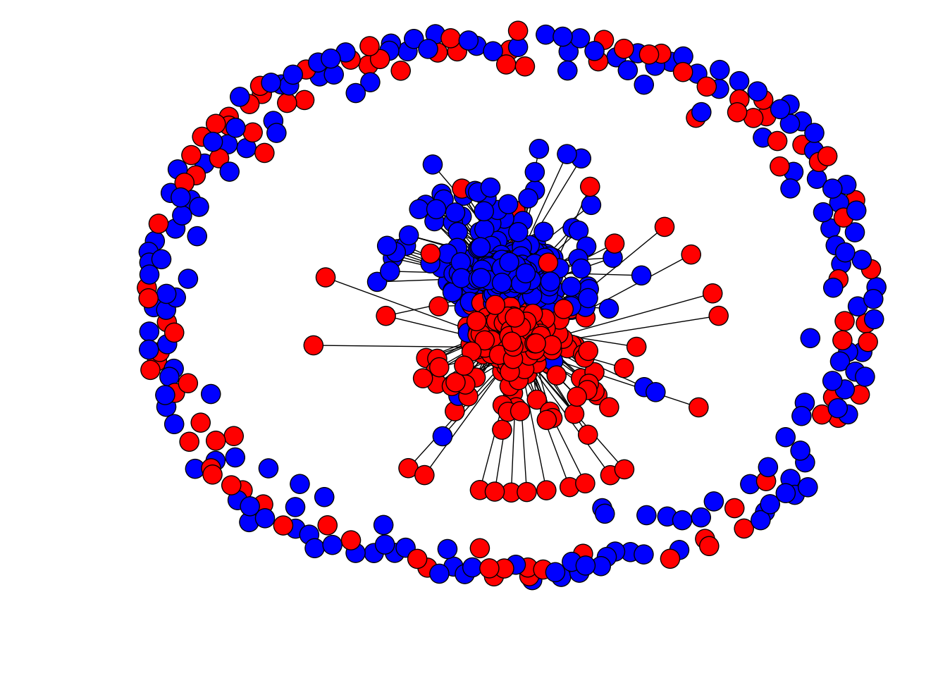
Network Datasets with Known Classes
UBMCBlog
AGBlog
MSPBlog
Cora
Citeseer

Slide 18
Some intuition
*
*
*

Slide 19
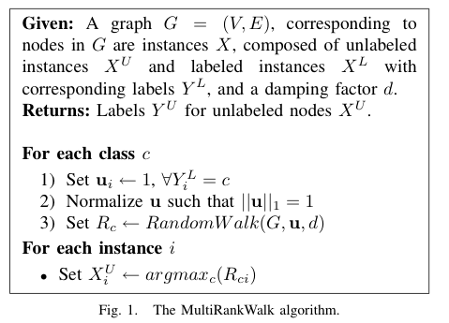
u is uniform over the seeds for class c
RWR - fixpoint of:
Seed selection
order by PageRank, degree, or randomly
go down list until you have at least k examples/class

Slide 20
Some intuition
*
*
*

Slide 21
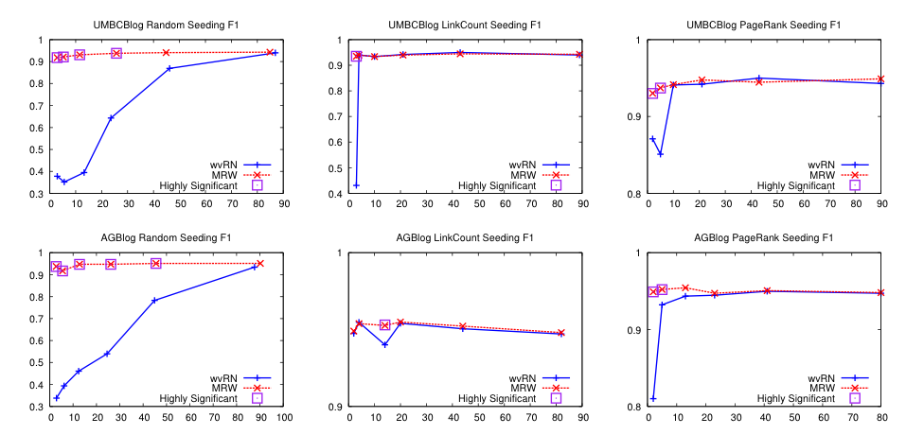
Results – Blog data
We’ll discuss this soon….
Random
Degree
PageRank

Slide 22
Results – More blog data
Random
Degree
PageRank

Slide 23
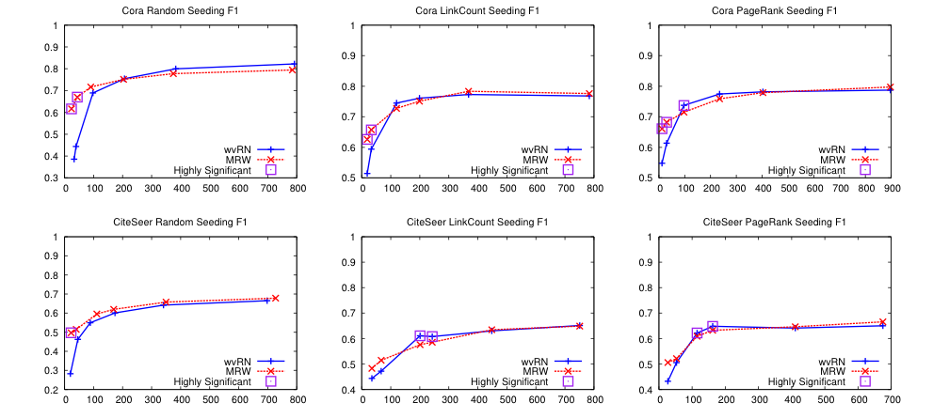
Results – Citation data
Random
Degree
PageRank

Slide 24
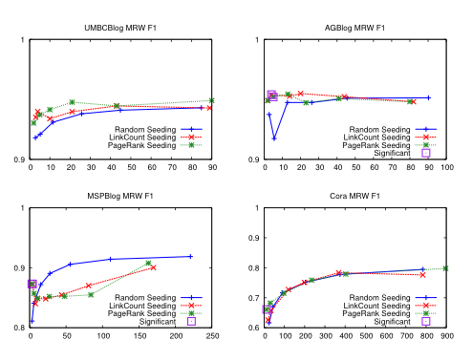
Seeding – MultiRankWalk

Slide 25
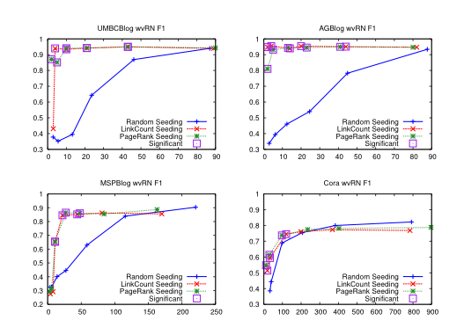
Seeding – HF/wvRN

Slide 26
Back to Experiments: Network Datasets with Known Classes
UBMCBlog
AGBlog
MSPBlog
Cora
Citeseer

Slide 27
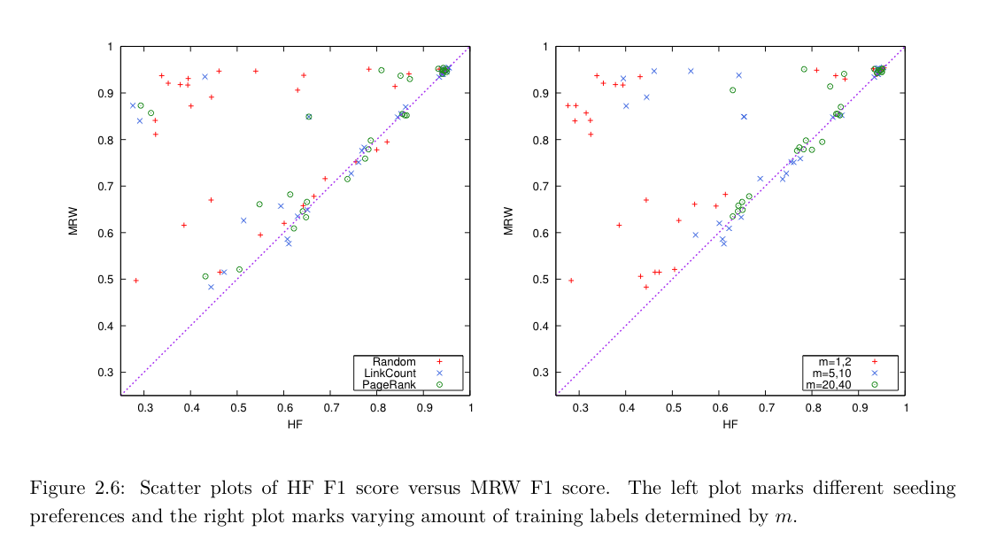
MultiRankWalk vs wvRN/HF/CoEM

Slide 28
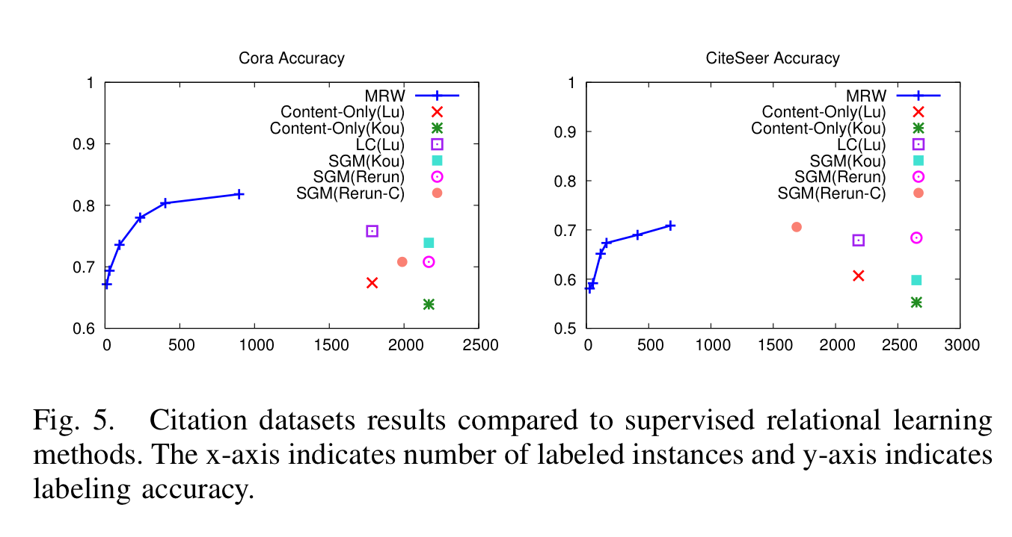
How well does MWR work?
Notes:
Re-run-C connected version of dataset
Lu is Lu & Getoor, 2003

Slide 29
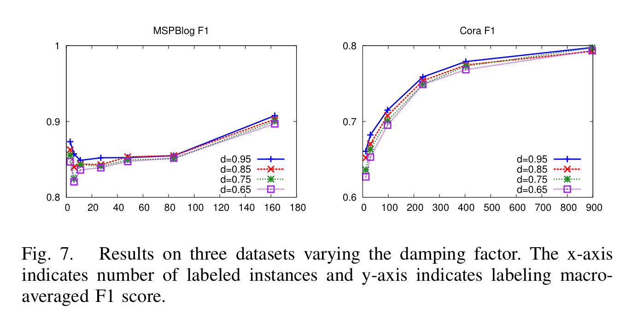
Parameter Sensitivity

Slide 30
Harmonic Fields aka coEM aka wvRN

Slide 31
CoEM/HF/wvRN
One definition [MacKassey & Provost, JMLR 2007]:…
Another definition: A harmonic field (HF) – the score of each node in the graph is the harmonic (linearly weighted) average of its neighbors’ scores --- also sometimes called LP-ZGL
[X. Zhu, Z. Ghahramani, and J. Lafferty, ICML 2003]

Slide 32
Co-EM Learner: equivalent to HF on a bipartite graph (Ghani & Nigam, 2000)
NPs
contexts
+
Pittsburgh
+
+
+
+
+
+
lives in _
+
+
-
-
-
-
-
-
-
-
-
-
-
-

Slide 33
The HF Algorithm
= labeled examples
= unlabeled examples
= graph = similarity between x_{i} and x_{j}
Optimization problem: minimize
subject to constraint that all labeled examples are classified correctly

Slide 34
The HF Loss In Matrix Form
= graph = similarity between x_{i} and x_{j} is symmetric

Slide 35
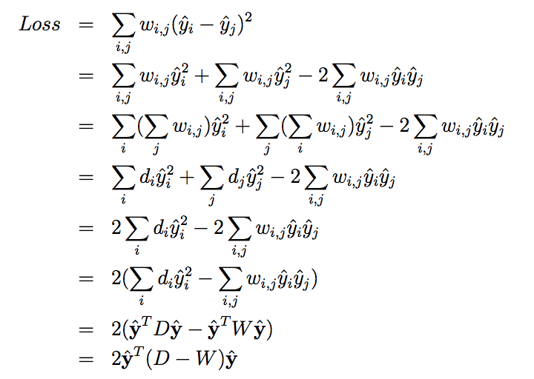

Slide 36
The HF Algorithm
= labeled examples
= unlabeled examples
= graph = similarity between x_{i} and x_{j}
S[i,i] = 1 for all seed nodes i<m+1
Optimization problem: minimize
subject to

Slide 37
The HF Algorithm
Optimization problem: minimize
subject to
This converges quickly: on Frank’s data usually 5-10 iterations was best (and more tends to overfit)

Slide 38
What is HF aka coEM aka wvRN?
Algorithmically:
HF propagates weights and then resets the seeds to their initial value
MRW propagates weights and does not reset seeds

Slide 39
MultiRank Walk vs HF/wvRN/CoEM
Seeds are marked S
HF
MRW

Slide 40
MultiRank Walk vs HF/wvRN/CoEM

Slide 41
SSL as optimization and Modified Adsorption slides from Partha Talukdar

Slide 43
yet another name for HF/wvRN/coEM

Slide 44
match seeds
prior
smoothness

Slide 45
Adsorption SSL algorithm

Slide 48
How to do this minimization?
First, differentiate to find min is at
The minimize with Jacobi method (which works for linear matrix equations like this one)

Slide 49
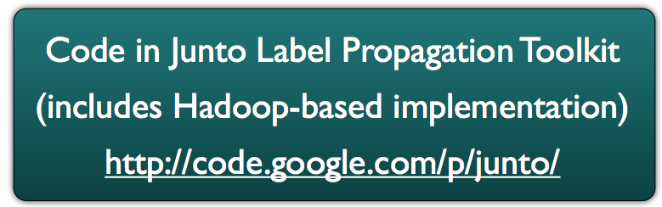

Slide 50
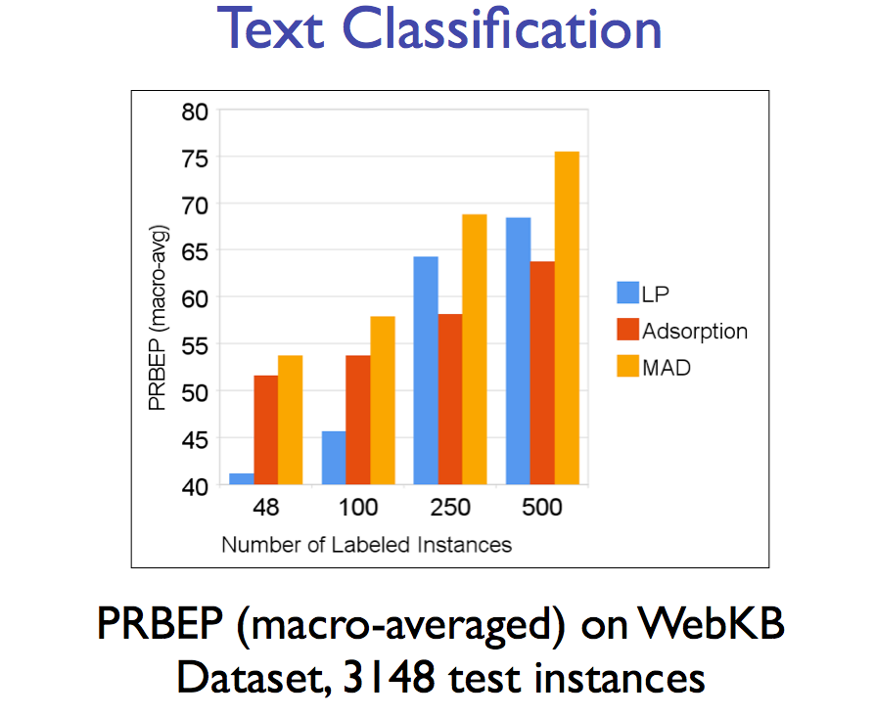
k-NN graph
/HF/…
precision-recall break even point

Slide 51
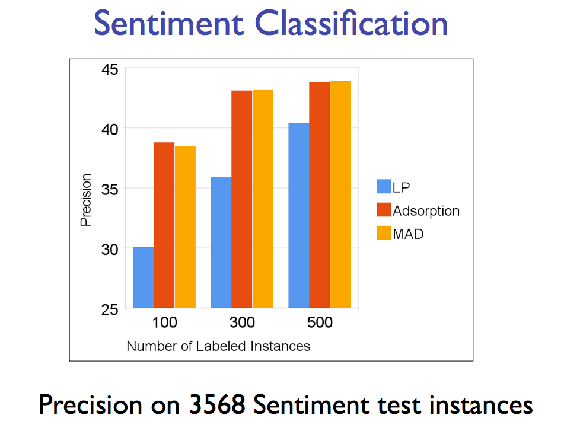
k-NN graph
/HF/…

Slide 52
coupling graph
/HF/…

Slide 53
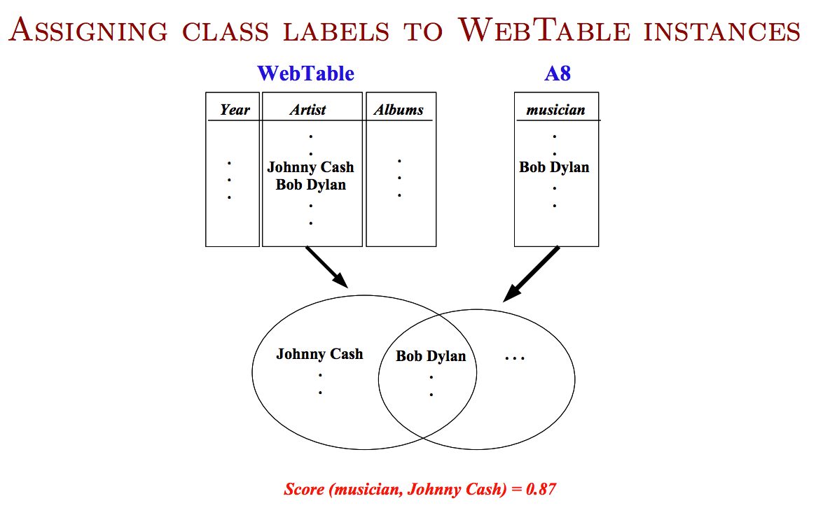
from HTML tables on the web that are used for data, not formatting
from mining patterns like “musicians such as Bob Dylan”

Slide 54
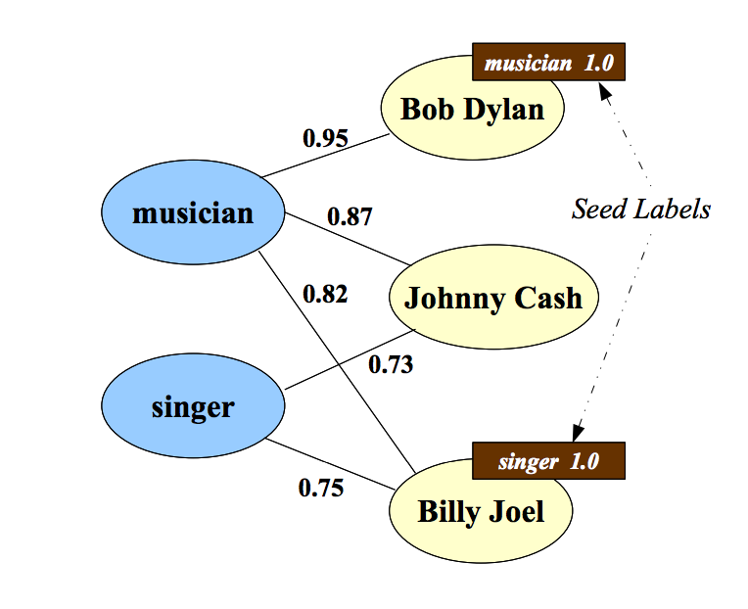

Slide 56
Scaling up Graph SSL

Slide 57
Followup work (AIStats 2014)
Propagating labels requires usually small number of optimization passes
Basically like label propagation passes
Each is linear in
the number of edges
and the number of labels being propagated
Can you do better?
basic idea: store labels in a countmin sketch
which is basically an compact approximation of an object→double mapping

Slide 58
Count-min sketches
split a real vector into k ranges, one for each hash function
0 | 0 | 0 | 0 | 0 | 0 | 0 | 0 | 0
cm.inc(“fred flintstone”, 3):
add the value to each hash location
h3
h1
h2
0 | 3 | 0 | 3 | 0 | 0 | 0 | 3 | 0
cm.inc(“barney rubble”,5):
h3
h1
h2
5 | 3 | 0 | 8 | 0 | 0 | 5 | 3 | 0

Slide 59
Count-min sketches
split a real vector into k ranges, one for each hash function
0 | 0 | 0 | 0 | 0 | 0 | 0 | 0 | 0
cm.get(“fred flintstone”):
3
take min when retrieving a value
h3
h1
h2
5 | 3 | 0 | 8 | 0 | 0 | 5 | 3 | 0
cm.get(“barney rubble):
5
h3
h1
h2
5 | 3 | 0 | 8 | 0 | 0 | 5 | 3 | 0

Slide 60
Followup work (AIStats 2014)
Propagating labels requires usually small number of optimization passes
Basically like label propagation passes
Each is linear in
the number of edges
and the number of labels being propagated
the sketch size
sketches can be combined linearly without “unpacking” them: sketch(av + bw) = a*sketch(v)+b*sketch(w)
sketchs are good at storing skewed distributions

Slide 61
Followup work (AIStats 2014)
Label distributions are often very skewed
sparse initial labels
community structure: labels from other subcommunities have small weight

Slide 62
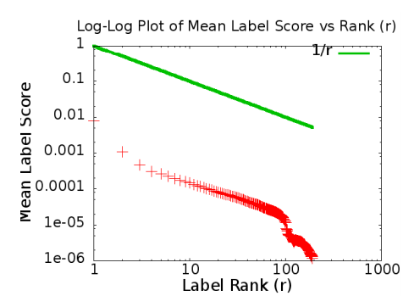
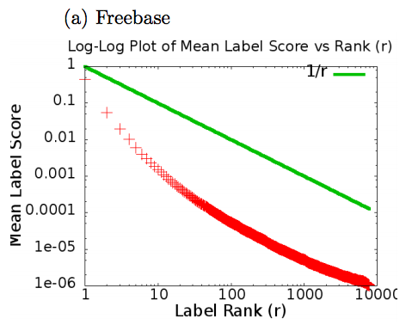
Followup work (AIStats 2014)
“self-injection”: similarity computation
Freebase
Flick-10k

Slide 63
Followup work (AIStats 2014)
Freebase

Slide 64
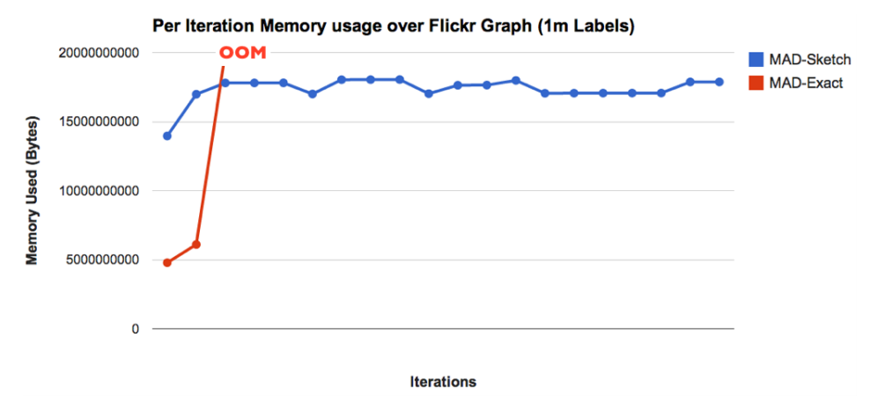
Followup work (AIStats 2014)
100 Gb available

Slide 65
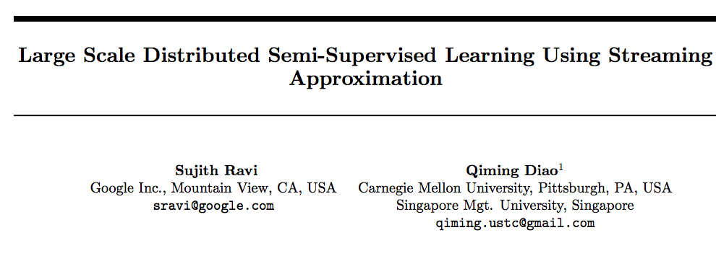
Even more recent work
AIStats 2016

Slide 66
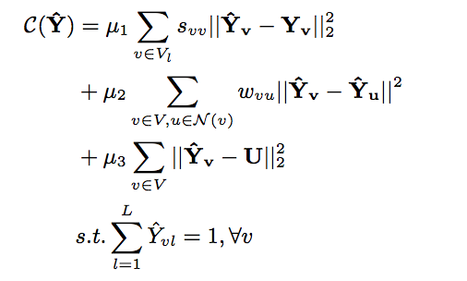
Differences: objective function
seeds
smoothness
close to uniform label distribution
normalized predictions

Slide 67
Differences: scaling up
Updates done in parallel with Pregel
Replace count-min sketch with “streaming approach”
updates from neighbors are a “stream”
break stream into “sections”
maintain a list of (y, Prob(y), Δ)
filter out labels at end of “section” if Prob(y)+Δ is small

Slide 68
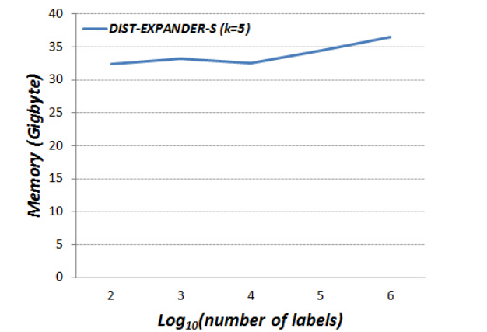
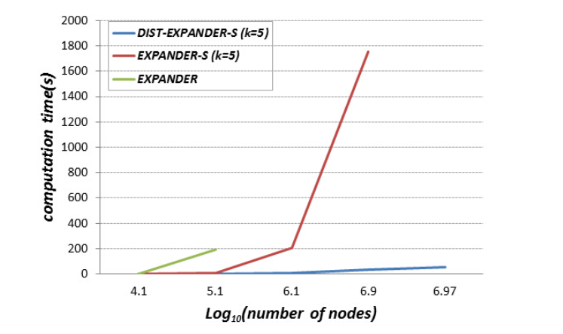
Results with EXPANDER

