Slide 1
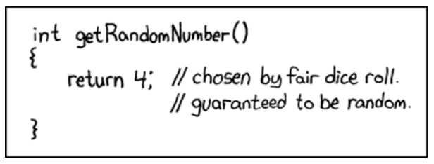
10-405: Randomized Algorithms 2/2

Slide 2
Bloom Filters/Countmin Sketches - RECAP

Slide 3
Bloom filters
Interface to a Bloom filter
  BloomFilter(int maxSize, double p);
  void bf.add(String s); // insert s
  bool bd.contains(String s);
    // If s was added return true;
    // else with probability at least 1-p return false;
    // else with probability at most p return true;
  I.e., a noisy “set” where you can test membership (and that’s it)
Notes:
note a hash table would do this in constant time and storage
the hash trick does this as well

Slide 4
Bloom filters
0 | 0 | 0 | 0 | 0 | 0 | 0 | 0 | 0 | 0
bf.add(“fred flintstone”):
set several “random” bits
h1
h2
h3
0 | 1 | 1 | 0 | 0 | 0 | 0 | 1 | 0 | 0
bf.add(“barney rubble”):
h1
h2
h3
1 | 1 | 1 | 0 | 0 | 1 | 0 | 1 | 0 | 0

Slide 5
Bloom filters
1 | 1 | 1 | 0 | 0 | 1 | 0 | 1 | 0 | 0
bf.contains (“fred flintstone”):
return min of “random” bits
h1
h2
1 | 1 | 1 | 0 | 0 | 1 | 0 | 1 | 0 | 0
bf.contains(“barney rubble”):
h1
h2
h3
1 | 1 | 1 | 0 | 0 | 1 | 0 | 1 | 0 | 0

Slide 6
Bloom filters
1 | 1 | 1 | 0 | 0 | 1 | 0 | 1 | 0 | 0
bf.contains(“wilma flintstone”):
h1
h2
h3
1 | 1 | 1 | 0 | 0 | 1 | 0 | 1 | 0 | 0
bf.contains(“wilma flintstone”):
a false positive
h1
h2
h3
1 | 1 | 1 | 0 | 0 | 1 | 0 | 1 | 0 | 0

Slide 7
Bloom Filters VS Count-Min Sketches

Slide 8
Bloom filters – a variant
split the bit vector into k ranges, one for each hash function
0 | 0 | 0 | 0 | 0 | 0 | 0 | 0 | 0
bf.add(“fred flintstone”):
set one random bit in each subrange
h3
h1
h2
0 | 1 | 0 | 1 | 0 | 0 | 0 | 1 | 0
bf.add(“barney rubble”):
h3
h1
h2
1 | 1 | 0 | 1 | 0 | 0 | 1 | 1 | 0

Slide 9
Bloom filters – a variant
split the bit vector into k ranges, one for each hash function
0 | 0 | 0 | 0 | 0 | 0 | 0 | 0 | 0
bf.contains(“fred flintstore”):
return AND of all hashed bits
h3
h1
h2
1 | 1 | 0 | 1 | 0 | 0 | 1 | 1 | 0
bf.contains(“pebbles”):
h3
h1
h2
1 | 1 | 0 | 1 | 0 | 0 | 1 | 1 | 0

Slide 10
Bloom filters – a variant
split the bit vector into k ranges, one for each hash function
0 | 0 | 0 | 0 | 0 | 0 | 0 | 0 | 0
a false positive!
bf.contains(“pebbles”):
h3
h1
h2
1 | 1 | 0 | 1 | 0 | 0 | 1 | 1 | 0

Slide 11
Count-min sketches
split a real vector into k ranges, one for each hash function
0 | 0 | 0 | 0 | 0 | 0 | 0 | 0 | 0
cm.inc(“fred flintstone”, 3):
add the value to each hash location
h3
h1
h2
0 | 3 | 0 | 3 | 0 | 0 | 0 | 3 | 0
cm.inc(“barney rubble”,5):
h3
h1
h2
5 | 3 | 0 | 8 | 0 | 0 | 5 | 3 | 0

Slide 12
Count-min sketches
split a real vector into k ranges, one for each hash function
0 | 0 | 0 | 0 | 0 | 0 | 0 | 0 | 0
cm.get(“fred flintstone”):
3
take min when retrieving a value
h3
h1
h2
5 | 3 | 0 | 8 | 0 | 0 | 5 | 3 | 0
cm.get(“barney rubble):
5
h3
h1
h2
5 | 3 | 0 | 8 | 0 | 0 | 5 | 3 | 0

Slide 13
Count-min sketches
split a real vector into k ranges, one for each hash function
0 | 0 | 0 | 0 | 0 | 0 | 0 | 0 | 0
cm.get(“barney rubble):
5
h3
h1
h2
5 | 3 | 0 | 8 | 0 | 0 | 5 | 3 | 0
cm.add(“pebbles”, 2):
h3
h1
h2
7 | 3 | 0 | 10 | 0 | 0 | 5 | 5 | 0

Slide 14
Count-min sketches
Equivalently, use a matrix, and each hash leads to a different row
cm.inc(“fred flintstone”, 3):
0 | 3 | 0
3 | 0 | 0
0 | 3 | 0
cm.inc(“barney rubble”,5):
5 | 3 | 0
8 | 0 | 0
5 | 3 | 0

Slide 15
Applications of Sketches

Slide 16
Applications of count-min sketches
Keeping lots of lots of running totals
  naïve Bayes event counters
  word co-occurrence counters for semantic orientation, highly related words, ….
  anywhere, in place of a large sparse feature vector

Slide 17
Applications of Bloom filters
Replace a sparse set input to a deep-learning model
Replace a sparse set output to a deep-learning model
…

Slide 18
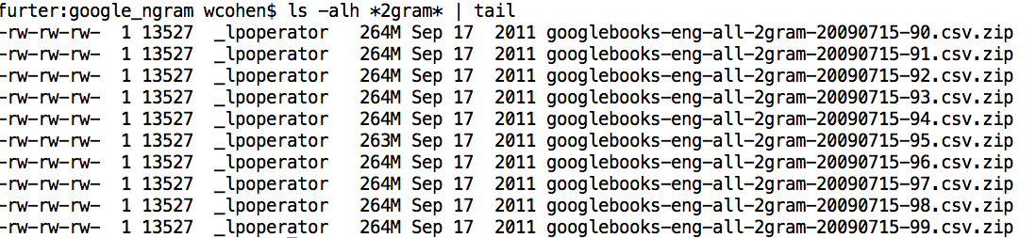
Some uses of Bloom filters
An example application
  Finding items in “sharded” data
    Easy if you know the sharding rule
    Harder if you don’t (like Google n-grams)

Slide 19
Some Uses of Bloom filters
An example application
  Finding items in “sharded” data
    Easy if you know the sharding rule
    Harder if you don’t (like Google n-grams)
Simple idea:
  Build a BF of the contents of each shard
  To look for key, load in the BF’s one by one, and search only the shards that probably contain key
  Analysis: you won’t miss anything, you might look in some extra shards
  You’ll hit O(1) extra shards if you set p=1/#shards

Slide 20
Some Uses of Bloom filters
An example application
  discarding singleton features from a classifier
Scan through data once and check each w:
  if bf1.contains(w): bf2.add(w)
  else bf1.add(w)
Now:
  bf1.contains(w) ⬄ w appears >= once
  bf2.contains(w) ⬄ w appears >= 2x
Then train, ignoring words not in bf2

Slide 21
Some Uses of Bloom filters
An example application
  discarding rare features from a classifier
  seldom hurts much, can speed up experiments
Scan through data once and check each w:
  if bf1.contains(w):
    if bf2.contains(w): bf3.add(w)
    else bf2.add(w)
  else bf1.add(w)
Now:
  bf2.contains(w) ⬄ w appears >= 2x
  bf3.contains(w) ⬄ w appears >= 3x
Then train, ignoring words not in bf3

Slide 22
Some Uses of Bloom filters
An example application
  discarding rare features from a classifier
  seldom hurts much, can speed up experiments
Scan through data once and check each w:
  if bf1.contains(w):
    if bf2.contains(w): bf3.add(w)
    else bf2.add(w)
  else bf1.add(w)
Now:
  bf2.contains(w) ⬄ w appears >= 2x
  bf3.contains(w) ⬄ w appears >= 3x
Then train, ignoring words not in bf3

Slide 23
Locality Sensitive Hashing (LSH)

Slide 24
LSH: key ideas
Goal:
  map feature vector x to bit vector bx
  ensure that bx preserves “similarity”

Slide 25
LSH: key ideas
Goal:
  map feature vector x to bit vector bx
  ensure that bx preserves “similarity”
Different similarities require different hash schemes
  cosine distance: random projections
  dot product: winner-take-all hash
  Jaccard similarity: min-hash (Broder, 1997)
  L2 distance: LSH with p-stable distributions
  spherical LSH: …
  …

Slide 26
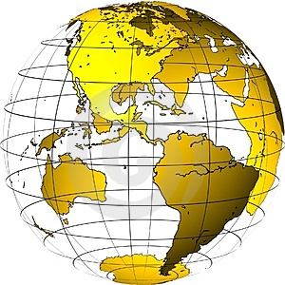
Random Projections

Slide 27
Random projections
u
+
+
+
+
+
+
+
+
+
-
-
-
-
-
-
-
-
-
-u
2γ

Slide 28
Random projections
To make those points “close” we need to project to a direction orthogonal to the line between them
+
+
+
+
+
+
+
+
+
-
-
-
-
-
-
-
-
-

Slide 29
Random projections
Any other direction will keep the distant points distant.
+
+
+
+
+
+
+
+
+
-
-
-
-
-
-
-
-
-
So if I pick a random r and r.x and r.x’ are closer than γ then probably x and x’ were close to start with.
-u

Slide 30
LSH: key ideas
Goal:
  map feature vector x to bit vector bx
  ensure that bx preserves “similarity”
Basic idea: use random projections of x
  Repeat many times:
    Pick a random hyperplane r by picking random weights for each feature (say from a Gaussian)
    Compute the inner product of r with x
    Record if x is “close to” r (r.x>=0)
      the next bit in bx
    Theory says that is x’ and x have small cosine distance then bx and bx’ will have small Hamming distance

Slide 31
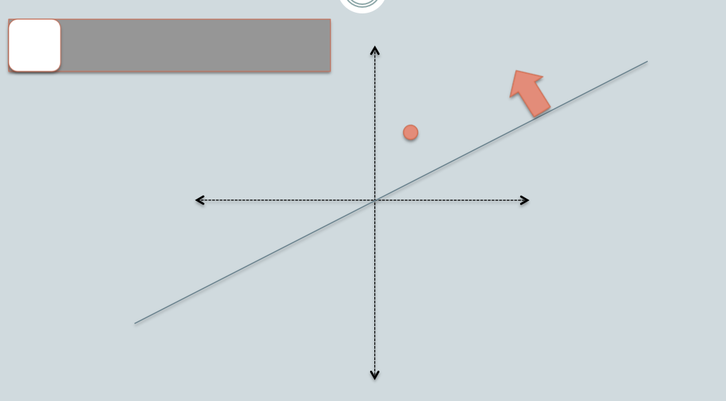
[Slides: Ben van Durme]

Slide 32
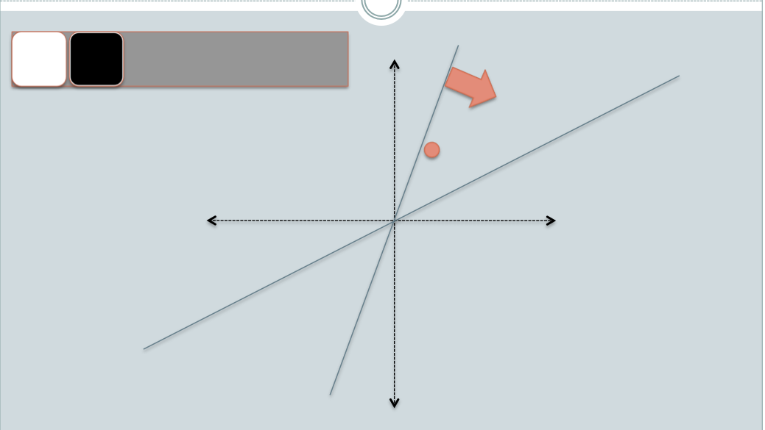
[Slides: Ben van Durme]

Slide 33
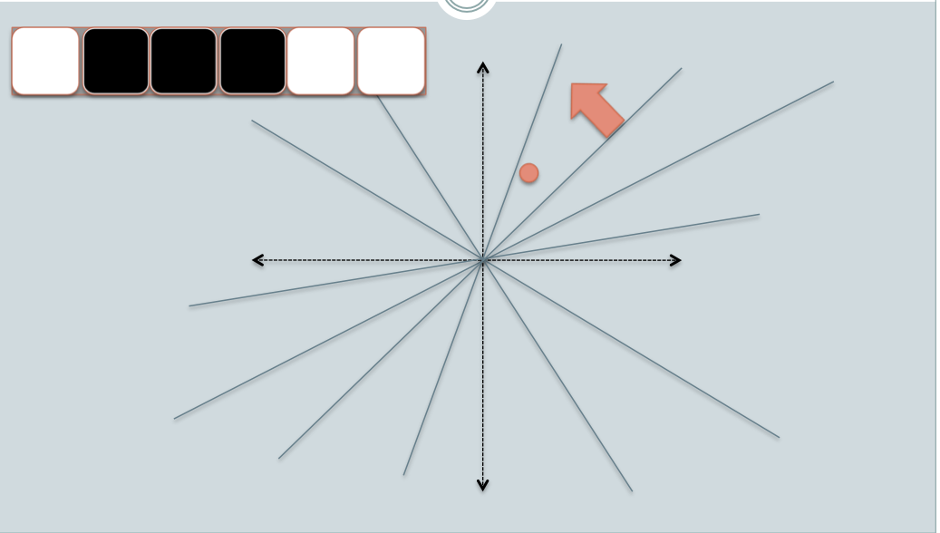
[Slides: Ben van Durme]

Slide 34
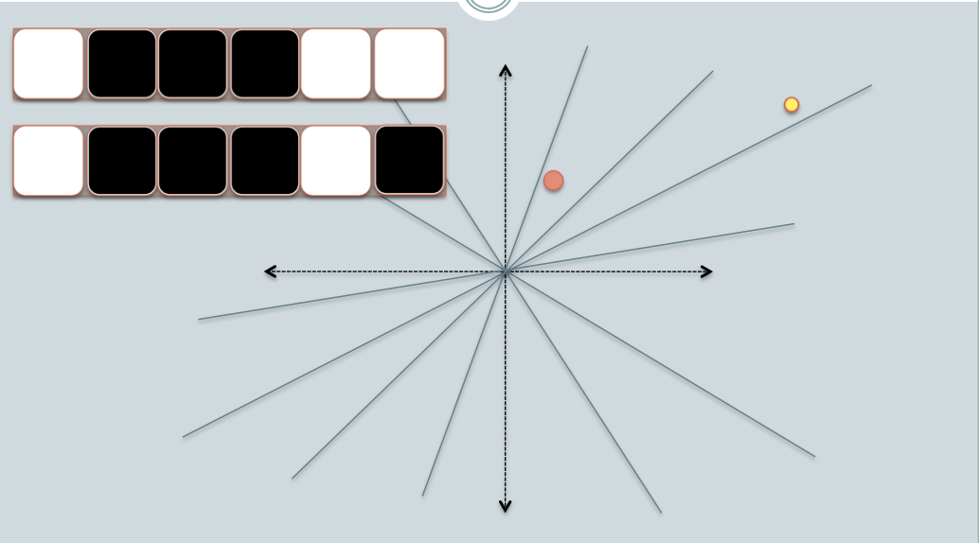
[Slides: Ben van Durme]

Slide 35
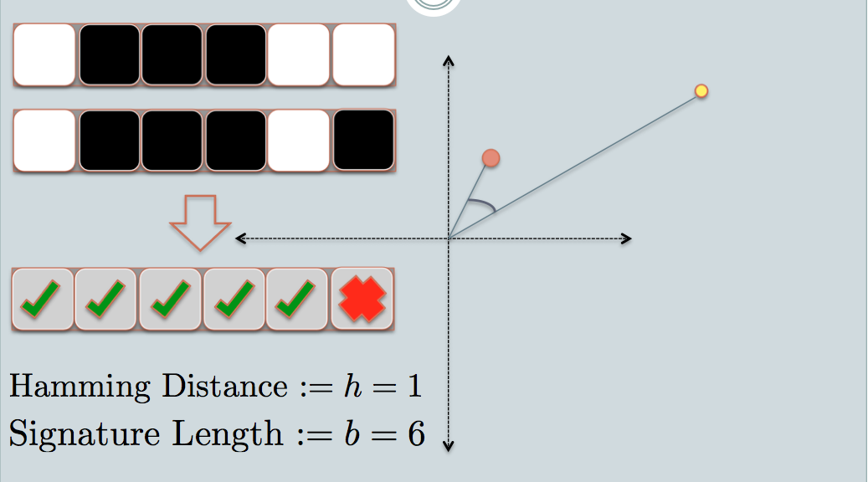
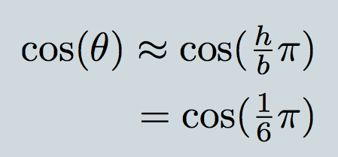
[Slides: Ben van Durme]

Slide 36
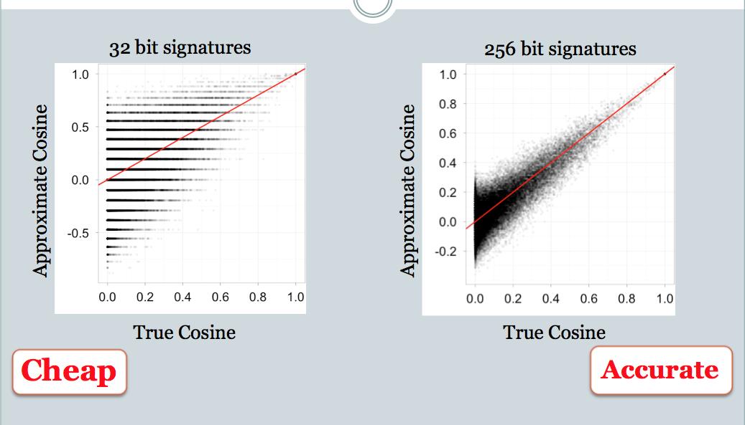
[Slides: Ben van Durme]

Slide 37
LSH applications
Compact storage of data
  and we can still compute similarities
LSH also gives very fast approximations:
  approx nearest neighbor method
    just look at other items with bx’=bx
    also very fast nearest-neighbor methods for Hamming distance
  very fast clustering
    cluster = all things with same bx vector

Slide 38
Online LSH and Pooling

Slide 39
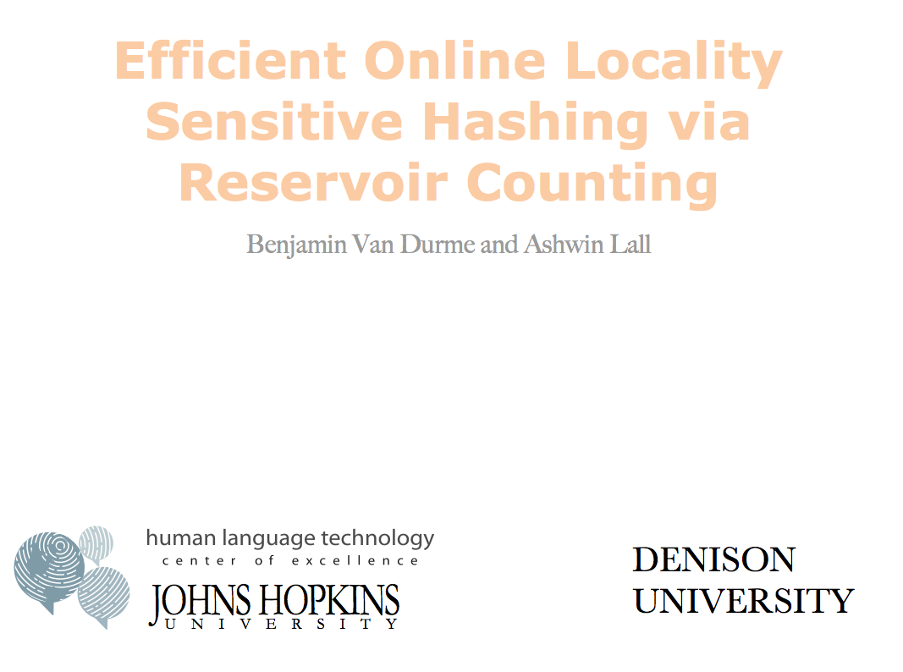



Slide 40
LSH algorithm
Naïve algorithm:
  Initialization:
    For i=1 to outputBits:
      For each feature f:
        Draw r(f,i) ~ Normal(0,1)
  Given an instance x
    For i=1 to outputBits:
      LSH[i] =
      sum(x[f ]*r[i,f ] for f with non-zero weight in x) > 0 ? 1 : 0
    Return the bit-vector LSH

Slide 41
LSH algorithm
But: storing the k classifiers is expensive in high dimensions
  For each of 256 bits, a dense vector of weights for every feature in the vocabulary
Storing seeds and random number generators:
  Possible but somewhat fragile

Slide 42
LSH: “pooling” (van Durme)
Better algorithm:
  Initialization:
    Create a pool:
      Pick a random seed s
      For i=1 to poolSize:
        Draw pool[i] ~ Normal(0,1)
    For i=1 to outputBits:
      Devise a random hash function hash(i,f):
  Given an instance x
    For i=1 to outputBits:
      LSH[i] = sum(
      x[f] * pool[hash(i, f ) % poolSize] for f in x) > 0 ?
      1 : 0
    Return the bit-vector LSH

Slide 43
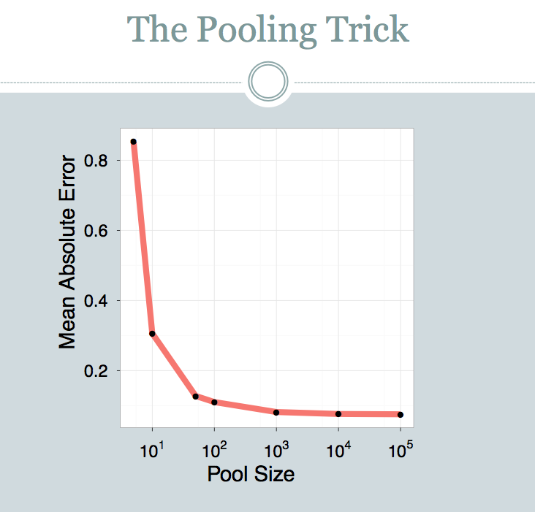

Slide 44
LSH: key ideas: pooling
Advantages:
  with pooling, this is a compact re-encoding of the data
    you don’t need to store the r’s, just the pool

Slide 45
Locality Sensitive Hashing (LSH) in an On-line Setting

Slide 46
LSH: key ideas: online computation
Common task: distributional clustering
  for a word w, v(w) is sparse vector of words that co-occur with w
  cluster the v(w)’s
…guards at Pentonville prison in North London discovered that an escape attempt…
An American Werewolf in London is to be remade by the son of the original director…
…UK pop up shop on Monmouth Street in London today and on Friday the brand…
v(London): Pentonville, prison, in, North, …. and, on Friday

Slide 47
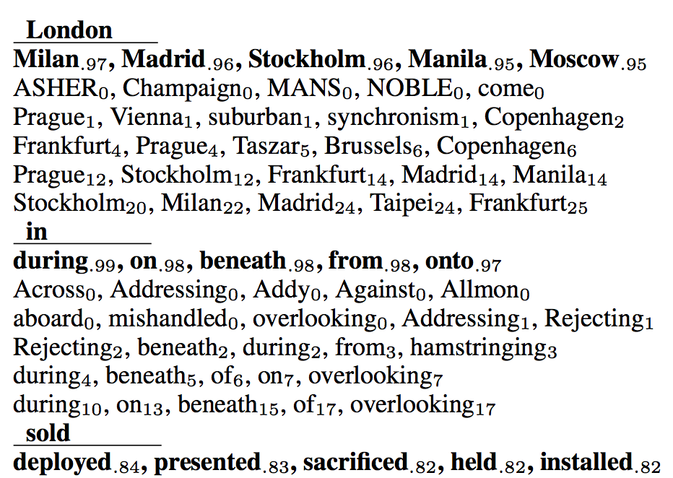
LSH: key ideas: online computation
Common task: distributional clustering
  for a word w, v(w) is sparse vector of words that co-occur with w
  cluster the v(w)’s – or here, compute similarities
is similar to:
is similar to:
is similar to:

Slide 48
LSH: key ideas: online computation
Common task: distributional clustering
  for a word w, v(w) is sparse vector of words that co-occur with w
  cluster the v(w)’s
Levy, Omer, Yoav Goldberg, and Ido Dagan. "Improving distributional similarity with lessons learned from word embeddings." Transactions of the Association for Computational Linguistics 3 (2015): 211-225.
v(w) is very similar to a word embedding (eg, from word2vec or GloVE)

Slide 49
LSH: key ideas: online computation
Construct LSH(v(w)) for each word w in the corpus
  stream through the corpus once
  use minimal amount of memory
  ideally no more than size of output
…guards at Pentonville prison in North London discovered that an escape attempt…
An American Werewolf in London is to be remade by the son of the original director…
…UK pop up shop on Monmouth Street in London today and on Friday the brand…
v(London): Pentonville, prison, in, North, …. and, on Friday
LSH(v(London)): 0101101010111011101
LSH(v(Monmouth)): 0111101000110010111
…

Slide 50
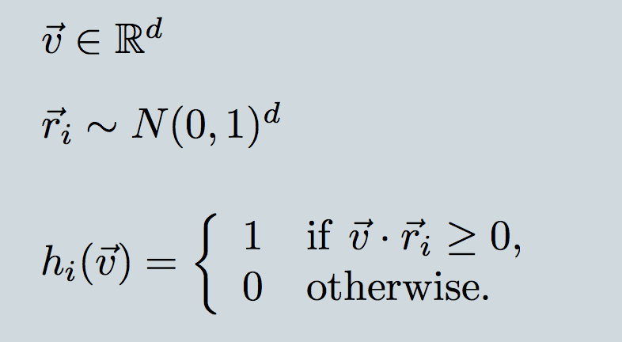
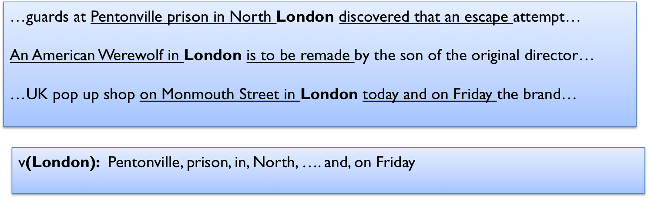
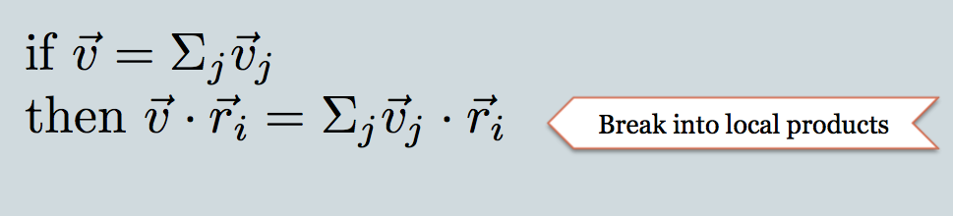
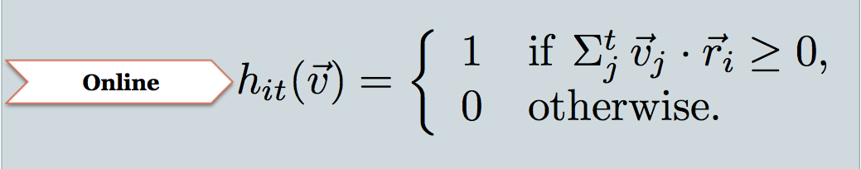
v is context vector; d is vocab size
r_{i} is i-th random projection
h_{i}(v) i-th bit of LSH encoding
because context vector is sum of mention contexts
these come one by one as we stream thru the corpus
keep this

Slide 51
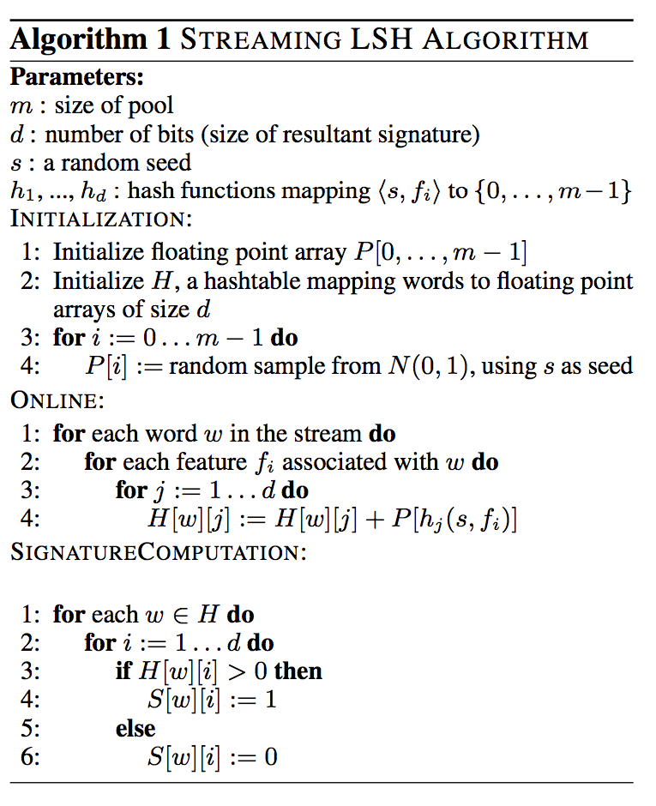
weight of f_{i} in r_{j}
j-th hash of f_{i}

Slide 52
Experiment
Corpus: 700M+ tokens, 1.1M distinct bigrams
For each, build a feature vector of words that co-occur near it, using on-line LSH
Check results with 50,000 actual vectors

Slide 53
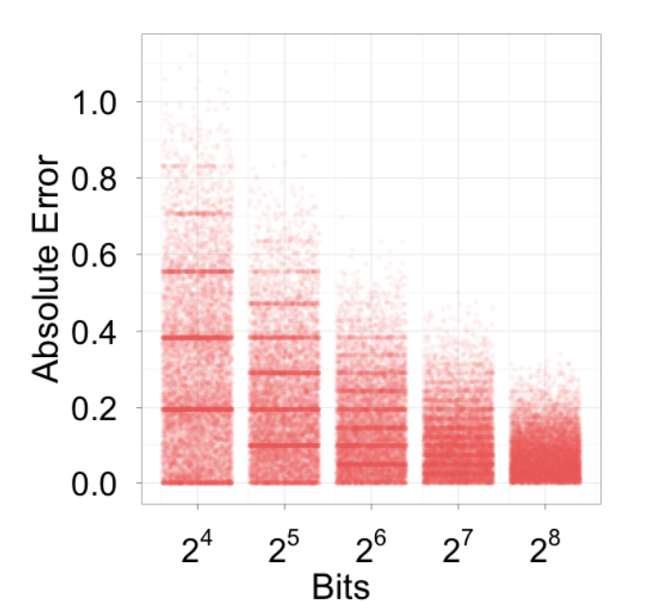
Experiment

Slide 54
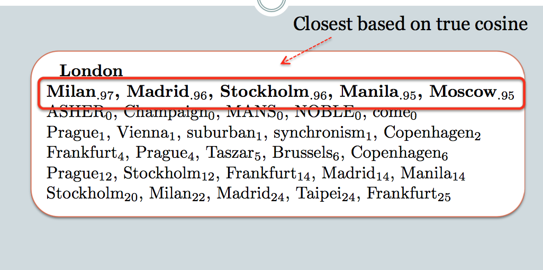
16
32
64
128
256

Slide 55
Points to review
APIs for:
  Bloom filters, CM sketch, LSH
Key applications of:
  Very compact noisy sets
  Efficient counters accurate for large counts
  Fast approximate cosine distance
Key ideas:
  Uses of hashing that allow collisions
  Random projection
  Multiple hashes to control Pr(collision)
  Pooling to compress a lot of random draws

Slide 56
A Deep-learning Variant of LSH

Slide 57
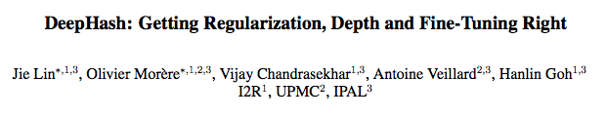
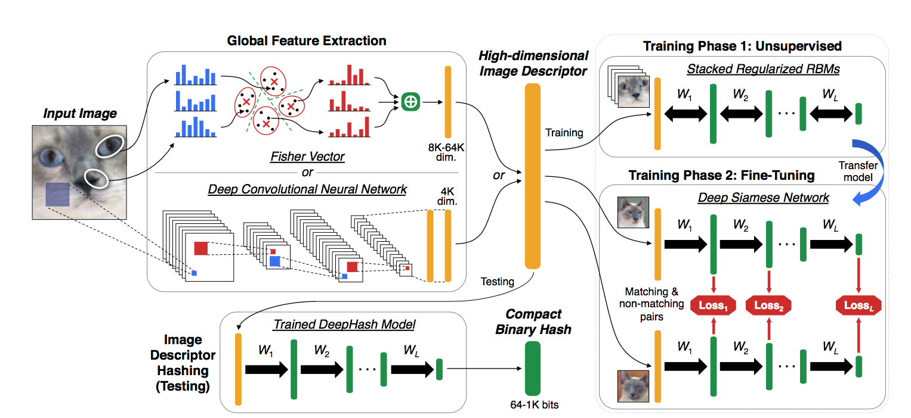
ICMR 2017

Slide 58
DeepHash
Image
Compact Bit Vector
64-1000 bits long

Slide 59
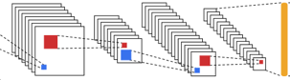
DeepHash
Image
Compact Bit Vector
64-1000 bits long
LSH, …
4k floats

Slide 60
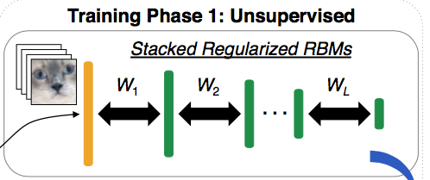
DeepHash
Deep Restricted Boltzmann Machine
Image
4k floats
Compact Bit Vector
64-1000 bits long

Slide 61
DeepHash
compact representation of x
Deep Restricted Boltzmann Machine
input x
output y=x
Restricted Boltzmann Machine is closely related to an autoencoder
An autoencoder

Slide 62
DeepHash
compact representation of x
Deep Restricted Boltzmann Machine
output y=x
input x
Deep Restricted Boltzmann Machine is closely related to a deep autoencoder
A deeper autoencoder

Slide 63
DeepHash
compact representation of x
Deep Restricted Boltzmann Machine
output y=x
input x
Deep Restricted Boltzmann Machine is closely related to a deep autoencoder
But the RBM is symmetric: weights W from layer j to j+1 are the transpose of weights from j+1 back to j
RBM is also stochastic: compute Pr(hidden|visible), sample from that distribution, compute Pr(visible|hidden), sample, …

Slide 64
DeepHash
Deep Restricted Boltzmann Machine
Image
A trick: regularize so that the representations are dense (about 50-50 “on” and “off” for an image ) and each bit has 50-50 chance of being “on”
4k floats
This model is trained to compress image features, then reconstruct the image features from the reconstructions.
And then more training….

Slide 65
Training on matching vs non-matching pairs
Learned deep RBM
Loss pushes the representation for “matching” pairs together and representation for non-matching pairs apart

Slide 66
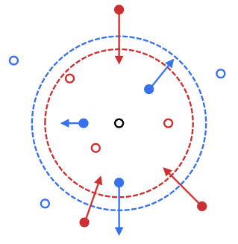
Training on matching vs non-matching pairs
margin-based matching loss

Slide 67
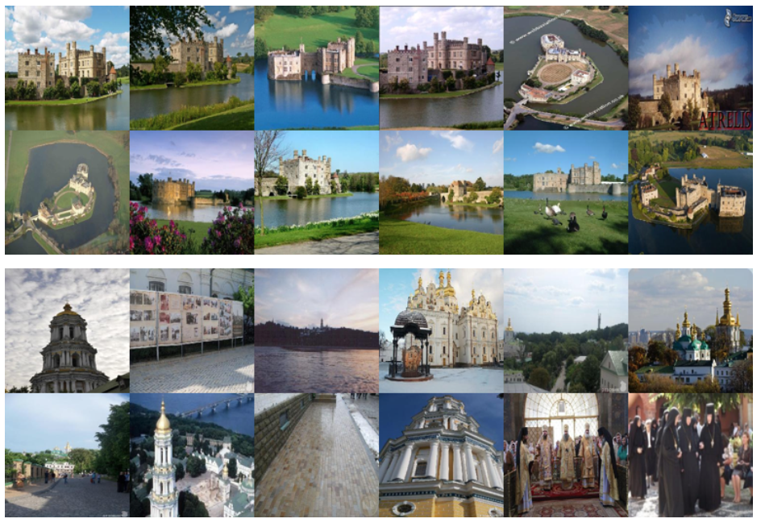
Training on matching vs non-matching pairs
matching pairs were photos of the same “landmark”

Slide 68
ICML 2017

Slide 69
ICML 2017
threshold

Slide 70
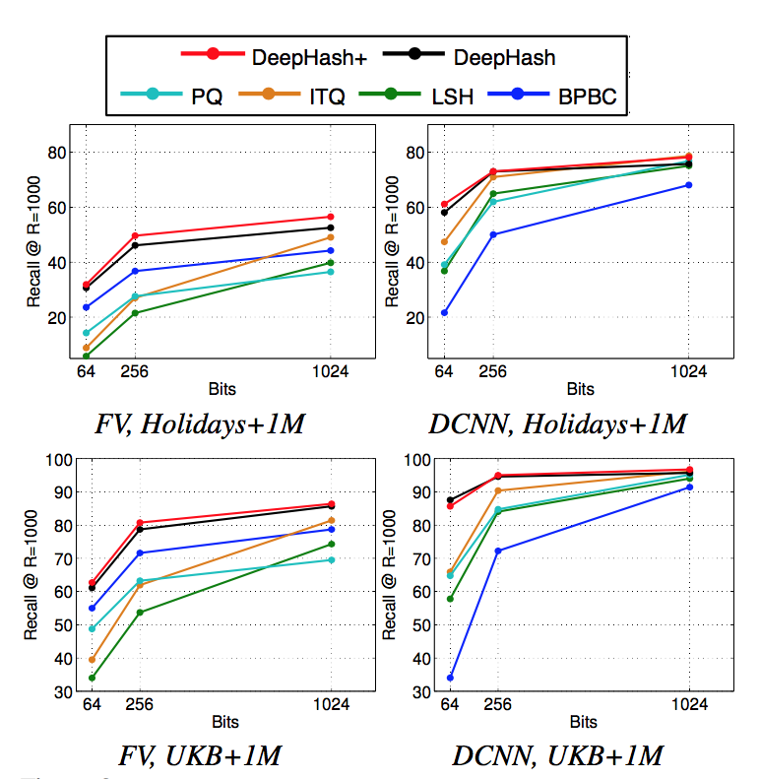
old-school feature vector representation
CNN encoding of image

Slide 71
CNN hidden layer representation
CNN encoding of image

Slide 72
ICML 2017
Picking random classifiers (with LSH) is surprisingly close in performance to DeepHash --- when the similarity metric you start with is good

