Slide 1
Announcements

Slide 2
Announcements
Wed, usual time/place
not finals period!
Closed book, but 2 sheets of notes are allowed
Open-ended projects due midnight Sun 5/6
I fixed that quiz from last week – Tues noon

Slide 3
Deep Neural Networks

Slide 4
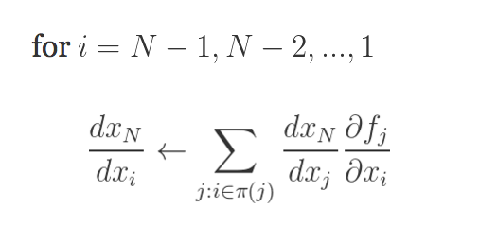
Generalizing backprop
https://justindomke.wordpress.com/
e.g.
Starting point: a function of n variables
Step 1: code your function as a series of assignments
Step 2: back propagate by going thru the list in reverse order, starting with…
…and using the chain rule
Step 1: forward
Wengert list
inputs:
return
Step 2: backprop
A function
Computed in previous step

Slide 5
Example: 2-layer neural network
X
W1
Z1A
B1
Z1B
A1
W2
Z2A
B2
Z2B
A2
mul
add*
tanh
mul
add*
tanh
X is N*D, W1 is D*H, B1 is 1*H, W2 is H*K, …
Inputs: X,W1,B1,W2,B2
Z1a = mul(X,W1) // matrix mult
Z1b = add*(Z1a,B1) // add bias vec
A1 = tanh(Z1b) //element-wise
Z2a = mul(A1,W2)
Z2b = add*(Z2a,B2)
A2 = tanh(Z2b) // element-wise
P = softMax(A2) // vec to vec
C = crossEnt_{Y}(P) // cost function
Z1a is N*H
Z1b is N*H
$${p }_{i}= \frac{exp⁡(a_{i})}{\sum_{j}{exp⁡(a_{j})}}$$
A1 is N*H
Z2a is N*K
Z2b is N*K
A2 is N*K
P is N*K
C is a scalar
Target Y; N examples; K outs; D feats, H hidden

Slide 6
Minibatch SGD on GPU
Let X be a matrix with k examples
Let w_{i} be the input weights for the i-th hidden unit
Then A = X W is output for all m units
for all k examples
w₁ | w₂ | w₃ | … | w_{m}
0.1 | -0.3 | …
-1.7 | …
0.3 | …
1.2
x₁ | 1 | 0 | 1 | 1
x₂ | …
…
x_{k}
There’s a lot of chances to do this in parallel
x₁.w₁ | x₁.w₂ | … | x₁.w_{m}
x_{k}.w₁ | … | … | x_{k}.w_{m}
XW =

Slide 7
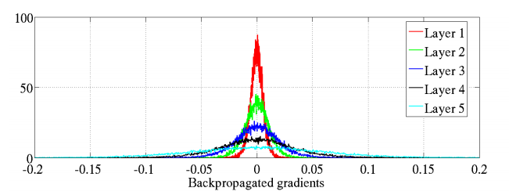
AI Stats 2010
input
output
Histogram of gradients in a 5-layer network for an artificial image recognition task

Slide 8
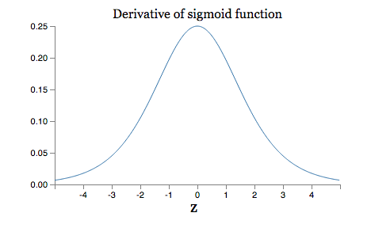
Gradients are unstable
Max at 1/4
If weights are usually < 1 then we are multiplying by many numbers < 1 so the gradients get very small.
The vanishing gradient problem
What happens as the layers get further and further from the output layer? E.g., what’s gradient for the bias term with several layers after it in a trivial net?

Slide 9
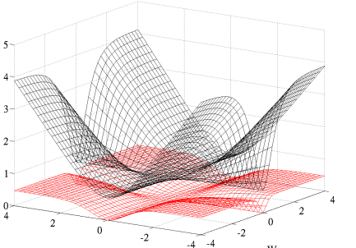
Some key differences in modern ANNs
Use of softmax and entropic loss instead of quadratic loss.
Use of alternate non-linearities
reLU and hyperbolic tangent
Better understanding of weight initialization
…

Slide 10
Bloom filters
Interface to a Bloom filter
BloomFilter(int maxSize, double p);
void bf.add(String s); // insert s
bool bd.contains(String s);
// If s was added return true;
// else with probability at least 1-p return false;
// else with probability at most p return true;
I.e., a noisy “set” where you can test membership (and that’s it)
Notes:
note a hash table would do this in constant time and storage
the hash trick does this as well

Slide 11
Randomized algorithms

Slide 12
Bloom filters
0 | 0 | 0 | 0 | 0 | 0 | 0 | 0 | 0 | 0
bf.add(“fred flintstone”):
set several “random” bits
h1
h2
h3
0 | 1 | 1 | 0 | 0 | 0 | 0 | 1 | 0 | 0
bf.add(“barney rubble”):
h1
h2
h3
1 | 1 | 1 | 0 | 0 | 1 | 0 | 1 | 0 | 0

Slide 13
Bloom filters
1 | 1 | 1 | 0 | 0 | 1 | 0 | 1 | 0 | 0
bf.contains (“fred flintstone”):
return min of “random” bits
h1
h2
1 | 1 | 1 | 0 | 0 | 1 | 0 | 1 | 0 | 0
bf.contains(“barney rubble”):
h1
h2
h3
1 | 1 | 1 | 0 | 0 | 1 | 0 | 1 | 0 | 0

Slide 14
Bloom filters
1 | 1 | 1 | 0 | 0 | 1 | 0 | 1 | 0 | 0
bf.contains(“wilma flintstone”):
h1
h2
h3
1 | 1 | 1 | 0 | 0 | 1 | 0 | 1 | 0 | 0
bf.contains(“wilma flintstone”):
a false positive
h1
h2
h3
1 | 1 | 1 | 0 | 0 | 1 | 0 | 1 | 0 | 0

Slide 15
Randomized algorithms
What is a Bloom filter for (what’s the API)?
What are the guarantees? What kind of errors do they make?
How can you build up more complex operations (eg, counting to K) with multiple filters?
How about countmin sketches?
How about LSH?
What are the problems that on-line LSH is trying to fix?

Slide 16
Architectures

Slide 17
Graph architectures
Differences between
Signal/collect
GraphX
PowerGraph
GraphChi
Can you understand/extend simple programs?

Slide 18
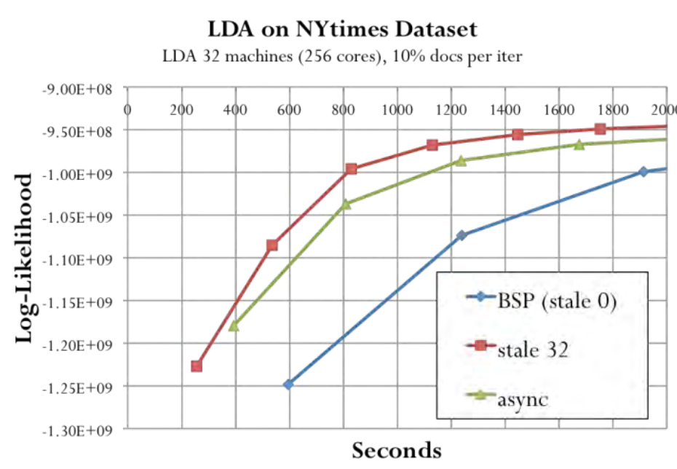
Stale Synchronous Parallel (SSP)
[Ho et al 2013]
Notes:
LDA experiment. Log likelihood vs time.
SSP with correct staleness value is better than Async and BSP.
SSP retains theoretical convergence guarantees.

Slide 19
LDAs and sampling

Slide 20
Unsupervised NB vs LDA
different class distrib θ for each doc
one class prior
α
π
α
θ_{d}
one Y per doc
Y
Y
Y
Z_{di}
one Z per word
W
W_{di}
N_{d}
N_{d}
D
D
β
γ
β
γ_{k}
K
K
Notes:
can you write down the generative model for each?

Slide 21
Recap: Collapsed Sampling for LDA
α
θ_{d}
Pr(Z|E+)
Pr(E-|Z)
Y
Z_{di}
“fraction” of time
Z=t in doc d
fraction of time
W=w in topic t
W_{di}
ignores a detail – counts should not include the Z_{di} being sampled
N_{d}
D
Only sample the Z’s
γ_{k}
β
K

Slide 22
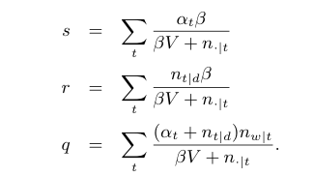
z=2
height s
z=3
…
…
z=2
r
z=3
z=s+r+q
…
…
z=1
z=2
z=3
q
…
…

Slide 23
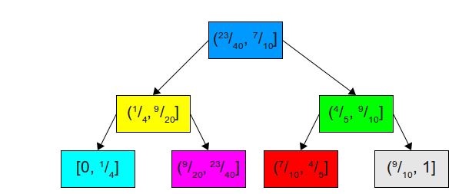
Fenwick Tree Sampler
O(K)
Basic problem: how can we sample from a biased die quickly….
…and update quickly? maybe we can use a binary tree….
r in (23/40,7/10]
O(log2K)
http://www.keithschwarz.com/darts-dice-coins/

Slide 24
Data structures and algorithms
F+ tree

Slide 25
Unsupervised/SS Learning on graphs
What’s different between HF, MRW, MAD?
Which have hard/soft seeds?
How do they scale with #edges, #nodes?
What are the methods trying to optimize?
Do they optimize it exactly or approximately?

