Slide 1
WASM Performance Investigation
Dr Ajay Chhokra. (ajay.chhokra@siemens.com)
Chris Woods. (chris.woods@siemens.com)

Slide 2
Areas of Interest
Cyber Physical Control
From Robots to Trains
Range of supported devices
Legacy Software Support
Performance and consistency

Slide 3
Areas of Interest
Cyber Physical Control
Embedded micro controllers
STM32 / ESP32 (<500kb RAM)
RTOS
Gateway Support Devices
ARM and x86/64
500mb RAM
1 to 4 cores
Linux or RTOS
Industrial PCs
x86/64
16 GB RAM
4 cores +
Linux / Windows
Cloud Servers
x86/64
16GB +
4 cores +
Range of supported devices
Legacy Software Support
Performance and consistency

Slide 4
Areas of Interest
Cyber Physical Control
C and C++ Application Support The ability to port existing popular libraries and routines to the platform.
Application Space
AI / ML
Data processing
Data storage
Stream data handling
Control systems
Capabilities Needed
Exception handling
Threads
Filesystems
Networking and I/O
Co-routine support
Timing / clocks
Access to underlying hardware (STM32 / RTOS, etc).
Range of supported devices
Legacy Software Support
Performance and consistency

Slide 5
Areas of Interest
Cyber Physical Control
Real time and Performance
Not “hard”
Comparison against
Real Time Linux
Native gcc ‘c/c++’
Prior latency and response time (External Input – GPIO)
Effect of memory bounds checking on algorithm and software design
Matrix Multiplication
Memory Allocation
Travelling Salesperson
Merge Sort
Graph Traversal DFS
C++ Inheritance – large nested class architectures and virtual functions (vtables)
Range of supported devices
Legacy Software Support
Performance and consistency
Linux kernel: 5.15.65-rt49 #1 SMP PREEMPT_RT
Arch: x86_64
OS: Ubuntu 22.04.1 LTS
CPU performance scaling using performance governor
Processor: Core-i5
RAM: 16 GB

Slide 6
Areas of Interest
Cyber Physical Control
Wasmtime
Wamr
Wasmer
Wasm3
Range of supported devices
Legacy Software Support
Performance and consistency
Which runtime for which environment?

Slide 7
Runtimes Under Test
Category | Baseline | Wasmtime | Wamr | Wasmer | Wasm3
Interpreter | û | û | ü (iwasm-CI, iwasm-FI) | û | ü
Just in time | û | ü (wasmtime-cranelift) | ü (iwasm-FJIT, iwasm-LJIT, iwasm-LMCJIT) | ü (wasmer-llvm, wasmer-singlepass, wasmer-cranelift) | û
Ahead of time | ü (GCC Native AMD64) | ü (wasmtime-cranelift) | ü (iwasm-AOT) | ü (wasmer-llvm, wasmer-singlepass, wasmer-cranelift) | û
* Still work in progress

Slide 8
Why Create our own test suite ?
Focus on embeddable / non browser environments
Jetstream 2
PSPDFKit WebAssembly Benchmark
WebAssembly Benchmarking Proposal
Massive
Embenchen (Deprecated)
Coremark
Polybench
Sightglass
Focus on Web, assume Javascript host
Collection of compute intensive c programs
Profiling benchmark well suited for our use case,
but is not intended for general purposes.
It is used to compare performance of different versions of
Wasmtime and Cranelift

Slide 9
Benchmarking Applications
Test | Matrix Multiplication | Memory Allocation | Travelling Salesperson | Merge Sort | Graph Traversal DFS | Inheritance
Description | Multiplies two square matrices | Allocate and de-allocate linear heap in a fixed pattern | Solves a travelling salesperson problem | Sorts a list using merge sort (statically defined) | Performs a DFS on a binary tree | Iterate over the inheritance tree
Input & Scale | Matrix Size 10x10 100x100 1000x1000 | Allocation (initial heap) 110% 120% 130% | Distance Matrix 6x6 10x10 15x15 | List 100 1000 10000 | Graph Size 64 128 256 | Inheritance Tree 5x5 10x10 15x15
Only import WASI functions.
Input via I/O and results via I/O.
Repeated executions x 25
High Priority - Prevent preemption.
Pinned to specific CPU.
Notes:
Benchmark program should be deterministic.
Three associated workloads: small, medium, large.
Compiling, instantiating and executing the workload should be completed in order of seconds.
Benchmark program should only import WASI functions.
Input given through I/O and results reported through I/O.
Repeated executions (25) for good statistical analyses.
High Priority to prevent preemption
Pinned to specific cpu

Slide 10
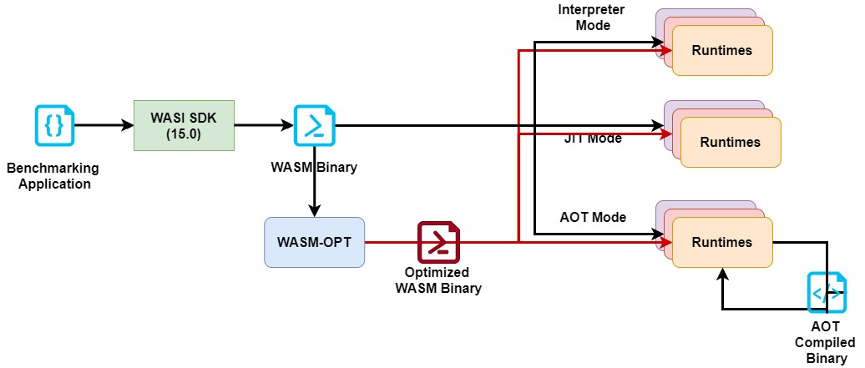
Toolchain Overview & More Test Combinations
Design Variables:
CPU-features
Design Variables:
Optimization levels O0-O3
Design Variables:
Backends
Design Variables:
Backends
Design Variables:
Optimization levels O0-O4
Design Variables:
Optimization levels O0-O4

Slide 11
Results: Matrix Multiplication

Slide 12
Results: Matrix Multiplication

Slide 13
Results: Matrix Multiplication

Slide 14
Results: TSP

Slide 15
Results: TSP

Slide 16
Results: TSP

Slide 17
Results: Sort

Slide 18
Results: Sort

Slide 19
Results: Sort

Slide 20
Results: DFS

Slide 21
Results: DFS

Slide 22
Results: DFS

Slide 23
Results: Inheritance

Slide 24
Results: Inheritance

Slide 25
Results: Inheritance

Slide 26
Results: Memory Allocation

Slide 27
Results: Memory Allocation

Slide 28
Results: Memory Allocation

Slide 29
Conclusions
The profiling tool-chain includes
4 different runtimes
3 modes of execution
3 different backends
12 optimization levels
3 types of workloads
6 benchmarking applications
Analyzed 50375 datapoints
There is an order of magnitude performance penalty in interpreter mode.
In both JIT and AOT mode the performance varies from 0.4x to 2x
Recommendations:
wasm3 (interpreter mode) wasmer-llvm (JIT mode) wamr (AOT mode)
Extensions (Future Work):
Build runtimes with experimental features
Integrate WASM-OPT
Integrate other benchmarking test-suites into the toolchain

