Slide 1
Approximating NP-hard Problems
Efficient Algorithms and their Limits
Prasad Raghavendra
University of Washington
Seattle

Slide 2
Combinatorial Optimization Problems
Set Cover
Steiner Tree
Max 3 SAT
Find an assignment that satisfies the maximum number of clauses.
NP Hard!
MultiCut
Vertex Cover
NP Hard!
Max 3 SAT
Max Cut
Label Cover
Sparsest Cut
Multiway Cut
Max Di Cut
Max 2 SAT
Metric TSP
Max 4 SAT
Notes:
Example of a CSP, it is NP-hard, still want to solve it, hence we approximate the solution. Most CSPs are NP-hard to optimize.. In fact most combinatorial optimization problems are NP-hard to optimize

Slide 3

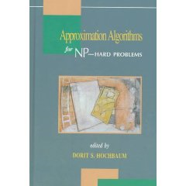
Approximation Algorithms
An algorithm A is an α-approximation for a problem if for every instance I,
A(I) ≥ α ∙ OPT(I)
Can we find a solution that is say half as good as optimum?
--Vast Literature--
Notes:
Hence we approximate the optimum. Define approximation algorithms, there is vast literature,

Slide 4
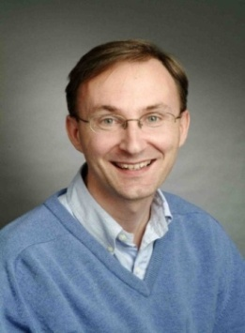

The Tools
Till 1994,
A majority of approximation algorithms directly or indirectly relied on Linear Programming.
In 1994,
Semidefinite Programming based algorithm for Max Cut
[Goemans-Williamson]
Semidefinite Programming - A generalization of Linear Programming.
Semidefinite Programming is the one of the most powerful tools in approximation algorithms.
Notes:
Till 1994, linear programs were the best. In 1994, Goemans and Williamson came up with SDP for solving MaxCut. SDP is the strongest tool available today, and nearly all approximation algorithms.

Slide 5
Constraint Satisfaction Problems
Max 3 SAT
Find an assignment that satisfies the maximum number of clauses.
Variables
Finite Domain
Constraints
{x₁ ,x₂ , x₃ , x₄ , x₅}
{0,1}
Clauses
Kind of constraints permitted
Different CSPs
Notes:
Depending on the number of constraints,

Slide 6
Approximability of CSPs
Gap for MaxCUT
Algorithm = 0.878
Hardness = 0.941
ALGORITHMS
[Charikar-Makarychev-Makarychev 06]
[Goemans-Williamson]
[Charikar-Wirth]
[Lewin-Livnat-Zwick]
[Charikar-Makarychev-Makarychev 07]
[Hast]
[Charikar-Makarychev-Makarychev 07]
[Frieze-Jerrum]
[Karloff-Zwick]
[Zwick SODA 98]
[Zwick STOC 98]
[Zwick 99]
[Halperin-Zwick 01]
[Goemans-Williamson 01]
[Goemans 01]
[Feige-Goemans]
[Matuura-Matsui]
[Trevisan-Sudan-Sorkin-Williamson]
MAX k-CSP
Unique Games
MAX 3-CSP
NP HARD
MAX 3-AND
MAX 3-MAJ
MAX E2 LIN3
MAX 3 DI-CUT
MAX 4-SAT
MAX DI CUT
MAX 3-SAT
MAX CUT
MAX 2-SAT
MAX Horn SAT
MAX k-CUT
0
1
Notes:
Since then, SDPs have been used to approximate several CSPs (show a list). These are all the CSPs that have been approximated.. On the hardness side, PCP machinery has shown several results, yet some remained open. Again the culprit is MaxCut.

Slide 7
x-y = 11 (mod 17)
x-z = 13 (mod 17)
…
….
z-w = 15(mod 17)
Given linear equations of the form:
X_{i} – X_{k} = c_{ik} mod p
Satisfy maximum number of equations.
Towards bridging this gap,
In 2002, Subhash Khot introduced the
Unique Games Conjecture
Unique Games Conjecture [Khot 02] [KKMO]
For every ε> 0, for large enough p,
Given : 1-ε (99%) satisfiable system,
NP-hard to satisfy
ε (1%) fraction of equations.

Slide 8
Unique Games Conjecture
A notorious open problem.
Hardness Results:
No constant factor approximation for unique games. [Feige-Reichman]
Algorithm | On (1-Є) satisfiable instances
[Khot 02]
[Trevisan]
[Gupta-Talwar] | 1 – O(ε logn)
[Charikar-Makarychev-Makarychev]
[Chlamtac-Makarychev-Makarychev]
[Arora-Khot-Kolla-Steurer-Tulsiani-Vishnoi]

Slide 9
Assuming UGC
UGC HARD
NP HARD
UGC Hardness Results
[Khot-Kindler-Mossel-O’donnell]
[Austrin 06]
[Austrin 07]
[Khot-Odonnell]
[Odonnell-Wu]
[Samorodnitsky-Trevisan]
MAX k-CSP
Unique Games
MAX 3-CSP
For MaxCut, Max-2-SAT,
Unique Games based hardness
=
approximation obtained by Semidefinite programming!
MAX 3-AND
MAX 3-MAJ
MAX E2 LIN3
MAX 3 DI-CUT
MAX 4-SAT
MAX DI CUT
MAX 3-SAT
MAX CUT
MAX 2-SAT
MAX Horn SAT
MAX k-CUT
0
1
Notes:
Optimal hardness for MaxCut, Then came Max2SAT hardness which also matched. Mysteriously, UG hardness results exactly matched the SDP algorithms.

Slide 10
The Connection
GENERIC
ALGORITHM
MAX k-CSP
UGC Hard
Unique Games
How Simple an SDP?
takes near linear time in the size of the CSP.
(techniques from [Arora-Kale])
Theorem: [Raghavendra 08]
Assuming Unique Games Conjecture, For every CSP,
“the simplest semidefinite programs give the best approximation computable efficiently.”
How General a CSP?
Can Specify
10% of 3-Clauses
70% of Cut constraints
20% of 2-SAT constraints
MAX 3-CSP
MAX 3-AND
Theorem: [Raghavendra08]
A generic algorithm that is optimal for every CSP under UGC! (at least as good as all known algorithms)
MAX 3-MAJ
MAX E2 LIN3
MAX 3 DI-CUT
MAX 4-SAT
MAX DI CUT
MAX 3-SAT
MAX CUT
MAX 2-SAT
MAX Horn SAT
MAX k-CUT
0
1
Notes:
I showed that for every constraint satisfaction problem, the simplest SDP gives best approximation assuming UGC. Somewhat Surprisingly, this also led to an algorithm to approximate the optimum for every CSP

Slide 11
3-way Cut
3-Way Cut:
“Separate the 3-terminals while separating the minimum number of edges”
A generalization of the classic s-t cut problem
B
10
15
7
A
1
1
3
C
B
[Karger-Klein-Stein-Thorup-Young]
A 12/11 factor approximation algorithm for 3-Way Cut
A
C
Notes:
Describe labelling problems.

Slide 12
Graph Labelling Problems
ALGORITHMS
[Calinescu-Karloff-Rabani 98]
[Chekuri-Khanna-Naor-Zosin]
[Calinescu-Karloff-Rabani 01]
[Gupta-Tardos]
[Karger-Klein-Stein-Thorup-Young]
[Kazarnov 98]
[Kazarnov 99]
[Kleinberg-Tardos]
Generalizations of 3-Way Cut
k-Way Cut
0-Extension
Class of Metric Labelling Problems
Theorem: [Manokaran-Naor-Raghavendra-Schwartz]
Assuming Unique Games Conjecture,
The “earthmover linear program” gives the best approximation for every graph labelling problem.
Notes:
Show that under UGC, even for labelling problems.. LP gives best

Slide 13





Ranking Teams?
Maximum Acyclic Subgraph
“Given a directed graph, order the vertices to maximize the number of forward edges.”
Rank teams so that result of maximum number of games agrees with the ranking
Best known approximation algorithm :
“Output a Random Ordering!”
Notes:
MaxAcyclic Subgraph, Karp’s original list of NP-complete problems.. UG hard to approximate better than 1/2

Slide 14
Result
Theorem: [Guruswami-Manokaran-Raghavendra]
Assuming Unique Games Conjecture,
The best algorithm’s output is as good as a random ordering.
More generally,
Theorem: [Guruswami-Manokaran-Raghavendra]
Assuming Unique Games Conjecture, For every Ordering CSP,
a simple SDP relaxation gives the best approximation.
Notes:
Ordering CSPs all turn out to be hard

Slide 15
The UG Barrier
Constraint Satisfaction Problems
If UGC is true,
Then Simplest SDPs give the best approximation possible.
Graph Labelling Problems
Ordering CSPs
Kernel Clustering Problems
UGC
HARD
Grothendieck Problem
If UGC is false,
Hopefully, a new algorithmic technique will arise.
Notes:
Big picture.. My work has shown that we have hit a common barrier on a surprising variety of problems.. If UGC is true, then we know that simplest algorithms give best approixmation.. If UGC is false, then it will be a big breakthrough..

Slide 16
Even if UGC is false
  SDP Lower Bounds
For problems like Maximum Acyclic Subgraph, Multiway Cut,
Generic Approximation Algorithm for CSPs
At least as good as all known algorithms for CSPs.
Computing Approximation Ratios
An algorithm to compute the value of approximation ratio obtained by a certain SDP
Notes:
It gave a method to compute integrality gaps, which was completely unsuspected earlier.. Indeed this gives a way to compute the Grothendieck constant.. (an age old constant)

Slide 17
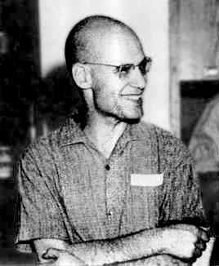

An Interesting Aside
Grothendieck’s Inequality (1953)
There exists constant K_{G} such that, for all matrices (a_{ij})
1.67 < K_{G} < 1.78 [Krivine]
In computer science terminology,
Grothendieck constant = Approximation given by the Semidefinite relaxation for the Bipartite Quadratic Programming Problem
Algorithm to compute Grothendieck constant [Raghavendra-Steurer09]

Slide 18
SemiDefinite Programming

Slide 19
Max Cut
Max CUT
Input :
A weighted graph G
Find :
A Cut with maximum number/weight of crossing edges
10
15
7
1
1
3
Fraction of crossing edges
Notes:
What is semidefinite programming? We will explain it with maxcut, . Explain Maxcut.

Slide 20
Max Cut SDP
Semidefinite Program
Variables : v₁ , v₂ … v_{n}
| v_{i} |² = 1
Maximize
-1
Quadratic Program
Variables : x₁ , x₂ … x_{n}
x_{i} = 1 or -1
Maximize
1
-1
1
10
-1
15
1
7
1
1
1
-1
-1
3
-1
-1
Relax all the x_{i} to be unit vectors instead of {1,-1}.
All products are replaced by inner products of vectors
Notes:
Maxcut semidefinite programming relaxation, can be solvable in cubic time ( in linear time [Kale])

Slide 21
MaxCut Rounding
v₂
Cut the sphere by a random hyperplane, and output the induced graph cut.
A 0.878 approximation for the problem.
  [Goemans-Williamson]
v₁
v₃
v₅
v₄

Slide 22
The Simplest Relaxation for MaxCut
Max Cut SDP:
Embedd the graph on the
N - dimensional unit ball,
Maximizing
¼ (Average Squared Length of the edges)
v₂
v₁
v₃
v₅
v₄
In the integral solution, all the v_{i} are 1,-1. Thus they satisfy additional constraints
For example : (v_{i} – v_{j})² + (v_{j} – v_{k})² ≥ (v_{i} – v_{k})²
Assuming UGC, No additional constraint helps!

Slide 23
Building on the work of [Khot-Vishnoi],
[Raghavendra-Steurer 09]
Adding all valid constraints on at most
2^O((loglogn)^{1/4} ) variables to the simple SDP does not disprove the Unique Games Conjecture
Possibility:
Adding a simple constraint on every 5 variables yields a better approximation for MaxCut,
Breaches the UG barrier and disproves Unique Games Conjecture!
Constraint Satisfaction Problems
Metric Labelling Problems
Ordering Constraint Satisfaction Problems
Kernel Clustering Problems
Grothendieck Problem

Slide 24
So far :
Unique Games Barrier
Semidefinite Programming technique (Maxcut example)
Coming Up :
Generic Algorithm for CSPs
Hardness Result for MaxCut.

Slide 25
Generic Algorithm for CSPs

Slide 26
Semidefinite Program for CSPs
Variables :
For each variable X_{a}
Vectors {V_{(a,0)} , V_{(a,1)}}
For each clause P = (x_{a} ν x_{b} ν x_{c}),
Scalar variables
μ_{(P,000)} , μ_{(P,001)} , μ_{(P,010)} , μ_{(P,100)} , μ_{(P,011)} , μ_{(P,110)} , μ_{(P,101)} , μ_{(P,111)}
Constraints :
For each clause P,
0 ≤μ_{(P,α)} ≤ 1
For each clause P (x_{a} ν x_{b} ν x_{c}),
For each pair X_{a ,} X_{b} in P, consitency between vector and LP variables.
V_{(a,0)} ∙V _{(b,0)} = μ_{(P,000)} + μ_{(P,001)}
V_{(a,0)} ∙V _{(b,1)} = μ_{(P,010)} + μ_{(P,011)}
V_{(a,1)} ∙V _{(b,0)} = μ_{(P,100)} + μ_{(P,101)}
V_{(a,1)} ∙V _{(b,1)} = μ_{(P,100)} + μ_{(P,101)}
X_{a} = 1 V_{(a,0)} = 0
V_{(a,1)} = 1
X_{a} = 0 V_{(a,0)} = 1
V_{(a,1)} = 0
If X_{a} = 0, X_{b} = 1, X_{c} = 1
μ_{(P,000)} = 0 μ_{(P,011)} = 1
μ_{(P,001)} = 0 μ_{(P,110)} = 0
μ_{(P,010)} = 0 μ_{(P,101)} = 0
μ_{(P,100)} = 0 μ_{(P,111)} = 0
Objective Function :

Slide 27

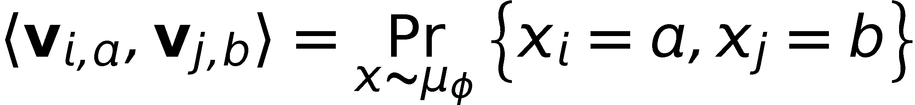
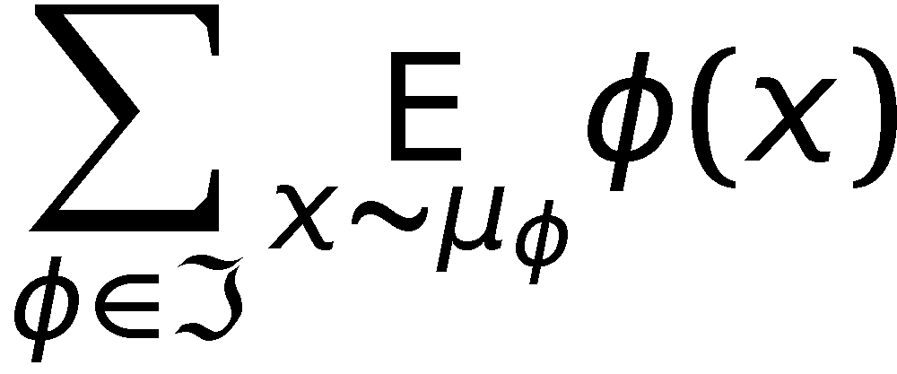
Semidefinite Relaxation for CSP
SDP solution for =:
Example of local distr.:
Á = 3XOR(x₃, x₄, x₇)
for every constraint Á in =
local distributions ¹_{Á} over
assignments to the variables of Á
x₃ x₄ x₇ ¹_{Á}
0 0 0 0.1
0 0 1 0.01
0 1 0 0
…
1 1 1 0.6
for every variable x_{i} in =
vectors v_{i,1} , … , v_{i,q}
constraints
Explanation of constraints:
first and second moments of
distributions are consistent
and form PSD matrix
(also for first moments)
SDP objective:
maximize

Slide 28
Rounding Scheme
[Raghavendra-Steurer]
v₂
v₁
v₃
STEP 1 : Dimension Reduction
Project the SDP solution along say 100 random directions.
Map vector V
V → V’ = (V∙G₁ , V∙G₂ , … V∙G₁₀₀)
v₅
v₄
v₂
STEP 2 : Discretization
Pick an Є –net for the
100 dimensional sphere
Move every vertex to the nearest point in the Є –net
v₁
v₂
v₃
v₄
v₅
Constant dimensions
STEP 3 : Brute Force
Find a solution to the new instance by brute force.
FINITE MODEL
Graph on Є –net points

Slide 29
Hardness Result FOR MAXCUT

Slide 30
The Goal
Theorem: [Raghavendra 08]
Assuming Unique Games Conjecture, For MaxCut,
“the simple semidefinite program give the best approximation computable efficiently.”
UG Hardness
Assuming UGC,
On instances with MaxCut = C,
It is NP-hard to find a MaxCut better than S
HARD INSTANCE G
Suppose for an instance G,
the SDP value = C
The actual MaxCut value = S
Notes:
I showed that for every constraint satisfaction problem, the simplest SDP gives best approximation assuming UGC. Somewhat Surprisingly, this also led to an algorithm to approximate the optimum for every CSP

Slide 31
v₂
Dimension Reduction
v₁
v₃
Max Cut SDP:
Embed the graph on the
N - dimensional unit ball,
Maximizing
¼ (Average Squared Length of the edges)
100
v₅
v₄
v₂
v₁
v₃
v₅
Project to random 1/ Є² dimensional space.
v₄
Constant dimensional hyperplane
New SDP Value = Old SDP Value + or - Є

Slide 32
Making the Instance Harder
v₂
v₂
v₂
v₂
v₂
SDP Value = Average Squared
Length of an Edge
v₁
v₃
v₁
v₃
v₁
v₃
v₁
v₁
v₃
v₃
Transformations
Rotation does not change the SDP value.
Union of two rotations has the same SDP value
v₅
v₅
v₅
v₅
v₅
v₄
v₄
v₄
v₄
v₄
Sphere Graph H :
Union of all possible rotations of G.
SDP Value (Graph G) = SDP Value ( Sphere Graph H)
Notes:
Rotation does not affect SDP value. Nor does union. So construct the sphere graph. A good cut for sphere graph implies a good cut for original graph.

Slide 33
Making the Instance Harder
v₂
v₂
v₂
v₂
v₂
v₁
v₃
MaxCut (H) = S
v₁
v₃
v₁
v₃
v₁
v₁
v₃
v₃
MaxCut (G) ≥ S
v₅
v₅
v₅
v₅
v₅
Pick a random rotation of G and read the cut induced on it.
Thus,
v₄
v₄
v₄
v₄
v₄
v₂
v₁
v₃
MaxCut (H) ≤ MaxCut(G)
v₅
SDP Value (G) = SDP Value (H)
v₄
Notes:
Rotation does not affect SDP value. Nor does union. So construct the sphere graph. A good cut for sphere graph implies a good cut for original graph.

Slide 34
Hypercube Graph
v₂
v₁
v₃
For each edge e, connect every pair of vertices in hypercube separated by the length of e
v₅
SDP Solution
v₄
Generate Edges of Expected Squared Length = d
1) Starting with a random x Є {-1,1}¹⁰⁰ ,
1) Generate y by flipping each bit of x with probability d/4
Output (x,y)
100 dimensional hypercube : {-1,1}¹⁰⁰
Notes:
Hypercube graph . SDP value = SDP(G), and Integral value = SDP.

Slide 35
Dichotomy of Cuts
1
1
1
1
A cut gives a function F on the hypercube
F : {-1,1}¹⁰⁰ -> {-1,1}
-1
Dictator Cuts
F(x) = x_{i}
Cuts Far From Dictators
(influence of each coordinate on function F is small)
-1
-1
Hypercube = {-1,1}¹⁰⁰
Notes:
Gives a “finite model”, so finding the best cut reduces to finding a cut far from dictator in a constant sized hypercube

Slide 36
Dictator Cuts
v₂
v₁
v
X
For each edge e = (u,v), connect every pair of vertices in hypercube separated by the length of e
v₅
u
Y
100 dimensional hypercube
Pick an edge e = (u,v), consider all edges in hypercube corresponding to e
Number of bits in which X,Y differ
=
|u-v|²/4
Fraction of red edges cut by horizontal dictator .
Fraction of dictators that cut one such edge (X,Y)
=
=
Fraction of edges cut by dictator = ¼ Average Squared Distance
Value of Dictator Cuts = SDP Value (G)

Slide 37
Cuts far from Dictators
v₂
-1
v₁
v₃
-1
-1
v₅
v₄
1
1
1
100 dimensional hypercube
v₂
v₂
Intuition:
Sphere graph : Uniform on all directions
Hypercube graph : Axis are special directions
If a cut does not respect the axis, then it should not distinguish between Sphere and Hypercube graphs.
v₂
v₁
v₃
v₁
v₃
v₁
v₃
v₅
v₅
v₅
v₄
v₄
v₄

Slide 38
The Invariance Principle
  Central Limit Theorem
  ``Sum of large number of {-1,1} random variables
  has similar distribution as
  Sum of large number of Gaussian random variables.”
Invariance Principle for Low Degree Polynomials
[Rotar] [Mossel-O’Donnell-Oleszkiewich], [Mossel 2008]
  “If a low degree polynomial F has no influential coordinate, then F({-1,1}^{n}) and F(Gaussian) have similar distribution.”

Slide 39
Hypercube vs Sphere
H
P : sphere -> Nearly {-1,1}
is the multilinear extension of F
F:{-1,1}¹⁰⁰ -> {-1,1}
is a cut far from every dictator.
By Invariance Principle,
MaxCut value of F on hypercube ≈ Maxcut value of P on Sphere graph H

Slide 40
Hyper Cube Graph
v₂
v₁
v₃
[Dictatorship Test]
[Bellare-Goldreich-Sudan]
v₅
v₄
Completeness
Value of Dictator Cuts
= SDP Value (G)
Graph G
Soundness
Cuts far from dictators
≤ MaxCut( Sphere Graph)
≤ MaxCut( G)
Hypercube = {-1,1}¹⁰⁰
Notes:
Gives a “finite model”, so finding the best cut reduces to finding a cut far from dictator in a constant sized hypercube

Slide 41
UG Hardness
UG Hardness
“On instances, with value C, it is NP-hard to output a solution of value S, assuming UGC”
Dictatorship Test
Completeness C
Soundness S
[KKMO]
In our case,
Completeness = SDP Value (G)
Soundness = MaxCut(G)
Cant get better approximation than SDP, assuming UGC!
Notes:
Need more work to show that algorithm is at least as good as all known algorithms

Slide 42
FUTURE WORK

Slide 43
Understanding Unique Games
“Unique Games Conjecture is false→New algorithms?”
[Reverse Reduction from MaxCut/CSPs to Unique Games]
“Stronger SDP relaxations → Better approximations?”
equivalently,
“Can stronger SDP relaxations disprove the UGC?”
Unique Games and Expansion of small sets in graphs?
Notes:
Future Work : Resolve Unique games conjecture, show some sort of reverse connection, SDP integrality gaps

Slide 44
Beyond CSPs
Semidefinite Programming or UG hardness results
for problems beyond CSP
Example :
Metric Travelling Salesman Problem,
Minimum Steiner Tree.
Beyond
Approximability
Dichotomy Conjecture
“Every CSP is polynomial time solvable or NP-hard”
[Kun-Szegedy] Techniques from approximation could be useful here.
When do local propogation algorithms work?
When do SDPs work?
Notes:
Dichotomy Conjecture..

Slide 45
Thank You

Slide 46
Dictatorship Test
Given a function
F : {-1,1}^{R} {-1,1}
Toss random coins
Make a few queries to F
Output either ACCEPT or REJECT
F is a dictator function
F(x₁ ,… x_{R}) = x_{i}
F is far from every dictator function
(No influential coordinate)
Pr[ACCEPT ] = Completeness
Pr[ACCEPT ] =
Soundness

Slide 47
A Dictatorship Test for Maxcut
A dictatorship test is a graph G on the hypercube.
A cut gives a function F on the hypercube
Completeness
Value of Dictator Cuts
F(x) = x_{i}
Soundness
The maximum value attained by a cut far from a dictator
Hypercube = {-1,1}¹⁰⁰
Notes:
Gives a “finite model”, so finding the best cut reduces to finding a cut far from dictator in a constant sized hypercube

Slide 48
Connections
SDP Gap Instance
SDP = 0.9
OPT = 0.7
[This Work]
[Khot-Vishnoi]
For sparsest cut, max cut.
UG Hardness
0.9 vs 0.7
Dictatorship Test
Completeness = 0.9
Soundness = 0.7
[Khot-Kindler-Mossel-O’Donnell]
All these conversions hold for very general classes of problems

Slide 49
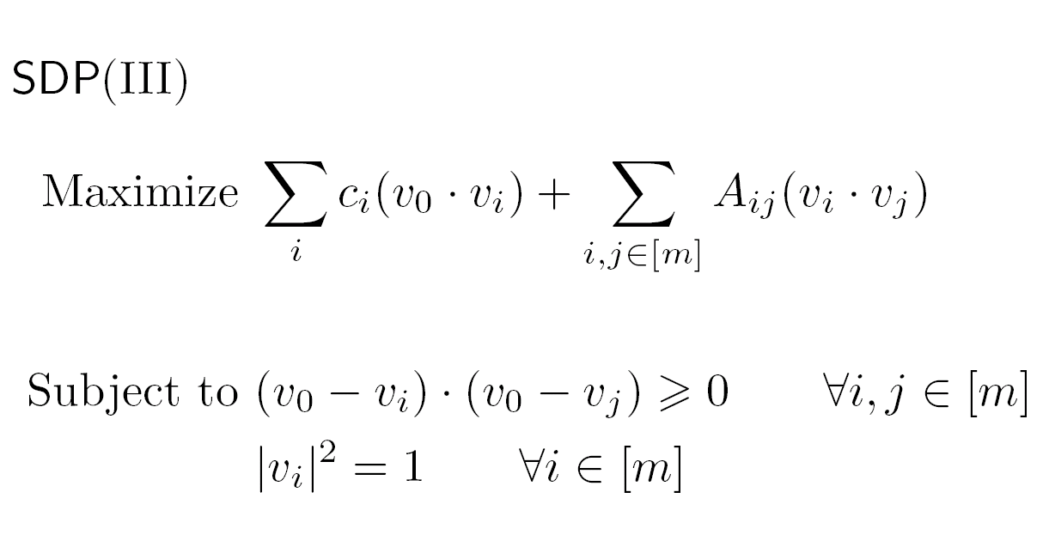
General Boolean 2-CSPs
In Integral Solution
v_{i} = 1 or -1
V₀ = 1
Total PayOff
Triangle Inequality
Notes:
Total payoff…

Slide 50
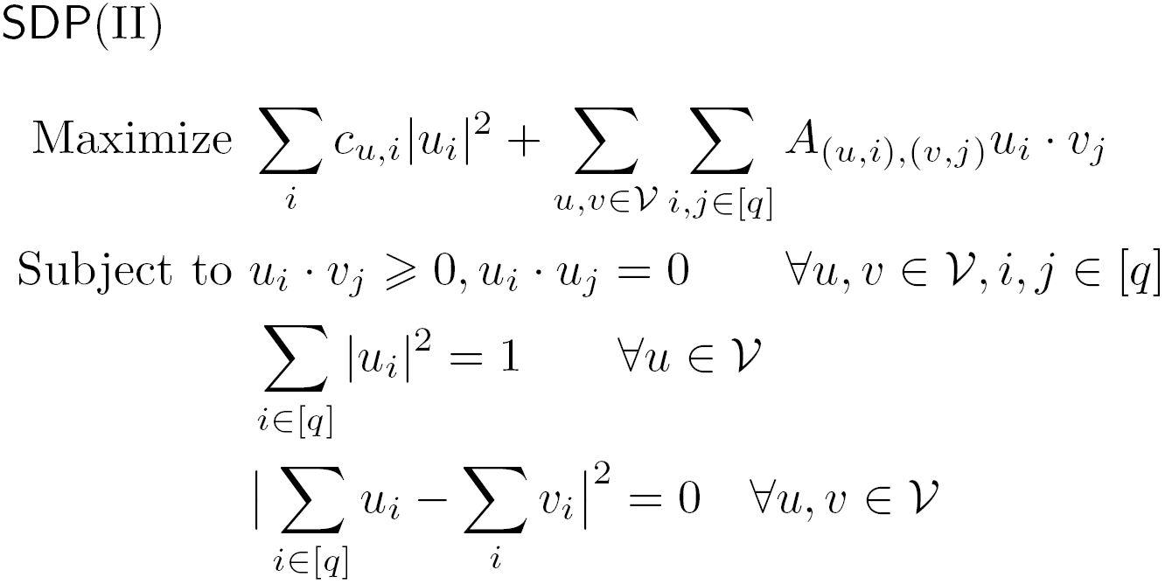
2-CSP over {0,..q-1}
Total PayOff

Slide 51
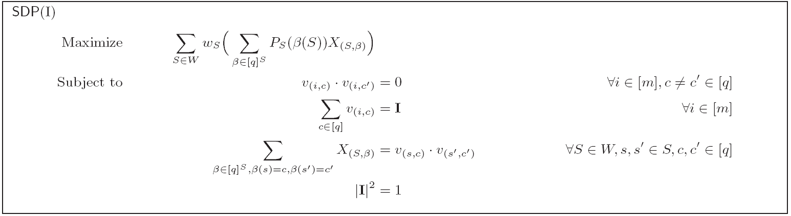
Arbitrary k-ary GCSP
SDP is similar to the one used by [Karloff-Zwick] Max-3-SAT algorithm.
It is weaker than k-rounds of Lasserre / LS+ heirarchies

Slide 52
Key Lemma
1) Tests of the verifier are same as the constraints in instance G
2) Completeness = SDP(G)
DICT_{G}
Dictatorship Test
on functions
F : {-1,1}^{n} ->{-1,1}
Any
CSP Instance G
Any
Function
F: {-1,1}^{n} → {-1,1}
Round_{F}
Rounding Scheme
on CSP Instances G
If F is far from a dictator,
Round_{F} (G) ≈ DICT_{G} (F)
Notes:
Mention that n, \eta are constants

Slide 53
Key Lemma : Through An Example
SDP:
Variables : v₁ , v₂ ,v₃
|v₁|² = |v₂|² = |v₃|² =1
Maximize
1
2
3

Slide 54
Local Random Variables
c = SDP Value
v₁ , v₂ , v₃ = SDP Vectors
Fix an edge e = (1,2).
There exists random variables a₁ a₂ taking values {-1,1} such that:
1
A₁₂
A₁₃
2
A₂₃
3
For every edge, there is a local distribution over integral solutions such that:
All the moments of order at most 2 match the inner products.
E[a₁ a₂] = v₁∙ v₂
E[a₁²] = |v₁|² E[a₂²] = |v₂|²

Slide 55
Analysis
A₁₂,A₂₃,A₃₁ = Local Distributions
Pick an edge (i,j)
Generate a_{i},a_{j} in {-1,1}^{R} as follows:
The k^{th} coordinates a_{ik},a_{jk} come from distribution A_{ij}
Add noise to a_{i},a_{j}
Accept if
F(a_{i}) ≠ F(a_{j})
Max Cut Instance
1
2
3
Input Function:
F : {-1,1}^{R} -> {-1,1}

Slide 56
Completeness
A₁₂,A₂₃,A₃₁ = Local Distributions
Input Function is a Dictator : F(x) = x₁
Suppose (a₁ ,a₂) is sampled from A₁₂ then :
E[a₁₁ a₂₁] = v₁∙ v₂ E[a₁₁²] = |v₁|² E[a₂₁²] = |v₂|²
Summing up, Pr[Accept] = SDP Value(v₁ , v₂ ,v₃)

Slide 57
Global Random Variables
c = SDP Value
v₁ , v₂ , v₃ = SDP Vectors
g = random Gaussian vector.
(each coordinate generated by i.i.d normal variable)
b₁ = v₁ ∙ g
b₂ = v₂ ∙ g
b₃ = v₃ ∙ g
1
B
3
2
There is a global distribution B=(b₁ ,b₂ ,b₃) over real numbers such that:
All the moments of order at most 2 match the inner products.
E[b₁ b₂] = v₁∙ v₂ E[b₂ b₃] = v₂∙ v₃ E[b₃ b₁] = v₃∙ v₁
E[b₁²] = |v₁|² E[b₂²] = |v₂|² E[b₃²] = |v₃|²

Slide 58
Rounding with Polynomials
1
B
Input Polynomial : F(x₁ ,x₂ ,.. x_{R})
Generate
b₁ = (b₁₁ ,b₁₂ ,… b_{1R})
b₂ = (b₂₁ ,b₂₂ ,… b_{2R})
b₃ = (b₃₁ ,b₃₂ ,… b_{3R})
with each coordinate (b_{1t} ,b_{2t} ,b_{3t}) according to global distribution B
Compute F(b₁),F(b₂) ,F(b₃)
Round F(b₁),F(b₂),F(b₃) to {-1,1}
Output the rounded solution.
3
2

Slide 59
Invariance
Suppose F is far from every dictator then since A₁₂ and B have same first two moments,
F(a₁),F(a₂) has nearly same distribution as F(b₁),F(b₂)
F(b₁), F(b₂) are close to {-1,1}

Slide 60
Rounding Scheme
(For Boolean CSPs)
Rounding Scheme was discovered by the reversing the soundness analysis.
This fact was independently observed by Yi Wu

Slide 61
SDP Rounding Schemes
SDP Vectors
(v₁ , v₂ .. v_{n} )
For any CSP, it is enough to do the following:
Instead of one random projection, pick sufficiently many projections
Use a multilinear polynomial P to process the projections
Random Projection
Projections
(y₁ , y₂ .. y_{n} )
Process the projections
Assignment

Slide 62

Rounding By Polynomial P(y₁,… y_{R})
Roughly | Formally
Sample R Random Directions | Sample R independent vectors : w⁽¹⁾, w⁽²⁾ ,.. w^{(R)} Each with i.i.d Gaussian components.
Project along them | Project each v_{i} along all directions w⁽¹⁾, w⁽²⁾ ,.. w^{(R)} Y_{i}^{(j)} = v₀∙v_{i} + (1-ε)(v_{i} – (v₀∙v_{i})v₀) ∙ w^{(j)}
Compute P on projections | Compute x_{i} = P(Y_{i}⁽¹⁾ , Y_{i}⁽²⁾ ,.. Y_{i}^{(R)})
Round the output of P | If x_{i} > 1, x_{i} = 1 If x_{i} < -1, x_{i} = -1 If x_{i} is in [-1,1] x_{i} = 1 with probability (1+x_{i})/2 -1 with probability (1-x_{i})/2

Slide 63
Algorithm
R is a constant parameter
Solve SDP(III) to obtain vectors (v₁ ,v₂ ,… v_{n} )
Smoothen the SDP solution (v₁ ,v₂ ,… v_{n} )
For all multlinear polynomials P(y₁ ,y₂, .. y_{R}) do
Round using P(y₁ ,y₂, .. y_{R})
Output the best solution obtained

Slide 64
Discretization
“For all multilinear polynomials P(y₁ ,y₂, .. y_{R}) do”
- All multilinear polynomials with coefficients bounded within [-1,1]
- Discretize the set of all such multi-linear polynomials
There are at most a constant number of such polynomials.

Slide 65
Smoothening SDP Vectors
Let u₁ ,u₂ .. u_{n} denote the SDP vectors corresponding to the following distribution over integral solutions:
``Assign each variable uniformly and independently at random”
Substitute
v_{i}* ∙ v_{j}* = (1-ε) (v_{i} ∙ v_{j}) + ε (u_{i}∙ u_{j})

Slide 66
Semidefinite Program
Linear program over the inner products of vectors
Simplest SDP for MaxCut
Variables : v₁ , v₂ … v_{n}
| v_{i} |² = 1
Maximize
In the integral solution,
all the v_{i} are 1,-1
Thus they satisfy additional constraints
In the integral solution,
all the v_{i} are 1,-1
Thus they satisfy additional constraints
Example Constraint: (v_{i} – v_{j})² + (v_{j} – v_{k})² ≥ (v_{i} – v_{k})²

Slide 67
Thank You

Slide 68
GENERIC
ALGORITHM
MAX k-CSP
Unique Games
MAX 3-CSP
MAX 3-AND
MAX 3-MAJ
MAX E2 LIN3
MAX 3 DI-CUT
MAX 4-SAT
MAX DI CUT
MAX 3-SAT
MAX CUT
MAX 2-SAT
MAX Horn SAT
MAX k-CUT
0
1

Slide 69
MAX k-CSP
Unique Games
MAX 3-CSP
MAX 3-AND
MAX 3-MAJ
MAX E2 LIN3
MAX 3 DI-CUT
MAX 4-SAT
MAX DI CUT
MAX 3-SAT
MAX CUT
MAX 2-SAT
MAX Horn SAT
MAX k-CUT
0
1

Slide 70
MAX k-CSP
Unique Games
MAX 3-CSP
MAX 3-AND
MAX 3-MAJ
MAX E2 LIN3
MAX 3 DI-CUT
MAX 4-SAT
MAX DI CUT
MAX 3-SAT
MAX CUT
MAX 2-SAT
MAX Horn SAT
MAX k-CUT
0
1

Slide 71
Approximability of CSPs
ALGORITHMS
[Charikar-Makarychev-Makarychev 06]
[Goemans-Williamson]
[Charikar-Wirth]
[Lewin-Livnat-Zwick]
[Charikar-Makarychev-Makarychev 07]
[Hast]
[Charikar-Makarychev-Makarychev 07]
[Frieze-Jerrum]
[Karloff-Zwick]
[Zwick SODA 98]
[Zwick STOC 98]
[Zwick 99]
[Halperin-Zwick 01]
[Goemans-Williamson 01]
[Goemans 01]
[Feige-Goemans]
[Matuura-Matsui]
Unique Games
MAX 3-CSP
MAX CUT
MAX 2-SAT
MAX k-CSP
MAX 3-SAT
MAX DI CUT
MAX 4-SAT
MAX k-CUT
MAX Horn SAT
MAX 3 DI-CUT
MAX E2 LIN3
MAX 3-AND
MAX 3-MAJ
0
1
Notes:
Since then, SDPs have been used to approximate several CSPs (show a list). These are all the CSPs that have been approximated.. On the hardness side, PCP machinery has shown several results, yet some remained open. Again the culprit is MaxCut.

