Slide 1
PCPs and Inapproximability: Recent Milestones and Continuing Challenges
Venkatesan Guruswami
Carnegie Mellon University
© V. Guruswami, 2011

Slide 2
Intended to be a survey of some key developments of last ≈ 10 years Let’s begin with a glimpse of where PCP theory was ≈ a decade back

Slide 3
PCPs circa 2000

Slide 4
PCP theorem
PCP theorem:
[Arora-Safra, Arora-Lund-Motwani-Sudan-Szegedy]
Polynomial size witnesses for membership claims
“x ∈ L” in NP languages L that are checkable by a randomized polytime verifier by just probing 3 bits
with soundness < 0.99
soundness = max. prob. of accepting some witness for strings x ∉ L

Slide 5
Probabilistically Checkable Proofs
PCP Theorem: characterization of NP
NP Proof y
PCP π
Probabilistic
Verifier
Deterministic
Verifier

Slide 6
Probabilistically Checkable Proofs
PCP Theorem: characterization of NP
NP Proof y
PCP π
Probabilistic
Verifier
Deterministic
Verifier
PCP π – locally testable encoding of the NP proof y

Slide 7
Probabilistically Checkable Proofs
PCP Theorem: characterization of NP
NP Proof y
PCP π
Probabilistic
Verifier
Deterministic
Verifier
Completeness:
If ϕ ∈ SAT, there exists a PCP π such all local views are accepting
Soundness:
If ϕ ∉ L, then for all PCPs π at most 99% of the local views
are accepting

Slide 8
PCP theorem
⇔ Gap3SAT_{1,α} is NP-hard for some α < 1
That is, polytime reduction mapping
satisfiable formulae ϕ to satisfiable formulae ψ
Unsatisfiable formulae ϕ to formulae ψ that is
at most α-satisfiable
Implies factor α-approximation for Max 3SAT is NP-hard

Slide 9
PCPs: early years
PCP theorem implied hardness of approximation many problems (via their classic reductions from 3SAT).
Generally very weak factors.
Quest for better (optimal?) factors followed
2-prover 1-round proof systems emerged as the canonical PCP to reduce from:
Constraint satisfaction problem called Label Cover
Example early Label Cover-based success:
Ω(log n) hardness for set cover [Lund-Yannakakis]

Slide 10
Label Cover
V
W
Arity 2 CSP over large
domain [R] with “projection” constraints.
Instance consists of:
Bipartite graph G=(V,W,E)
For each e =(v,w) ∈ E, a function π_{e} : [R] → [R].
Assignment (labeling) A: V ∪ W → [R] satisfies an edge e=(v,w) if π_{e}(A(v)) = A(w)
Value of instance = maximum fraction of edges satisfied by a labeling
PCP Theorem + Raz’s parallel repetition theorem ⇒ a strong (value 1 vs 1/R^{γ}) gap hardness for Label Cover
e

Slide 11
Strong(er)/optimal PCPs
Improvements in PCP parameters, aimed in part at better hardness results
Label Cover used as “outer” PCP
Composed with “inner” PCP
Paradigm: Encode labels & test codewords
“Inner” task: Check if π(a)=b reading very few bits of Enc(a) and Enc(b)
Goal: trade off soundness for much smaller # queries
Which code to use?
Brilliant invention of [Bellare-Goldreich-Sudan]: LONG CODE

Slide 12
Long Code (aka Dictator functions)
For a 2 {1,2,…,R}, LONG(a) : {0,1}^{R} → {0,1}
LONG(a)(x) = x_{a} for every x 2 {0,1}^{R}
Very redundant (encodes log R bits into 2^{R} bits)
has the value of every function [R] → {0,1} at a
but doesn’t hurt to have around if R is constant.
Surprisingly useful!

Slide 13
The first optimal PCPs
[Håstad’96]: zero “amortized free bit” PCP ⇒ factor n^{1-ε} inapproximability for Clique
[Håstad’97]: Gap3LIN_{1-ε,½+ε} is NP-hard (3-query PCP with completeness 1-ε and soundness ½+ε). Optimal!
Also, similar result mod p, and NP-hardness of
Gap3SAT_{1,7/8+ε} & Gap-4-Set-Splitting_{1,7/8+ε}
Several hardness results (currently best known, under NP ≠ P) via gadget reductions from Håstad’s results:
MaxCut: 16/17 Max2SAT: 21/22 MaxDiCut: 11/12
NAE-3SAT: 15/16 3-Set-Splitting: 19/20 3-coloring: 32/33 (these are with perfect completeness)
Optimal!

Slide 14
Optimal algorithms
In parallel with hardness revolution, sophisticated SDP rounding methods developed. Eg.
7/8 algo for Max3SAT [Karloff-Zwick]
Factor 2/3 for Max 3MAJ
Factor ½ algo for Max3CSP and factor 5/8 for satisfiable 3CSP.

Slide 15
Optimal PCPs: queries vs soundness
[G.-Lewin-Sudan-Trevisan] 3-query adaptive PCP with perfect completeness & soundness ½+ε
[Samorodnitsky-Trevisan] 1+ε amortized query complexity: k queries, soundness 2^{-k+o(k)}
Useful starting points in some reductions,
eg. Clique, Low-congestion network routing

Slide 16
Low-soundness Multiprover systems
[Arora-Sudan; Raz-Safra] O(1) prover 1-round proof systems with exp(-(log n)^{Ω(1)}) soundness
NP-hardness of Ω(log n) factor for set cover
Similar result for 2-prover case open
Would have more applications, like hardness of lattice problems
[Dinur-Fischer-Kindler-Raz-Safra] O(1) prover systems with
exp(-(log n)^{0.99}) soundness.
Proof of BGLR “sliding scale” conjecture for up to
(log n)^{0.99} bits read

Slide 17
Covering PCPs [G.-Håstad-Sudan]
Notion of soundness tailored to coloring problems
Covering soundness = minimum number of proofs that can “cover” all constraints (for every check, at least one proof should cause acceptance)
[G.-Håstad-Sudan] 4-query PCP with ω(1) covering soundness
Super-constant hardness for coloring 2-colorable 4-uniform hypergraphs.
Later also for 3-uniform hypergraphs [Khot] [Dinur-Regev-Smyth]
Frontier: Rule out 5-coloring 3-colorable graphs in polytime

Slide 18
PCPs till ~ 2000 summary
Label Cover hardness
versatile starting point for inapproximability (continues to be prominent)
Label Cover + Long Code + Fourier analysis paradigm
Tight hardness results for several CSPs of arity ≥ 3
Arity 2 CSPs not well understood (results only via gadgets)

Slide 19
New Proof Composition methods
Low soundness error 2-query PCPs
Short PCPs (n^{1+o(1)} size):
- Best known n (log n)^{O(1)}
New “outer” PCPs
- multilayered, smooth, mixing, Dinur-Safra, etc.
- Conjectural forms:
Unique Games, 2-to-1, …
PCPs in the last decade
New proofs, notions:
- Dinur’s gap amplification
- Robust PCPs
- PCP of proximity (PCPP)
Dictatorship tests and new “inner” PCPs
- New analytic machinery

Slide 20
New proofs and notions

Slide 21
Dinur’s proof
Gap amplification: Reduce Gap-3Color_{1,1−δ} to Gap-3Color_{1,1−2δ} provided δ < 10⁻⁶
Apply O(log n) times starting with δ=1/m
Shows that Gap-3Color_{1,α} is NP-hard for some constant α<1 (this implies the PCP theorem)
PCP via inapproximability instead of other way around
Requires elements of old PCP in alphabet reduction
A constant sized PCP (variant called “PCPP” or “assignment tester”)

Slide 22
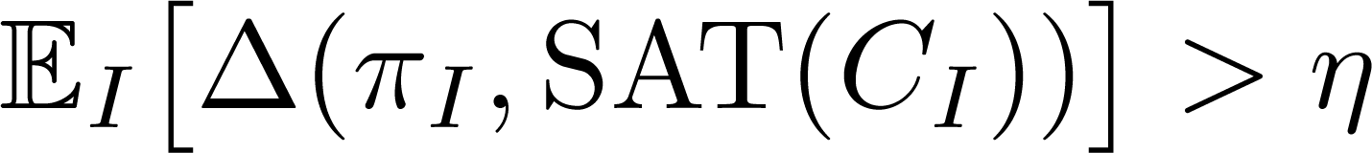
Robust PCPs
PCP soundness: When ϕ∉ SAT, for all proofs π, with probability ρ, check C_{I} rejects π_{I} (I=randomly chosen query positions)
Robust PCP: stronger soundness guarantee
π_{I} far from satisfying C_{I} (with good prob.)
Formally,
I
Proof π
Check C_{I}(¼_{I})= 1
( η = robust soundness)

Slide 23
Robust PCPs & PCPPs
Check if π_{I} satisfies C_{I} or is far from satisfying C_{I} recursively, using another “inner” PCP
Inner primitive: PCP of proximity (PCPP)
Input: circuit C
Proof: (purported) satisfying assignment x and proof of proximity σ that x satisfies C
Verifier (Assignment Tester): read few bits in both x and σ;
For satisfying x, ∃ σ with acc. prob. 1
If x is δ-far from satisfying C, then ∀ σ, Ω(1) rej. prob.
Useful when robust distance η of outer PCP > proximity parameter δ of inner PCPP

Slide 24
Composition streamlined
Robust PCPs compose “syntactically” with “inner” PCPs of proximity (when PCPP proximity parameter < robustness)
[Ben-Sasson, Goldreich, Harsha, Sudan, Vadhan] Can check that original polynomial and Hadamard based PCPs can be made robust PCPPs.
Simplifies details of composition
Used to give near-linear size PCPs
PCPP also used in Dinur’s alphabet reduction step
Explicit coding used to create distance between inconsistent assignments

Slide 25
Talk Plan
New proofs and notions
Robust PCPs and PCPs for proximity
Short PCPs
Low-soundness error Label Cover
Unique Games, Dictatorship tests, etc.
NP-hardness via structured outer PCPs
Some challenges

Slide 26

Quasi-linear PCPs
[BGHSV] PCPs of length n ⋅ 2^{(log n)²} (O(1/ε) queries)
[Ben-Sasson, Sudan] Univariate polynomial based PCP
Proof of proximity for Reed-Solomon codes which makes it locally testable
n (log n)^{O(1)} sized PCP with (log n)^{O(1)} queries
O(log log n) steps of Dinur’s gap amplification gives
n (log n)^{O(1)} sized PCP with O(1) queries
Implication for approximation: APX-hardness via reduction from 3SAT hold for time algos, under the ETH

Slide 27
New proofs and notions
Robust PCPs and PCPs for proximity
Short PCPs
Low-soundness error Label Cover
Unique Games, Dictatorship tests, etc.
NP-hardness via structured outer PCPs
Some challenges

Slide 28
Label cover with o(1) soundness
Håstad’s 7/8+ε hardness for 3SAT requires soundness error of Label Cover to be << ε
Getting this via parallel repetition makes Label Cover instance size n^{Ω(log (1/²))} (with large hidden constant factor)
Can we get such soundness with LC size say O_{ε}(n³) ?
Answer: [Moshkovitz-Raz] YES. In fact, with near-linear size !
(Was very surprising to me)
For soundness ε, Label Cover with n^{1+o(1)} poly(1/ε) vertices.
Worse dependence on domain size: R = exp(poly(1/ε))
instead of poly(1/ε) in Raz.

Slide 29
Inapproximability consequence
7/8+ε approx. for 3SAT requires exp(Ω_{²}(n^{1-o(1)})) time (under “Exponential Time Hypothesis”)
Similar claims for other hardness results based on Label cover + Long code testing
Sharp complexity dichotomy at the approximation threshold 7/8: polytime vs. exponential time.

Slide 30
[Moshkovitz-Raz] approach
Start with Label Cover of low soundness error ε but large alphabet Σ
ε = (log n)^{-0.01}, |Σ| = poly(n) (based on low-degree testing)
reduce alphabet size via composition
New composition method to reduce alphabet size
that does not increase # provers
Next: Few words on an alternate approach (giving polynomial instead of near-linear size)

Slide 31
Derandomized parallel repetition
u-parallel repetition of Label Cover reduces soundness error from (say) 0.99 to ε=2^{−O(u)}, but blows up size to ≈ n^{u}
Can’t get o(1) soundness with polytime reduction (const. u)
Derandomization: Can we select a poly-sized subset of all possible u questions?
[Dinur-Meir] Achieve u=O(log n), poly(n) size
and ε ≤ 1/(log n)^{0.01}
Derandomized direct product testing based on subspaces [Impagliazzo-Kabanets-Wigderson]
Apply this to “structured” PCPs (constraints have a subspace structure)

Slide 32
Composing without an extra prover
[Dinur-Harsha] alternate composition method to reduce alphabet size keeping number of provers at 2
Based on “decodable PCPs”
Exploit equivalence between robust PCPs and Label Cover
Applying this to [Dinur-Meir] construction, gives:
Label Cover of fixed polynomial (though not near-linear) size with soundness ε, ∀constants ε > 0

Slide 33
Label Cover ⇔ Robust PCPs
V
W

Slide 34
Label Cover ⇒ Robust PCPs
Proof π
Verifier
Verifier
Selects a random “big” vertex v ∈ V
Reads entire neighborhood of v
Accepts iff there is a value for v that would cause all edge constraints to accept.

Slide 35
Label Cover ⇒ Robust PCPs
Proof π
Robust PCP !
Verifier
YES instances – all views are “happy”
NO instances – average view is very “unhappy”, i.e. view from a random window is at most δ-close to a satisfying view.

Slide 36
Label Cover ⇐ Robust PCPs
Proof π
Verifier
This transformation is “invertible” (rotate back!)
|Σ| corresponds to the number of accepting configurations, which is ≤ exp(# PCP queries)
Reducing PCP queries ⇒ reducing LC alphabet size
Notes:
already pointed out in BGHSV.

Slide 37
Low-error 2-prover systems summary
Some very exciting recent constructions
Frontier: 2-query PCP of polynomial size and polynomial alphabet with soundness error 1/(log n)¹⁰

Slide 38
New proofs and notions
Robust PCPs and PCPs for proximity
Short PCPs
Low-soundness error Label Cover
Unique Games, Dictatorship tests, etc.
NP-hardness via structured outer PCPs
Some challenges

Slide 39
Label Cover
V
W
Domain [R]
Instance consists of:
Bipartite graph G=(V,W,E)
For each e =(v,w) ∈ E, a function π_{e} : [R] → [R].
Assignment (labeling) A: V ∪ W → [R] satisfies an edge e=(v,w) if π_{e}(A(v)) = A(w)
e

Slide 40
Long code based “inner” PCPs
Task: Checking that labels a=A(v) and b=A(w) satisfy some Label Cover projection constraint π(a) = b
Check this by probing few (say q) bits of (purported) long codes f, g : {0,1}^{R} → {0,1} of labels a and b
If f and g are long codes of “consistent” a, b (i.e., π(a) = b), accept with probability (close to) 1
Acceptance with prob. > s + ε implies one can randomly “decode” f, g into labels a’, b’ s.t. π(a’) = b’ with prob. θ=θ(ε)
This would imply a q-query PCP with soundness s + 2ε
Let’s see Håstad’s 3-query inner PCP, and difficulty with constructing 2-query PCPs.
Recall: f=LONG(a) ⇒ f(x) = x_{a}

Slide 41
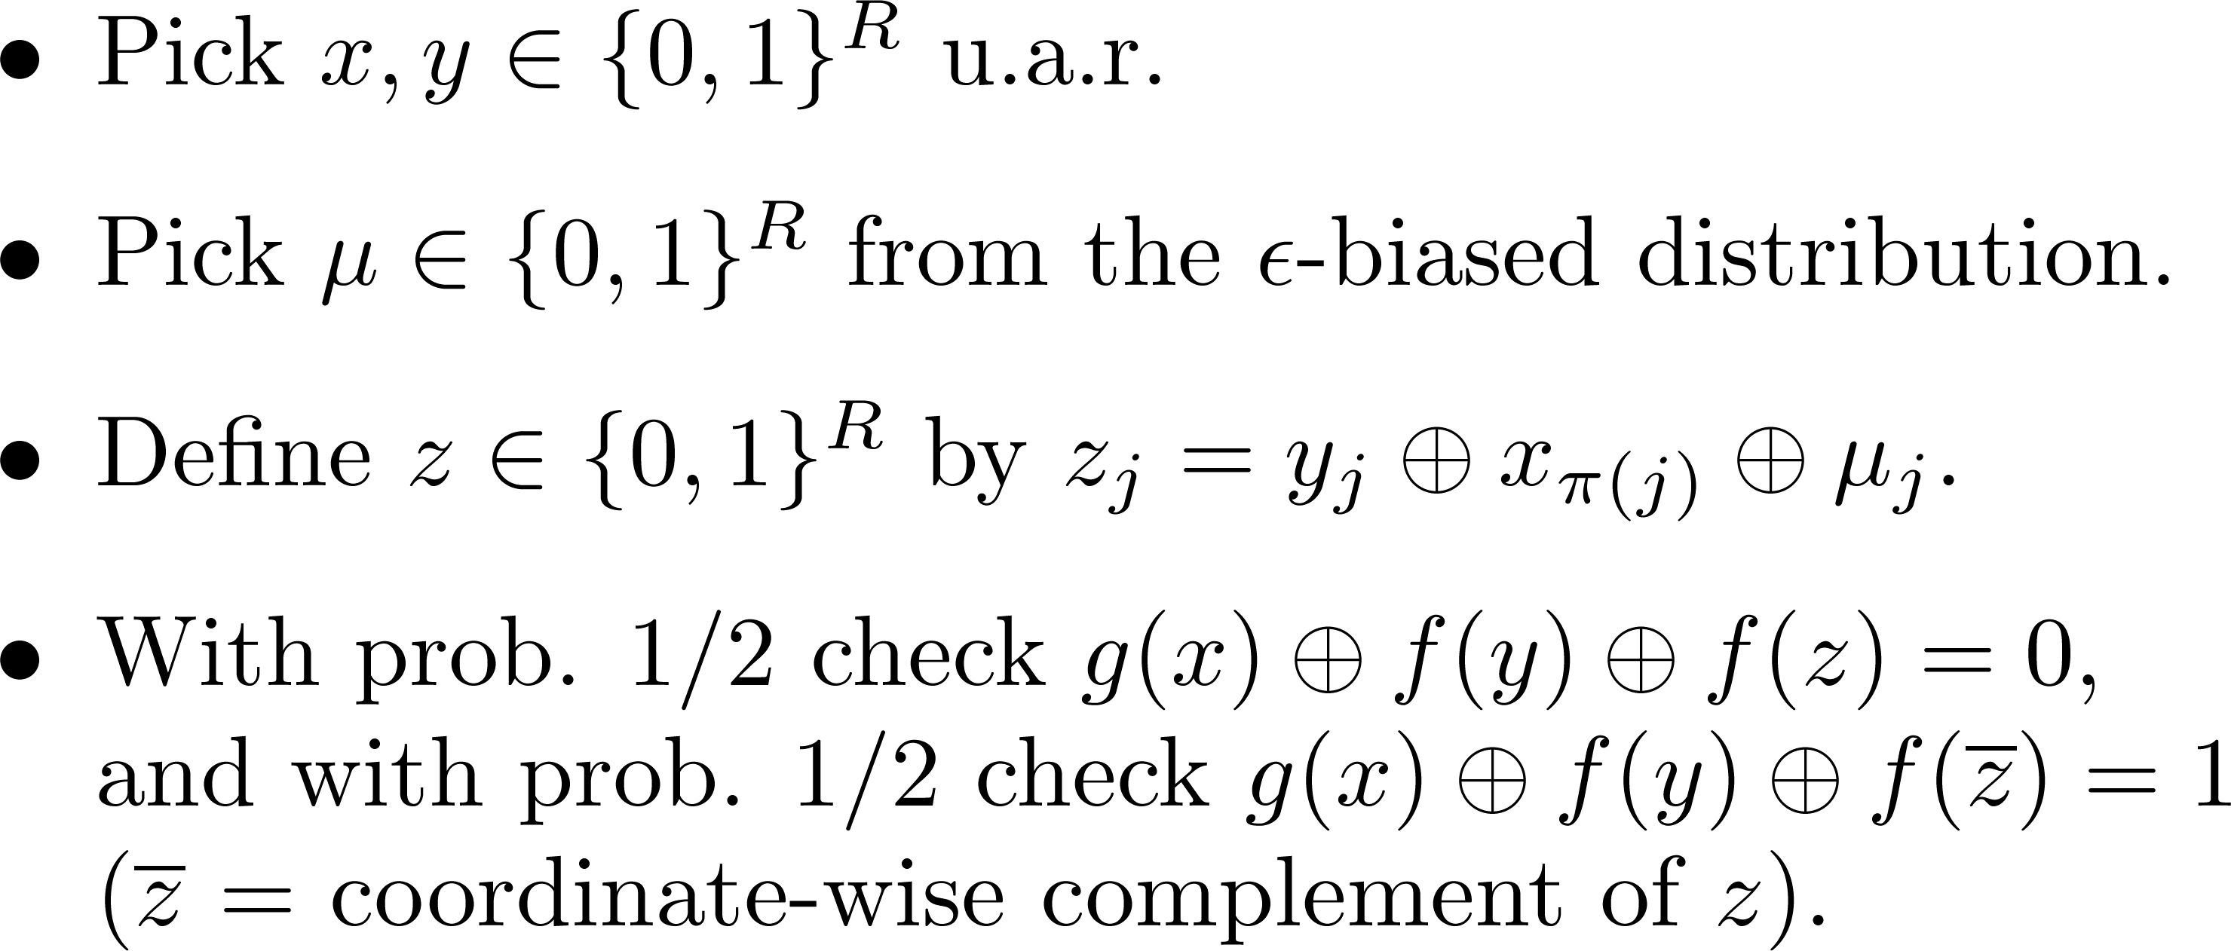
Håstad’s 3-query PCP
Given proof tables
f, g : {0,1}^{R} → {0,1}
Completeness: If f(y) = y_{a} and g(x) = x_{b} and π(a) = b, then
g(x) ⊕ f(y) ⊕ f(z) = x_{b} ⊕ y_{a} ⊕ y_{a} ⊕ x_{π(a)} ⊕ μ_{a} = μ_{a}
Suffices for decoding labels
Soundness: Acceptance prob. > ½ +ε ⇒ g, f have non-trivial agreement with “consistent” low-weight linear functions

Slide 42
3 vs. 2 queries
Get (1−ε) vs. (½ +ε) hardness for Max3LIN (mod 2)
Tight!
Each query point x,y, z is uniformly distributed in {0,1}^{R}
y,z are correlated, but f has to give value to each separately (and each is uniform)
What about 2-variable linear equations mod 2?
[Goemans-Williamson] algo finds assignment of value 1−O(√ε) in (1−ε)-satisfiable instance
Matching hardness through a 2-query PCP ?

Slide 43
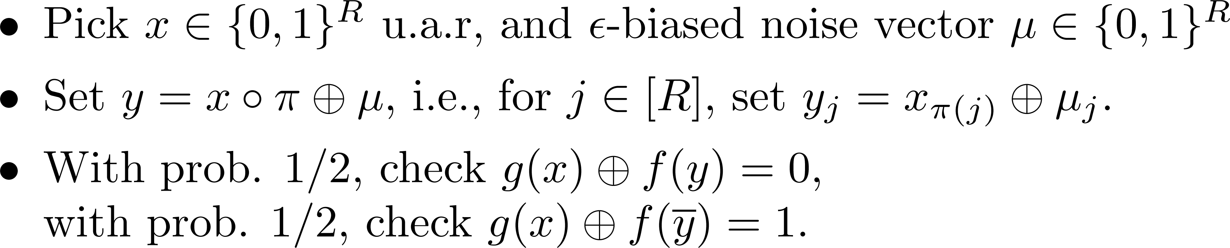
A 2-query PCP?
Here’s a natural test, saving 1 query in Håstad’s test:
Trouble: query y to f is not uniform.
y_{j} = y_{k} with prob. close to 1 when π(j) = π(k)
Query y reveals lots of information about projection π
Could form “cheating” f by “piecing together”
many inconsistent long codes, for portions of {0,1}^{R}
corresponding to different projections π_{e}
How to circumvent this?

Slide 44
Unique Games
Khot’s insight: if π is a bijection, then y = x ° π is uniformly distributed (since x is); gives no clue about π
UGC ⇒ analysis of 2-query test reduces to f=g case
show that if f passes w.h.p, then f is “like” a long code (modern term: dictator)
just codeword testing, no “consistency” checking
Unique Game (UG)
* Label Cover where all projection constraints are bijections
Khot’s Unique Games Conjecture (UGC):
GapUG_{1−ε,ε} is NP-hard for R > R(ε)

Slide 45
2-query dictator testing
The core question becomes analyzing “noise stability” NS_{ε}(f)= Prob_{x,μ} [ f(x) = f(x ⊕ μ) ] (assume f is balanced)
If f = dictator, then NS_{ε}(f) = 1− ε
If NS_{ε}(f) is close to 1− ε, what can we say?
[Bourgain] If NS_{ε}(f)> 1− ε^{0.51} then f is close to a junta (depends on few coordinates)
[Mossel-O’Donnell-Oleszkiewicz] (Majority is Stablest Thm) If NS_{ε}(f) > 1− Θ(√ ε) then f has an influential coordinate.
Both of these can be used in reduction from Unique Games

Slide 46
UGC consequences…
(2- ε) hardness for Vertex cover [Khot-Regev]
0.878.. hardness for Max Cut [Khot-Kindler-Mossel-O’Donnell] (using Majority is Stablest)
Near-tight hardness for all Boolean 2CSPs [Austrin]
Optimal hardness for every CSP [Raghavendra] (using invariance principle of [Mossel])
Approximation resistance of every ordering CSP
[G.-Håstad-Manokaran-Raghavendra-Charikar]
Hardness matching LP integrality gaps:
Multiway Cut, Metric Labeling [Manokaran-Naor-Raghavendra-Schwartz]
Vertex cover, covering problems [Kumar-Manokaran-Tulsiani-Vishnoi]

Slide 47
New proofs and notions
Robust PCPs and PCPs for proximity
Short PCPs
Low-soundness error Label Cover
Unique Games, Dictatorship tests, etc.
NP-hardness via structured outer PCPs
Some challenges
Proving UGC predictions without UGC?

Slide 48
Bypassing UGC?
UGC has predicted many strong results
All plausible & consistent with our knowledge
“combinatorial” ones (like embedding lower bound) confirmed unconditionally
Yet, no UG-completeness result so far
Possible that consequences of UGC are true but conjecture itself is false
Natural question: Can we verify some of UGC’s predictions without resorting to UGC?
Ideally, show NP-hardness
Or hardness under weaker assumptions (like optimality of Goemans-Williamson)?

Slide 49
Smooth Label Cover
[Khot] Label Cover where for each v 2 V, the projections π_{e} for edges e incident on v form a “hash family”
Gap-Smooth-Label-Cover_{1,ε} is NP-hard
Reduction from Label Cover (note perfect completeness)
Such “locally unique” projections have been useful in some NP-hardness reductions
3-coloring 3-uniform hypergraphs [Khot]
Learning problems [Khot-Saket] [Feldman-G.-Raghavendra-Wu]
Geometric problems in L_{p} norm (p > 2):
Subspace approximation and Grothendieck problems

Slide 50
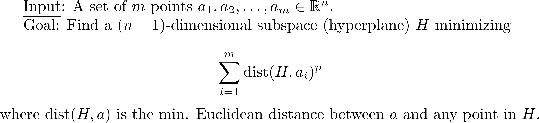

A Gaussian approximation threshold
L_{p} Subspace approximation problem (2 < p < ∞)
[Deshpande-Tulsiani-Vishnoi]
Factor β_{p} algorithm where is the p’th moment of the standard Gaussian.
And matching β_{p}−ε Unique-Games-hardness
[G.-Raghavendra-Saket-Wu] NP-hardness of factor β_{p}−ε approximation,
using smooth Label Cover

Slide 51
Other Label Cover variants
Other structured Label Cover instances
discovered in the last decade:
Multilayered PCPs
2-to-1 projections (conjectural)
Dinur-Safra

Slide 52
Multilayered PCP
Multipartite label cover:
L layers of vertices V₁, V₂, …, V_{L}
Projection maps between every pair of layers:
for edge e between v_{i} ∈ V_{i} and v_{j} ∈ V_{j} (i < j),
π_{e} : [R] → [R] from label of v_{i} to label of v_{j}
Ensure every γ fraction of vertices have many constraints amongst them (for L > L(γ ))
Introduced in [Dinur-G.-Khot-Regev] to show factor (k−1−ε) hardness for vertex cover on k-uniform hypergraphs
Later use in hypergraph coloring, non-mixed 3SAT, etc.

Slide 53
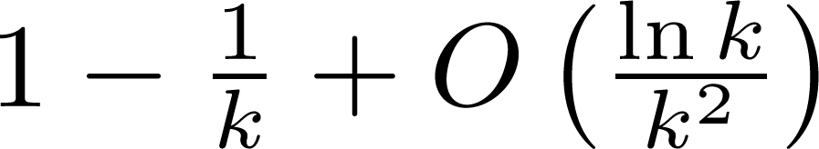
2-to-1 conjecture
Label Cover where projection maps are 2-to-1
Conjecture [Khot]: Gap-2-to-1-LC_{1,ε} is NP-hard
Parallel repetition gives poly(1/ε)-to-1 projections
Consequences:
√2−ε hardness for vertex cover [Dinur-Safra], [Khot]
Hardness of O(1)-coloring 4-colorable graphs [Dinur-Mossel-Regev]
Hardness of Gap-No-Two_{1,5/8+ε} [O’Donnell-Wu]
Factor hardness for Max k-coloring [G.-Sinop]

Slide 54
[Dinur-Safra]
This remarkable paper showed factor 1.3606 NP-hardness for vertex cover
Underlying this was a “2-to-1 like” Label Cover
label for v consistent with one or two labels for w
Soundness: ∀ labeling, every ε fraction of vertices has a 100-clique of inconsistent pairs.
Other applications?

Slide 55
Wrap-up
PCPs remarkably successful in showing inapproximability (even beyond initial expectations?)
Breadth of problems.
I find it amazing what all Label Cover can be reduced to!
Many tight results
Some notorious problems have withstood resolution
Densest subgraph, minimum linear arrangement, bipartite clique, sparsest cut, graph bisection, etc.
Known algorithms have superconstant approx. ratio,
but even APX-hardness not known

Slide 56
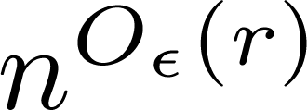
Cut challenges
Eg. Uniform Sparsest Cut, Minimum Graph Bisection:
Best approximation (log n)^{Ω(1)}. Hardness evidence:
Refuting random 3SAT is hard ⇒ Factor 1.1 hardness [Feige]
Polytime (1+ε) approximation ⇒ NP has 2^{n²’} time algorithms [Khot, “quasi-random PCPs”]
Superconstant hardness under “SSE hypothesis” (stronger than Unique Games conjecture) [Raghavendra-Steurer-Tulsiani]
“Easiness” evidence [G.-Sinop]
Factor (1+ε)/λ_{r} approximation in time where
λ_{r} is the r’th smallest eigenvalue of normalized Laplacian.

Slide 57
Challenges
Can PCP machinery (even assuming UGC) give strong hardness results for Steiner Tree, TSP, Asymmetric TSP ?
Lasserre integrality gaps beyond known hardness bound for Vertex Cover, Max Cut (or Unique Games)?
Just 4 rounds could improve [GW] and refute UGC !
Unique-Games-completeness?
Bypass UGC for some other consequences?
Unchartered terrain for inapproximability:
eg. , nearest codeword in algebraic codes, bin packing, …

