Slide 1
Presenting: Dafna Shahaf

Slide 2
Infranet: Circumventing Web Censorship and Surveillance Nick Feamster, Magdalena Balazinska, Greg Harfst, Hari Balakrishnan, David Karger

Slide 3
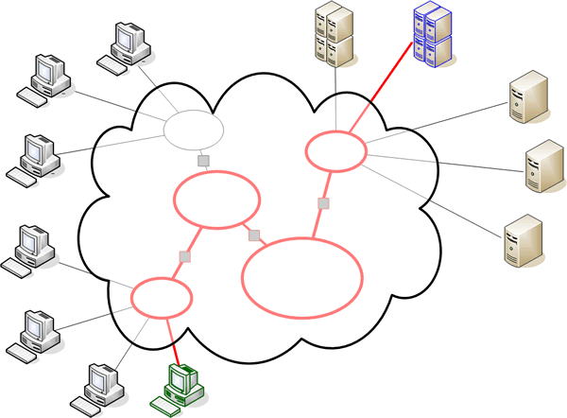

Slide 4
?
+ IP, key

Slide 5
3. Hide( )
1. Tunnel
2. Hide( BBC.com )
Challenge!
+ IP, key

Slide 6
Discussion (1)
James Bond movie!
Response of U.S. Army?
Human component: software distribution
Assumptions
Scope of possible attacks from the censor?
Censor does not want to affect normal users
Downsampling images?
Notes:
Gabriel
Hiding the data inside Jpeg images is a good idea, but I do wonder if an entity that would censor the internet might also try to be "helpful" when passing through images by downsampling them to reduce the transfer size.
it's well known that many web sites append random numbers to hyperlinks in order to work around broken browsers and proxies that ignore "no-cache" flags in HTTP responses - I wonder if "random" numbers could be chosen to encode extra information.
David
Very cool... Feels like something from a James Bond movie :)
learn IKeys in a way that fools the censor. It seems that the censor could just detect that suspected responder is indeed a responder by posing as a requester and subsequently blocking it. Detection of responders could be done by analyzing downstream traffic: finding content with covert messages would probably be doable by examining the images and checking for abnormal number of errors in the redundancy checks. Consistent abnormalities would be strong indication of responder. This approach, however, would probably require large amounts of state keeping. The weakest link in this system actually seems to be the human component of Infranet software distribution (a dissident needing access to another dissident can be hugely dangerous in some circunstances). The authors acknowledge this problem and remit to future work an enhancement for downloading the Infranet over the Infranet itself. This would be very desirable in order to eliminate this huge caveat.
measuring the actual usage of these systems is probably (as it should) be very difficult, but I would really be interested to know if this has taken up or not. Does anyone have a clue?
REPLY:
As for David's remark that detection of responders could be done analyzing downstream traffic, I'm inclined to disagree. The idea behind the use of steganography is to encode a message within the image by using a pre-determined pattern that can only be observed to be such if one knows about it a priori. It is not necessarily the case that "errors" can be detected within the image, so its really hard to break this.
untrusted people can still get their hands on it
The overhead they find in their simulations seems significant
However, what if people really need a much higher level of covertness in fear of punishment of dealing with censor information? Perhaps applying steganography using "packet transfer timings" can be harder to censor than applying steganography using "content" though transfer rates would become very low.
response of U.S. Army about the paper
The authors say that they assume that "the censor does not want to affect the experience of normal users," but this seems to be a very strong assumption. In an oppressive government, I'm not sure that this assumption would actually hold. Even if it does generally hold, it's not clear that the censor would need to dramatically affect normal users' experience to block Infranet -- perhaps only slight changes are needed.
highly unclear what is within and outside the scope of possible attacks from the censor.
I'm not quite ready to accept that the bandwidth is good enough
For example, to get 80k of bytes, which is sometimes the size of a single image from a webpage, somewhere around 50 to 60 requests have to be made. However, and I don't think the authors mention this, each request has to be adequately spaced.
If requests are flowing too fast, it becomes easy for the censor to identify that non-human navigation pattern and stifle it.
I was curious about the certain types of attacks the authors mention might be made against their steganographic technique. The authors discuss the possibility that a suspicious adversary would request the same ostensibly static image data from an Infranet server multiple times to see if its hash changes. They suggest a solution would be to host webcam-like streams. This is lacking as it's an explicit mark that can serve to increase suspicion that a given Web server is an Infranet responder.
What kind of additional load does Infranet put on a Web server?
Infranet depends on the altruism of server administrators in environments with relatively uncensored links
I feel access patterns for such requests is another such issue that needs some consideration. I think this will perform very poorly as more connections are made through the framework (which is probably the access pattern for most of the accesses on the web- a few things are popular at a time and rest are rarely accessed).

Slide 7
Discussion (2)
Detecting responders by analyzing downstream traffic
Errors? See if hash changes?
Other schemes
Random numbers in hyperlinks?
Overhead seems significant
Requests adequately spaced
Human factors
Altruism
Fear of punishment
Notes:
Gabriel
Hiding the data inside Jpeg images is a good idea, but I do wonder if an entity that would censor the internet might also try to be "helpful" when passing through images by downsampling them to reduce the transfer size.
it's well known that many web sites append random numbers to hyperlinks in order to work around broken browsers and proxies that ignore "no-cache" flags in HTTP responses - I wonder if "random" numbers could be chosen to encode extra information.
David
Very cool... Feels like something from a James Bond movie :)
learn IKeys in a way that fools the censor. It seems that the censor could just detect that suspected responder is indeed a responder by posing as a requester and subsequently blocking it. Detection of responders could be done by analyzing downstream traffic: finding content with covert messages would probably be doable by examining the images and checking for abnormal number of errors in the redundancy checks. Consistent abnormalities would be strong indication of responder. This approach, however, would probably require large amounts of state keeping. The weakest link in this system actually seems to be the human component of Infranet software distribution (a dissident needing access to another dissident can be hugely dangerous in some circunstances). The authors acknowledge this problem and remit to future work an enhancement for downloading the Infranet over the Infranet itself. This would be very desirable in order to eliminate this huge caveat.
measuring the actual usage of these systems is probably (as it should) be very difficult, but I would really be interested to know if this has taken up or not. Does anyone have a clue?
REPLY:
As for David's remark that detection of responders could be done analyzing downstream traffic, I'm inclined to disagree. The idea behind the use of steganography is to encode a message within the image by using a pre-determined pattern that can only be observed to be such if one knows about it a priori. It is not necessarily the case that "errors" can be detected within the image, so its really hard to break this.
untrusted people can still get their hands on it
The overhead they find in their simulations seems significant
However, what if people really need a much higher level of covertness in fear of punishment of dealing with censor information? Perhaps applying steganography using "packet transfer timings" can be harder to censor than applying steganography using "content" though transfer rates would become very low.
response of U.S. Army about the paper
The authors say that they assume that "the censor does not want to affect the experience of normal users," but this seems to be a very strong assumption. In an oppressive government, I'm not sure that this assumption would actually hold. Even if it does generally hold, it's not clear that the censor would need to dramatically affect normal users' experience to block Infranet -- perhaps only slight changes are needed.
highly unclear what is within and outside the scope of possible attacks from the censor.
I'm not quite ready to accept that the bandwidth is good enough
For example, to get 80k of bytes, which is sometimes the size of a single image from a webpage, somewhere around 50 to 60 requests have to be made. However, and I don't think the authors mention this, each request has to be adequately spaced.
If requests are flowing too fast, it becomes easy for the censor to identify that non-human navigation pattern and stifle it.
I was curious about the certain types of attacks the authors mention might be made against their steganographic technique. The authors discuss the possibility that a suspicious adversary would request the same ostensibly static image data from an Infranet server multiple times to see if its hash changes. They suggest a solution would be to host webcam-like streams. This is lacking as it's an explicit mark that can serve to increase suspicion that a given Web server is an Infranet responder.
What kind of additional load does Infranet put on a Web server?
Infranet depends on the altruism of server administrators in environments with relatively uncensored links
I feel access patterns for such requests is another such issue that needs some consideration. I think this will perform very poorly as more connections are made through the framework (which is probably the access pattern for most of the accesses on the web- a few things are popular at a time and rest are rarely accessed).

Slide 8
Improving Wireless Privacy with an Identifier-Free Link Layer Protocol
Ben Greenstein, Damon McCoy, Jeffrey Pang, Tadayoshi Kohno, Srinivasan Seshan, David Wetherall

Slide 9
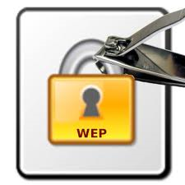
Problem
Packets still carry header information
Cleartext
Can be used to identify and track users
Solution: Slyfy
Use predetermined aliases
Encapsulating protocol

Slide 10
Discussion
Surprise
Deployment:
Different encryption mechanism
Cold start
Large reduction in throughput
De-emphasized, deal breaker
Wireless
Who does the sender trust?
Mechanism for distributing symmetric keys reveals too much?
Solved(?)

