Slide 1
15-446 Distributed Systems Spring 2009
L-15 Fault Tolerance

Slide 2
Fault Tolerance
Terminology & Background
Byzantine Fault Tolerance
Issues in client/server
Reliable group communication

Slide 3
Fault Tolerance
Being fault tolerant is strongly related to what are called dependable systems. Dependability implies the following:
Availability: probability the system operates correctly at any given moment
Reliability: ability to run correctly for a long interval of time
Safety: failure to operate correctly does not lead to catastrophic failures
Maintainability: ability to “easily” repair a failed system

Slide 4
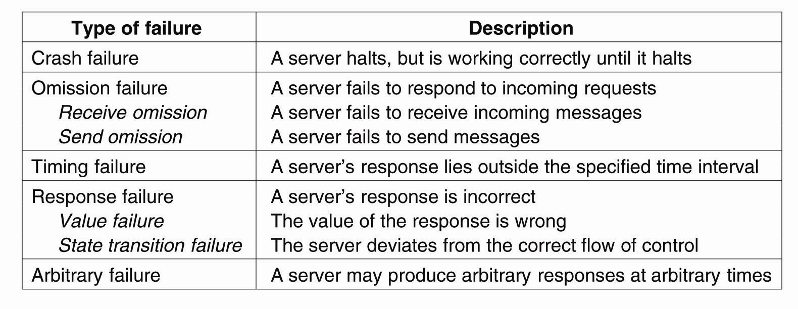
Failure Models
A system is said to fail if it cannot meet its promises. An error on the part of a system’s state may lead to a failure. The cause of an error is called a fault.

Slide 5
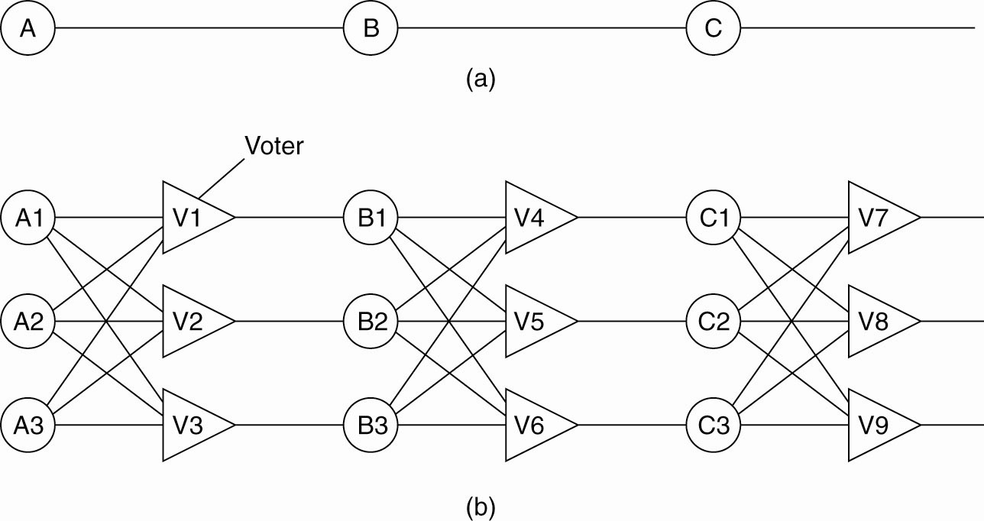
Failure Masking by Redundancy
Triple modular redundancy. For each voter, if two or three of the inputs are the same, the output is equal to the input. If all three inputs are different, the output is undefined.

Slide 6
Process Resilience - 1
The key approach to tolerating a faulty process is to use process groups:
This group can be thought of as an abstraction for a single “process”. Messages to the “process” are sent to the entire group.
Group membership can be dynamic
Need mechanisms for creating and destroying groups
Need mechanisms for adding and removing processes from groups
Many choices for the structure of the group

Slide 7
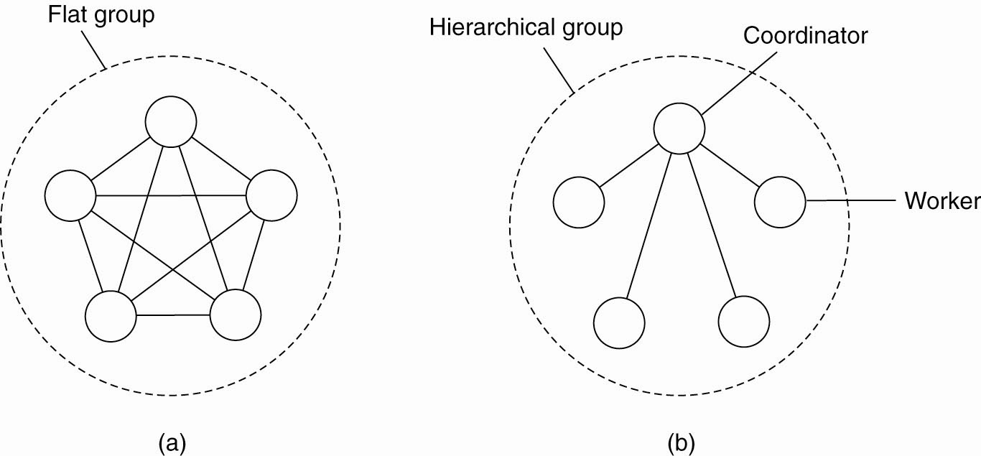
Flat Groups versus Hierarchical Groups
(a) Communication in a flat group.
(b) Communication in a simple hierarchical group.

Slide 8
Process Resilience - 2
Reaching agreement:
computation results
Electing a leader
synchronization
committing to a transaction
…
How much replication is necessary?
A system is k fault tolerant if it can survive faults in k components and still meet its specifications.

Slide 9
Agreement in Faulty Systems - 1
Many things can go wrong…
Communication
Message transmission can be unreliable
Time taken to deliver a message is unbounded
Adversary can intercept messages
Processes
Can fail or team up to produce wrong results
Agreement very hard, sometime impossible, to achieve!

Slide 10
Agreement in Faulty Systems - 2
Possible characteristics of the underlying system:
Synchronous versus asynchronous systems.
A system is synchronized if the process operation in lock-step mode. Otherwise, it is asynchronous.
Communication delay is bounded or not.
Message delivery is ordered or not.
Message transmission is done through unicasting or multicasting.

Slide 11
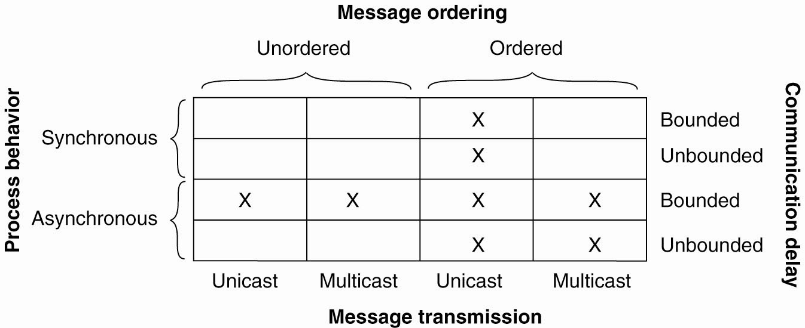
Agreement in Faulty Systems - 3
Circumstances under which distributed agreement can be reached. Note that most distributed systems assume that
processes behave asynchronously
messages are unicast
communication delays are unbounded (see red blocks)

Slide 12
Fault Tolerance
Terminology & Background
Byzantine Fault Tolerance
Issues in client/server
Reliable group communication

Slide 13
Agreement in Faulty Systems - 4
Byzantine Agreement [Lamport, Shostak, Pease, 1982]
Assumptions:
Every message that is sent is delivered correctly
The receiver knows who sent the message
Message delivery time is bounded

Slide 14
Agreement in Faulty Systems - 5
System of N processes, where each process i will provide a value v_{i} to each other. Some number of these processes may be incorrect (or malicious)
Goal: Each process learn the true values sent by each of the correct processes
Figure 8-5. The Byzantine agreement problem for three nonfaulty and one faulty process.

Slide 15
Byzantine General’s Problem
The Problem: “Several divisions of the Byzantine army are camped outside an enemy city, each division commanded by its own general. After observing the enemy, they must decide upon a common plan of action. Some of the generals may be traitors, trying to prevent the loyal generals from reaching agreement.”
Goal:
All loyal generals decide upon the same plan of action.
A small number of traitors cannot cause the loyal generals to adopt a bad plan.
The paper considers a slightly different version from the standpoint of one general (i.e. process) and multiple lieutenants.
Goal:
All loyal lieutenants obey the same order.
If the commanding general is loyal, the every loyal lieutenant obeys the order he sends.
Lamport, Shostak, Pease. The Byzantine General’s Problem. ACM TOPLAS, 4,3, July 1982, 382-401.

Slide 16
Impossibility Results
General 1
General 1
attack
attack
attack
retreat
General 2
General 3
General 2
General 3
retreat
retreat
No solution for three processes can handle a single traitor.
In a system with m faulty processes agreement can be achieved only if there are 2m+1 (more than 2/3) functioning correctly.
Lamport, Shostak, Pease. The Byzantine General’s Problem. ACM TOPLAS, 4,3, July 1982, 382-401.

Slide 17
Byzantine Agreement Algorithm (oral messages) - 1
Phase 1: Each process sends its value to the other processes. Correct processes send the same (correct) value to all. Faulty processes may send different values to each if desired (or no message).
Assumptions: 1) Every message that is sent is delivered correctly; 2) The receiver of a message knows who sent it; 3) The absence of a message can be detected.
Lamport, Shostak, Pease. The Byzantine General’s Problem. ACM TOPLAS, 4,3, July 1982, 382-401.

Slide 18
Byzantine General Problem Example - 1
Phase 1: Generals announce their troop strengths to each other
1
P1
P2
1
1
P3
P4

Slide 19
Byzantine General Problem Example - 2
Phase 1: Generals announce their troop strengths to each other
2
P1
P2
2
2
P3
P4

Slide 20
Byzantine General Problem Example - 3
Phase 1: Generals announce their troop strengths to each other
P1
P2
4
4
4
P3
P4

Slide 21
Byzantine Agreement Algorithm (oral messages) - 2
Phase 2: Each process uses the messages to create a vector of responses – must be a default value for missing messages.
Assumptions: 1) Every message that is sent is delivered correctly; 2) The receiver of a message knows who sent it; 3) The absence of a message can be detected.
Lamport, Shostak, Pease. The Byzantine General’s Problem. ACM TOPLAS, 4,3, July 1982, 382-401.

Slide 22
Byzantine General Problem Example - 4
Phase 2: Each general construct a vector with all troops
P1 | P2 | P3 | P4
1 | 2 | y | 4
P1 | P2 | P3 | P4
1 | 2 | x | 4
P1
P2
x
y
z
P1 | P2 | P3 | P4
1 | 2 | z | 4
P3
P4

Slide 23
Byzantine Agreement Algorithm (oral messages) - 3
Phase 3: Each process sends its vector to all other processes.
Phase 4: Each process the information received from every other process to do its computation.
Assumptions: 1) Every message that is sent is delivered correctly; 2) The receiver of a message knows who sent it; 3) The absence of a message can be detected.
Lamport, Shostak, Pease. The Byzantine General’s Problem. ACM TOPLAS, 4,3, July 1982, 382-401.

Slide 24
Byzantine General Problem Example - 5
Phase 3,4: Generals send their vectors to each other and compute majority voting
P1 | P2 | P3 | P4
1 | 2 | x | 4
e | f | g | h
1 | 2 | z | 4
P1 | P2 | P3 | P4
1 | 2 | y | 4
a | b | c | d
1 | 2 | z | 4
P1
P2
P1
P2
P3
P3
P4
P4
(a, b, c, d)
(1, 2, ?, 4)
(1, 2, ?, 4)
(e, f, g, h)
P1 | P2 | P3 | P4
1 | 2 | x | 4
1 | 2 | y | 4
h | i | j | k
(h, i, j, k)
P3
P4
P1
P2
P3
(1, 2, ?, 4)

Slide 25
Byzantine Agreement Algorithm (oral messages) - 4
Byzantine Agreement:
Note: This result only guarantees that each process receives the true values sent by correct processors, but it does not identify the correct processes!
Lamport, Shostak, Pease. The Byzantine General’s Problem. ACM TOPLAS, 4,3, July 1982, 382-401.

Slide 26
Byzantine Agreement Algorithm (signed messages)
Adds the additional assumptions:
A loyal general’s signature cannot be forged and any alteration of the contents of the signed message can be detected.
Anyone can verify the authenticity of a general’s signature.
Algorithm SM(m):
The general signs and sends his value to every lieutenant.
For each i:
If lieutenant i receives a message of the form v:0 from the commander and he has not received any order, then he lets Vi equal {v} and he sends v:0:i to every other lieutenant.
If lieutenant i receives a message of the form v:0:j1:…:jk and v is not in the set Vi then he adds v to Vi and if k < m, he sends the message v:0:j1:…:jk:i to every other lieutenant other than j1,…,jk
For each i: When lieutenant i will receive no more messages, he obeys the order in choice(Vi).
Algorithm SM(m) solves the Byzantine General’s problem if there are at most m traitors.
Lamport, Shostak, Pease. The Byzantine General’s Problem. ACM TOPLAS, 4,3, July 1982, 382-401.

Slide 27
Signed messages
General
General
attack:0
attack:0
attack:0
retreat:0
???
retreat:0:2
Lieutenant 1
Lieutenant 2
Lieutenant 1
Lieutenant 2
attack:0:1
attack:0:1
SM(1) with one traitor
Lamport, Shostak, Pease. The Byzantine General’s Problem. ACM TOPLAS, 4,3, July 1982, 382-401.

Slide 28
Fault Tolerance
Terminology & Background
Byzantine Fault Tolerance
Issues in client/server
Reliable group communication

Slide 29
Fault Tolerance in Client/Server Systems
Five different classes of failures that can occur in RPC systems:
The client is unable to locate the server. Can be dealt with at the client.
The request message from the client to the server is lost.
The server crashes after receiving a request.
The reply message from the server to the client is lost.
The client crashes after sending a request.

Slide 30
Lost Messages
The request message from the client to the server is lost.
The reply message from the server to the client is lost.
Timers at OS level can be used to detect lost messages.
From the client standpoint – these two cases look the same but they aren’t.
Idempotent messages aren’t a problem.
Client can safely re-issue a message that isn’t idempotent if there is some way (sequence numbers, stamps) for a server to detect the re-issue
Basically make them idempotent

Slide 31
Server Crashes (1)
A server in client-server communication. (a) The normal case. (b) Crash after execution. (c) Crash before execution.

Slide 32
Server Crashes (2)
No way for client to differentiate between the two crash cases (b) and (c).
How should client react? There several options:
At-least-once semantics– client keeps trying (sending messages) until a reply is received.
At-most-once semantics – client gives up
No guarantees

Slide 33
Server Crashes (3)
Consider scenario where a client sends text to a print server.
There are three events that can happen at the server:
Send the completion message (M),
Print the text (P),
Crash (C) – at recovery, send ‘recovery’ message to clients.
Server strategies:
send completion message before printing
send completion message after printing

Slide 34
Server Crashes (4)
These events can occur in six different orderings:
M →P →C: A crash occurs after sending the completion message and printing the text.
M →C (→P): A crash happens after sending the completion message, but before the text could be printed.
P →M →C: A crash occurs after sending the completion message and printing the text.
P→C(→M): The text printed, after which a crash occurs before the completion message could be sent.
C (→P →M): A crash happens before the server could do anything.
C (→M →P): A crash happens before the server could do anything.

Slide 35
Server Crashes (5)
Client strategies after a crash:
do nothing (i.e. do not re-issue request)
Always re-issue request
Re-issue only if request acknowledged
Re-issue only if request not acknowledged.

Slide 36
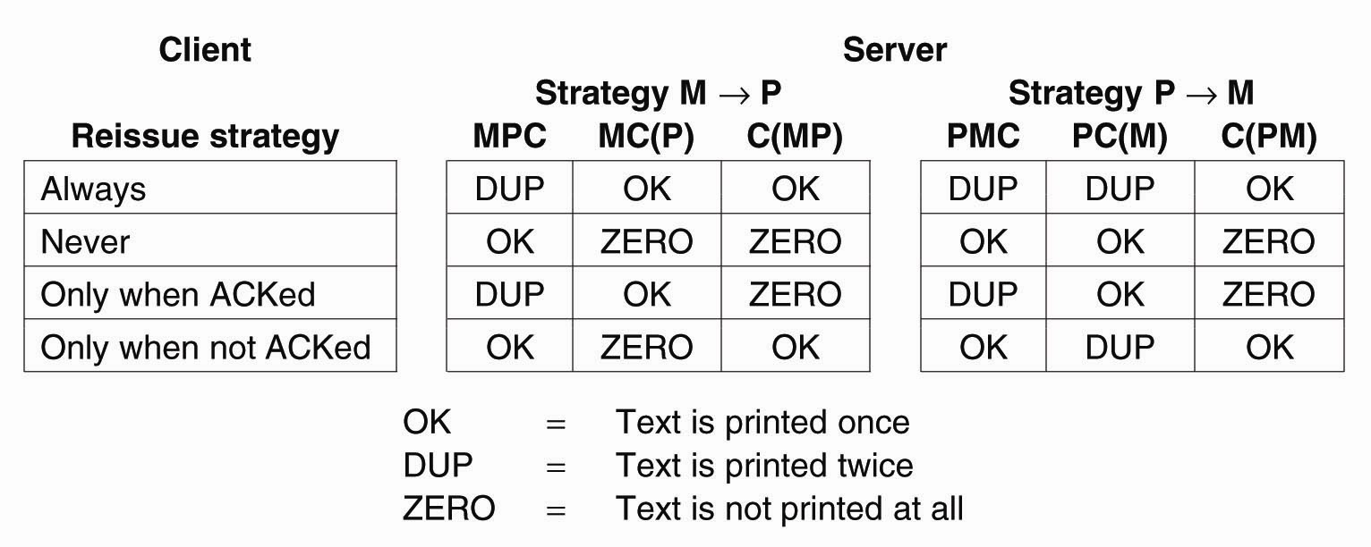
Server Crashes (6)
Different combinations of client and server strategies in the presence of server crashes.

Slide 37
Client Crashes
Can create orphans (unwanted computations) that waste CPU, potentially lock up resources and create confusion when client re-boots.
Nelson solutions:
Orphan Extermination – keep a log of RPCs at client that is checked at re-boot time to remove orphans.
Reincarnation – divide time into epochs. After a client re-boot, increment its epoch and kill off any of its requests belonging to an earlier epoch.
Gentle Reincarnation – at reboot time, an epoch announcement causes all machines to locate the owners of any remote computations.
Expiration – each RPC is given time T to complete (but a live client can ask for more time)
Nelson. Remote Procedure Call. Ph.D. Thesis, CMU, 1981.

Slide 38
Fault Tolerance
Terminology & Background
Byzantine Fault Tolerance
Issues in client/server
Reliable group communication

Slide 39
Reliable Group Communication
Can we guarantee that all members of a process group receive all messages delivered to that group?
Simplest solutions assume that we have a small number of processes in the group, processes do not fail, and the group does not change during message transmission.
Approaches that rely on feedback (acknowledgements) do not scale well
Will look at this later in semester

Slide 40
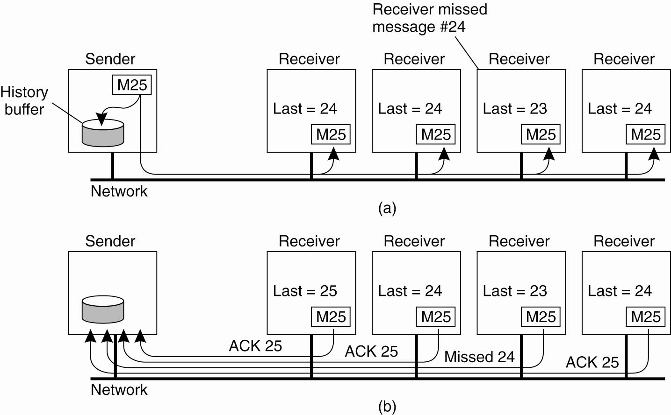
Basic Reliable-Multicasting Schemes
A simple solution to reliable multicasting when all receivers are known and are assumed not to fail
(a) Message transmission. (b) Reporting feedback.

Slide 41
Atomic Multicast
All messages are delivered in the same order to “all” processes
Group view: the set of processes known by the sender when it multicast the message
Virtual synchronous multicast: a message multicast to a group view G is delivered to all nonfaulty processes in G
If sender fails after sending the message, the message may be delivered to no one

Slide 42
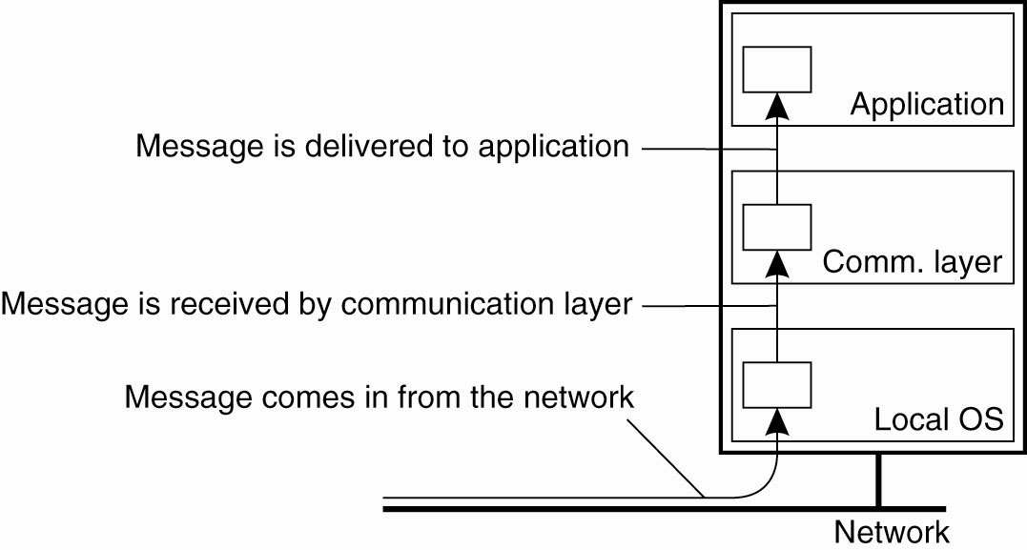
Virtual Synchrony (1)
Logical organization of a distributed system to distinguish between message receipt and message delivery.

Slide 43
Group communication
Group membership service
Provides an interface for group membership changes
Implements a failure detector
Notifies members of group membership changes
Group
address
expansion
Group
Leave
send
Multicast
Group membership
communication
Fail
management
Join
Process group

Slide 44
View delivery
A view reflects current membership of group
A view is delivered when a membership change occurs and the application is notified of the change
View-synchronous group communication
the delivery of a new view draws a conceptual line across the system and every message is either delivered on side or the other of that line

Slide 45
View-synchronous group communication
a (allowed).
b (allowed).
p crashes
p crashes
p
p
q
q
r
r
view (p, q, r)
view (q, r)
view (p, q, r)
view (q, r)
c (disallowed).
d (disallowed).
p crashes
p crashes
p
p
q
q
r
r
view (p, q, r)
view (q, r)
view (p, q, r)
view (q, r)

Slide 46
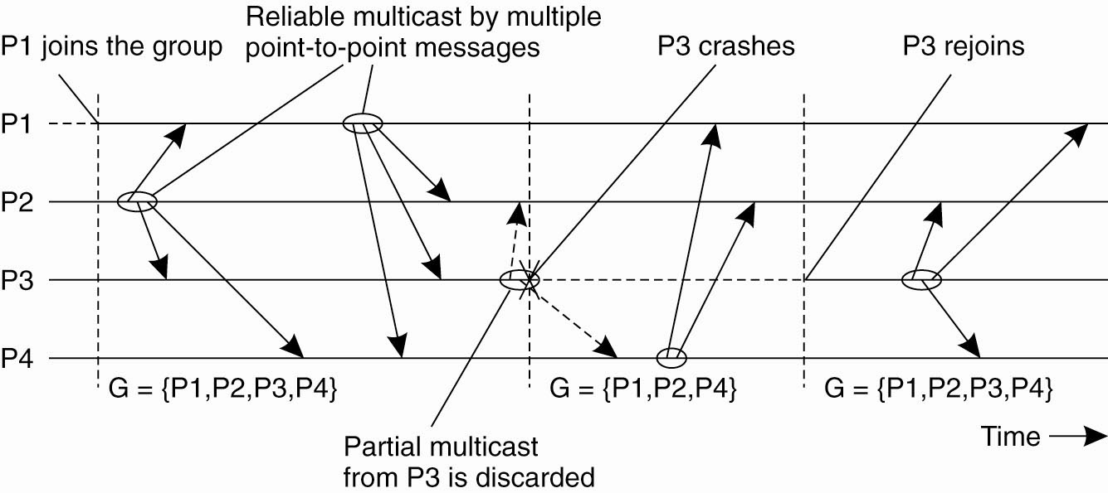
Virtual Synchrony (2)

Slide 47
Virtual Synchrony Implementation: [Birman et al., 1991]
Only stable messages are delivered
Stable message: a message received by all processes in the message’s group view
Assumptions (can be ensured by using TCP):
Point-to-point communication is reliable
Point-to-point communication ensures FIFO-ordering

Slide 48
Message Ordering (1)
Four different orderings are distinguished:
Unordered multicasts
FIFO-ordered multicasts
Causally-ordered multicasts
Totally-ordered multicasts
Atomicity (everyone sees same order) is an orthogonal property

Slide 49
Unordered Multicast
Figure 8-14. Three communicating processes in the same group. The ordering of events per process is shown along the vertical axis.

Slide 50
FIFO Multicast
Figure 8-15. Four processes in the same group with two different senders, and a possible delivery order of messages under FIFO-ordered multicasting

Slide 51
Virtual Synchrony Implementation: Example
G_{i} = {P1, P2, P3, P4, P5}
P5 fails
P1 detects that P5 has failed
P1 send a “view change” message to every process in G_{i+1} = {P1, P2, P3, P4}
P2
P3
P1
change view
P4
P5

Slide 52
Virtual Synchrony Implementation: Example
Every process
Send each unstable message m from Gi to members in G_{i+1}
Marks m as being stable
Send a flush message to mark that all unstable messages have been sent
unstable message
P2
P3
P1
flush
message
P4
P5

Slide 53
Virtual Synchrony Implementation: Example
Every process
After receiving a flush message from any process in G_{i+1} installs G_{i+1}
P2
P3
P1
P4
P5

Slide 54
Important Lessons
Terminology & Background
Failure models
Byzantine Fault Tolerance
Protocol design → with and without crypto
How many servers do we need to tolerate
Issues in client/server
Where do all those RPC failure semantics come from?
Reliable group communication
How do we manage group membership changes as part of reliable multicast

Slide 55
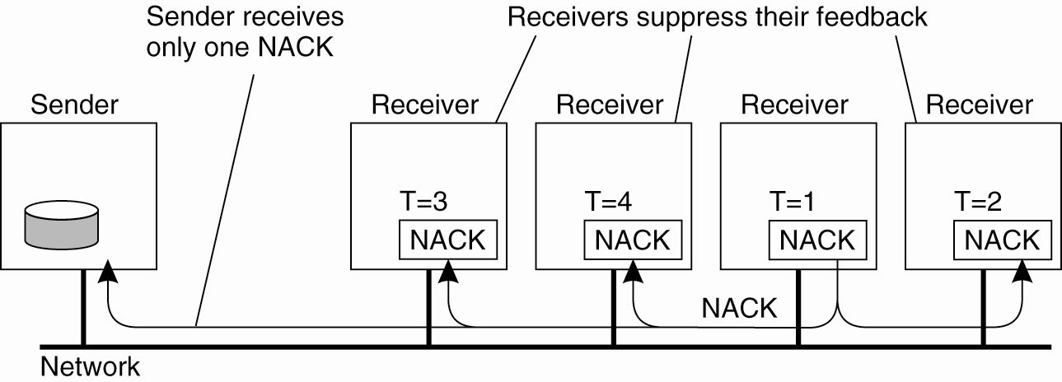
Scalable Reliable Group Communication - 1
Scalable Reliable Multicasting (SRM) – uses only negative acknowledgements
Several receivers have scheduled a request for retransmission, but the first retransmission request leads to the suppression of others.

Slide 56
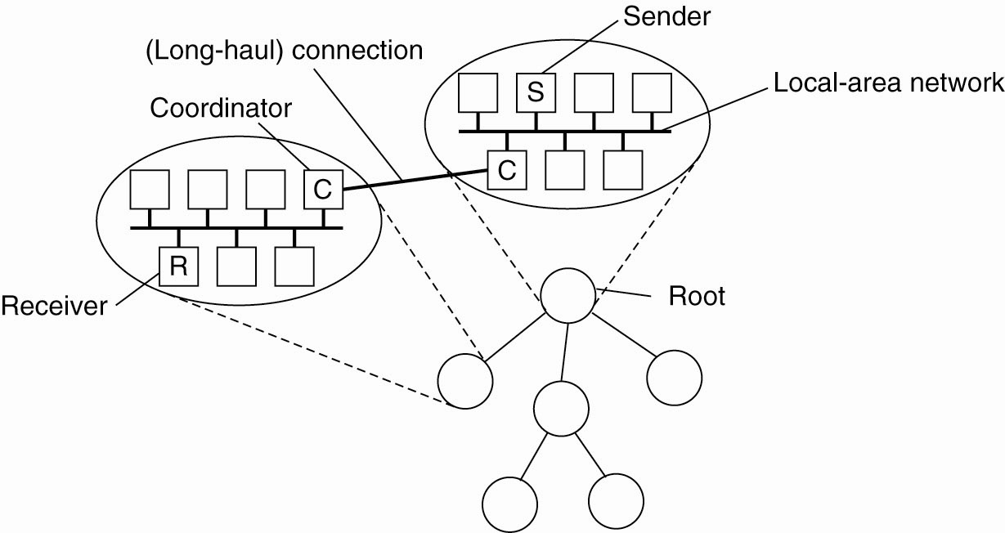
Scalable Reliable Group Communication - 2
The essence of hierarchical reliable multicasting. Each local coordinator forwards the message to its children and later handles retransmission requests.
Construction of the coordinator tree, which is typically done dynamically, is one of the main problems with implementing this approach.

Slide 57
Byzantine General’s Problem
Also in the paper:
Approximate agreement (ex: agreement on time or troop strength within a delta) – no impact on impossibility results
Case where not every process can send directly to every other process. Looks at both oral and signed messages.
Lamport, Shostak, Pease. The Byzantine General’s Problem. ACM TOPLAS, 4,3, July 1982, 382-401.

Slide 58
Agreement in Faulty Systems - 6
For other types of systems, agreement is impossible:
“No completely asynchronous consensus protocol can tolerate even a single unannounced process death.”
Fischer, Lynch. The Impossibility of Distributed Consensus with One Faulty Process. JACM, 32,2, April 1985, 374-382.

Slide 59
Agreement in Faulty Systems - 7
Processing is completely asynchronous: i.e. no assumptions about relative speed of processes or delays on message delivery.
Consensus problem:
Each process starts with an initial value {0,1}. A non-faulty process decides on a value {0,1} by entering an appropriate decision state.
All non-faulty processes that make a decision are required to choose the same value.
Processes are modeled as automata. In one step, a process can attempt to receive a message, perform a local computation on the basis of whether or not a message was delivered to it and send an arbitrary but finite set of messages to other processes.
Atomic broadcast assumed – if one non-faulty process receives a message, than all non-faulty processes do. Every message is eventually delivered as long as the destination processes makes infinitely many attempts to receive; however, messages can be delayed and delivered out of order.
agreement
Fischer, Lynch. The Impossibility of Distributed Consensus with One Faulty Process. JACM, 32,2, April 1985, 374-382.

