Slide 1
15-446 Distributed Systems Spring 2009
L-8 Synchronizing Physical Clocks

Slide 2
Announcements
Proj1 checkpoint – due midnight tonight
HW1 checkpoint – due 2/12

Slide 3
Last Lecture – RPC Important Lessons
Procedure calls
Simple way to pass control and data
Elegant transparent way to distribute application
Not only way…
Hard to provide true transparency
Failures
Performance
Memory access
Etc.
How to deal with hard problem → give up and let programmer deal with it
“Worse is better” (http://www.jwz.org/doc/worse-is-better.html) → implementation simplicity more important than interface simplicity

Slide 4
Today's Lecture
Need for time synchronization
Time synchronization techniques
Lamport

Slide 5
Clocks in a Distributed System
Computer clocks are not generally in perfect agreement
Skew: the difference between the times on two clocks (at any instant)
Computer clocks are subject to clock drift (they count time at different rates)
Clock drift rate: the difference per unit of time from some ideal reference clock
Ordinary quartz clocks drift by about 1 sec in 11-12 days. (10-6 secs/sec).
High precision quartz clocks drift rate is about 10-7 or 10-8 secs/sec
Notes:
Low batteries -> large drift rate

Slide 6
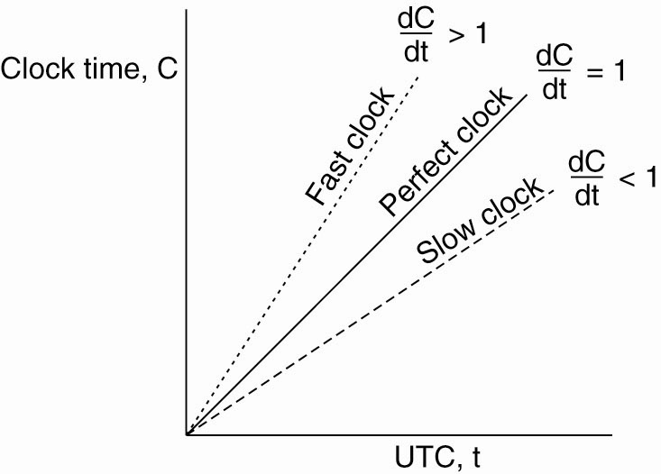
Clock Synchronization Algorithms
The relation between clock time and UTC when clocks tick at different rates.

Slide 7
Impact of Clock Synchronization
When each machine has its own clock, an event that occurred after another event may nevertheless be assigned an earlier time.

Slide 8
Need for Precision Time
Distributed database transaction journalling and logging
Stock market buy and sell orders
Secure document timestamps (with cryptographic certification)
Aviation traffic control and position reporting
Radio and TV programming launch and monitoring
Intruder detection, location and reporting
Multimedia synchronization for real-time teleconferencing
Interactive simulation event synchronization and ordering
Network monitoring, measurement and control
Early detection of failing network infrastructure devices and air conditioning equipment
Differentiated services traffic engineering
Distributed network gaming and training

Slide 9
Coordinated Universal Time (UTC)
International Atomic Time is based on very accurate physical clocks (drift rate 10⁻¹³)
UTC is an international standard for time keeping
It is based on atomic time, but occasionally adjusted to astronomical time
It is broadcast from radio stations on land and satellite (e.g. GPS)
Computers with receivers can synchronize their clocks with these timing signals
Signals from land-based stations are accurate to about 0.1-10 millisecond
Signals from GPS are accurate to about 1 microsecond
Why can't we put GPS receivers on all our computers?
Notes:
GPS does not work inside buildings

Slide 10
NTP Reference Clock Sources (1997 survey)
In a survey of 36,479 peers, found 1,733 primary and backup external reference sources
231 radio/satellite/modem primary sources
47 GPS satellite (worldwide), GOES satellite (western hemisphere)
57 WWVB radio (US)
17 WWV radio (US)
63 DCF77 radio (Europe)
6 MSF radio (UK)
5 CHU radio (Canada)
7 modem time service (NIST and USNO (US), PTB (Germany), NPL (UK))
25 other (precision PPS sources, etc.)
1,502 local clock backup sources (used only if all other sources fail)
For some reason or other, 88 of the 1,733 sources appeared down at the time of the survey

Slide 11
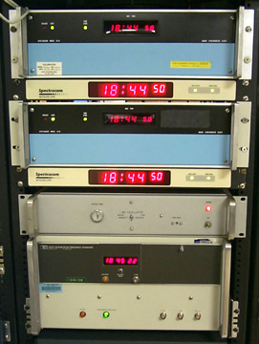
Udel Master Time Facility (MTF) (from January 2000)
Spectracom 8170 WWVB Receiver
Spectracom 8183 GPS Receiver
Spectracom 8170 WWVB Receiver
Spectracom 8183 GPS Receiver
Hewlett Packard 105A Quartz Frequency Standard
Hewlett Packard 5061A Cesium Beam Frequency Standard

Slide 12
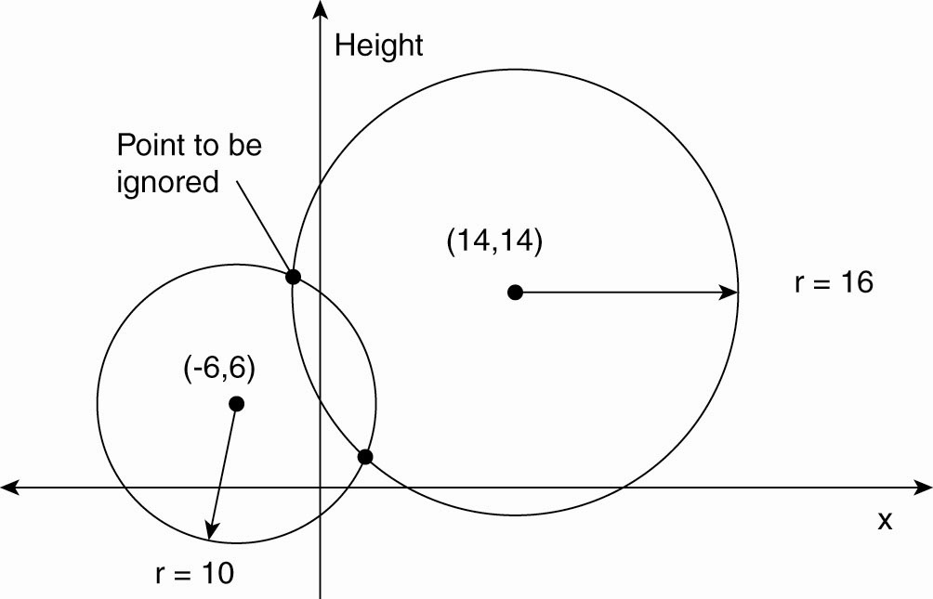
Global Positioning System (1)
Computing a position in a two-dimensional space.

Slide 13
Global Positioning System (2)
Real world facts that complicate GPS
It takes a while before data on a satellite’s position reaches the receiver.
The receiver’s clock is generally not in synch with that of a satellite.

Slide 14
Today's Lecture
Need for time synchronization
Time synchronization techniques
Lamport

Slide 15
Cristian’s Time Sync
A time server S receives signals from a UTC source
Process p requests time in m_{r} and receives t in m_{t} from S
p sets its clock to t + T_{round}/2
Accuracy ± (T_{round}/2 - min) :
because the earliest time S puts t in message m_{t} is min after p sent m_{r}.
the latest time was min before m_{t} arrived at p
the time by S’s clock when m_{t} arrives is in the range [t+min, t + T_{round} - min]
m
r
p
m
t
Time server,S
T_{round} is the round trip time recorded by p
min is an estimated minimum round trip time
Notes:
What is the potential problem in using a single time server?
The algorithm is probabilistic. Works if round trip times are shortB

Slide 16
Network Time Protocol (NTP)
A time service for the Internet - synchronizes clients to UTC
Reliability from redundant paths, scalable, authenticates time sources
Primary servers are connected to UTC sources
Secondary servers are synchronized to primary servers
Synchronization subnet - lowest level servers in users’ computers
1
2
2
3
3
3
Figure 10.3
Notes:
animates the points relaibility, primary and secondary servers

Slide 17
Server population by stratum (1997 survey)

Slide 18
Client population by stratum (1997 survey)

Slide 19
NTP - synchronisation of servers
The synchronization subnet can reconfigure if failures occur, e.g.
a primary that loses its UTC source can become a secondary
a secondary that loses its primary can use another primary
Modes of synchronization:
Multicast
A server within a high speed LAN multicasts time to others which set clocks assuming some delay (not very accurate)
Procedure call
A server accepts requests from other computers (like Cristiain’s algorithm). Higher accuracy. Useful if no hardware multicast.
Symmetric
Pairs of servers exchange messages containing time information
Used where very high accuracies are needed (e.g. for higher levels)

Slide 20
NTP Protocol
All modes use UDP
Each message bears timestamps of recent events:
Local times of Send and Receive of previous message
Local times of Send of current message
Recipient notes the time of receipt T_{i} (we have T_{i-3}, T_{i-2}, T_{i-1}, T_{i})
In symmetric mode there can be a non-negligible delay between messages
Server B
T
i
-2
T
i-1
Time
m
m'
Time
Server A
T
i
-
3
T
i
Notes:
Local times of Send and Receive of previous message
Local times of Send of current message
Recipient notes the time of receipt ( we have T_{i-3}, T_{i-2}, T_{i-1}, T_{i})
In symmetric mode there can be a non-negligible delay between messages

Slide 21
Accuracy of NTP
For each pair of messages between two servers, NTP estimates an offset o, between the two clocks and a delay d_{i} (total time for the two messages, which take t and t’)
T_{i-2} = T_{i-3} + t + o and T_{i} = T_{i-1} + t’ - o
This gives us (by adding the equations) :
d_{i} = t + t’ = T_{i-2} - T_{i-3} + T_{i} - T_{i-1}
Also (by subtracting the equations)
o = o_{i} + (t’ - t )/2 where o_{i} = (T_{i-2} - T_{i-3} + T_{i-1} - T_{i})/2
Using the fact that t, t’>0 it can be shown that
o_{i} - d_{i} /2 ≤ o ≤ o_{i} + d_{i} /2 .
Thus o_{i} is an estimate of the offset and d_{i} is a measure of the accuracy
NTP servers filter pairs <o_{i}, d_{i}>, estimating reliability from variation, allowing them to select peers
Accuracy of 10s of millisecs over Internet paths (1 on LANs)
Notes:
from the above: o-oi = (t’-t)/2
therefore |o-oi| = |t’-t|/2
now |t’-t| <= |t’+t| = di therefore |o-oi| <=di/2. i.e. o-oi<=dii/2 or o<oi+di/2
also -o+oi<= di/2 i.e. oi-di/2 <= o

Slide 22
How To Change Time
Can’t just change time
Why not?
Change the update rate for the clock
Changes time in a more gradual fashion
Prevents inconsistent local timestamps

Slide 23
Berkeley algorithm
Cristian’s algorithm -
a single time server might fail, so they suggest the use of a group of synchronized servers
it does not deal with faulty servers
Berkeley algorithm (also 1989)
An algorithm for internal synchronization of a group of computers
A master polls to collect clock values from the others (slaves)
The master uses round trip times to estimate the slaves’ clock values
It takes an average (eliminating any above some average round trip time or with faulty clocks)
It sends the required adjustment to the slaves (better than sending the time which depends on the round trip time)
Measurements
15 computers, clock synchronization 20-25 millisecs drift rate < 2x10⁻⁵
If master fails, can elect a new master to take over (not in bounded time)
•

Slide 24
The Berkeley Algorithm (1)
The time daemon asks all the other machines for their clock values.

Slide 25
The Berkeley Algorithm (2)
The machines answer.

Slide 26
The Berkeley Algorithm (3)
The time daemon tells everyone how to adjust their clock.

Slide 27
Clock Synchronization in Wireless Networks (1)
The usual critical path in determining network delays.

Slide 28
Clock Synchronization in Wireless Networks (2)
The critical path in the case of RBS.

Slide 29
Today's Lecture
Need for time synchronization
Time synchronization techniques
Lamport

Slide 30
Lamport’s Logical Clocks (1)
The "happens-before" relation → can be observed directly in two situations:
If a and b are events in the same process, and a occurs before b, then a → b is true.
If a is the event of a message being sent by one process, and b is the event of the message being received by another process, then a → b

Slide 31
Lamport’s Logical Clocks (2)
Three processes, each with its own clock. The clocks run at different rates.

Slide 32
Lamport’s Logical Clocks (3)
Lamport’s algorithm corrects the clocks.

Slide 33
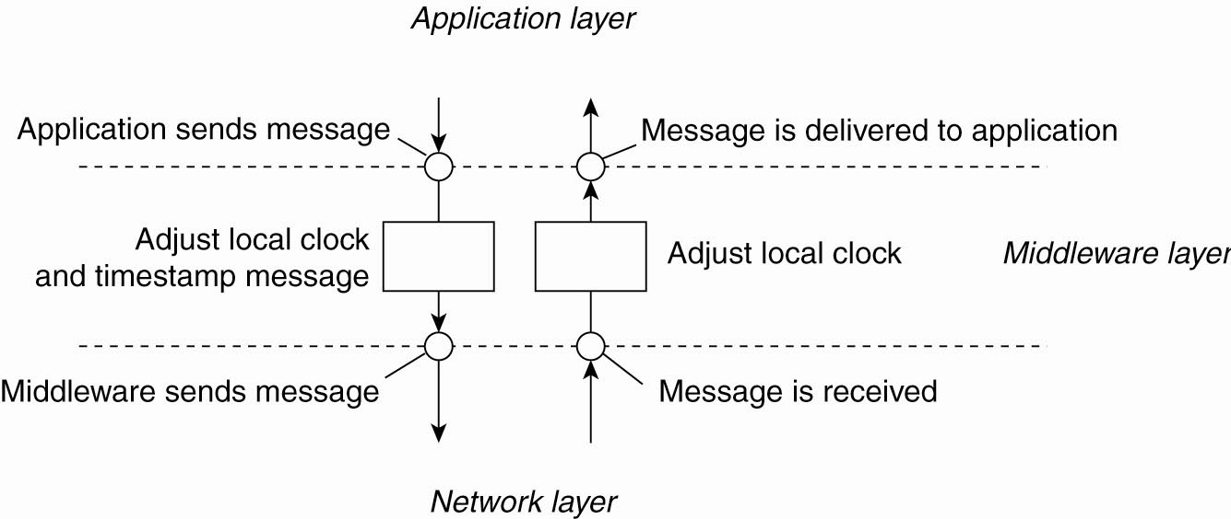
Lamport’s Logical Clocks (4)
The positioning of Lamport’s logical clocks in distributed systems.

Slide 34
Lamport’s Logical Clocks (5)
Updating counter C_{i} for process P_{i}
Before executing an event P_{i} executes C_{i} ← C_{i} + 1.
When process P_{i} sends a message m to P_{j}, it sets m’s timestamp ts (m) equal to C_{i} after having executed the previous step.
Upon the receipt of a message m, process P_{j} adjusts its own local counter as C_{j} ← max{C_{j} , ts (m)}, after which it then executes the first step and delivers the message to the application.

Slide 35
Important Lessons
Clocks on different systems will always behave differently
Skew and drift between clocks
Time disagreement between machines can result in undesirable behavior
Two paths to solution: synchronize clocks or ensure consistent clocks
Clock synchronization
Rely on a time-stamped network messages
Estimate delay for message transmission
Can synchronize to UTC or to local source

Slide 36
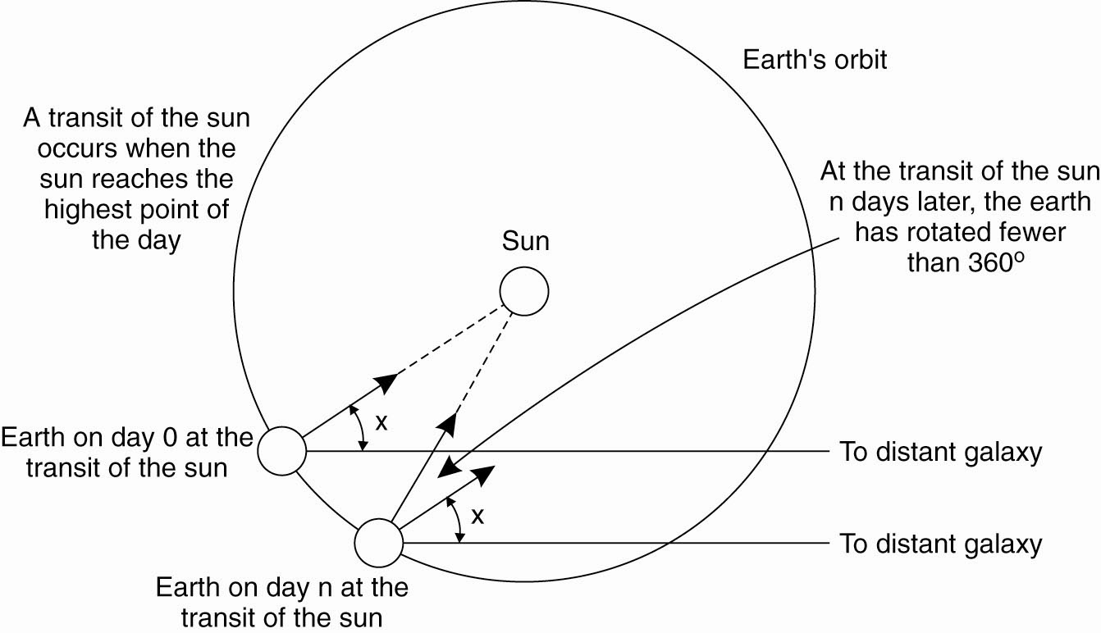
Physical Clocks (1)
Figure 6-2. Computation of the mean solar day.

Slide 37
Physical Clocks (2)
Figure 6-3. TAI seconds are of constant length, unlike solar seconds. Leap seconds are introduced when necessary to keep in phase with the sun.

