Slide 1
Brain-Implantable Computing Platforms for Emerging Neuroscience Applications
Ken Mai
Electrical and Computer Engineering
Carnegie Mellon University

Slide 2
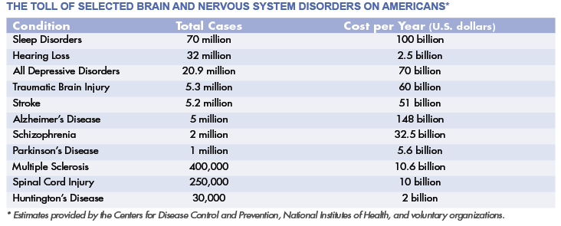
Brain and CNS Disorder Impact
Source: Society for Neuroscience
>50M Americans suffer from brain/CNS disorders
Annual cost of >$400B

Slide 3
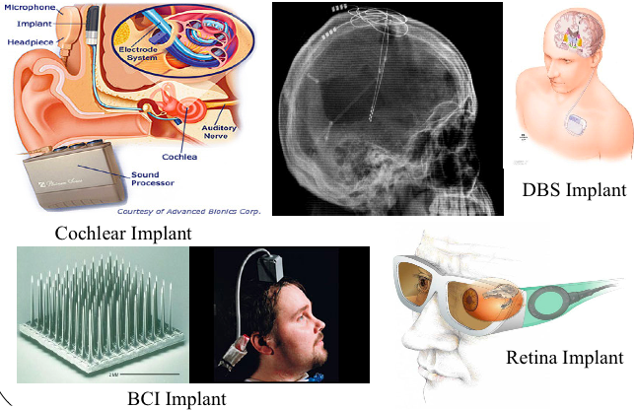
Current Bio-Implantable Devices

Slide 4
Current Bio-Implantable Devices
Wired communications and power delivery
  Prone to breakage, source of infection
External computation resources
  Minimal computation at implant = lots of communication
Custom hardware implementation
  High NRE costs, long design/verification time
Behind leading edge IC design technology
  Sub-optimal power/performance/efficiency/cost
Requires periodic replacement / servicing
  Significant user impact (e.g., annual major surgery)

Slide 5
Brain-Implantable Computing Platform
Wireless power delivery (mW range)
Wireless communication
Significant computation resources within implant
Cubic millimeter form-factor
Platform technology

Slide 6
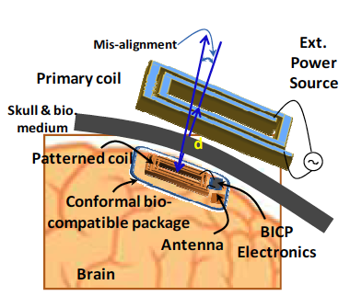
Brain-Implantable Computing Platform
Solution technologies
Algorithm / software / hardware co-design
3D chip integration
Modular architecture
Trans-threshold ckts
Sloppy computation
Inductive power delivery

Slide 7
Emerging Neuroscience Applications
Distributed therapeutic electrical brain stimulation
Brain-controlled functional electrical stimulation

Slide 8
Progress So Far …

Slide 9
The Team
Carnegie Mellon
G. Fedder
J. Hoe
X. Li
K. Mai
J. Paramesh
Y. Rabin
University of Pittsburgh
A. Cheng
T. Cui
A. Schwartz
R. Sclabassi
M. Sun
D. Weber
D. Whiting

Slide 10
ISCA Workshop
Workshop on Biomedicine in Computing:
Systems, Architectures, and Circuits
Austin, TX -- June 21, 2009
Held in conjunction with ISCA
Extended abstracts due April 10, 2009
http://www.engr.pitt.edu/act/bic2009/

Slide 12
Our Goals
Support wide range of neuroscience applications
Highly energy efficient operation
Wireless delivery of mWatt-level power
Minimal thermal effect on surrounding tissues
Efficient wireless communication to external devices and to a distributed system of BICPs
Cubic millimeter form-factor
Biocompatible packaging
Secure, reliable operation over multiple years

Slide 13
Workshop Topics
Architectures for bio-implantation
Architectures for interfacing to biological systems
Custom computing machines for the bioscience
Biologically inspired architectures
Computers constructed from biological building blocks
Workload characterization for biomedical applications
Design for bio-compatibility, reliability, and security

