Slide 1
Haptic and Tactile Sensors for Planetary Exploration Robots
sensing & sensors
CMU SCS RI 16722 S2009
M. Emre Karagozler
emre@cmu.edu
Version 5

Slide 2
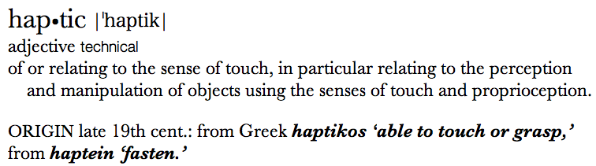
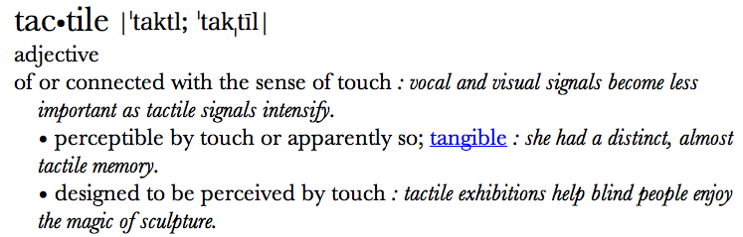
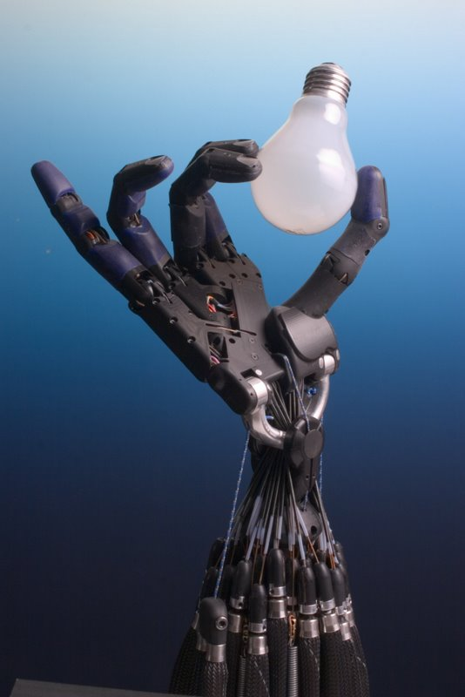
Haptics, Tactile Sensing:
In robotics, they are used in slightly different context:
  Tactile (sensor): “a device that measures parameters of a contact interaction between the device and some physical stimuli” [Nicholls and Lee, 1989]
Main application areas: cutaneous sensors, sensing fingers, soft materials, industrial robot grippers, multifingered hands, probes and whiskers, analysis of sensing devices, haptic perception, processing sensory data

Slide 3
Tactile Sensing:
What is sensed?
Deformation of bodies (strain) or fields (electric or magnetic).
  Through deformations, measure change of parameters, and find:
    Static texture, local compliance, or local shape
    Force (normal and/or shear) (indirect)
    Pressure
    Slippage
Categories of tactile sensing
  Simple contact
  Magnitude of force
  three-dimensional shape
  Slip
  Thermal properties

Slide 4
Tactile sensing: Methods of transduction
Usually an array of discrete sensing elements or a continuous sensitive medium with discrete sampling.
Sensing elements can be many types:
  On/Off: a simple switch
  Resistive: strain gauge, piezoresistive.
  Capacitive
  many other methods
  (magnetic, piezoelectric,
  thermal)

Slide 5
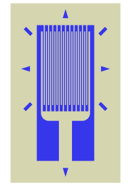
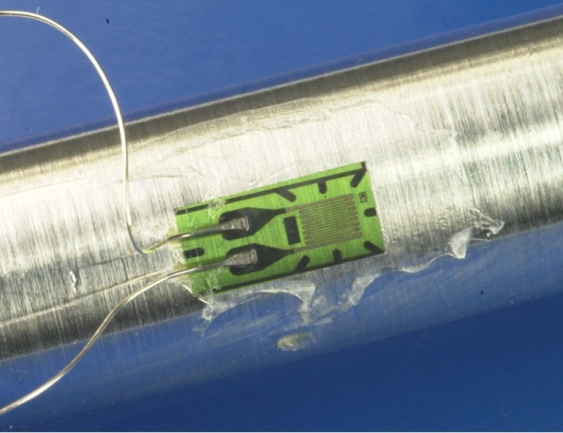
1) Resistance change elements:
One of the most common.
-Sensing element changes resistance when strained.
Strain gauge: a thin film with a metal pattern that changes resistance when strained.
Piezoresistive element.
Force changes shape = changes resistance
Resistance change is a result of both geometry change and resistivity change.
Advantages: very simple, good dynamic range, easy readout, durable,
Disadvantages: non-linearity, hysteresis, many wires
Strain gauge

Slide 6
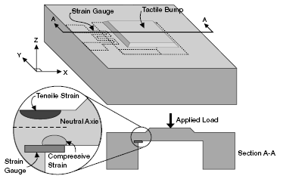
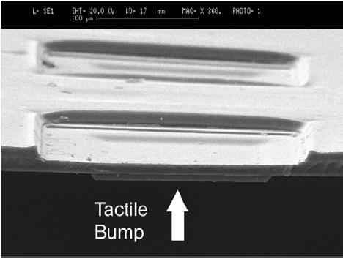
An example: resistive sensing
A polyimide based MEMS tactile sensor (10 x 10 array)
  MEMS diaphragm
  Strain gauge located where the diaphragm connects to the substrate.
  10 μm wide serpentine trace of NiCr in a 100 μm × 100 μm square area.
  Sensitivity is 0.61 Ω μm⁻¹, with good linearity (R² = 0.974).
[Engel, et al., “Development of Polyimide Flexible Tactile Sensor Skin”]
Notes:
University of Illinois, Urbana-Champagne, Journal of Microengineering. 2003

Slide 7
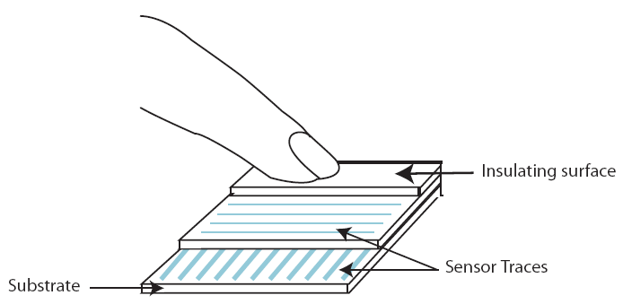
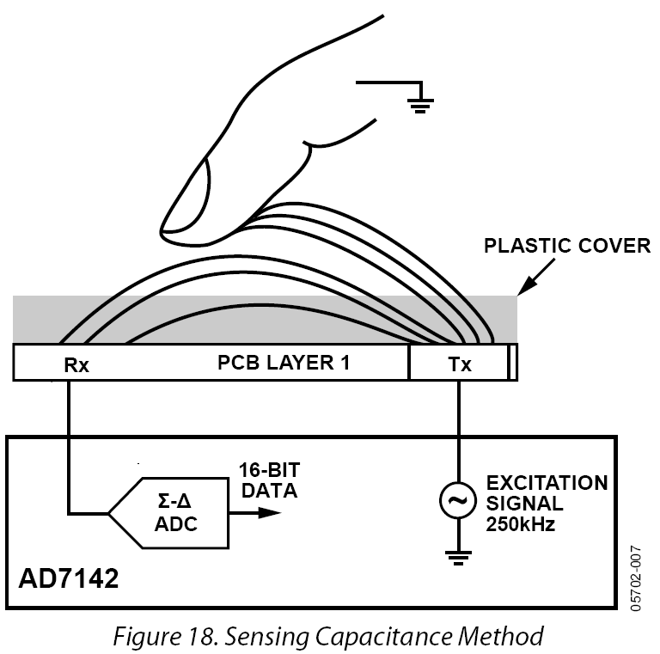
2) Capacitance change elements:
Main application area: touchpad!
2 Different sensing methods:
  Mechanically deform and change the capacitance of parallel conducting plates
  Or: sense the capacitance change due to stray fields (capacitance is increased)
  Touchpads are tuned to human skin!
Advantages: good dynamic range, linearity
Disadvantages: noise, measuring capacitance is hard! (compared to measuring resistance)
http://www.synaptics.com/sites/default/files/Capacitive_Resistive.pdf
http://www.analog.com/static/imported-files/data_sheets/AD7142.pdf

Slide 8
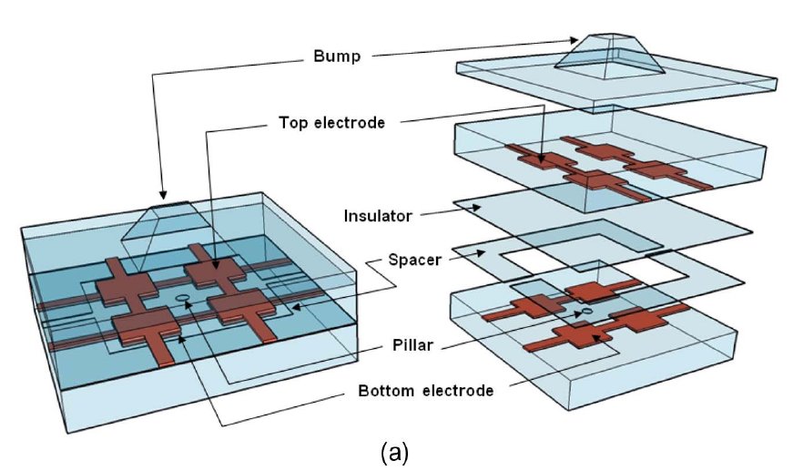
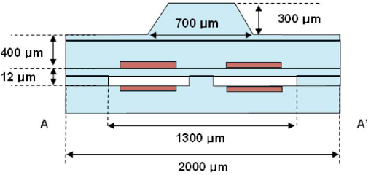
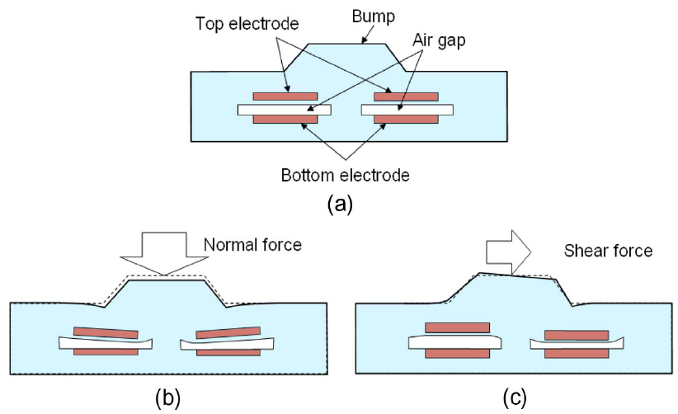
An example: capacitive sensing
An 8 x 8 array tactile sensor
  Polydimethylsiloxane (PDMS)
  Detect force of 10mN, 131kPa in all directions
  Flexible
  Sensitivity: 2.5%/mN, 3.0%/mN, and 2.9%/mN for the X, Y, and Z directions, respectively.
  (why not equal?)
[Lee, et al., “Normal and Shear Force Measurement Using a Flexible Polymer Tactile Sensor With Embedded Multiple Capacitors”]
Notes:
Journal of MEMS, 2008, University of Minesota.

Slide 9
Other sensing methods:
Piezoelectric: measure voltage created due to polarization under stress
Magnetic: use Hall effect to measure change in flux density
Optical, thermal, others

Slide 10
Assignment
We have a rectangular resistive block with dimensions
L x L x 2L, resistivity ρ, young’s modulus E, and a current source that produces I.
We want to use this resistive block as a tactile sensor to measure a force, F, with the voltage across this resistive block, V, being the output of the sensor.
How would you align the block with respect to the applied force, and which faces of the block would you use to make electrical contacts, so that the absolute value of the sensitivity of the sensor is maximum? What is the maximum sensitivity? (sensitivity = ∆V/∆F in Volts/Newtons)

Slide 11
Some Math for the Assignment
The resistance of a block is:
R = ρ L / A,
    ρ = Resistivity
    L = Length
    A = Cross sectional Area
Please assume that the volume of the block does not change.
(change in one dimension results in change in other dimensions, symmetrically)Assume force is orthogonal to the faces.
Assume percent change in dimensions is very small
A block is deformed under force F as:
∆ L / L₀ = F/ (E A₀)
    L₀ , A₀ = Original length and cross sectional Area
And finally:
    V= IR

Slide 12
Applications
There are many of them! A few examples:
  Robotic Grippers/Manipulators
    Fingertips of grippers or actuators
  Medical
    Rehabilitation and service robotics
    Minimally invasive surgery
  Consumer Electronics/Industrial
    Touch screen phones
Many tactile sensors are customized, so, built by research institutions for different purposes.

Slide 13
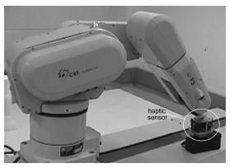
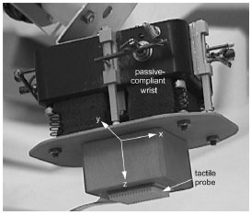
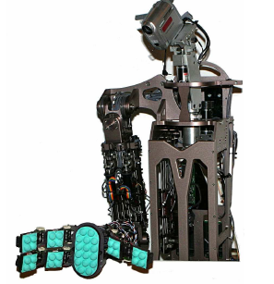
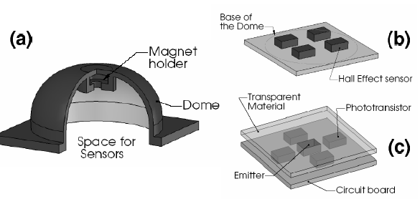
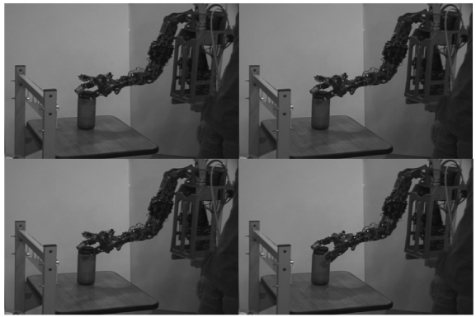
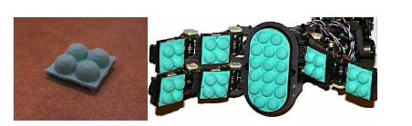
Application: Robotic manipulation
[Shadow Robot Company, England]
[Payeur, et al., “Intelligent Haptic Sensor System for Robotic Manipulation”]
[Torres-Jara, et al., “A soft touch: Compliant Tactile Sensors for Sensitive Manipulation”]

Slide 14
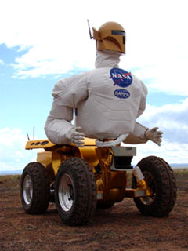
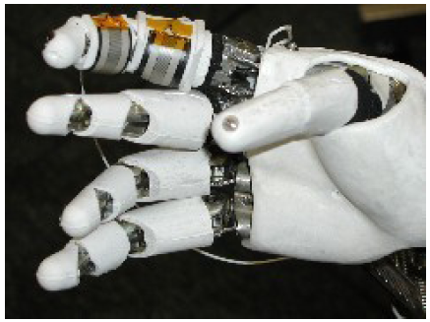
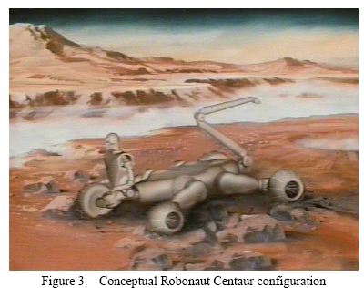
Application: Nasa’s Robonaut
One of the examples directly related to planetary exploration.
Nasa wants use this on the International Space Station, helping humans with repairing/maintenance tasks in cluttered environments.
They tried many tactile sensors (initially Force-Sensitive-Resistors(FSR), now Quantum Tunneling Composites (QTC))
[Martin, et al., “Tactile gloves for Autonomous Grasping with the NASA/DARPA Robonaut”]
http://en.wikipedia.org/wiki/Quantum_Tunneling_Composite

Slide 15
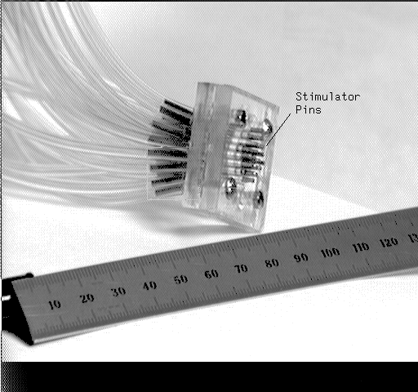
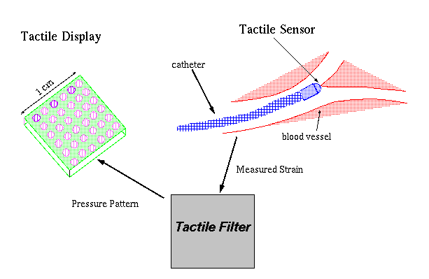
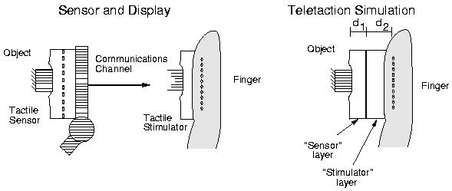
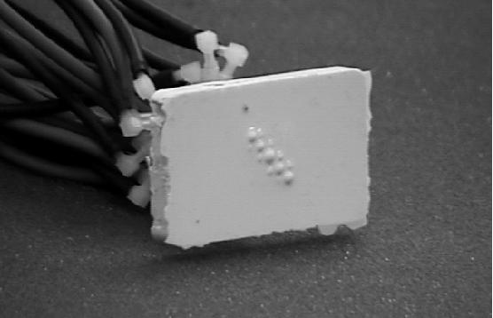
Application: Tactile Displays
The inverse problem:
  When the collected data is to be presented directly to human as touch, force feedback…
UC Berkeley’s tactile display: 5 x 5 array of pneumatic pins
  0.3 N per element, 3 dB point of 8 Hz, and 3 bits of force resolution
[Moy, et al., “A Compliant Tactile Display for Teletaction, ”]

Slide 16
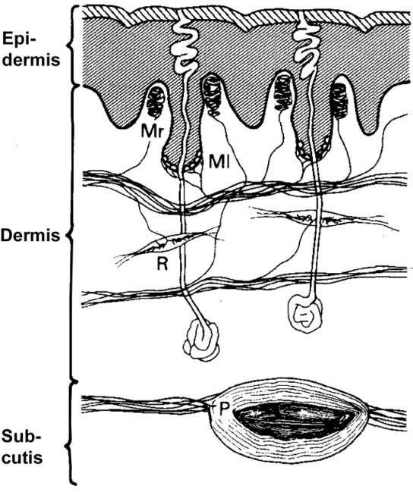
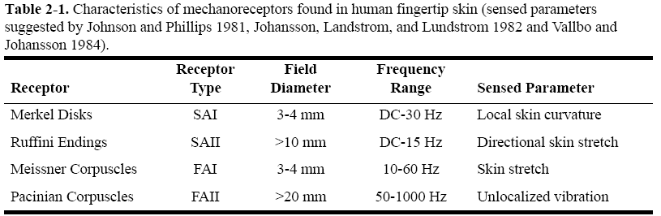
Human mechanoreception:
Understanding human touch is important because in the case of displays, it is an upper limit, in the case of sensors, it is a reference point.
“An ideal display requires 50 N/cm² peak pressure, 4 mm stroke, and 50 Hz bandwidth; that is, a power density of 10W/cm² with an actuator density of 1 per mm²”. [Moy, et al., “Human Psychophysics for Teletaction System Design” ]

Slide 17
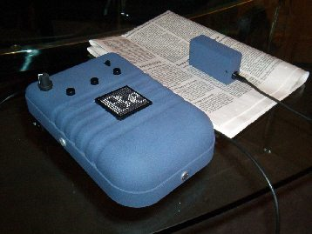
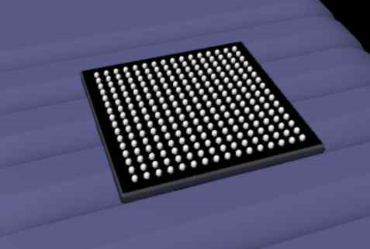
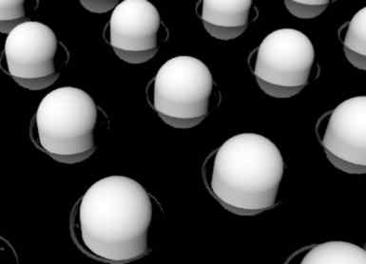
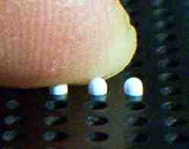
Application:
Tactile Displays for the blind
Display with 256 tactile dots on an area of 4 x 4 cm
Displays characters instead of Braille cells
Piezoelectric actuators
Can read from cell phone screen and show video (black-white)!
http://www.abtim.com/home__e_/home__e_.html

Slide 18
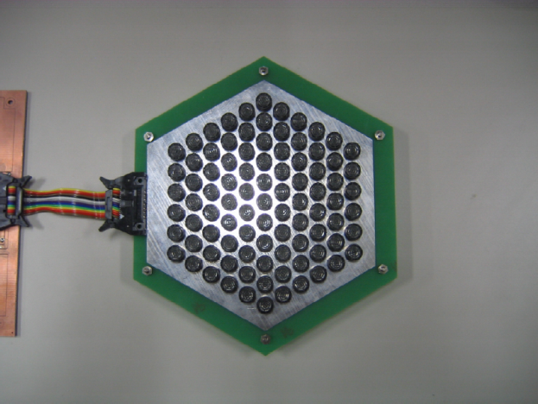
Application: Ultrasound tactile display
It creates and focuses ultrasonic pressure using 91 transducers. (no air flow, localized pressure)
20 Pa at 300 mm, at 40kHz
“Now we are developing a 3D interaction system which enables its users to handle 3D graphic objects with tactile feedbacks without any gloves or wearable devices.”
I think it means “variable or multiple focal points”
[Iwamoto, et al., "Non-Contact Method for Producing Tactile Sensation Using Airborne Ultrasound," Proc. EuroHaptics 2008, LNCS 5024, pp. 504-513, June, 2008.”]
http://www.youtube.com/watch?v=hSf2-jm0SsQ&eurl=http://www.alab.t.u-tokyo.ac.jp/~siggraph/08/Tactile/SIGGRAPH08-Tactile.html&feature=player_embedded
Notes:
SinodaLab , U of Tokyo, Japan

Slide 19
Application: Ultrasound tactile display
[Iwamoto, et al., "Non-Contact Method for Producing Tactile Sensation Using Airborne Ultrasound," Proc. EuroHaptics 2008, LNCS 5024, pp. 504-513, June, 2008.”]
http://www.youtube.com/watch?v=hSf2-jm0SsQ&eurl=http://www.alab.t.u-tokyo.ac.jp/~siggraph/08/Tactile/SIGGRAPH08-Tactile.html&feature=player_embedded
Notes:
SinodaLab , U of Tokyo, Japan

Slide 20
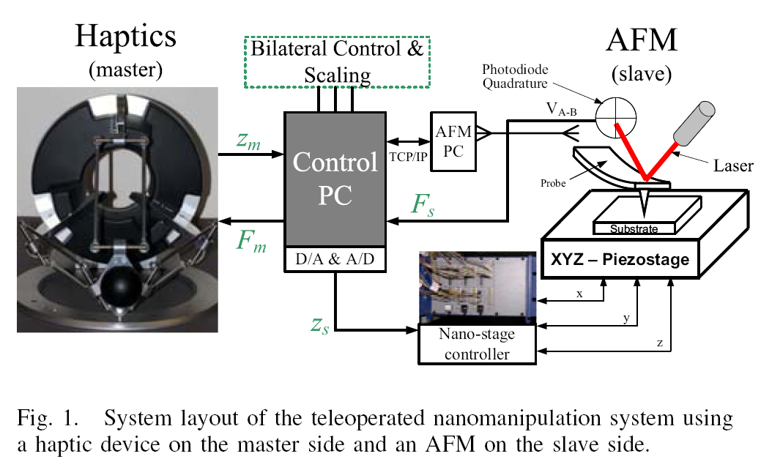
Application: A haptic system;
Tele-nano-manipulation
From NanoRobotics Lab at CMU.
A combination of a sensor (AFM) and a robotic device for human interaction
An atomic force microscope scans the specimen, and interfaces to the human as force feedback, using a robotic arm (Force Dimension Inc.)
[Onal, et al., "A Scaled Bilateral Control System for Experimental 1-D Teleoperated Nanomanipulation Applications," IEEE/RSJ Int. Conf. on Intelligent Robots and Systems, pp. 483-488, October 2007]

Slide 21
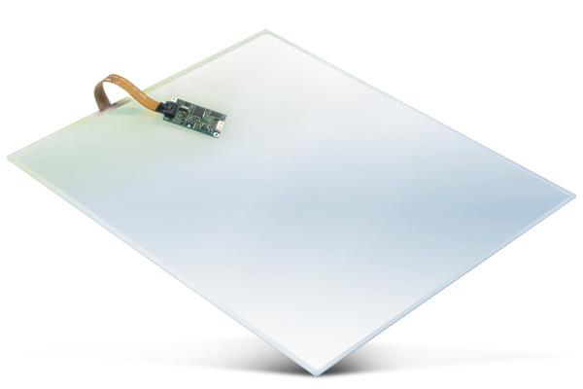
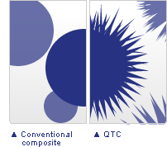
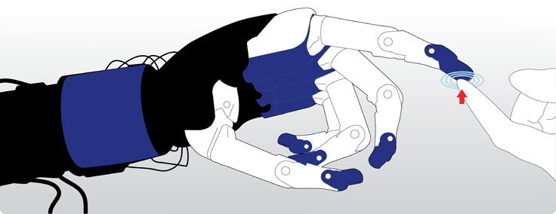
Some commercial tactile sensors you can buy today (1)
Elo Touchsystems (Tyco Electronics):
  Touch screens for kiosks, ATMs, etc…
  Positional accuracy ≈ 5mm
  Price ≈ 100$ - 300$ for (10” x 12”)
  Capacitive, resistive, acoustic…
  http://www.elotouch.com/Products/Touchscreens/default.asp
Peratech, Ltd., in Durham, England
  Quantum Tunneling Composite
  Pressure switching and sensing material technology
  Unstressed Resistance ≈ 10¹²Ohms , Under Stress ≈ 1 Ohm
  Flexible, durable, easily integrated sheets
  More sensitive than Force-Sensitive-Resistor
  (metal particles with spikes!)
  http://www.peratech.com/index.php

Slide 22
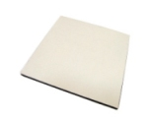
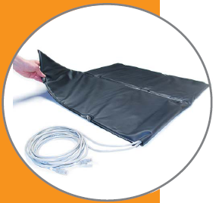
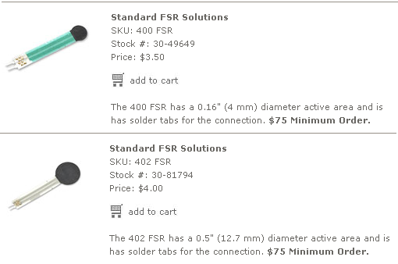
Some commercial tactile sensors you can buy today (2)
Tactex Array and multi touch interfaces
  Optical tactile sensor – Fiber optic sensor pad
  Photo transmitter receiver embedded in a foam
  Rigid or Flexible
  100 to 600 sensing elements
  Letter-size to mattresses for sleep monitoring
  http://www.tactex.com/
Interlink Electronics
  Touchpads and Force-Sensitive-Resistors (FSR)
  Price < 5$ for each FSR unit
Shadow Robot Company

Slide 23
Directions for Future Research
Flexible substrates for skin-like tactile sensors? Seems like there are many publications related to the fabrication of sensors on flexible (and conformal) substrates.
Materials with different surface properties (durable, self cleaning)
Different display mediums (acoustic)
Slip Sensing (detecting how it initiates)

Slide 24
Researchers
Chang Liu, University of Illinois, Urbana-Champagne.
  Flexible tactile sensor skin
  (The author of a famous MEMS book)
Ron Fearing, UC Berkeley
  Tactile Sensor/Display for Teletaction
S. Payandeh, Simon Fraser University, Burnaby, Canada
  Tactile Sensor for an Endoscopic Grasper

Slide 25
Labs that work on tactile sensing and Haptics
There are many groups in Japanese robotics industry and academia.
MIT, Touch Lab, Artificial Intelligence Laboratory.
The Haptics Laboratory at McGill University.
Tactile Research Laboratory at The Naval Aerospace Medical Research Laboratory
Haptics Laboratory, Johns Hopkins University

Slide 26
References (1)
Provancher, W. R. 2003. On Tactile Sensing and Display, Ph.D. Thesis, Department of Mechanical Engineering, Stanford University.
Hyung-Kew Lee; Jaehoon Chung; Sun-Il Chang; Euisik Yoon, "Normal and Shear Force Measurement Using a Flexible Polymer Tactile Sensor With Embedded Multiple Capacitors," Microelectromechanical Systems, Journal of , vol.17, no.4, pp.934-942, Aug. 2008
URL: http://ieeexplore.ieee.org/stamp/stamp.jsp?arnumber=4558019&isnumber=4585407
Legnemma, K.; Brooks, C.; Dubowsky, S., "Visual, tactile, and vibration-based terrain analysis for planetary rovers," Aerospace Conference, 2004. Proceedings. 2004 IEEE , vol.2, no., pp. 841-848 Vol.2, 6-13 March 2004
URL: http://ieeexplore.ieee.org/stamp/stamp.jsp?arnumber=1367684&isnumber=29901
Martin, T.B.; Ambrose, R.O.; Diftler, M.A.; Platt, R., Jr.; Butzer, M.J., "Tactile gloves for autonomous grasping with the NASA/DARPA Robonaut," Robotics and Automation, 2004. Proceedings. ICRA '04. 2004 IEEE International Conference on , vol.2, no., pp. 1713-1718 Vol.2, April 26-May 1, 2004
URL: http://ieeexplore.ieee.org/stamp/stamp.jsp?arnumber=1308071&isnumber=29025
Walker, S. P. and Salisbury, J. K. 2003. Large haptic topographic maps: marsview and the proxy graph algorithm. In Proceedings of the 2003 Symposium on interactive 3D Graphics (Monterey, California, April 27 - 30, 2003). I3D '03. ACM, New York, NY, 83-92. DOI= http://doi.acm.org/10.1145/641480.641499
Onal, et al., "A Scaled Bilateral Control System for Experimental 1-D Teleoperated Nanomanipulation Applications," IEEE/RSJ Int. Conf. on Intelligent Robots and Systems, pp. 483-488, October 2007.

Slide 27
References (2)
Martin, T.B.; Ambrose, R.O.; Diftler, M.A.; Platt, R., Jr.; Butzer, M.J., "Tactile gloves for autonomous grasping with the NASA/DARPA Robonaut," Robotics and Automation, 2004. Proceedings. ICRA '04. 2004 IEEE International Conference on , vol.2, no., pp. 1713-1718 Vol.2, April 26-May 1, 2004
URL: http://ieeexplore.ieee.org/stamp/stamp.jsp?arnumber=1308071&isnumber=29025
Development of polyimide flexible tactile sensor skin, Engel, Jonathan; Chen, Jack; Liu, Chang. Journal of Micromechanics and Microengineering, Volume 13, Issue 3, pp. 359-366 (2003).
Payeur, P.; Pasca, C.; Cretu, A.-M.; Petriu, E.M., "Intelligent haptic sensor system for robotic manipulation," Instrumentation and Measurement, IEEE Transactions on , vol.54, no.4, pp. 1583-1592, Aug. 2005
URL: http://ieeexplore.ieee.org/stamp/stamp.jsp?arnumber=1468573&isnumber=31498
Torres-Jara, E., Vasilescu, I., and Coral, R. (2006). A soft touch: Compliant tactile sensors for sensitive manipulation. Technical Report MITCSAIL-TR-2006-014, MIT-CSAIL, 32 Vassar St. Cambridge, MA 02319, USA.
Moy, G.; Wagner, C.; Fearing, R.S., "A compliant tactile display for teletaction," Robotics and Automation, 2000. Proceedings. ICRA '00. IEEE International Conference on , vol.4, no., pp.3409-3415 vol.4, 2000
URL: http://ieeexplore.ieee.org/stamp/stamp.jsp?arnumber=845247&isnumber=18314
Human Psychophysics for Teletaction System Design G. Moy, U. Singh, E. Tan, and R.S. FearingHaptics-e The Electronics Journal of Haptics Research Vol. 1, No. 3, February, 18, 2000.

