Slide 1
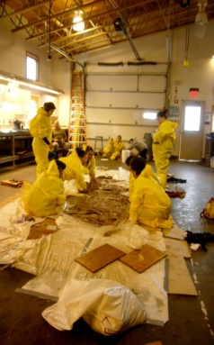
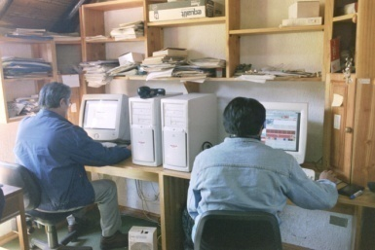
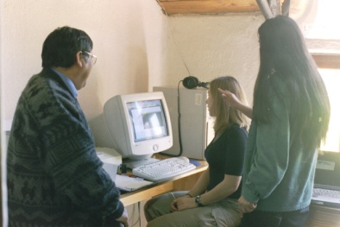
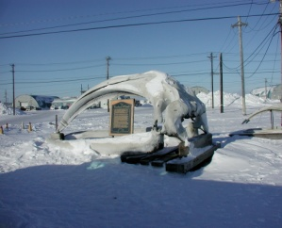
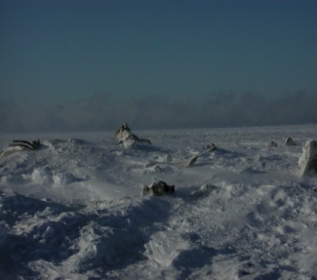
Adaptable, Community Controlled Language Technologies
Lori Levin
Language Technologies Institute
Carnegie Mellon University
Pictures by Rodolfo Vega
Pictures by Laura Tomokiyo

Slide 2
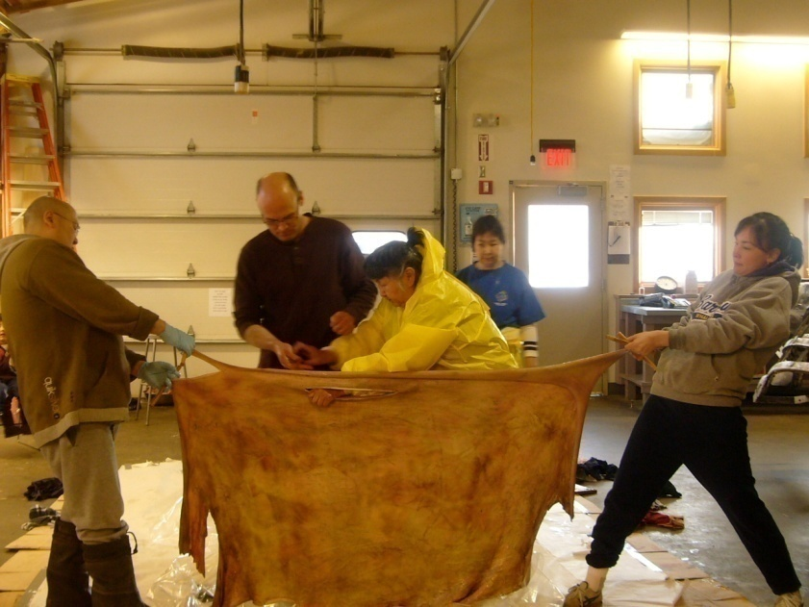
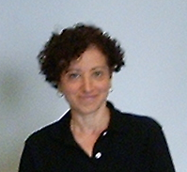
The double life of an endangered language researcher
Researchers urgently need to try new things.
[endangered [language researcher]]
  Speakers of endangered languages urgently need tools that work.
[[endangered language] researcher]
Picture by Laura Tomokiyo

Slide 3
Outline
The needs of language communities
The AVENUE project’s experience with:
  Iñupiaq (Alaska)
  Mapudungun (Chile)

Slide 4
Suggested Research Program
Beyond bootstrapping from low resources
    Genre and register adaptation
    Translation between related languages and dialects
    Non-synchronous grammars in order to handle extreme agglutination and polysynthesis
    Technologies based on mobile phones
    New techniques: Learning in the wild (in the context of use), active learning, self training, etc.

Slide 5
Endangered Languages
Around 6000 human languages are currently spoken
90% are not expected to survive the next century
  In the US, about 200 indigenous languages are still spoken
  Only a few will survive the next 30 years (Noori p.c.)

Slide 6
Importance of Endangered Languages
Cultural loss
  Stories, songs, ethnic identity
Scientific loss
  The study of human language will suffer from losing 90% of the samples
Another kind of scientific loss
  Names of places, geological formations, plants, animals, etc.

Slide 7
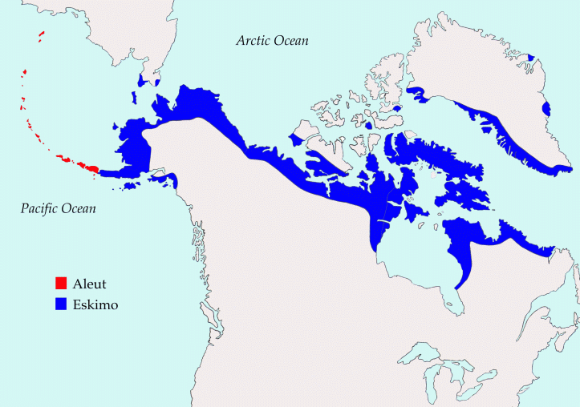
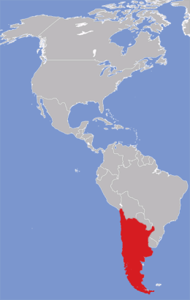
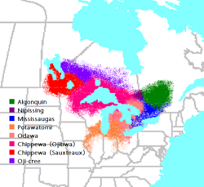
Three Language Communities
North Slope Iñupiat (Alaska)
  Edna MacLean (linguist, lexicographer, native speaker)
  Larry Kaplan (linguist, Alaska Native Language Center, University of Alaska, Fairbanks)
  Aric Bills (linguistics student, UAF)
Mapuche (Chile, Argentina)
  Rosendo Huisca (language expert, lexicographer, native speaker)
  Eliseo Cañulef (bilingual education and language maintenance)
Anishinaabe (Ojibwe, Potawatame, Odawa) (Great Lakes)
  Margaret Noori (linguist, language revitalization)

Slide 8
Other sources of information
Delyth Prys
  Welsh, Native speaker
  Language technologies developer, terminologist, language revitalization
Jonathan Amith
  Nahuatl (Mexico), Anthropologist, linguist
  Language technologies developer
Per Langgaard
  Kalaallisut (Greenland), Greenlandic Government
  Language technologies developer

Slide 9
North Slope Iñupiat
Language: North Slope Iñupiaq
About 5000 people
Almost all native speakers are over 40 years old
Some bilingual education and second language education
Status: endangered
  Related to languages whose status is better: Inuktitut (Canada), Kalaallisut (Greenland)
  Related to languages that are also endangered: Kobuk Pass Inupiaq.

Slide 10
Properties of Iñupiaq
(From notes by Lawrence Kaplan)
vowels: a i u aa ii uu ai ia au ua iu ui
consonants:
p t ch k q ‘
(f) ł ł s sr kh (x) qh (X) h
v l ļ z y g (ɣ) ġ (ʁ)
m n ñ ŋ

Slide 11
Properties of Iñupiaq
Word structure
Stem (noun or verb) – postbase/s (optional) – inflection –enclitic (optional)
Niġi – ñiaq – tu(q) – guuq.
Eat - will - s/he – it is said
“It is said that s/he will eat.’

Slide 12
Properties of Iñupiaq
Dual Number
  Niġi-ruŋa.
  ‘I am eating’ or ‘I ate.’ (singular)
  Niġi-ruguk.
  ‘We₂ are eating.’ or ‘We₂ ate.’ (dual)
  Niġi-rugut.
  ‘We are eating. or ‘We ate.’ (plural)

Slide 13
Properties of Iñupiaq
Ergative Case (transitive sentences)
  Aŋuti-m tuttu niġi-gaa.
  Man-Rel. caribou-Abs. eat-trans. 3s-3s
  ‘The man ate/is eating caribou.’
  Tuttu-m aŋun niġi-gaa.
  caribou-Rel. man-Abs. eat-trans. 3s-3s
  ‘The caribou ate the man.’

Slide 14
Properties of Iñupiaq
Anti-passive (indefinite object)
  Tuttu-mik tautuk-tuŋa.
  ‘I ate caribou.’ or ‘I am eating caribou.’
  Aŋuti-m tuttu niġi-gaa.
  Man-Rel. caribou-Abs. eat-trans. 3s-3s
  ‘The man ate/is eating caribou.’

Slide 15
Properties of Iñupiaq
Long, multi-morphemic words
  Tauqsiġñiaġviŋmuŋniaŋitchugut.
  ‘We won’t go to the store.’
Kalaallisut (Greenlandic, Per Langgaard, p.c.)
  Pittsburghimukarthussaqarnavianngilaq
  Pittsburgh+PROP+Trim+SG+kar+tuq+ssaq+qar+naviar+nngit+v+IND+3SG
  "It is not likely that anyone is going to Pittsburgh"

Slide 16
Type token curves

Slide 17
Type token ratio curves

Slide 18
Iñupiaq Orthography and Fonts
Spelling and orthography are standardized
Roman alphabet with 12 additional characters
Some community members want to change the 12 characters to digraphs for text messaging
Non-uniformity in fonts and character representations
  Ascii and Unicode

Slide 19
Mapuche
Language: Mapudungun
  Varieties in Chile: Pewenche, Lafkenche, Nguluche, Huilliche
440,000 speakers, including children
  Everyone is bilingual in Spanish
Huilliche is endangered
  Less than 100 speakers, all older (Pilar Alvarez, p.c.)
Chilean Ministry of Education is committed to bilingual education
Considerable Web presence in the last few years
  Proposal for Wikipedia in Mapudungun

Slide 20
Properties of Mapudungun
(Zúñiga 2000)
 | labial | interdental | dental | alveolar | palatal | retroflex | velar
plosive | p |  | t | t |  |  | k
fricative | f | d |  | s
affricate |  |  |  |  | ch | tr
nasal | m |  | n | n | ñ |  | ng
liquid |  |  | l | l | ll | r
glide | w |  |  |  | y |  | g

Slide 21
Properties of Mapudungun
 | prounoun | Verb (walk)
1sg | inche | trekan
1du | inchiu | trekayu
1pl | iñchiñ | trekaiñ
2sg | eymi | trekaymi
2du | eymu | trekaymu
2pl | eymün | trekaymün
3sg | fey | trekay
3du | feyegu | trekay egu, amuyngu (go)
3pl | feyegün | Trekay egün, amuyngün (go)
Pilar Alvarez p.c.; Zúñiga 2000

Slide 22
Properties of Mapudungun
Inverse agreement (Zúñiga 2000)
  Pe –fi –ñ Juan.
  See 3obj 1sg Juan
  “I saw Juan”
  Kallfüpan engu Antüpan kellu –e –n –ew
  Calfupán and Antipán help -inverse -1sg – loc
  “Calfupán and Antipán helped me”

Slide 23
Properties of Mapudungun
Noun Incorporation
  Becoming more rare (Aranovich, Fasola, p.c.)
  Examples from Zúñiga, citing Harmelink.
  Katrü-me-a-n kachu
  Cut-AND-FUT-1sg grass
  “I am going to cut the grass.”
  Katrü-kachu-me-a-n
  cut-grass-AND-FUT-1sg
  “I am going to cut the grass”

Slide 24
Properties of Mapudungun
Aranovich 2007
  Denominal verbalization:
  kofke-tu-n
  bread(N)-VERB-1.sg.IND
  ‘I ate bread’
  Deadjectival verbalization:
  are-le-y
  hot(ADJ)-VERB-IND
  ‘It is hot’

Slide 25
Type Token Curve

Slide 26
Mapudungun Orthography
European character set
There are a few competing orthographies

Slide 27
Anishinaabe
Language: Aninshinaabemowin
  Varieties: Ojibwe, Potawame, Odawa
Status varies by location and dialect
  Stronger in Canada
  Native speakers in the US are all over 40

Slide 28
Low (Digital) Resources
Inupiaq
  Some transcripts of elders’ conferences
    not currently in a usable font or character set
  Some dictionaries/word lists: Alaskool.org
  10K word corpus, mostly stories, collected for our current work on OCR and morphology
  Some films of cultural events are being made for bilingual and second language education
Anishaabe
  Some transcripts of Facebook , blogging, chatting, texting
  Some films being made for bilingual education
  Some stories being recorded
Mapudungun
  Diario Conadi
  Literature
  Web
  170 Hours of speech collected for Avenue Mapudungun
  Textbooks for bilingual education

Slide 29
Beyond Low Resources
Use of electronic and spoken language by non-native speakers in informal styles
Rapidly changing and not standardized language
Many small geographical varieties
Morpho-syntactic divergence between languages

Slide 30
Language technologies in informal registers
(language styles)
Most communities want their language to have a place in the future, not just in the past
  Use in modern media and social networking are critical
    Ojibwe is used in Facebook and twitter (Noori p.c.)
      About ten new users per month on Facebook
    There is a proposal for Mapudungun Wikipedia
  Use on mobile phones is critical
The users of the media are often not native speakers or are diaspora speakers
  Need support for grammar, vocabulary, spelling, pronunciation

Slide 31
Rapid change
Informal registers change more quickly than formal
  English: pwned
    pronounced “poned”; typo for “owned”
    Utterly defeated (in World of Warcraft)
    Also in active voice and intransitive:
      “Don’t bother him now. He’s pwning.”
  English: We were leaving-ish.
    We were sort of leaving.
    Nathan Schneider, unpublished term paper

Slide 32
Rapid change
Reconstruction of lost or missing vocabulary:
  Ojibwe (USA Today, May 11, 2008)
    Black person: mkade-aase (black skin)
      Similar to the offensive reference to Native Americans as redskins
    Make a new word incorporating “chimookiman” (American)
      That means “the ones with long knives.” Mixed race people didn’t want to identify themselves that way.
    Settled on: mkade-bmizidjig (the ones who live in a black way)

Slide 33
Attitudes toward change
Examples from Ojibwe
There is documentation of change in Native American languages during early colonization.
  Ojibwe (Noori p.c.):
    Priests: ones who wear black → ones who carry crosses → ones who pray
In the 18th to 20th centuries, Native American communities were separated and children were taken to boarding schools.
  Corporal punishment for speaking Native American languages
Resulted in language stasis and inability to communicate across dialects.

Slide 34
Attitudes toward change
Examples from Ojibwe
Native speakers
  Elders may not change their speech
  More likely to use English words if they are not involved in revitalization
Second language speakers
  Leading revitalization
  Promoting artistic use of the language
  Using the language in electronic media
  Tolerant of innovation and dialect mixing

Slide 35
Attitudes toward change
From Richard Littlebear. 1999. “Some Rare and Radical Ideas for Keeping Indigenous Languages Alive”, in Revitalizing Endangered Languages, Reyner et al. eds (web publication)
“A fifth radical idea is that we must inform our elders and our fluent speakers that they must be more accepting of those people who are just now learning our languages….Words change, cultures change, social situations change. Consequently, one generation does not speak the same language as the preceding generation. Languages are living, not static. If they are static, they are beginning to die. When I first heard young Cheyennes speaking Cheyenne a little differently from the way my generation did, I was upset. One little added glottal stop here and there and I thought my whole world was falling apart. It wasn’t, and it still hasn’t fallen apart. So we must welcome new speakers of our languages to our languages, especially young ones, and recognize they will continue to shape our languages as they see fit, just as my generation and the generation before mine did.”

Slide 36
Attitudes toward change
Stephen Greymorning. 1999. “Running the Gauntlet of an Indigenous Language Program.” In Revitalizating Endangered Languages.
“It is interesting how some of our strongest efforts can at times bring about opposition from our own people. As our language efforts intensified so did the criticism. I frequently heard comments about the sacredness of the language and that it should not be in a cartoon, in books, or on a computer. Comments like these made me wonder what benefit could come by keeping language locked away as though it was in a closet.”

Slide 37
Attitudes toward change
Revitalized languages are not the same as the originals. However, many speakers would rather keep the language alive with contact-induced scars and amputations than let it die.
Revitalization involves rapid change.

Slide 38
Many small varieties
Against standardization:
  Ojibwe speakers with geographic ties like to preserve dialect differences for very small geographic areas. (Noori p.c.)
  Iñupiaq speakers would like to preserve differences between North Slope and Kobuk Pass varieties. (Kaplan p.c.)

Slide 39
Support for many small varieties
Against standardization
Amith (2009) argues against a Mexican government proposal to standardize Nahuatl. Citing Rice and Saxon:
  “Rather than see dictionaries of First Nations languages as deficiente [sic] in being unable to reach standardization in spelling, we might view many Western dictionaries as deficient in not recognizing the full range of pronunciations that a word can have but hiding them with a common spelling. Standardization of spelling may emerge in these langauges [sic] or it may not, depending on many factors, and standardization might be at a community level or at a regional level. Nevertheless, standardization of spelling should not necessarily be taken as a factor in dictionary making. Dictionaries should represent the fullness of what a lnaguage [sic] is rther [sic] than be a straightjacket, turning it into something less than it is.”

Slide 40
Many small varieties
In favor of variety through mixing dialects
  Ojibwe revitalists and diaspora speakers like to choose from among words from different geographic dialects (Noori p.c.)
    “niishin”, “giiyak” (good)
    “zigwan”, “minokamig” (Spring)
      Period of melting, or good early time

Slide 41
Many small varieties
Advantages of standardization
  Three dialects of Cornish agreed on a standard for the purpose of making textbooks.
    Prys p.c.
  Standard Greenlandic has been used in Education and government for many years.

Slide 42
Morphosyntactic divrgences
Highly agglutinating and polysynthetic languages are not synchronous with isolating and fusional languages.

Slide 43
What Language technologies are useful?
Localization of software
OCR
Morphological analyzer
Spell checker
Speech recognition: say a word to see how to spell it.
Speech synthesis: how to pronounce a word.
Everything needs to work on a mobile phone.
  Example: Welsh

Slide 44
What do language communities want?
Noori:
  Aid for transcription of the speech of elders.
    Adult second language learners benefit from explicit instruction in addition to immersion
  Dictionary with morphological analysis and links to examples
  Video games that level up based on your use of verb forms (as opposed to experience on quests, etc.)

Slide 45
What do language communities want?
Prys:
  A framework for modular, reusable components (dictionaries, etc.) that can be configured into different language technologies.

Slide 46
What do language communites want?
Kaplan:
  Attach sound and video to written words
  Anything that will give the message that these languages belong in the 21st century

Slide 47
What about MT?
Useful for bigger languages like Welsh and Mapudungun, with education and government recognition.
Difficult for Mapudungun because of differences from European languages.
Not very useful for smaller languages like Iñupiaq and Ojibwe.
  However, if post-edited, it could be useful for converting teaching materials between varieties of the language.
    Research challenge: Usually no parallel corpus or bilingual speakers

Slide 48
Suggested Research Program
Beyond bootstrapping from low resources
    Genre and register adaptation
    Translation between related languages and dialects
    Non-synchronous grammars in order to handle extreme agglutination and polysynthesis
    Technologies based on mobile phones
    New techniques: Learning in the wild (in the context of use), active learning, self training, etc.

Slide 49
AVENUE Mapudungun and Iñupiaq
AVENUE project
  Language Technologies Institute
  Carnegie Mellon University
  Jaime Carbonell, Alon Lavie, Lori Levin
Evolution of the project
  MT for low resource languages
  Omnivorous MT for any kind of language
  Statistical Transfer (Lavie)

Slide 50
Avenue Architecture
Elicitation
Morphology
Rule Learning
Run-Time System
Rule Refinement
Learning
Module
Word-Aligned Parallel Corpus
INPUT TEXT
Translation
Correction
Tool
Learned Transfer Rules
Run Time Transfer System
Rule
Refinement
Module
Elicitation Corpus
Learning Module
Handcrafted
rules
Decoder
Elicitation Tool
Morphology
Analyzer
Lexical Resources
OUTPUT TEXT

Slide 51
Transfer Rule Formalism
;SL: the old man, TL: ha-ish ha-zaqen
NP::NP [DET ADJ N] -> [DET N DET ADJ]
(
(X1::Y1)
(X1::Y3)
(X2::Y4)
(X3::Y2)
((X1 AGR) = *3-SING)
((X1 DEF = *DEF)
((X3 AGR) = *3-SING)
((X3 COUNT) = +)
((Y1 DEF) = *DEF)
((Y3 DEF) = *DEF)
((Y2 AGR) = *3-SING)
((Y2 GENDER) = (Y4 GENDER))
)
Type information
Part-of-speech/constituent information
Alignments
x-side constraints
y-side constraints
xy-constraints,
e.g. ((Y1 AGR) = (X1 AGR))

Slide 52
Transfer Rule Formalism (II)
;SL: the old man, TL: ha-ish ha-zaqen
NP::NP [DET ADJ N] -> [DET N DET ADJ]
(
(X1::Y1)
(X1::Y3)
(X2::Y4)
(X3::Y2)
((X1 AGR) = *3-SING)
((X1 DEF = *DEF)
((X3 AGR) = *3-SING)
((X3 COUNT) = +)
((Y1 DEF) = *DEF)
((Y3 DEF) = *DEF)
((Y2 AGR) = *3-SING)
((Y2 GENDER) = (Y4 GENDER))
)
Value constraints
Agreement constraints

Slide 53


Mapudungun
There was no corpus when we started
Some historic texts were typed by a team in Chile
A corpus of 170 hours of spoken language was recorded and transcribed
  Partnership between CMU, Universidad de la Frontera, Chilean Ministry of Education
  Conversations about health problems and what kind of care was sought (doctor or traditional healer).
    See Monson et al. LREC 2004
The corpus was sorted by frequency of stems and suffix strings in order to prioritize MT coverage.

Slide 54
Mapudungun-to-Spanish
Morphological Analysis
  Carlos Fasola and Roberto Aranovich
    kofketu- {V, non-stative}
    -n {VSuff, 1st, sg, indicative}
  Spaces were inserted between morphemes
Transfer
  130 rules, 2100 lexical entries
  Roberto Aranovich and Christian Monson
Morphological Generation
  From someone in Barcelona. Raise your hand if it was you.

Slide 55
Mapudungun-to-Spanish
Mapudungun suffixes need to be turned into separate words in Spanish:
  Hacer, no, lo, fue, etc.
Dual number needs to be turned into plural number without doubling the number of transfer rules.
Verb agreement needs to be reversed for inverse agreement.
The correlate of Spanish tense is either not expressed in Mapudungun or is expressed by two morphemes that are not contiguous.

Slide 56
Mapudungun-to-Spanish
There are 2³⁰ possible combinations of verb suffixes in Mapudungun. Can’t write a transfer rule for each of them.
Lock-step synchronous rules do not work for this language pair.
We used feature structures to store and calculate features in order to override synchrony of the transfer rule formalism.

Slide 57
Mapudungun morphemes → Spanish words
Mapudungun
  treka-lü-la-n
  walk-CAUS-NEG-1.sg.IND
  ‘I didn’t make someone walk’
Spanish
  no hice caminar
  not made walk
  ‘I didn’t make someone walk’

Slide 58
Mapudungun morphemes → Spanish words
Tense unmarked in Mapudungun, marked in Spanish
Mapudungun
  pe-fi-ñ
  see-3OBJ-1.sg.IND
  ‘I saw he/she/them/it’
Spanish
  lo/la/los/las vi
  clitic see.1.Sg.PAST.IND
  ‘I saw he/she/them/it’

Slide 59
Mapudungun verb agrees with first person; Spanish verb agrees with third person
Mapudungun
  pe-enew
  see-1SgSUBJ.3OBJ.INV.IND
  ‘He/she saw me’
Spanish
  me vio
  1.Sg.Acc.Cl see.3.Sg.PAST.IND
  ‘He/she saw me’

Slide 60
Mapudungun dual → Spanish Plural
Mapudungun
  treka-yu
  walk-IND-1.dual
  ‘We (the two of us) walked’
Spanish
  camin-a-mos
  walk-thematic vowel-1.pl.IND
  ‘We (the two of us) walked’

Slide 61
Kofketun → I eat bread
  Mapudungun
    iñche kofke-tu-n
    I bread-VERB-1.sg.IND
    ‘I ate bread’
  Spanish
  yo com-í pan.

Slide 62
Morphemes that correspond to Spanish tense, aspect, and mood
Future (unreal)
  pe-a-n
  see-FUT-1.sg.IND
  ‘I will see’
past (imperfective) (unexpected implicature: to no avail)
  pe-fu-n
  see-PAST-1.sg.IND
  ‘I saw/I was seeing’
conditional
  pe-afu-n
  see-COND-1.sg.IND
  ‘I would see’

Slide 63
Correspondences between Mapudungun and Spanish expression of tense
Unmarked tense + non-stative lexical aspect + unmarked grammatical aspect → past interpretation.
  kellu-n
  help-1.sg.IND
  ‘I helped’
Unmarked tense + stative lexical aspect → present interpretation.
  niye-n
  own-1.sg.IND
  ‘I own’
Unmarked tense + non-stative lexical aspect + habitual grammatical aspect → present interpretation.
  kellu-ke-n
  help-HAB-1.sg.IND
  ‘I help’
Unmarked tense + non-stative lexical aspect + progressive lexical aspect → present progressive interpretation.
  kellu-le-n
  help-PROGR-1.sg.IND
  ‘I am helping’

Slide 64
Feature manipulation before transfer
Mapudungun
  pe-wiyu
  see-1DualSUB.1DualOBJ.IND
  ‘We (two) saw you (two)’
Spanish
  los/ las vimos
  clitic see.1.Pl.PAST.IND
  ‘We (two) saw you (two)’
wiyu [1du.subj, 1du.obj]
Subject agreement rule
  [1pl.subj, 1du.obj]
Object agreement rule
  [1pl.subj, 1pl.obj]

Slide 65
Feature manipulation before transfer
Mapudungun
  treka-la-n
  see-NEG-1.Sg.IND
  ‘I didn’t walk’
Spanish
  no caminé
  NEG walk.1.Sg.PAST.IND
  ‘I didn’t walk’
-la: [neg]
-n: [1sg.subj.indic]
-lan: [neg,1sg.subj.indic]
Tense interpretation
  [neg, 1.sg.subj.indic,
  past, non-stative]
  [neg, 1.sg.subj.indic,
  pres, stative]
treka: [non-stat]
Trekalan:[neg, 1.sg.subj.indic,
past, non-stat]

Slide 66
Test suite
a. ¿Iney am kutran-küle-y?
who INT sick-DUR-IND
‘Who is sick?’ (Spanish: ‘¿Quién está enfermo?’)
b. Petu kure-nge-la-n.
still wife-VERB-NEG-1.sg.IND
‘I´m still not married’ (Spanish: ‘No estoy casado todavía’)
c. Fill ant´u rume are-nge-y.
QUANT day much hot-VERB-IND
‘It´s very hot every day’ (Spanish: ‘Hace mucho calor todos los días’)

Slide 67
Evaluation
116 unseen sentences
Harmalink (1996) textbook
Greetings, health, family
Criterion: full parse of source sentence
  Two conditions
    Out of vocabulary (35%)
    No out of vocabulary (51%)
Criterion: partial parse of source sentence
  Conditions
    OOV: 37%
    No OOV: 65%

Slide 68
Sample Output
Full parse:
  sl: tami kure küme-le-y (your wife good-VERB-3.IND)
  tl: TU ESPOSA ESTÁ BIEN (‘your wife is fine’)
  tree: <((S (NP (DET 'TU') (NBAR (N 'ESPOSA') ) ) (VPBAR (VP (POLP (VBAR (AUX 'ESTÁ') (V 'BIEN') ) ) ) ) ) )>
Partial parse:
  sl: tami pu che küme-le-y kom (your PL people good-VERB-3.IND QUANT)
  tl: TUS PERSONAS ESTÁN BIEN TODO (‘your people are all fine’)
  tree: <((S (NP (DET 'TUS') (NBAR (N 'PERSONAS') ) ) (VPBAR (VP (POLP (VBAR (AUX 'ESTÁN') (V 'BIEN') ) ) ) ) ) )> <(DET 'TODO')>

Slide 69
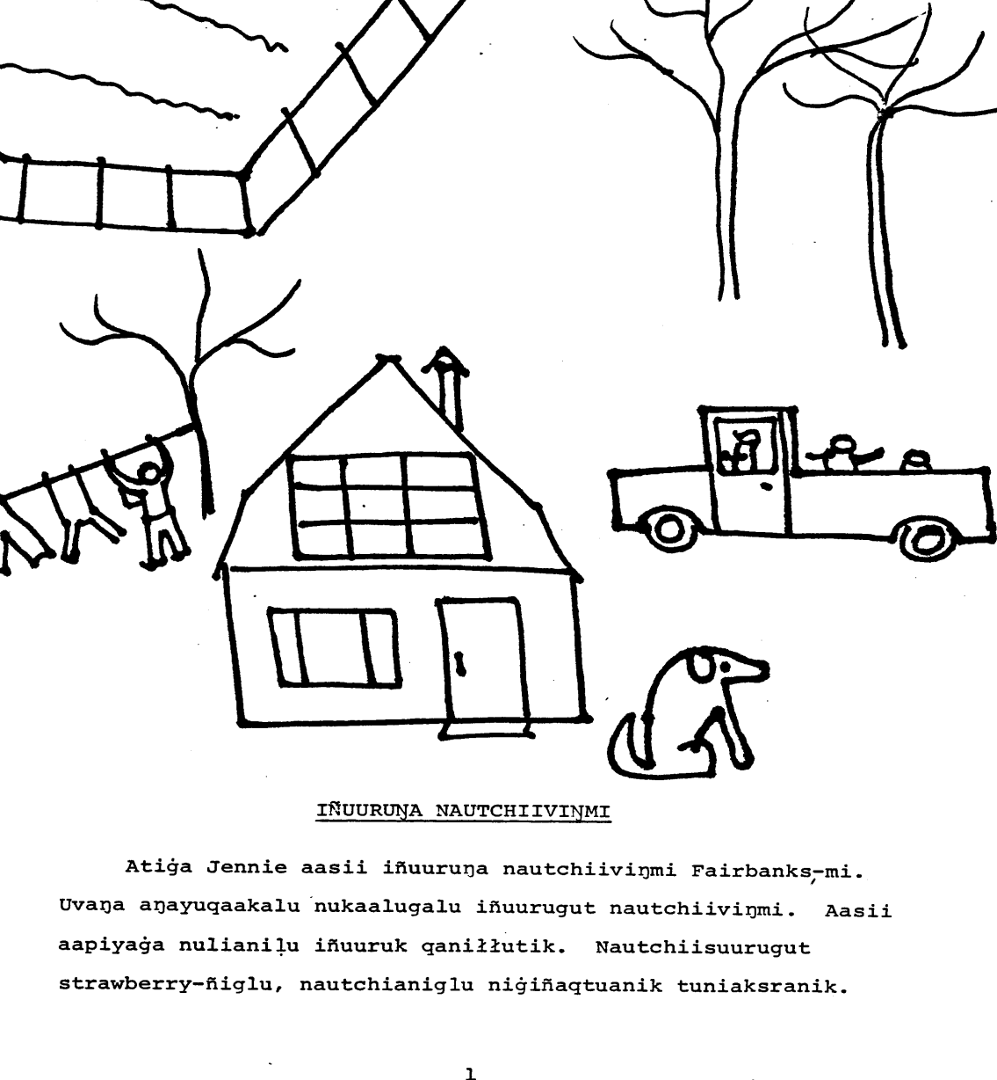
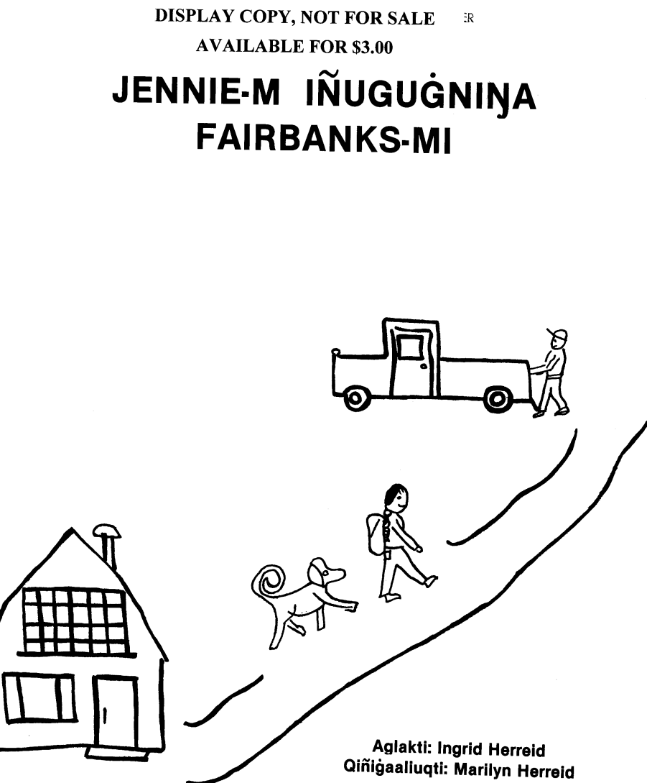
Iñupiaq

Slide 70
Iñupiaq resources
Larry Kaplan and Aric Bills collected stories from the Alaska Native Language Center
CMU undergraduates typed them.
Aric Bills proofread.
Total number of tokens: around 10K.
Some words were taken from Alaskool.org, but many lexical items were typed by Aric and CMU unergraduates
  Based on a paper lexicon by Edna MacLean

Slide 71

Iñupiaq XFST transducer
Implemented by Aric Bills.
Inspired by Per Langaard’s Kalaallisut spelling checker

Slide 72
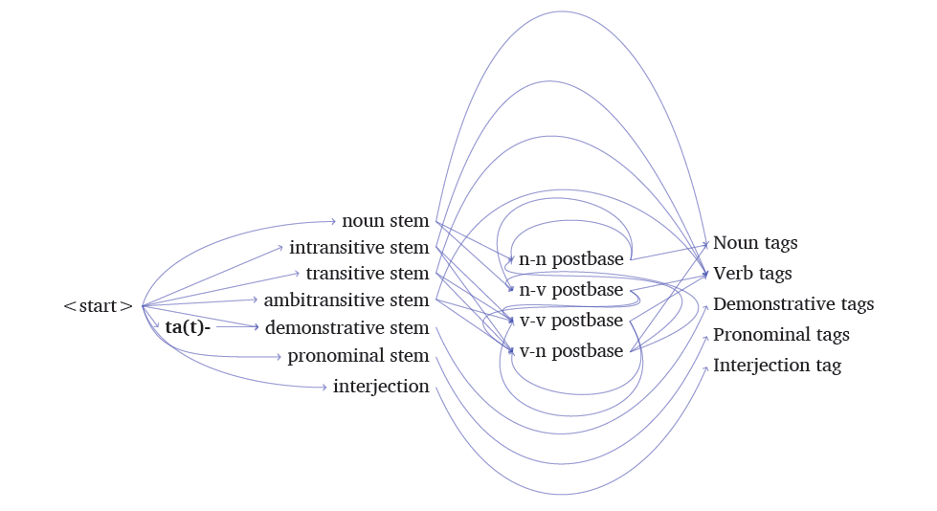
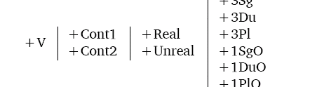
Morphotactics

Slide 73
Morphophonemics
Assimilation
Palatalization
Gemination
Etc.

Slide 74
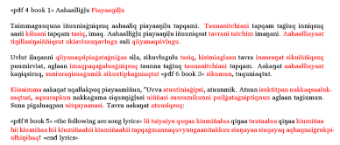
Red: not covered
Black: covered
Currently creating gold standard output for automatic testing.

Slide 75
A call to action
Find an endangered language community and offer your services.

