Slide 1
Collecting EL data: working with language communities
Laura Tomokiyo

Slide 2
We know why we care
Scientific interest – what is possible in human language?
Preserving cultural identity – when a community loses its language, it loses part of its identity, heritage, history, and culture
Preserving knowledge – when words are lost, knowledge is lost
Diversity – diversity in all domains is good

Slide 3
So what can we do?
A major thrust of this class is to conceive and prototype systems that are useful for the documentation and revitalization of endangered languages
On real endangered languages, not simulated ones
Simulating using small amounts of data for major languages doesn’t approximate what it’s like to work with an endangered language community.

Slide 4
Iñupiaq
Barrow, Alaska

Slide 5
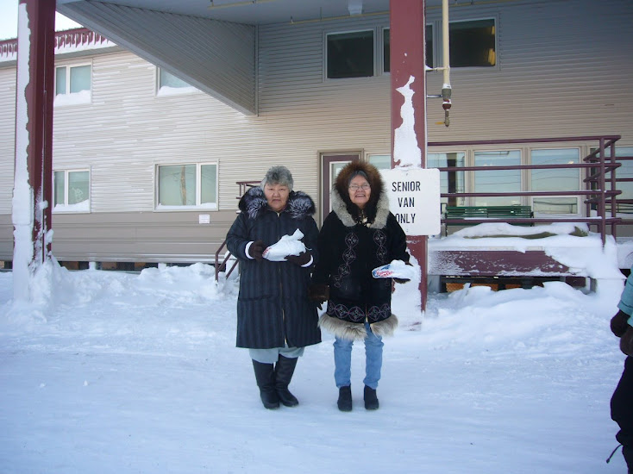
Notes:
I’d like to paint a picture of what it is like to go into a community and ask them for examples of language

Slide 6
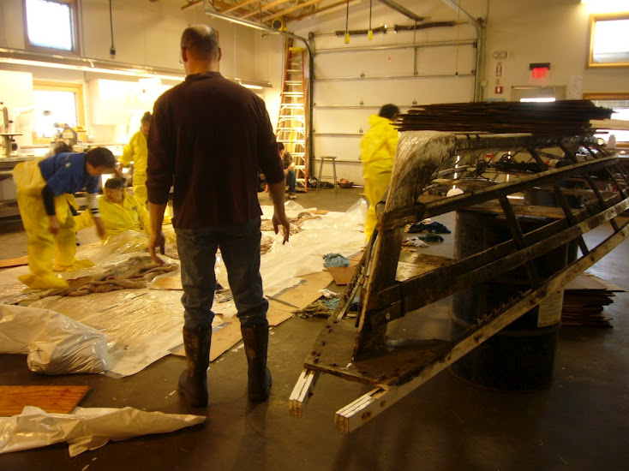
Notes:
This is where the language is left in Iñupiat youth

Slide 7
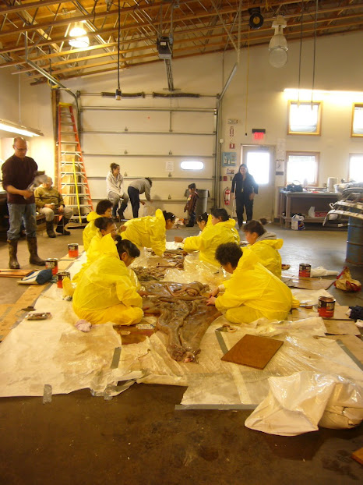
Notes:
There are fascinating cultural practices that are still a vital part of living in a remote part of the world.

Slide 8
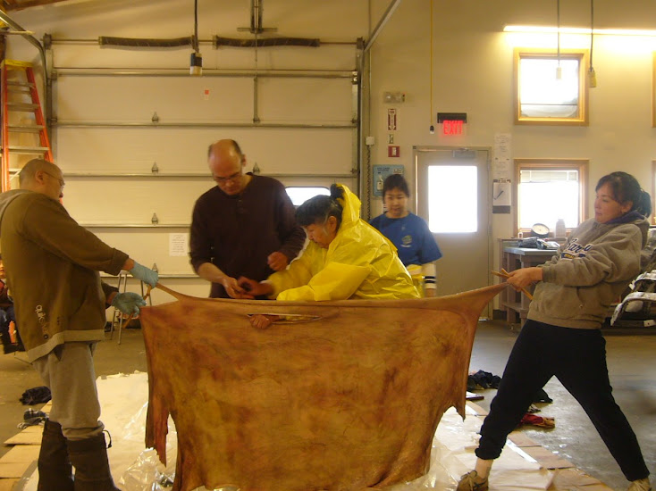

Slide 9
Challenges (overt)
Young people may not know the language, know only a little, or be embarrassed about their abilities
Older people may not be able to speak
Sense of fear about speaking the language
Older people may have learned a different variety (Martha/Anaktuvuk Pass)
Speakers may not be literate
Speakers may feel the language shouldn’t be shared with the outside
Speakers may feel speaking with their own community is a greater priority
Speakers may prioritize meeting with you differently than you do, or have a different sense of time

Slide 10
Challenges (covert)
Speakers may be trying to produce the language they think you want to hear, not what’s natural to them
Writers/transcribers may not be using a consistent orthography
Pronunciation may be impacted by speakers’ physical condition (missing teeth, weak voice, etc.)

Slide 11
Bambara
Bamako, Mali

Slide 12
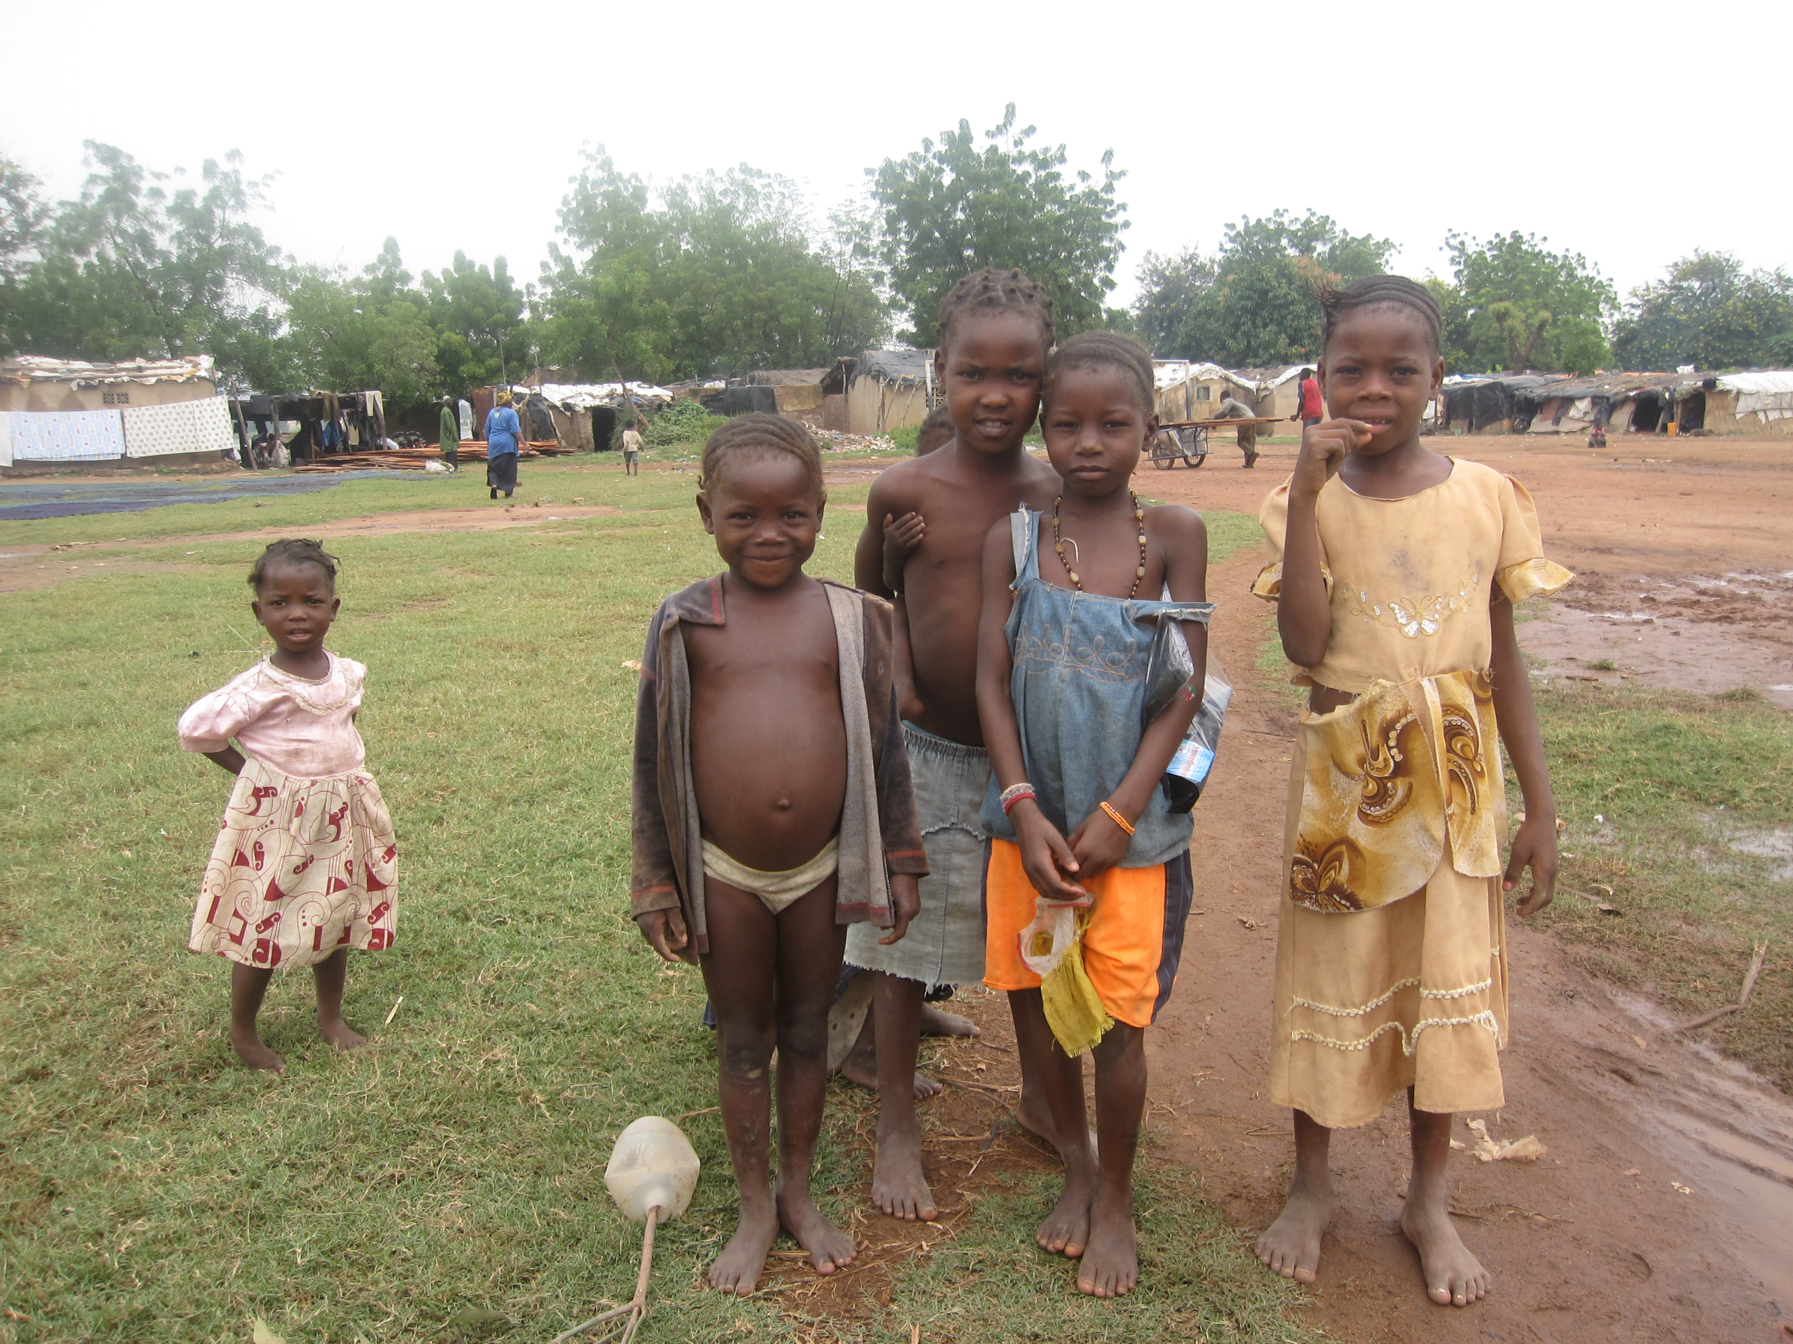

Slide 13
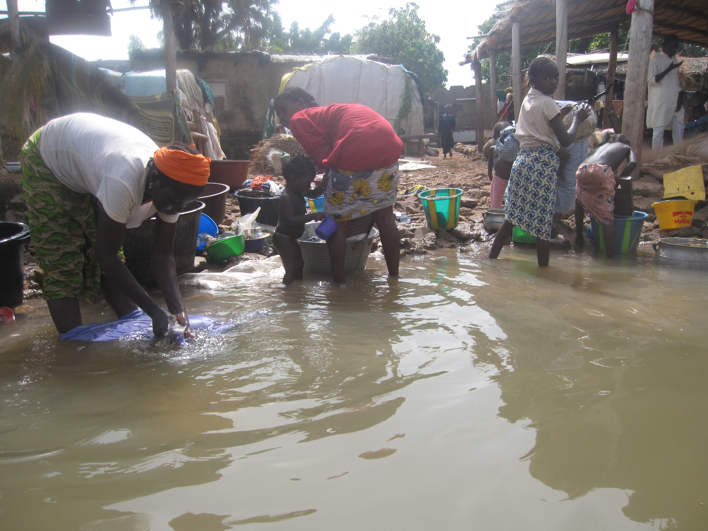

Slide 14
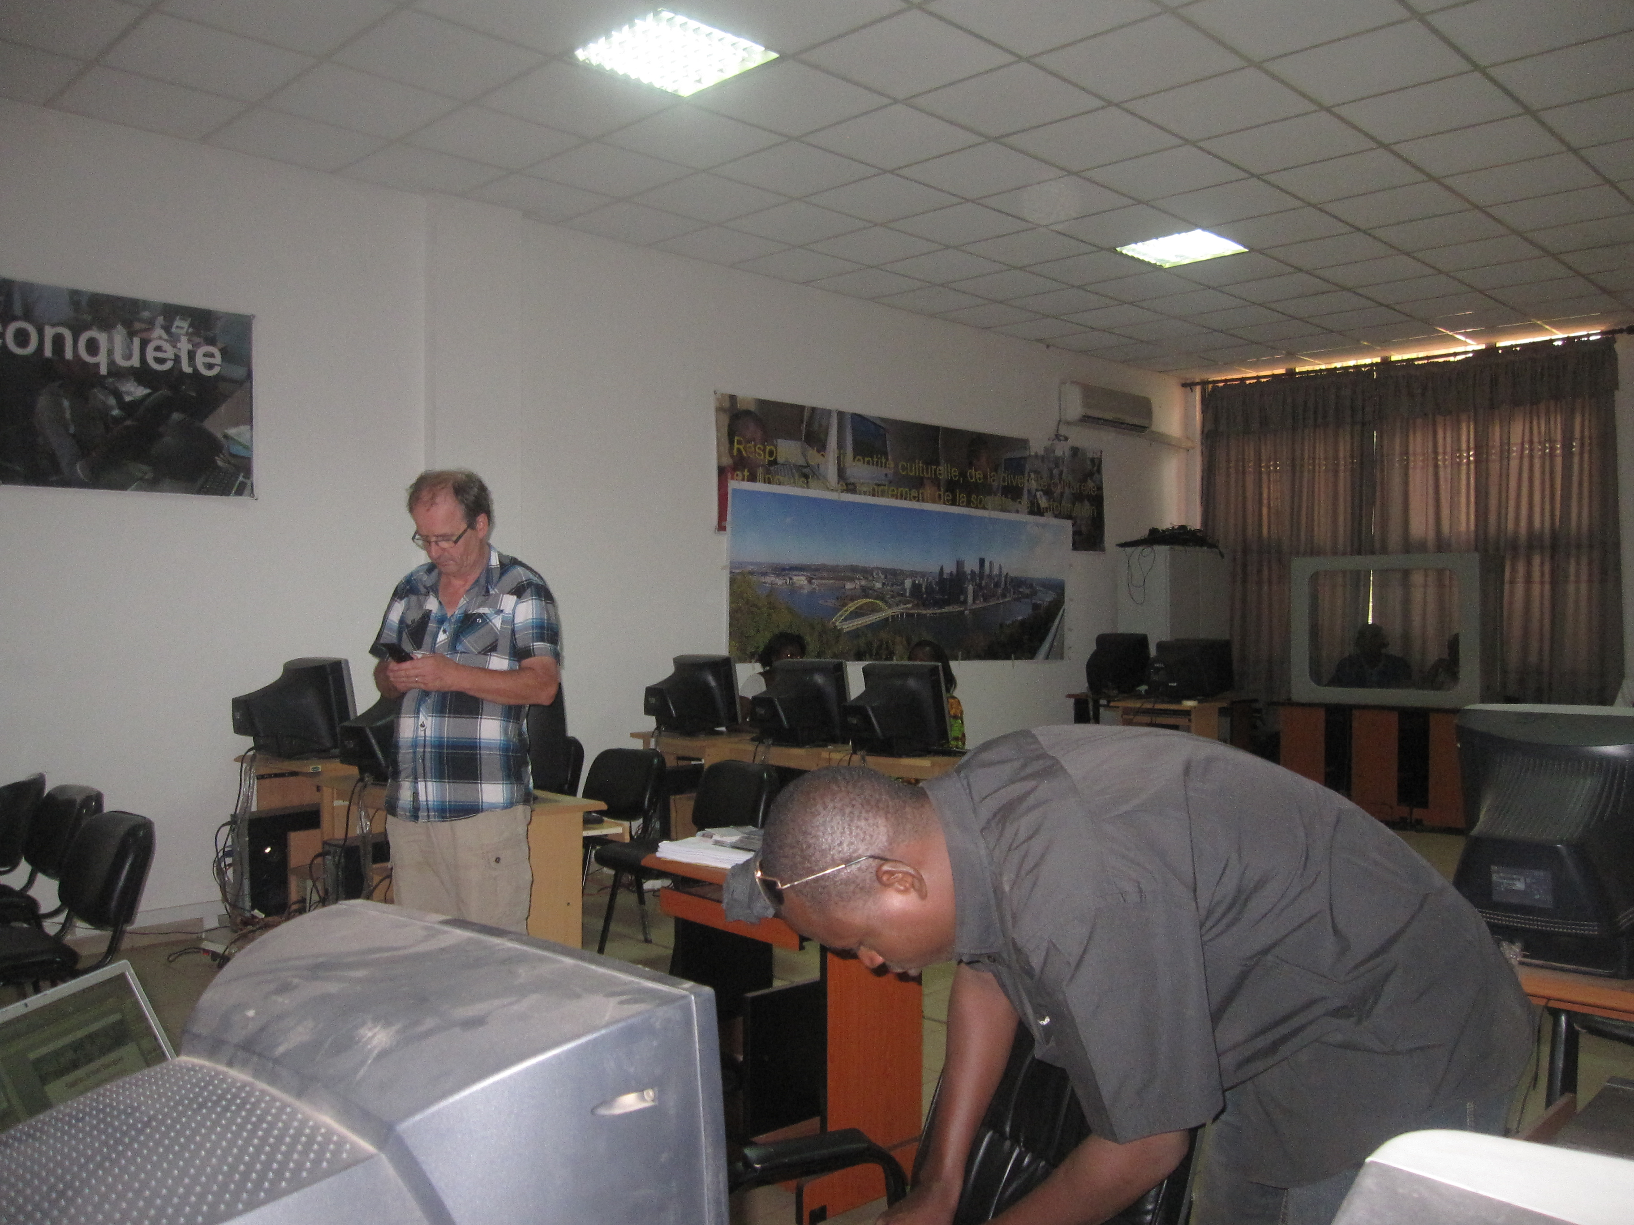

Slide 15
Bambara
6 million speakers
Language of colonization is French
Educated speakers adamantly don’t want their children to speak Bambara; French is the language of opportunity
Not interested in helping to preserve it
What is its future?

Slide 16
Iraqi Arabic
Pittsburgh, PA

Slide 17
Iraqi Arabic collection for TTS
Few speakers in Pittsburgh
Little written data
So we decided to use Egyptian
More media data
Created a voice
Speaker thought it soun
d too much like him and was frightened about ramifications
Ultimately could not deploy the voice
Notes:
Not an EL but some similarities
We can’t answer questions about repercussions from his government or community!

