Slide 1




OMG UR Funny! Computer-Aided Humor with an Application to Chat
miaomiao Wen
Nancy Baym
Omer Tamuz
Jaime Teevan
Susan Dumais
Adam Kalai

Slide 2
Outline
Introduction
System Design
Image Suggestion Strategies
Experiments & Results
Qualitative Insights
Conclusions

Slide 3
Outline
Introduction
System Design
Image Suggestion Strategies
Experiments & Results
Qualitative Insights
Conclusions

Slide 4

Motivation
Can computers be funny?

Slide 5
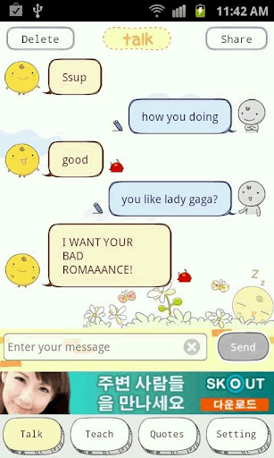
Simsimi http://www.simsimi.com/

Slide 6
Motivation
Can computers help people be funny?

Slide 7
Outline
Introduction
System Design
Image Suggestion Strategies
Experiments & Results
Qualitative Insights
Conclusions

Slide 8
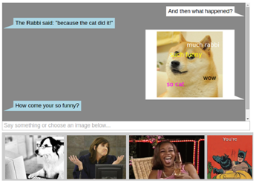
Computer Generated Humor vs. Computer Aided Humor
Notes:
----- Meeting Notes (6/29/15 09:37) -----
add a pic
simisimi --> suggestions

Slide 9


The Iterative Design Process
We started with text-based humor suggestions based on prior work [e.g. Valitutti et al. 2009]
Puns
Canned jokes
“that’s what she said”
Etc.
Negative user feedback from crowdsourced workers
“The jokes might be funny for a three year old”
“The suggestions are very silly”
Suffered from lack of context
Most human jokes are produced within humorous frames and rarely communicate meanings outside it [Dynel 2009]
Notes:
----- Meeting Notes (6/29/15 09:37) -----
negative feedback first

Slide 10
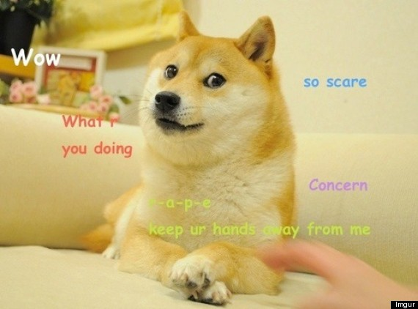
Image vs. Text Suggestions
Success of adding a meme image into suggestions
Image vs. Text
images are often more open to interpretation than text
images are slower for users to provide on their own than entering text
images provide much more context on their own
We will focus on generating funny images suggestions.

Slide 11
User Interface
Chat History
Input Box
Generated
Suggestions

Slide 12
Outline
Introduction
System Design
Image Suggestion Strategies
Experiments & Results
Qualitative Insights
Conclusions

Slide 13
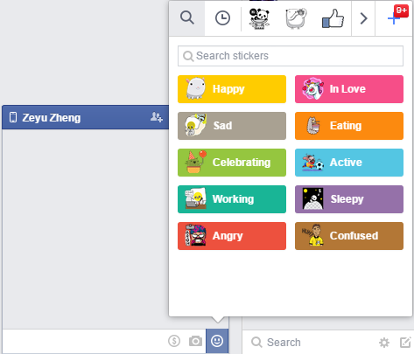
Strategy 1. Emotional Reaction Images and gifs
Emoticons can support nonverbal communications [Walther and Kyle 2001]
Emoticons are often used to display or support humor [Tossell et al 2012]
Many chat apps provide emoticon libraries

Slide 14





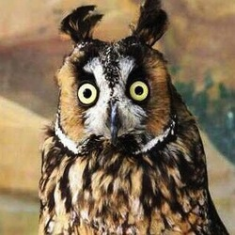
Emotional Reaction Images and gifs
Detected Sentiment | Suggestion Reaction Image
Question | “I don’t know”
Anger | Mad and Confused
Disgust | Gross
Joy | Love and Win
Sadness | Sad and Face-palm
Surprise | OMG
http://giphy.com
http://reacticons.com
Notes:
Suggest reaction images/gifs based on the emotion extracted from the last sentence
gifs not moving
----- Meeting Notes (6/29/15 14:48) -----
reacticon

Slide 15
Strategy 2. Image Retrieval
Image retrieval using Bing image search API
“funny keyword(s)”
Mturk is like a desert today. Not a ton of great HITs.
Notes:
----- Meeting Notes (6/29/15 11:16) -----
API

Slide 16
Image Retrieval
Image retrieval using Bing image search API
“funny keyword(s)”
Keywords chosen based on tf-idf
Mturk is like a desert today. Not a ton of great HITs.

Slide 17
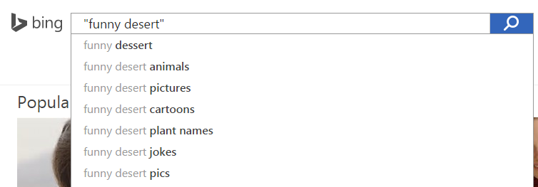
Image Retrieval
Image retrieval using Bing image search API
“funny keyword(s)”
keywords chosen based on tf-idf

Slide 18
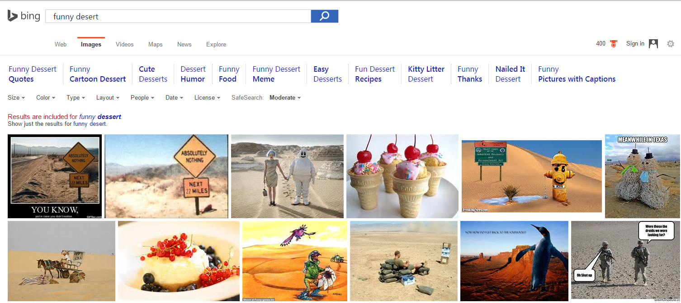
Image Retrieval
Image retrieval using Bing image search API
“funny keyword(s)”
keywords chosen based on tf-idf

Slide 19
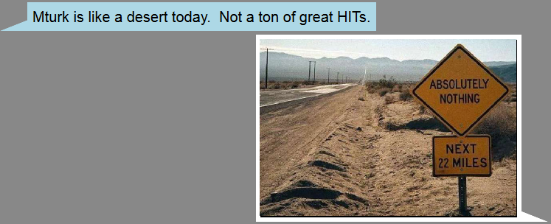
Image Retrieval
Image retrieval using Bing image search API
“funny keyword(s)”
keywords chosen based on tf-idf

Slide 20
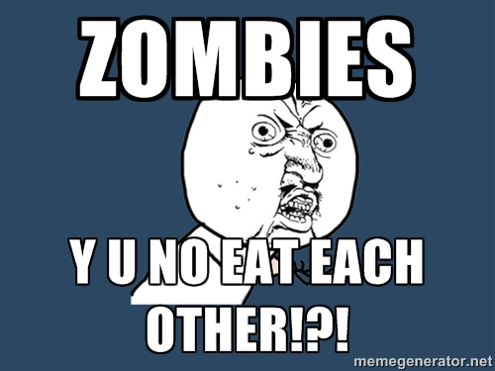
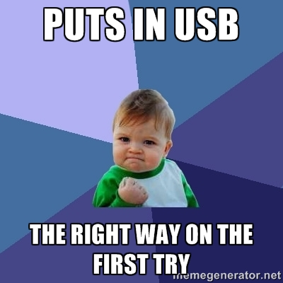

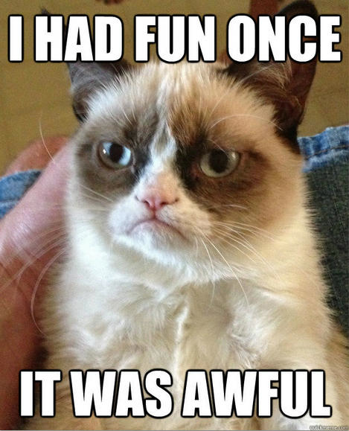
Strategy 3. Meme Images
“Viral images, videos, and catchphrases under constant modification by users” [Coleman 2012]
a meme template is an image of a meme character without the captions
Users generate their own memes pictures through meme generation website
writes the last utterance on the top and bottom of a popular meme template
Notes:
add Y-U-Not
----- Meeting Notes (6/29/15 11:16) -----
move last sentence up front
----- Meeting Notes (6/29/15 14:48) -----
character+captions
websites

Slide 21
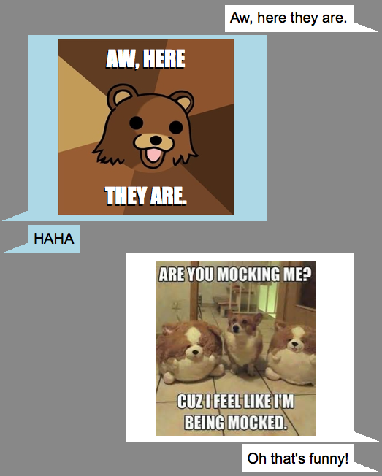
Meme Images
Machine-learning trained classifier picks the most suitable meme template image based on the last utterance
Top 50 popular meme templates and their instances from memegenerator.net
Bag-of-word features
Accuracy 51%
Notes:
----- Meeting Notes (6/29/15 11:16) -----
order!!

Slide 22
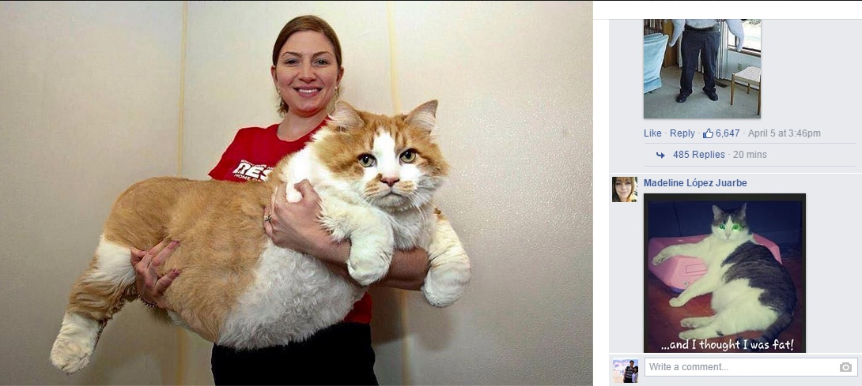
Strategy 4. Responding to Images with Images
Users often responding to images with similar images

Slide 23
Responding to Images with Images
Respond-in-kind strategy
an image chosen from a search for “funny keyword” with a second image from the same search
Rule-of-three
a common joke structure [Quijano 2012]
comedians use the first two points to establish a pattern
throw the audience off with the third element
“funny keyword” -> “no keyword” -> “many keyword”
Notes:
----- Meeting Notes (6/29/15 11:16) -----
example of rule-of three

Slide 24
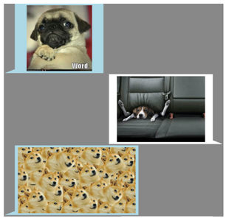
Responding to Images with Images
“funny dog”
“no dog”
“many dog”

Slide 25


Responding to Images with Images
Response to images with emoticons
“LOL”
“not-amused”
Notes:
add emoticon pics
----- Meeting Notes (6/29/15 11:16) -----
remove amused

Slide 26
Ranking Suggestions using Reinforcement Learning
Rank images based on
how often it was chosen before
Back-off: how often the strategy was chosen before
Notes:
----- Meeting Notes (6/29/15 11:16) -----
back off

Slide 27
Outline
Introduction
System Design
Image Suggestion Strategies
Experiments & Results
Qualitative Insights
Conclusions

Slide 28
Experiments
Three Systems
Computer-aided Humor (with 1,2,3,6,10 suggestions)
Computer-generated Humor
automatically insert the top-ranking image
Plain chat
Pair of crowdsourced workers chatted for 10 minutes, no topic restrictions
738 participants
At least 100 participants using each system
Evaluation: Post chat survey [Jiang et al. 2011]
The conversation was fun.
I was able to express my sense of humor in this conversation.
I felt pretty close to my partner during the conversation.
I was involved in the conversation.
Notes:
add citation

Slide 29
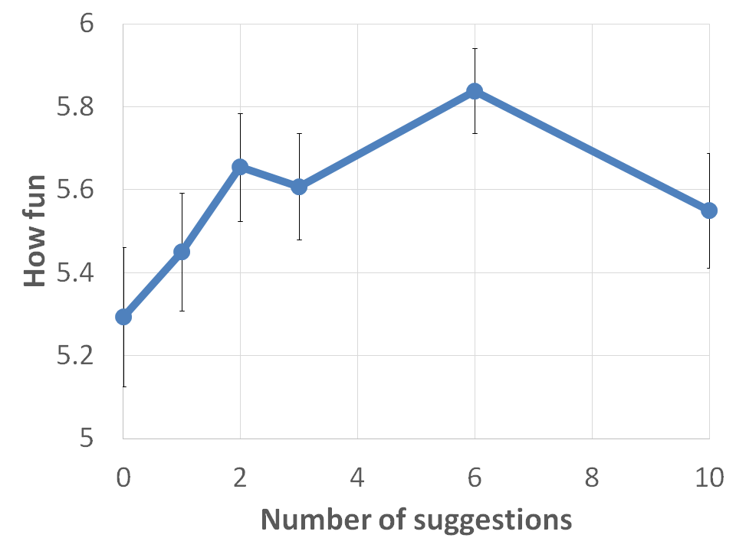
Experimental Results: Number of Suggestions
Notes:
----- Meeting Notes (6/29/15 11:16) -----
first use this

Slide 30
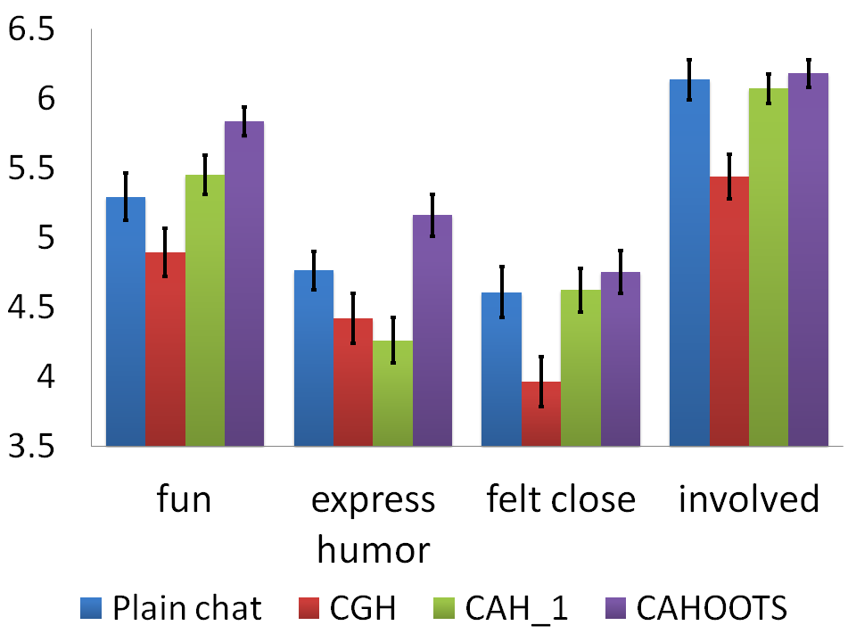
Experimental Results

Slide 31

Experimental Results: Computer Generated Humor vs. Computer Aided Humor

Slide 32
Experimental Results: Computer Aided Humor v.s. Plain Chat

Slide 33
Experimental Results: Which strategies are more successful?
 | #suggestions | % chosen
Bing Images | 44,710 | 10%
Reaction Images & gifs | 4,375 | 19%
Meme | 709 | 13%
Rule-of-three | 698 | 24%

Slide 34
Outline
Introduction
System Design
Image Suggestion Strategies
Experiments & Results
Qualitative Insights
Conclusions

Slide 35
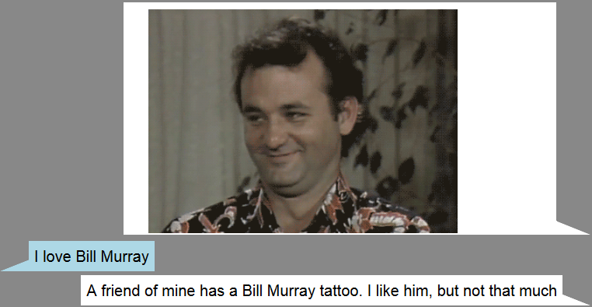
Qualitative Insights (1)
Humorous Images Bring New Topics to the Conversation

Slide 36
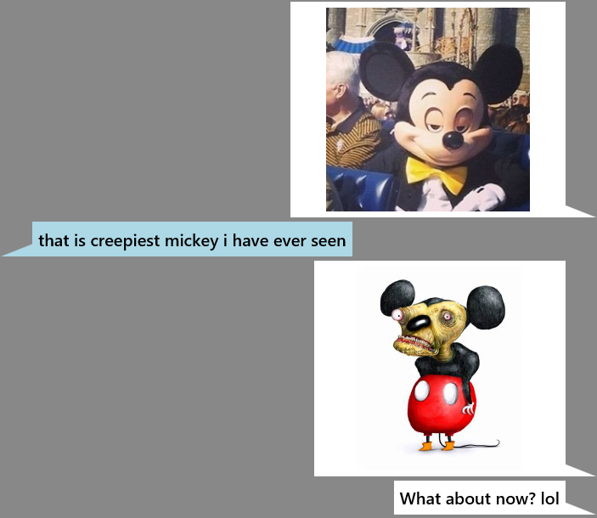
Qualitative Insights (2)
Yes, and…
first accept one another’s suggestions and try to build them into something even funnier [Moshavi 2001]
Our strategies can lead to yes-and behaviors

Slide 37
Qualitative Insights (3) Image Humor is Robust
Participants had different backgrounds and thus understand images differently
some participants did not recognize that the images were memes
still find the images amusing
Endless funny images online
Positive feedback
“It should be used for online speed dating!”
“When will this app be available for phones and whatnot? I want to use it ”

Slide 38
Outline
Introduction
System Design
Image Suggestion Strategies
Experiments & Results
Qualitative Insights
Conclusions

Slide 39
Conclusions
A chat system that builds on the relative strengths of people and computers to generate humor by suggesting images
Compared to plain chat and a computer generated humor system
more fun
enabled them to express their sense of humor

Slide 40
Q & A
Thanks for your attentions!!
Miaomiao Wen
mwen@cs.cmu.edu

