Slide 1


Directed Graphical Models
(aka. Bayesian Networks)
School of Computer Science
10-601B Introduction to Machine Learning
Readings:
Bishop 8.1 and 8.2.2
Mitchell 6.11
Murphy 10
Matt Gormley
Lecture 21
November 9, 2016

Slide 2
Reminders
Homework 6
  due Mon., Nov. 21
Final Exam
  in-class Wed., Dec. 7

Slide 3
Outline
Motivation
  Structured Prediction
Background
  Conditional Independence
  Chain Rule of Probability
Directed Graphical Models
  Bayesian Network definition
  Qualitative Specification
  Quantitative Specification
  Familiar Models as Bayes Nets
  Example: The Monty Hall Problem
Conditional Independence in Bayes Nets
  Three case studies
  D-separation
  Markov blanket

Slide 4
Motivation

Slide 5
Structured Prediction
Most of the models we’ve seen so far were for classification
  Given observations: x = (x₁, x₂, …, x_{K})
  Predict a (binary) label: y
Many real-world problems require structured prediction
  Given observations: x = (x₁, x₂, …, x_{K})
  Predict a structure: y = (y₁, y₂, …, y_{J})
Some classification problems benefit from latent structure

Slide 6
Structured Prediction Examples
Examples of structured prediction
  Part-of-speech (POS) tagging
  Handwriting recognition
  Speech recognition
  Word alignment
  Congressional voting
Examples of latent structure
  Object recognition

Slide 7
Dataset for Supervised
Part-of-Speech (POS) Tagging
Data:
n
v
p
d
n
y⁽¹⁾
Sample 1:
time
flies
like
an
arrow
x⁽¹⁾
n
n
v
d
n
y⁽²⁾
Sample 2:
time
flies
like
an
arrow
x⁽²⁾
n
v
p
n
n
y⁽³⁾
Sample 3:
flies
fly
with
their
wings
x⁽³⁾
p
n
n
v
v
y⁽⁴⁾
Sample 4:
with
time
you
will
see
x⁽⁴⁾
Notes:
Why would you want a model that’s not a linear chain?
Well, here’s an example.
Here I’ll generate tagged sentences.
When I pull a sample out of my pocket, sometimes it’s a tagging of “Time flies like an arrow” … but sometimes it’s a tagging of some other sentence.
Some sentences are more likely than others, and we are using POS tags to help model which sentences are likely.
The bigram “an arrow” is likely not because there’s a bigram parameter for it – there isn’t – but because the model captures something more general: determiners like to be followed by nouns.

Slide 8
Dataset for Supervised
Handwriting Recognition
Data:
Sample 1:
u
n
e
x
p
e
c
t
e
d
y⁽¹⁾
x⁽¹⁾
Sample 2:
v
o
l
c
a
n
i
c
y⁽²⁾
x⁽²⁾
Sample 2:
e
m
b
r
a
c
e
s
y⁽³⁾
x⁽³⁾
Figures from (Chatzis & Demiris, 2013)
Notes:
Why would you want a model that’s not a linear chain?
Well, here’s an example.
Here I’ll generate tagged sentences.
When I pull a sample out of my pocket, sometimes it’s a tagging of “Time flies like an arrow” … but sometimes it’s a tagging of some other sentence.
Some sentences are more likely than others, and we are using POS tags to help model which sentences are likely.
The bigram “an arrow” is likely not because there’s a bigram parameter for it – there isn’t – but because the model captures something more general: determiners like to be followed by nouns.

Slide 9
Dataset for Supervised
Phoneme (Speech) Recognition
Data:
Sample 1:
h#
dh
ih
s
w
uh
z
iy
z
iy
y⁽¹⁾
x⁽¹⁾
Sample 2:
f
ao
r
ah
s
s
h#
y⁽²⁾
x⁽²⁾
Figures from (Jansen & Niyogi, 2013)
Notes:
Why would you want a model that’s not a linear chain?
Well, here’s an example.
Here I’ll generate tagged sentences.
When I pull a sample out of my pocket, sometimes it’s a tagging of “Time flies like an arrow” … but sometimes it’s a tagging of some other sentence.
Some sentences are more likely than others, and we are using POS tags to help model which sentences are likely.
The bigram “an arrow” is likely not because there’s a bigram parameter for it – there isn’t – but because the model captures something more general: determiners like to be followed by nouns.

Slide 10
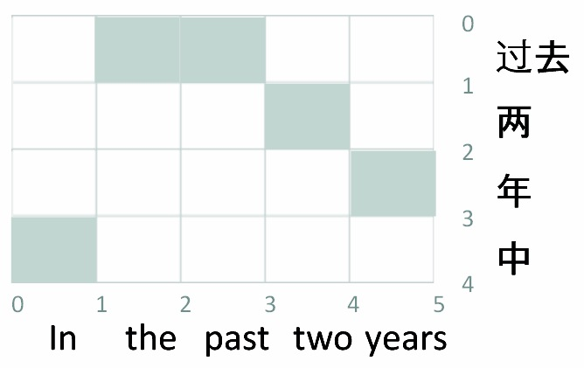
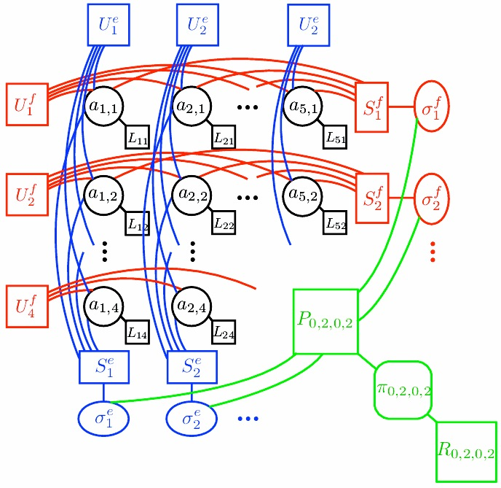
Word Alignment / Phrase Extraction
Application:
Variables (boolean):
  For each (Chinese phrase, English phrase) pair,
  are they linked?
Interactions:
  Word fertilities
  Few “jumps” (discontinuities)
  Syntactic reorderings
  “ITG contraint” on alignment
  Phrases are disjoint (?)
(Burkett & Klein, 2012)
Notes:
Maybe you work on MT. You’ve got a French sentence and an English sentence, 10 words each. So there’s 100 possible alignment links. Each could be on or off.
So we’re encoding an alignment as a vector of 100 bits, describing which links are present. You want to assign a probability to each of those vectors.
And there are lots of things to consider …
If word 3 aligns to word 10, maybe it doesn’t align to anything else.
It’s bad if words 3 and 4, which are adjacent, align to words 10 and 20, which are far apart.
This is a CRF, by the way, since the factors that evaluate an alignment are specific to the sentence pair.

Slide 11
Congressional Voting
Application:
Variables:
  Representative’s vote
  Text of all speeches of a representative
  Local contexts of references between two representatives
Interactions:
  Words used by representative and their vote
  Pairs of representatives and their local context
(Stoyanov & Eisner, 2012)
Notes:
Here’s an example with language in the world.
You’re trying to predict how each politician voted.
This depends on sentiment analysis of her speeches.
But also, her vote is correlated with the votes of other politicians.
If she attacks you in her speech, probably the two of you are voting differently.
So we have an inference problem to predict all of the votes at once.

Slide 12
Structured Prediction Examples
Examples of structured prediction
  Part-of-speech (POS) tagging
  Handwriting recognition
  Speech recognition
  Word alignment
  Congressional voting
Examples of latent structure
  Object recognition

Slide 13
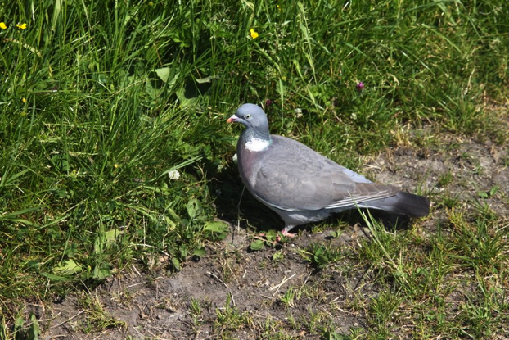
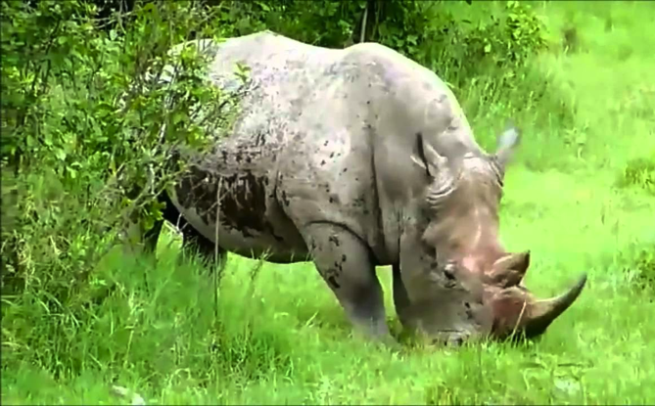

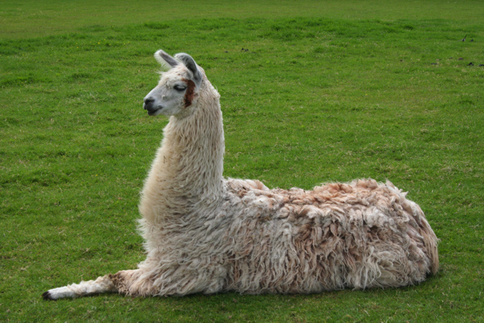
Case Study: Object Recognition
Data consists of images x and labels y.
x⁽¹⁾
x⁽²⁾
y⁽¹⁾
y⁽²⁾
pigeon
rhinoceros
x⁽³⁾
x⁽⁴⁾
leopard
y⁽³⁾
llama
y⁽⁴⁾

Slide 14

Case Study: Object Recognition
Data consists of images x and labels y.
Preprocess data into “patches”
Posit a latent labeling z describing the object’s parts (e.g. head, leg, tail, torso, grass)
Define graphical model with these latent variables in mind
z is not observed at train or test time
leopard

Slide 15
Case Study: Object Recognition
Data consists of images x and labels y.
Preprocess data into “patches”
Posit a latent labeling z describing the object’s parts (e.g. head, leg, tail, torso, grass)
Z₇
Z₆
Z₅
X₇
X₆
Define graphical model with these latent variables in mind
z is not observed at train or test time
Z₄
Z₁
Z₂
Z₃
X₅
X₄
X₁
X₂
X₃
Y
leopard

Slide 16
Case Study: Object Recognition
Data consists of images x and labels y.
Preprocess data into “patches”
Posit a latent labeling z describing the object’s parts (e.g. head, leg, tail, torso, grass)
Z₇
ψ₄
Z₆
ψ₁
Z₅
X₇
ψ₁
ψ₄
X₆
Z₄
ψ₉
Define graphical model with these latent variables in mind
z is not observed at train or test time
Z₃
Z₁
Z₂
ψ₄
X₅
ψ₂
ψ₇
ψ₁
ψ₃
ψ₅
X₄
X₁
X₂
X₃
Y
leopard

Slide 17
Structured Prediction
Preview of challenges to come…
Consider the task of finding the most probable assignment to the output
Classification
Structured Prediction

Slide 18
Machine Learning
The data inspires the structures we want to predict
Our model defines a score for each structure
It also tells us what to optimize
Domain Knowledge
Mathematical Modeling
ML
Inference finds
{best structure, marginals, partition function} for a new observation
Combinatorial Optimization
Optimization
Learning tunes the parameters of the model
(Inference is usually called as a subroutine in learning)

Slide 19

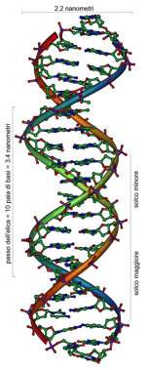
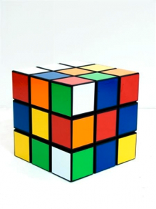
Machine Learning
Model
Data
X₁
X₂
X₃
X₄
X₅
Objective
Inference
Learning
(Inference is usually called as a subroutine in learning)

Slide 20
Background

Slide 21
Background: Chain Rule of Probability

Slide 22
Background:
Conditional Independence
Later we will also write: I<A, {C}, B>

Slide 23
Directed Graphical Models
Bayesian Networks

Slide 24
Whiteboard
Writing Joint Distributions
Strawman: Giant Table
Alternate #1: Rewrite using chain rule
Alternate #2: Assume full independence
Alternate #3: Drop variables from RHS of conditionals

Slide 25
Bayesian Network
Definition:
X₁
X₃
X₂
X₄
X₅

Slide 26
Bayesian Network
Definition:
X₁
X₃
X₂
X₄
X₅

Slide 27
Bayesian Network
Definition:
X₁
X₃
X₂
X₄
X₅
A Bayesian Network is a directed graphical model
It consists of a graph G and the conditional probabilities P
These two parts full specify the distribution:
  Qualitative Specification: G
  Quantitative Specification: P

Slide 28
Qualitative Specification
Where does the qualitative specification come from?
  Prior knowledge of causal relationships
  Prior knowledge of modular relationships
  Assessment from experts
  Learning from data
  We simply link a certain architecture (e.g. a layered graph)
  …

Slide 29
Whiteboard
If time…
Example: 2016 Presidential Election

Slide 30
Towards quantitative specification of probability distribution
Separation properties in the graph imply independence properties about the associated variables
For the graph to be useful, any conditional independence properties we can derive from the graph should hold for the probability distribution that the graph represents
The Equivalence Theorem
For a graph G,
Let D₁ denote the family of all distributions that satisfy I(G),
Let D₂ denote the family of all distributions that factor according to G,
Then D₁≡D₂.

Slide 31
Quantitative Specification
A
B
p(A,B,C) =
C

Slide 32
Conditional probability tables (CPTs)
a⁰ | 0.75
a¹ | 0.25
b⁰ | 0.33
b¹ | 0.67
P(a,b,c.d) = P(a)P(b)P(c|a,b)P(d|c)
A
B
 | a⁰b⁰ | a⁰b¹ | a¹b⁰ | a¹b¹
c⁰ | 0.45 | 1 | 0.9 | 0.7
c¹ | 0.55 | 0 | 0.1 | 0.3
C
 | c⁰ | c¹
d⁰ | 0.3 | 0.5
d¹ | 07 | 0.5
D

Slide 33
P(a,b,c.d) = P(a)P(b)P(c|a,b)P(d|c)
A~N(μ_{a}, Σ_{a})
B~N(μ_{b}, Σ_{b})
A
B
C
C~N(A+B, Σ_{c})
D
D~N(μ_{a}+C, Σ_{a})

Slide 34
Conditional Independencies
_{Y}
Label
X₁
X₂
X_{n-1}
X_{n}
Features
What is this model
When Y is observed?
When Y is unobserved?

Slide 35
Conditionally Independent Observations
θ
Model parameters
X₁
X₂
X_{n-1}
X_{n}
Data = {y₁,…y_{n}}

Slide 36
“Plate” Notation
θ
Model parameters
X_{i}
Data = {x₁,…x_{n}}
i=1:n
Plate = rectangle in graphical model
variables within a plate are replicated
in a conditionally independent manner

Slide 37
Example: Gaussian Model
μ
σ
Generative model:
p(x₁,…x_{n} | μ, σ) = P p(x_{i} | μ, σ)
= p(data | parameters)
= p(D | θ)
where θ = {μ, σ}
x_{i}
i=1:n
Likelihood = p(data | parameters)
= p( D | θ )
= L (θ)
Likelihood tells us how likely the observed data are conditioned on a particular setting of the parameters
  Often easier to work with log L (θ)

Slide 38
Bayesian models
θ
x_{i}
i=1:n

Slide 39
More examples
Density estimation
m,s
Parametric and nonparametric methods
X
X
Regression
X
Y
Linear, conditional mixture, nonparametric
Q
Q
Classification
Generative and discriminative approach
X
X

Slide 40
Example:
The Monty Hall Problem
Extra slides from
last semester
Slide from William Cohen

Slide 41
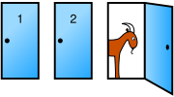

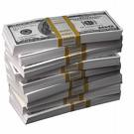
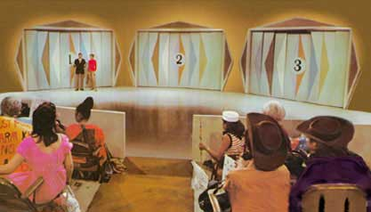
The (highly practical) Monty Hall problem
You’re in a game show. Behind one door is a prize. Behind the others, goats.
You pick one of three doors, say #1
The host, Monty Hall, opens one door, revealing…a goat!
3
You now can either
stick with your guess
always change doors
flip a coin and pick a new door randomly according to the coin
Extra slides from
last semester
Slide from William Cohen

Slide 42
The (highly practical) Monty Hall problem
Extra slides from
last semester
A | P(A)
1 | 0.33
2 | 0.33
3 | 0.33
First guess
The money
B | P(B)
1 | 0.33
2 | 0.33
3 | 0.33
You’re in a game show. Behind one door is a prize. Behind the others, goats.
You pick one of three doors, say #1
The host, Monty Hall, opens one door, revealing…a goat!
You now can either stick with your guess or change doors
A
B
Stick, or swap?
D
C
The revealed goat
D | P(D)
Stick | 0.5
Swap | 0.5
A | B | C | P(C|A,B)
1 | 1 | 2 | 0.5
1 | 1 | 3 | 0.5
1 | 2 | 3 | 1.0
1 | 3 | 2 | 1.0
… | … | … | …
Second guess
E
W
Slide from William Cohen

Slide 43
The (highly practical) Monty Hall problem
Extra slides from
last semester
A | P(A)
1 | 0.33
2 | 0.33
3 | 0.33
First guess
The money
B | P(B)
1 | 0.33
2 | 0.33
3 | 0.33
A
B
Stick or swap?
D
C
The goat
A | B | C | P(C|A,B)
1 | 1 | 2 | 0.5
1 | 1 | 3 | 0.5
1 | 2 | 3 | 1.0
1 | 3 | 2 | 1.0
… | … | … | …
Second guess
E
If you stick: you win if your first guess was right.
If you swap: you win if your first guess was wrong.
A | C | D | P(E|A,C,D)
… | … | … | …
Slide from William Cohen

Slide 44
The (highly practical) Monty Hall problem
We could construct the joint and compute P(E=B|D=swap)
A | P(A)
1 | 0.33
2 | 0.33
3 | 0.33
First guess
The money
B | P(B)
1 | 0.33
2 | 0.33
3 | 0.33
A
B
…again by the chain rule:
P(A,B,C,D,E) =
P(E|A,C,D) *
P(D) *
P(C | A,B ) *
P(B ) *
P(A)
Stick or swap?
D
C
The goat
A | B | C | P(C|A,B)
1 | 1 | 2 | 0.5
1 | 1 | 3 | 0.5
1 | 2 | 3 | 1.0
1 | 3 | 2 | 1.0
… | … | … | …
Second guess
E
A | C | D | P(E|A,C,D)
… | … | … | …
Extra slides from
last semester
Slide from William Cohen

Slide 45
The (highly practical) Monty Hall problem
We could construct the joint and compute P(E=B|D=swap)
A | P(A)
1 | 0.33
2 | 0.33
3 | 0.33
First guess
The money
B | P(B)
1 | 0.33
2 | 0.33
3 | 0.33
A
B
…again by the chain rule:
P(A,B,C,D,E) =
P(E | A,B,C,D) *
P(D | A,B,C) *
P(C | A,B ) *
P(B | A) *
P(A)
Stick or swap?
D
C
The goat
A | B | C | P(C|A,B)
1 | 1 | 2 | 0.5
1 | 1 | 3 | 0.5
1 | 2 | 3 | 1.0
1 | 3 | 2 | 1.0
… | … | … | …
Second guess
E
A | C | D | P(E|A,C,D)
… | … | … | …
Extra slides from
last semester
Slide from William Cohen

Slide 46
The (highly practical) Monty Hall problem
The joint table has…?
A | P(A)
1 | 0.33
2 | 0.33
3 | 0.33
First guess
The money
B | P(B)
1 | 0.33
2 | 0.33
3 | 0.33
A
B
3*3*3*2*3 = 162 rows
Stick or swap?
The conditional probability tables (CPTs) shown have … ?
Big questions:
why are the CPTs smaller?
how much smaller are the CPTs than the joint?
can we compute the answers to queries like P(E=B|d) without building the joint probability tables, just using the CPTs?
D
C
The goat
A | B | C | P(C|A,B)
1 | 1 | 2 | 0.5
1 | 1 | 3 | 0.5
1 | 2 | 3 | 1.0
1 | 3 | 2 | 1.0
… | … | … | …
3 + 3 + 3*3*3 + 2*3*3 = 51 rows < 162 rows
Second guess
E
A | C | D | P(E|A,C,D)
… | … | … | …
Extra slides from
last semester
Slide from William Cohen

Slide 47
The (highly practical) Monty Hall problem
A | P(A)
1 | 0.33
2 | 0.33
3 | 0.33
First guess
Why is the CPTs representation smaller? Follow the money! (B)
The money
B | P(B)
1 | 0.33
2 | 0.33
3 | 0.33
A
B
Stick or swap?
D
C
The goat
E is conditionally independent of B given A,D,C
A | B | C | P(C|A,B)
1 | 1 | 2 | 0.5
1 | 1 | 3 | 0.5
1 | 2 | 3 | 1.0
1 | 3 | 2 | 1.0
… | … | … | …
Second guess
E
A | C | D | P(E|A,C,D)
… | … | … | …
Extra slides from
last semester
Slide from William Cohen

Slide 48
The (highly practical) Monty Hall problem
What are the conditional indepencies?
I<A, {B}, C> ?
I<A, {C}, B> ?
I<E, {A,C}, B> ?
I<D, {E}, B> ?
…
First guess
The money
A
B
Stick or swap?
D
C
The goat
Second guess
E
Extra slides from
last semester
Slide from William Cohen

Slide 49
Graphical Models:
Determining Conditional Independencies
Slide from William Cohen

Slide 50
What Independencies does a Bayes Net Model?
In order for a Bayesian network to model a probability distribution, the following must be true:
  Each variable is conditionally independent of all its non-descendants in the graph given the value of all its parents.
This follows from
But what else does it imply?
Slide from William Cohen

Slide 51
What Independencies does a Bayes Net Model?
Three cases of interest…
Cascade
Common Parent
V-Structure
Z
Y
X
Z
Y
Y
X
Z
Y
X

Slide 52
What Independencies does a Bayes Net Model?
Three cases of interest…
Cascade
Common Parent
V-Structure
Z
Y
X
Z
Y
Y
X
Z
Y
X
Knowing Y
decouples X and Z
Knowing Y
couples X and Z

Slide 53
Whiteboard
Common Parent
Y
Proof of conditional independence
(The other two cases can easily be shown just as easily.)
X
Z

Slide 54
The “Burglar Alarm” example
Your house has a twitchy burglar alarm that is also sometimes triggered by earthquakes.
Earth arguably doesn’t care whether your house is currently being burgled
While you are on vacation, one of your neighbors calls and tells you your home’s burglar alarm is ringing. Uh oh!
Burglar
Earthquake
Alarm
Phone Call
Quiz: True or False?
Slide from William Cohen

Slide 55
The “Burglar Alarm” example
But now suppose you learn that there was a medium-sized earthquake in your neighborhood. Oh, whew! Probably not a burglar after all.
Earthquake “explains away” the hypothetical burglar.
But then it must not be the case that
even though
Burglar
Earthquake
Alarm
Phone Call
Slide from William Cohen

Slide 56
D-Separation (Definition #1)
Fortunately, there is a relatively simple algorithm for determining whether two variables in a Bayesian network are conditionally independent: d-separation.
Definition: variables X and Z are d-separated (conditionally independent) given a set of evidence variables E iff every undirected path from X to Z is “blocked”, where a path is “blocked” iff one or more of the following conditions is true: ...
ie. X and Z are dependent iff there exists an unblocked path
Slide from William Cohen

Slide 57
D-Separation (Definition #1)
A path is “blocked” when...
There exists a variable Y on the path such that
  it is in the evidence set E
  the arcs putting Y in the path are “tail-to-tail”
Or, there exists a variable Y on the path such that
  it is in the evidence set E
  the arcs putting Y in the path are “tail-to-head”
Or, ...
unknown “common causes” of X and Z impose dependency
Y
unknown “causal chains” connecting X an Z impose dependency
Y
Slide from William Cohen

Slide 58
D-Separation (Definition #1)
A path is “blocked” when...
… Or, there exists a variable Y on the path such that
  it is NOT in the evidence set E
  neither are any of its descendants
  the arcs putting Y on the path are “head-to-head”
Known “common symptoms” of X and Z impose dependencies… X may “explain away” Z
Y
Slide from William Cohen

Slide 59
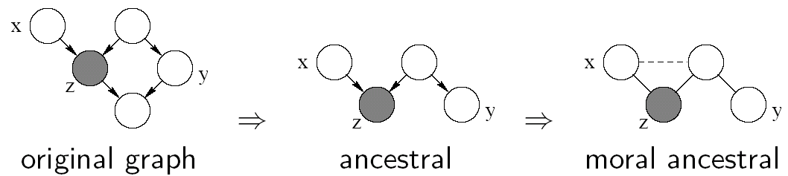
D-Separation (Definition #2)
D-separation criterion for Bayesian networks (D for Directed edges):
Definition: variables X and Y are D-separated (conditionally independent) given Z if they are separated in the moralized ancestral graph
Example:

Slide 60
D-Separation
Theorem [Verma & Pearl, 1998]:
  If a set of evidence variables E d-separates X and Z in a Bayesian network’s graph, then I<X, E, Z>.
d-separation can be computed in linear time using a depth-first-search-like algorithm.
Be careful: d-separation finds what must be conditionally independent
  “Might”: Variables may actually be independent when they’re not d-separated, depending on the actual probabilities involved
Slide from William Cohen

Slide 61
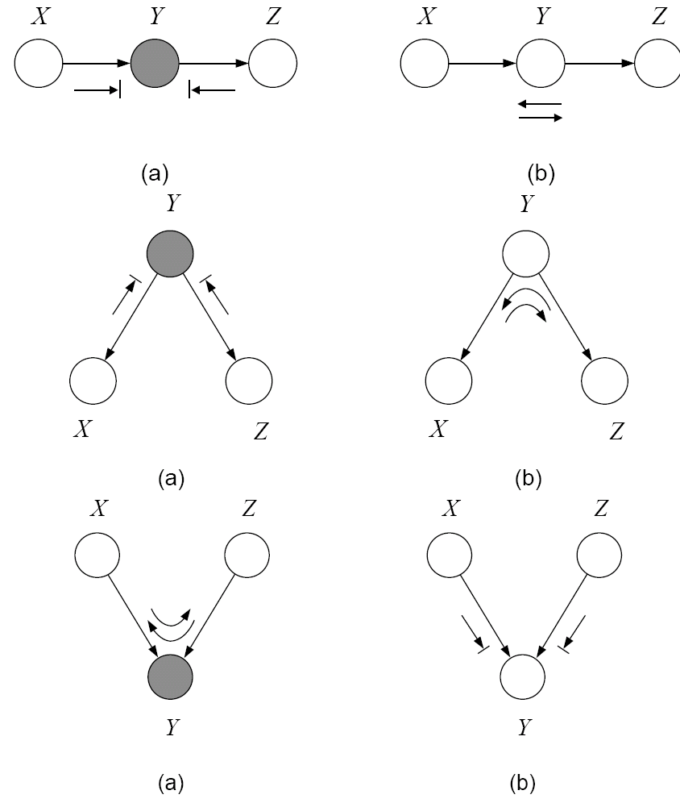
“Bayes-ball” and D-Separation
X is d-separated (directed-separated) from Z given Y if we can't send a ball from any node in X to any node in Z using the "Bayes-ball" algorithm illustrated bellow (and plus some boundary conditions):
Defn: I(G)=all independence properties that correspond to d-separation:
D-separation is sound and complete

Slide 62
Markov Blanket
Ancestor
Parent
A node is conditionally independent of every other node in the network outside its Markov blanket
Y₁
Y₂
X
Child
Co-parent
Co-parent
Descendent

Slide 63
Summary: Bayesian Networks
Structure: DAG
Meaning: a node is conditionally independent of every other node in the network outside its Markov blanket
Local conditional distributions (CPD) and the DAG completely determine the joint dist.
Give causality relationships, and facilitate a generative process
Y₁
Y₂
X

