Slide 1
Clustering.
Unsupervised Learning
Maria-Florina Balcan
10/12/2016

Slide 2
Clustering, Informal Goals
Goal: Automatically partition unlabeled data into groups of similar datapoints.
Question: When and why would we want to do this?
Useful for:
• Automatically organizing data.
• Understanding hidden structure in data.
• Preprocessing for further analysis.
• Representing high-dimensional data in a low-dimensional space (e.g., for visualization purposes).

Slide 3





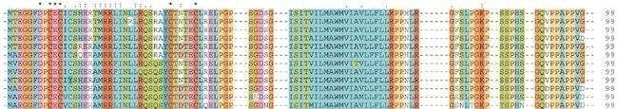
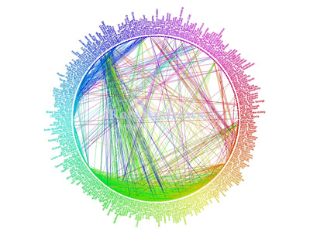
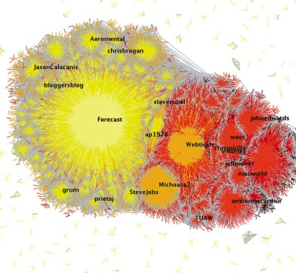
Applications (Clustering comes up everywhere…)
Cluster news articles or web pages or search results by topic.
Cluster protein sequences by function or genes according to expression profile.
Cluster users of social networks by interest (community detection).
Facebook network
Twitter Network

Slide 4

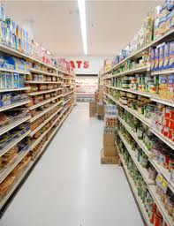
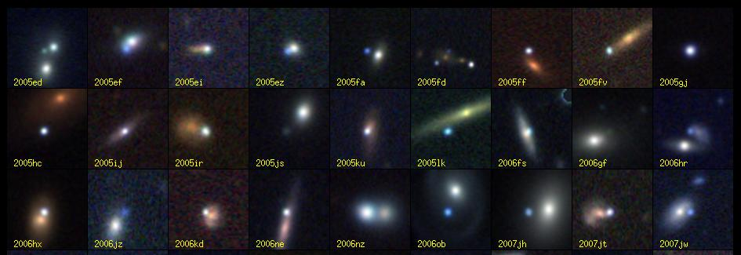
Applications (Clustering comes up everywhere…)
Cluster customers according to purchase history.
Cluster galaxies or nearby stars (e.g. Sloan Digital Sky Survey)
And many many more applications….

Slide 5
Clustering
Today:
Objective based clustering
K-means clustering
Hierarchical clustering

Slide 6









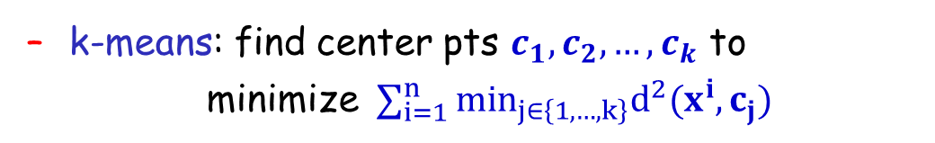
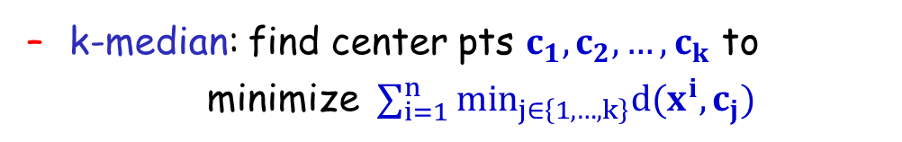
Objective Based Clustering
Input: A set S of n points, also a distance/dissimilarity measure specifying the distance d(x,y) between pairs (x,y).
E.g., # keywords in common, edit distance, wavelets coef., etc.
[sports]
[fashion]
Goal: output a partition of the data.
k-means: find center pts $c_{1},c_{2}, …, c_{k}$ to
minimize $∑_{i=1 }^{n }min_{j∈\left\{1, …,k\right\}}d^{2}(x^{i},c_{j})$
s
c₃
k-median: find center pts $c_{1},c_{2}, …, c_{k}$ to
minimize $∑_{i=1 }^{n }min_{j∈\left\{1, …,k\right\}}d(x^{i},c_{j})$
y
c₁
z
x
c₂
K-center: find partition to minimize the maximum radius

Slide 7
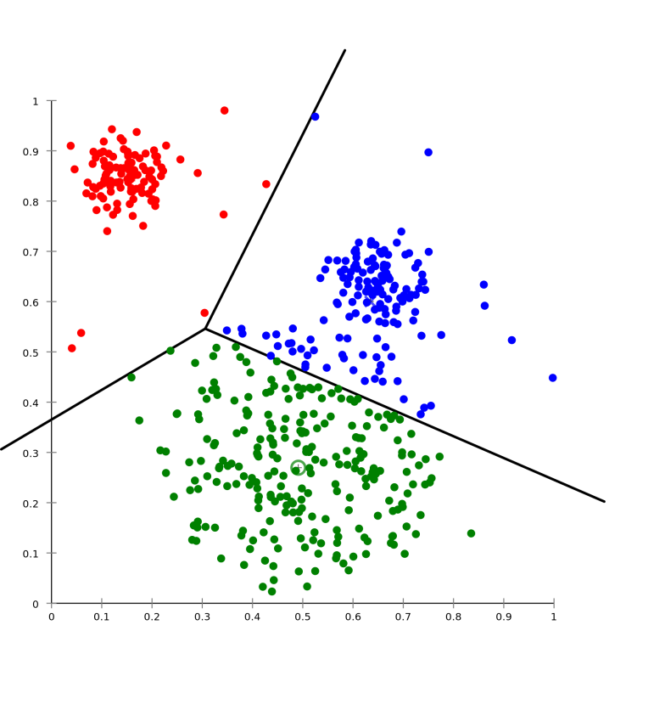
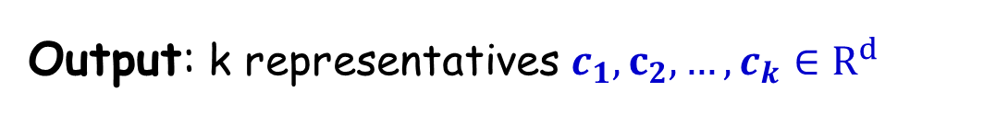
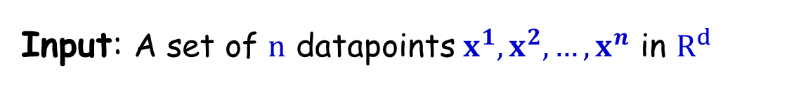

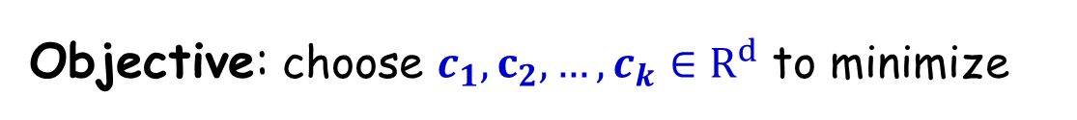
Euclidean k-means Clustering
Input: A set of $n$ datapoints $x^{1}, x^{2}, …, x^{n}$ in $R^{d}$
target #clusters k
Output: k representatives $c_{1},c_{2}, …, c_{k}∈R^{d}$
Objective: choose $c_{1},c_{2}, …, c_{k}∈R^{d}$ to minimize
$$∑_{i=1 }^{n }min_{j∈\left\{1, …,k\right\}}{\left|\left|x^{i}−c_{j}\right|\right|}^{2}$$

Slide 8

Euclidean k-means Clustering
Input: A set of $n$ datapoints $x^{1}, x^{2}, …, x^{n}$ in $R^{d}$
target #clusters k
Output: k representatives $c_{1},c_{2}, …, c_{k}∈R^{d}$
Objective: choose $c_{1},c_{2}, …, c_{k}∈R^{d}$ to minimize
$$∑_{i=1 }^{n }min_{j∈\left\{1, …,k\right\}}{\left|\left|x^{i}−c_{j}\right|\right|}^{2}$$
Natural assignment: each point assigned to its closest center, leads to a Voronoi partition.

Slide 9

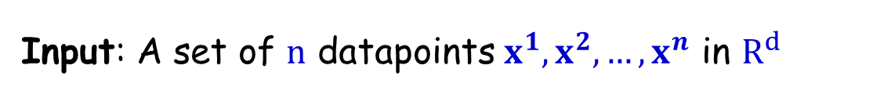
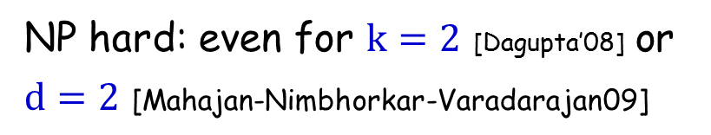

Euclidean k-means Clustering
Input: A set of $n$ datapoints $x^{1}, x^{2}, …, x^{n}$ in $R^{d}$
target #clusters k
Output: k representatives $c_{1},c_{2}, …, c_{k}∈R^{d}$
Objective: choose $c_{1},c_{2}, …, c_{k}∈R^{d}$ to minimize
$$∑_{i=1 }^{n }min_{j∈\left\{1, …,k\right\}}{\left|\left|x^{i}−c_{j}\right|\right|}^{2}$$
Computational complexity:
NP hard: even for $k=2$ [Dagupta’08] or $d=2$ [Mahajan-Nimbhorkar-Varadarajan09]
There are a couple of easy cases…

Slide 10
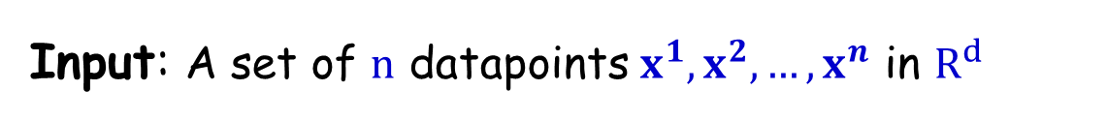
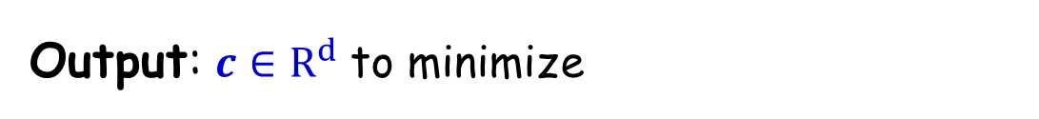
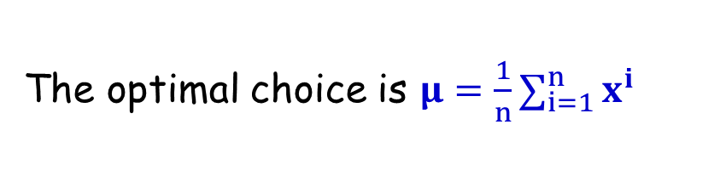
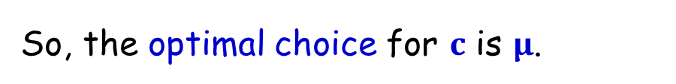
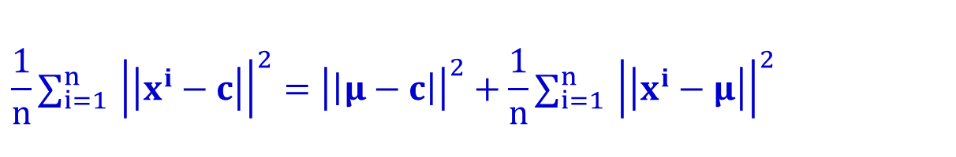
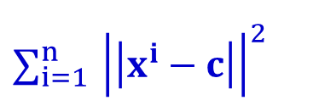
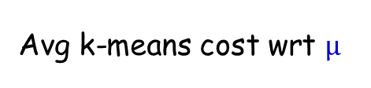
An Easy Case for k-means: k=1
Input: A set of $n$ datapoints $x^{1}, x^{2}, …, x^{n}$ in $R^{d}$
$$∑_{i=1 }^{n }{\left|\left|x^{i}−c\right|\right|}^{2}$$
Output: $c∈R^{d}$ to minimize
The optimal choice is $μ=\frac{1}{n}∑_{i=1 }^{n }x^{i}$
Solution:
Idea: bias/variance like decomposition
$$\frac{1}{n}∑_{i=1 }^{n }{\left|\left|x^{i}−c\right|\right|}^{2}={\left|\left|μ−c\right|\right|}^{2}+\frac{1}{n}∑_{i=1 }^{n }{\left|\left|x^{i}−μ\right|\right|}^{2}$$
Avg k-means cost wrt c
Avg k-means cost wrt $μ$
So, the optimal choice for $c$ is $μ$.

Slide 11
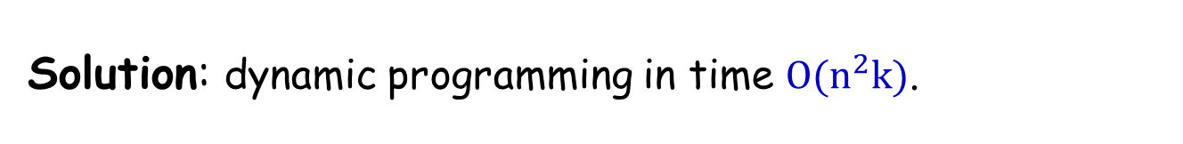
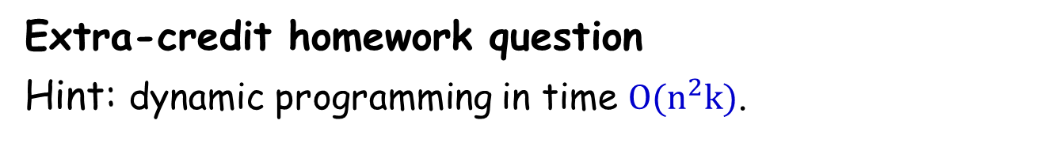
Another Easy Case for k-means: d=1
Input: A set of $n$ datapoints $x^{1}, x^{2}, …, x^{n}$ in $R^{d}$
$$∑_{i=1 }^{n }{\left|\left|x^{i}−c\right|\right|}^{2}$$
Output: $c∈R^{d}$ to minimize
Extra-credit homework question
Hint: dynamic programming in time $O(n^{2}k)$.

Slide 12
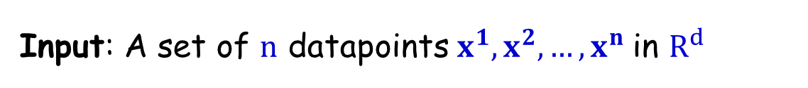
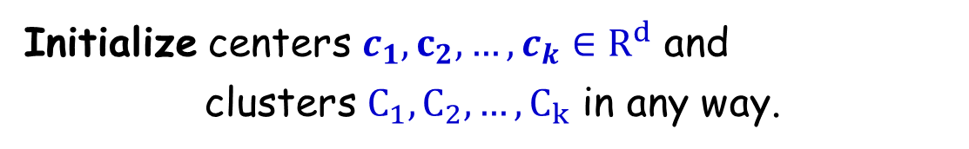
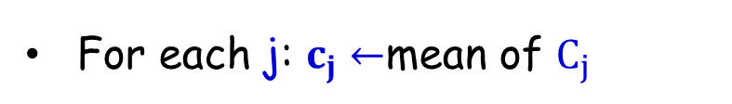
Common Heuristic in Practice:
The Lloyd’s method
[Least squares quantization in PCM, Lloyd, IEEE Transactions on Information Theory, 1982]
Input: A set of $n$ datapoints $x^{1}, x^{2}, …, x^{n}$in $R^{d}$
Initialize centers $c_{1},c_{2}, …, c_{k}∈R^{d}$ and
clusters $C_{1},C_{2}, …, C_{k}$ in any way.
Repeat until there is no further change in the cost.
For each j: $C_{j}←${$x∈S$ whose closest center is $c_{j}$}
For each j: $c_{j}←$mean of $C_{j}$

Slide 13
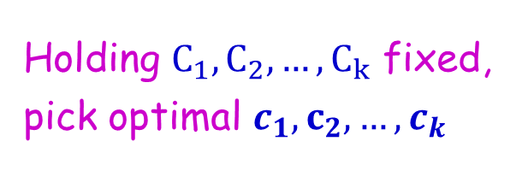
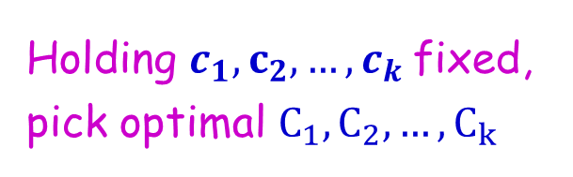
Common Heuristic in Practice:
The Lloyd’s method
[Least squares quantization in PCM, Lloyd, IEEE Transactions on Information Theory, 1982]
Input: A set of $n$ datapoints $x^{1}, x^{2}, …, x^{n}$in $R^{d}$
Initialize centers $c_{1},c_{2}, …, c_{k}∈R^{d}$ and
clusters $C_{1},C_{2}, …, C_{k}$ in any way.
Repeat until there is no further change in the cost.
For each j: $C_{j}←${$x∈S$ whose closest center is $c_{j}$}
For each j: $c_{j}←$mean of $C_{j}$
Holding $c_{1},c_{2}, …, c_{k}$fixed, pick optimal $C_{1},C_{2}, …, C_{k}$
Holding $C_{1},C_{2}, …, C_{k}$ fixed, pick optimal $c_{1},c_{2}, …, c_{k}$

Slide 14
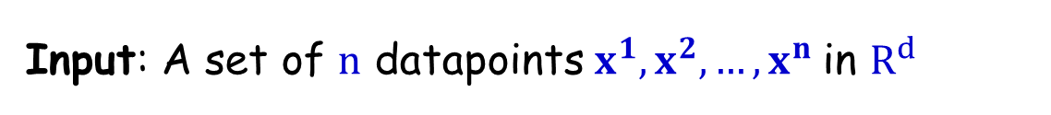
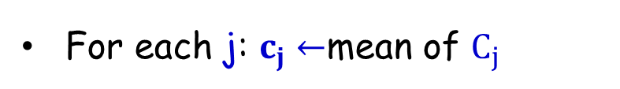
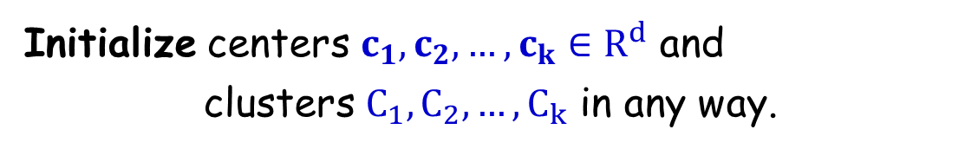
Common Heuristic: The Lloyd’s method
Input: A set of $n$ datapoints $x^{1}, x^{2}, …, x^{n}$in $R^{d}$
Initialize centers $c_{1},c_{2}, …, c_{k}∈R^{d}$ and
clusters $C_{1},C_{2}, …, C_{k}$ in any way.
Repeat until there is no further change in the cost.
For each j: $C_{j}←${$x∈S$ whose closest center is $c_{j}$}
For each j: $c_{j}←$mean of $C_{j}$
Note: it always converges.
the cost always drops and
there is only a finite #s of Voronoi partitions (so a finite # of values the cost could take)

Slide 15
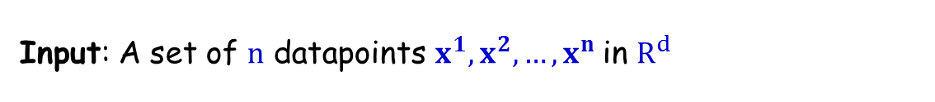
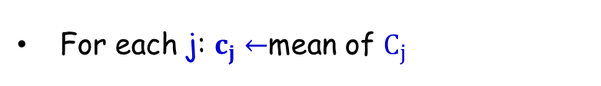
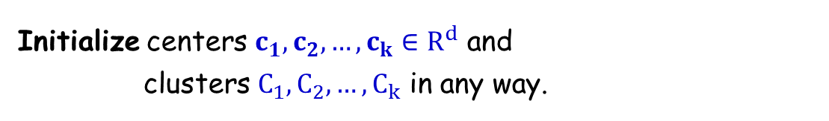
Initialization for the Lloyd’s method
Input: A set of $n$ datapoints $x^{1}, x^{2}, …, x^{n}$in $R^{d}$
Initialize centers $c_{1},c_{2}, …, c_{k}∈R^{d}$ and
clusters $C_{1},C_{2}, …, C_{k}$ in any way.
Repeat until there is no further change in the cost.
For each j: $C_{j}←${$x∈S$ whose closest center is $c_{j}$}
For each j: $c_{j}←$mean of $C_{j}$
Initialization is crucial (how fast it converges, quality of solution output)
Discuss techniques commonly used in practice
Random centers from the datapoints (repeat a few times)
Furthest traversal
K-means ++ (works well and has provable guarantees)

Slide 16
Lloyd’s method: Random Initialization

Slide 17
Lloyd’s method: Random Initialization
Example: Given a set of datapoints

Slide 18
Lloyd’s method: Random Initialization
Select initial centers at random

Slide 19
Lloyd’s method: Random Initialization
Assign each point to its nearest center

Slide 20
Lloyd’s method: Random Initialization
Recompute optimal centers given a fixed clustering

Slide 21
Lloyd’s method: Random Initialization
Assign each point to its nearest center

Slide 22
Lloyd’s method: Random Initialization
Recompute optimal centers given a fixed clustering

Slide 23
Lloyd’s method: Random Initialization
Assign each point to its nearest center

Slide 24
Lloyd’s method: Random Initialization
Recompute optimal centers given a fixed clustering
Get a good quality solution in this example.

Slide 25
Lloyd’s method: Performance
It always converges, but it may converge at a local optimum that is different from the global optimum, and in fact could be arbitrarily worse in terms of its score.

Slide 26
Lloyd’s method: Performance
Local optimum: every point is assigned to its nearest center and every center is the mean value of its points.

Slide 27
Lloyd’s method: Performance
.It is arbitrarily worse than optimum solution….

Slide 28
Lloyd’s method: Performance
This bad performance, can happen even with well separated Gaussian clusters.

Slide 29
Lloyd’s method: Performance
This bad performance, can happen even with well separated Gaussian clusters.
Some Gaussian are combined…..

Slide 30
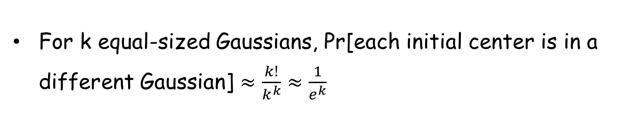
Lloyd’s method: Performance
If we do random initialization, as k increases, it becomes more likely we won’t have perfectly picked one center per Gaussian in our initialization (so Lloyd’s method will output a bad solution).
For k equal-sized Gaussians, Pr[each initial center is in a different Gaussian] $≈\frac{k!}{k^{k}}≈\frac{1}{e^{k}}$
Becomes unlikely as k gets large.

Slide 31
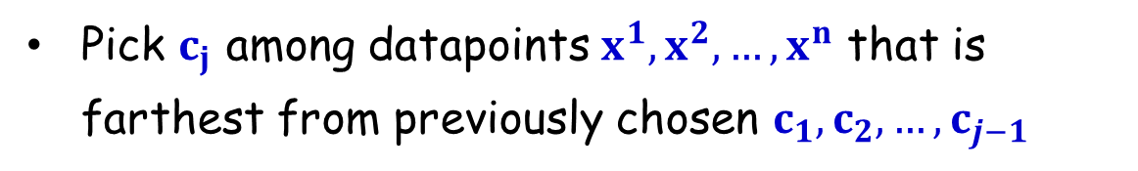
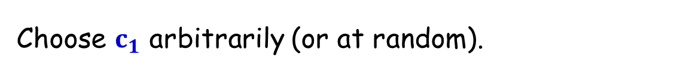
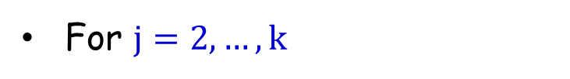
Another Initialization Idea: Furthest Point Heuristic
Choose $c_{1}$ arbitrarily (or at random).
For $j=2, …,k$
Pick $c_{j}$ among datapoints $x^{1}, x^{2}, …, x^{n}$ that is farthest from previously chosen $c_{1},c_{2}, …, c_{j−1}$
Fixes the Gaussian problem. But it can be thrown off by outliers….

Slide 32
Furthest point heuristic does well on previous example

Slide 33
Furthest point initialization heuristic sensitive to outliers
Assume k=3
(0,1)
(-2,0)
(3,0)
(0,-1)

Slide 34
Furthest point initialization heuristic sensitive to outliers
Assume k=3
(0,1)
(-2,0)
(3,0)
(0,-1)

Slide 35
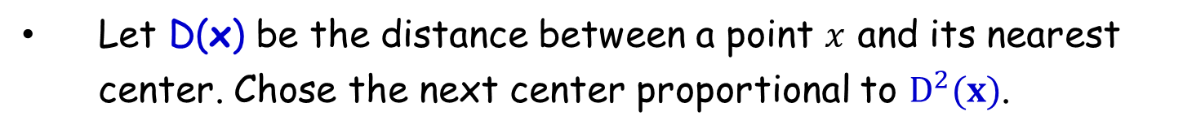
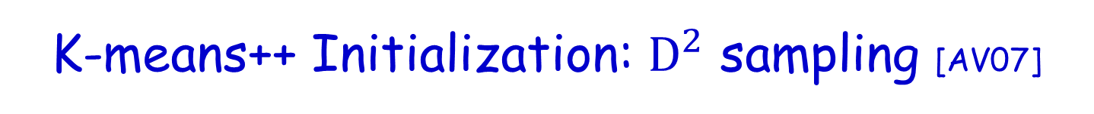
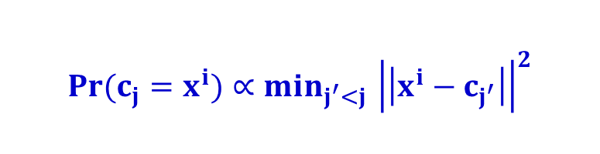

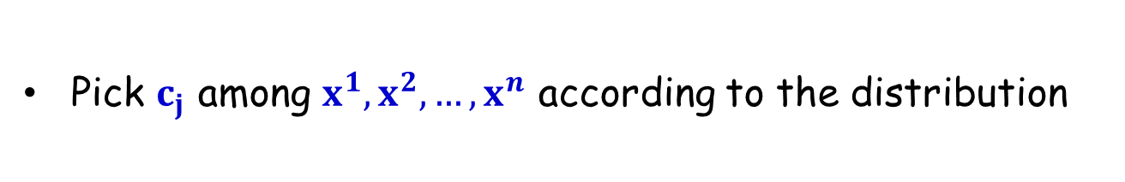
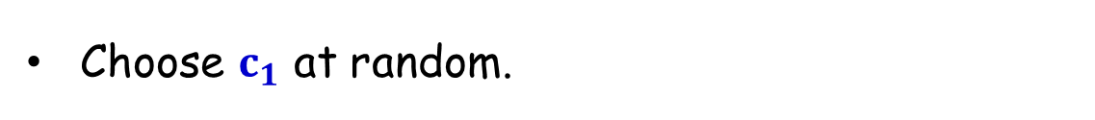

K-means++ Initialization: $D^{2}$ sampling [AV07]
Interpolate between random and furthest point initialization
Let D(x) be the distance between a point $x$ and its nearest center. Chose the next center proportional to $D^{2}(x)$.
Choose $c_{1}$ at random.
For $j=2, …,k$
Pick $c_{j}$ among $x^{1}, x^{2}, …, x^{n}$ according to the distribution
$${Pr(c}_{j}=x^{i})∝min_{j^{′}<j }{\left|\left|x^{i}−c_{j^{′}}\right|\right|}^{2}$$
$$D^{2}(x^{i})$$
Theorem: K-means++ always attains an O(log k) approximation to optimal k-means solution in expectation.
Running Lloyd’s can only further improve the cost.

Slide 36

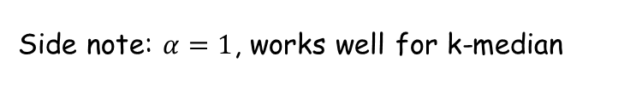

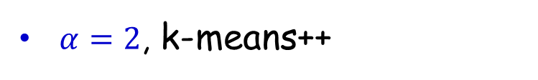
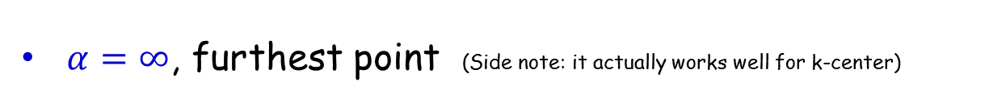
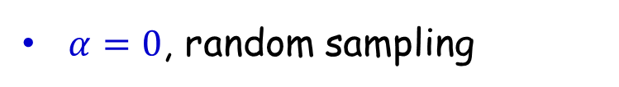
K-means++ Idea: $D^{2}$ sampling
Interpolate between random and furthest point initialization
Let D(x) be the distance between a point $x$ and its nearest center. Chose the next center proportional to $D^{α}(x)$.
$α=0$, random sampling
$α=∞$, furthest point (Side note: it actually works well for k-center)
$α=2$, k-means++
Side note: $α=1$, works well for k-median

Slide 37
K-means++ approximation factor intuition
Theorem: K-means++ always attains an O(log k) approximation to optimal k-means solution in expectation.
To get a constant-factor approximation for a given cluster, it turns out to be enough to have a random center from that cluster.
Ideally, after each center is chosen, we would set weights to 0 for points in its cluster, 1 for points outside its cluster.
K-means++ is an approximation to this that we can run without knowing the clusters in advance.

Slide 38
K-means ++ Fix
(0,1)
(-2,0)
(3,0)
(0,-1)

Slide 39
K-means ++ Fix
If the outlier should be in its own cluster…
(-2,0)
(0,1)
(100,0)
(0,-1)

Slide 40
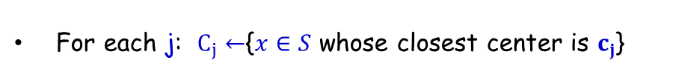
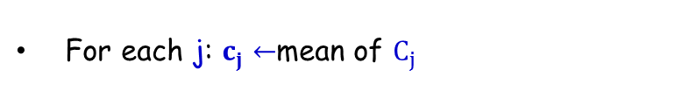
K-means++/ Lloyd’s Running Time
K-means ++ initialization: O(nd) and one pass over data to select next center. So O(nkd) time in total.
Lloyd’s method
Repeat until there is no change in the cost.
Each round takes time O(nkd).
For each j: $C_{j}←${$x∈S$ whose closest center is $c_{j}$}
For each j: $c_{j}←$mean of $C_{j}$
Exponential # of rounds in the worst case [AV07].
Expected polynomial time in the smoothed analysis (non worst-case) model!

Slide 41
K-means++/ Lloyd’s Summary
K-means++ always attains an O(log k) approximation to optimal k-means solution in expectation.
Running Lloyd’s can only further improve the cost.
Exponential # of rounds in the worst case [AV07].
Expected polynomial time in the smoothed analysis model!
Does well in practice.

Slide 42
What value of k???
Heuristic: Find large gap between k -1-means cost and k-means cost.
Hold-out validation/cross-validation on auxiliary task (e.g., supervised learning task).
Try hierarchical clustering.

Slide 43









Hierarchical Clustering
[sports]
All topics
[fashion]
sports
fashion
tennis
Lacoste
soccer
Gucci
A hierarchy might be more natural.
Different users might care about different levels of granularity or even prunings.

Slide 44
What You Should Know
Partitional Clustering. k-means and k-means ++
Lloyd’s method
Initialization techniques (random, furthest traversal, k-means++)

