Slide 1






CoreScope:
Graph Mining Using k-Core Analysis
- Patterns, Anomalies and Algorithms
Kijung Shin
Carnegie Mellon University
Tina Eliassi-Rad
Northeastern University
Christos Faloutsos
Carnegie Mellon University

Slide 2
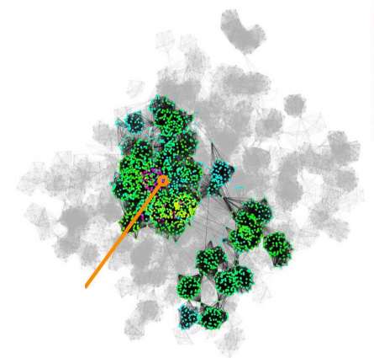
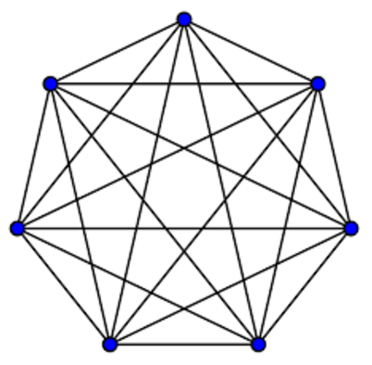
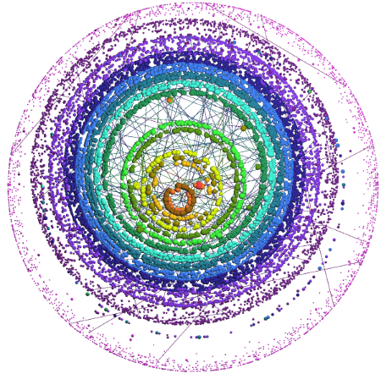
Motivation: k-Core Analysis
k-Cores in a Graph
individually
together
Dense Subgraphs
Layered Structure
Influential Spreader
(Kitsak et al. 2010)
Densest Subgraph
(Andersen et al, 2009)
Graph Visualization
(Alvarez-Hamelin et al. 2005)

Slide 3







Research Questions
Question 1 [Patterns]
What are common patterns regarding k-cores
occurring across graphs in diverse domains?
(e.g., , , )
Question 2 [Anomalies]
What are anomalies deviating from
these patterns?
Question 3 [Algorithms]
How can these patterns and anomalies be
used for designing algorithms?

Slide 4


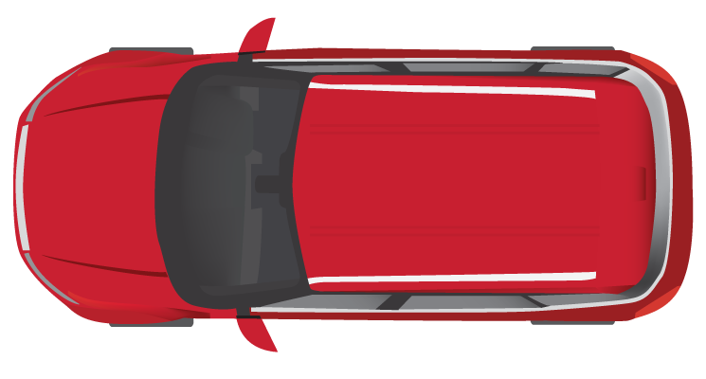
Road Map
Introduction
Definition of K-Cores <<
Pattern 1: “Mirror Pattern”
Pattern 2: “Core-Triangle Pattern”
Pattern 3: “Structural-Core Pattern”
Conclusion

Slide 5
Definition: k-Core
k-core: maximal subgraph of nodes with degree at least k in the subgraph
Degeneracy: maximum k such that the k-core exists
Coreness of a node: maximum k such that
the node is in the k-core
1-Core
2-Core
Nodes with coreness 1
Nodes with coreness 2
Nodes with coreness 3
3-Core

Slide 6
Road Map
Introduction
Definition of K-Cores.
Pattern 1: “Mirror Pattern” <<
  Pattern
  Anomaly
  Algorithm: Core-A (Anomaly Detection)
Pattern 2: “Core-Triangle Pattern”
Pattern 3: “Structural-Core Pattern”
Conclusion

Slide 7

Mirror Pattern: Question
Question:
What is the key factor determining
the coreness of nodes?
[Reminder] Coreness of a node is the highest k value such that the node is in the k-core
Coreness

Slide 8
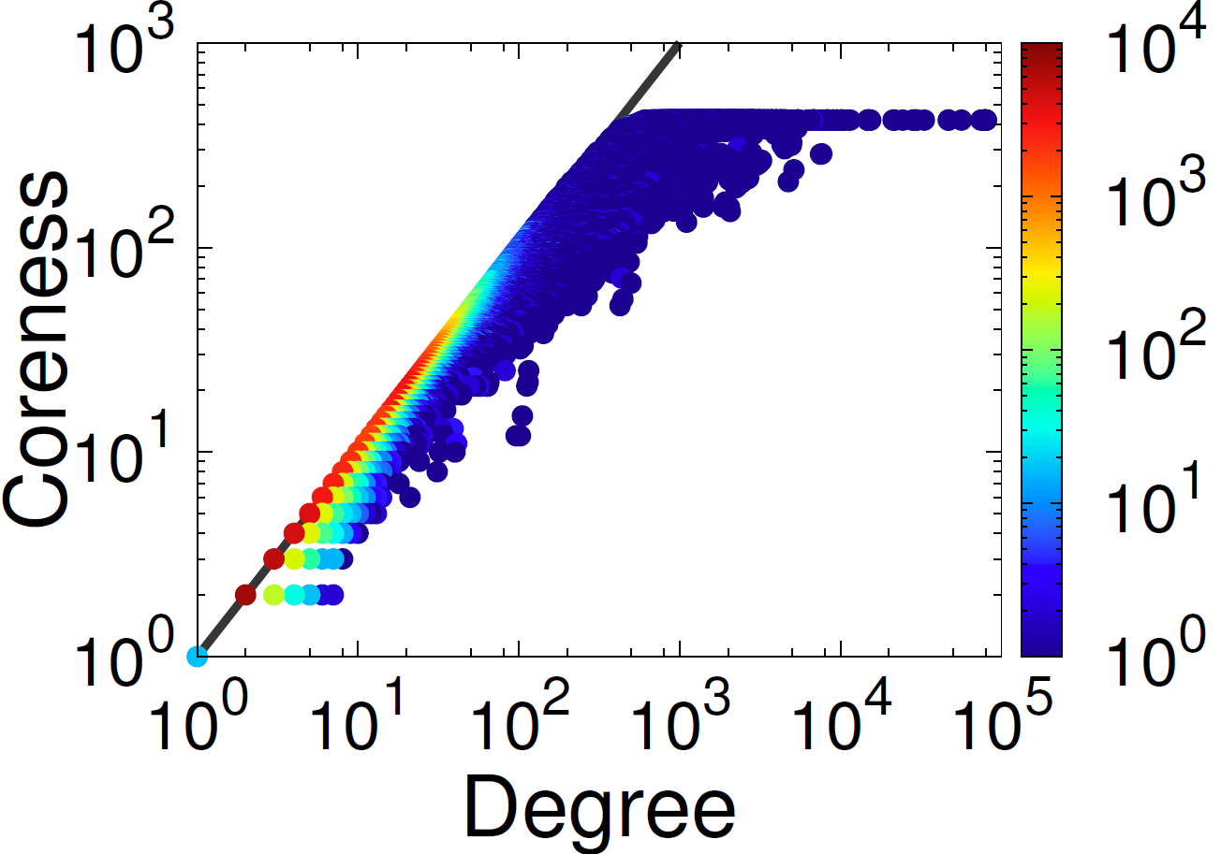
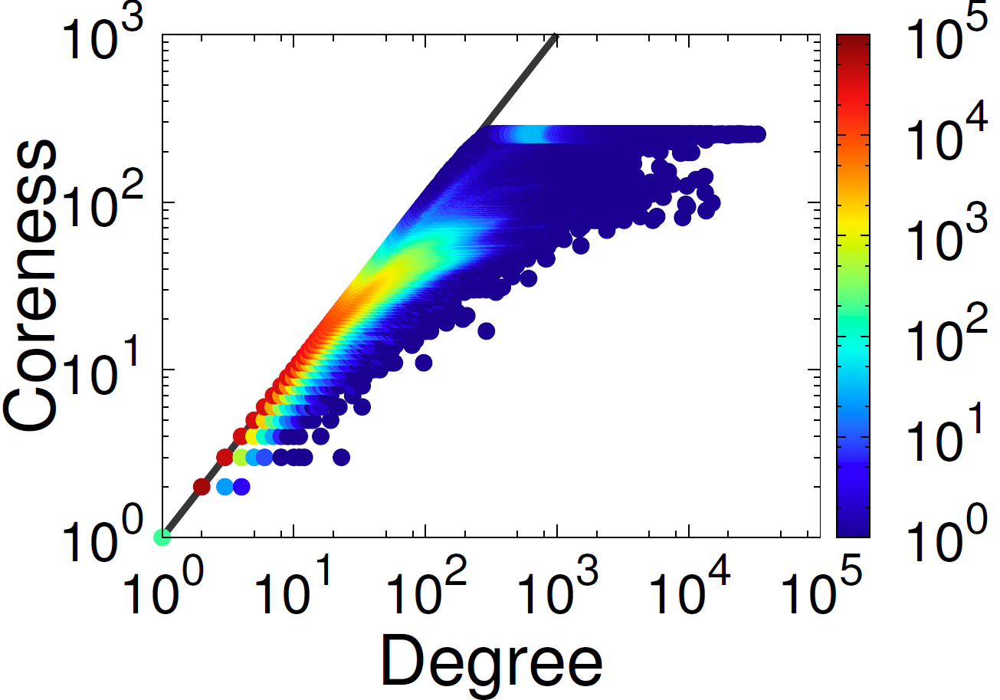


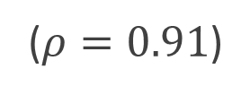
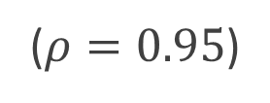
Mirror Pattern: Pattern
Pattern 1: Mirror Pattern
Strong correlation between degree and coreness
with “Boomerang” shape distribution
($ρ=0.95$)
($ρ=0.91$)
Social Network in Catster
Social Network in Orkut

Slide 9

Mirror Pattern: Anomalies
Question:
Do all nodes follow this pattern?
Answer:
No! Nodes deviating from the pattern
are interesting anomalies.

Slide 10



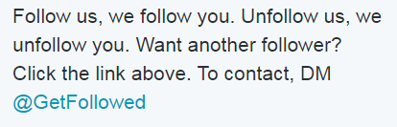
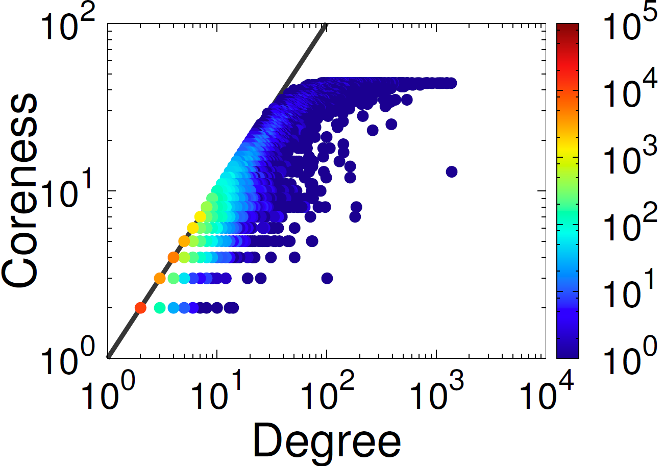
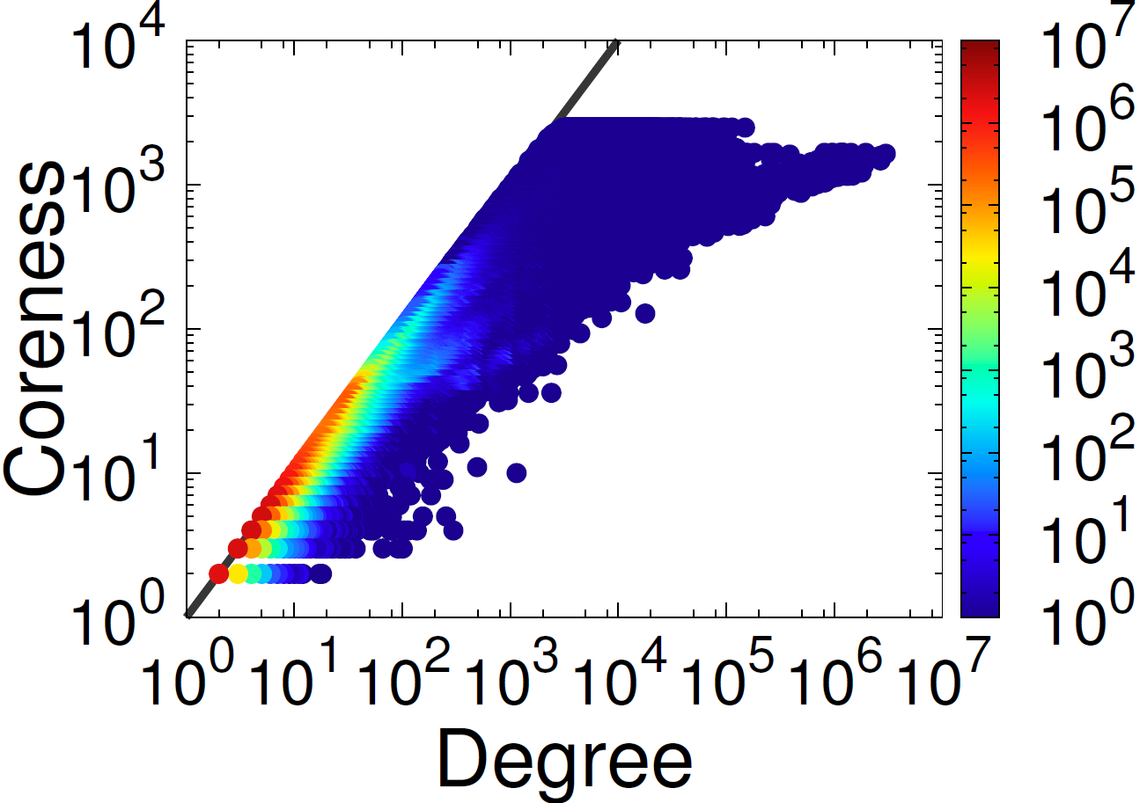


Mirror Pattern: Anomalies
CEO
20X
4X
Email Network in
Social Network in

Slide 11

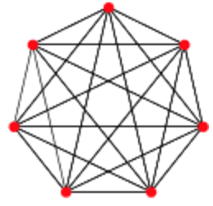
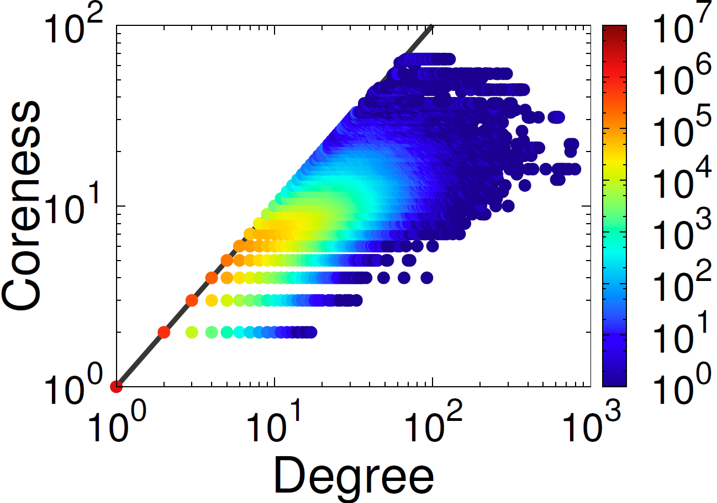
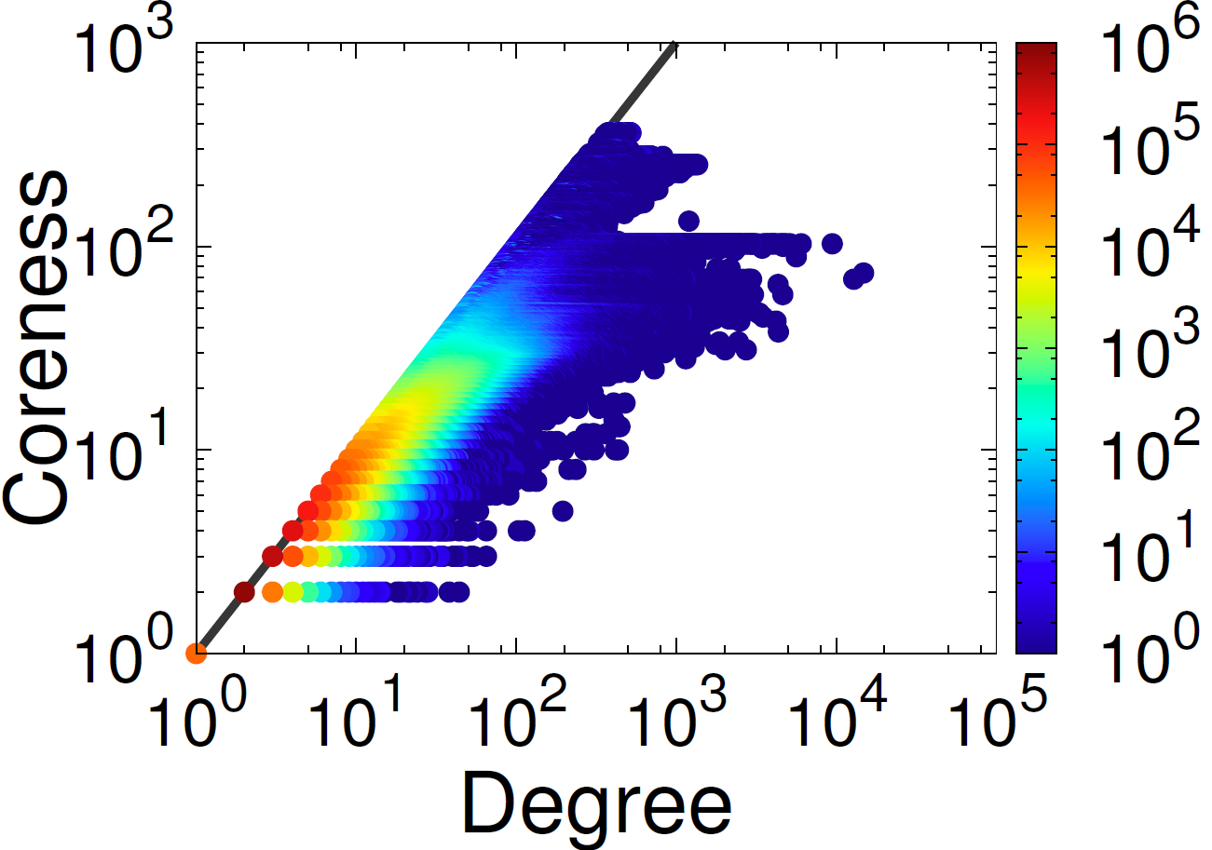


Mirror Pattern: Anomalies
Copy-and-paste
References
Isolated
Near-clique
6X
28X
Patent Citation Network
Social Network in

Slide 12
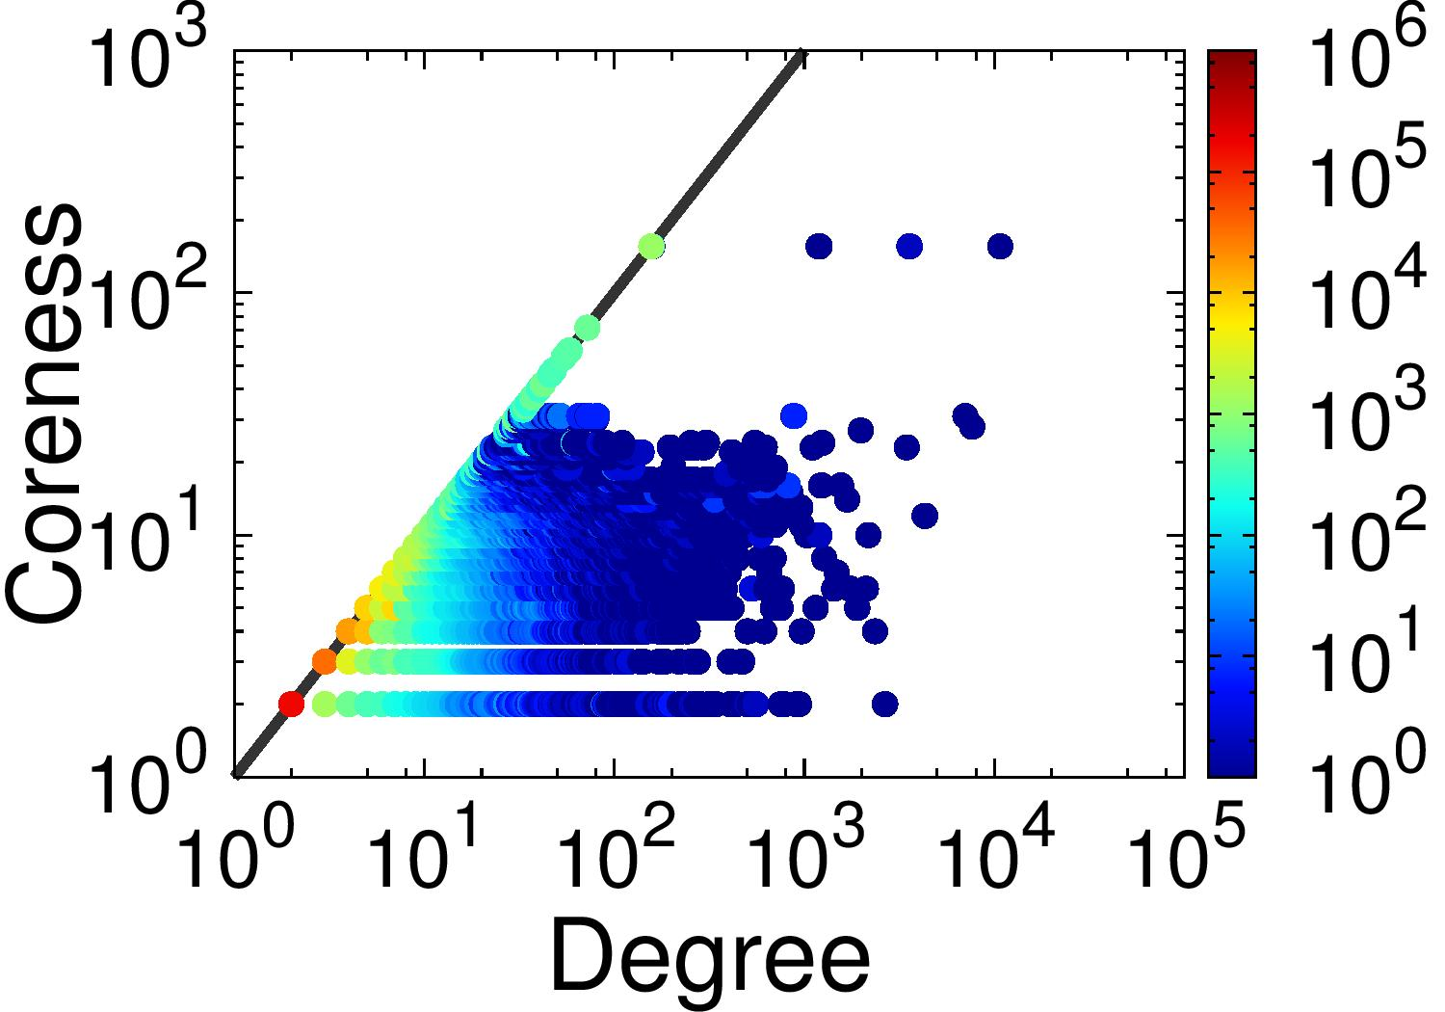
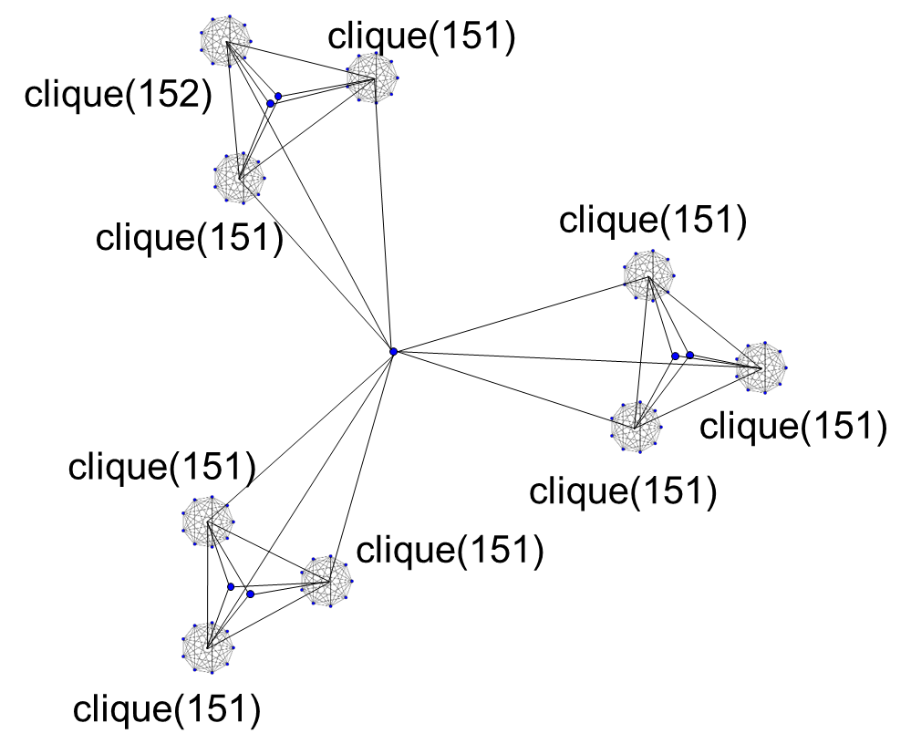

Mirror Pattern: Anomalies
Propeller-Shaped Subgraph
69X
NotreDame Web graph

Slide 13
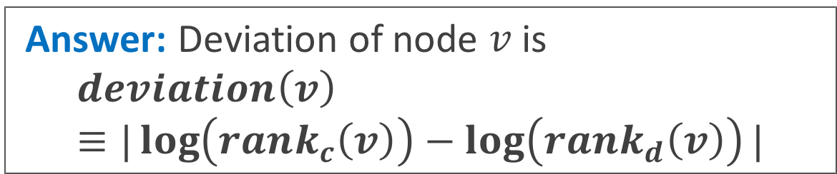
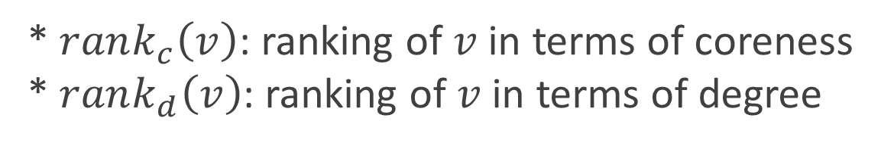
Mirror Pattern: Algorithm
Question:
How can we measure the deviation
from Mirror Pattern?
Answer: Deviation of node $v$ is
$$deviation\left(v\right)≡|\log\left(rank_{c}\left(v\right)\right)−\log\left(rank_{d}\left(v\right)\right)|$$
* $rank_{c}\left(v\right)$: ranking of $v$ in terms of coreness
* $rank_{d}\left(v\right)$: ranking of $v$ in terms of degree

Slide 14
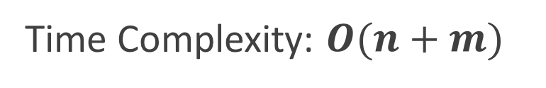
Mirror Pattern: Algorithm
Algorithm 1: Core-A
Anomaly Detection based on Mirror Pattern
Input: a graph
Output: suspiciousness of every node
compute the degree of every node
rank in terms of degree
compute the coreness of every node
rank in terms of coreness
compute the deviation of every node
Time Complexity: $O(n+m)$

Slide 15
Mirror Pattern: Experiment
Question:
Does Core-A detect different anomalies with other dense-subgraph based algorithms?
Answer:
Yes, they are complementary

Slide 16
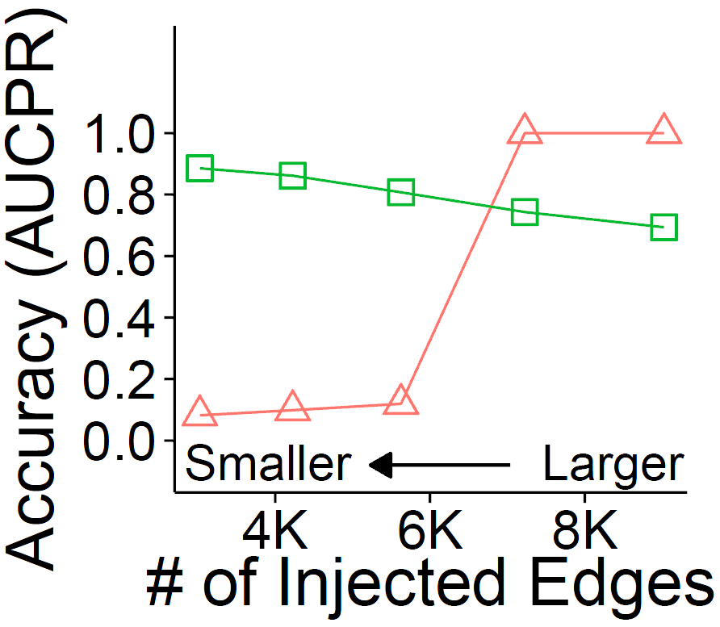
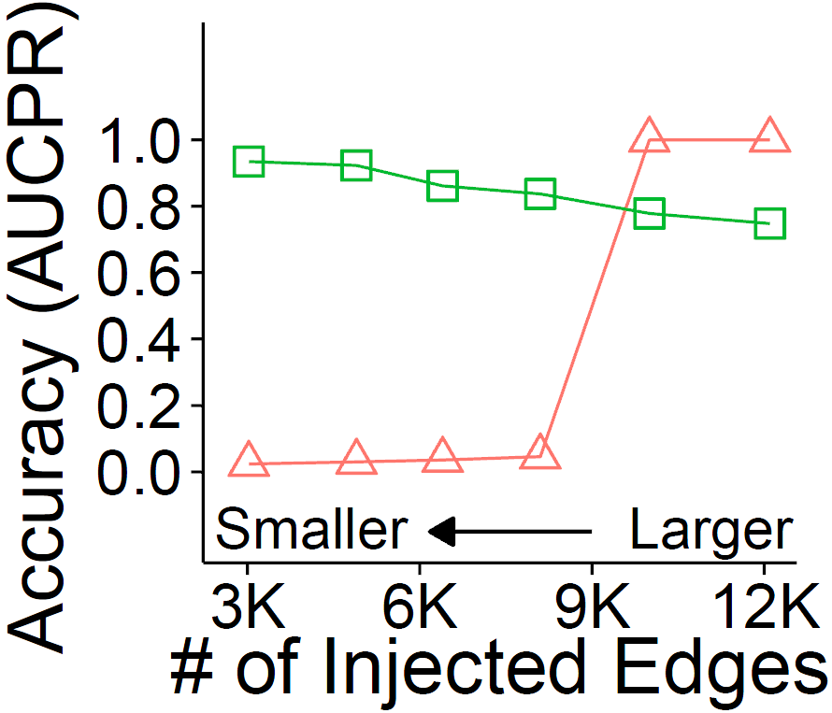

Mirror Pattern: Experiment
Question: How accurately does Core-A detect injected subgraph with different sizes?
Core-A (Proposed) Densest Subgraph (Shin et al. 2016)
Core-A
Core-A
Email Network in
Social Network in Youtube

Slide 17
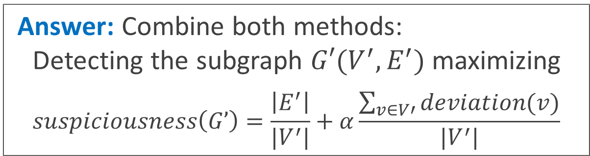
Mirror Pattern: Algorithm
Question:
How can we detect anomalies accurately regardless of the size of subgraphs?
Answer: Combine both methods:
Detecting the subgraph $G′(V^{′},E^{′})$ maximizing
$$suspiciousness\left(G’\right)=\frac{\left|E^{′}\right|}{|V^{′}|}+α\frac{\sum_{v∈V′}{deviation(v)}}{|V^{′}|}$$
Density
Average Deviation

Slide 18

Mirror Pattern: Algorithm
Algorithm 2: Core-A++
Combine Core-A with Densest Subgraph Method
Input: a graph
Output: suspicious dense subgraph
compute the deviation of every node (core-A)
find the subgraph maximizing suspiciousness
(Hooi et al. 2016)
- Time complexity for 2-approximation:
$$O\left(n+\operatorname{mlog}{n}\right)$$

Slide 19
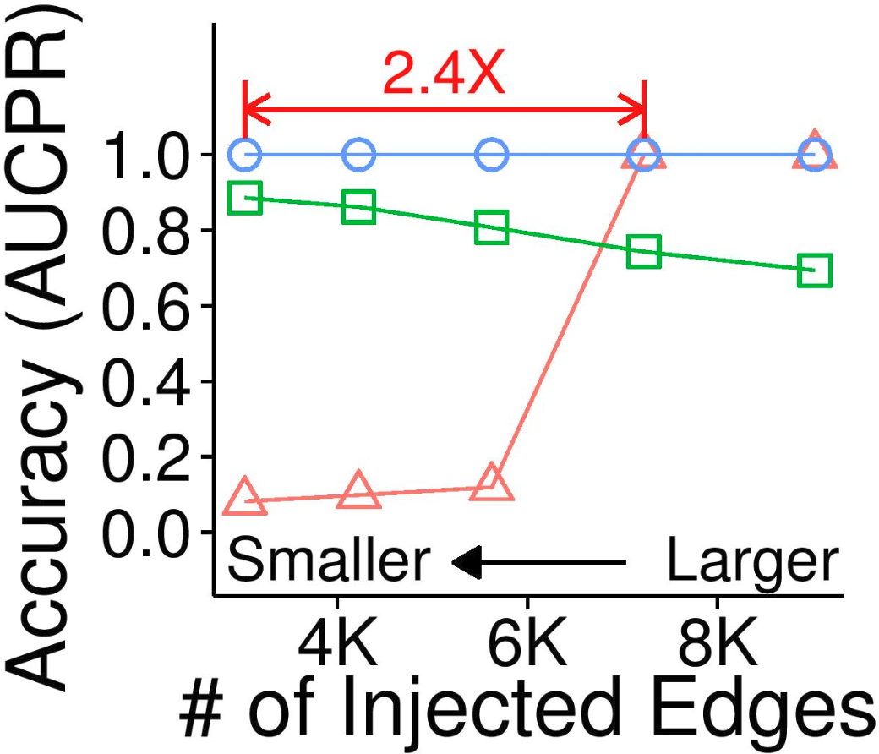
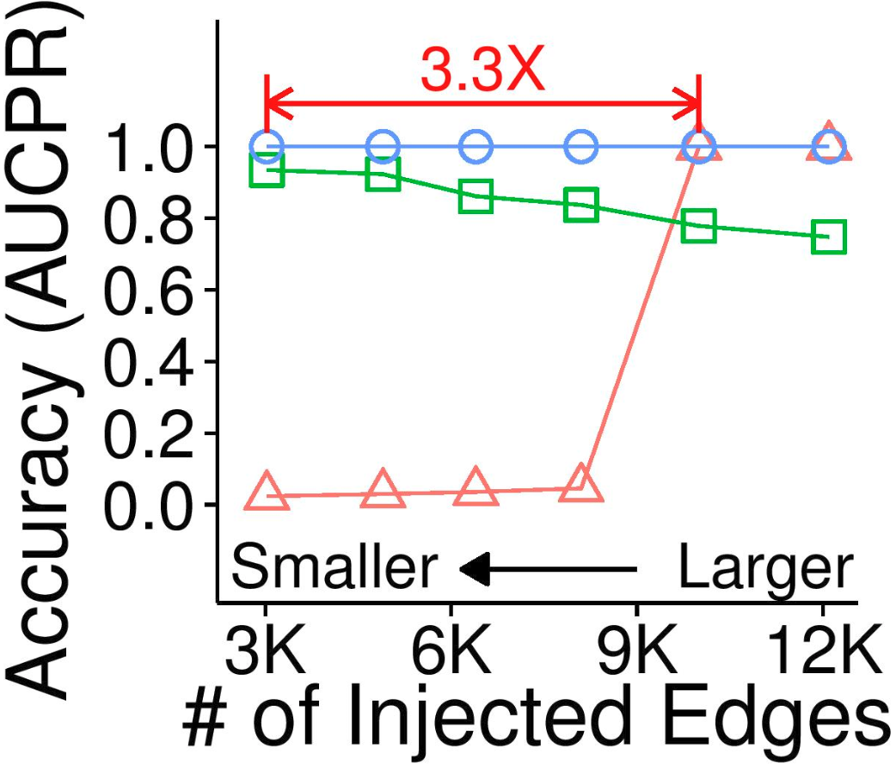
Mirror Pattern: Experiment
Question: How accurately does Core-A++ detect injected subgraph with different sizes?
Core-A++ (Proposed) Core-A Densest Subgraph
Core-A++
Core-A++
Email Network in
Social Network in Youtube

Slide 20
Road Map
Introduction
Definition of K-Cores
Pattern 1: “Mirror Pattern”
Pattern 2: “Core-Triangle Pattern” <<
  Pattern
  Analysis
  Algorithm: Core-D (Degeneracy in Graph Stream)
Pattern 3: “Structural-Core Pattern”
Conclusion

Slide 21
Core-Triangle Pattern: Question
Question:
What is the key factor determining degeneracy?
[Reminder] Degeneracy of a graph is the highest value k such that the k-core exists
Degeneracy

Slide 22


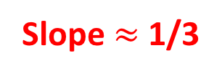
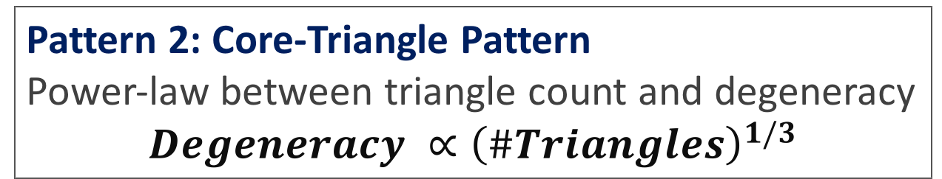
Core-Triangle Pattern: Pattern
Pattern 2: Core-Triangle Pattern
Power-law between triangle count and degeneracy
$$Degeneracy ∝{\left(\#Triangles\right)}^{1/3}$$
Social Network
Web Graph
Citation Network
Internet Topology
Slope $≈$ 1/3

Slide 23
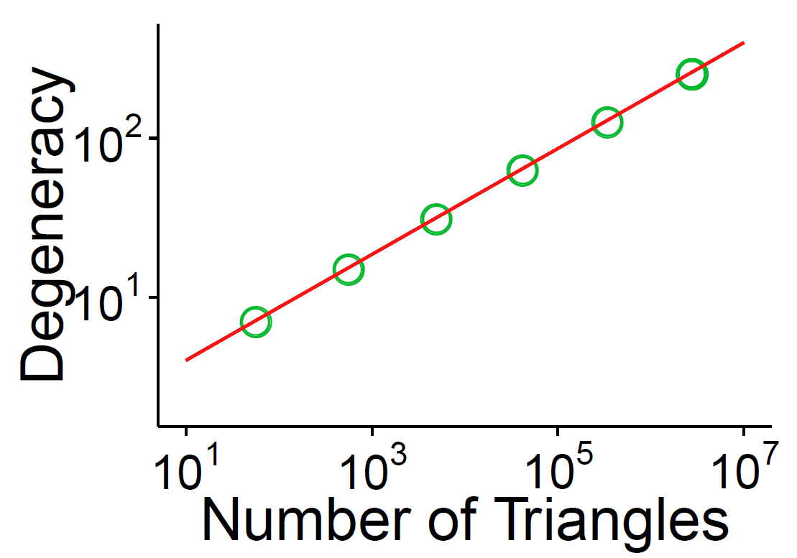
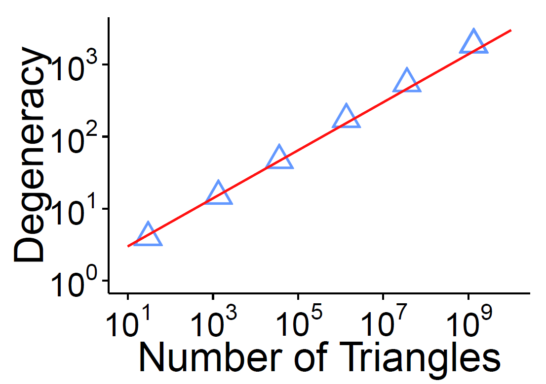
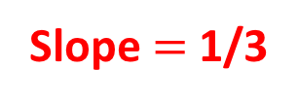
Core-Triangle Pattern: Analysis
Question:
How can we explain this pattern?
Slope $=$ 1/3
Slope $=$ 1/3
Kronecker Graph
(Leskovec et al. 2010)
ER Random Graph
*Detailed Conditions are in the paper

Slide 24
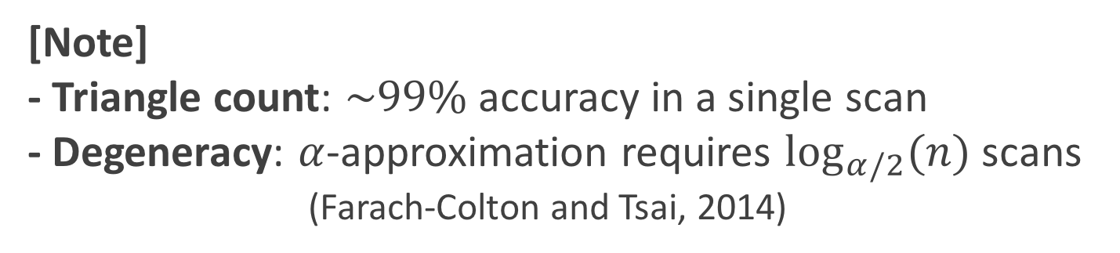
Core-Triangle Pattern: Algorithm
Question:
How can we exploit the relation between
the triangle count and degeneracy?
Answer:
Estimating Degeneracy in graph stream
[Note]
- Triangle count: $\sim 99\%$ accuracy in a single scan
- Degeneracy: $α$-approximation requires $\log_{α/2}(n)$ scans
(Farach-Colton and Tsai, 2014)

Slide 25
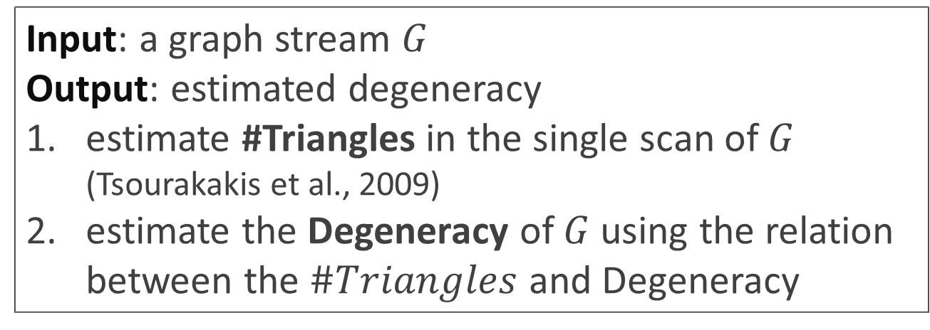
Core-Triangle Pattern: Algorithm
Algorithm 3: Core-D
Estimate Degeneracy in Graph Stream
Input: a graph stream $G$
Output: estimated degeneracy
estimate #Triangles in the single scan of $G$ (Tsourakakis et al., 2009)
estimate the Degeneracy of $G$ using the relation between the $\#Triangles$ and Degeneracy
Number of scans of the graph stream: 1

Slide 26
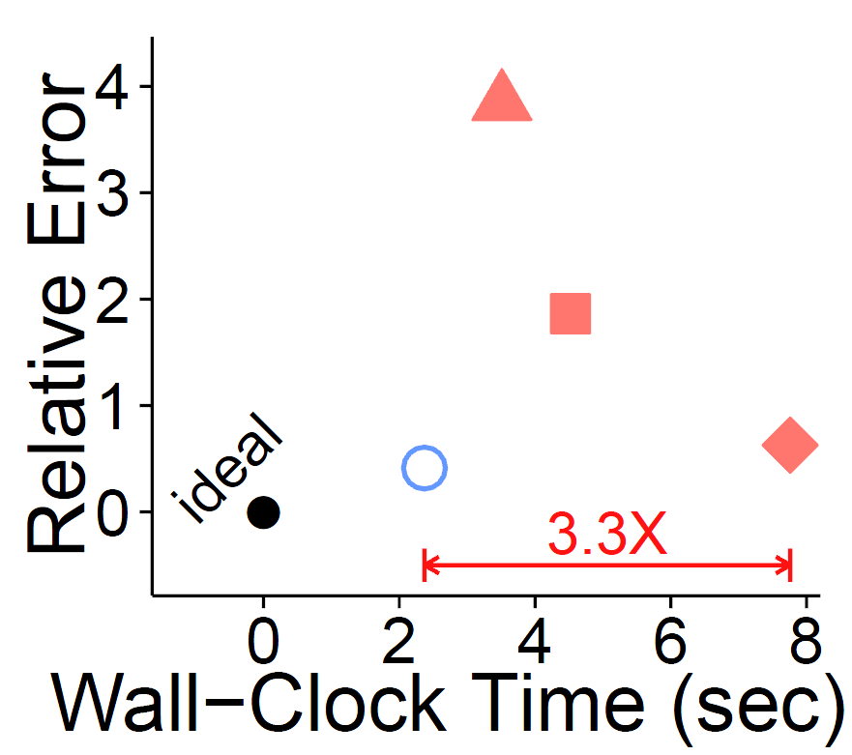
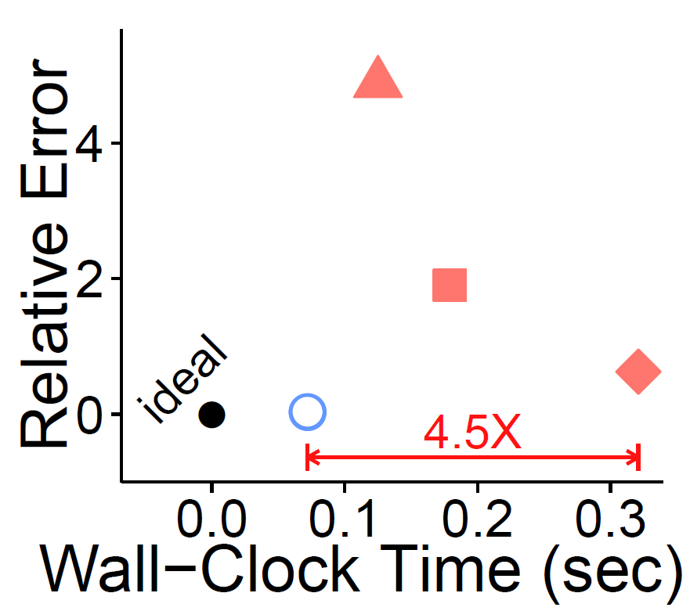


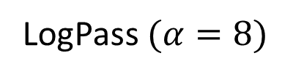
Core-Triangle Pattern: Experiment
Question: How fast and accurately does
Core-D estimate degeneracy?
Core-D (Proposed)
LogPass $(α=8)$
$$α=4$$
$$α=2$$
Core-D
Core-D
Social Network in
Email Network in

Slide 27
Road Map
Introduction
Pattern 1: “Mirror Pattern”
Pattern 2: “Core-Triangle Pattern”
Pattern 3: “Structural-Core Pattern” <<
  Pattern
  Algorithm: Core-S (Spreader Identification)
Conclusion

Slide 28
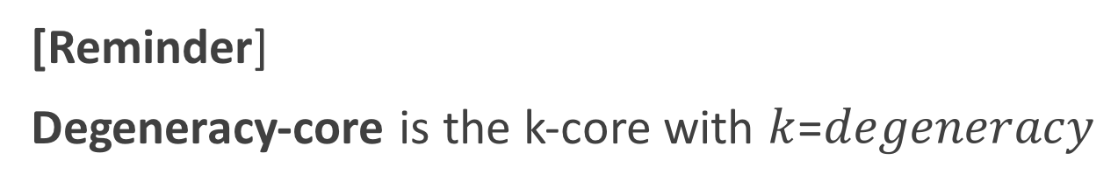
Structural-Core Pattern: Question
Question: Do degeneracy-cores have structural patterns? Are they cliques?
[Reminder]
Degeneracy-core is the k-core with $k$=$degeneracy$
Degeneracy-core

Slide 29
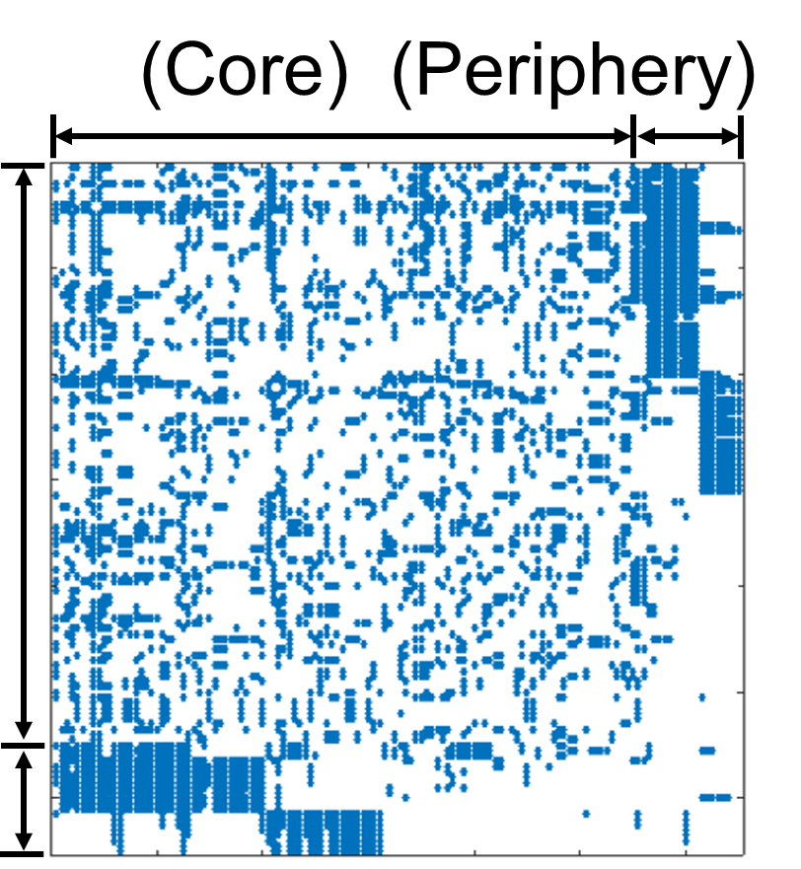
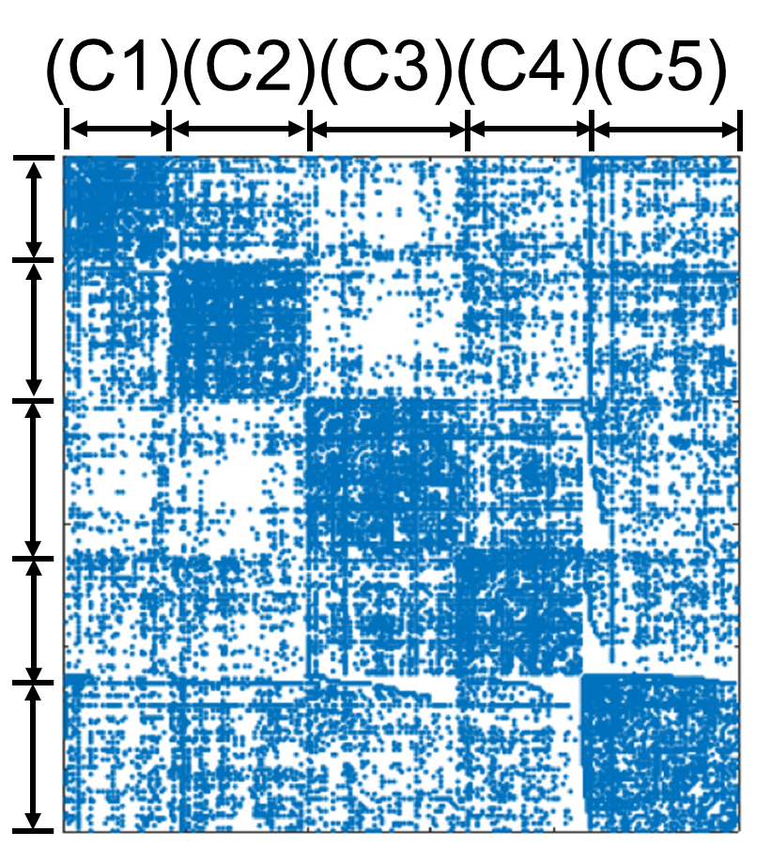
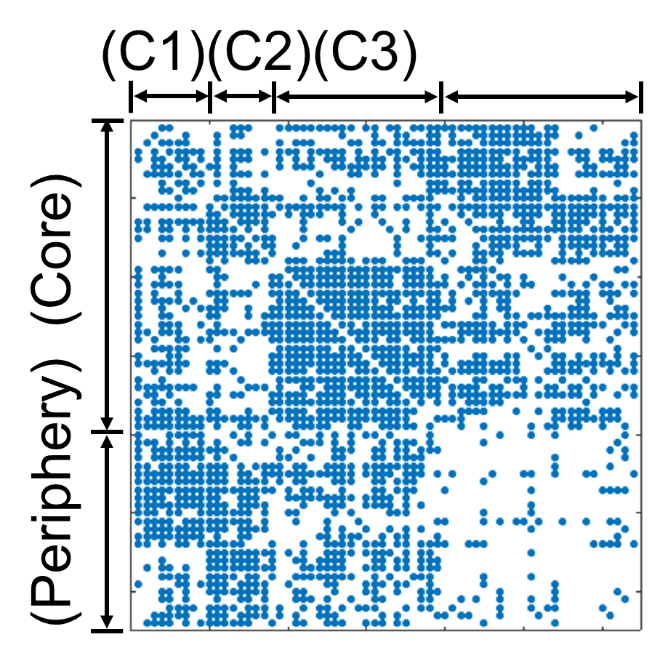


Structural-Core Pattern: Pattern
Pattern 3: Structural-Core Pattern
Degeneracy-cores have structural patterns such as
core-periphery and communities
Nodes in degeneracy-cores
are not homogeneous
Core-periphery
Communities
Combination

Slide 30
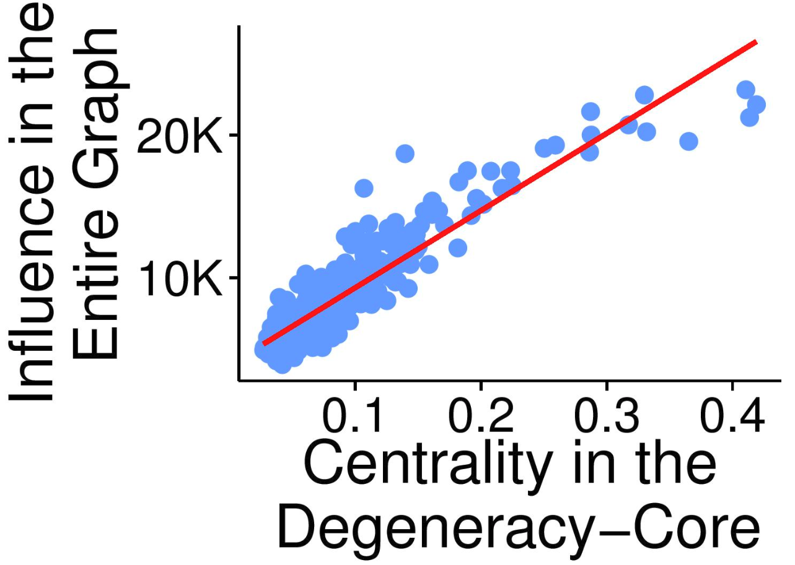
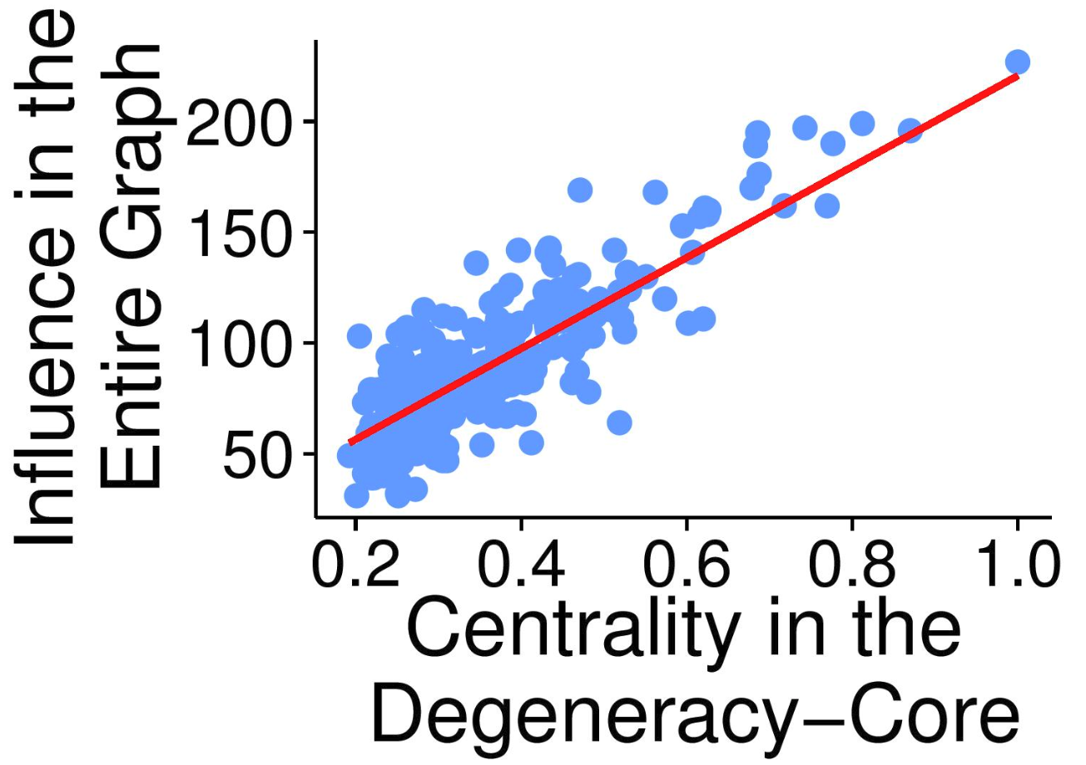
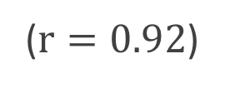
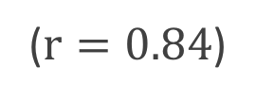
Structural-Core Pattern: Algorithm
Question: Nodes in degeneracy-cores are known as influential spreaders (Kitsak et al. 2010).
Do better spreaders exist among them?
($r=0.92$)
($r=0.84$)
Social Network in Orkut
Email Network in.

Slide 31
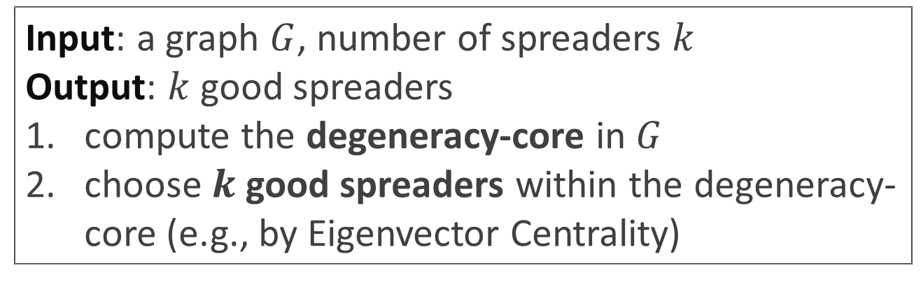
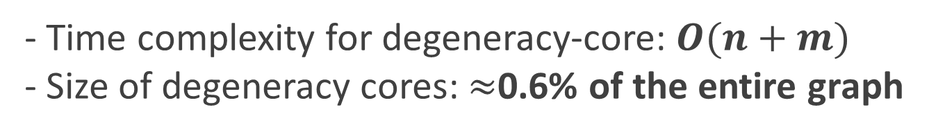
Structural-Core Pattern: Algorithm
Algorithm 3: Core-S
Fast Identification of Spreaders
Input: a graph $G$, number of spreaders $k$
Output: $k$ good spreaders
compute the degeneracy-core in $G$
choose $k$ good spreaders within the degeneracy-core (e.g., by Eigenvector Centrality)
- Time complexity for degeneracy-core: $O(n+m)$
- Size of degeneracy cores: $≈$0.6% of the entire graph

Slide 32
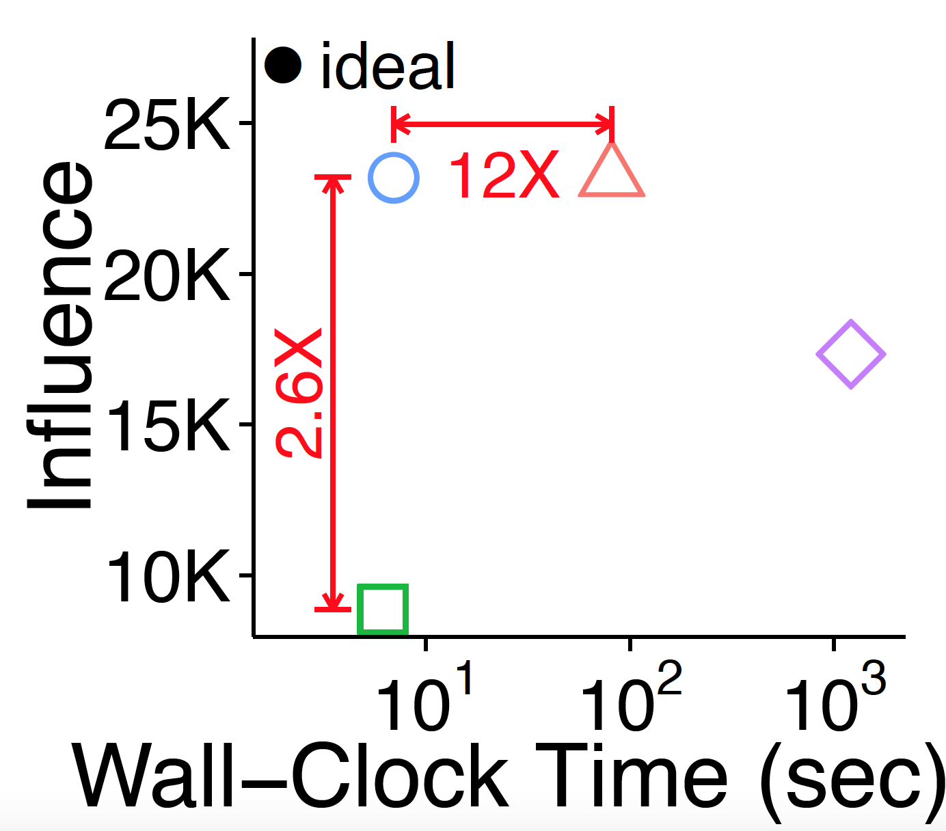
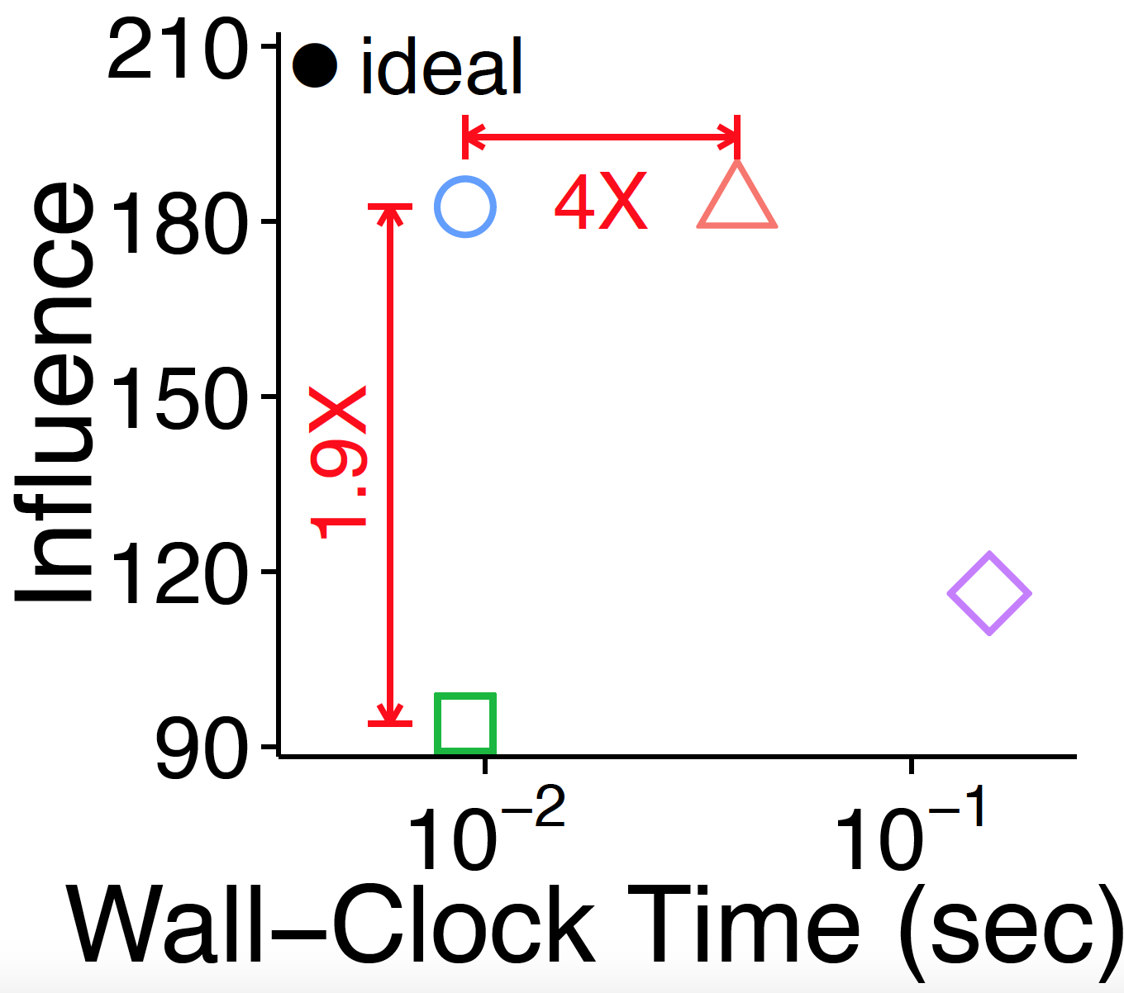
Structural-Core Pattern: Algorithm
Question: How fast and accurately does
Core-S identify good spreaders?
Core-S (Proposed) K-Core K-Truss Eigen Centrality
Core-S
Core-S
Social Network in Orkut
Email Network in.

Slide 33
Road Map
Introduction
Definition of K-Cores
Pattern 1: “Mirror Pattern”
Pattern 2: “Core-Triangle Pattern”
Pattern 3: “Structural-Core Pattern”
Conclusion <<

Slide 34
Conclusion
Three Patterns related to k-cores in real-world graphs
1. Strong correlation between coreness and degree
2. Power law between #Triangles and degeneracy
3. Non-trivial structures of degeneracy-cores
Mirror Core-Triangle Structural-Core

Slide 35
Conclusion
Three algorithms inspired by the patterns
1. Core-A: Anomaly detection
2. Core-D: Degeneracy estimation in graph stream
3. Core-S: Fast identification of good spreaders
Core-A Core-D Core-S

Slide 36
Thank you!
Source codes and datasets used in the paper are available at https://github.com/kijungs/corescope

Slide 37
Backup Slides

Slide 38
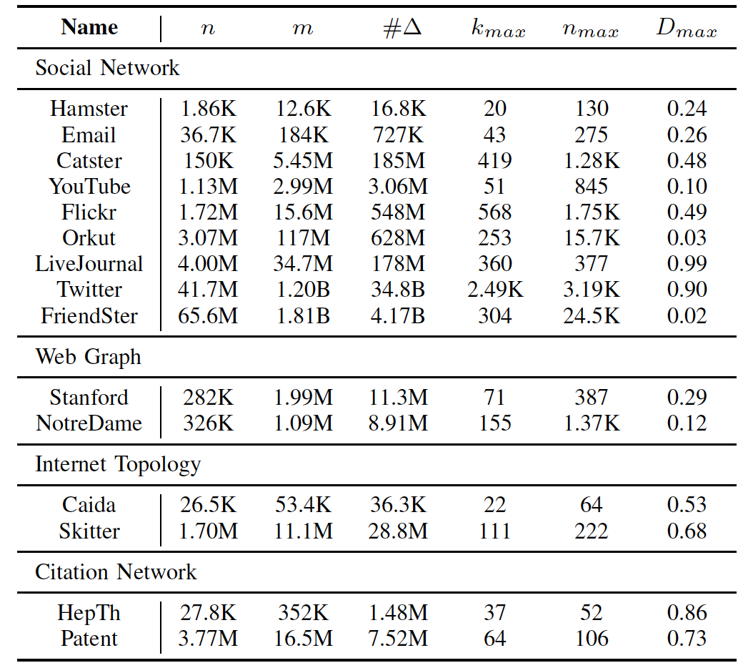
Real-world Graphs

Slide 39
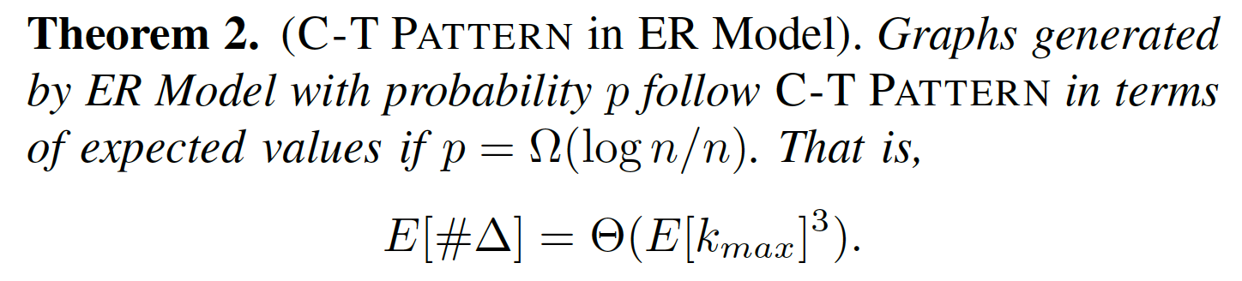
Theorems (Core-Triangle Pattern)
Core-Triangle Pattern in ER Random Graphs

Slide 40
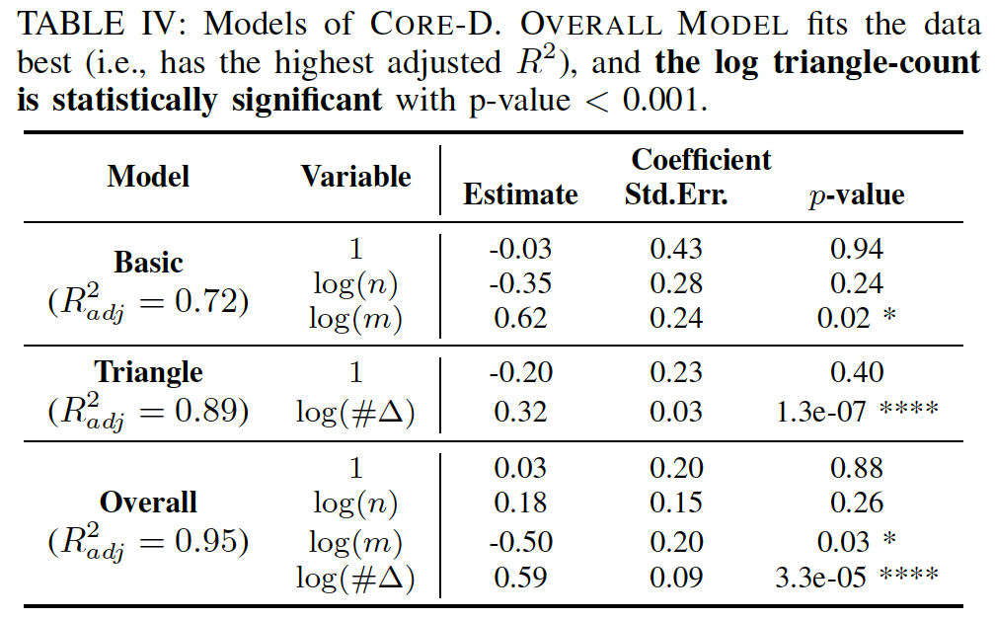
Statistical Significance

Slide 41
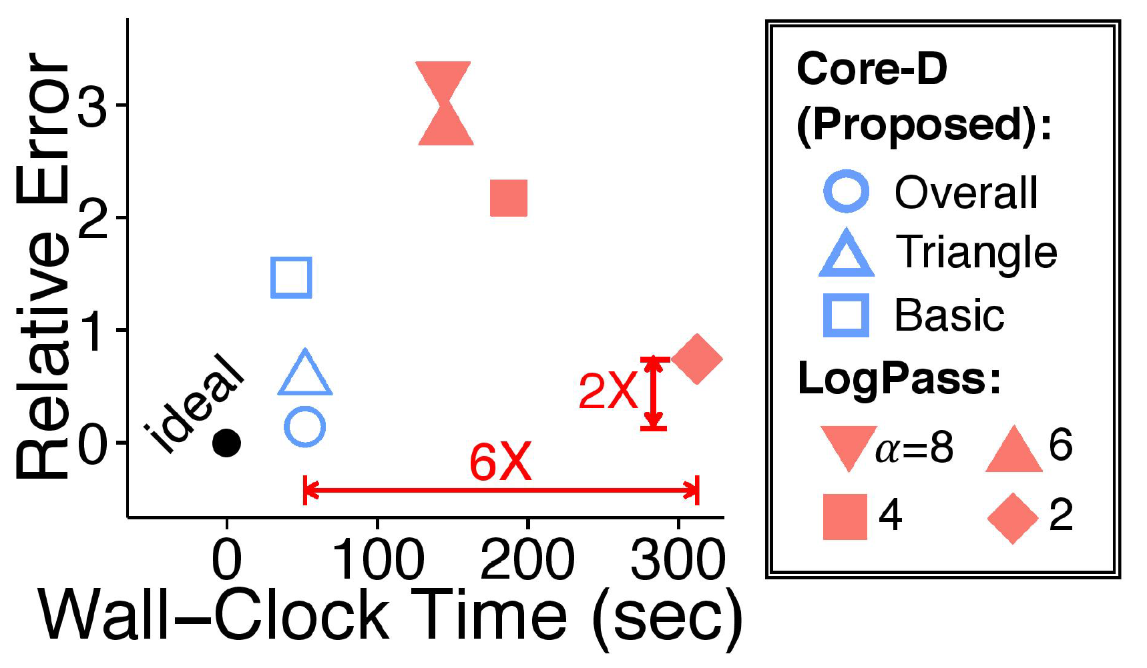
Core-D with other models
Social Network in Orkut

Slide 42

Modularity & C-P Score

Slide 43


Error Bars in Core-S
Core-S (Proposed) K-Core K-Truss Eigen Centrality
Social Network in Orkut
Email Network in.

Slide 44
Why Log Rank Difference?
Node 1:
  Degree: 10 millions
  (Top 0.001%)
  Coreness: 1000
  (Top 10%)
  Rank Difference: 10%
  Log Rank Difference: 4
Node 2:
  Degree: 3
  (Top 80%)
  Coreness: 2
  (Top 90%)
  Rank Difference: 10%
  Log Rank Difference: 0.05
More Suspicious

