Slide 1
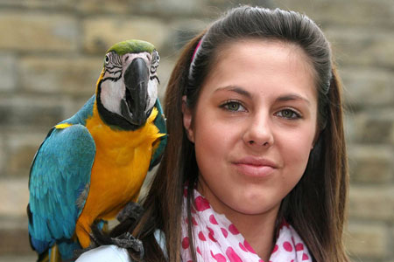
The Companion Metaphor

Slide 2
Where has attention been focused?
Notes:
Here are nine new developments associated with Mobility:
Constraints. Software engineering inside a phone must cope with limited power, screens, bandwidth, and computing power.
Location. The location of the phone and the conditions there are important to what it does. Input can be abbreviated and output sharpened by using a phone’s location. Phones can be used as a global sensor net to augment internet databases.
Platforms. There is a complicated, evolving ecosystem involving competing handsets, carriers, and middleware services. Many engineers and companies are working to sort it out and attempting to obviate the differences. It is made more difficulty by owners’* preference for native apps over browser-mediated services.
It seems that 75% of effort has gone into difficult engineering problems and the exploitation of location-specific information. The natural approach to smart phones has been to move computer applications to them, so the most effort has gone into adapting those apps to the severe constraints. As Moore’s Law solves some of these problems we should turn our attention to area that exploit other unique aspects of mobile computing. That is where entirely new and profitable apps will arise from.
Personal. Phones are perceived as extensions of their owners. This makes style and customization important. Phones are companions.
Connectivity. The major development that has enabled mobile computing is the phone-driven spread of connectivity which is actually more significant.
Coexistence. User interface designers assume they have the undivided attention of the owner. Now, the owner is not paying attention to the device and, even when she is, wants the interaction to be very simple.
Social. Communication by phone, not computing, is the app that sells the device.
Global. Because cell phones have become the standard phone in many developing countries, many innovations are found there.
I say “owner” instead of “user” to emphasize the exclusivity of one’s phone.

Slide 3
Six Killer Apps

Slide 4
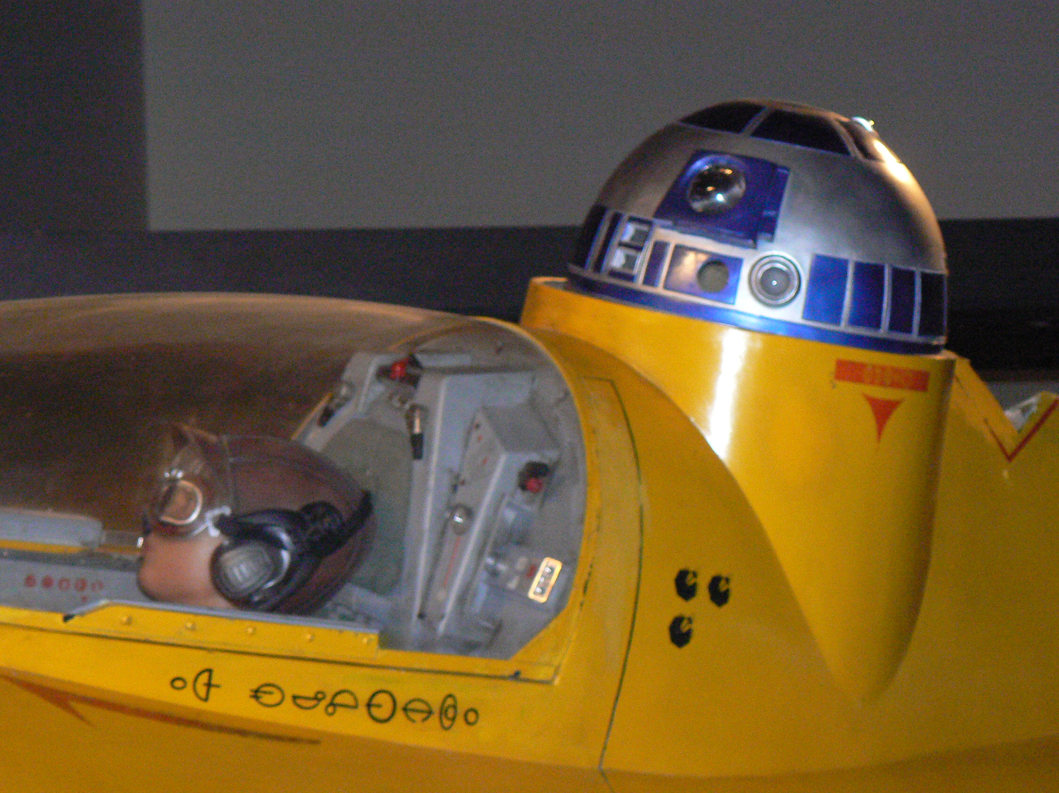
1. The Travel Companion
Notes:
When you’re traveling, you phone is your only resource. Recall that R2D2’s first job was as the navigator for Anakin Skywalker. Car GPS’s are great, but there are many more traveling modes, beyond driving a car, to be supported. A cell phone should help one to travel short distances and long, indoors and out. You designate a place and get a plan employing one or more modes—walking, driving, public transit, taxis, biking, or hitchhiking. The trip, along with possible transfers of modes, is monitored, adjustments made, and safety assured.
The companion might be proactive about things to do as well as where to go.

Slide 5

2. The Attention Mediator
Notes:
Like the executive assistants of old, my device knows where I am and where it is; e.g. I’m driving at 65 on I95 and it’s in my pocket. It can often understand my situation; e.g. I’m going to a meeting with Fred at 10:00. It should know the priority I currently attach to requests for attention, e.g. messages from Fred are important; one from the staff are not. My device uses a variety of signals to alert me to different sorts of communication, converts their form to fit my situation; e.g. translate a changed meeting place to voice and play it without hesitation. Similarly, the gatekeeper prepares my communications and requests for attention to appropriate forms, needing a minimum of specification, e.g. “Call Sally, and ask her to call when free.”

Slide 6
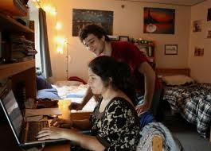
3. The Virtual Roommate
Notes:
This one is especially appropriate for a university.
Every student is given a virtual roommate when they enroll in the college. This roommate is an intelligent agent that holds many techniques and much knowledge that the student might need in their classes and career. It becomes a customized, life-long companion and assistant.
It attends all the classes, labs, and projects with (or without) the student and takes perfect notes.
It has been through many courses before, has done the assignments, and taken the exams.
It can critique essays, solve differential equation, and tackle many other tasks that people used to do by hand.
It speaks many languages.
It has an encyclopedic knowledge of the past as well as current events.
It performs as a teaching assistant and coach for each course the student takes.
It tracks the student’s performance and comments constructively on progress.
It goes with the student on all vacations and lives with him or her after graduation.
It remembers everything the student learned or didn’t.
It stays connected with the college and all the students’ friends and acquaintances.
It remembers whom to call upon for help when the graduate needs it.
It can even get the student a date or find her a job, using its connections.
Graduates can rely on it as they go into the world. Their virtual roommate hooks them into a life-long source of knowledge and power that encompasses the college, the internet, and a network of people. It crystallizes how schools deliver value. Beyond basic thinking and communication skills, it makes the student the beneficiary of a huge network of information, tools, and people. Their participation customizes it and their continued connection keeps it current.

Slide 7
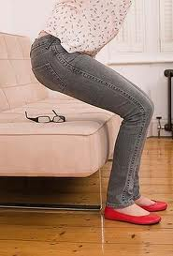
4. Possession Finder
Notes:
My phone remembers where my possessions are, e.g. my glasses. The challenge is finding a low-cost, owner-friendly design.
One can buy dongles that attach to objects like key chains. But we need sensing with very small, barely\y visible tags. The most likely technology is RFID.

Slide 8
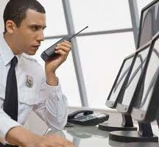
5. Emergency Manager
Notes:
The manager gathers information from a large, distributed population; e.g. all the people in the potential path of a weather disturbance. Some is owner-mediated, e.g. a picture of a collapsed house; some is automatic, e.g. temperature. It integrates the information with historic data bases and uses it to dispatch appropriate resources. It works because Barack Obama is at the controls.
Using phones to gather information is new. Heretofore the only reporting a client sent to a server was mediated by a user sitting with a computer.
Connection to the cloud allows computationally demanding apps not possible on a personal computer. Using ad hoc networks, created post-event is necessary.

Slide 9
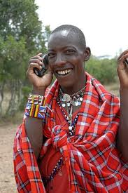
6. Telephone!
Notes:
For many people in the developing work cell phones are the first PHONE they have ever used. We can only imagine how big a deal this is. Furthermore, developing countries are very innovative in the uses they make because they are using them to create other kinds of infrastructure, e.g. international banking via cell phone minutes.
Another major attraction of the developing world, especially China, is the emergence of a large middle class—defined as people with disposable income.

Slide 10
Five Technology Innovations

Slide 11
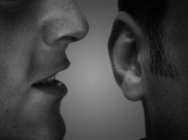
1. Voice Interface
Notes:
Rather than struggle with a tiny keyboard and screen, smart phones should communicate with voice.
Speech communication might have evolved for communication when hands and eyes are busy. We expect a human companion to hear our faintest words, whisper to us, or shout at us, depending on the context.
Today’s telephone response system are not bad at recognition but they lack personal context.

Slide 12
1. Voice Interface
State of Technology
  Voice recognition and generation are good enough.
  Phone response systems are good but clueless.
Research
  Speaker-dependent dialog
  Make agent “natural”.
  Support sub-vocalization.
  Experts: Cassell, ML, Rudnicky, Waibel, Zhang
Notes:
Maybe we can solve the obnoxious cell phoner problem, too.
This is a major opportunity for speech recognition and generation which has rarely been able to beat a keyboard and screen. Furthermore, its recognizers and generator can be speaker-dependent. The biggest challenge is making the dialog adaptive, error-correcting and natural. I hope to learn from Cassell how to test voice interfaces “intersubjective”.

Slide 13
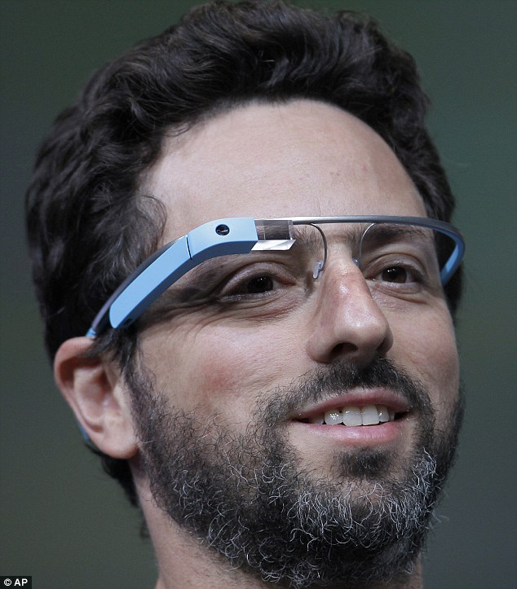
2. Vision Interface
Notes:
If the owner will wear glasses captured video can be used to enhance the device’s knowledge of where it is and what the owner is seeing.
Fancier hardware can also project onto the lenses, but must be controlled so as not to be intrusive.
A fantasy scenario: I arrive at a Tokyo metro station and my companion knows where I’m trying to go. Using GPS and video it “sees” where I am and whispers
“Can you see the sign that says “Sinjuku” with “Akihibara” to its right?” I whisper “Yes.” It says, “Go under the Akihabara” sign and turn right down the hall for 50 feet”. Later it whispers, “You walked past your train, and the person in front of you is Wanatabe san”.

Slide 14
2. Vision Interface
State of Technology
  iPhoto face-recognition trick is startling.
  The Army must know a lot….
  Local company, Pittpat.com
Research
  Machine learning for recognition.
  Acceptable devices.
  Experts: Efros, ML, RI
Notes:
I won’t even pretend to know about this compared to others. My secret weapon is knowing Kanade et al.
I assume those cameras on soldiers helmets are doing somethiing.
The idea is to store as many images of people, places, and things as we can and leverage all the work that will be done for more general purposes.

Slide 15
3. Location and Mapping
State of Technology
  GPS-based systems for drivers are generally successful.
  Tom-tom uses crowd sourcing to collect traffic data
  Nokia/Berkeley experiment has done the same.
  Foursquare, Places, etc. are succeeding.
  Point Inside navigates malls.
Missing Research
  The last mile is a problem. Wifi and Bluetooth (Redpin) are not very dependable (but check recent paper by Biswas & Veloso).
  Maps can be difficult to obtain (but see paper by Rosenthal, Biswas, and Veloso).
  Accumulating traveler experience using crowd sourcing might be better, if owners can be induced to contribute.
  Furthermore, maps are not the most cognitively aligned tools for way finding; learning local landmarks and other methods need to be tried.
  Experts: von Ahn, Bareiss, Biswas, Cassell, Forlizzi, Griss, Veloso, Zhang

Slide 16
4. Disposition & Priority Sensing
State of Technology
  Interruptibility. Research on interruptibility needs to be adapted to mobile situations. There is interesting work based on EEG readings.
  Prioritization. There has been extensive research on email filtering, learning from owners’ actions what messages to show them. Gmail represents the start of the art.
  What did Aura and Radar learn?
  SenSay, successful student project
  Recent work by Stephanie Rosenthal
Missing Research
  Both interruptibility and prioritization need to be conditioned on here and now.
  Develop new owner/device interaction modes using attachments to the owner’s body. Biometric monitors, sold as a health enhancers, can be used.
Experts: Dabbish, Dey, Griss, Hudson, Pomerleau, Siewiorek, Smailagic

Slide 17
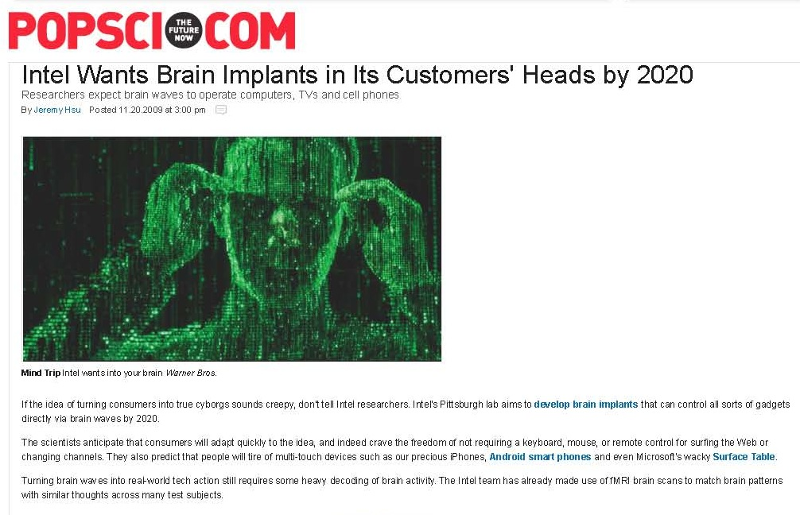
4. Brain Interface?!
Also see John Brockman’s This Will Change Everything

Slide 18
End

