Slide 1
Political, Social, Economic, and Technological
Factors of Innovation

Slide 2
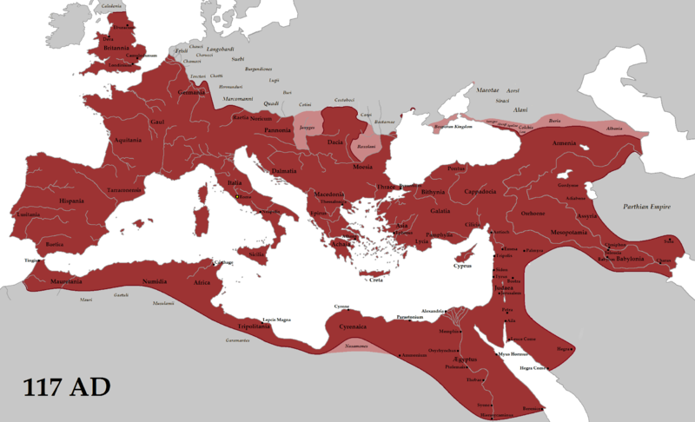
100AD, Roman Empire
 | Problems | Opportunities
Political | Dictatorship Slow decline | Peace Common laws Local control Military hierarchy
Economic | Wealth disparity GDP/person 60% higher in Italia | GDP/person = $640 Coinage
Social | Tiny elite over all Slavery Class-based justice Sexism Polytheism | Common Language Travel Urbanization Literacy Religious tolerance
Technological | Little manufacturing | roads, water, sewage, fire protection, mining, agriculture, writing, ships

Slide 3
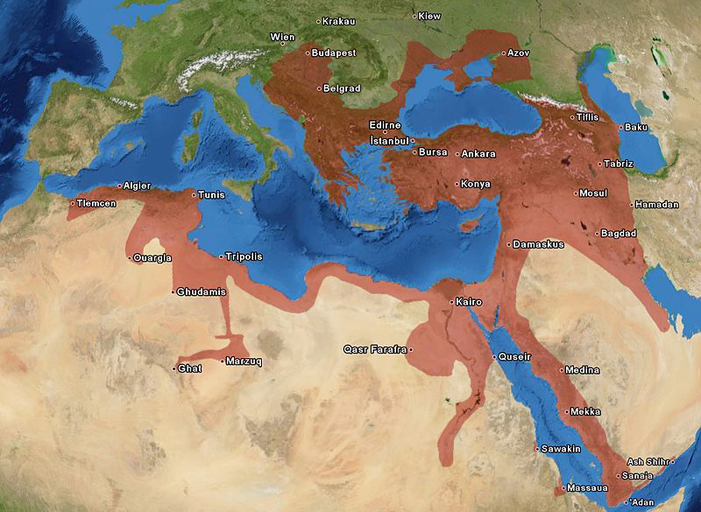
1500, Europe
 | Problems | Opportunities
Political | Ottoman Empire controls Middle East and Mediterranean Religious Wars | Rise of the West Protestantism
Economic | Need for Gold and Silver Land controlled by state, church, aristocracy | Growth of cities and economy End of Black Plague
Social | Stratified Society Peasant Revolts | Towns growing Taste for Asian goods
Technological | Defense of cities Plague | Copernicus Celestial Navigation Leonardo da Vinci Printing Sailing: caravel, tacking Gunpowder

Slide 4
1750, Atlantic Ocean
 | Problems | Opportunities
Political | Seven Years’ War | Extensive Colonization Decline of Ottomans Rise of 1st British Empire
Economic | Lack of people in America Lack of land and raw material in Europe Lack of technology in Africa | Beginning of industrial revolution
Social | Population pressure in Europe | Agriculture still dominant
Technological | Few mechanical aids | Sailing ships New crops Animal husbandry Steam Power Mechanical Devices

Slide 5
1850, US
 | Problems | Opportunities
Political | North/South Tension | Land Grants
Economic | Access to hinterland | Industrial Revolution Increasing trade and specialization.
Social | Many farmers everywhere | California Gold Rush Westward expansion
Technological | Access to coal and raw materials | Bessemer process for Steel Telegraph Steam power

Slide 6
1900, US
 | Problems | Opportunities
Political | Gilded Age Six Assassinations | Start of Progressive Era
Economic | Farmers resent gold standard Financial panics | Significant GDP growth Oil cheaper than electricity Unemployment between 1.5% and 5.2%
Social | Bad working conditions Strikes | Coast-to-coast settlement Silent Movies Increasing travel
Technological | Fires | Oil-based heat and light Radio Kodak Wright brothers fly 1st cross-country car trip Mass production European leadership

Slide 7
1945, US
 | Problems | Opportunities
Political | World War II | National Unity Centralized Government Planning
Economic | Increasing Debt Potential unemployment | War mobilization Postwar consumer boom Government tech investment Big business
Social | Housing shortage | Baby Boom University research GI Bill scholarships
Technological | Encrypted radio communication Air Warfare Atom Bomb Design | Electronics Transistor von Neumann’s EDVAC design

Slide 8
Now, US
 | Problems | Opportunities
Political | Liberal/Conservative Split Terrorism Threat Money in Politics | Militarization Transparency
Economic | Unemployment Government deficits Unequal wealth | Stimulus money Multi-Millionaires Green Energy Venture Capital
Social | End of Dating Low Fertility Housing Polarization Isolation | Retiring Baby Boomers Rise of Millennials Mobility Two income families
Technological | Weather Events | Internet Mobile Phones, Sensors Biotech Fracking

Slide 9
Now, Africa
 | Problems | Opportunities
Political | Colonial legacy Border wars | Growing stable democracies Arab Spring
Economic | Government deficits Unemployment Corruption | Natural resources Emerging middleclass Tourism
Social | Poor education Disease | Youth/Birth Rate Art
Technological | Transport Energy | Internet Mobile Phones, Sensors No legacy systems

