Slide 1
Political, Social, Economic, and Technological
Factors of Innovation

Slide 2
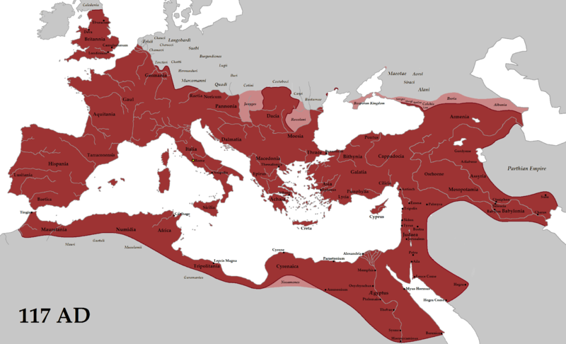
100AD, Roman Empire
 | Problems | Opportunities
Political | Dictatorship Slow decline | Peace Common laws Local control Military hierarchy
Social | 1% vs. 99% Slavery Class-based justice Polytheism Sexism | Common Language Travel Urbanization Literacy Religious tolerance
Economic | Wealth disparity GDP/person 60% higher in Italia | GDP/person = $640 Coinage
Technological | Little manufacturing | roads, water, sewage, fire protection, mining, agriculture, writing, ships
Notes:
I’ve focused on the things that were relatively new or changing. What was the innovation? Christianity as envisioned by Paul of Tarsus.

Slide 3
1945
 | Problems | Opportunities
Political | World War II | US Strength Government command and control
Social | Anti-Semitism | National Unity Military Mobilization European intellectual immigrants to US
Economic | Rapid industrial mobilization War Debts | Comparative US strength Pent up demand
Technological | Physics calculations Encrypted submarine communication Air warfare | Electronics Nuclear fission
Notes:
.

