Slide 1
05.899/499
Designing Mobile
Services
Jim Morris
John Zimmerman
Spring Semester 2012

Slide 2
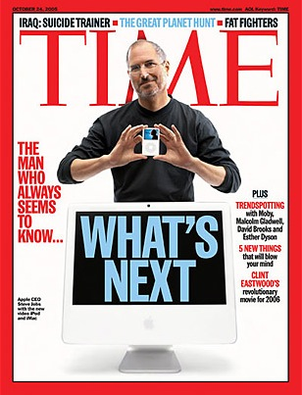

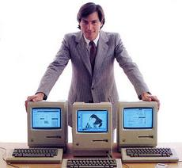
How did they do it?
Image source: http://www.bittenandbound.com/2010/12/15/time-mag-2010-person-of-the-year-mark-zuckerberg-cover-photo/

Slide 3
Changes in the world
Growth of service sector, and recasting of products as services
Arrival of social computing
Explosive growth of mobiles
Lower barriers to startup, especially for mobile service companies
App store, Android marketplace, Amazon hosting, Sales force, Google docs

Slide 4
Learning Objectives
Attitudes
  Be an active searcher and learner
  Adopt an improv approach to teamwork.
Skills
  Value analysis
  Reality checking
  Planning
  Presentations.
Understanding
  Services
  Mobility

Slide 5
Main Task
Design a mobile service that is …
Desirable
Technically feasible
Economically viable

Slide 6
5 Phases
Orientation: Learn new approaches.
Exploration: Analyze value ecosystems.
Generation: Generate some service concepts.
Refinement: Evaluate one in terms of user experience, financial viability, and technical viability.
Delivery: Pitch your idea to s public audience with a video sketch of the user experience.

Slide 7
1. Orientation
Form teams
Understand two new techniques to be used throughout the course.
  Improvisation
  Value Analysis

Slide 8
Course style
Seminar/studio/team project course
Students do a lot of talking and doing.
Read and discuss.
Present and critique your work in progress.
Work on an interdisciplinary five- person team

Slide 9
Sharing with Posterity
“I grant Carnegie Mellon’s Human Computer Interaction Institute the non-exclusive right to use all the materials I submit for the course Design of Mobile Services for the purposes of advertising, describing, and instructing in other versions of the course.”
Look in Samples subdirectories for last year’s work.

Slide 10
Grading
Exploration presentation and report 20%
Discovery presentation and report 20%
Generative presentation and report 20%
Final presentation, video sketch, and report 30%
Class Participation 10%
Peer Evaluation ±10%

Slide 11
Reading presentations (899)
Graduate students will read and critique assigned papers
Presentations …
  Should NEVER be more than 5 minutes.
  Should NOT be a summary of the material … instead, presenters need to identify key issues and communicate them to their classmates in a way that makes the information operational within the context of the current project.
  Should provide students with an introduction to the paper.
See template in Dropbox.

Slide 12
Wait List/Add/Drop
Everyone’s in.
Drop soon so teams can be adjusted.

Slide 13
Tasks for Thursday
Find Dropbox.
Find Orientation schedule.
Add your folder to Students folder.
Fill out survey.
Send permission statement to james.morris@cmu.edu.
Read.

