Slide 1
05.899/499
Designing Mobile
Services
Jim Morris
John Zimmerman
Spring Semester 2011

Slide 2
Changes in the world
Growth of service sector, and recasting of products as services
Ex: Software as a Service
Arrival of social computing
Explosive growth of mobiles
Lower barriers to startup, especially for mobile service companies
App store, Android marketplace, Amazon hosting, Sales force, Google docs

Slide 3
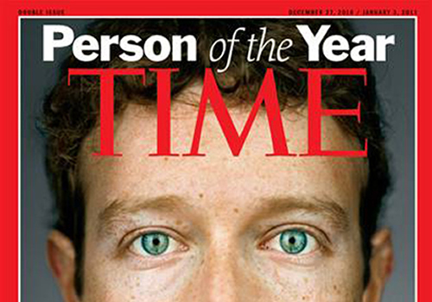
Why isn’t this you?
Image source: http://www.bittenandbound.com/2010/12/15/time-mag-2010-person-of-the-year-mark-zuckerberg-cover-photo/

Slide 4
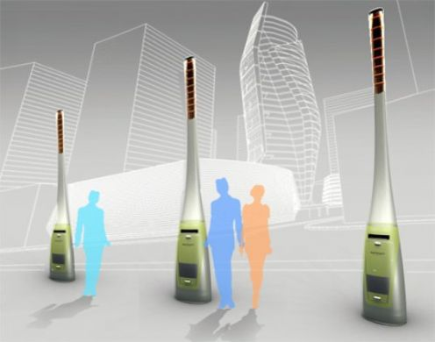
This class is about invention
Goan trash powered street light
Image source: http://hubpages.com/slide/Eco-Friendly-Technology-That-Will-Change-the-World/2635536
Notes:
http://hubpages.com/slide/Eco-Friendly-Technology-That-Will-Change-the-World/2635536

Slide 5

You can change the world
Image source: http://www.flickr.com/photos/sara/215916577/

Slide 6
Overview
Class overview (john)
Jim’s 5 target areas for mobile (Jim)

Slide 7
class overview

Slide 8
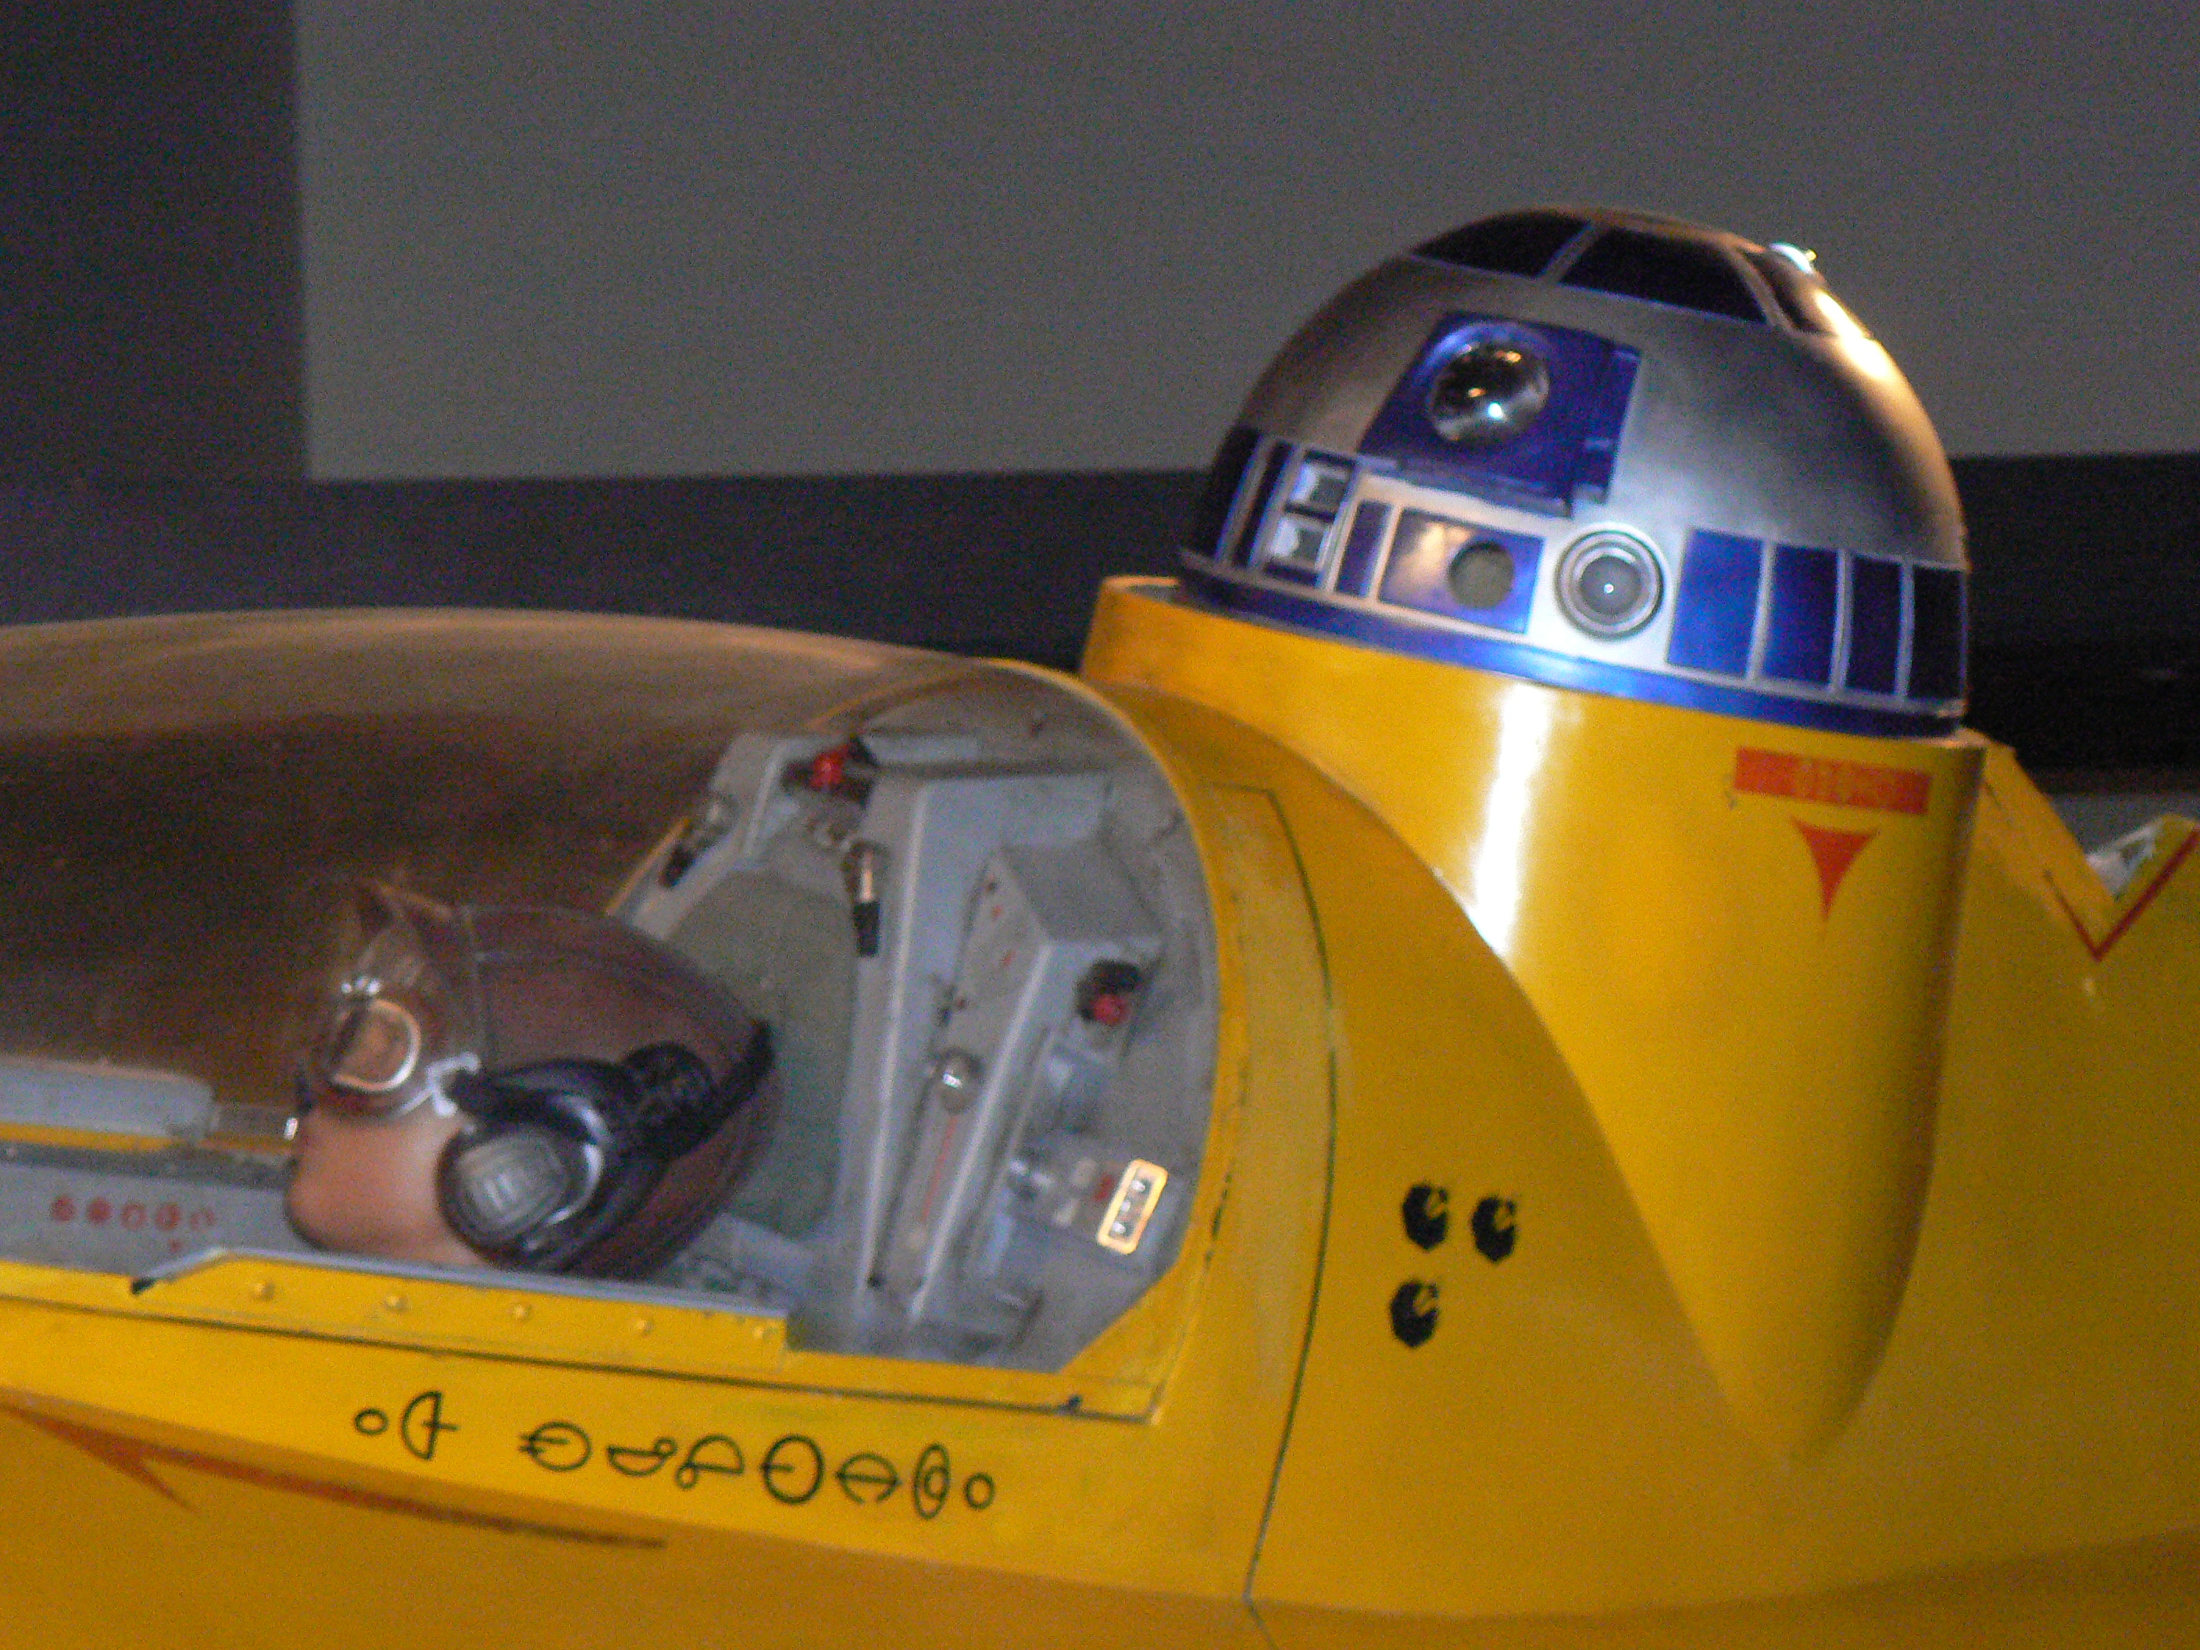
The Travel Companion
Notes:
When you’re traveling, you phone is your only resource. Recall that R2D2’s first job was as the navigator for Anakin Skywalker. Car GPS’s are great, but there are many more traveling modes, beyond driving a car, to be supported. A cell phone should help one to travel short distances and long, indoors and out. You designate a place and get a plan employing one or more modes—walking, driving, public transit, taxis, biking, or hitchhiking. The trip, along with possible transfers of modes, is monitored, adjustments made, and safety assured.
The companion might be proactive about things to do as well as where to go.

Slide 9

The Attention Mediator
Notes:
Like the executive assistants of old, my device knows where I am and where it is; e.g. I’m driving at 65 on I95 and it’s in my pocket. It can often understand my situation; e.g. I’m going to a meeting with Fred at 10:00. It should know the priority I currently attach to requests for attention, e.g. messages from Fred are important; one from the staff are not. My device uses a variety of signals to alert me to different sorts of communication, converts their form to fit my situation; e.g. translate a changed meeting place to voice and play it without hesitation. Similarly, the gatekeeper prepares my communications and requests for attention to appropriate forms, needing a minimum of specification, e.g. “Call Sally, and ask her to call when free.”

Slide 10
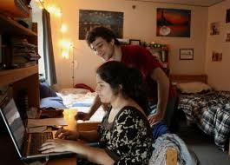
The Virtual Roommate
Notes:
This one is especially appropriate for a university.
Every student is given a virtual roommate when they enroll in the college. This roommate is an intelligent agent that holds many techniques and much knowledge that the student might need in their classes and career. It becomes a customized, life-long companion and assistant.
It attends all the classes, labs, and projects with (or without) the student and takes perfect notes.
It has been through many courses before, has done the assignments, and taken the exams.
It can critique essays, solve differential equation, and tackle many other tasks that people used to do by hand.
It speaks many languages.
It has an encyclopedic knowledge of the past as well as current events.
It performs as a teaching assistant and coach for each course the student takes.
It tracks the student’s performance and comments constructively on progress.
It goes with the student on all vacations and lives with him or her after graduation.
It remembers everything the student learned or didn’t.
It stays connected with the college and all the students’ friends and acquaintances.
It remembers whom to call upon for help when the graduate needs it.
It can even get the student a date or find her a job, using its connections.
Graduates can rely on it as they go into the world. Their virtual roommate hooks them into a life-long source of knowledge and power that encompasses the college, the internet, and a network of people. It crystallizes how schools deliver value. Beyond basic thinking and communication skills, it makes the student the beneficiary of a huge network of information, tools, and people. Their participation customizes it and their continued connection keeps it current.

Slide 11
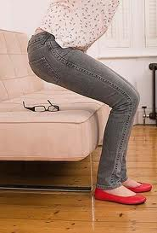
The Possession Finder
Notes:
My phone remembers where my possessions are, e.g. my glasses. The challenge is finding a low-cost, owner-friendly design.
One can buy dongles that attach to objects like key chains. But we need sensing with very small, barely\y visible tags. The most likely technology is RFID.

Slide 12
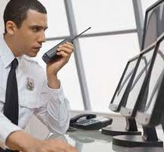
The Emergency Manager
Notes:
The manager gathers information from a large, distributed population; e.g. all the people in the potential path of a weather disturbance. Some is owner-mediated, e.g. a picture of a collapsed house; some is automatic, e.g. temperature. It integrates the information with historic data bases and uses it to dispatch appropriate resources. It works because Barack Obama is at the controls.
Using phones to gather information is new. Heretofore the only reporting a client sent to a server was mediated by a user sitting with a computer.
Connection to the cloud allows computationally demanding apps not possible on a personal computer. Using ad hoc networks, created post-event is necessary.

Slide 13
Course objectives
Design a mobile service that is …
Desirable
Economically viable
Technically feasible

Slide 14
How - 1
Discover a service opportunity in terms of user experience,
co-production of value, customer competence, and market gap.

Slide 15
How-2
Generate a business model that describes the systemic interaction between stakeholders including the flows of value and revenue.

Slide 16
How-3
Generate a system architecture that describes server/client relationship and system/network performance constraints and risks.

Slide 17
How-4
Create an effective pitch of your a mobile service startup for an appropriate funder.
By the end of class you should be ready to go out and raise the capital to launch a startup.

Slide 18
Course structure
Seminar/studio/team project course
Read and discuss
Present and critique your work in progress
Work on an interdisciplinary 5 person team

Slide 19
5 Phases
Orientation: gain breadth of domain
Discovery: find an opportunity
Generative: generate many concepts and framings
Refinement: evaluate in terms of user experience, financial viability, and technical viability
Delivery: Pitch your idea with video sketch of the user experience

Slide 20
Grading/Deliverables
Hunt statement pitch 5%
Discovery presentation and report 20%
Generative presentation and report 25%
Final presentation and report 25%
Video sketch 10%
Class Participation 10%

Slide 21
Class participation
Coming to class on time and with a positive attitude
Participating in discussions of readings
Reading group presentations (899)
Critiquing of other teams’ work including problems, suggested solutions to problems, and kudos for exceptionally good work

Slide 22
Team grading
You earn what your team earns
Peer evaluations influence by 10%
  Group participation
  Time management and effort
  Team culture
  Application of skills
  Communication

Slide 23
Reading groups (899)
Pairs of grads will read and share the contents of assigned papers
Presentations …
  Should NEVER be more than 5 minutes
  Should NOT be a summary of the material … instead, presenters need to identify key issues and communicate them to their classmates in a way that makes the information operational within the context of the current project
  Provide students with an opportunity to critically disagree with an author

Slide 24
Hunt statement
Designers can help themselves focus by creating a hunt statement before going out into the field. A hunt statement is a tool for narrowing down what the designer is researching and why. Hunt statements typically take this form: I am going to research X so that I can do Y. X is often an activity, and Y is usually a project goal or subject area. Here's an example: I am going to research how doctors use laptops on the job so that I can design a laptop for them. Hunt statements should be developed before doing research so that there is a purpose to each piece of research. The more specific the hunt statement, the better.
Designing for Interaction
by Dan Saffer
http://www.peachpit.com/articles/article.aspx?p=1389669&seqNum=2

Slide 25
Assignment 1
Hunt statement Pitch
  > 2 minute pitch
  Title for speculative service
  Hunt statement
  Rationale for selection
  Personal interest in this topic
Based on pitches, student ratings of pitches, and skill sets, instructors will assign teams

