Slide 1
Exploratory Phase
Presentation

Slide 2
Team Members
Arun Balachandran Ganesan
Clifton Lin
Jared Pryor
Sriram Ramasubramanian
Molly Samuels

Slide 3
Hunt Statement
We want to research current coupon distribution and redemption in order to design a context-aware mobile service that creates a new coupon experience for both merchants and their costumers.

Slide 4
SET Factors
Social
Influence of other people
Mentality change based on accessibility
Diversified behaviors
Trust Issues
Mismatch of context
Economy
Down economy
Coupons as a method to generate additional sales
Technology
Large number of smartphone users
Adapting emerging technology
Widespread use of GPS
Notes:
Social
We observed that ppl are more likely to use coupons given by their friends, this is also backed up from prior research
When a person is overloaded with a bunch of coupons, he/she is more likely to see it as advertisement instead of value-adding opportunity
Different ppl have very different usage of coupons (moms vs young ppl)
Difficulty of validation
Economy
Causing ppl to be more aware of their wallet
Being leverage mainly to generate additional sales
Technology
Blah
NFC and geo fencing

Slide 5
POG
Believe in opportunity for service to bridge the gap between consumers and merchants.
Leverage social influences
Leverage current context
Reliable and easy distribution methods

Slide 6







Competitive Analysis
Location based services
Free to customers
Sponsored by merchants
Search deals nearby
New tech: Geo-fencing
Check-in based
Free to customers
Free to merchants
Privacy becomes an issue

Slide 7
Literature Review
Insights from “An Exploratory Field Experiment on Actual Usage of Discount Coupons”
Forwarding rate of email coupons was significantly higher than that of SMS coupons, although there was no significant difference between the two in terms of coupon redemption.
Discount coupons received from peers will have higher usage rate than discount coupons received from the merchant
Study provides indication that the coupons
received from social network contacts were more likely to
be used than those received from merchants

Slide 8
User Research
3 stages to narrow down focus
  Stage 1 – Merchants & Consumers
  Stage 2 – Local Businesses
  Stage 3 – Consumers

Slide 9
Stage 1 (Merchants & Consumers)
Merchants at Waterfront and S. Craig St.
Large merchants
  Use social media
  Send out coupons often
  Mail, email, magazines
Small merchants
  Do not use social media much
  Know that coupons brings in new customers
  Sometimes through magazines

Slide 10
Stage 2 (Local Businesses)
Mom-and-Pop store owners
Do not use social media
Unable to gauge loyalty programs
Coupons are sent out time to time
Discounts run all throughout the year
“Facebook Places” not used much
“Twitter updates” help based on location
Sometimes people forge coupons

Slide 11
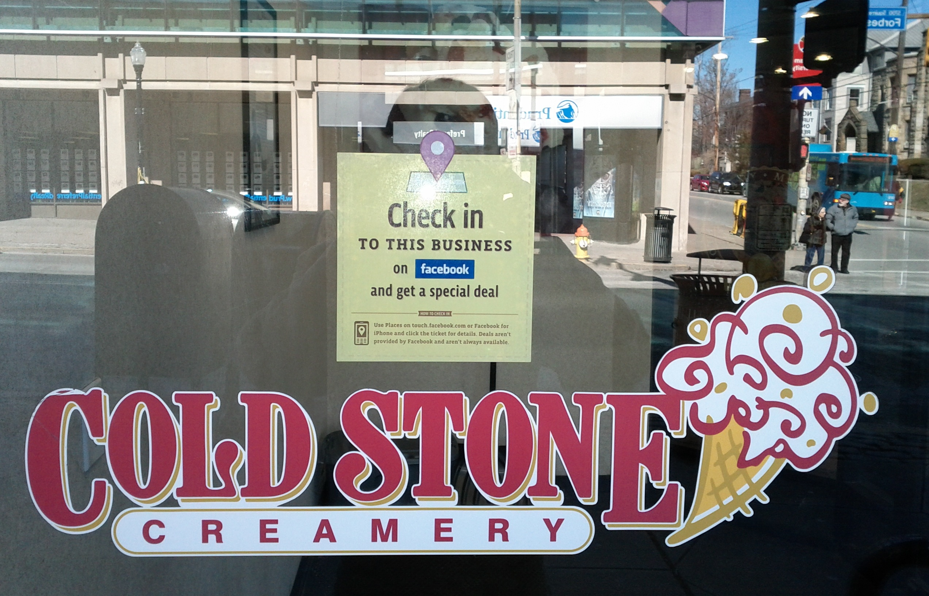
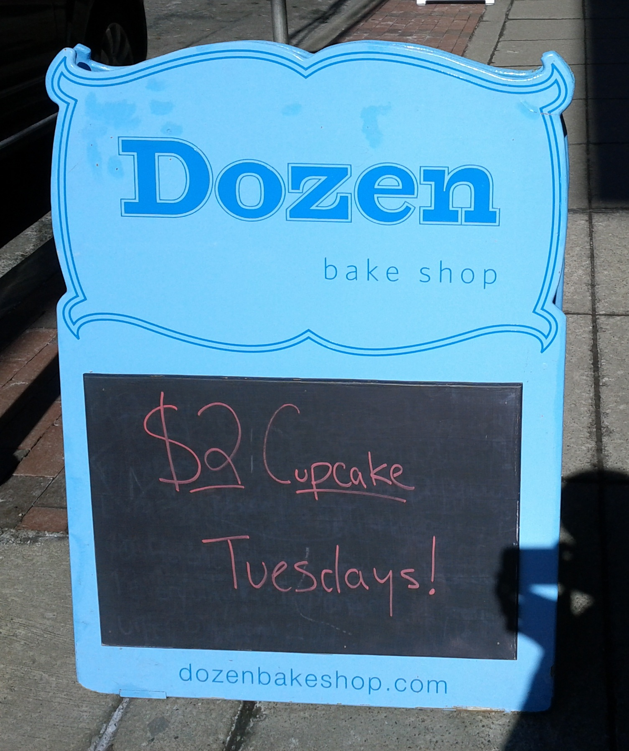
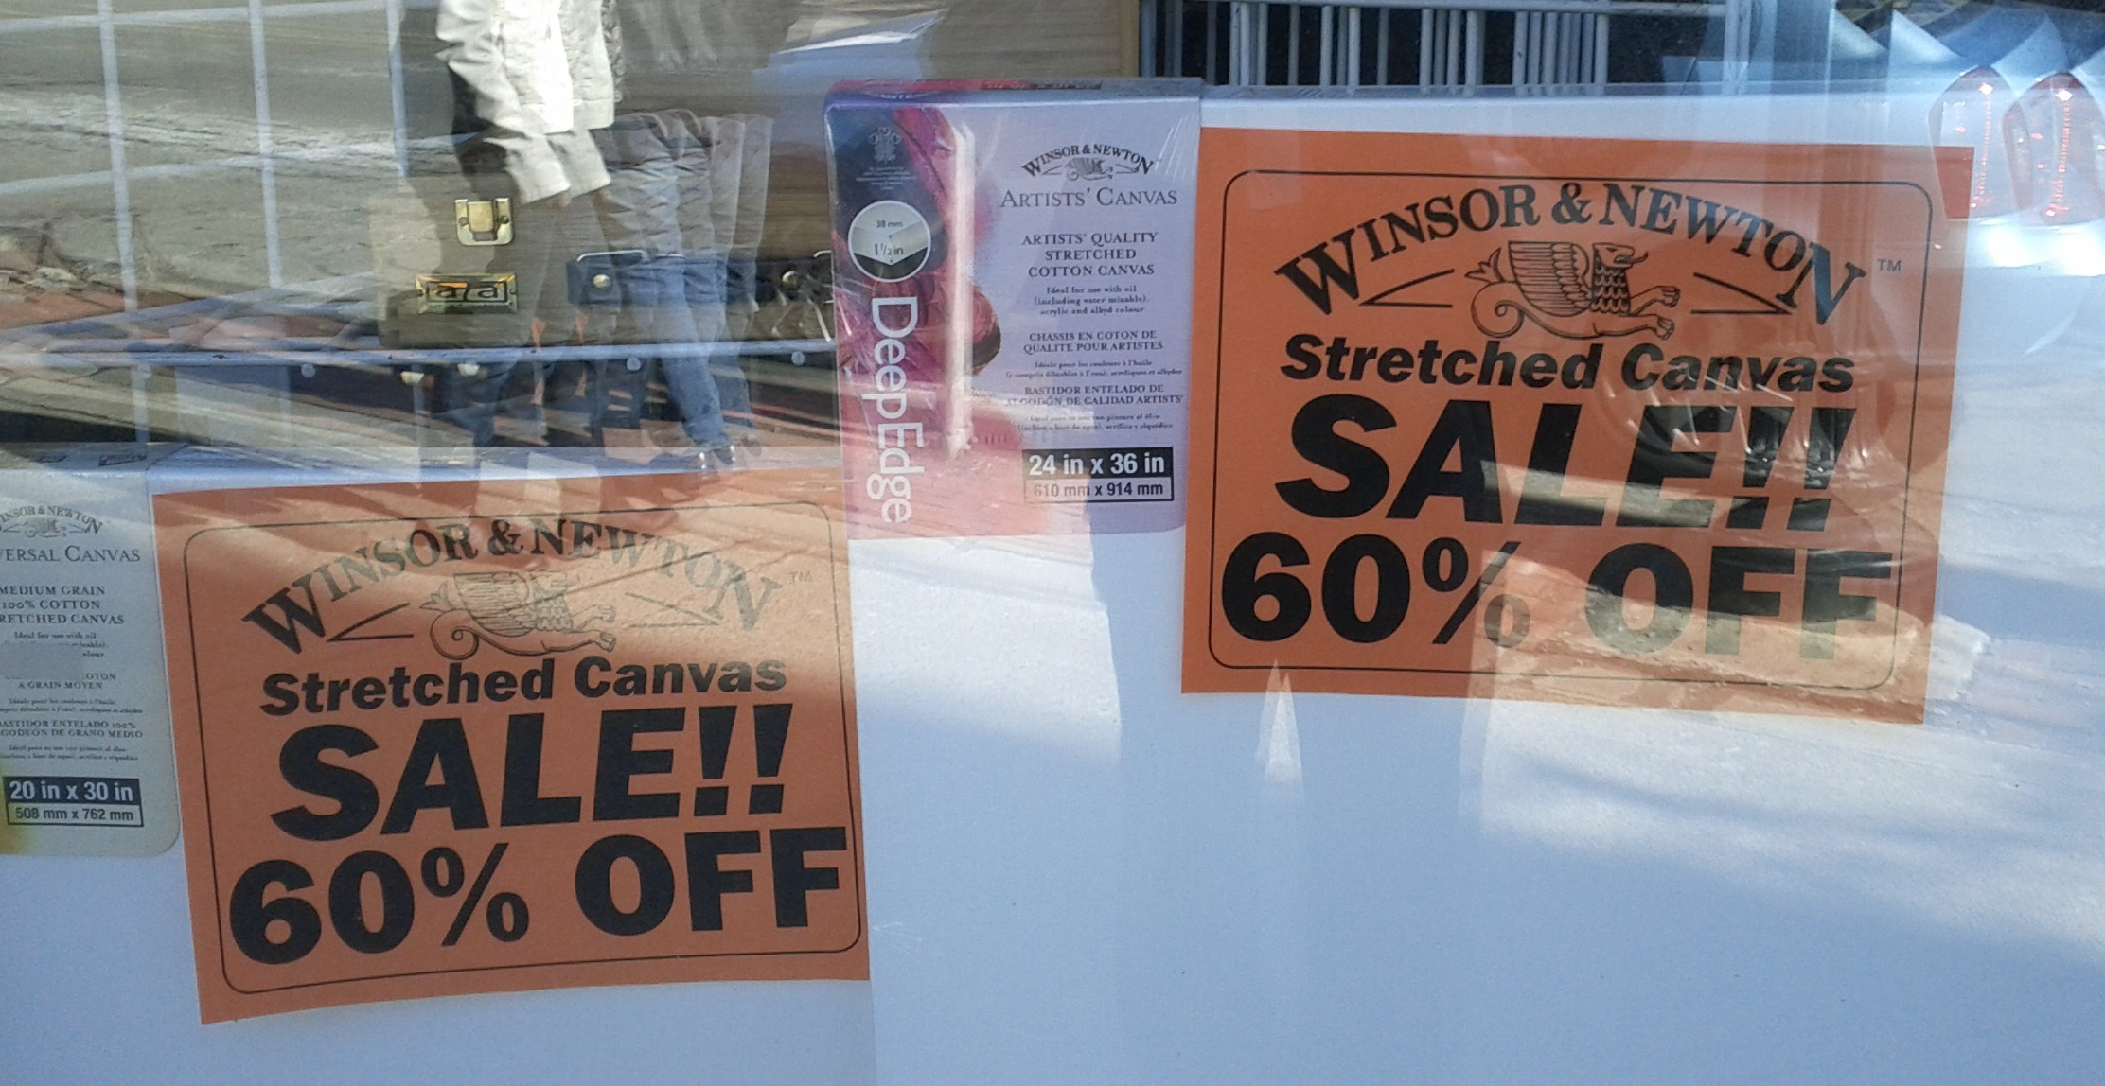
Advertising Deals

Slide 12
Stage 3 (Consumers)
Needs of the consumer does not match with what is being offered as coupons
Consumers do not like ads when it’s about what they don’t want
Consumers find it difficult to keep track of expiry date of coupons/do not notice it
Social media affects customer usage of coupons

Slide 13
Personas
Decided on two categories of Personas
  Merchants
  Consumers
Created multiple Personas for each category

Slide 14
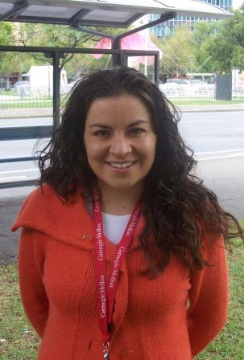
Persona 1 Introduction
Name: Sarah Rodriguez
Location: Pittsburgh, PA
Age: 20
Occupation: Student at CMU, studying Civil Engineering
Family: Single, never been married, no kids
Background:
From New York, NY,
Never been to Pittsburgh before
Interested in spending very little money

Slide 15
Persona 1 Goals
End
Save Money while shopping
Experience
Easily access coupons and discounts
No large personal effort
Life
Little spending money available
Important to get high value for money
Take advantage of available discounts
Explore Pittsburgh area

Slide 16
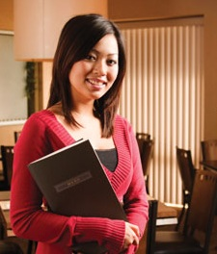
Persona 2 Introduction
Name: Irene Wong
Location: Pittsburgh, PA
Age: 30
Occupation: Owns a Chinese Restaurant in Squirrel Hill
Family: Single, never been married, no kids
Background:
First Generation US Citizen
Has taken over parent's restaurant
Interested in attracting a younger demographic to the restaurant

Slide 17
Persona 2 Goals
End
Attract new customers
Expand business
Experience
Create culture experience for customers
Desires to provide authentic Chinese food
Life
Promote authentic Chinese cuisine throughout US

Slide 18
Insights
Small scale merchants
Know that coupons are good for business
Are not sure on how to use social media
Do not know how to gauge loyalty programs
Want to serve the local community
Consumers
Cannot carry all the coupons all the time
Do not like being spammed
Not sure what deal is available nearby
Cannot keep track of expiry of coupons

Slide 19
Conclusions
Finished Exploratory Phase
  User Research
  Competitive Analysis
  Literature Review
Determined SET Facts and POG
Determined Insights
Ready for the next phase

Slide 20
Questions?

