Slide 1
MediTRACK
Exploratory Phase Presentation
Chung-Yi Chi, Jackson Chu, Eric Dudiak, Rami Shomali, Pallav Vyas

Slide 2
Agenda
1. Tools
2. SET
3. POG
4. Persona
5. Scenario
6. Challenges

Slide 3
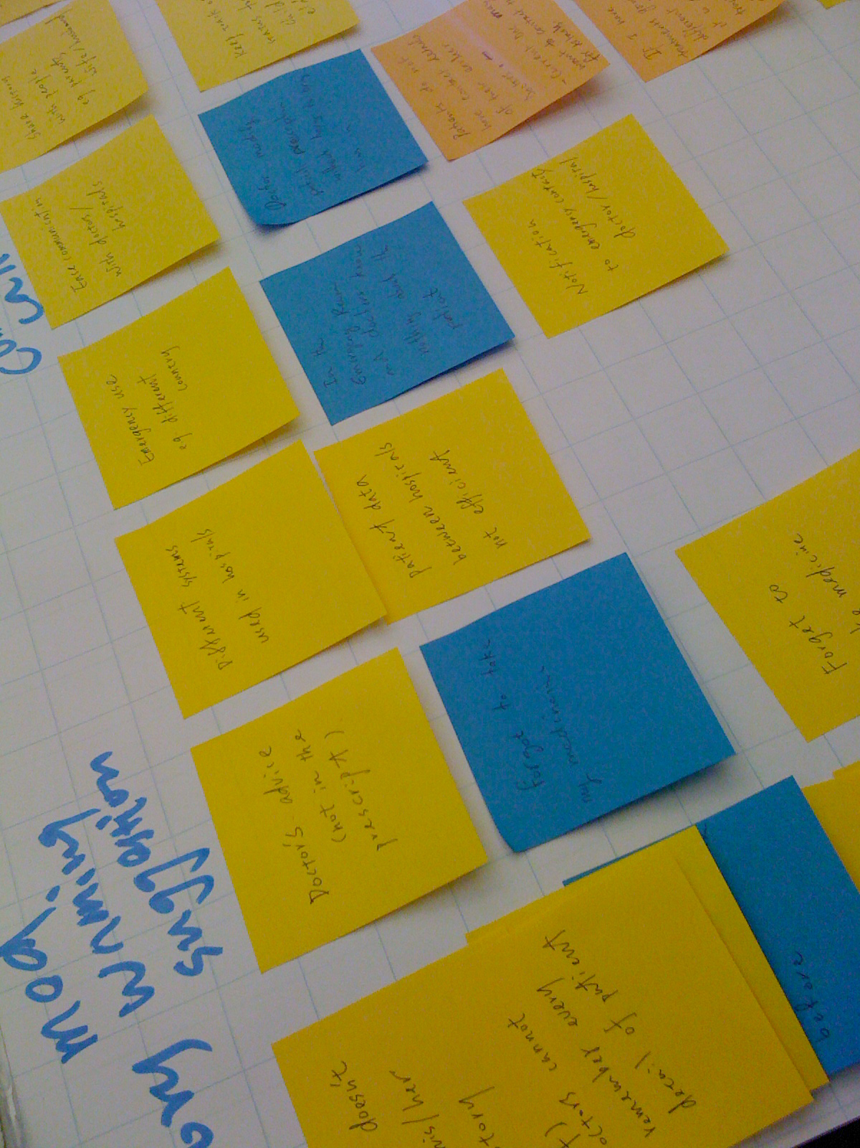
Tools: Affinity Diagram
Identified issues related to healthcare
Focused on medical history

Slide 4
Tools: Field Research
Conducted interviews with professionals, patients, and other healthcare related personnel
Found histories were a complex area, doctors and patients used to current system
Began to interview about more selective areas of medical history – mothers, paramedics

Slide 5
Tools: Competitive Analysis
Found existing tools similar to original idea (but not mobile)
Google Health
Microsoft HealthVault
Dossia
Even with big names behind it, digitized medical records are not taking off
MedicAlert

Slide 6
SET Factors
TECHNOLOGY
SOCIAL
ECONOMIC

Slide 7
SET Factors
TECHNOLOGY
social
ECONOMIC
social
Parents concerned about children
Grown children concerned about aging parents
People are increasingly busy and may be harder to contact by traditional means

Slide 8
SET Factors
TECHNOLOGY
SOCIAL
ECONOMIC
ECONOMIC
Patients willing to pay for medicine even without insurance coverage
Adult children buying aids for their aging parents
High cost of mistakes (improper treatment of someone could easily result in death and/or lawsuits)

Slide 9
SET Factors
TECHNOLOGY
SOCIAL
ECONOMIC
TECHNOLOGY
Near ubiquitous nature of mobile phones (not smartphones)
Massive mobile communication networks
Each device connected to network is uniquely identified and individually owned
Notes:
Hospitals do not share records

Slide 10
POG
A secure and automated service that delivers patients’ medical and contact information in an emergency.
Notes:
A secure, intuitive, and automated service that manages patients’ medical information while maximizing compatibility and accessibility for both patients and doctors.

Slide 11
Persona
Laura Mellon, 47
Experience Goal
As a busy professional, Laura wants to avoid as much interaction with the service as possible, ideally using it in a “set and forget” manner.
End Goal
Laura wants to feel confident allowing her children and father to be outside her immediate supervision while at work. Additionally, she wants to be able to immediately know of any emergencies in her family.
Life Goal
As a mother, Laura wants to ensure the safety and health of her family while being able to maintain her career.
Notes:
Married with two children
Also cares for her elderly father
Works full-time, often in meetings

Slide 12
Family Tree

Slide 13

Persona
Michael Chalkas, 31
EMT
Experience Goal
Well trained to provide first aid procedures and handles emergency with confidence. Michael can use the history of a patient to better aid him, but knows that the current system cannot satisfy these needs
End Goal
Michael wants to provide the best medical help to patients until they reach the hospital
Life Goal
Michael is working hard to save enough money to start his own company in selling medical supplies.

Slide 14
Scenario
5:00AM: Michael Wakes up
10:00AM: drinks coffee and sleeps in the lounge
1:00PM: Receives dispatch for an unconscious high school girl (Jessica)
1:30PM: Utilizes the emergency service on his way back to the hospital to retrieve the girls medical records
6:00AM: Arrive at hospital and checks ambulance
1:40PM: Her family arrives at the hospital notified by the service

Slide 15
Challenges
Scheduling appointments with healthcare personnel takes time.
There exist wide range of healthcare issues which requires focused research to uncover. With limited time and resources, it is not feasible to research all opportunities.
Our competitive analysis showed that there has been lots of work in this field, but limited results.

Slide 16
Questions?
Notes:
A service that keeps track of patients’ medical information (lab results, medication, operations, injuries, allergies…etc.), minimalizing patient intervention. A service that serves as a reminder of doctors’ advice, warnings, and medication intake. A service that patients can use to shares records between medical institutions.

