Slide 1
Parametric Verification of Address Space Separation
Jason Franklin
with Sagar Chaki, Anupam Datta,
Jonathan M. McCune, Arvind Seshadri, and Amit Vasudevan
Cylab & SEI @ Carnegie Mellon University

Slide 2
Outline
Security Kernels
Definition & Importance
Interfaces
Parametricity
Refinement
How we model adversaries
Data structure reduction
Verification of source code

Slide 3
Security Kernels
Security kernels utilize protection mechanisms to prevent actions that violate a security policy
  OSes, hypervisors and web browsers
Uses: cloud computing, online banking, DRM (PS3), malware testing, national security?, etc.
Critically important to verify absence of security bugs
APP
Adversary
Security Kernel
Security
Policy
Notes:
OSes, hypervisor, and web browsers prevent one execution context from accessing memory regions allocated to other contexts

Slide 4
State of the Art in Security Kernel Verification
Manual/semi-automated verification
  Similar goals, costly and time consuming (requires patience)
    SRI HDM, InaJo, Gypsy, UCLA, PSOS, [Heitmeyer et al.], seL4
Model checking work for security kernels
  Study non-parametric verification
    [Guttman et al.], [Lie et al.], [Mitchell et al.]
Bug finding with adversaries
  Unsound or incomplete methods
    [Kidd et al.], [Emmi et al.], [Bugrara and Aiken]
Notes:
Explain difference between theorem proving and our work, mention similar goals, but our focus is on reducing effort

Slide 5
State of the Art in High-Assurance Systems
App
App
App
App
App
App
➔
OS + TCB
OS
Hypervisor (TCB)
Hardware
Hardware
  Security-critical components extracted and moved to hypervisor
  Reduces system code size and interface
    < 10k L.O.C. and < 10 system calls
  Promising initial step to reduce complexity of verification
    TRANGO Virtual Processor, Open Kernel Labs OKL4, VirtualLogix’s VLX, SecVisor (CMU), TrustVisor (CMU), and many others
Notes:
SecVisor uses page tables to protect kernel code
Large data structure increase cost of verification

Slide 6
Limitations of State of the Art
Limitations
Small TCBs alone don’t enable automated formal verification
Overcome limitations by exploiting structure of protection mechanisms
Our Goal
Major source of complexity for model checking is size of data structures
Manual verification effort for theorem proving is high
Notes:
For example, a page table implementation can have 1024 entries and each entry can link to an additional table with 1024 entries

Slide 7
Approach
Automatic source-level verification of OS protection mechanisms can be realized by:
Parametrically reasoning about protection data structures and
Using refinement to carry verification down to source code level

Slide 8
Verification Process
Verification
Model system & property
Apply Parametricity to reduce data structure size
Relate abstract models and C code
Source-level Verification
Prove refinement &
build refinement checker

Slide 9
Scope
Systems
Protection mechanisms of Xen, TrustVisor, SecVisor
Properties
Adversary model
Adversary constrained to system interface
Address separation, W xor X, access control
Manages protection data structures, performs permission and bounds checks
Notes:
Fill this in…

Slide 10
Outline
Security Kernels
Interfaces
Parametricity
Refinement
How we model adversaries

Slide 11
Interface-Constrained Adversary
Adversary model = arbitrary number of calls to system call interface with non-deterministic inputs
  Reduces complexity of adversary models, eases model checking
Without Interface Abstraction
Interface-constrained Adversary
Kernel
A(w)
Kernel
Adversary
A(*)
B(x,y)
B(*,*)
C(z)
C(*)

Slide 12
Example
Adversary-Controlled
Authoritative
*
Sync ≡
foreach row do
if (Secure) then
copy
Read
Write
*
eXe
*
Write
Key Insights:
Adversary is constrained to interface
Kernel page table is adversary-controlled data structure
I = {Sync(*) , Add(*,*) , Delete(*)}
Sync copies adversary-controlled data into memory
Sys Call
Interface
Sync(*)
Add(*,*)
Delete(*)
Notes:
Transition, process
Explain interface abstraction with respect to secvisor example
Add examples of how adversary models can be abstracted in this way

Slide 13
Common Examples
Remote Adversary
Constrained to network interface
Malicious Process
Constrained to OS system call interface
Malicious Web Gadget
Constrained to browser interface
Malicious Peripheral
Constrained to IOMMU interface
Adversary

Slide 14
Outline
Security Kernels
Interfaces
Parametricity
Refinement
Data structure reduction

Slide 15
Protection Data Structures
Kernel Page Table
Shadow Page Table
R
UM
UM
SecVisor Sync ≡
foreach row do
if (W XOR X) then
Sync
R
W
W
KD
X
KC
WX
KC
W
KD
UM=User Memory KD=Kernel Data KC=Kernel Code
Notes:
Transition, process

Slide 16
Data Structure Size and Verification Complexity
Goal: automated verification techniques that scale gracefully with increase in data structure size
Security kernels operate on large data structures
  Page tables, memory protection structures, etc.
Complexity of automated verification increases exponentially with increase in data structure size
Page Table Entries | States | Space | Time
3 | 55,000 | 8MB | 2 sec
4 | 1,700,000 | <256MB | 360 sec
5 | -- | Out of Memory | --
1024 | -- | -- | --
Murphi model checking SecVisor security hypervisor with increasing page table size
Notes:
Bit more detail about verification, model checking etc…

Slide 17
Hierarchical Nesting
Registers
cr3
Multi-level Page Tables
Single-level Page Tables
PDT
PT
Memory
PT
pde0
pte0
pte0
pde1
pte1
PT
pte2
pde2
pte0
pde3
pte1
Notes:
Multiple, linked, parametric arrays
Extended PGCL to handle multiple parametric arrays

Slide 18
Parametricity of System Data Structures
shadow_paging_sync ≡
foreach row do
if (Row_Check) then
modify row;
Row uniform
Row independent
≅
n
1

Slide 19
Small Model Analysis:
Modeling Systems and Properties
Model kernel and adversaries
  Parametric Guarded Command Language (PGCL)
Express security properties
  Parametric Temporal Specification Logic (PTSL)
SYS(n)
ADV(n)
Apps
Adversary
SK(n)
Security Kernel
Policy
P(n)
Notes:
Solution/approach

Slide 20
Language Design Challenges
Balancing expressiveness with small model analysis
  Conditionals
  Whole array ops
  Assignment
  Parallel and sequential composition
  Non-deterministic update
Distinctive features
  Modeling systems and adversaries: whole array operations
  Adversary: Non-deterministic updates
foreach row do
if (Condition) then
Set row = x;
Adversary ≡
foreach row do
row[0] = *;

Slide 21
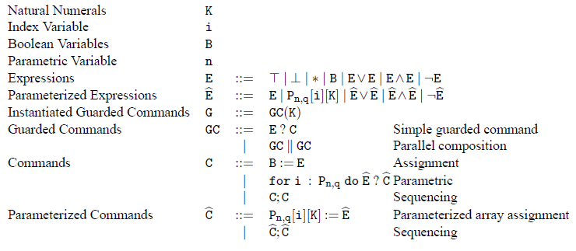
Parametric Programming Language
Language for modeling system & adversary
  Finite number of Boolean variables
  System parameter: n
  Single parametric array: P of size n x q
  Parametric loop
    for i : P[n,q] do E ? C
Kernel Entry ≡
￢kernelmode ? kernelmode := ⊤;
for i : Pn,q do
Pn,q[i][Write] = T ? Pn,q[i][eXe] := ⊥;

Slide 22
SecVisor Model
Kernel Entry ≡
￢kernelmode ? kernelmode := ⊤;
for i : Pn,q do
Pn,q[i][SPTPA] = KC ?
Pn,q[i][SPTRW] := ⊥;
Pn,q[i][SPTX] := ⊤;
…
Sync ≡
⊤ ? for i : Pn,q do
⊤ ? Pn,q[i][SPTPA] := Pn,q[i][KPTPA]
Attacker ≡
⊤ ? for i : Pn,q do
Pn,q[i][KPTPA] := ∗;
Pn,q[i][KPTRW] := ∗;
Pn,q[i][KPTX] := ∗
Kernel Page Table
Shadow Page Table
R
UM
R
UM
R X
KD
Sync
RW
KD
WX
KC
X
KC

Slide 23
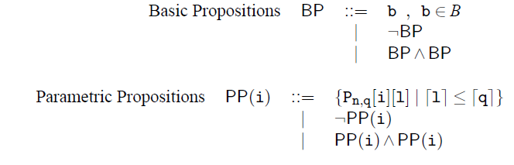
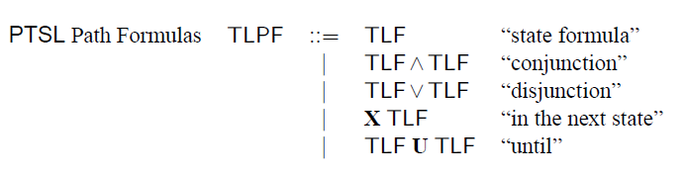
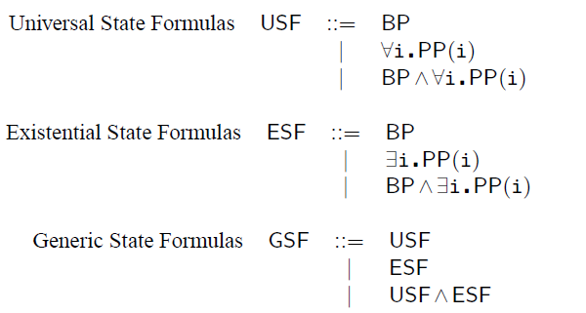
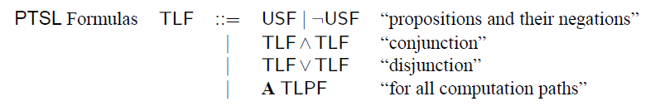
Expressive Specification Logic
Propositions
Basic range over Booleans
Parametric range over rows of parameterized array
Execution Integrity:
In kernel mode, only kernel code should be executable.
It is stated as follows:
Pexec == MODE=KERNEL⇒(∀ i P[i][eXe]⇒(P[i][CodeType] = KC))
Temporal logic specifications
Path formulas
Subset of ACTL* with USF as atomic propositions
Reachability properties
State formulas
Universal, existential, and generic
Notes:
Better describe propositions, -- check statement about range
Why can we have X without getting decidability issues like Emerson and Kahlon?
Why doesn’t execution integrity include path quantifiers?

Slide 24
Small Model Theorems
Verify
  Relate properties of System(1) to System(n), for all finite n
  Sound: If small model is secure then large model is secure
  Complete: If small model is insecure then large model is insecure
Secure!
Insecure
System(1)
SMT
Secure!
Insecure
System(n)

Slide 25
Small Model Safety Theorem
System model
  Let gc(k) be any instantiated guarded command (i.e., any well-formed program)
Security property
  Let ϕ in GSF be any generic state formula
    Forall i. P(i) , Exists i. P(i), or conjunctions of
Initial state
  Let Init in USF be any universal state formula (For all i. P(i))
  Definition: model exhibits ϕ if contains reachable state that satisfies ϕ
  Theorem: M(gc(k), Init) exhibits ϕ iff M(gc(1), Init) exhibits ϕ
  Thms with different initial conditions & properties in [Oakland2010]
Notes:
Generalization for programs works like so…
Generalization for properties works like so…
High level description of logic
Build table with columns that have init condition type, property type, and result

Slide 26
Small Model Analysis
Initial condition:
SecVisor starts in kernel mode and only kernel code is executable
In PTSL:
Init == MODE=KERNEL ^
(∀ i. P[i][SPTX]⇒(P[i][SPTPA] = KC))
SYS(n)
ADV(n)
System
Adversary
mode = kernel AND
FOREACH page in SPT, if eXe then
page maps kernel code
RM(n)
SecVisor(n)
Execution Integrity:
In kernel mode, only kernel code should be executable.
In PTSL:
Pexec == MODE=KERNEL⇒
(∀ i. P[i][SPTX]⇒(P[i][SPTPA] = KC))
W xor X
If mode = kernel then
FOREACH page in SPT, if eXe then
page maps kernel code
SMT
SecVisor(1)
Verify

Slide 27
Verification Results
SecVisor (Shadowvisor, sHype, Xen), adversary, and properties expressible
  Small Model Theorems apply
Translate to Murphi, verify
  Two vulnerabilities, repaired, verified
    Two more in ShadowVisor
Sync ≡
⊤ ? for i : Pn,q do
⊤ ?
Pn,q[i][SPTPA] :=Pn,q[i][KPTPA]
Secure Sync ≡
⊤ ? for i : Pn,q do
(￢Pn,q[i][SPTX] ∧ ￢(Pn,q[i][KPTPA] = KC)) ?
Pn,q[i][SPTPA] := Pn,q[i][KPTPA]

Slide 28
Extending Parametricity Results
Complexities and Solutions
Multiple, linked, parametric arrays
Extended PGCL to handle multiple parametric arrays
New small model theorems
Added nested quantifiers to PTSL
page_fault (u32 addr) {
pdt = get_pdt(addr);
if (pdt is ADDR) {
if (pdt < MAX)
copy;
} else {
if (getpde(addr) < MAX)
copy;
}
}

Slide 29
Related Work
Parametric verification for correctness
  Missing whole array operators (adversary) or less efficient
    [Lazic et al.] and [Emerson and Kahlon]
  Incomplete methods (environment abstraction)
    [Clarke et al.] and [Talupur et al.]
Parametric verification for security
  Focus on security protocols
    [Lowe et al.], [Roscoe and Broadfoot], [Durgin et al.], [Millen]
Notes:
More related work in the paper.

Slide 30
Outline
Security Kernels
Interfaces
Parametricity
Refinement
Verification of source code

Slide 31
Towards Source Level Verification
C code
page_fault (u32 addr) {
pdt = get_pdt(addr);
if (pdt.ADDR) {
if (pdt < MAX)
copy;
} else {
if (getpde(addr) < MAX)
copy;
}
}
Guarded Command Representation
page_fault ≡
pdt.ADDR && pdt < MAX ?
Pn,k[i][ADDR] := Pn,k[i][ADDR];
!pdf.ADDR && pde(pdt) < MAX ?
Pn,k[i][ADDR] := Pn,k[i][ADDR];
1. Convert
Refinement Theorem
2. Check language containment
Yes, results apply.
No, modify or results do not apply.
Language containment ➔ refinement
Check language containment to prove GC is in PGCL
Convert C code to guarded commands (GC)

Slide 32
Verification
Verification
1. Model system & property
Apply Parametricity to reduce data structure size
Relate abstract models and C code
Prove soundness & build abstractor
2. Source-level Verification
Adversary abstraction to identify security-relevant code
Prove refinement & build refinement checker
Complete
In Progress

Slide 33
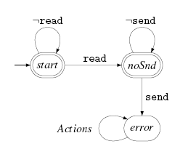
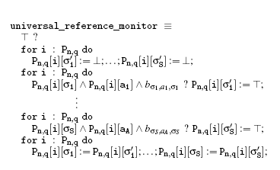
Expressiveness and Limitations
PGCL/PTSL can model:
  Protection mechanisms that are row independent and row uniform
  Policies that are expressible as FSA over rows (safety properties)
Developed compilation to convert FSA policy to PGCL reference monitor

Slide 34
Assumptions and/or Limitations
Verification
  Applies to row-uniform, hierarchical-row independent systems (expressible in PGCL)
  Properties expressible in large subset of ACTL*/X
  Currently at model level and some source-level guarantees
  Assumptions about semantics of C, correctness of model checker, translation tools, and of proofs
Validation
  Security properties might not be right properties or strong enough
  Adversary model may not match reality

Slide 35
Related Work
Model checking for security
  Study non-parametric verification of secure systems
    [Guttman et al.], [Lie et al.], [Mitchell et al.]
Bug finding with adversaries
  Unsound or incomplete methods
    [Kidd et al.], [Emmi et al.]
Operating system verification
  Manual/semi-automated verification
    [Walker et al.], [Heitmeyer et al.], [Klein et al.]
Notes:
More related work in the paper.

Slide 36
Conclusions
Questions?
More info @
http://www.cs.cmu.edu/~jfrankli
Towards scalable automated source-level verification of protection mechanisms
  Adversary abstraction reduces model complexity
  Parametric reasoning reduces data complexity
    Small model theorems relate small/large models
    Application to SecVisor, sHype, Shadowvisor, & Xen
  Refinement theorem pushes guarantees to source
Outlined path to source level verification
  Building models is time-consuming, costly, and error-prone
  In progress, proof of refinement theorem

