Slide 1


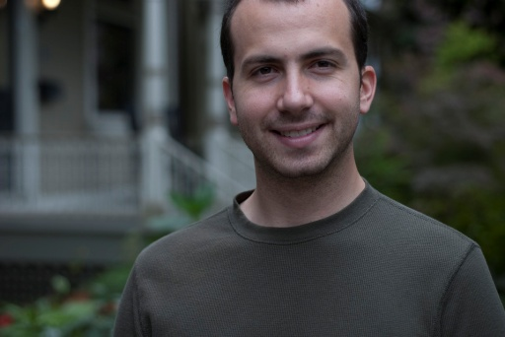




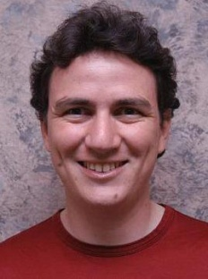

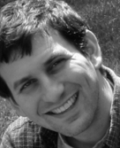
2
@
The Next Generation of the GraphLab Abstraction.
Joseph Gonzalez
Joint work with
Yucheng
Low
Aapo
Kyrola
Jay
Gu
Danny
Bickson
Carlos
Guestrin
Alex
Smola
Joe
Hellerstein

Slide 2
How will we
design and implement
parallel learning systems?

Slide 3
Map-Reduce / Hadoop
... a popular answer:
Build learning algorithms on-top of
high-level parallel abstractions

Slide 4
Map-Reduce for Data-Parallel ML
Excellent for large data-parallel tasks!
Data-Parallel Graph-Parallel
Map Reduce
Feature
Extraction
Cross
Validation
Label Propagation
Lasso
Belief
Propagation
Kernel
Methods
Computing Sufficient
Statistics
Tensor
Factorization
PageRank
Deep Belief
Networks
Neural
Networks

Slide 5
Example of
Graph Parallelism

Slide 6
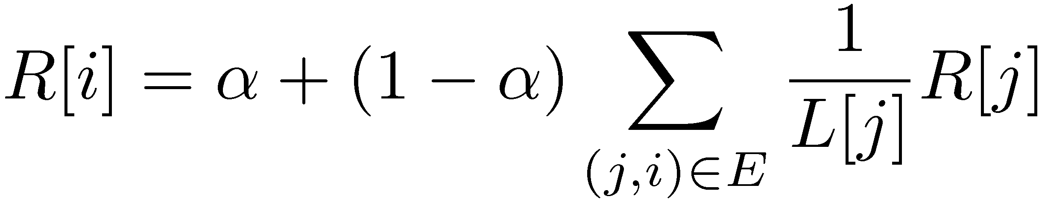
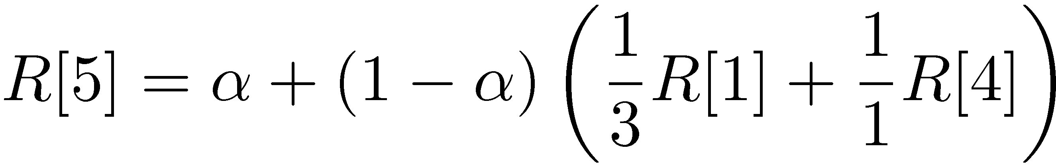
PageRank Example
Iterate:
Where:
  α is the random reset probability
  L[j] is the number of links on page j
1
2
3
4
5
6

Slide 7
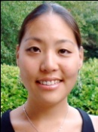





Properties of Graph Parallel Algorithms
Dependency
Graph
Factored
Computation
Iterative
Computation
My Rank
Friends Rank

Slide 8
Map-Reduce for Data-Parallel ML
Excellent for large data-parallel tasks!
Data-Parallel Graph-Parallel
Map Reduce
Pregel (Giraph)?
Map Reduce?
Feature
Extraction
Cross
Validation
SVM
Lasso
Belief
Propagation
Kernel
Methods
Computing Sufficient
Statistics
Tensor
Factorization
PageRank
Deep Belief
Networks
Neural
Networks

Slide 9
Pregel (Giraph)
Bulk Synchronous Parallel Model:
Compute
Communicate
Barrier

Slide 10
PageRank in Giraph (Pregel)
public void compute(Iterator<DoubleWritable> msgIterator) {
double sum = 0;
while (msgIterator.hasNext())
sum += msgIterator.next().get();
DoubleWritable vertexValue =
new DoubleWritable(0.15 + 0.85 * sum);
setVertexValue(vertexValue);
if (getSuperstep() < getConf().getInt(MAX_STEPS, -1)) {
long edges = getOutEdgeMap().size();
sentMsgToAllEdges(
new DoubleWritable(getVertexValue().get() / edges));
} else voteToHalt();
}

Slide 11
Bulk synchronous computation can be inefficient.
Problem

Slide 12
Curse of the Slow Job
Iterations
Data
Data
Data
Data
CPU 1
CPU 1
CPU 1
Data
Data
Data
Data
Data
Data
Data
Data
CPU 2
CPU 2
CPU 2
Data
Data
Data
Data
Data
Data
Data
Data
CPU 3
CPU 3
CPU 3
Data
Data
Data
Data
Data
Data
Data
Data
Barrier
Barrier
Barrier

Slide 13
Curse of the Slow Job
Assuming runtime is drawn from an exponential distribution with mean 1.

Slide 14
Problem with Messaging
Storage Overhead:
  Requires keeping Old and New Messages [2x Overhead]
  Redundant messages:
    PageRank: send a copy of your own rank to all neighbors
      O(|V|) → O(|E|)
Often requires complex protocols
  When will my neighbors need information about me?
Unable to constrain neighborhood state
  How would you implement graph coloring?
CPU 1
CPU 2
Sends the same message
three times!

Slide 15
Converge More Slowly
Optimized in Memory Bulk Synchronous
Asynchronous Splash BP

Slide 16
Bulk synchronous computation can be wrong!
Problem

Slide 17
The problem with Bulk Synchronous Gibbs
t=1
t=2
t=3
Strong Positive
Correlation
t=0
Sequential
Execution
Strong Positive
Correlation
Heads:
Tails:
Strong Negative
Correlation
Parallel
Execution
Adjacent variables cannot be sampled simultaneously.

Slide 18

The Need for a New Abstraction
If not Pregel, then what?
Data-Parallel Graph-Parallel
Map Reduce
Pregel (Giraph)
Feature
Extraction
Cross
Validation
Belief
Propagation
Kernel
Methods
SVM
Computing Sufficient
Statistics
Tensor
Factorization
PageRank
Neural
Networks
Lasso
Deep Belief
Networks

Slide 19
What is GraphLab?

Slide 20
The GraphLab Framework
Graph Based
Data Representation
Update Functions
User Computation
Scheduler
Consistency Model

Slide 21
Data Graph
A graph with arbitrary data (C++ Objects) associated with each vertex and edge.
Graph:
Social Network
Vertex Data:
User profile text
Current interests estimates
Edge Data:
Similarity weights

Slide 22
Comparison with Pregel
Pregel
GraphLab
Data is associated only with vertices
Data is associated with both vertices and edges

Slide 23
Update Functions
An update function is a user defined program which when applied to a vertex transforms the data in the scope of the vertex
pagerank(i, scope){
// Get Neighborhood data
(R[i], W_{ij}, R[j]) ←scope;
// Update the vertex data
// Reschedule Neighbors if needed
if R[i] changes then
reschedule_neighbors_of(i);
}

Slide 24
PageRank in GraphLab2
struct pagerank : public iupdate_functor<graph, pagerank> {
void operator()(icontext_type& context) {
vertex_data& vdata = context.vertex_data();
double sum = 0;
foreach ( edge_type edge, context.in_edges() )
sum += 1/context.num_out_edges(edge.source()) *
context.vertex_data(edge.source()).rank;
double old_rank = vdata.rank;
vdata.rank = RESET_PROB + (1-RESET_PROB) * sum;
double residual = abs(vdata.rank – old_rank) /
context.num_out_edges();
if (residual > EPSILON)
context.reschedule_out_neighbors(pagerank());
}
};

Slide 25
Comparison with Pregel
Pregel
GraphLab
Data must be sent to adjacent vertices
The user code describes the movement of data as well as computation
Data is read from adjacent vertices
User code only describes the computation

Slide 26
The Scheduler
The scheduler determines the order that vertices are updated.
CPU 1
b
c
d
a
b
c
Scheduler
e
f
b
e
f
g
a
i
h
i
j
h
i
j
k
CPU 2
The process repeats until the scheduler is empty.

Slide 27
The GraphLab Framework
Graph Based
Data Representation
Update Functions
User Computation
Scheduler
Consistency Model

Slide 28
Ensuring Race-Free Code
How much can computation overlap?

Slide 29
GraphLab Ensures Sequential Consistency
For each parallel execution, there exists a sequential execution of update functions which produces the same result.
CPU 1
time
Parallel
CPU 2
Sequential
Single
CPU

Slide 30
Consistency Rules
Full Consistency
Data
Guaranteed sequential consistency for all update functions

Slide 31
Full Consistency
Full Consistency

Slide 32
Obtaining More Parallelism
Full Consistency
Edge Consistency

Slide 33
Edge Consistency
Edge Consistency
Safe
CPU 1
Read
CPU 2

Slide 34
In Summary …
Is pretty neat!

Slide 35
Pregel vs. GraphLab
Multicore PageRank (25M Vertices, 355M Edges)
Pregel [Simulated]
  Synchronous Schedule
  No Skipping [Unfair updates comparison]
  No Combiner [Unfair runtime comparison]

Slide 36
Update Count Distribution
Most vertices need to be updated infrequently

Slide 37
SVD
CoEM
Matrix
Factorization
Bayesian Tensor
Factorization
Lasso
PageRank
LDA
Gibbs Sampling
SVM
Dynamic Block Gibbs Sampling
Belief Propagation
K-Means
…Many others…

Slide 38











































Startups Using GraphLab
Companies experimenting with Graphlab
1600++ Unique Downloads Tracked
(possibly many more from direct repository checkouts)
Academic projects Exploring Graphlab

Slide 39
Why do we need a
NEW GraphLab?

Slide 40
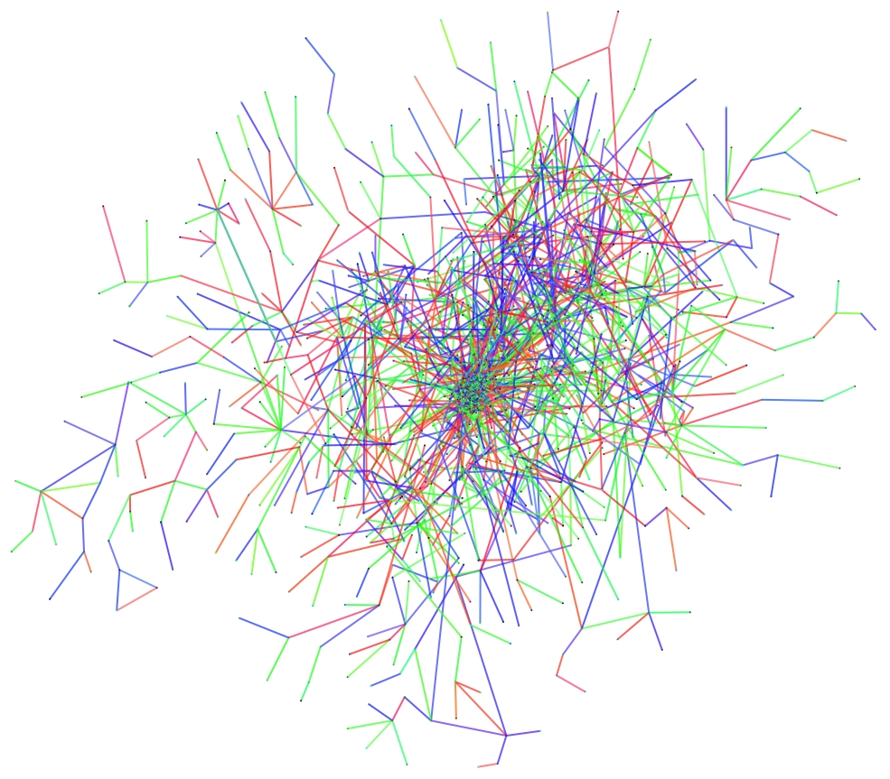
Natural Graphs

Slide 41
Natural Graphs → Power Law
Yahoo! Web Graph
Top 1% vertices is adjacent to
53% of the edges!
“Power Law”
Notes:
----- Meeting Notes (11/15/11 20:27) -----
Review of the scope.

Slide 42
Problem: High Degree Vertices
High degree vertices limit parallelism:
Touch a Large
Amount of State
Requires Heavy
Locking
Processed
Sequentially

Slide 43



High Degree Vertices are Common
“Social” People
Popular Movies
Users
Netflix
Movies
Hyper Parameters
Common Words
θ
B
α
θ
Docs
Freq.
Z
θ
Z
θ
Z
Z
Z
Z
Obama
Z
Z
w
Z
w
Z
Z
w
Z
w
Z
w
Z
w
w
Z
w
Z
w
w
w
Words
w
w
w
w
w

Slide 44
Proposed Four Solutions
Decomposable Update Functors
  Expose greater parallelism by further factoring update functions
Commutative- Associative Update Functors
  Transition from stateless to stateful update functions
Abelian Group Caching (concurrent revisions)
  Allows for controllable races through diff operations
Stochastic Scopes
  Reduce degree through sampling

Slide 45
PageRank in GraphLab
struct pagerank : public iupdate_functor<graph, pagerank> {
void operator()(icontext_type& context) {
vertex_data& vdata = context.vertex_data();
double sum = 0;
foreach ( edge_type edge, context.in_edges() )
sum += 1/context.num_out_edges(edge.source()) *
context.vertex_data(edge.source()).rank;
double old_rank = vdata.rank;
vdata.rank = RESET_PROB + (1-RESET_PROB) * sum;
double residual = abs(vdata.rank – old_rank) /
context.num_out_edges();
if (residual > EPSILON)
context.reschedule_out_neighbors(pagerank());
}
};

Slide 46
PageRank in GraphLab
struct pagerank : public iupdate_functor<graph, pagerank> {
void operator()(icontext_type& context) {
vertex_data& vdata = context.vertex_data();
double sum = 0;
foreach ( edge_type edge, context.in_edges() )
sum += 1/context.num_out_edges(edge.source()) *
context.vertex_data(edge.source()).rank;
double old_rank = vdata.rank;
vdata.rank = RESET_PROB + (1-RESET_PROB) * sum;
double residual = abs(vdata.rank – old_rank) /
context.num_out_edges();
if (residual > EPSILON)
context.reschedule_out_neighbors(pagerank());
}
};
Parallel “Sum” Gather
Atomic Single Vertex Apply
Parallel Scatter [Reschedule]

Slide 47
Decomposable Update Functors
Decompose update functions into 3 phases:
Locks are acquired only for region within a scope → Relaxed Consistency
Gather
Apply
Scatter
Scope
Y
Y
Y
Parallel
Sum
+ + … + → Δ
Apply the accumulated
value to center vertex
Update adjacent edges
and vertices.
Y
Y
Y
User Defined:
User Defined:
User Defined:
Gather( ) → Δ
Apply( , Δ) →
Y
Scatter( ) →
Y
Y
Y
Δ₁ + Δ₂ → Δ₃

Slide 48
Factorized PageRank
struct pagerank : public iupdate_functor<graph, pagerank> { double accum = 0, residual = 0;
void gather(icontext_type& context, const edge_type& edge) {
accum += 1/context.num_out_edges(edge.source()) *
context.vertex_data(edge.source()).rank;
}
void merge(const pagerank& other) { accum += other.accum; }
void apply(icontext_type& context) {
vertex_data& vdata = context.vertex_data();
double old_value = vdata.rank;
vdata.rank = RESET_PROB + (1 - RESET_PROB) * accum;
residual = fabs(vdata.rank – old_value) /
context.num_out_edges();
}
void scatter(icontext_type& context, const edge_type& edge) {
if (residual > EPSILON)
context.schedule(edge.target(), pagerank());
}
};

Slide 49
Decomposable Execution Model
Split computation across machines:
F₁
Y
F₂
Y
( o )( )→
Y
Y
Y
Y

Slide 50
Weaker Consistency
Neighboring vertices maybe be updated simultaneously:
Gather
Gather
A
B
Apply
Gather
C

Slide 51
Other Decomposable Algorithms
Loopy Belief Propagation
  Gather: Accumulates product (log sum) of in messages
  Apply: Updates central belief
  Scatter: Computes out messages and schedules adjacent vertices
Alternating Least Squares (ALS)
x₁
y₁
Movies
w₁
Netflix
≈
x
Users
Users
y₂
x₂
User Factors (W)
y₃
Movie Factors (X)
w₂
y₄
x₃
Movies

Slide 52
LDA: Collapsed Gibbs Sampling
Implement LDA in bipartite graph:
  Gather: Collects topic counts for all words in a document
  Apply: re-samples all words
  Scatter: updates word topic counts
Topic A
Word1 Topics
Doc1 Topics
Topic A
Topic B
Doc2 Topics
Word3 Topics
Topic A
Topic B
Doc3 Topics
Topic B
Word3 Topics

Slide 53
Convergent Gibbs Sampling
Cannot be done:
Gather
Gather
Unsafe
A
B
Gather
C

Slide 54
Decomposable Functors
Fits many algorithms
  Loopy Belief Propagation, Label Propagation, PageRank…
Addresses the earlier concerns
Problem: Does not exploit asynchrony at the vertex level.
Large State
Heavy Locking
Sequential
Parallel
Gather and Scatter
Distributed
Gather and Scatter
Fine Grained
Locking

Slide 55
Need for Vertex Level Asynchrony
Costly gather for a
single change!
Y
Exploit commutative associative “sum”
+ + + + + →
Y

Slide 56
Need for Vertex Level Asynchrony
Y
Exploit commutative associative “sum”
+ + + + + →
Y

Slide 57
Need for Vertex Level Asynchrony
Y
Exploit commutative associative “sum”
+ + + + + + - →
Y

Slide 58
Need for Vertex Level Asynchrony
Y
Exploit commutative associative “sum”
+ + + + + + Δ →
Y

Slide 59
Need for Vertex Level Asynchrony
Y
Exploit commutative associative “sum”
+ + + + + + Δ →
Old (Cached) Sum
Y

Slide 60
Need for Vertex Level Asynchrony
Δ
Δ
Δ
Δ
Y
Exploit commutative associative “sum”
+ + + + + + Δ →
Old (Cached) Sum
Y

Slide 61
Commutative-Associative Update
struct pagerank : public iupdate_functor<graph, pagerank> {
double delta;
pagerank(double d) : delta(d) { }
void operator+=(pagerank& other) { delta += other.delta; }
void operator()(icontext_type& context) {
vertex_data& vdata = context.vertex_data();
vdata.rank += delta;
if(abs(delta) > EPSILON) {
double out_delta = delta * (1 – RESET_PROB) *
1/context.num_out_edges(edge.source());
context.schedule_out_neighbors(pagerank(out_delta));
}
}
};
// Initial Rank: R[i] = 0;
// Initial Schedule: pagerank(RESET_PROB);

Slide 62
Scheduling Composes Updates
Calling reschedule neighbors forces update function composition:
reschedule_out_neighbors(pagerank(3))
pagerank(3)
pagerank(3)
Pending:
pagerank(7)
Pending:
pagerank(10)
Pending:
pagerank(3)

Slide 63
Experimental Comparison

Slide 64
Comparison of Abstractions:
Multicore PageRank (25M Vertices, 355M Edges)

Slide 65
Comparison of Abstractions:
Distributed PageRank (25M Vertices, 355M Edges)

Slide 66
PageRank on the Web circa 2000
Invented Comparison:

Slide 67
Ongoing work
Extending all of GraphLab2 to the distributed setting
  Implemented push based engines (chromatic)
  Need to build GraphLab2 distributed locking engine
Improving storage efficiency of the distributed data-graph
Porting large set of Danny’s applications

Slide 68
Questions
http://graphlab.org

Slide 69
Extra Material

Slide 70
Abelian Group Caching
Enabling eventually consistent data races

Slide 71
Abelian Group Caching
Issue:
  All earlier methods maintain a sequentially consistent view of data across all processors.
Proposal: Try to split data instead of computation.
How can we split the graph without changing the update function?
CPU 4
CPU 1
CPU 1
CPU 4
CPU 2
CPU 3
CPU 3
CPU 2

Slide 72
Insight from WSDM paper
Answer: Allow Eventually Consistent data races
High degree vertices admit slightly “stale” values:
  Changes in a few elements → negligible effect
High degree vertex updates typically a form of “sum” operation which has an “inverse”
  Example: Counts, Averages, Sufficient statistics
  Counter Example: Max
Goal: Lazily synchronize duplicate data
  Similar to a version control system
  Intermediate values partially consistent
  Final value at termination must be consistent

Slide 73
Example
Every processor initial has a copy of the same central value:
Master
10
10
10
10
Current
Current
Current
Processor 1
Processor 2
Processor 3

Slide 74
Example
Each processor makes a small change to its value:
Master
10
11
10
7
10
13
10
Current
Old
Current
Old
Current
Old
Processor 1
Processor 2
Processor 3
True Value: 10 + 1 - 3 + 3 = 11

Slide 75
Example
Send delta values (Diffs) to the master:
Master
10
1
-3
11
10
7
10
13
10
Current
Old
Current
Old
Current
Old
Processor 1
Processor 2
Processor 3
True Value: 10 + 1 - 3 + 3 = 11

Slide 76
Example
Send delta values (Diffs) to the master:
Master
10
1
-3
11
7
13
10
Current
Current
Current
Old
Processor 1
Processor 2
Processor 3
True Value: 10 + 1 - 3 + 3 = 11

Slide 77
Example
Send delta values (Diffs) to the master:
Master
8
1
-3
11
7
13
10
Current
Current
Current
Old
Processor 1
Processor 2
Processor 3
True Value: 10 + 1 - 3 + 3 = 11

Slide 78
Example
Master is consistent with first two processors changes
Master
8
11
7
13
10
Current
Current
Current
Old
Processor 1
Processor 2
Processor 3
True Value: 10 + 1 - 3 + 3 = 11

Slide 79
Example
Master decides to refresh other processors
Master
8
8
8
8
8
11
7
13
10
Current
Current
Current
Old
Processor 1
Processor 2
Processor 3
True Value: 10 + 1 - 3 + 3 = 11

Slide 80
Example
Master decides to refresh other processors
Master
8
8
8
8
8
13
10
Current
Current
Current
Old
Processor 1
Processor 2
Processor 3
True Value: 10 + 1 - 3 + 3 = 11

Slide 81
Example
Master decides to refresh other processors
Master
8
8
8
+3
8
8
13
10
Current
Current
Current
Old
Processor 1
Processor 2
Processor 3
True Value: 10 + 1 - 3 + 3 = 11

Slide 82
Example
Master decides to refresh other processors
Master
8
8
8
+3
8
8
8+3
8
Current
Current
Current
Old
Processor 1
Processor 2
Processor 3
True Value: 10 + 1 - 3 + 3 = 11

Slide 83
Example
Master decides to refresh other processors
Master
8
8
8
8
11
8
Current
Current
Current
Old
Processor 1
Processor 2
Processor 3
True Value: 10 + 1 - 3 + 3 = 11

Slide 84
Example
Processor 3 decides to update the master
Master
8
8
3
8
8
11
8
Current
Current
Current
Old
Processor 1
Processor 2
Processor 3
True Value: 10 + 1 - 3 + 3 = 11

Slide 85
Example
Processor 3 decides to update the master
Master
8
8
3
8
8
11
Current
Current
Current
Processor 1
Processor 2
Processor 3
True Value: 10 + 1 - 3 + 3 = 11

Slide 86
Example
Processor 3 decides to update the master
Master
11
3
8
8
11
Current
Current
Current
Processor 1
Processor 2
Processor 3
True Value: 10 + 1 - 3 + 3 = 11

Slide 87
Example
Master is globally consistent:
Master
11
8
8
11
Current
Current
Current
Processor 1
Processor 2
Processor 3
True Value: 10 + 1 - 3 + 3 = 11

Slide 88
Example
Master is globally consistent:
Master
11
11
11
11
8
8
11
Current
Current
Current
Processor 1
Processor 2
Processor 3
True Value: 10 + 1 - 3 + 3 = 11

Slide 89
Example
Master is globally consistent:
Master
11
11
11
11
11
11
11
Current
Current
Current
Processor 1
Processor 2
Processor 3
True Value: 10 + 1 - 3 + 3 = 11

Slide 90
Abelian Group Caching
Abelian Group Caching:
  Data must have a commutative (+) and inverse (-) operation
In GraphLab we have encountered many applications with the following bipartite form:
Data
Parameter
Data
High
Degree
(Power Law)
Bounded
Low
Degree
Data
Parameter
Data
Data
Parameter
Data

Slide 91
Abelian Group Caching
Abelian Group Caching:
  Data must have a commutative (+) and inverse (-) operation
In GraphLab we have encountered many applications with the following bipartite form:
  Clustering
  Topic models
  Lasso
  …
Data
Parameter
Data
Data
Parameter
Data
Data
Parameter
Data

Slide 92
Caching Replaces Locks
Instead of locking cache entries are created:
  Each processor maintains a LRU vertex data cache
  Locks are acquired in parallel and only on a cache miss
User must define (+) and (-) operations for vertex data
  Simpler: vdata.apply_diff(new_vdata, old_vdata)
User specifies maximum allowable “staleness”
Works with existing update functions/functors
Cache
Cache
Cache

Slide 93
Hierarchical Caching
The caching strategy can be composed across varying latency systems:
Thread Cache
Thread Cache
Thread Cache
Thread Cache
Thread Cache
Thread Cache
Thread Cache
Thread Cache
Thread Cache
Thread Cache
Thread Cache
Thread Cache
System
Cache
System
Cache
System
Cache
Cache Resolution
System
Cache
Rack 1 Cache
Rack 2 Cache
Distributed Hash Table of Masters

Slide 94
Hierarchical Caching
Current implementation uses two tiers:
Thread Cache
Thread Cache
Thread Cache
Thread Cache
Thread Cache
Thread Cache
Thread Cache
Thread Cache
Thread Cache
Thread Cache
Thread Cache
Thread Cache
Cache Resolution
System
Cache
System
Cache
System
Cache
System
Cache
Distributed Hash Table of Masters

Slide 95
Contention Based Caching
Idea: Only use cache strategy when a lock is in frequently contention
Tested on LDA and PageRank
  Reduces the effective cache size
  Works under LDA
  Does not work on Y!Messenger
    Due to sleep-based implementation of try_write in Pthreads
Fail
Try_Lock
Lock and Cache
Use true data
Used Cached Copy

Slide 96

Global Variables
Problem: Current global aggregation is fully synchronous and contrary to GraphLab philosophy:
  Don’t want to repeatedly re-compute entire sum.
Solution: Trivial (now): use abelian caching
Problem: Does not support Max operation (no inverse)
  Maintain the top k items and whenever the set is empty synchronously re-compute max.
Converged
Slowly Converging
Converged
Slowly
Converging
f(v₁) + f(v₂) + … + f(v_{i}) + … + f(v_{n})

Slide 97
Created a New Library!
Abelian cached distributed hash table:
Should be running on the grid soon ☺
int main(int argc, char** argv) {
dc_init_param rpc_parameters;
init_param_from_env(rpc_parameters);
distributed_control dc(rpc_parameters);
delta_dht< std::string, double > tbl(dc, 100);
tbl[“hello”] += 1.0;
tbl[“world”] -= 3.0;
tbl.synchronize(“world”);
std::cout << tbl[“hello”] << std::endl;
}
Initialize system using Hadoop
Friendly TCP connections
Create an Abelian
Cached Map
Add entries
Read values

Slide 98
Stochastic Scopes
Bounded degree through sampling

Slide 99
Stochastic Scopes
Idea: Can we “sample” the neighborhood of a vertex
Randomly sample neighborhood of fixed size:
Currently only supports uniform sampling
  Will likely need weighted sampling
Need to develop theory of stochastic scopes in learning algorithms
label_prop(i, scope, p){
// Get Neighborhood data
// Update the vertex data
// Reschedule Neighbors if needed
}
Randomly construct
a sample scope
lock all selected
neighbors

Slide 100
Early Experiment

Slide 101
Implemented LDA in GraphLab
Used collapsed Gibbs sampling for LDA as test App.
GraphLab Formulation:
Doc
1
{#[w,d,t], #[w,d]}
#[d,t]
Word A
#[w,t]
Doc
2
Word B
Word C
Doc
3
Word D
Global Variable:
#[t]

Slide 102
Implemented LDA in GraphLab
Used collapsed Gibbs sampling for LDA as test App.
GraphLab Formulation:
Doc
1
{#[w,d,t], #[w,d]}
#[d,t]
Word A
#[w,t]
Doc
2
Word B
Resample #[w,d,t] using:
Update: #[d,t], #[w,d,t], #[w,t]
Word C
Doc
3
Word D
Global Variable:
#[t]

Slide 103
Implemented LDA in GraphLab
Used collapsed Gibbs sampling for LDA as test App.
GraphLab Formulation:
Doc
1
{#[w,d,t], #[w,d]}
#[d,t]
Word A
#[w,t]
Doc
2
Word B
Resample #[w,d,t] using:
Update: #[d,t], #[w,d,t], #[w,t]
Word C
Doc
3
Word D
Global Variable:
#[t]

Slide 104

GraphLab LDA Scaling Curves
Factorized is close to exact parallel Gibbs sampling!
  Only uses “stale” topic counts #[t]
Cached system with 2 update lag
  Need to evaluate lag effect on convergence

Slide 105
Other Preliminary Observations
Pagerank on Y!Messenger Friend Network
  14x speedup (on 16 cores) using new approaches GraphLab
  12x speedup (on 16 cores) using original GraphLab?
    I suspect an inefficiency in functor composition is “improving” scaling
LDA over new DHT data-structures
  Appears to scale linearly on small 4x machine deployments
  Keep’s cache relative fresh (2-3 update Lag)
Needs more evaluation!
Needs system optimization

Slide 106
Summary and Future Work
We have identified several key weakness of GraphLab
  Data Management [Mostly Engineering]
  Natural Graphs and High degree vertices [Interesting]
After substantial engineering effort we have:
  Update Functors & Decomposable Update Functors
  Abelian Group Caching: Eventual consistency
  Stochastic Scopes [Not Evaluated but interesting]
Plan to evaluate on following applications
  LDA (both collapsed Gibbs and CVB0)
  Probabilistic Matrix Factorization
  Loopy BP on Markov Logic Networks
  Label Propagation on Social Networks

Slide 107
GraphLab LDA Scaling Curves

Slide 108
Problems with GraphLab

Slide 109
Problems with the Data Graph
How is the Data Graph constructed?
  Sequentially and in physical memory by the user
    graph.add_vertex(vertex_data) → vertex_id;
    graph.add_edge(source_id, target_id, edge_data);
  In parallel using a complex binary file format
    Graph Atoms: Fragments of the Graph
How is the Data Graph stored between runs?
  By the user in a distributed file-system
  No notion of locality
  No convenient tools to read the output of GraphLab
No out-of-core storage → limit size of graphs

Slide 110
Solution: Hadoop/HDFS DataGraph
Graph Construction and Storage using Hadoop:
  Developed a simple AVRO graph file format
  Implemented a reference AVRO graph constructor in Hadoop.
    Automatically sorts records for fast locking
    Simplifies computing edge reversal maps
    Tested on a subset of the twitter data-set
Hadoop/HDFS manages launching and post-processing
  Hadoop streaming assigns graph fragments
  Output of GraphLab can be processed in Hadoop
Problem: Waiting on C++
ScopeRecord {
ID vertexId;
VDataRecord vdata;
List<ID> NeighborsIds;
List<EDataRecord> EdgeData;
}

Slide 111
Out-of-core Storage
Problem: What if graph doesn’t fit in memory?
Solution: Disk based caching.
Only completed design specification
  Collaborator is writing a mem-cached file-system
In Physical Memory
Local Vertex Locks
Object Cache
Local Scope Map:
Local VertexId → File Offset
Adjacency Lists
Vdata
Edata
Fail
Fail
Out-of-Core Storage
DHT
Scope Record
Scope Record
Distributed Map:
VertexId → Owning Instance
Vdata
Adj. Lists
Edata
Vdata
Adj. List
Edata
Remote Storage

