Slide 1

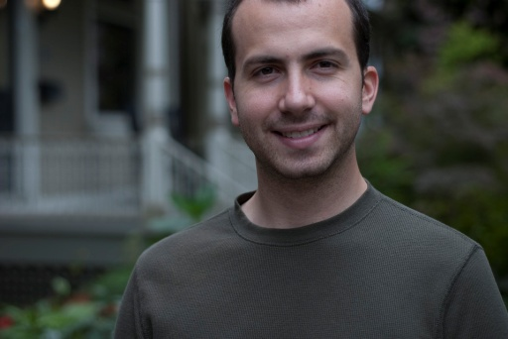



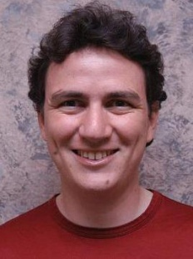

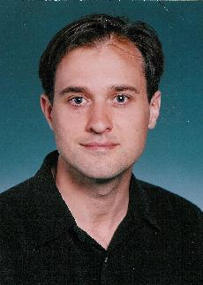


A New Parallel Framework for
Machine Learning
Joseph Gonzalez
Joint work with
Yucheng
Low
Aapo
Kyrola
Danny
Bickson
Carlos
Guestrin
Alex
Smola
Guy
Blelloch
Joe
Hellerstein
David
O’Hallaron

Slide 2



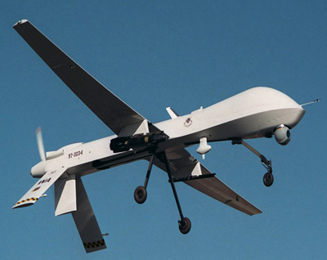


A
C
Originates
From
Lives
B
C
Is the driver hostile?
D

Slide 3
Patient ate
which contains
purchased
from
Also sold
to
Diagnoses
Patient presents abdominal pain.
Diagnosis?
with
E. Coli
infection

Slide 4

Cameras
Cooking
Shopper 1
Shopper 2
Notes:
Here we have two shoppers. We would like to recommend things for them to buy based on their interests. However we may not have enough information to make informed recommendations by examining their individual histories in isolation.
We can use the rich probabilistic structure to improve the recommendations for individual people.

Slide 5

The Hollywood Fiction…
Mr. Finch develops software which:
Runs in “consolidated” data-center with access to all government data
Processes multi-modal data
    Video Surveillance
    Federal and Local Databases
    Social Networks
    …
  Uses Advanced Machine Learning
    Identify connected patterns
    Predict catastrophic events

Slide 6
…how far is this from reality?

Slide 7
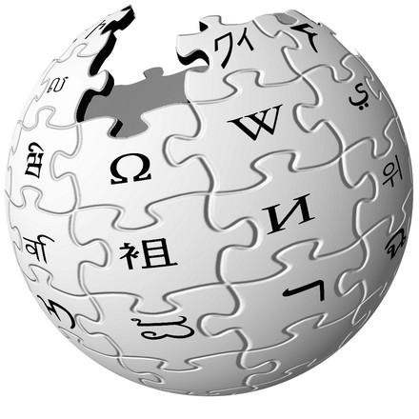



Big Data is a reality
750 Million
Facebook Users
24 Million
Wikipedia Pages
6 Billion
Flickr Photos
48 Hours a Minute
YouTube

Slide 8

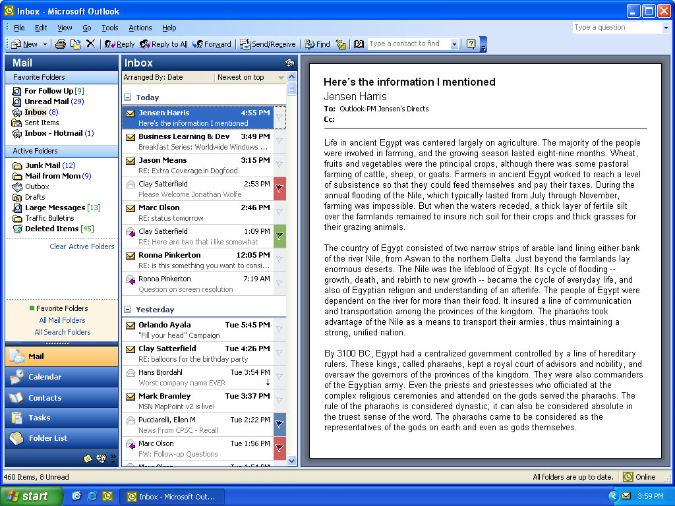
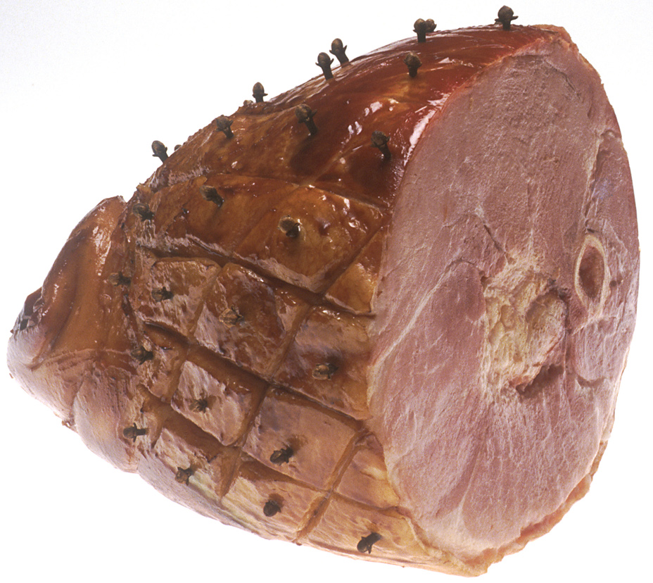
Machine learning is a reality
Raw Data
Understanding
Machine
Learning
Linear Regression
x
x
x
x
x
x
x
x
x
x

Slide 9

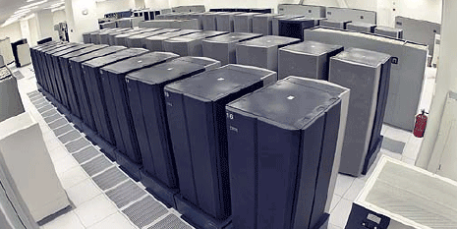
We have mastered:
Big Data
Simple
Machine Learning
Large-Scale
Compute Clusters
+
+
x
x
x
x
x
x
x
x
x
x
Limited to Simplistic Models
  Fail to fully utilize the data
Substantial System Building Effort
  Systems evolve slowly and are costly

Slide 10
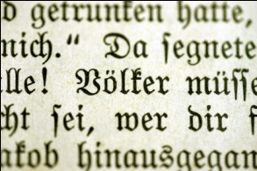
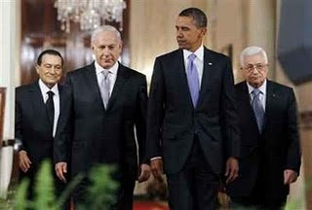


Advanced Machine Learning
Raw Data
Understanding
Machine
Learning
Markov Random Fields
Mubarak Obama
Netanyahu Abbas
Data dependencies substantially
complicate parallelization
Supports
Deep Belief / Neural
Networks
Distrusts
Cooperate
Cameras
Cooking
Needs

Slide 11
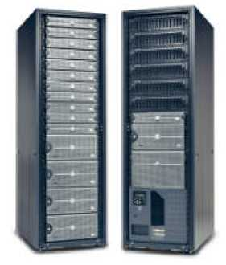
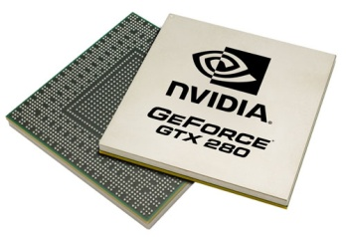
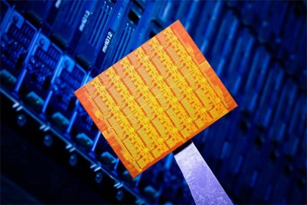
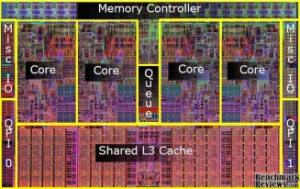

Challenges of Learning at Scale
Wide array of different parallel architectures:
New Challenges for Designing Machine Learning Algorithms:
  Race conditions and deadlocks
  Managing distributed model state
  Data-Locality and efficient inter-process coordination
New Challenges for Implementing Machine Learning Algorithms:
  Parallel debugging and profiling
  Fault Tolerance
GPUs
Multicore
Clusters
Mini Clouds
Clouds

Slide 12
The goal of the GraphLab project …
Big Data
Advanced
Machine Learning
Large-Scale
Compute Clusters
+
+
Rich Structured Machine Learning Techniques
  Capable of fully modeling the data dependencies
Goal: Rapid System Development
  Quickly adapt to new data, priors, and objectives
  Scale with new hardware and system advances

Slide 13
Outline
Importance of Large-Scale Machine Learning
  Need to model data-dependencies
Existing Large-Scale Machine Learning Abstractions
  Need for a efficient graph structured abstraction
GraphLab Abstraction:
  Addresses data-dependences
  Enables the expression of efficient algorithms
Experimental Results
  GraphLab dramatically outperforms existing abstractions
Open Research Challenges

Slide 14
How will we
design and implement
parallel learning systems?

Slide 15
Threads, Locks, & Messages
We could use ….
“low level parallel primitives”

Slide 16
Threads, Locks, and Messages
ML experts repeatedly solve the same parallel design challenges:
  Implement and debug complex parallel system
  Tune for a specific parallel platform
  6 months later the conference paper contains:
“We implemented ______ in parallel.”
The resulting code:
  is difficult to maintain
  is difficult to extend
  couples learning model to parallel implementation
Graduate students

Slide 17
Map-Reduce / Hadoop
... a better answer:
Build learning algorithms on-top of
high-level parallel abstractions

Slide 18










MapReduce – Map Phase
CPU 1
4
2
.
3
2
1
.
3
2
5
.
8
1
2
.
9
CPU 2
CPU 3
CPU 4
Embarrassingly Parallel independent computation
No Communication needed

Slide 19
MapReduce – Map Phase
CPU 1
8
4
.
3
1
8
.
4
8
4
.
4
2
4
.
1
CPU 2
CPU 3
CPU 4
1
2
.
9
4
2
.
3
2
1
.
3
2
5
.
8
Image Features

Slide 20
MapReduce – Map Phase
CPU 1
6
7
.
5
1
4
.
9
3
4
.
3
1
7
.
5
CPU 2
CPU 3
CPU 4
1
2
.
9
2
4
.
1
4
2
.
3
8
4
.
3
2
1
.
3
1
8
.
4
2
5
.
8
8
4
.
4
Embarrassingly Parallel independent computation

Slide 21
MapReduce – Reduce Phase
Attractive Face
Statistics
Ugly Face
Statistics
22
26
.
26
17
26
.
31
CPU 1
CPU 2
Attractive Faces
Ugly Faces
1
2
.
9
2
4
.
1
1
7
.
5
4
2
.
3
8
4
.
3
6
7
.
5
2
1
.
3
1
8
.
4
1
4
.
9
2
5
.
8
8
4
.
4
3
4
.
3
U A A U U U A A U A U A
Image Features

Slide 22
Map-Reduce for Data-Parallel ML
Excellent for large data-parallel tasks!
Data-Parallel Graph-Parallel
Is there more to
Machine Learning
?
Map Reduce
Feature
Extraction
Algorithm
Tuning
Label Propagation
Lasso
Belief
Propagation
Kernel
Methods
Basic Data Processing
Tensor
Factorization
PageRank
Deep Belief
Networks
Neural
Networks

Slide 23
Concrete Example
Label Propagation

Slide 24

Label Propagation Algorithm
Social Arithmetic:
Recurrence Algorithm:
  iterate until convergence
Parallelism:
  Compute all Likes[i] in parallel
Sue Ann
50% What I list on my profile
40% Sue Ann Likes
10% Carlos Like
80% Cameras
20% Biking
+
40%
I Like:
60% Cameras, 40% Biking
Profile
50%
50% Cameras
50% Biking
Me
Carlos
10%
30% Cameras
70% Biking

Slide 25
Properties of Graph Parallel Algorithms
Dependency
Graph
Factored
Computation
Iterative
Computation
What I Like
What My
Friends Like

Slide 26
Map-Reduce for Data-Parallel ML
Excellent for large data-parallel tasks!
Data-Parallel Graph-Parallel
Map Reduce
Map Reduce?
?
Feature
Extraction
Algorithm
Tuning
Label Propagation
Lasso
Belief
Propagation
Kernel
Methods
Basic Data Processing
Tensor
Factorization
PageRank
Deep Belief
Networks
Neural
Networks

Slide 27
Why not use Map-Reduce for
Graph Parallel Algorithms?

Slide 28
Data Dependencies
Map-Reduce does not efficiently express
data dependencies
  User must code substantial data transformations
  Costly data replication
Independent Data Rows

Slide 29
Iterative Algorithms
Map-Reduce not efficiently express iterative algorithms:
Iterations
Data
Data
Data
Data
CPU 1
CPU 1
CPU 1
Data
Data
Data
Data
Data
Data
Data
Data
Slow
Processor
CPU 2
CPU 2
CPU 2
Data
Data
Data
Data
Data
Data
Data
Data
CPU 3
CPU 3
CPU 3
Data
Data
Data
Data
Data
Data
Data
Data
Barrier
Barrier
Barrier

Slide 30
MapAbuse: Iterative MapReduce
Only a subset of data needs computation:
Iterations
Data
Data
Data
Data
CPU 1
CPU 1
CPU 1
Data
Data
Data
Data
Data
Data
Data
Data
CPU 2
CPU 2
CPU 2
Data
Data
Data
Data
Data
Data
Data
Data
CPU 3
CPU 3
CPU 3
Data
Data
Data
Data
Data
Data
Data
Data
Barrier
Barrier
Barrier

Slide 31
MapAbuse: Iterative MapReduce
System is not optimized for iteration:
Iterations
Data
Data
Data
Data
CPU 1
CPU 1
CPU 1
Data
Data
Data
Data
Data
Data
Data
Data
CPU 2
CPU 2
CPU 2
Startup Penalty
Disk Penalty
Startup Penalty
Disk Penalty
Startup Penalty
Data
Data
Disk Penalty
Data
Data
Data
Data
Data
Data
CPU 3
CPU 3
CPU 3
Data
Data
Data
Data
Data
Data
Data
Data

Slide 32
Map-Reduce for Data-Parallel ML
Excellent for large data-parallel tasks!
Data-Parallel Graph-Parallel
Map Reduce
Bulk Synchronous?
Map Reduce?
Feature
Extraction
Cross
Validation
SVM
Lasso
Belief
Propagation
Kernel
Methods
Computing Sufficient
Statistics
Tensor
Factorization
PageRank
Deep Belief
Networks
Neural
Networks

Slide 33
Bulk Synchronous Parallel (BSP)
Implementations: Pregel, Giraph, …
Compute
Communicate
Barrier

Slide 34
Bulk synchronous computation can be highly inefficient.
Problem

Slide 35
Problem with Bulk Synchronous
Example Algorithm: If Red neighbor then turn Red
Bulk Synchronous Computation :
  Evaluate condition on all vertices for every phase
    4 Phases each with 9 computations → 36 Computations
Asynchronous Computation (Wave-front) :
  Evaluate condition only when neighbor changes
    4 Phases each with 2 computations → 8 Computations
Time 0
Time 1
Time 2
Time 3
Time 4

Slide 36
Real-World Example:
Loopy Belief Propagation

Slide 37
Loopy Belief Propagation (Loopy BP)
Iteratively estimate the “beliefs” about vertices
  Read in messages
  Updates marginal
  estimate (belief)
  Send updated
  out messages
Repeat for all variables
until convergence
Notes:
Belief propagation is a message passing algorithm in which messages are sent <click> from variable to factor and then <click> from factor to variable and the processes is repeated. At each phase the new messages are computed using the old message from the previous phase leading to a naturally parallel algorithm known as synchronous Belief Propagation.

Slide 38

Bulk Synchronous Loopy BP
Often considered embarrassingly parallel
  Associate processor
  with each vertex
  Receive all messages
  Update all beliefs
  Send all messages
Proposed by:
  Brunton et al. CRV’06
  Mendiburu et al. GECC’07
  Kang,et al. LDMTA’10
  …
Notes:
Belief propagation is a message passing algorithm in which messages are sent <click> from variable to factor and then <click> from factor to variable and the processes is repeated. At each phase the new messages are computed using the old message from the previous phase leading to a naturally parallel algorithm known as synchronous Belief Propagation.

Slide 39
Sequential Computational Structure
Notes:
Consider the following cyclic factor graph. For simplicity lets collapse <click> the factors the edges. Although this model is highly cyclic, hidden in the structure and factors <click> is a sequential path or backbone of strong dependences among the variables. <click>

Slide 40
Hidden Sequential Structure
Notes:
This hidden sequential structure takes the form of the standard chain graphical model. Lets see how the naturally parallel algorithm performs on this chain graphical models <click>.

Slide 41
Hidden Sequential Structure
Evidence
Evidence
Running Time:
Time for a single
parallel iteration
Number of Iterations
Notes:
Suppose we introduce evidence at both ends of the chain. Using 2n processors we can compute one iteration of messages entirely in parallel. However notice that after two iterations of parallel message computations the evidence on opposite ends has only traveled two vertices. It will take n parallel iterations for the evidence to cross the graph.
<click> Therefore, using p processors it will take 2n / p time to complete a single iteration and so it will take 2n^2/p time to compute the exact marginals.
We might now ask “what is the optimal sequential running time on the chain.”

Slide 42
Optimal Sequential Algorithm
Running
Time
Bulk Synchronous
2n²/p
Gap
p ≤ 2n
Forward-Backward
2n
p = 1
Optimal Parallel
n
p = 2
Notes:
Using p processors we obtain a running time of 2n^2/p.
Meanwhile <click> using a single processor the optimal message scheduling is the standard Forward-Backward schedule in which we sequentially pass messages forward and then backward along the chain. The running time of this algorithm is 2n, linear in the number of variables.
Surprisingly, for any constant number of processors the naturally parallel algorithm is actually slower than the single processor sequential algorithm. In fact, we need the number of processors to grow linearly with the number of elements to recover the original sequential running time.
Meanwhile, <click> the optimal parallel scheduling for the chain graphical model is to calculate the forward messages on one processor and the backward messages on a second processor resulting in <click> a factor of two speedup over the optimal sequential algorithm.
Unfortunately, we cannot use additional processors to further improve performance without abandoning the belief propagation framework.
However, by introducing slight approximation, we can increase the available parallelism in chain graphical models. <click>

Slide 43
The Splash Operation
Generalize the optimal chain algorithm:
to arbitrary cyclic graphs:
~
Grow a BFS Spanning tree with fixed size
Forward Pass computing all messages at each vertex
Backward Pass computing all messages at each vertex
Notes:
We introduce the Splash operation as a generalization of this parallel forward backward pass.
Given a root <click> we grow <click> a breadth first spanning tree. Then starting at the leaves <click> we pass messages inward to the root in a “forward” pass. Then starting at the root <click> we pass messages outwards in a backwards pass.
It is important to note than when we compute a message from a vertex we also compute all other messages in a procedure we call updating a vertex. This both ensures that we update all edges in the tree and confers several scheduling advantages that we will discuss later.
To make this a parallel algorithm we need a method to select Splash roots in parallel and so provide a parallel scheduling for Splash operations. <click>

Slide 44
Data-Parallel Algorithms can be Inefficient
Optimized in Memory Bulk Synchronous
Asynchronous Splash BP

Slide 45
Summary of Work Efficiency
Bulk Synchronous Model Not Work Efficient!
  Compute “messages” before they are ready
  Increasing processors → increase the overall work
  Costs CPU time and Energy!
How do we recover work efficiency?
  Respect sequential structure of computation
  Compute “message” as needed: asynchronously

Slide 46
The Need for a New Abstraction
Map-Reduce is not well suited for Graph-Parallelism
Data-Parallel Graph-Parallel
Map Reduce
Bulk Synchronous
Feature
Extraction
Cross
Validation
Belief
Propagation
Kernel
Methods
SVM
Computing Sufficient
Statistics
Tensor
Factorization
PageRank
Neural
Networks
Lasso
Deep Belief
Networks

Slide 47
Outline
Importance of Large-Scale Machine Learning
  Need to model data-dependencies
Existing Large-Scale Machine Learning Abstractions
  Need for a efficient graph structured abstraction
GraphLab Abstraction:
  Addresses data-dependences
  Enables the expression of efficient algorithms
Experimental Results
  GraphLab dramatically outperforms existing abstractions
Open Research Challenges

Slide 48
What is GraphLab?

Slide 49
The GraphLab Abstraction
Graph Based
Data Representation
Update Functions
User Computation
Scheduler
Consistency Model

Slide 50
Data Graph
A graph with arbitrary data (C++ Objects) associated with each vertex and edge.
Graph:
Social Network
Vertex Data:
User profile text
Current interests estimates
Edge Data:
Similarity weights

Slide 51
Implementing the Data Graph
Multicore Setting
Cluster Setting
In Memory
Relatively Straight Forward
  vertex_data(vid) → data
  edge_data(vid,vid) → data
  neighbors(vid) → vid_list
Challenge:
  Fast lookup, low overhead
Solution:
  Dense data-structures
  Fixed Vdata & Edata types
  Immutable graph structure
In Memory
Partition Graph:
  ParMETIS or Random Cuts
Cached Ghosting
A
B
C
D
Node 1
Node 2
A
B
A
B
C
D
C
D

Slide 52
The GraphLab Abstraction
Graph Based
Data Representation
Update Functions
User Computation
Scheduler
Consistency Model

Slide 53
Update Functions
An update function is a user defined program which when applied to a vertex transforms the data in the scope of the vertex
label_prop(i, scope){
// Get Neighborhood data
(Likes[i], W_{ij}, Likes[j]) ←scope;
// Update the vertex data
// Reschedule Neighbors if needed
if Likes[i] changes then
reschedule_neighbors_of(i);
}

Slide 54
The GraphLab Abstraction
Graph Based
Data Representation
Update Functions
User Computation
Scheduler
Consistency Model

Slide 55
The Scheduler
The scheduler determines the order that vertices are updated.
CPU 1
b
c
d
a
b
c
Scheduler
e
f
b
e
f
g
a
i
h
i
j
h
i
j
k
CPU 2
The process repeats until the scheduler is empty.

Slide 56
Choosing a Schedule
The choice of schedule affects the correctness and parallel performance of the algorithm
GraphLab provides several different schedulers
  Round Robin: vertices are updated in a fixed order
  FIFO: Vertices are updated in the order they are added
  Priority: Vertices are updated in priority order
Obtain different algorithms by simply changing a flag!
--scheduler=roundrobin
--scheduler=fifo
--scheduler=priority
Optimal Splash BP
Algorithm

Slide 57
Implementing the Schedulers
Multicore Setting
Cluster Setting
Challenging!
  Fine-grained locking
  Atomic operations
Approximate FiFo/Priority
  Random placement
  Work stealing
Multicore scheduler on each node
  Schedules only “local” vertices
  Exchange update functions
Node 1
Node 2
f(v₁)
CPU 1
CPU 2
CPU 1
CPU 2
CPU 1
CPU 2
CPU 3
CPU 4
Queue 1
Queue 2
Queue 1
Queue 2
f(v₂)
Queue 1
Queue 2
Queue 3
Queue 4
v₁
v₂

Slide 58
The GraphLab Abstraction
Graph Based
Data Representation
Update Functions
User Computation
Scheduler
Consistency Model

Slide 59
Ensuring Race-Free Code
How much can computation overlap?

Slide 60
Importance of Consistency
Many algorithms require strict consistency or perform significantly better under strict consistency.
Alternating Least Squares
Notes:
There are some people who have claimed that ML is resilient to “soft-computation”
-- ask me afterwards I can give a number of examples

Slide 61
Importance of Consistency
Machine learning algorithms require “model debugging”
Build
Test
Debug
Tweak Model
Notes:
There are some people who have claimed that ML is resilient to “soft-computation”
-- ask me afterwards I can give a number of examples

Slide 62
GraphLab Ensures Sequential Consistency
For each parallel execution, there exists a sequential execution of update functions which produces the same result.
CPU 1
time
Parallel
CPU 2
Sequential
Single
CPU

Slide 63
Common Problem: Write-Write Race
Processors running adjacent update functions simultaneously modify shared data:
CPU1 writes:
CPU 1
CPU 2
CPU2 writes:
Final Value

Slide 64
Consistency Rules
Full Consistency
Data
Guaranteed sequential consistency for all update functions

Slide 65
Full Consistency
Full Consistency

Slide 66
Obtaining More Parallelism
Full Consistency
Edge Consistency

Slide 67
Edge Consistency
Edge Consistency
Safe
CPU 1
Read
CPU 2

Slide 68
Consistency Through R/W Locks
Read/Write locks:
  Full Consistency
  Edge Consistency
Write
Write
Write
Canonical Lock Ordering
Read
Write
Read
Read
Write

Slide 69
Consistency Through R/W Locks
Multicore Setting: Pthread R/W Locks
Distributed Setting: Distributed Locking
  Prefetch Locks and Data
  Allow computation to proceed while locks/data are requested.
Data Graph
Partition
Node 1
Node 2
Lock Pipeline

Slide 70
Consistency Through Scheduling
Edge Consistency Model:
  Two vertices can be Updated simultaneously if they do not share an edge.
Graph Coloring:
  Two vertices can be assigned the same color if they do not share an edge.
Phase 1
Phase 2
Phase 3
Barrier
Barrier
Barrier

Slide 71
The GraphLab Abstraction
Graph Based
Data Representation
Update Functions
User Computation
Scheduler
Consistency Model

Slide 72





The Code
http://graphlab.org
API Implemented in C++:
  Pthreads, GCC Atomics, TCP/IP, MPI, in house RPC
Multicore API
  Matlab/Java/Python support
  Available under Apache 2.0 License
Cloud API
  Built and tested on EC2
  No Fault Tolerance

Slide 73
Anatomy of a GraphLab Program:
Define C++ Update Function
Build data graph using the C++ graph object
Set engine parameters:
  Scheduler type
  Consistency model
Add initial vertices to the scheduler
Run the engine on the graph [Blocking C++ call]
Final answer is stored in the graph

Slide 74
SVD
CoEM
Matrix
Factorization
Bayesian Tensor
Factorization
Lasso
PageRank
LDA
Gibbs Sampling
SVM
Dynamic Block Gibbs Sampling
Belief Propagation
K-Means
…Many others…

Slide 75











































Startups Using GraphLab
Companies experimenting with Graphlab
1600++ Unique Downloads Tracked
(possibly many more from direct repository checkouts)
Academic projects Exploring Graphlab

Slide 76

GraphLab Matrix Factorization Toolkit
Used in ACM KDD Cup 2011 – track1
  5th place out of more than 1000 participants.
  2 orders of magnitude faster than Mahout
Testimonials:
  “The Graphlab implementation is significantly faster than the Hadoop implementation … [GraphLab] is extremely efficient for networks with millions of nodes and billions of edges …” -- Akshay Bhat, Cornell
  “The guys at GraphLab are crazy helpful and supportive … 78% of our value comes from motivation and brilliance of these guys.” -- Timmy Wilson, smarttypes.org
  “I have been very impressed by Graphlab and your support/work on it.” -- Clive Cox, rumblelabs.com

Slide 77
Outline
Importance of Large-Scale Machine Learning
  Need to model data-dependencies
Existing Large-Scale Machine Learning Abstractions
  Need for a efficient graph structured abstraction
GraphLab Abstraction:
  Addresses data-dependences
  Enables the expression of efficient algorithms
Experimental Results
  GraphLab dramatically outperforms existing abstractions
Open Research Challenges

Slide 78
Shared Memory
Experiments
Shared Memory Setting
16 Core Workstation

Slide 79
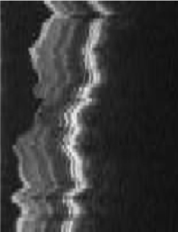

Loopy Belief Propagation
3D retinal image denoising
Vertices: 1 Million
Edges: 3 Million
Data Graph
Update Function:
Loopy BP Update Equation
Scheduler:
Approximate Priority
Consistency Model:
Edge Consistency

Slide 80
Loopy Belief Propagation
Better
Optimal
SplashBP
15.5x speedup

Slide 81
CoEM (Rosie Jones, 2005)
Named Entity Recognition Task
the dog
<X> ran quickly
Is “Dog” an animal?
Is “Catalina” a place?
Australia
travelled to <X>
Vertices: 2 Million
Edges: 200 Million
Catalina Island
<X> is pleasant
Hadoop | 95 Cores | 7.5 hrs

Slide 82
CoEM (Rosie Jones, 2005)
Better
Optimal
Hadoop | 95 Cores | 7.5 hrs
GraphLab | 16 Cores | 30 min
GraphLab CoEM
6x fewer CPUs!
15x Faster!
82

Slide 83
Experiments
Amazon EC2
High-Performance Nodes

Slide 84
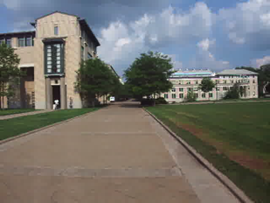
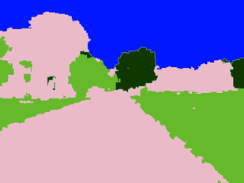
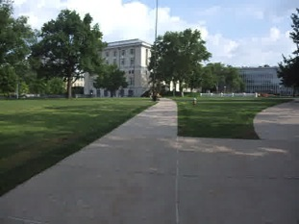
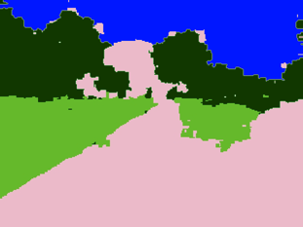
Video Cosegmentation
Segments mean the same
Gaussian EM clustering + BP on 3D grid
Model: 10.5 million nodes, 31 million edges

Slide 85
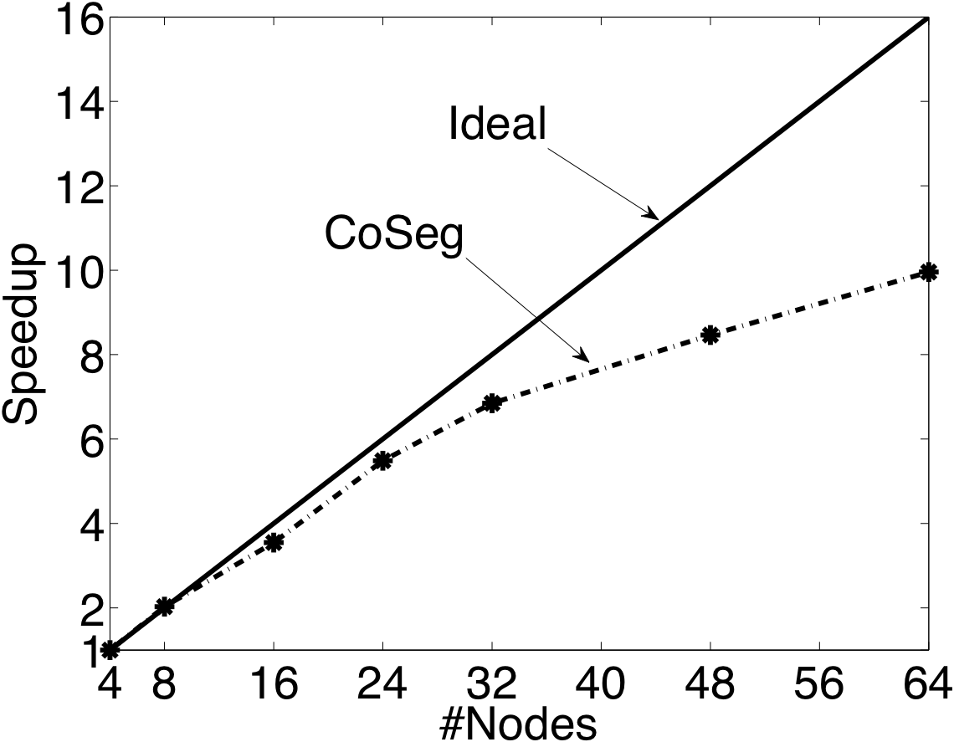
Video Coseg. Speedups

Slide 86
Prefetching Data & Locks

Slide 87
Matrix Factorization
Netflix Collaborative Filtering
  Alternating Least Squares Matrix Factorization
Model: 0.5 million nodes, 99 million edges
Users
Netflix
d
Movies

Slide 88
Netflix
Speedup Increasing size of the matrix factorization

Slide 89
Distributed GraphLab

Slide 90
The Cost of Hadoop

Slide 91
Outline
Importance of Large-Scale Machine Learning
  Need to model data-dependencies
Existing Large-Scale Machine Learning Abstractions
  Need for a efficient graph structured abstraction
GraphLab Abstraction:
  Addresses data-dependences
  Enables the expression of efficient algorithms
Experimental Results
  GraphLab dramatically outperforms existing abstractions
Open Research Challenges

Slide 92
Storage of Large Data-Graphs
Fault tolerance to machine/network failure
  Can I remove (re-task) a node or network resources without restarting dependent computation?
Relaxed transactional consistency
  Can I eliminate locking and approximately recover when data corruption occurs?
Support rapid vertex and edge addition
  How can I allow graphs to continuously grow while computation proceeds?
Graph partitioning for “natural graphs”
  How can I balance the computation while minimizing communication on a power-law graph?

Slide 93
Event driven graph computation
Trigger computation on data and structural modifications
  Exploit small neighborhood effects

Slide 94
Summary
Importance of Large-Scale Machine Learning
  Need to model data-dependencies
Existing Large-Scale Machine Learning Abstractions
  Need for a efficient graph structured abstraction
GraphLab Abstraction:
  Addresses data-dependences
  Enables the expression of efficient algorithms
Experimental Results
  GraphLab dramatically outperforms existing abstractions
Open Research Challenges

Slide 95
Checkout GraphLab
Documentation… Code… Tutorials…
http://graphlab.org
Questions & Comments
jegonzal@cs.cmu.edu

Slide 96
Conclusions
An abstraction tailored to Machine Learning
  Targets Graph-Parallel Algorithms
Naturally expresses
  Data/computational dependencies
  Dynamic iterative computation
Simplifies parallel algorithm design
Automatically ensures data consistency
Achieves state-of-the-art parallel performance on a variety of problems

