Slide 1

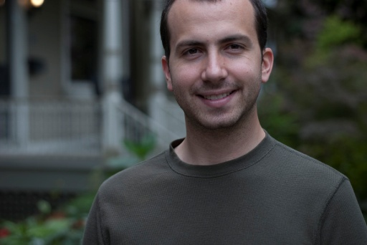



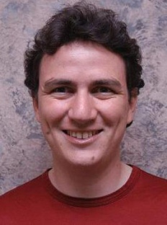
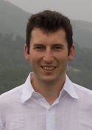
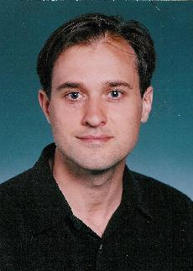

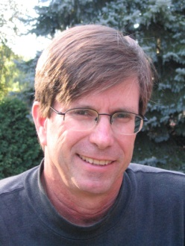
A New Parallel Framework for Machine Learning
Joseph Gonzalez
Joint work with
Yucheng
Low
Aapo
Kyrola
Danny
Bickson
Carlos
Guestrin
Alex
Smola
Guy
Blelloch
Joe
Hellerstein
David
O’Hallaron

Slide 2
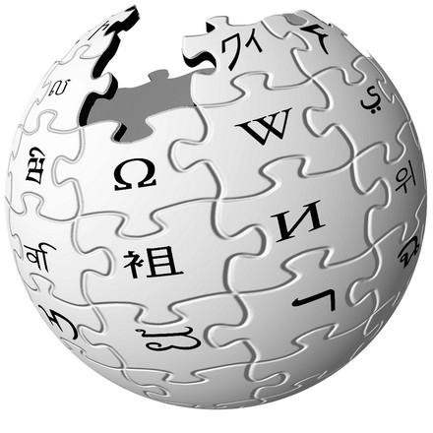



In ML we face BIG problems
750 Million
Facebook Users
24 Million
Wikipedia Pages
6 Billion
Flickr Photos
48 Hours a Minute
YouTube

Slide 3
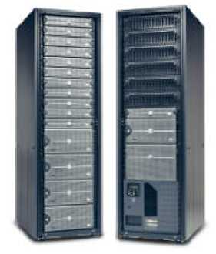
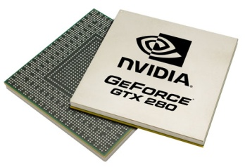
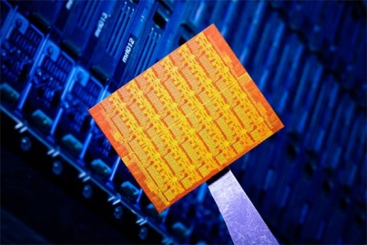
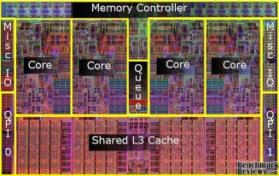

Parallelism: Hope for the Future
Wide array of different parallel architectures:
New Challenges for Designing Machine Learning Algorithms:
  Race conditions and deadlocks
  Managing distributed model state
New Challenges for Implementing Machine Learning Algorithms:
  Parallel debugging and profiling
  Hardware specific APIs
GPUs
Multicore
Clusters
Mini Clouds
Clouds

Slide 4
Core Question
How will we
design and implement
parallel learning systems?

Slide 5
Threads, Locks, & Messages
We could use ….
Build each new learning systems using
low level parallel primitives

Slide 6
Threads, Locks, and Messages
ML experts repeatedly solve the same parallel design challenges:
  Implement and debug complex parallel system
  Tune for a specific parallel platform
  Two months later the conference paper contains:
“We implemented ______ in parallel.”
The resulting code:
  is difficult to maintain
  is difficult to extend
  couples learning model to parallel implementation
Graduate students

Slide 7
Map-Reduce / Hadoop
... a better answer:
Build learning algorithms on-top of
high-level parallel abstractions

Slide 8










MapReduce – Map Phase
CPU 1
4
2
.
3
2
1
.
3
2
5
.
8
1
2
.
9
CPU 2
CPU 3
CPU 4
Embarrassingly Parallel independent computation
No Communication needed

Slide 9
MapReduce – Map Phase
CPU 1
8
4
.
3
1
8
.
4
8
4
.
4
2
4
.
1
CPU 2
CPU 3
CPU 4
1
2
.
9
4
2
.
3
2
1
.
3
2
5
.
8
Image Features

Slide 10
MapReduce – Map Phase
CPU 1
6
7
.
5
1
4
.
9
3
4
.
3
1
7
.
5
CPU 2
CPU 3
CPU 4
1
2
.
9
2
4
.
1
4
2
.
3
8
4
.
3
2
1
.
3
1
8
.
4
2
5
.
8
8
4
.
4
Embarrassingly Parallel independent computation
No Communication needed

Slide 11
MapReduce – Reduce Phase
Attractive Face
Statistics
Ugly Face
Statistics
22
26
.
26
17
26
.
31
CPU 1
CPU 2
1
2
.
9
2
4
.
1
1
7
.
5
4
2
.
3
8
4
.
3
6
7
.
5
2
1
.
3
1
8
.
4
1
4
.
9
2
5
.
8
8
4
.
4
3
4
.
3
Image Features

Slide 12
Map-Reduce for Data-Parallel ML
Excellent for large data-parallel tasks!
Data-Parallel Graph-Parallel
Is there more to
Machine Learning
?
Map Reduce
Feature
Extraction
Cross
Validation
SVM
Lasso
Belief
Propagation
Kernel
Methods
Computing Sufficient
Statistics
Tensor
Factorization
PageRank
Deep Belief
Networks
Neural
Networks

Slide 13
Concrete Example
Label Propagation

Slide 14
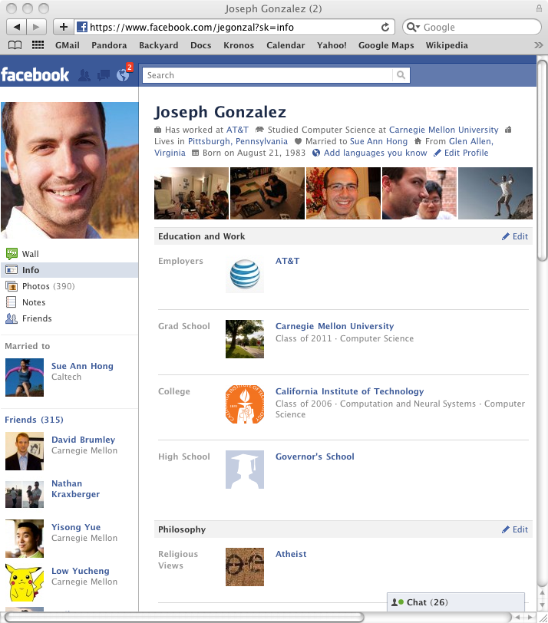
Label Propagation Algorithm
Social Arithmetic:
Recurrence Algorithm:
  iterate until convergence
Parallelism:
  Compute all Likes[i] in parallel
Sue Ann
50% What I list on my profile
40% Sue Ann Likes
10% Carlos Like
80% Cameras
20% Biking
+
40%
I Like:
60% Cameras, 40% Biking
Profile
50%
50% Cameras
50% Biking
Me
Carlos
10%
30% Cameras
70% Biking

Slide 15
Properties of Graph Parallel Algorithms
Dependency
Graph
Factored
Computation
Iterative
Computation
What I Like
What My
Friends Like

Slide 16
Map-Reduce for Data-Parallel ML
Excellent for large data-parallel tasks!
Data-Parallel Graph-Parallel
Map Reduce
Map Reduce?
?
Feature
Extraction
Cross
Validation
SVM
Lasso
Belief
Propagation
Kernel
Methods
Computing Sufficient
Statistics
Tensor
Factorization
PageRank
Deep Belief
Networks
Neural
Networks

Slide 17
Why not use Map-Reduce for
Graph Parallel Algorithms?

Slide 18
Data Dependencies
Map-Reduce does not efficiently express
dependent data
  User must code substantial data transformations
  Costly data replication
Independent Data Rows

Slide 19
Iterative Algorithms
Map-Reduce not efficiently express iterative algorithms:
Iterations
Data
Data
Data
Data
CPU 1
CPU 1
CPU 1
Data
Data
Data
Data
Data
Data
Data
Data
Slow
Processor
CPU 2
CPU 2
CPU 2
Data
Data
Data
Data
Data
Data
Data
Data
CPU 3
CPU 3
CPU 3
Data
Data
Data
Data
Data
Data
Data
Data
Barrier
Barrier
Barrier

Slide 20
MapAbuse: Iterative MapReduce
Only a subset of data needs computation:
Iterations
Data
Data
Data
Data
CPU 1
CPU 1
CPU 1
Data
Data
Data
Data
Data
Data
Data
Data
CPU 2
CPU 2
CPU 2
Data
Data
Data
Data
Data
Data
Data
Data
CPU 3
CPU 3
CPU 3
Data
Data
Data
Data
Data
Data
Data
Data
Barrier
Barrier
Barrier

Slide 21
MapAbuse: Iterative MapReduce
System is not optimized for iteration:
Iterations
Data
Data
Data
Data
CPU 1
CPU 1
CPU 1
Data
Data
Data
Data
Data
Data
Data
Data
CPU 2
CPU 2
CPU 2
Startup Penalty
Disk Penalty
Startup Penalty
Disk Penalty
Startup Penalty
Data
Data
Disk Penalty
Data
Data
Data
Data
Data
Data
CPU 3
CPU 3
CPU 3
Data
Data
Data
Data
Data
Data
Data
Data

Slide 22
Synchronous vs. Asynchronous
Example Algorithm: If Red neighbor then turn Red
Synchronous Computation (Map-Reduce) :
  Evaluate condition on all vertices for every phase
    4 Phases each with 9 computations → 36 Computations
Asynchronous Computation (Wave-front) :
  Evaluate condition only when neighbor changes
    4 Phases each with 2 computations → 8 Computations
Time 0
Time 1
Time 2
Time 3
Time 4

Slide 23
Data-Parallel Algorithms can be Inefficient
Optimized in Memory MapReduceBP
Asynchronous Splash BP
The limitations of the Map-Reduce abstraction can lead to inefficient parallel algorithms.

Slide 24
The Need for a New Abstraction
Map-Reduce is not well suited for Graph-Parallelism
Data-Parallel Graph-Parallel
Map Reduce
?
Feature
Extraction
Cross
Validation
Belief
Propagation
Kernel
Methods
SVM
Computing Sufficient
Statistics
Tensor
Factorization
PageRank
Neural
Networks
Lasso
Deep Belief
Networks

Slide 25
What is GraphLab?

Slide 26
The GraphLab Framework
Graph Based
Data Representation
Update Functions
User Computation
Scheduler
Consistency Model

Slide 27
Data Graph
A graph with arbitrary data (C++ Objects) associated with each vertex and edge.
Graph:
Social Network
Vertex Data:
User profile text
Current interests estimates
Edge Data:
Similarity weights

Slide 28
Implementing the Data Graph
Multicore Setting
Cluster Setting
In Memory
Relatively Straight Forward
  vertex_data(vid) → data
  edge_data(vid,vid) → data
  neighbors(vid) → vid_list
Challenge:
  Fast lookup, low overhead
Solution:
  Dense data-structures
  Fixed Vdata & Edata types
  Immutable graph structure
In Memory
Partition Graph:
  ParMETIS or Random Cuts
Cached Ghosting
A
B
C
D
Node 1
Node 2
A
B
A
B
C
D
C
D

Slide 29
The GraphLab Framework
Graph Based
Data Representation
Update Functions
User Computation
Scheduler
Consistency Model

Slide 30
Update Functions
An update function is a user defined program which when applied to a vertex transforms the data in the scope of the vertex
label_prop(i, scope){
// Get Neighborhood data
(Likes[i], W_{ij}, Likes[j]) ←scope;
// Update the vertex data
// Reschedule Neighbors if needed
if Likes[i] changes then
reschedule_neighbors_of(i);
}

Slide 31
The GraphLab Framework
Graph Based
Data Representation
Update Functions
User Computation
Scheduler
Consistency Model

Slide 32
The Scheduler
The scheduler determines the order that vertices are updated.
CPU 1
b
c
d
a
b
c
Scheduler
e
f
b
e
f
g
a
i
h
i
j
h
i
j
k
CPU 2
The process repeats until the scheduler is empty.

Slide 33
Choosing a Schedule
The choice of schedule affects the correctness and parallel performance of the algorithm
GraphLab provides several different schedulers
  Round Robin: vertices are updated in a fixed order
  FIFO: Vertices are updated in the order they are added
  Priority: Vertices are updated in priority order
Obtain different algorithms by simply changing a flag!
--scheduler=roundrobin
--scheduler=fifo
--scheduler=priority

Slide 34
Implementing the Schedulers
Multicore Setting
Cluster Setting
Challenging!
  Fine-grained locking
  Atomic operations
Approximate FiFo/Priority
  Random placement
  Work stealing
Multicore scheduler on each node
  Schedules only “local” vertices
  Exchange update functions
Node 1
Node 2
f(v₁)
CPU 1
CPU 2
CPU 1
CPU 2
CPU 1
CPU 2
CPU 3
CPU 4
Queue 1
Queue 2
Queue 1
Queue 2
f(v₂)
Queue 1
Queue 2
Queue 3
Queue 4
v₁
v₂

Slide 35
The GraphLab Framework
Graph Based
Data Representation
Update Functions
User Computation
Scheduler
Consistency Model

Slide 36
GraphLab Ensures Sequential Consistency
For each parallel execution, there exists a sequential execution of update functions which produces the same result.
CPU 1
time
Parallel
CPU 2
Sequential
Single
CPU

Slide 37
Ensuring Race-Free Code
How much can computation overlap?

Slide 38
Common Problem: Write-Write Race
Processors running adjacent update functions simultaneously modify shared data:
CPU1 writes:
CPU 1
CPU 2
CPU2 writes:
Final Value

Slide 39
Nuances of Sequential Consistency
Data consistency depends on the update function:
Some algorithms are “robust” to data-races
GraphLab Solution
  The user can choose from three consistency models
    Full, Edge, Vertex
  GraphLab automatically enforces the users choice
Unsafe
Safe
CPU 1
CPU 2
CPU 1
Read
CPU 2

Slide 40
Consistency Rules
Full Consistency
Data
Guaranteed sequential consistency for all update functions

Slide 41
Full Consistency
Full Consistency
Only allow update functions two vertices apart to be run in parallel
Reduced opportunities for parallelism

Slide 42
Obtaining More Parallelism
Not all update functions will modify the entire scope!
Full Consistency
Edge Consistency

Slide 43
Edge Consistency
Edge Consistency
Safe
CPU 1
Read
CPU 2

Slide 44
Obtaining More Parallelism
Full
Edge
Vertex
“Map” operations. Feature extraction on vertex data

Slide 45
Vertex Consistency
Vertex

Slide 46
Consistency Through R/W Locks
Read/Write locks:
  Full Consistency
  Edge Consistency
Write
Write
Write
Canonical Lock Ordering
Read
Write
Read
Read
Write

Slide 47
Consistency Through R/W Locks
Multicore Setting: Pthread R/W Locks
Distributed Setting: Distributed Locking
  Prefetch Locks and Data
  Allow computation to proceed while locks/data are requested.
Data Graph
Partition
Node 1
Node 2
Lock Pipeline

Slide 48
Consistency Through Scheduling
Edge Consistency Model:
  Two vertices can be Updated simultaneously if they do not share an edge.
Graph Coloring:
  Two vertices can be assigned the same color if they do not share an edge.
Phase 1
Phase 2
Phase 3
Barrier
Barrier
Barrier

Slide 49
The GraphLab Framework
Graph Based
Data Representation
Update Functions
User Computation
Scheduler
Consistency Model

Slide 50
Global State and Computation
Not everything fits the Graph metaphor
Shared Weight:
Global Computation:

Slide 51
Anatomy of a GraphLab Program:
Define C++ Update Function
Build data graph using the C++ graph object
Set engine parameters:
  Scheduler type
  Consistency model
Add initial vertices to the scheduler
Register global aggregates and set refresh intervals
Run the engine on the graph [Blocking C++ call]
Final answer is stored in the graph

Slide 52
Algorithms Implemented
PageRank
Loopy Belief Propagation
Gibbs Sampling
CoEM
Graphical Model Parameter Learning
Probabilistic Matrix/Tensor Factorization
Alternating Least Squares
Lasso with Sparse Features
Support Vector Machines with Sparse Features
Label-Propagation
…

Slide 53





The Code
http://graphlab.org
API Implemented in C++:
  Pthreads, GCC Atomics, TCP/IP, MPI, in house RPC
Multicore API
  Experimental Matlab/Java/Python support
  Nearly Complete Implementation
    Available under Apache 2.0 License
Cloud API
  Built and tested on EC2 using
  No Fault Tolerance
  Still Experimental

Slide 54
Shared Memory
Experiments
Shared Memory Setting
16 Core Workstation

Slide 55
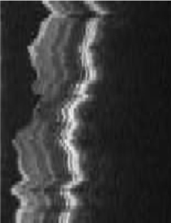
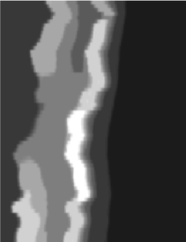
Loopy Belief Propagation
3D retinal image denoising
Vertices: 1 Million
Edges: 3 Million
Data Graph
Update Function:
Loopy BP Update Equation
Scheduler:
Approximate Priority
Consistency Model:
Edge Consistency

Slide 56
Loopy Belief Propagation
Better
Optimal
SplashBP
15.5x speedup

Slide 57
CoEM (Rosie Jones, 2005)
Named Entity Recognition Task
the dog
<X> ran quickly
Is “Dog” an animal?
Is “Catalina” a place?
Australia
travelled to <X>
Vertices: 2 Million
Edges: 200 Million
Catalina Island
<X> is pleasant
Hadoop | 95 Cores | 7.5 hrs
Notes:
Our 3rd experiment CoEM, a named entity recognition task. We test the scalability of our GraphLab implementation. The aim of coEM is to classify noun phrases. For instance…. The CoEM problem can be represented as a bipartite graph with noun phrases on the left, and contexts on the right. An edge between a noun phrase and a context means that the NP was observed with that context in the corpus. For instance, on the top edge, it means that the phrase “the dog ran quickly” was observed.

Slide 58
CoEM (Rosie Jones, 2005)
Better
Optimal
Hadoop | 95 Cores | 7.5 hrs
GraphLab | 16 Cores | 30 min
GraphLab CoEM
6x fewer CPUs!
15x Faster!
58
Notes:
We now show the performance of our implementation.
On the small problem, we achieve a respectable 12x speedup on 16 processors.
On the large problem, we are able to achieve nearly a perfect speedup. This is due to the large amount of work available.
So we used 6x fewer CPUS to get 15x faster performance.

Slide 59
Experiments
Amazon EC2
High-Performance Nodes

Slide 60
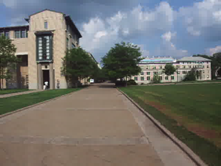
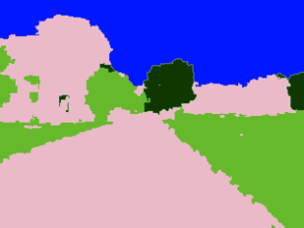
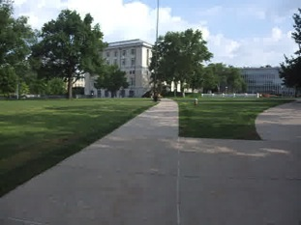
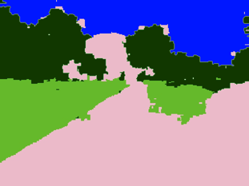
Video Cosegmentation
Segments mean the same
Gaussian EM clustering + BP on 3D grid
Model: 10.5 million nodes, 31 million edges

Slide 61
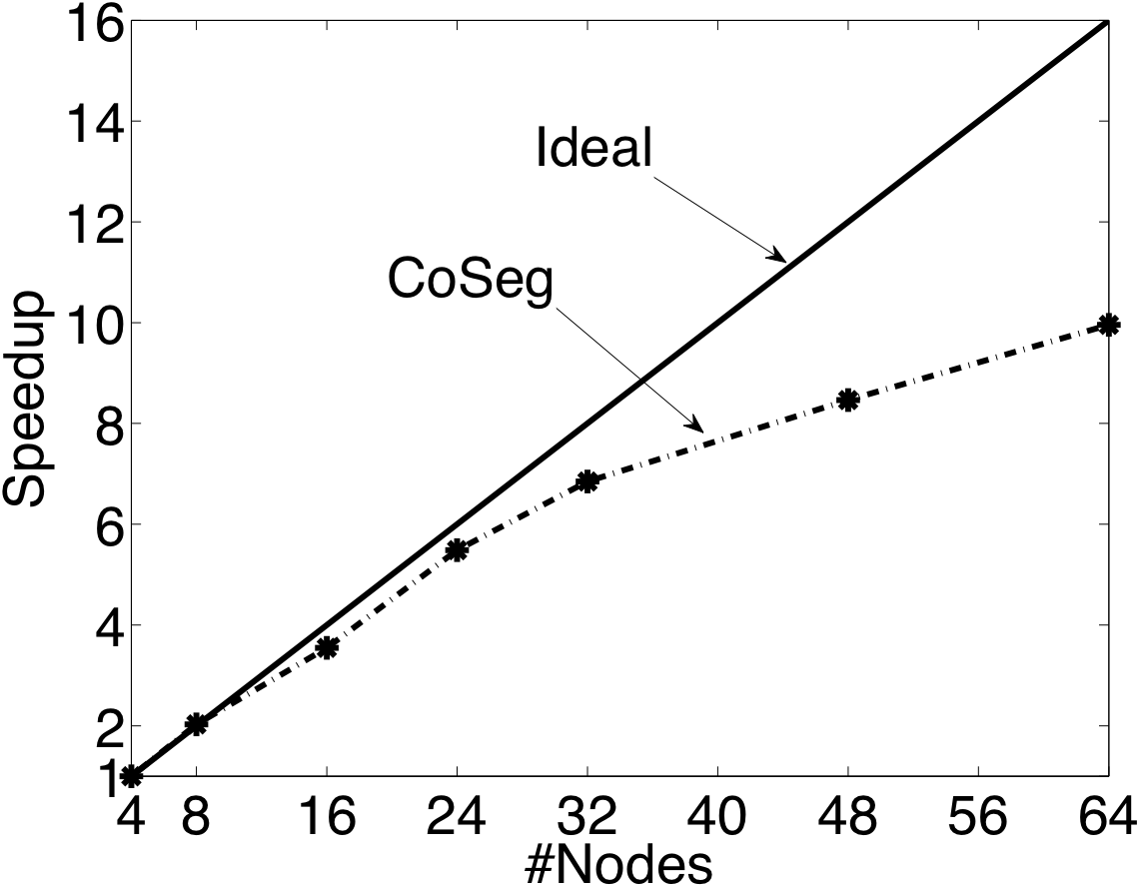
Video Coseg. Speedups

Slide 62
Prefetching Data & Locks

Slide 63
Matrix Factorization
Netflix Collaborative Filtering
  Alternating Least Squares Matrix Factorization
Model: 0.5 million nodes, 99 million edges
Users
Netflix
d
Movies

Slide 64
Netflix
Speedup Increasing size of the matrix factorization

Slide 65
The Cost of Hadoop

Slide 66
Summary
An abstraction tailored to Machine Learning
  Targets Graph-Parallel Algorithms
Naturally expresses
  Data/computational dependencies
  Dynamic iterative computation
Simplifies parallel algorithm design
Automatically ensures data consistency
Achieves state-of-the-art parallel performance on a variety of problems

Slide 67
Current/Future Work
Out-of-core Storage
Hadoop/HDFS Integration
  Graph Construction
  Graph Storage
  Launching GraphLab from Hadoop
  Fault Tolerance through HDFS Checkpoints
Sub-scope parallelism
  Address the challenge of very high degree nodes
Improved graph partitioning
Support for dynamic graph structure

Slide 68
Checkout GraphLab
Documentation… Code… Tutorials…
http://graphlab.org
Questions & Feedback
jegonzal@cs.cmu.edu

